Slide 1
[Client Name]
Monthly Service Review [Month Year]
Presented by [Nexon Representative]

Slide 2
Agenda - Vulnerability Overview - Service Desk Calls - Network Summary - Incident & Services Review - Trends Analysis - Problem Management - Change Management - Risks, Issues & Planning Review - Appendix

Slide 3
ABC XYZ
####### | ####### | ####### | #######
####### | ####### | ####### | #######
####### | ####### | ####### | #######
####### | ####### | ####### | #######
####### | ####### | ####### | #######

Slide 4
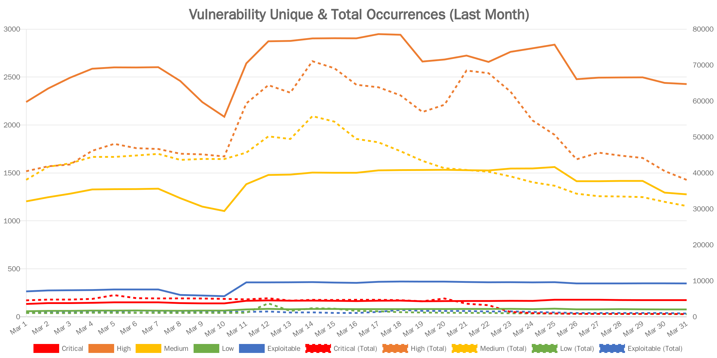
XYZ
Sample Chart
Dummy Text
Dummy content
Note: XYZ

Slide 5
XYZ ABC
Dummy Content
XXXXX | XXXXX | XXXXX
[###] | [###] | [###]
[###] | [###] | [###]
[###] | [###] | [###]
[###] | [###] | [###]
[###] | [###] | [###]
[###] | [###] | [###]
[###] | [###] | [###]
[###] | [###] | [###]
[###] | [###] | [###]
[###] | [###] | [###]

Slide 6
New Section

Slide 7
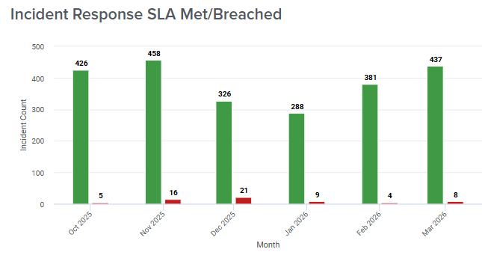
Sample
Commentary:
Dummy Comment

Slide 8











