Slide 1
Prompt & Speak AI Chatbot
Bachelor of Computer Application
Presented By:
Student name: Supriyo Maity
Roll No: 30001221043
Registration No: 213001001210043
Guided By:
Supervisor name Dr. Pabitra Pal
Department of Information Science (UG)
Maulana Abul Kalam Azad University Technology, West Bengal, India

Slide 2
Index
Introduction
Motivation
Project Overview
Proposed Method
Workflow Diagram
Experimental Results
Conclusion
References

Slide 3
Introduction
Welcome to the presentation on our Prompt & Speak AI
Chatbot project. This innovative chatbot supports both voice and text interactions, providing users with a versatile and intuitive experience. Our chatbot is designed to assist users by answering questions, fetching real-time information, and engaging in meaningful conversations.

Slide 4
Motivation
Interactive AI Solutions:
Increasing Demand: The need for interactive AI solutions is rapidly increasing across various sectors such as customer service, healthcare, education, and more. Businesses are seeking ways to automate and enhance user interactions through sophisticated AI systems.
Market Demand:
Aligning with Trends: The trend towards digital transformation and AI adoption is clear, with companies investing heavily in AI-driven customer engagement tools. By developing a chatbot, we are aligning with these market trends and addressing the demand for advanced AI.
Learning and Development:
Skill Enhancement: This project provides an excellent opportunity for me to develop and enhance my skills in web development, artificial intelligence, and large language models (LLM). Working on real-world applications solidifies theoretical knowledge through practical experience.

Slide 5
Project Overview
Key Features:
Dual Interface: Supports both voice and text interactions, allowing users to choose their preferred mode of communication.
AI-Powered Responses: Utilizes advanced AI models to understand and respond to user queries effectively.
Real-Time Information: Fetches and delivers real-time information using GoogleSearchAPIWrapper.
Project Goals:
Accurate Information Delivery: Ensure high accuracy and relevance in responses.
User Accessibility: Design for ease of use across different devices and user preferences.
Enhanced User Experience: Provide a seamless and efficient interaction experience through sophisticated AI.

Slide 6
Proposed Method
Technologies Used
Frontend: HTML, CSS, JavaScript
Backend: Flask
Conversational AI: LangChain, GoogleGenerativeAI
Real-Time Data: GoogleSearchAPIWrapper
Workflow
1. User inputs a query via text or voice.
2. The system determines whether to use Google Search or AI model.
3. The query is processed and a response is generated.
4. The response is displayed to the user.

Slide 7
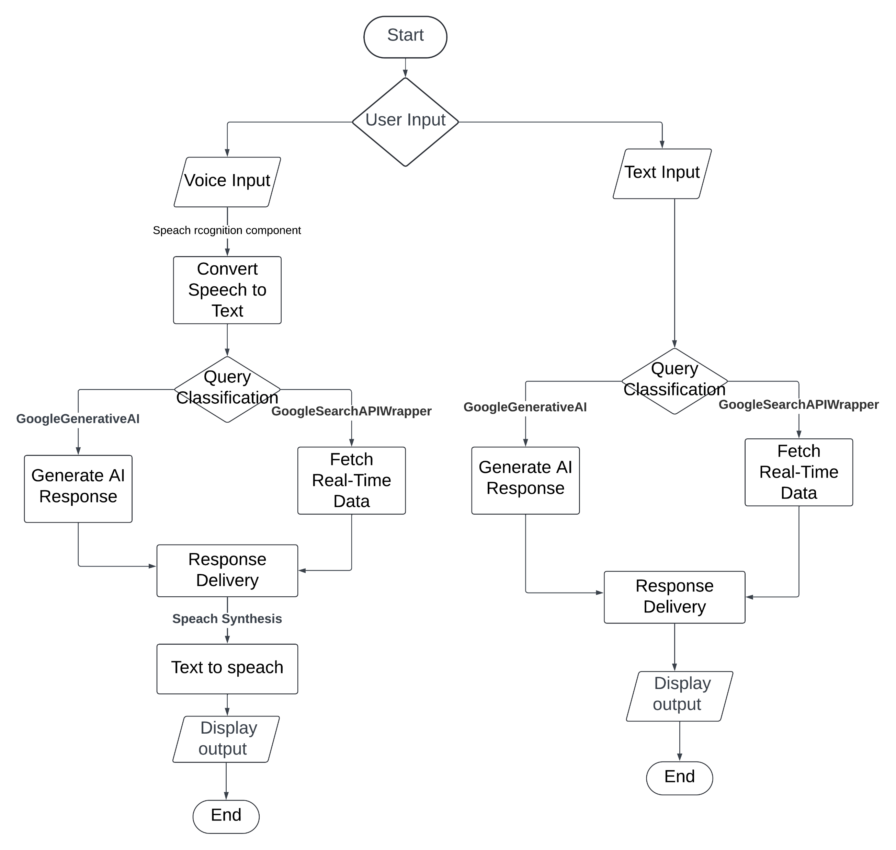
Workflow Diagram

Slide 8
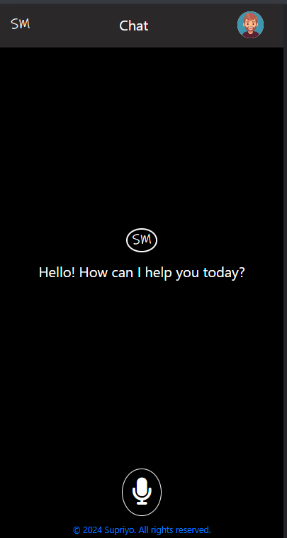
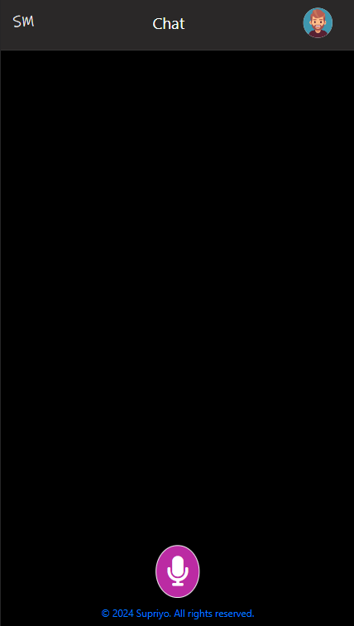
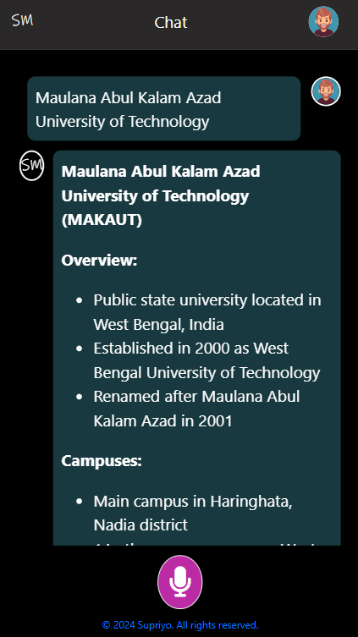
Experimental Results

Slide 9
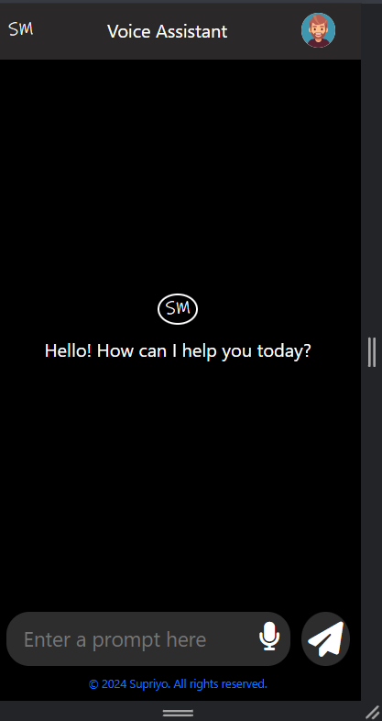
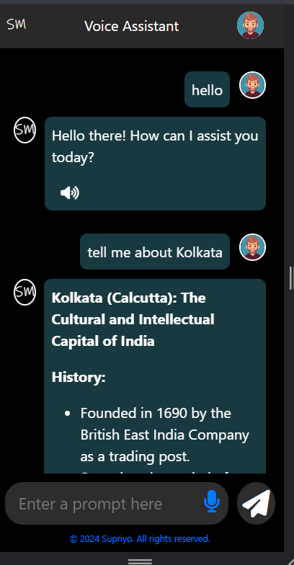
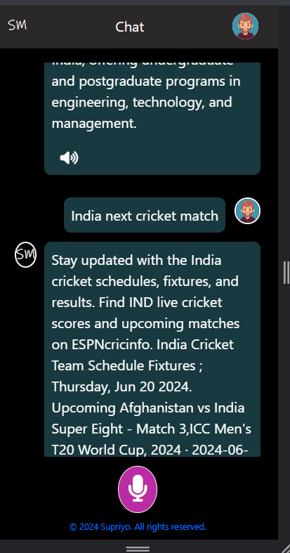

Slide 10
Conclusion
The project successfully integrates voice and text-based query handling using advanced AI tools. The system provides accurate and timely responses, demonstrating the potential for such applications in various domains. Future work includes improving response accuracy and expanding the range of queries handled.

Slide 11
Reference
Flask Documentation:
https://flask.palletsprojects.com/en/3.0.x/tutorial/
LangChain:
https://www.langchain.com/
GoogleGenerativeAI :
https://ai.google.dev/gemini-api/docs/api-key
GoogleSearchAPIWrapper: https://console.cloud.google.com/apis/credentials
Web Speech API:
https://developer.mozilla.org/enUS/docs/Web/API/Web_Speech_API

Slide 12
Thank You
Presentation By – Supriyo Maity
Roll - 30001221043
Date-20.6.2024

