Slide 1

Job Placement SQL Project Report
Name: Supriyo Maity
Tool Used: MySQL Workbench
This project aims to analyze job placement data using SQL queries. The dataset consists of student details such as gender, degree, stream, GPA, and salary. The main objective is to explore patterns that affect placement outcomes, salary trends, and overall employability.

Slide 2
Database and Table Creation
Database Creation
CREATE DATABASE job;
USE job;
Explanation: A new database named job is created and selected for analysis.
Insight: The database serves as the foundation for storing all placement-related tables and data.
Table Structure
CREATE TABLE job (
id INT PRIMARY KEY,
name VARCHAR(100),
gender VARCHAR(10),
age INT,
degree VARCHAR(50),
stream VARCHAR(100),
college_name VARCHAR(150),
placement_status VARCHAR(20),
salary INT,
gpa DECIMAL(3,2),
years_of_experience INT
);
Explanation: This table stores student demographic, academic, and placement data.
Insight: The structure allows tracking placement outcomes and analyzing multiple factors like gender, GPA, degree, and experience.
Measures:
Maintain consistent naming conventions.
Use constraints and data validation rules to avoid null or incorrect data entries.
Regularly update placement_status and salary fields for real-time insights.

Slide 3

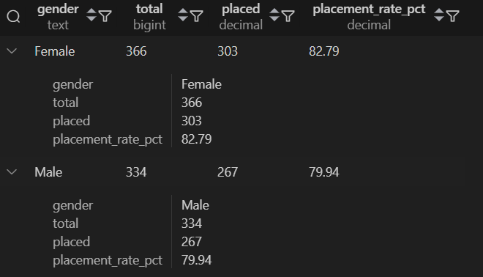
Q1 & Q2: Salary Analysis and Gender-Based Placement
Q1. Average Salary of Placed Students
WITH placed AS (
SELECT salary
FROM job
WHERE placement_status = 'Placed'
)
SELECT ROUND(AVG(salary), 2) AS avg_salary_placed
FROM placed;
Explanation: This query filters out all placed students and calculates the average salary among them.
Insight: Determines the average salary earned by successfully placed candidates.
Measures: Use this as a benchmark to evaluate future placement performance. Strengthen partnerships with companies offering above-average packages. Identify and address skill gaps to raise the overall average.
Q2. Gender-Based Placement Rate
WITH base AS (
SELECT gender, placement_status
FROM job
),
counts AS (
SELECT
gender,
COUNT(*) AS total,
SUM(CASE WHEN placement_status = 'Placed' THEN 1 ELSE 0 END) AS placed
FROM base
GROUP BY gender
)
SELECT
gender,
total,
placed,
ROUND(100.0 * placed / NULLIF(total, 0), 2) AS placement_rate_pct
FROM counts
ORDER BY gender;
Explanation: Calculates the placement rate for each gender by dividing placed students by the total number of students.
Insight: Shows the placement distribution by gender, identifying whether opportunities are balanced across male and female students.
Measures: If gender disparity exists, introduce equal opportunity training sessions. Encourage skill-building programs to bridge gaps. Collaborate with companies supporting diverse hiring practices.

Slide 4
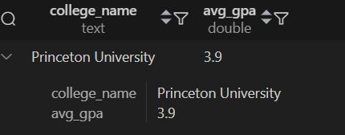
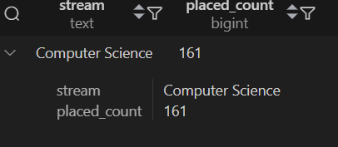
Q3 & Q4: College Performance and Stream Analysis
Q3. College with Highest Average GPA among Placed Students
WITH placed AS (
SELECT college_name, gpa
FROM job
WHERE placement_status = 'Placed'
),
avg_gpa AS (
SELECT college_name, AVG(gpa) AS avg_gpa
FROM placed
GROUP BY college_name
)
SELECT college_name, ROUND(avg_gpa, 3) AS avg_gpa
FROM avg_gpa
ORDER BY avg_gpa DESC
LIMIT 1;
Explanation: Calculates the average GPA of placed students in each college and retrieves the top one.
Insight: Reveals the college with the highest academic performance among placed candidates.
Measures: Share best academic practices from the top-performing college. Encourage other colleges to adopt academic excellence programs that support employability.
Q4. Most Popular Stream by Placement Count
WITH placed AS (
SELECT stream
FROM job
WHERE placement_status = 'Placed'
),
counts AS (
SELECT stream, COUNT(*) AS placed_count
FROM placed
GROUP BY stream
)
SELECT stream, placed_count
FROM counts
ORDER BY placed_count DESC
LIMIT 1;
Explanation: Counts the number of placed candidates in each academic stream.
Insight: Identifies the stream with the highest number of placed students, reflecting the most in-demand discipline in the job market.
Measures: Enhance career development resources for less popular streams. Align course curriculum with industry requirements to improve placement in weaker streams.

Slide 5
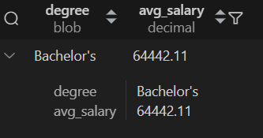
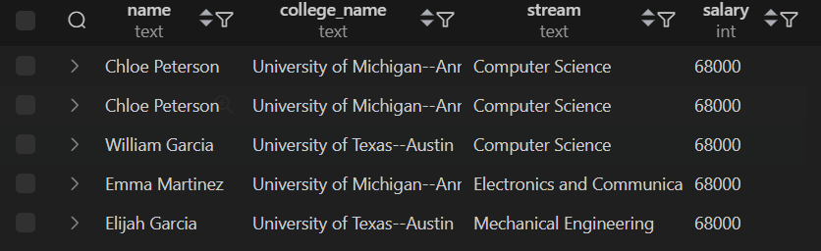
Q5 & Q6: Degree Comparison and Top Earners
Q5. Salary Comparison by Degree Type
WITH placed AS (
SELECT degree, salary
FROM job
WHERE placement_status = 'Placed'
)
SELECT degree, ROUND(AVG(salary), 2) AS avg_salary
FROM placed
GROUP BY degree
ORDER BY avg_salary DESC;
Explanation: Calculates the average salary per degree for placed students.
Insight: Displays which degrees provide better salary outcomes, showing the value of each qualification.
Measures: Promote high-performing degrees in career campaigns. Introduce certifications and technical skills in lower-performing degree programs to improve their employability.
Q6. Top 5 Highest Paid Students
SELECT
name, college_name, stream, salary
FROM job
WHERE placement_status = 'Placed'
ORDER BY salary DESC
LIMIT 5;
Explanation: Displays the top five placed students earning the highest salaries.
Insight: Highlights the top achievers and the colleges or streams contributing to their success.
Measures: Feature these students as success stories in institutional marketing. Study the profiles of top earners to understand key success factors (skills, degree, stream).

Slide 6
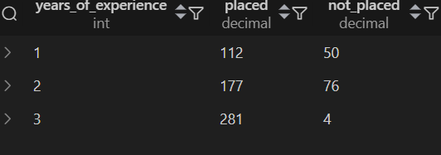
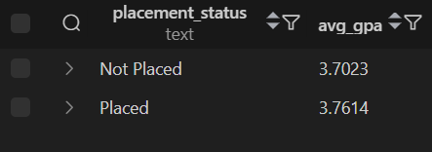
Q7 & Q8: Experience Impact and Academic Performance
Q7. Placement Status by Years of Experience
WITH base AS (
SELECT years_of_experience, placement_status
FROM job
)
SELECT
years_of_experience,
SUM(CASE WHEN placement_status = 'Placed' THEN 1 ELSE 0 END) AS placed,
SUM(CASE WHEN placement_status <> 'Placed' THEN 1 ELSE 0 END) AS not_placed
FROM base
GROUP BY years_of_experience
ORDER BY years_of_experience;
Explanation: Analyzes the impact of experience on placement by grouping candidates based on years of experience.
Insight: Shows whether experienced students have better placement chances compared to freshers.
Measures: Encourage internships and work-based learning programs. Offer industry readiness training to improve employability for less-experienced students.
Q8. Average GPA: Placed vs Not Placed
SELECT
placement_status,
ROUND(AVG(gpa), 4) AS avg_gpa
FROM job
GROUP BY placement_status
ORDER BY placement_status;
Explanation: Compares the average GPA between placed and unplaced students.
Insight: Shows the relationship between academic performance and placement success.
Measures: Implement remedial classes or academic mentoring for low-GPA students. Introduce GPA-linked career workshops to help students convert academic performance into employability skills.

Slide 7
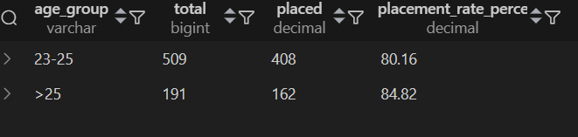
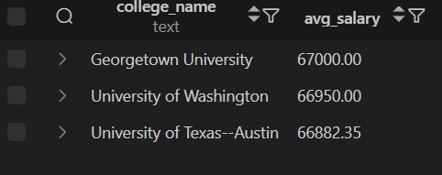
Q9 & Q10: Age Demographics and College Rankings
Q9. Age-Group Placement Rate
WITH placement_rate AS (
SELECT
CASE
WHEN age < 23 THEN '<23'
WHEN age BETWEEN 23 AND 25 THEN '23-25'
ELSE '>25'
END AS age_group,
placement_status
FROM job
),
agegroup AS (
SELECT
age_group,
COUNT(*) AS total,
SUM(CASE WHEN placement_status = 'Placed' THEN 1 ELSE 0 END) AS placed
FROM placement_rate
GROUP BY age_group
)
SELECT
age_group,
total,
placed,
ROUND(100.0 * placed / NULLIF(total, 0), 2) AS placement_rate_percent
FROM agegroup
ORDER BY CASE age_group WHEN '<23' THEN 1 WHEN '23-25' THEN 2 ELSE 3 END;
Explanation: Groups candidates into age brackets and calculates placement rates.
Insight: Indicates how age correlates with employability—for example, students aged 23–25 may have the highest placement rate.
Measures: Tailor career preparation programs by age group. Provide early career planning sessions for younger candidates. Offer advanced training for older students re-entering the job market.
Q10. Colleges with Highest Average Salary (Placed Only)
SELECT
college_name,
ROUND(AVG(salary), 2) AS avg_salary
FROM job
WHERE placement_status = 'Placed'
GROUP BY college_name
ORDER BY avg_salary DESC
LIMIT 3;
Explanation: Calculates the average salary for each college and lists the top three.
Insight: Reveals which colleges produce students with the highest average salaries, showcasing institutional effectiveness in placements.
Measures: Use top-performing colleges as benchmarks for others. Improve placement training programs in colleges with lower salary averages. Strengthen corporate tie-ups and employer relations to enhance salary outcomes.

Slide 8
Key Learnings from Analysis
Academic Performance Impact
Stream and Degree Demand
Institutional Excellence
High GPA and experience strongly influence placement outcomes, demonstrating the critical role of academic excellence in career success.
Certain degrees and streams are in greater demand by employers, reflecting market trends and industry requirements.
Colleges with strong industry relations achieve higher average salaries, highlighting the importance of corporate partnerships.

Slide 9
Measures for Improvement
1
Data-Driven Strategy
2
Pre-Placement Bootcamps
Introduce data-driven placement strategy using SQL dashboards to monitor real-time placement metrics and trends.
Conduct pre-placement bootcamps focused on aptitude and soft skills to enhance student readiness for interviews and workplace demands.
3
Feedback Loops
4
Database Maintenance
Ensure regular feedback loops between recruiters and institutions to align curriculum with industry expectations.
Maintain an updated, normalized database for yearly placement analytics to support continuous improvement initiatives.

Slide 10
Conclusion
This SQL analysis successfully evaluates multiple aspects of the job placement process using advanced SQL functions like CTEs, aggregation, and conditional logic.
The ten queries (Q1–Q10) provide comprehensive insights into placement performance across multiple dimensions including salary averages, gender-based placement rates, college performance, stream popularity, degree comparisons, top earners, experience impact, academic performance correlation, age demographics, and institutional salary rankings.
The analysis demonstrates that:
High GPA and experience strongly influence placement outcomes.
Certain degrees and streams are in greater demand by employers.
Colleges with strong industry relations achieve higher average salaries.
By implementing the recommended measures—including data-driven placement strategies, pre-placement bootcamps, regular feedback loops with recruiters, and maintaining an updated database—institutions can significantly enhance their placement outcomes and student employability.

Slide 11
THANK YOU

