Slide 1

🛍️ Myntra E-commerce Product Analysis – SQL Project Report
Name: Supriyo Maity
Environment: MySQL Workbench
Database: Myntra dataset from kaggle.com

Slide 2
📘 1. Project Overview
This project focuses on analyzing product data from Myntra, one of India’s largest online fashion marketplaces. The goal is to gain insights into brand performance, pricing strategy, discounts, and customer ratings using SQL queries.
The dataset (project_myntra) includes key product attributes such as:
Brand Name
Product Description
Price & MRP
Discount Percentage
Ratings
Number of Ratings
Through SQL analysis, we explore brand performance, customer engagement, and discount trends.

Slide 3
🧱 2. Database Schema
CREATE DATABASE myntra;
USE myntra;
CREATE TABLE project_myntra (
id SERIAL PRIMARY KEY,
brand_name VARCHAR(255) NOT NULL,
pants_description TEXT,
price DECIMAL(10,2),
MRP DECIMAL(10,2),
discount_percent DECIMAL(5,4),
ratings DECIMAL(3,2),
number_of_ratings INTEGER
);
This schema defines the structure of the project_myntra table, capturing essential product details for analysis.

Slide 4
📊 3. Business Objectives
The project answers 10 key analytical questions:
1
Which brands have the highest average rating?
2
Are there products with high discounts but low ratings?
3
Which brands generate the most revenue?
4
Are there brands with premium pricing but below-average ratings?
5
How does each product’s price compare with its brand’s average?
6
What is the most-rated product per brand?
7
How are discounts correlated with ratings?
8
Which brands have both highly loved and poorly rated products?
9
Are there products priced below 50% of MRP but rated above 4.0?
10
Which brands offer the highest discounts, meeting rating and product count thresholds?

Slide 5
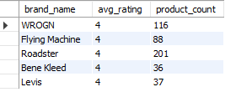
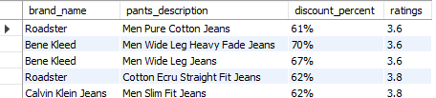
💻 4. SQL Analysis & Insights
Query 1: Top 5 Brands with Highest Average Rating
SELECT brand_name, ROUND(AVG(ratings)) as avg_rating,, COUNT(*) AS product_count
FROM project_myntra
GROUP BY brand_name
HAVING COUNT(*) >= 10
ORDER BY avg_rating DESC
LIMIT 5;
🔹 Finds most loved brands based on customer ratings.
✅ Insight: Identifies consistently high-rated brands with strong customer trust.
Query 2: High Discount but Low Rating Products
SELECT brand_name, pants_description,
CONCAT(ROUND(discount_percent * 100, 0), '%') AS discount_percent, ratings
FROM project_myntra
WHERE discount_percent > 0.6 AND ratings < 4.0;
🔹 Detects heavily discounted items with poor ratings.
✅ Insight: May indicate overstocked or low-quality items.

Slide 6

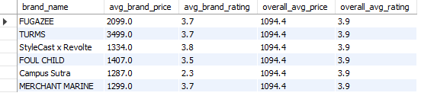
💻 4. SQL Analysis & Insights (Cont.)
Query 3: Top 3 Revenue Generating Brands
SELECT brand_name, SUM(price * number_of_ratings) AS total_revenue
FROM project_myntra
GROUP BY brand_name
ORDER BY total_revenue DESC
LIMIT 3;
🔹 Estimates brand performance based on sales and engagement.
✅ Insight: Reveals financially dominant brands on the platform.
Query 4: Brands with Higher Price but Lower Rating
WITH brand_stats AS (
SELECT brand_name, ROUND(AVG(price),1) as avg_brand_price, ROUND(AVG(ratings),1) as avg_brand_rating
FROM project_myntra
GROUP BY brand_name
),
overall_stats AS (
SELECT ROUND(AVG(price),1) as overall_avg_price, ROUND(AVG(ratings),1) as overall_avg_rating
FROM project_myntra
)
SELECT b.brand_name, b.avg_brand_price, b.avg_brand_rating, o.overall_avg_price, o.overall_avg_rating
FROM brand_stats b, overall_stats o
WHERE b.avg_brand_price > o.overall_avg_price AND b.avg_brand_rating < o.overall_avg_rating;
🔹 Identifies overpriced brands with underwhelming customer satisfaction.
✅ Insight: Highlights brands that charge above-average prices but fail to meet customer expectations.

Slide 7
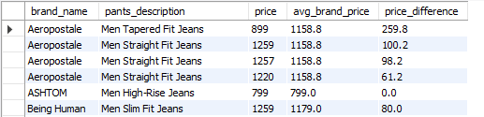
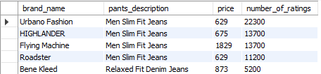
💻 4. SQL Analysis & Insights (Cont.)
Query 5: Product vs. Brand Average Price Difference
WITH brand_avg_prices AS (
SELECT brand_name, ROUND(AVG(price),1) as avg_brand_price
FROM project_myntra
GROUP BY brand_name
)
SELECT d.brand_name, d.pants_description, d.price, b.avg_brand_price,
ABS((d.price - b.avg_brand_price)) as price_difference
FROM project_myntra d
JOIN brand_avg_prices b ON d.brand_name = b.brand_name
ORDER BY d.brand_name, price_difference DESC;
🔹 Helps spot premium or budget-friendly products within each brand.
✅ Insight: Highlights pricing deviations within brands, revealing premium or budget outliers.
Query 6: Most Rated Product per Brand
WITH ranked_products AS (
SELECT brand_name, pants_description, price, number_of_ratings,
ROW_NUMBER() OVER (PARTITION BY brand_name ORDER BY number_of_ratings DESC) AS rn
FROM project_myntra
)
SELECT brand_name, pants_description, price, number_of_ratings
FROM ranked_products
WHERE rn = 1
ORDER BY NUMBER_OF_RATINGS DESC;
🔹 Finds the most popular product for every brand.
✅ Insight: This query identifies the most popular product for each brand based on customer engagement (number of ratings).

Slide 8

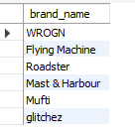
💻 4. SQL Analysis & Insights (Cont.)
Query 7: Correlation between Discount and Rating
WITH top_products AS (
SELECT discount_percent, ratings
FROM project_myntra
ORDER BY number_of_ratings DESC
LIMIT 10
)
SELECT ROUND((AVG(discount_percent * ratings) - AVG(discount_percent) * AVG(ratings)) /
(STDDEV(discount_percent) * STDDEV(ratings)),2) AS correlation_coefficient
FROM top_products;
🔹 Measures statistical relationship between discounts and ratings.
✅ Insight: • A negative correlation → deeper discounts don’t always mean better ratings. • A positive correlation → customers may appreciate discounts more.
Query 8: Brands with Both Excellent and Poor Products
SELECT DISTINCT brand_name
FROM project_myntra
WHERE brand_name IN (
SELECT brand_name FROM project_myntra WHERE ratings >= 4.5
) AND brand_name IN (
SELECT brand_name FROM project_myntra WHERE ratings <= 3.0
);
🔹 Shows brands with mixed customer sentiment.
✅ Insight: This query identifies brands that have polarizing products, i.e., brands with both highly-rated (≥4.5) and poorly-rated (≤3.0) products.

Slide 9
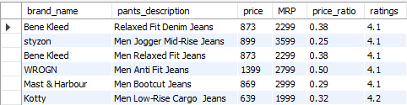
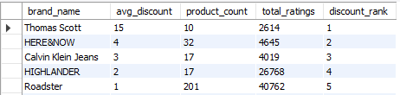
💻 4. SQL Analysis & Insights (Cont.)
Query 9: High-Rated Products at <50% Price
SELECT brand_name, pants_description, price, MRP,
ROUND((price/MRP),2) AS price_ratio, ratings
FROM project_myntra
WHERE price < (MRP * 0.5) AND ratings > 4.0;
🔹 Finds great value-for-money products.
✅ Insight: This query highlights highly-rated products that are selling at a significant discount (less than 50% of MRP).
Query 10: Ranking Brands by Average Discount
WITH brand_summary AS (
SELECT brand_name, ROUND(AVG(discount_percent)) AS avg_discount, COUNT(*) AS product_count,
SUM(number_of_ratings) AS total_ratings
FROM project_myntra
GROUP BY brand_name
HAVING COUNT(*) >= 5 AND SUM(number_of_ratings) > 1000
)
SELECT brand_name, avg_discount, product_count, total_ratings,
DENSE_RANK() OVER (ORDER BY avg_discount DESC) AS discount_rank
FROM brand_summary
ORDER BY discount_rank;
🔹 Ranks brands based on discount offerings with engagement criteria.
✅ Insight: This query identifies brands that actively offer significant discounts while maintaining a substantial product catalog and customer engagement.

Slide 10
📈 5. Key Insights Summary
⭐ Top Brands
💰 Revenue Leaders
💸 Discounts
Brands with consistently high average ratings maintain strong trust.
Brands with high product ratings and wide reach dominate revenue.
Deep discounts often correlate with average or below-average ratings.
🛍️ Pricing
🧮 Correlation
Some brands charge premium prices despite lower user satisfaction.
Discounts and ratings may not always align — indicating quality perception matters more.

