Slide 1
TECHNO ENGINEERING COLLEGE BANIPUR E-ORGANIC A Fresh Fruits and Vegetable Buying and Selling Platform FINAL YEAR PROJECT SYNOPSIS
Under the guidance of Professor Sujit Raha, TECB
NAME : BHASKAR BAKSHI ROLL : 24400221002 DEPT.: IT
NAME : SAYANJIT ROY ROLL : 24400122097 DEPT.: CSE
NAME : MUNMUN SANA ROLL : 24400122096 DEPT.: CSE
NAME : SUPRIYO BAIRAGI ROLL : 24400222002 DEPT.: IT
NAME : PRITAM DAS ROLL : 24400121047 DEPT.: CSE

Slide 2
TABLE OF CONTENTS
INTRODUCTION
PROJECT OVERVIEW
LITERATURE SURVEY
SPECIFICATIONS
SYSTEM FEATURES
FEASIBILITY STUDY
SYSTEM ANALYSIS & DESIGN
MODULE DESCRIPTION
FUTURE SCOPE
CONCLUSION
REFERENCES

Slide 3
INTRODUCTION
In the modern era, there is a growing demand for organic products due to their health benefits and environmental sustainability. However, buyers face challenges in finding reliable sources, and sellers struggle to reach their target audience.
Problem Statement:
- Difficulty finding authentic organic products.
- Lack of transparency and trust in existing platforms.
- Limited reach for small-scale organic farmers.
Objective:
- To create a user-friendly platform promoting trust and transparency.

Slide 4
PROJECT OVERVIEW
CORE OBJECTIVES :
- Build a reliable platform for organic goods.
- Ensure product authenticity through certifications.
- Empower farmers and small sellers.
KEY FEATURES :
- Buyer and seller profiles.
- Verified organic certifications.
- Advanced search filters (e.g., location-based search).
- Secure payment gateway

Slide 5
LITERATURE SURVEY
EXISTING SYSTEM CHALLENGES :
- Platforms like Amazon and eBay lack focus on organic certification.
- No direct farmer-to-buyer connection.
PROPOSED SOLUTION :
- A dedicated marketplace for organic products with transparency.
- Support for sustainability and community growth.

Slide 6
SPECIFICATIONS
HARDWARE REQUIREMENTS :
- Server with scalable storage.
- Client devices (desktop, mobile, tablets).
SOFTWARE REQUIREMENTS :
- Html, Css, JavaScript for front-end.
- Node.js for back-end.
- Firebase for real-time database and authentication.

Slide 7
SYSTEM FEATURES
BUYER FEATURES :
- Profile management.
- Order tracking.
- Location-based product search.
SELLER FEATURES :
- Product listing and inventory management.
- Sales tracking.
- Profile and review system.
PRODUCT FEATURES :
- Categories: New Arrivals, Bestsellers.
- Add-to-cart with payment integration.

Slide 8
FEASIBILITY STUDY
ECONOMIC FEASIBILITY :
- Cost-effective technologies (e.g., Firebase).
TECHNICAL FEASIBILITY :
- Scalable frameworks like Html,Css,JavaScript and Node.js.
OPERATIONAL FEASIBILITY :
- Simple UI ensures user adoption.

Slide 9
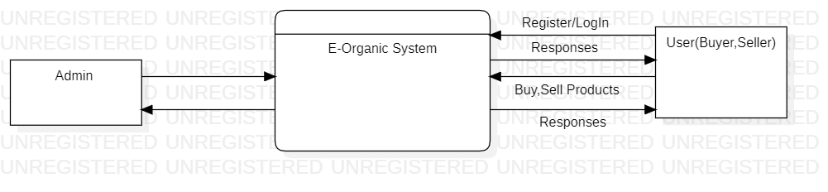
SYSTEM ANALYSIS & DESIGN
LEVEL 0 DFD OF E-ORGANIC SYSTEM

Slide 10
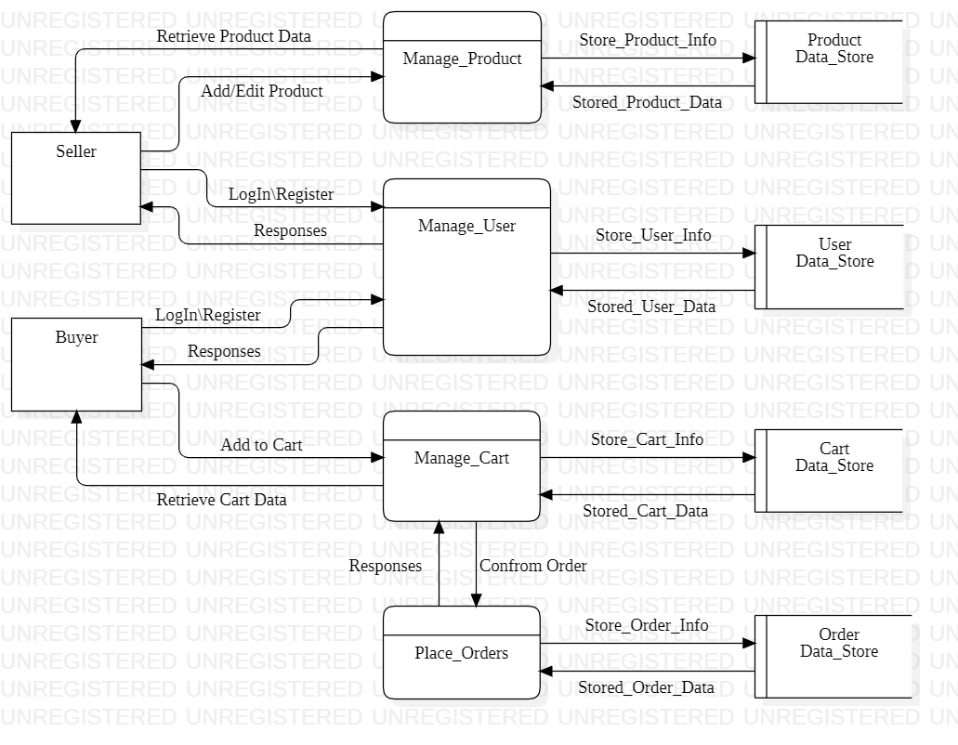
LEVEL 1 DFD OF E-ORGANIC SYSTEM

Slide 11
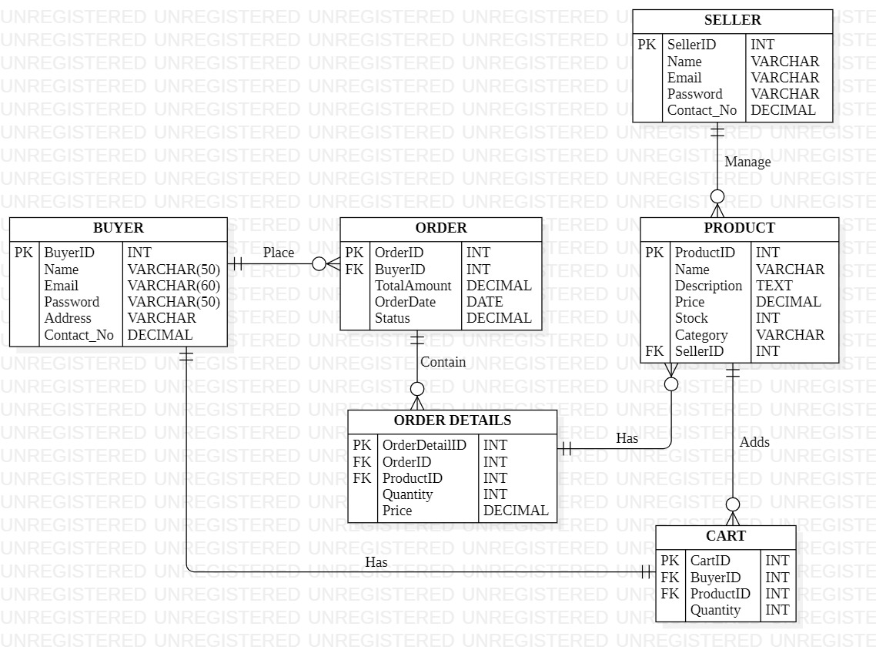
ER-DIAGRAM OF E-ORGANIC SYSTEM

Slide 12
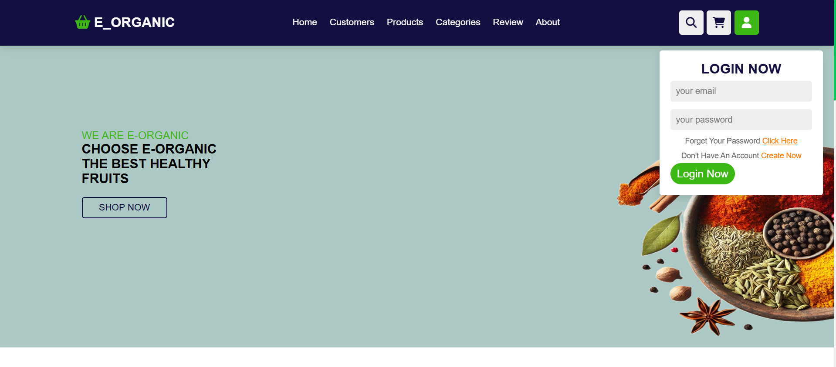
MODULE DESCRIPTION

Slide 13
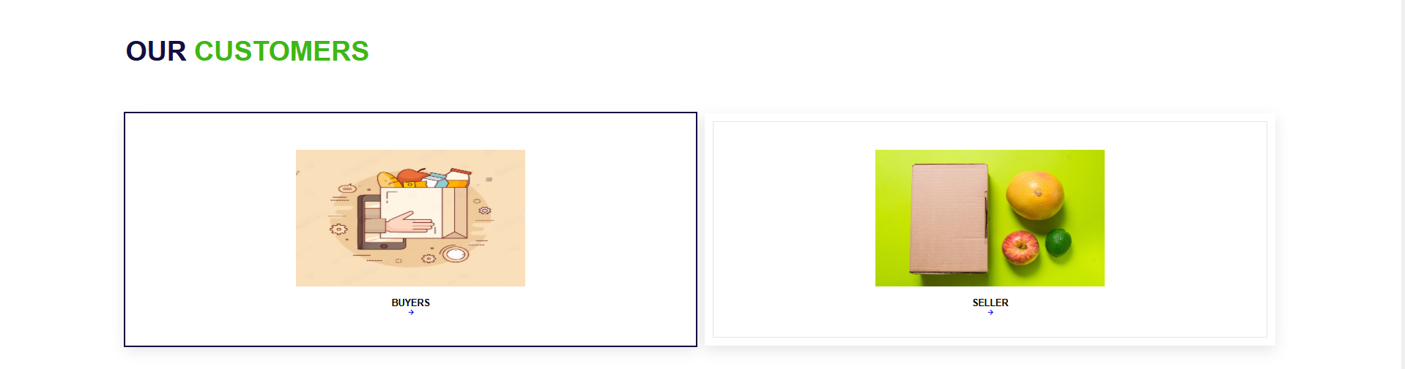
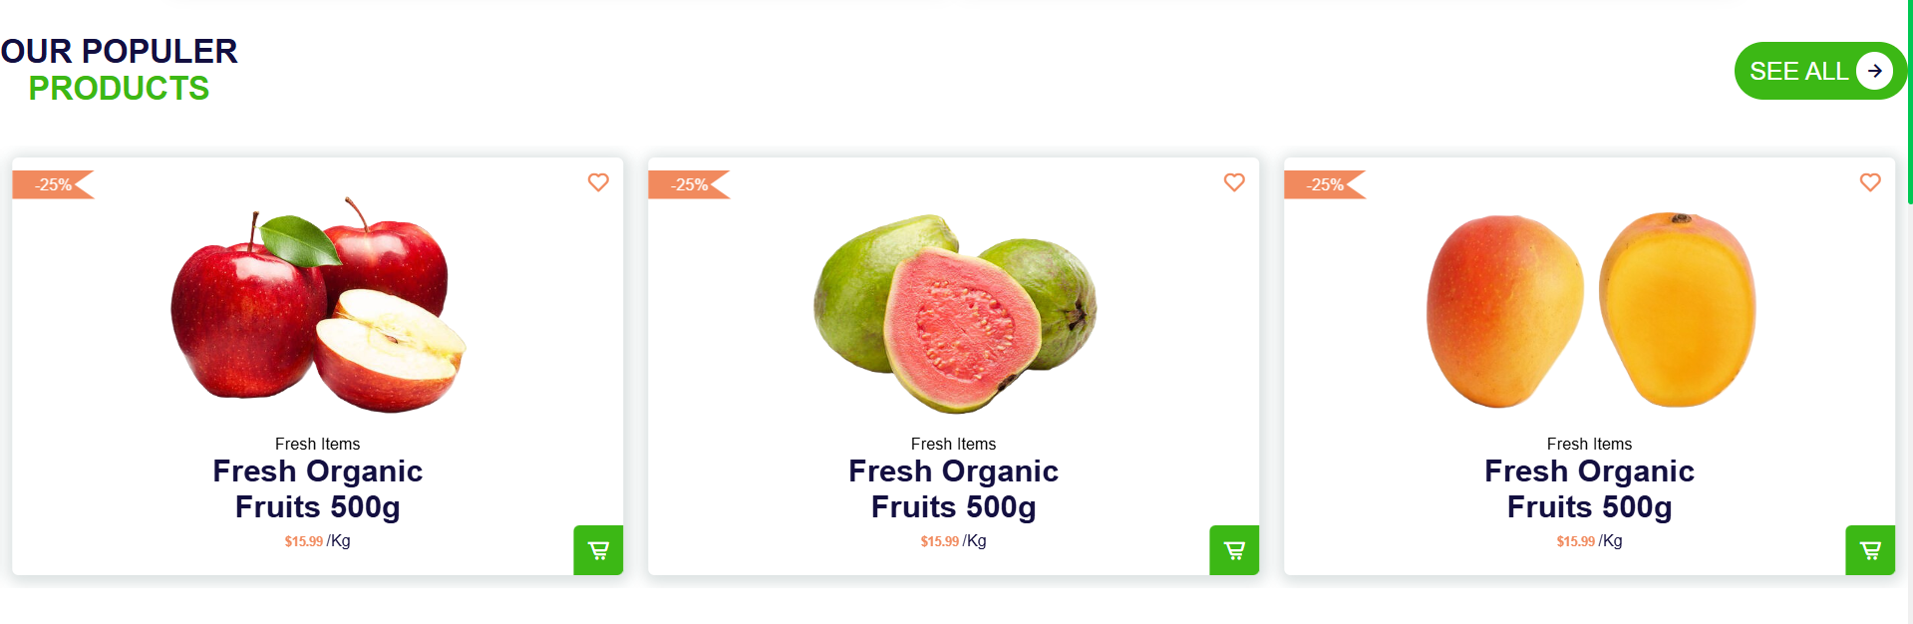

Slide 14
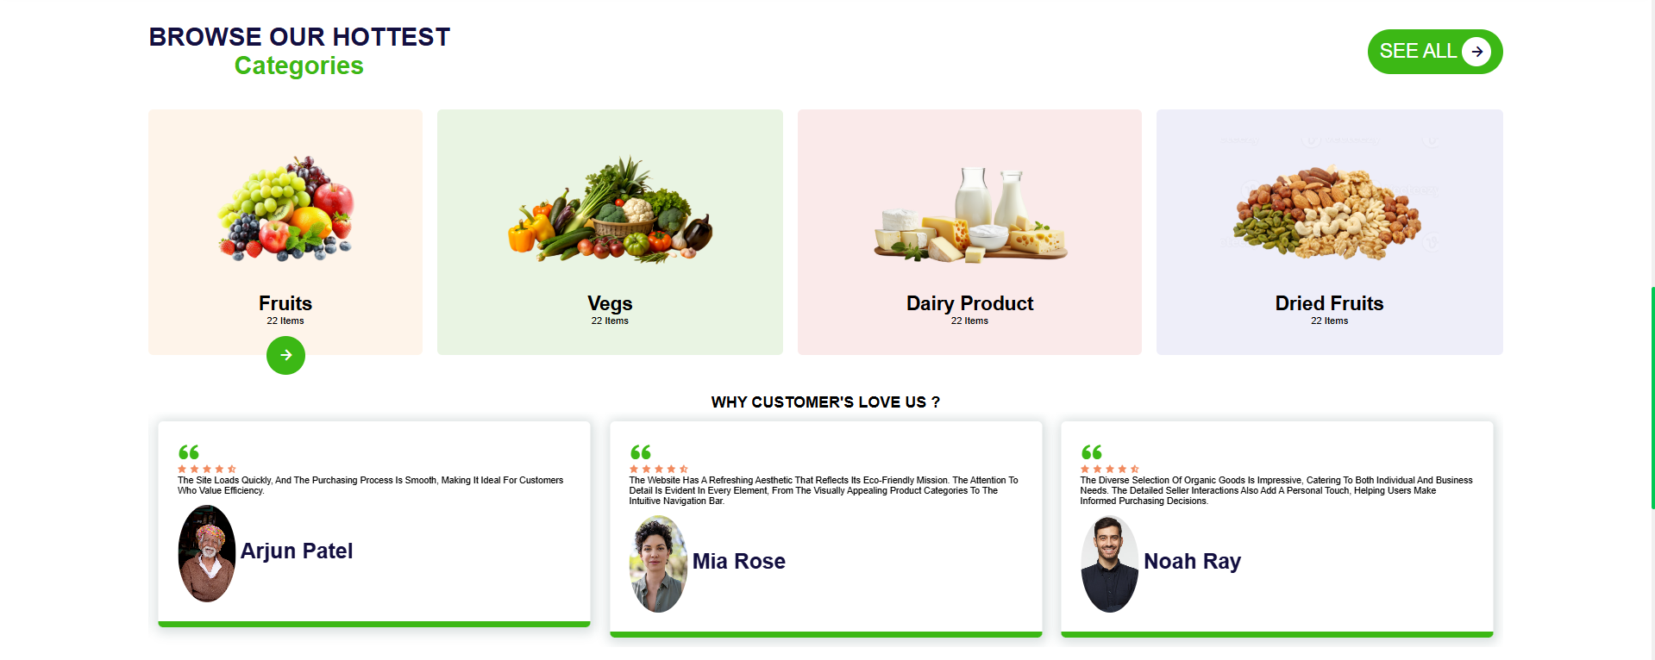

Slide 15
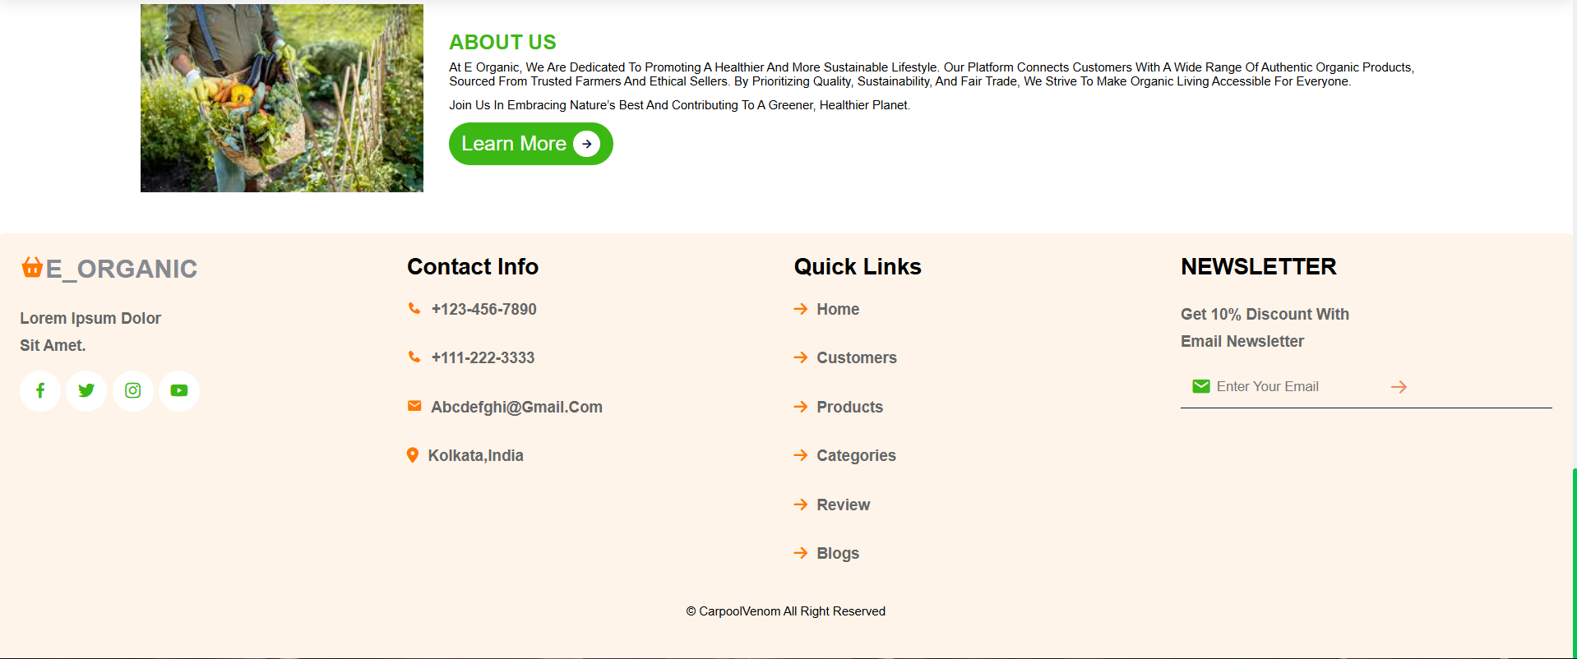

Slide 16
FUTURE SCOPE
- AI-driven recommendations for buyers.
- Blockchain for product traceability.
- Mobile apps for iOS and Android.
- Expansion into international markets.
- Partnerships for faster delivery and eco-friendly packaging.

Slide 17
CONCLUSION
- The E-Organic platform revolutionizes organic e-commerce by ensuring transparency, empowering farmers, and meeting global sustainability goals.
- Designed for scalability and innovation, it is poised to be a leader in the organic marketplace industry.

Slide 18
REFERENCES
BOOKS :
"E-Commerce and Organic Marketplaces" – John Wiley & Sons, 2022.
"Advances in Organic Certification and Market Transparency" – Elsevier Journal, 2021.
Websites and Online Resources:
"The Organic Trade Association: Market Insights and Trends" – www.ota.com.
"World Organic Market Statistics 2023" – www.organic-market.info.
"E-Commerce Frameworks for Specialized Markets" – developer.mozilla.org.

Slide 19
THANK YOU

