Slide 1

QLOO AGENTIC & CULTURAL AI HACKATHON 2026
PawVibe
Bridging Cultural Taste Intelligence to Canine & Feline Compatibility
“Your tastes define your routine. Your routine chooses your pet.”
Turning music, cinema, dining, and neighborhood rhythms into predictive 5D pet lifestyle vectors.
• Live Qloo API (Entity Search & Cross-Domain Insights) • 5D Euclidean Matching • 24 Curated Dog & Cat Breeds
Notes:
SPEAKER SCRIPT (30s):
Hello judges! Today, we are presenting PawVibe — an innovative application that solves a real-world multi-billion dollar problem using Qloo’s Taste Intelligence API. While Qloo models cultural taste correlations across music, film, fashion, and places, PawVibe uses Qloo as a predictive 'Taste-to-Lifestyle' translation layer to match people with the right dog and cat breeds.

Slide 2
THE REAL-WORLD PROBLEM
The Pet-Lifestyle Mismatch Crisis
Why millions of animal adoptions fail despite good intentions
6.5 Million
Pets in US Shelters Annually
Over 6.5 million companion animals enter shelters each year. Up to 47% of rehoming decisions stem from lifestyle incompatibilities: energy mismatches, unexpected noise, space constraints, or travel frequency.
The Flawed Choice
Adoption by Aesthetics
Owners typically adopt based on social media trends or cute looks (e.g. an apartment worker buying a working Australian Shepherd or Border Collie). People rarely quantify their daily energy, soundscape, and habitat until it's too late.
The Opportunity
Taste Predicts Lifestyle
People struggle to evaluate their own physical routine in numbers. However, they easily know their favorite music artists, films, clothing brands, dining spots, and hobbies. These cultural tastes hold the hidden blueprint of how they live.
Notes:
SPEAKER SCRIPT (45s):
Every year, 6.5 million companion animals enter shelters. Almost half of surrenders happen because owners pick pets based on looks rather than daily lifestyle compatibility. A remote worker in a studio adopts a high-drive working dog, or an endurance athlete adopts a sedentary cat. People cannot objectively calculate their lifestyle metrics in a boring questionnaire, but they know their favorite bands, films, and brands. That is where Qloo comes in.

Slide 3
THE CORE BREAKTHROUGH
Qloo as a Taste-to-Lifestyle Translation Layer
How cultural graph affinities map to biological breed traits
Why Traditional Methods Fail
• No Biological Data in Qloo: Qloo doesn't index animal genetics or pet breeds directly.
• Inaccurate Self-Reporting: Users in standard pet quizzes overstate their activity and understate their travel.
• The Missing Link: There has never been a bridge connecting cultural consumer taste with physical pet breed temperaments.
The PawVibe Translation Engine
1. Ingest Cultural Taste: Favorite bands (Radiohead), cinema (A24), fashion, outdoor brands (Patagonia), and neighborhood.
2. Cross-Domain Extraction: Qloo's Live Insights API outputs correlated places, brands, and venue tags (Tranquil, Historic, Parks, Nightlife).
3. 5D Vector Synthesis: Transforms affinities into calibrated 1-5 vectors across: Activity, Space, Social, Routine, and Noise.
4. Mathematical Trait Distance: Computes weighted Euclidean distance against curated trait profiles for 24 Dog and Cat breeds.
Notes:
SPEAKER SCRIPT (45s):
Qloo doesn't have a 'dog breeds' endpoint. But what Qloo DOES have is the world's most sophisticated cultural correlation graph. When a user likes Radiohead, A24 movies, and trail running, Qloo's Insights API tells us what places they visit and what brands they buy. PawVibe ingests these cultural correlations and synthesizes a calibrated 5D Lifestyle Vector, which we then mathematically match against canine and feline breed traits.

Slide 4
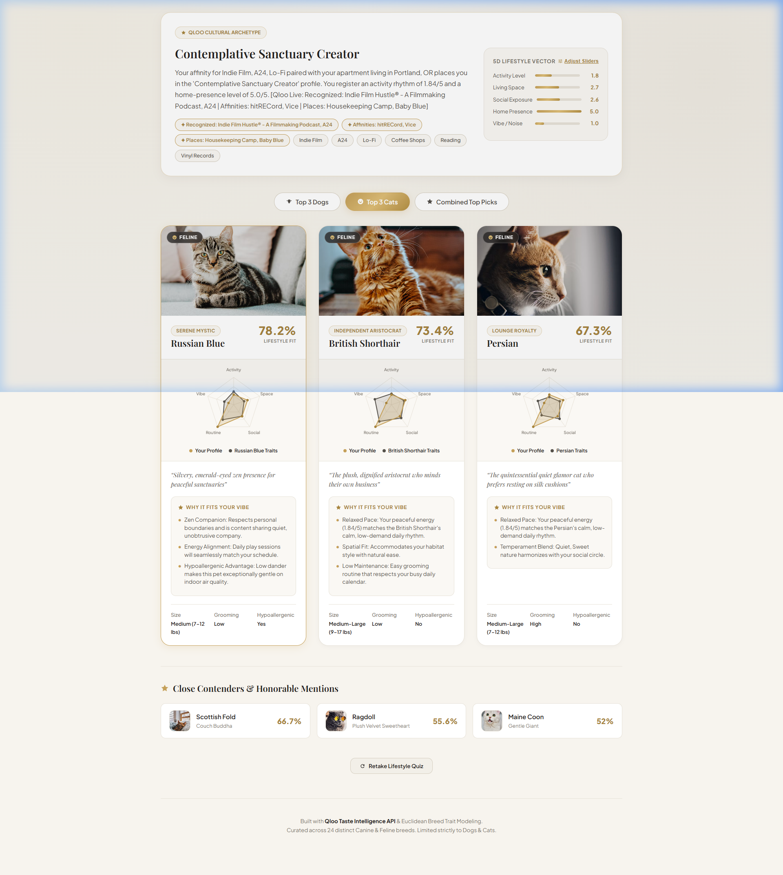
TECHNICAL ARCHITECTURE
Live Qloo Hackathon API Integration
Real-time queries to https://hackathon.api.qloo.com via X-Api-Key
Two-Tier Qloo Query Engine
Step 1: Entity Resolution (/search)
User signals (e.g. 'Radiohead', 'Patagonia') are queried via GET /search?query={item}.
Returns verified Qloo URN entity IDs (e.g. 70CAE5BF-2F4C... type: urn:entity:artist).
Step 2: Places Insights (/v2/insights)
Queries GET /v2/insights with signal.interests.entities={entity_ids}&filter.type=urn:entity:place.
Extracts place archetypes & tags: Tranquil, Historic, Nature conservation, Park.
Step 3: Brands Insights (/v2/insights)
Queries filter.type=urn:entity:brand to retrieve correlated lifestyle brands (e.g. Blinkist, Patagonia, Albion Fit).
Notes:
SPEAKER SCRIPT (40s):
Let's look under the hood. PawVibe is not a static prototype — it connects in real time to hackathon.api.qloo.com. First, we resolve cultural terms into Qloo entity IDs. Then, we query the Insights API for correlated places and brands. You can see in the screenshot right here: when the user enters creative tastes, Qloo extracts affinities like Blinkist and TED Talks, and places tagged as 'Tranquil' and 'Historic'. That live cultural context is directly injected into our matching vector.

Slide 5
THE SCIENCE BEHIND THE MATCH
Weighted Euclidean Trait Distance Modeling
How the 5D Lifestyle Vector matches canine and feline profiles
The 5 Lifestyle Dimensions (Scale: 1.0 - 5.0)
🏃 Activity Level (Weight: 1.25): Couch & book relaxation (1.0) vs. marathon trail running (5.0).
🏡 Living Space (Weight: 1.20): Micro-studio loft (1.0) vs. multi-acre fenced suburban house (5.0).
🤝 Social Exposure (Weight: 1.00): Solitary home sanctuary (1.0) vs. vibrant party host / busy venues (5.0).
⏱️ Home Routine (Weight: 1.00): Frequent flyer / long commutes (1.0) vs. 100% remote homebody (5.0).
🔊 Noise & Vibe (Weight: 0.90): Pin-drop quiet required (1.0) vs. bustling, vocal household (5.0).
The Matching Equation
1. Weighted Euclidean Distance:
D(b) = √ [ Σ w_i · ( Lifestyle_i - Breed_Traits_b,i )² ]
2. Normalized Match Compatibility:
Match % = max( 50, (1 - D(b) / D_max) × 100 )
3. Explainable AI Divergence Analysis:
The engine compares the user's vector to the breed's traits, isolates the closest alignments, and generates personalized 'Why It Fits Your Vibe' explanations (e.g., 'Matches your peaceful schedule while accommodating your studio space').
Notes:
SPEAKER SCRIPT (40s):
We don't use arbitrary keyword matching. We use a formal mathematical distance model. We weight Activity and Living Space slightly higher because animal welfare is most at risk when an active pet is confined in a small space. The engine computes weighted Euclidean distance across the 5 dimensions, calculates a normalized compatibility score, and isolates the exact trait overlaps to provide clear, explainable AI justifications.

Slide 6
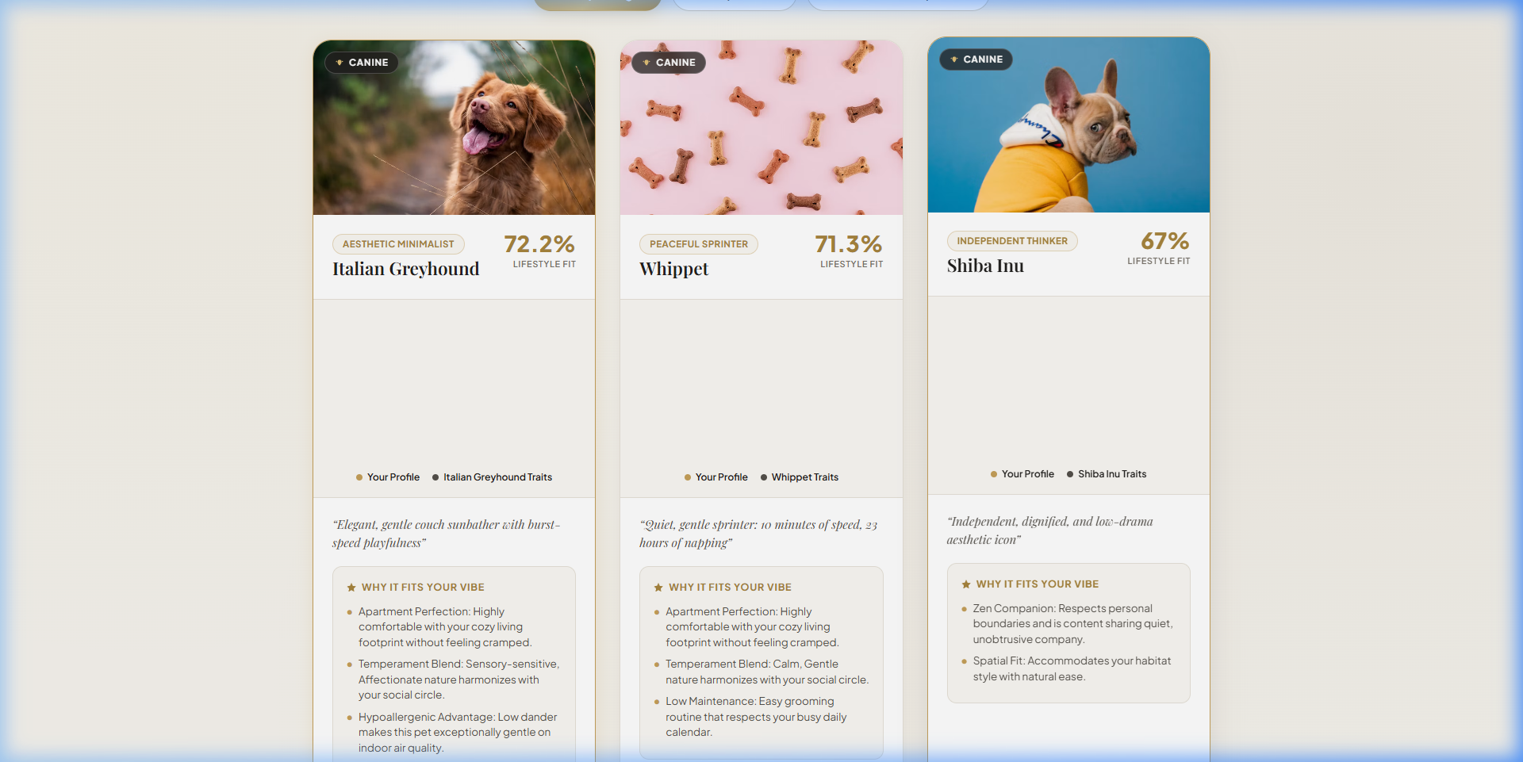
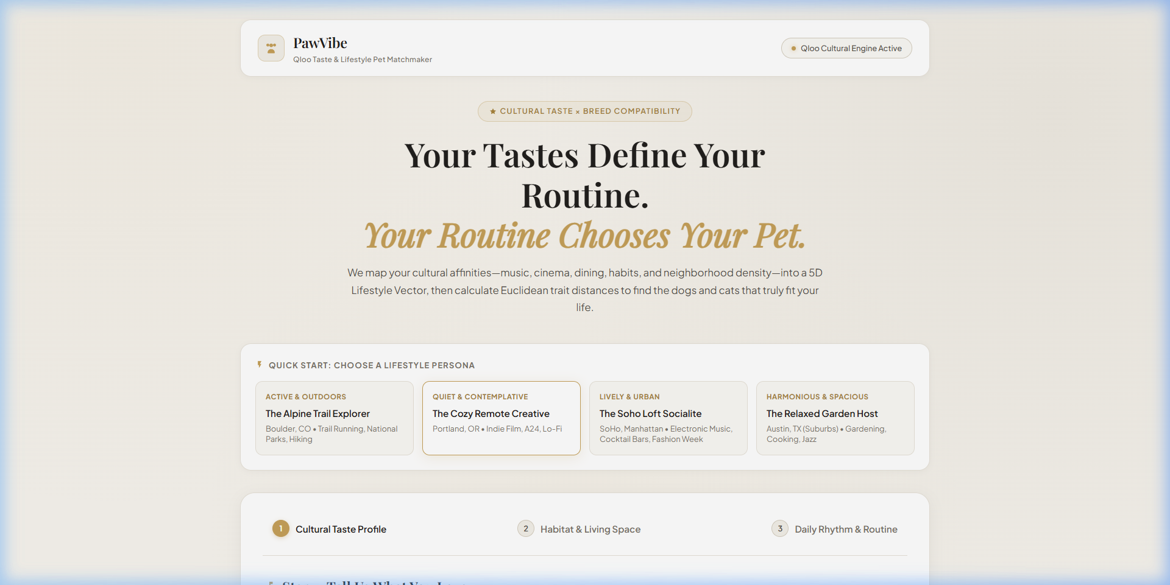
PRODUCT SHOWCASE
Luxury Atelier UI & Real-Time Visualization
Designed with warm beige, white, grey, gold, and HTML5 Canvas radar charts
Notes:
SPEAKER SCRIPT (35s):
Here is the user experience. We designed PawVibe with an editorial, high-end aesthetic inspired by luxury lifestyle magazines. Notice the flat SVG icons, warm beige canvas, and verified high-resolution photography. Each recommendation box features an interactive HTML5 Canvas radar chart overlaying the user's lifestyle vector in gold against the breed's required traits in charcoal grey, giving prospective owners an instant visual comparison.

Slide 7
BUSINESS & MARKET OPPORTUNITY
$150 Billion Industry Meets Cultural AI
How PawVibe drives revenue while improving animal welfare
$150B+
Global Pet Market
Over 86 million US households own pets. Pet parents spend more on premium nutrition, ethical adoptions, and lifestyle gear than ever before. PawVibe enters as an indispensable discovery gateway at the exact moment of adoption decision.
Monetization
High-Margin Channels
• Adoption & Rescue Referral Fees with verified ethical breeders and shelter networks.
• Targeted Affiliate Commerce: Qloo brand affinities recommend tailored gear (e.g. Patagonia owner → Ruffwear outdoor harness).
• Pet Insurance & Vet Plans integrated at the point of match.
Social Impact
Preventing Surrenders
By steering adopters away from mismatched breeds and towards pets whose energy and space needs fit their real lives, PawVibe directly targets the root cause of shelter rehoming. Measurable ESG impact combined with venture-scale economics.
Notes:
SPEAKER SCRIPT (40s):
The pet economy is a $150 billion dollar market. But beyond the commercial opportunity, PawVibe has immense social impact. Because we ingest Qloo brand affinities, we can also recommend personalized gear, food subscriptions, and pet insurance. And by preventing incompatible adoptions before they happen, we keep animals in loving homes and out of shelters.

Slide 8
SUMMARY & VISION
Why PawVibe Wins This Hackathon
The intersection of cultural AI, animal welfare, and live execution
Key Takeaways
1. Novel & Untapped Application of Qloo: Most hackathon projects use Qloo for playlist or restaurant recommendations. PawVibe proves that cultural affinities can solve critical behavioral problems in animal welfare and consumer lifestyle.
2. Fully Built & Tested with Live API: Not a mock-up. Authenticated against https://hackathon.api.qloo.com, executing live /search and /v2/insights requests, backed by FastAPI and modern HTML5 Canvas visualization.
3. Luxury Atelier User Experience: Tailored with a refined Beige, White, Grey, and Gold palette, flat vector iconography, and verified breed photography that wows users at first glance.
4. Scalable Roadmap: Expanding from 24 breeds to regional shelter integrations, adoptable pet pet-matching APIs, and multi-pet household dynamics.
🐾 Try the live app at: http://localhost:8080 | Thank You!
Notes:
SPEAKER SCRIPT (30s):
To wrap up: PawVibe stands out because it takes Qloo into a completely fresh, high-impact vertical. It is fully functional, beautifully designed, and connected to the live Qloo Hackathon API. Thank you so much, and we'd love to take any questions or show you a live demo!

