Slide 1
Cisco Blog
Sushil,Udaya
Krishna Mohan, Santosh John
Feb 2018

Slide 2
Demo Items
1)Mockup screens for various possible flows.
2)An architecture diagram with list/stack of technologies to be used
3)Complete list of REST APIs.
4)Class digram.
5)Code walk thorugh
5)Git Location.

Slide 3
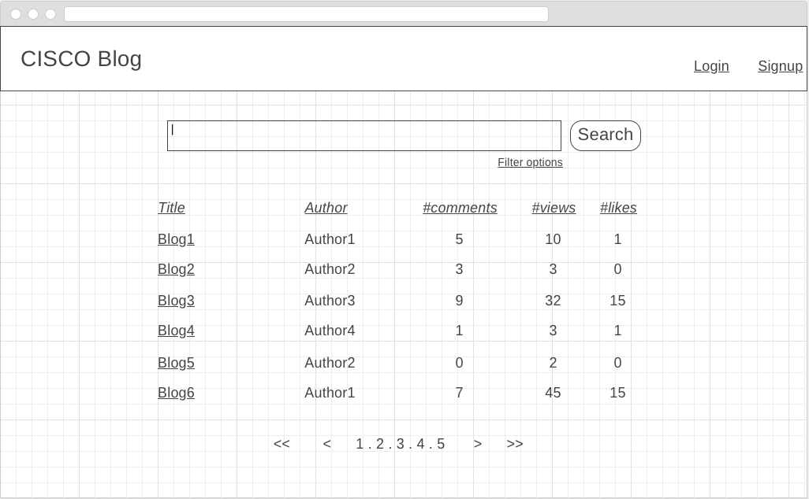
Landing Page/view all the blog posts
Notes:
Have option for various kind of search

Slide 4
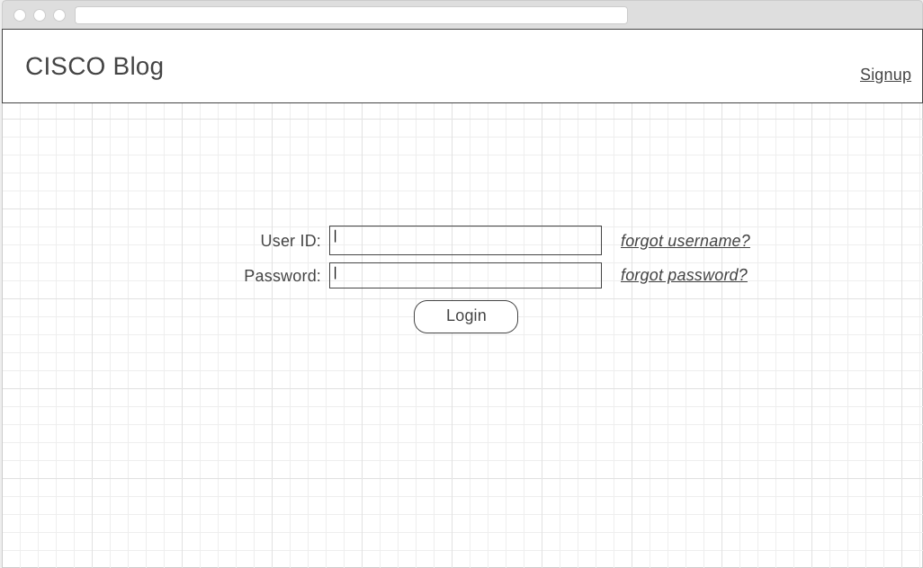
Login Screen

Slide 5
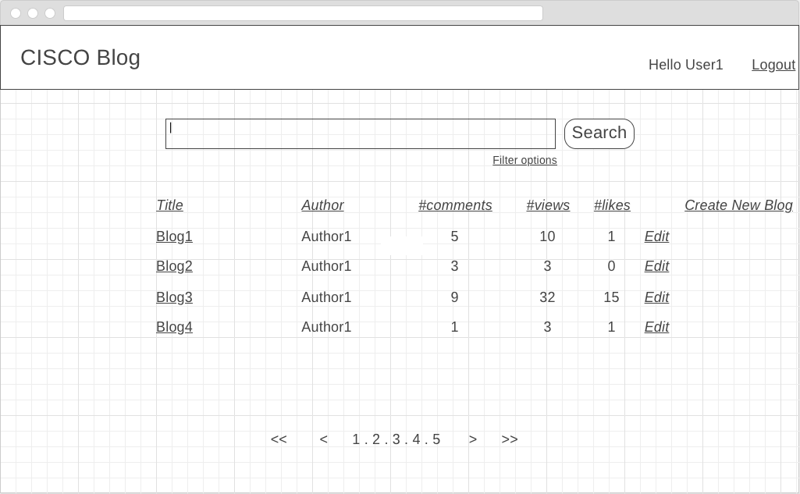
Logged-in Page/view the self blog posts
Notes:
Have Various kind of search

Slide 6
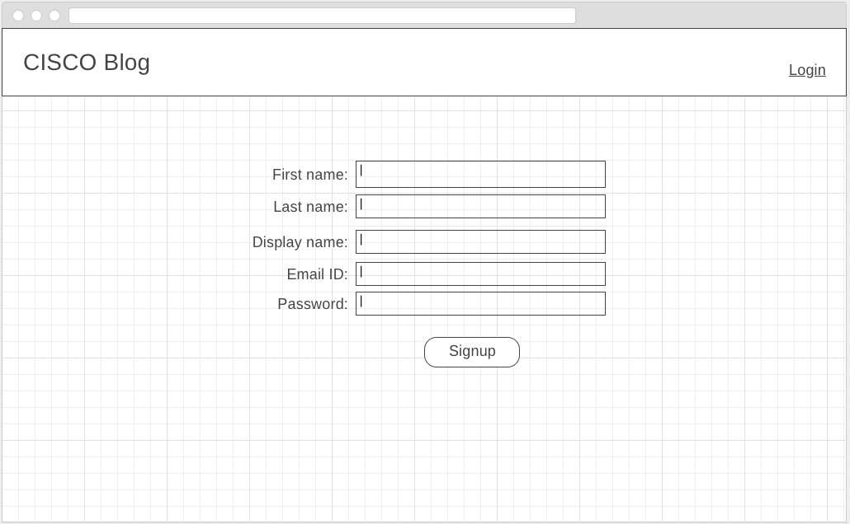
Sign-up for the blogging app

Slide 7
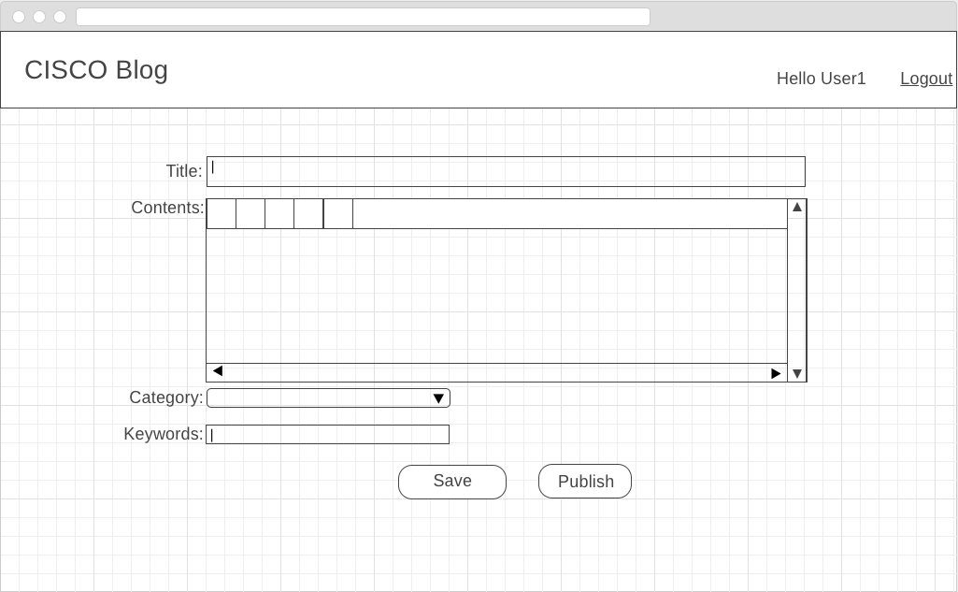
Create blog Screen

Slide 8
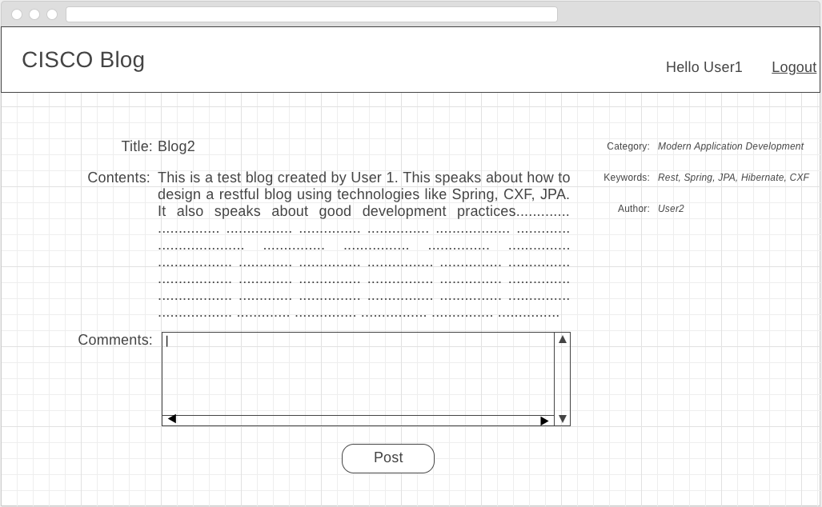
Comment blog Screen

Slide 9
Rest API
SignUp Operation | URI | Method | Success / Failure | Status code
Get SignUp Details | /signup | GET | Success | 200
 |  |  | Not found | 404
 |  |  | Failure | 500
Delete SignUp Details | /signup/{signupid} | DELETE | Success | 200 or 204
 |  |  | Not found | 404
 |  |  | Failure | 500
Edit SignUp Details | /signup/{signupid} | PUT | Success | 200
 |  |  | Wrong format / data | 400 or 415
 |  |  | Not found | 404
 |  |  | Failure | 500
Create SignUp Details | /signup | POST | Success | 201
 |  |  | Wrong format / data | 400 or 415
 |  |  | Failure | 500

Slide 10
Rest API
Profile Operation | URI | Method | Success / Failure | Status code
Get Profile | /profiles/{profileId} | GET | Success | 200
 |  |  | Not found | 404
 |  |  | Failure | 500
Delete Profile | /profiles/{profileId} | DELETE | Success | 200 or 204
 |  |  | Not found | 404
 |  |  | Failure | 500
Edit Profile | /profiles/{profileId} | PUT | Success | 200
 |  |  | Wrong format / data | 400 or 415
 |  |  | Not found | 404
 |  |  | Failure | 500
Create Profile | /profiles | POST | Success | 201
 |  |  | Wrong format / data | 400 or 415
 |  |  | Failure | 500

Slide 11
Blog Operation | URI | Method | Success / Failure | Status code
Get Blogs | /blogs | GET | Success | 200
 |  |  | Not found | 404
 |  |  | Failure | 500
Delete Blogs | /profiles/{profileId}/blogs/{blogId} | DELETE | Success | 200 or 204
 |  |  | Not found | 404
 |  |  | Failure | 500
Edit Blogs | /profiles/{profileId}/blogs/{blogId} | PUT | Success | 200
 |  |  | Wrong format / data | 400 or 415
 |  |  | Not found | 404
 |  |  | Failure | 500
Create Blogs | /profiles/{profileId}/blogs | POST | Success | 201
 |  |  | Wrong format / data | 400 or 415
 |  |  | Failure | 500

Slide 12
Comment Operation | URI | Method | Success / Failure | Status code
Get message | /blogs/{blogid}/comments/ | GET | Success | 200
 |  |  | Not found | 404
 |  |  | Failure | 500
Delete message | /blogs/{blogid}/comments/{commentId} | DELETE | Success | 200 or 204
 |  |  | Not found | 404
 |  |  | Failure | 500
Edit message | /blogs/{blogid}/comments/{commentId} | PUT | Success | 200
 |  |  | Wrong format / data | 400 or 415
 |  |  | Not found | 404
 |  |  | Failure | 500
Create message | /blogs/{blogid}/comments | POST | Success | 201
 |  |  | Wrong format / data | 400 or 415
 |  |  | Failure | 500

Slide 13






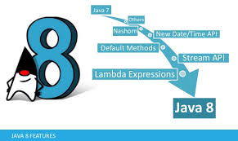

Technology requirements

Slide 14
Apache CXF
+Spring
DAO JPA
+Spring Transaction
Spring Container
business delegate
Spring Container

Slide 15
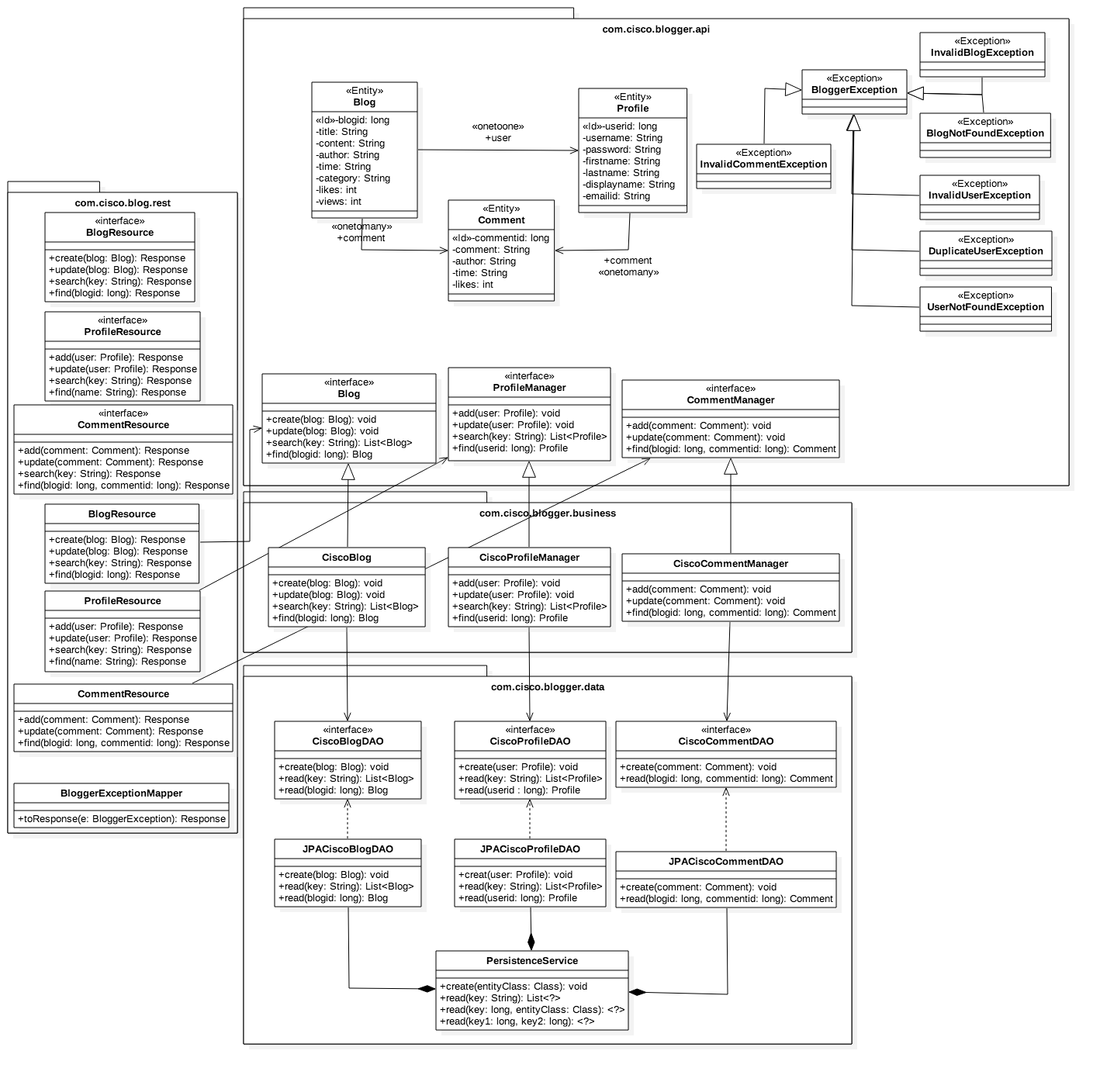

Slide 16
Git Link
https://github.com/udayamv/CMADBlog
https://github.com/suprusty/blog

