Slide 1
Network Analysis – Lecture-1

Slide 2
Networks and maps
A complex biological system, at cellular level :
A network of genes, proteins and metabolites governed by biochemical reactions.
A network with millions of interacting components
For any network, there is a map that gives the details of interaction between its components.
In cell, a map corresponds to a detailed list of binding interactions between these components of the network, namely genes, proteins and metabolites.
A biological network uses information from reductionist approaches, which try to establish the role of individual components like specific genes and poteins (Biomarkers)

Slide 3
Concept of network is very old and universal
The earliest network analysis by Leonard Euler, a Swiss mathematician, in 1735. “ Puzzle of Conigsberg bridge”
Electrical networks (network of power lines)
Chemical networks
Electronics networks
Control systems in industries
Telephone networks
Library networks
Neural networks
Biolchemical networks
Social networks

Slide 4
Examples (in last two decades)
Movie Actor Network, 1998;
World Wide Web, 1999.
C elegans neural wiring diagram 1990
Citation Network, 1998
Metabolic Network, 2000;
Protein Protein Interaction network (PPI), 2001

Slide 5
Network theory is...
Empirical and Data driven
Quantitiative and mathematical
Computational in nature
Graphy theory, Statistics and Differential equations are generally employed in the analysis

Slide 6
In this course, we will study
Protein and gene interaction networks using graph theory
Metabolic networks using differential equations
Studying networks using stochastic methods (Like Bayesian networks), if time permits.
Why it is the best time to do network theory in biology?
Flood of information from genomics, proteomics, transcriptomics and metabiolomics data is coming
Systems biology approach to disease studies and drug design
have been slowly accepted by medical community, though a long way to go.

Slide 7
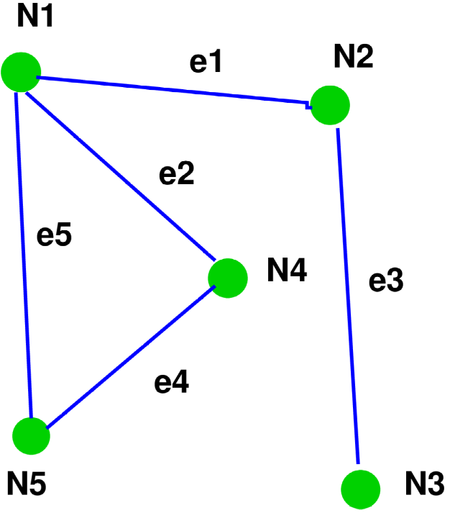

Graph Theory - Basics
A graph consists of systems components called nodes or vertices and the interactions between them called links or edges.
Interactions can be direted or undirected.
In the following graphs, N1, N2,... are nodes and e1,e2,... edges
Undirected graph
Directed graph

Slide 8
What do we do with the nodes and edges?
For a biochemical network, construct an interaction graph (directed or undirected) with nodes and edges.
Information on interactions are obtained from published papers and data bases.
Use graph theory to compute various mathematical parametrs in terms of nodes and edges.
For each node, these parameters quantify its relative importance in the network.
By applying certain combinations and cutoffs on these parameter values, sort the nodes in terms of their importance.
Short list few important nodes for further studies.
Is it necessary that a protein or gene selected as an important node should also be important in terms of biological interaction?
May or May not be.

Slide 9
Parameters of a Graph
1. Basic parameters : (go to Barabasi’s book)
1. Nodes, edges
2. Adjacency matrix and Sparse networks
3. Weighted networks
4. Bipartite graph
5. Degree and degree distribution
2. Distance measures : (go to Barabasi’s book)
1. Shortest path
2. Average path
3. Eulerian and Hamiltonian path
4. Network diameter
5. Clustering Ciefficuent
2. Centrality measures : (continue next few slides)
1. Degree Centrality
2. Closeness Centrality
3. Betweenness centrality
4. Eigenvector centrality

Slide 10
Degree Centrality
Degree centrality of a node represents the number of direct connections it has with all other nodes
If there are n nodes in the network,
Degree centrality of node i = (Number of direct connections to i) / (n-1)
In Proten_protein interaction networks, nodes with higher degree of centrality are important hubs,

Slide 11
Closeness Centrality
For a given node, the closeness centrality involves the shortest paths between this node and every other node.
Take a node, compute shortest paths with every other node. Take a sum of these values.
Now take a reciprocal of the sum.
Closeness centrality if node i = Reciprocal of (sum of shortest distance between i and all other node j)
The more the closeness centrality of a node, the more closer it is to other modes of the network

Slide 12
Betweenness centrality
Betweenness centrality of a node is the number of shortest paths that pass through the node.
Among the shortest paths between every possible pair of nodes in the network, how many of them pass through node i?
Nodes with higher betweenness centrality control the flow of information theough the network (“bottle necks”) and are important hubs in PP interactions.

Slide 13
Eigenvector centrality
Eighenvector centrality represents how much influence a node has on the networ.
(Will be explained in the Next class with a clear example)

