Slide 1

Digital assistant to aid individuals with print disabilities to interpret printed
materials
Progress PresentationI Project ID: 2022-024

Slide 2
Overall Project
Description

Slide 3

What is print disability?
Aprint disability is a difficulty or inability to read printed material due to a perceptual, physical or visual disability [1].

Slide 4

Research Problem

Slide 5

2.2 Billion
People have a near or distance vision impairment - WHO[2]
300 Million
Can be considered as print disabled [3]
1% - 7 %
Of all books are available in accessible formats [4]

Slide 6

Problems faced by
print disability
Lackof resources available in accessible mediums
Can affect everyday life,
education and work
Braille books cost more than
normal issues
Lackof accessibility options in available tools
Cannot get third party assistance for personal, confidential documents

Slide 7

Research Objectives

Slide 8

To explore and identify the feasible solutions to develop an assistive application to aid individuals with print disabilities to interpret printed materials
01
Document zone segmentation, classification and chart interpretation
02
03
04
Table and diagram interpretation
Text and mathematic expression interpretation
Image captioning

Slide 9

Overall System Diagram

Slide 10
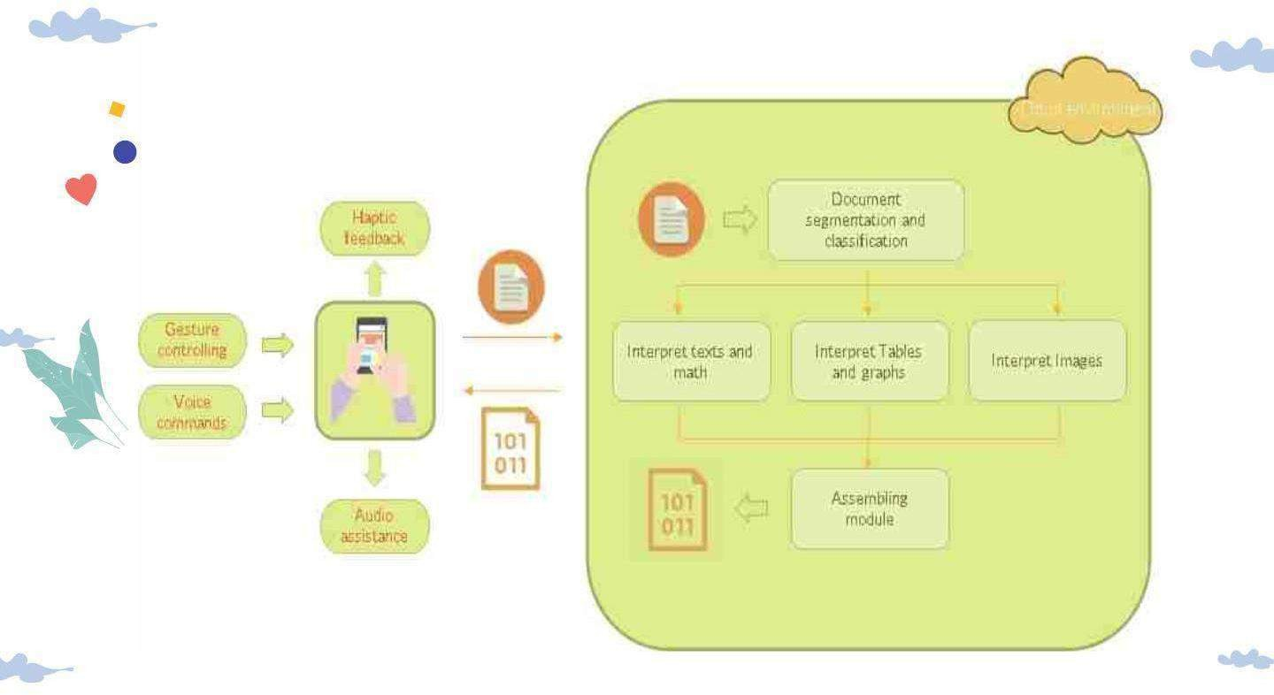

Slide 11

Document zone segmentation, classification and chart
interpretation
IT19187242
Priyashan Sandunhetti S. H. S.

Slide 12

Research Problem
How will the disabled user scan the document with the camera?
How will the disabled user scan the document with the camera?
How will the disabled user scan the document with the camera?
How will the disabled user scan the document with the camera?

Slide 13

Objectives
To develop the document content segmentation, classification methods
and the interpretation of the identified charts
wi thi n the document.
To assist the user with the document capturing process
To segment and classify the regions of the document
To classify the detected charts furthermore
into different types of charts
To extract the data from the charts and turn the extracted data into plain English sentences in a meaningful way

Slide 14
Methodology

Slide 15
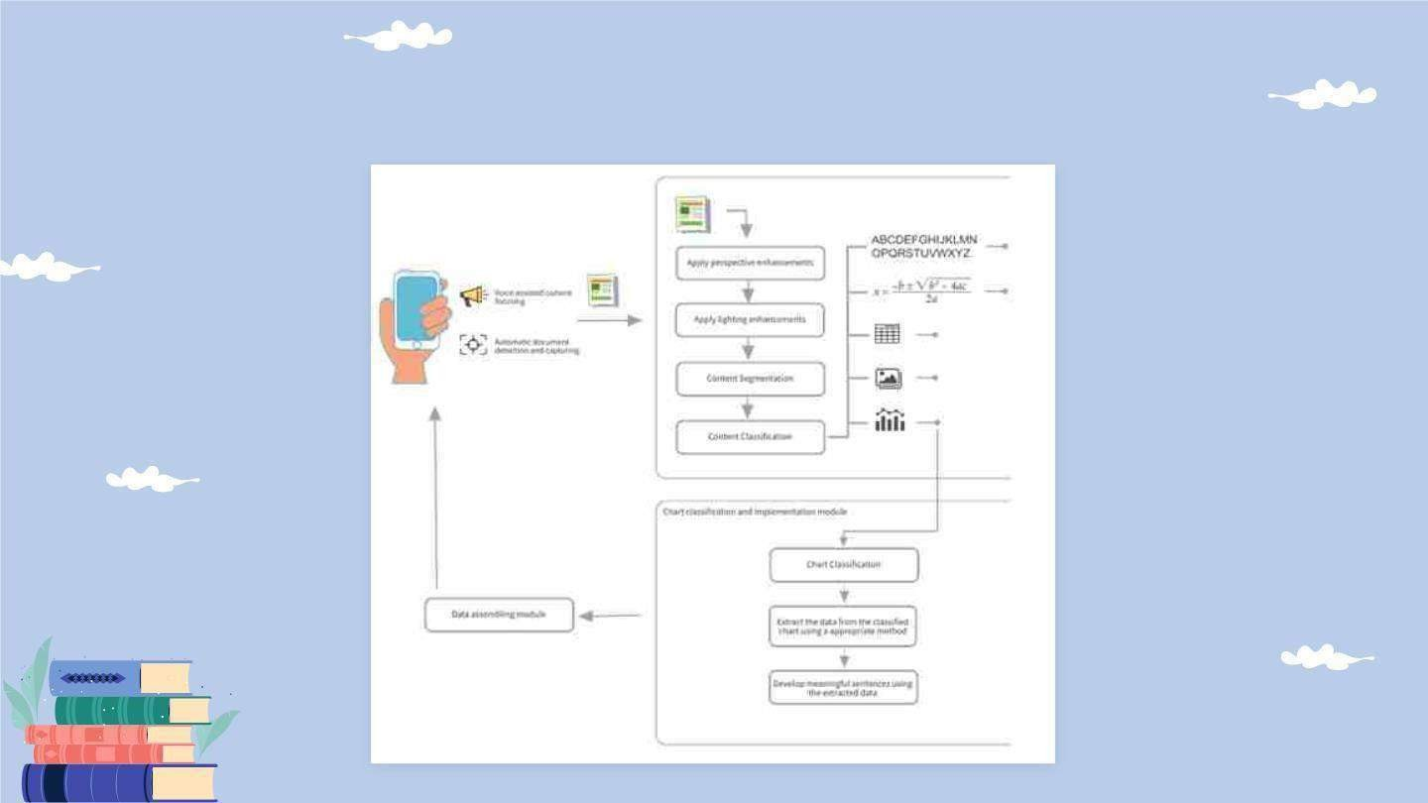
System Overview Diagram

Slide 16

Technologies
Flutter/ Dart
Python
Tensorflow + Keras
OpenCV

Slide 17

Evidences for the Completion

Slide 18

Assistive document capturing
Developed using flutter and OpenCV native JNI libs[1] for android
Edge detection method is in place to detect documents.
★ Needs further improvements to
identify only documents.

Slide 19
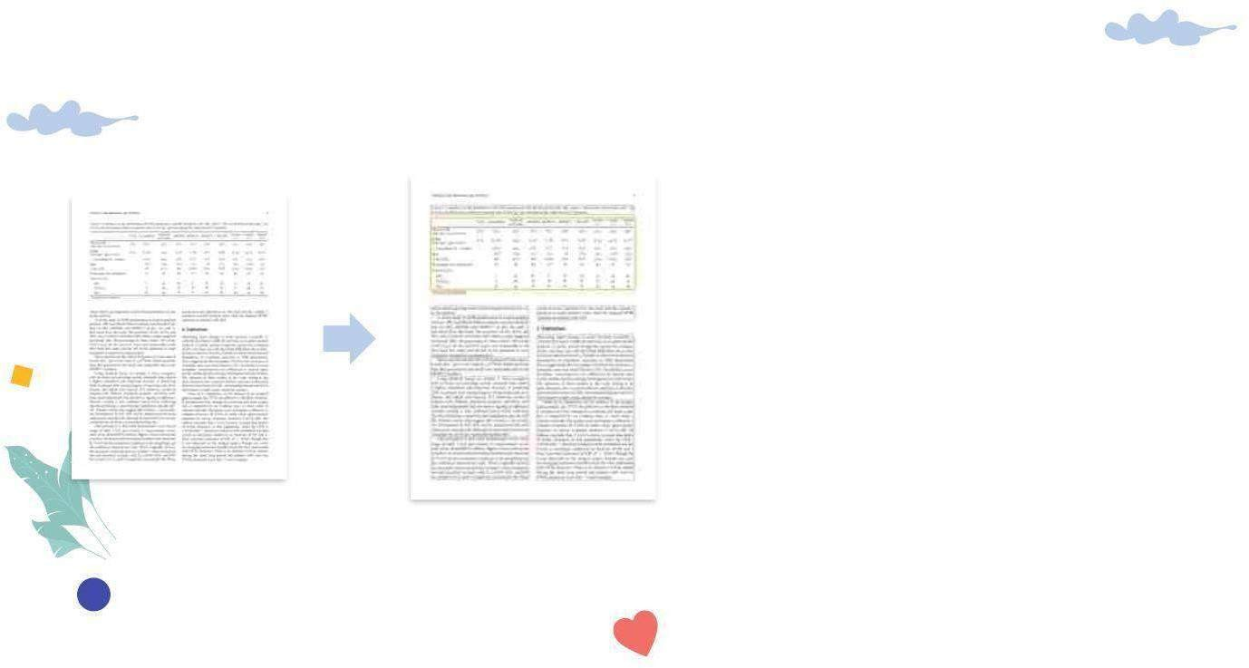
Document segmentation and classification
Developed using python
Using Layout Parser[2] and detectron2[3] library
Datasets:
PubLayNet[4]
PRImA Layout Analysis
Dataset[5]
★ Needs to further improve the algorithm with identificationof mathematical expressions.

Slide 20
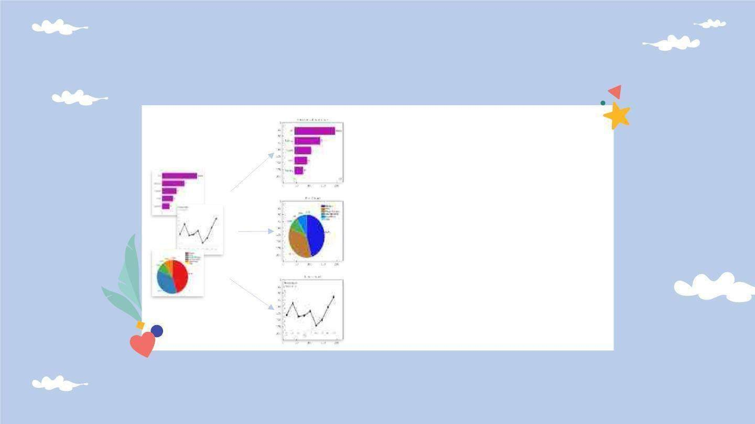
Chart Classification
Model implemented using convolutional neural network
According to VGG-16 architecture
Trained usingcustom
dataset with 4000 images
Classifies with 99%
accuracy

Slide 21

Tasks to be completed
Introduce voice
guidance to
the
document scanning process
Develop an algorithm to extract data
from the charts
Integrate and test the
whole system together
Comm ercialize the
application

Slide 22
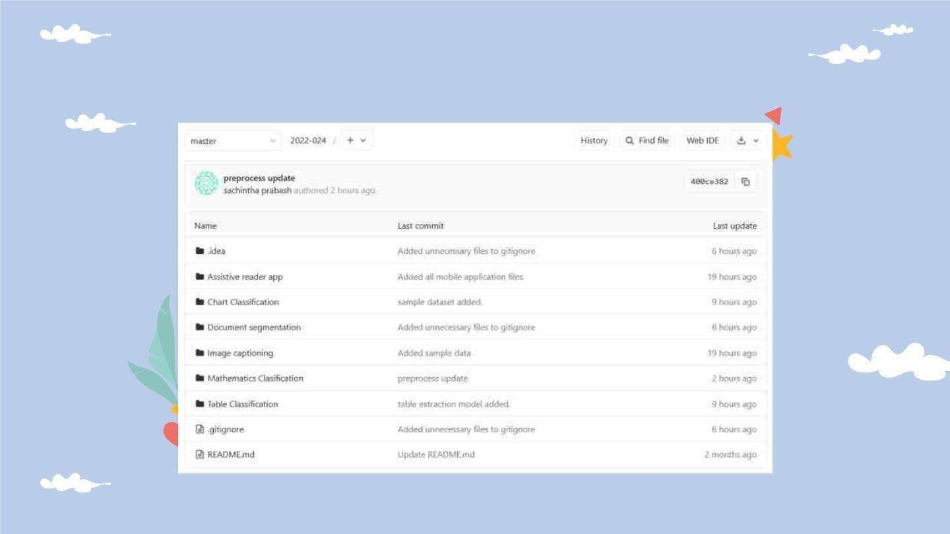
GitLab Repository

Slide 23
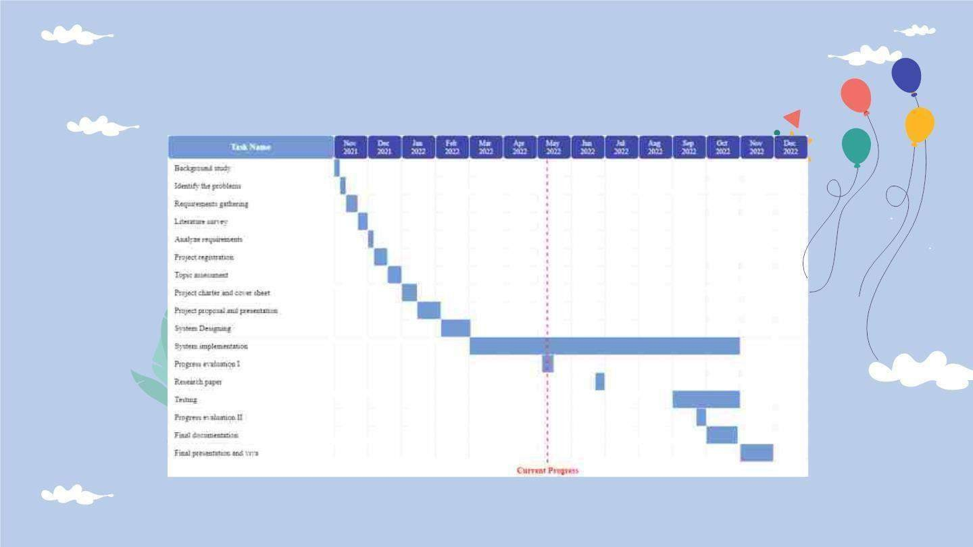
Gantt Chart

Slide 24
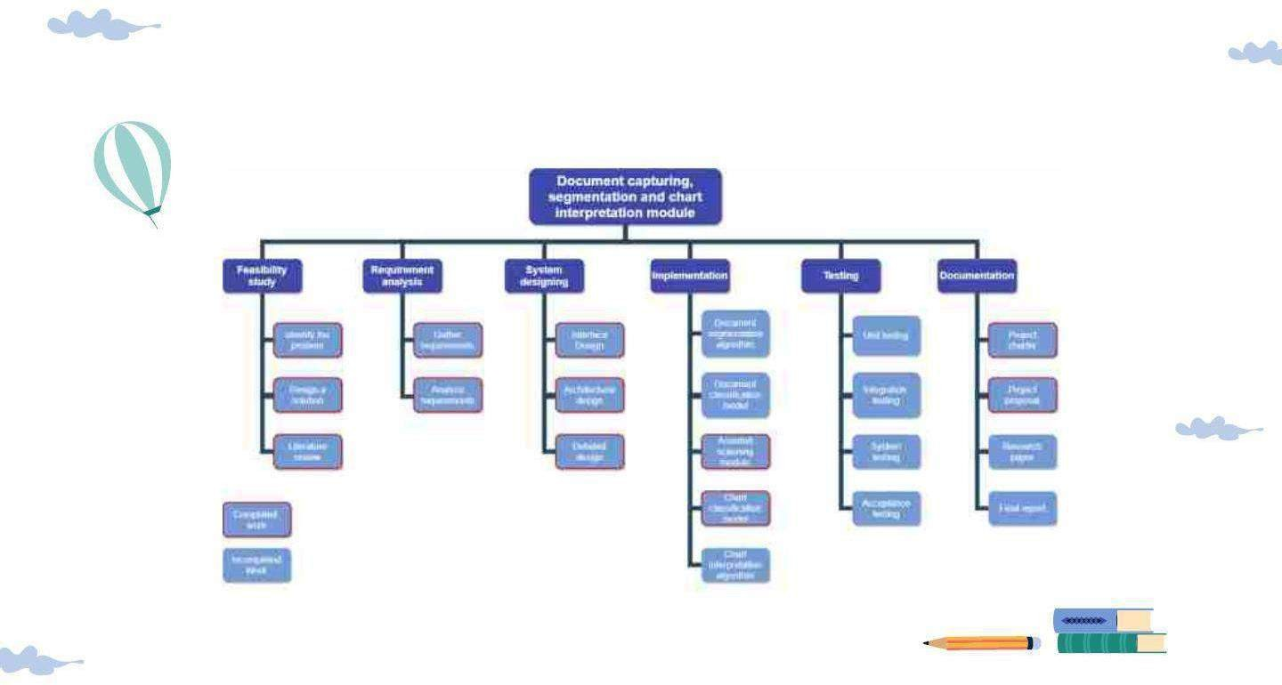
Work Breakdown Structure

Slide 25

References
1L. Rai, Z. Wang, A. Rodrigo, Z. Deng, and H. Liu, “Software development framework for real-time face detection and recognition in mobile devices,” Int. J.Interact. Mob. Technol., vol. 14, no. 04, p.
103, 2020.
Z. Shen, R. Zhang, M. Dell, B. C. G. Lee, J.Carlson, and W. Li, “LayoutParser: Aunified toolkit for deep learning based document
image analysis,” arXiv [cs.CV], 2021.
V. Pham, C. Pham, and T. Dang, “Road damage detection
and classification with Detectron2 and faster R-CNN,” in 2020 IEEE International Conference on Big Data (Big Data), 2020, pp. 5592–
5601.
X.Zhong, J.Tang, and A. J.Yepes, “PubLayNet: largest dataset ever for document layout analysis,” arXiv [cs.CL], 2019.
5C. Clausner, “PRImA contemporary dataset,” Primaresearch.org. [Online]. Available: https://www.primaresearch.org/dataset/. [Accessed: 25-May-2022].
6 K.Simonyan and A. Zisserman, “Very deep convolutional
networks for large-scale image recognition,” arXiv [cs.CV], 2014.

Slide 26
Table identification and interpretation model within the
system
IT19156484
Dilitha Ranjuna G.P.

Slide 27

Research Problem
For visually impaired people, there is no such thing as a separate table identifying tool.
There is no assistant tool that scans tables in a waythat a blind person can use.
Rare to find that explaining tables for blind or visually impaired person.
All the documents are not in braillelanguage.

Slide 28
Objectives
To identify a proper model to read a Table identification and
interpretation model wi thi n the system
Create a model to translate the document's tables into basic plain English.
To allow voice control, develop a speech recognition system.
Create a speech engine to provide guide
and information to the user.

Slide 29
Methodology

Slide 30
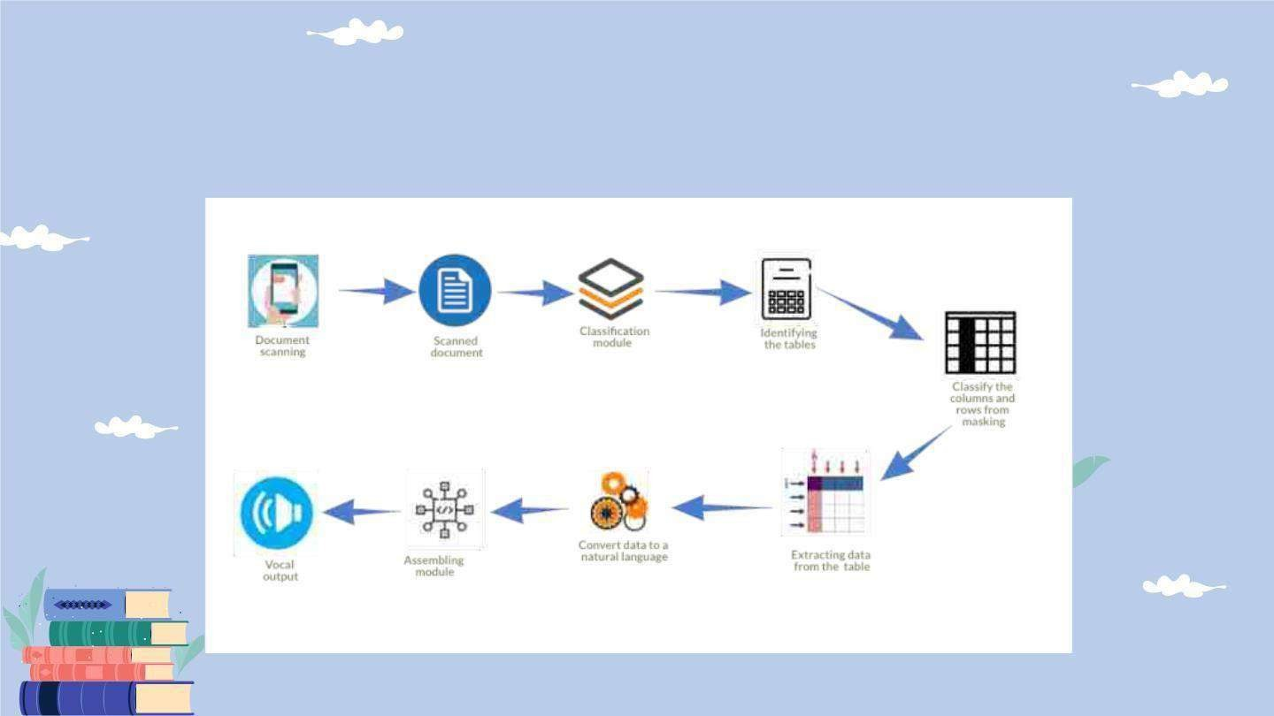
System Diagram

Slide 31
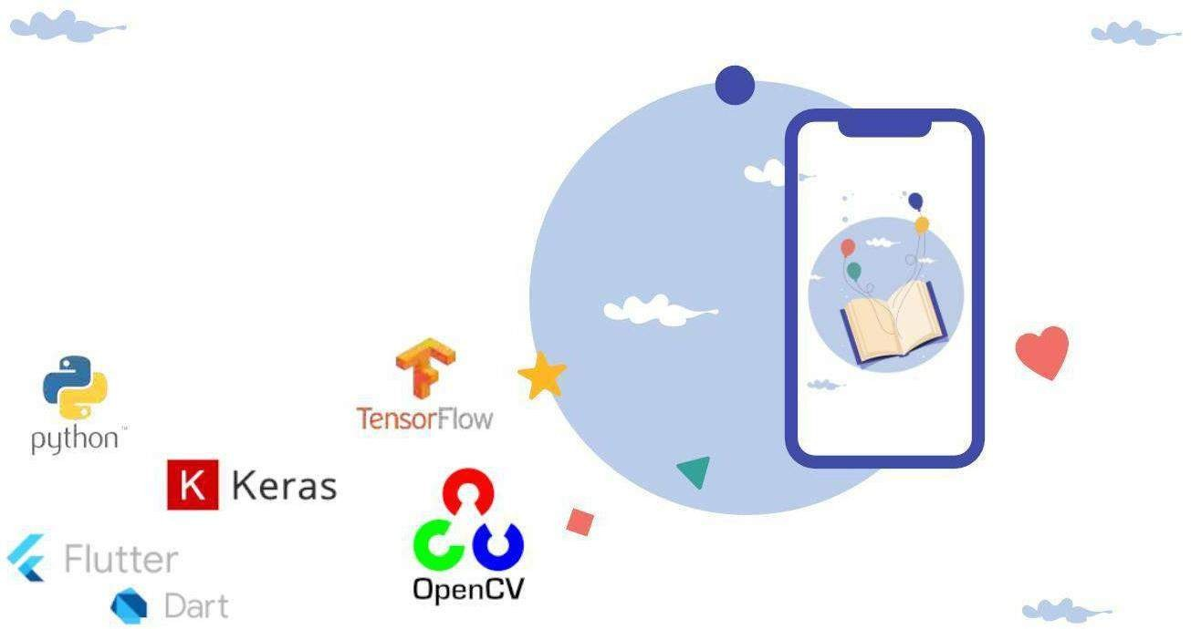
Technologies
Flutter/Dart
Python
Tensorflow/Keras
Opencv

Slide 32
Evidences for the Completion

Slide 33
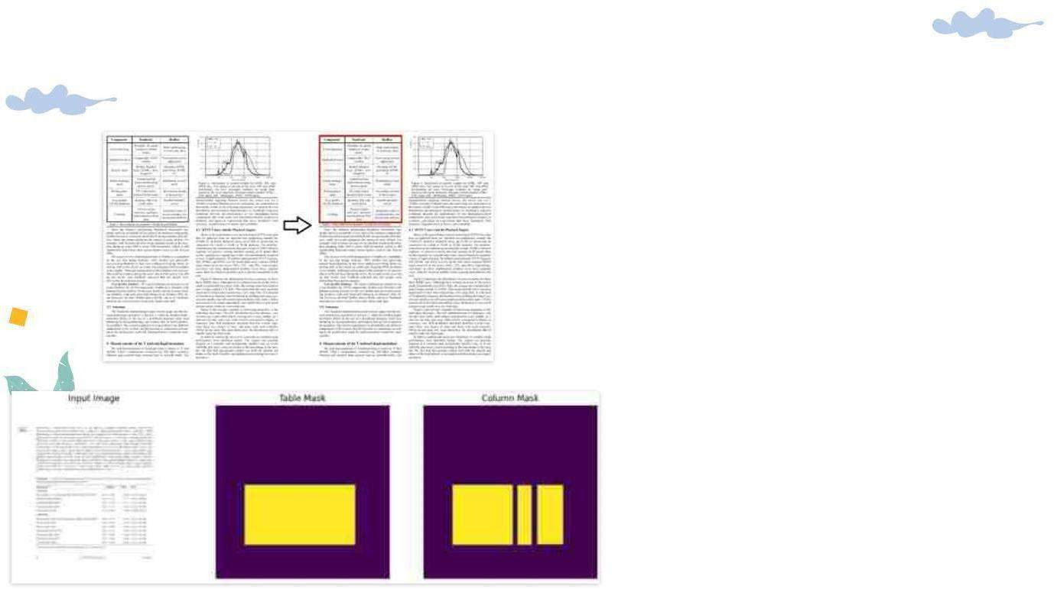
Table Identification and Classification
Developed using python
Using pytesseract and numpy libraries
Datasets:
ICDAR 2017 dataset
Marmot dataset
★ Needs to optimize processingtime of the model.

Slide 34
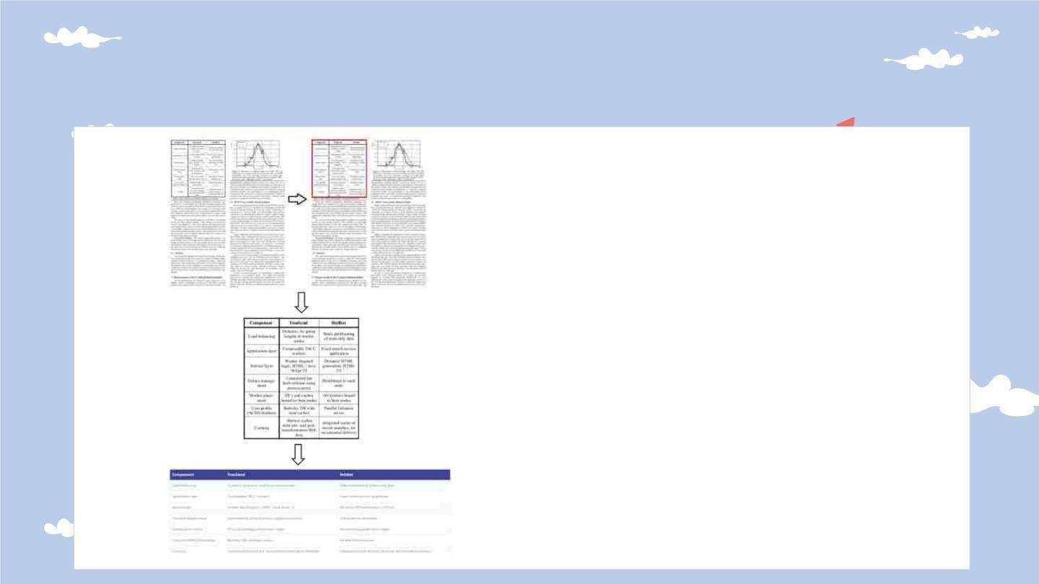
Table Classification
Model implemented using convolutional neural network
According to VGG-19
architecture
Trained using dataset with 2400 images
Classifies with 90%
accuracy
Used pytesseract library for character recognition.

Slide 35

Tasks to be completed
Introduce text to speech engine to
l isten the printed
document
content
Introduce
voice
guidance for the mobile
app to guide the user
Integrate
and test the whole system together
Comm ercialize the
application

Slide 36
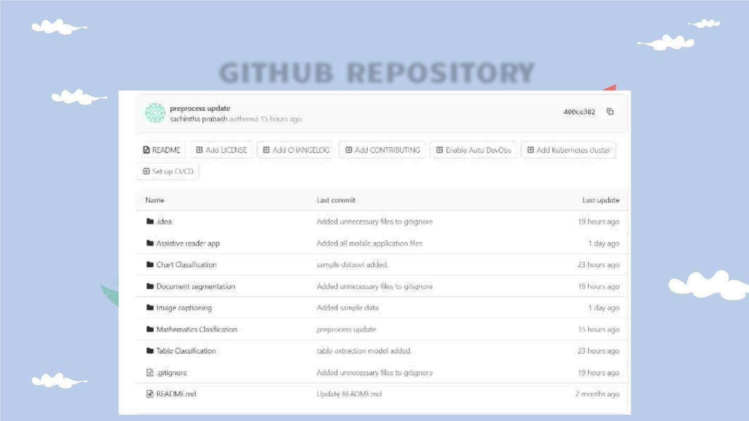
GITHUB REPOSITORY

Slide 37
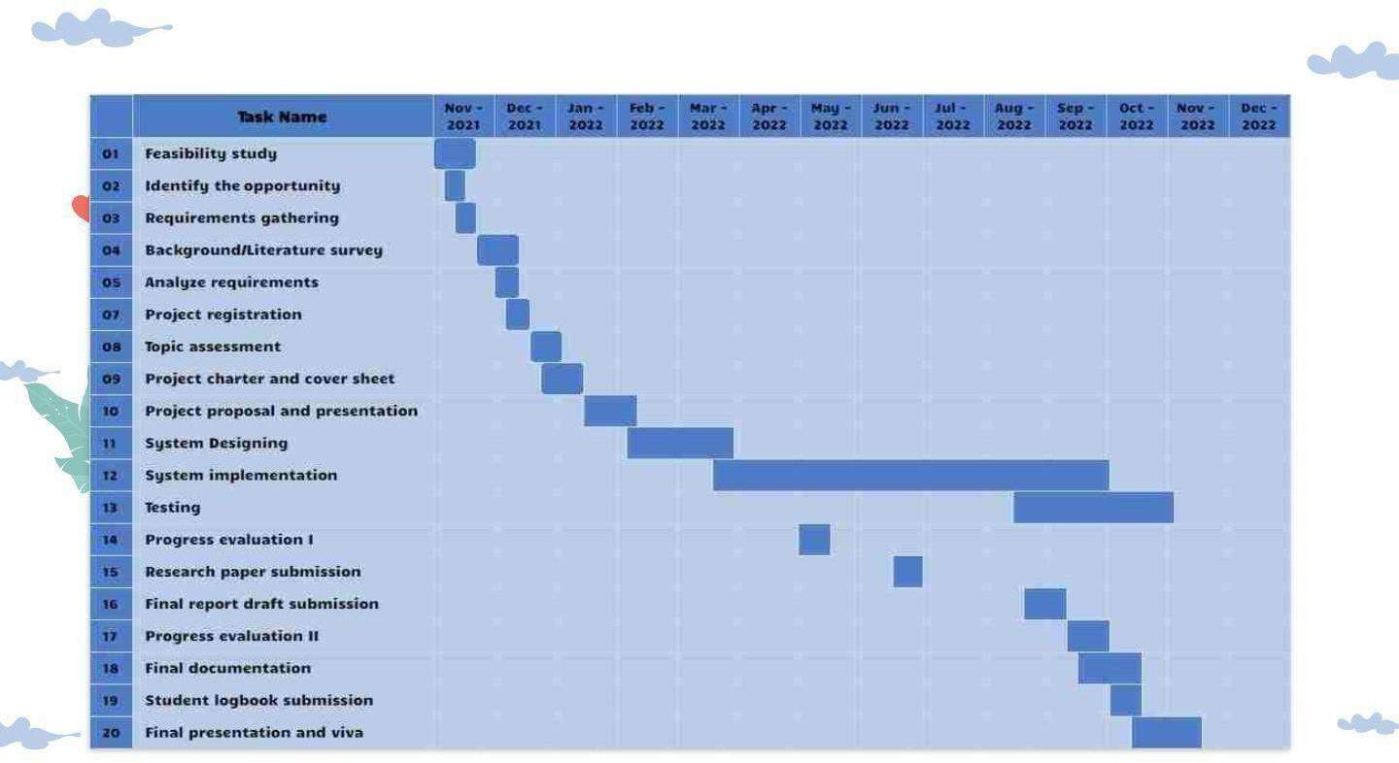
GANTT CHART

Slide 38
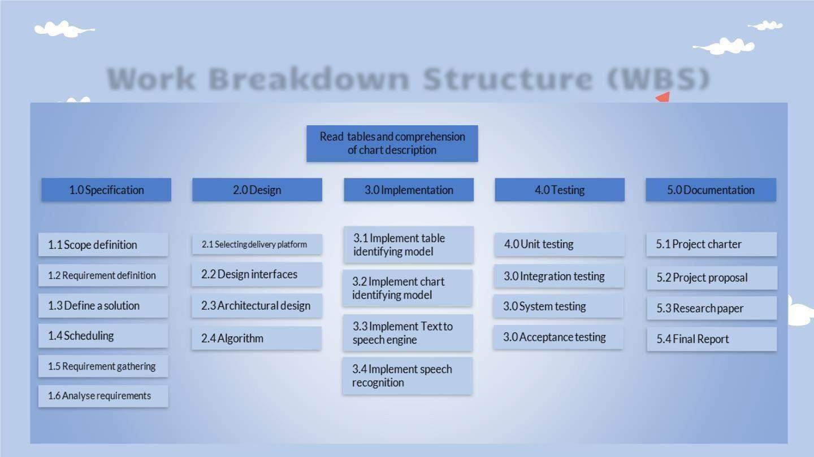
Work Breakdown Structure (WBS)

Slide 39
References
1 Paliwal, S. S., Vishwanath, Rahul, R., Sharma, M., & Vig, L. (2019). TableNet: Deep learning model for end-to-end table detection and tabular data extraction from scanned document images. 2019 International Conference on Document Analysisand Recognition (ICDAR), 128–133.
2Hashmi, K. A., Liwicki, M., Stricker, D., Afzal, M. A., Afzal, M. A., & Afzal, M. Z. (2021). Current status and performance analysis of table recognition in document images with deep neural networks. IEEE Access: Practical Innovations, Open Solutions, 9, 87663–87685.
https://doi.org/10.1109/access.2021.3087865
3 Namysl, M., Esser, A. M., Behnke, S., & Köhler,
J. (2021). Flexible table recognition and semantic interpretation system. In arXiv [cs.CV]. https://www.ais.uni- bonn.de/papers/VISAPP_2022_Namysl.pdf

Slide 40
Explain complex mathematical expressions to the user in a
meaningful way
IT19117492
Sachintha Prabhash K.V.A.

Slide 41

Research Problem
Mathematical equation not clearly identified
Mathematics in brail language also hard to comprehend
How will the vision impaired users read the maths equations ?

Slide 42
Objectives
To explore and identify
an algorithm to explain text and
complex mathematical expressions to the user i n meaningful way.
Improve the identifying the math's and plain
text
Mathematics equation read mathematics way
Improve the recognizingmathematics
symbols

Slide 43
METHODOLOGY

Slide 44
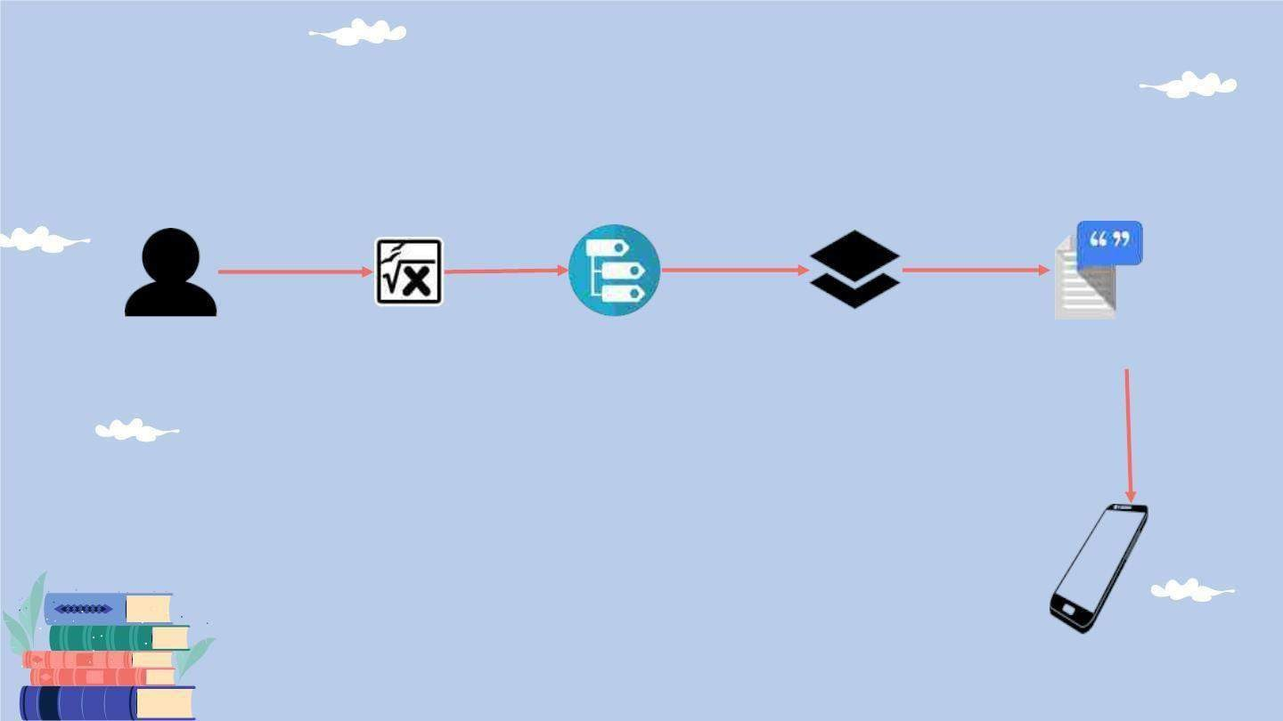
System Diagram
Formula Image
Preprocess model
Classification model
Latex convert readable
Read the formula to the user

Slide 45

Technologies
Python: v-3.9.7
PyTorch
Flutter/Dart
Used Libraries
Numpy
Pillow
Nltk
Tqdm
Distance

Slide 46
COMPLETION

Slide 47
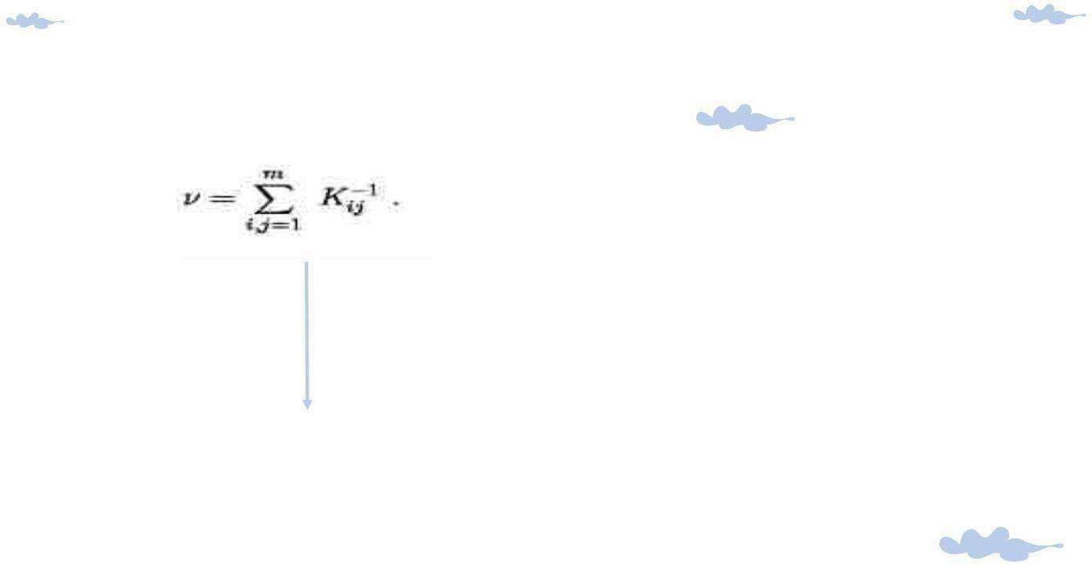
Developed usingpython
Convert images to Latex
Used dataset:
im2latex-100k
The method for identifying mathematical expressions has to be improved further.
v = sum _ { i , j = 1 } ^ { m } K_ { i j } ^ { - 1}

Slide 48
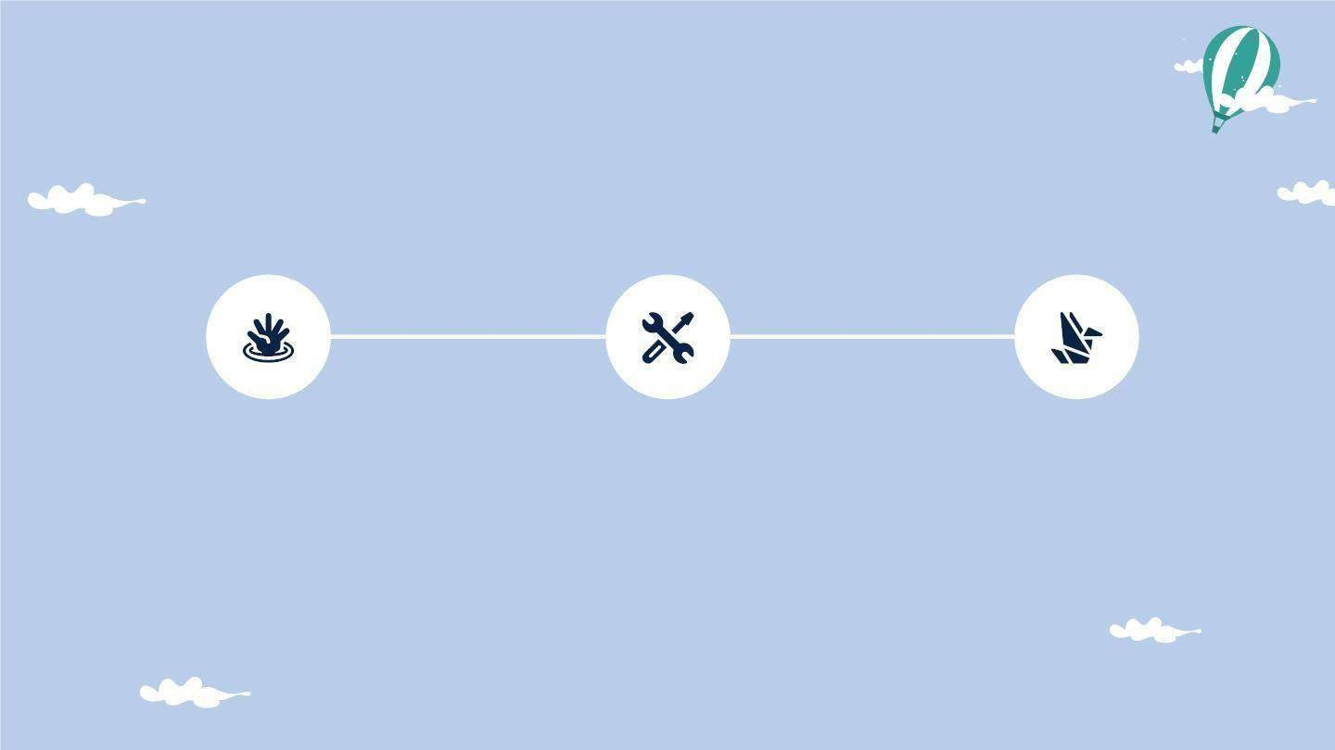
TIMELINE OF COMPLETION
Preprocessing
Model Tran i nni ng
Evaluate
Latex maths formula pre-process
CNN
RNN
Exactmatching formula 72.4%

Slide 49
Evidences for the Completion

Slide 50
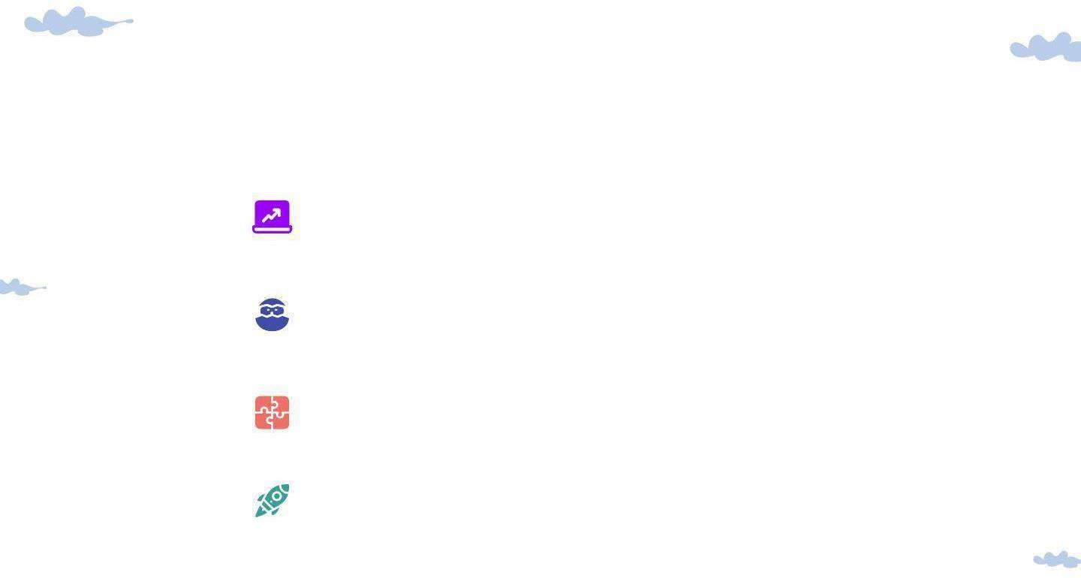
Task to be Completed
Improve the accuracy of the model
Develop the latex formula to readable
Implement the mobile application Commercialization the app

Slide 51
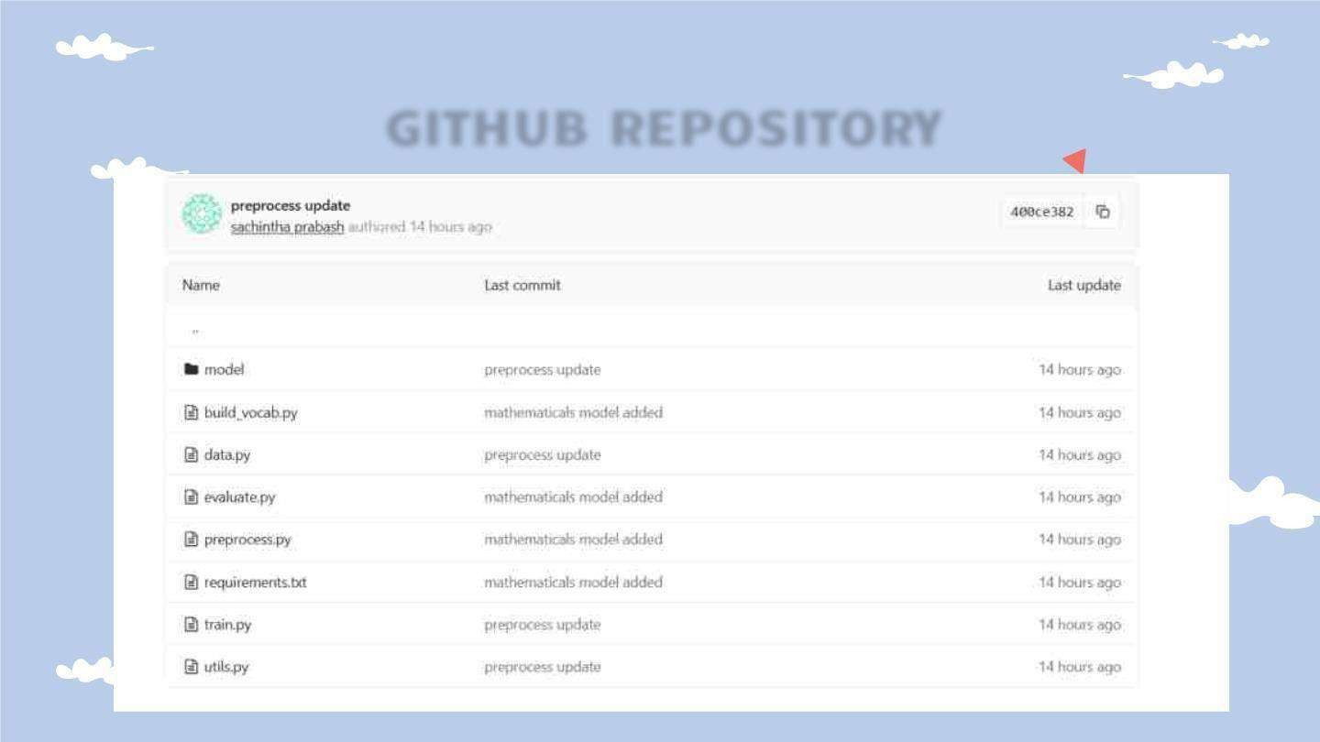
GITHUB REPOSITORY

Slide 52
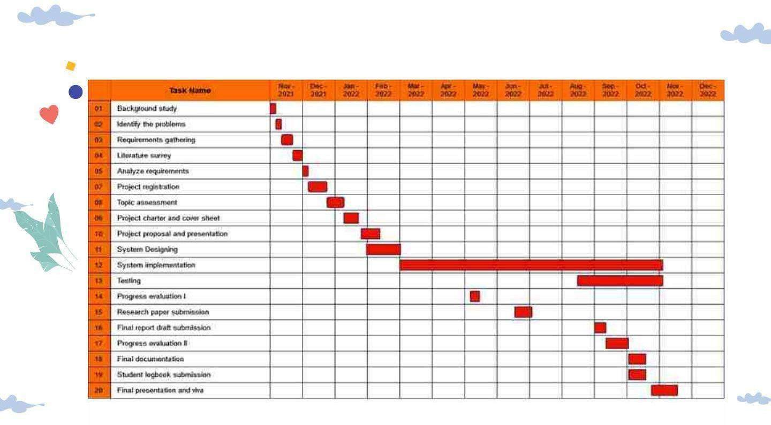
GANTT CHART
a

Slide 53
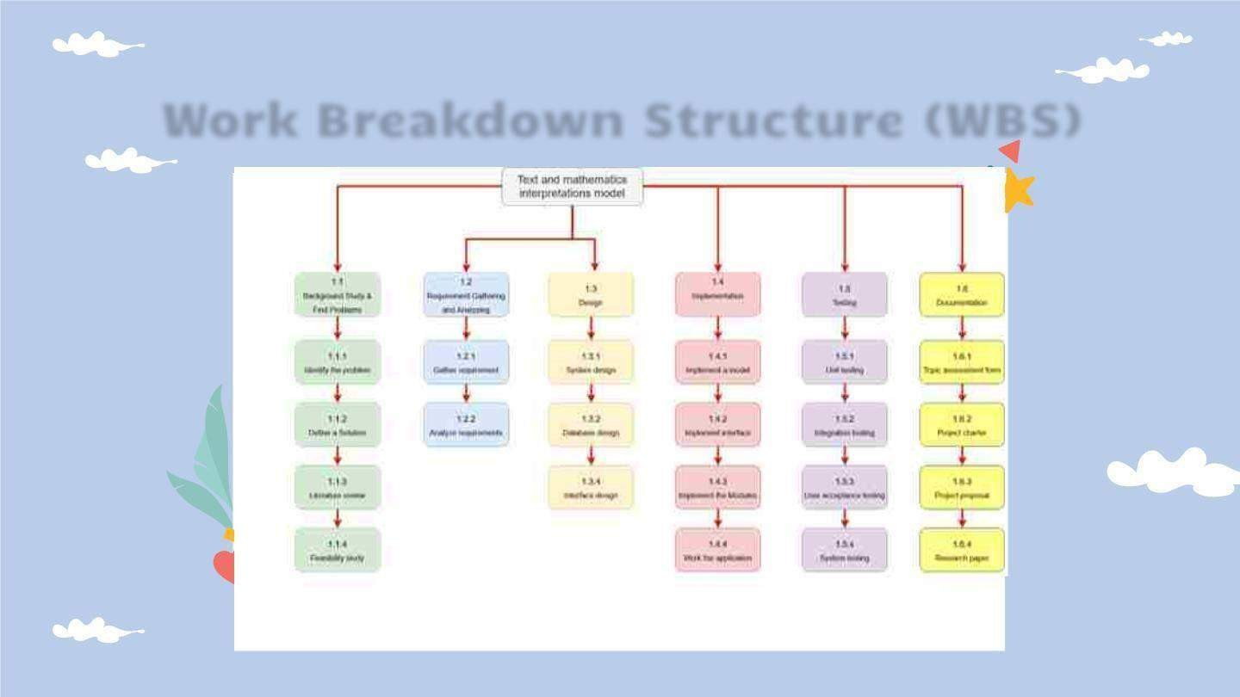
Work Breakdown Structure (WBS)

Slide 54

References
1.R. Noor, K. Mejbaul Islam and M. J. Rahimi,
" Handwritten Bangla Numeral Recognition Using
Ensembling of Convolutional Neural Network," 2018 21st International Conference of Computer and
Information Technology (ICCIT), 2018, pp. 1-6, doi: 10.1109/ICCITECHN.2018.8631944.
S. Bender, M. Haurilet, A. Roitberg and R. Stiefelhagen, "Learning Fine-Grained Image Representations for Mathematical Expression Recognition," 2019 International Conference on Document Analysis and Recognition Workshops (ICDARW), 2019, pp. 56-61, doi: 10.1109/ICDARW.2019.00015.
DBian, X., Qin, B., Xin, X., Li, J., Su, X., & Wang, Y. (2021). Handwritten mathematical expression
recognition via attention aggregation based Bi- directional mutual learning. In arXiv [cs.CV]. http://arxiv.org/abs/2112.03603

Slide 55
Identifying a proper image captioning approach to facilitate interpreting an image in a document
IT19392172
Sanduni Madara P.G.

Slide 56
Research Problem

Slide 57

Research Problem
Inability to interpret an image in a printed document without others’ assistance
Every time, cannot get a third- party assistant for image identification.
Cannot have a descriptive explanation of an image through braille
Existing tools lackthe accessibilityoptions for print disabled individuals
Lackof understanding / sufficient explanation of the images in existing tools

Slide 58
Research Objectives

Slide 59
Objectives
To explore and identify
the feasible system
wi th a proper image interpretation model
to facilitate reading a printed document.
To identify a proper image identification
model to extract image features.
To identify a proper language model to generate a descriptive explanation.
To develop a gesture-controlled process with a haptic feedback system in the mobile application.

Slide 60
Methodology

Slide 61
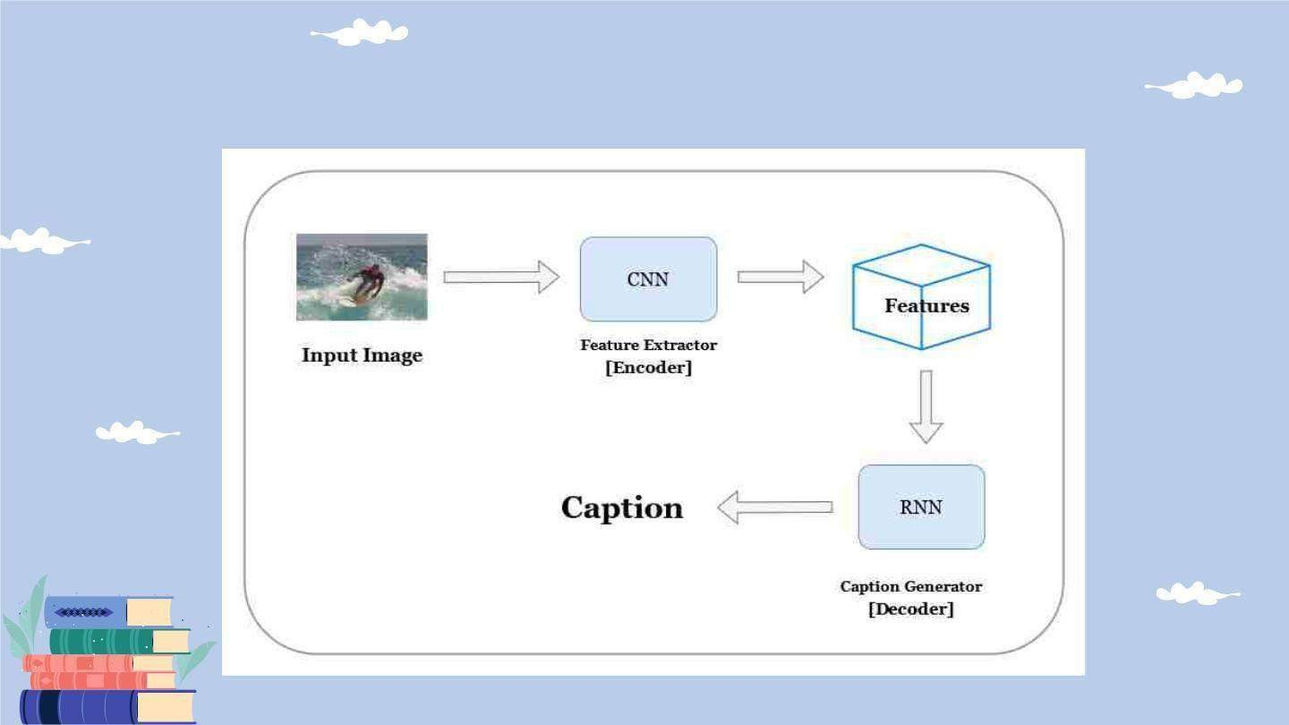
System Overview Diagram

Slide 62

Technologies
Python
Tensorflow + Keras
InceptionV3
Numpy

Slide 63
Evidences for the Completion

Slide 64

Image Captioning
Dataset
MS COCO dataset[1]
Large-scale object detection, segmentation, and captioning dataset
Developed by Microsoft
Consists of 82,783 images
With at least 5 different captions for a image

Slide 65

Preprocessing
Preprocess the images using InceptionV3[2]
Resizing the image to 299px by 299px
Normalize the pixel values in range -1,1 to match the input
Extract image features from InceptionV3 and
cache in the hard disk

Slide 66
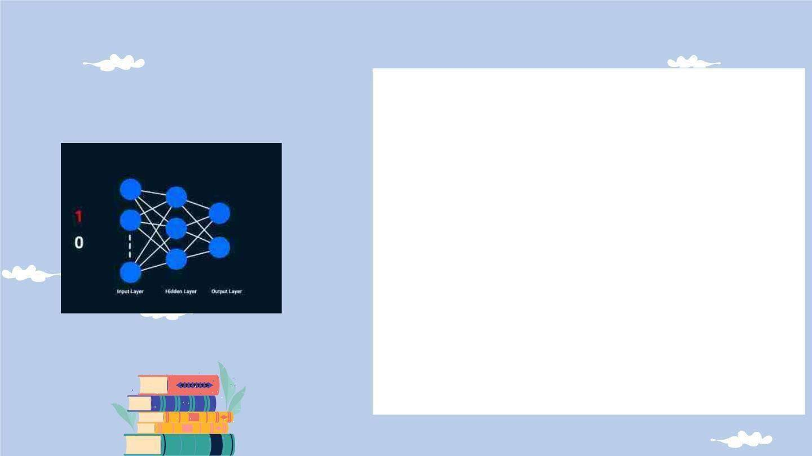
The model
Neural network with encoder decoder[3]
model
With the added Bahdanau Attention Mechanism[4] [5]
Attention model consists of 3 Dense layers
CNN Encoder consists of a single fully connected layer. (Dense layer)
RNN Decoder consists of 4 convolutional layers (Embedding, GRU and Dense)

Slide 67
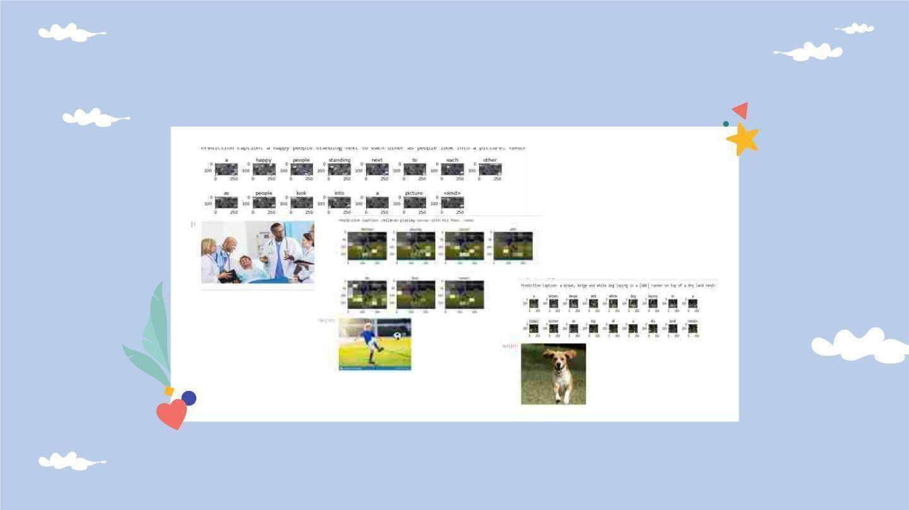
Sample outputs

Slide 68

Tasks to be completed
Develop the haptic feedback
module
within the application
Improve the generated captions to cater blind users
Integrate and test the
whole system together
Comm ercialize the
application
Improve the accuracy of the model

Slide 69
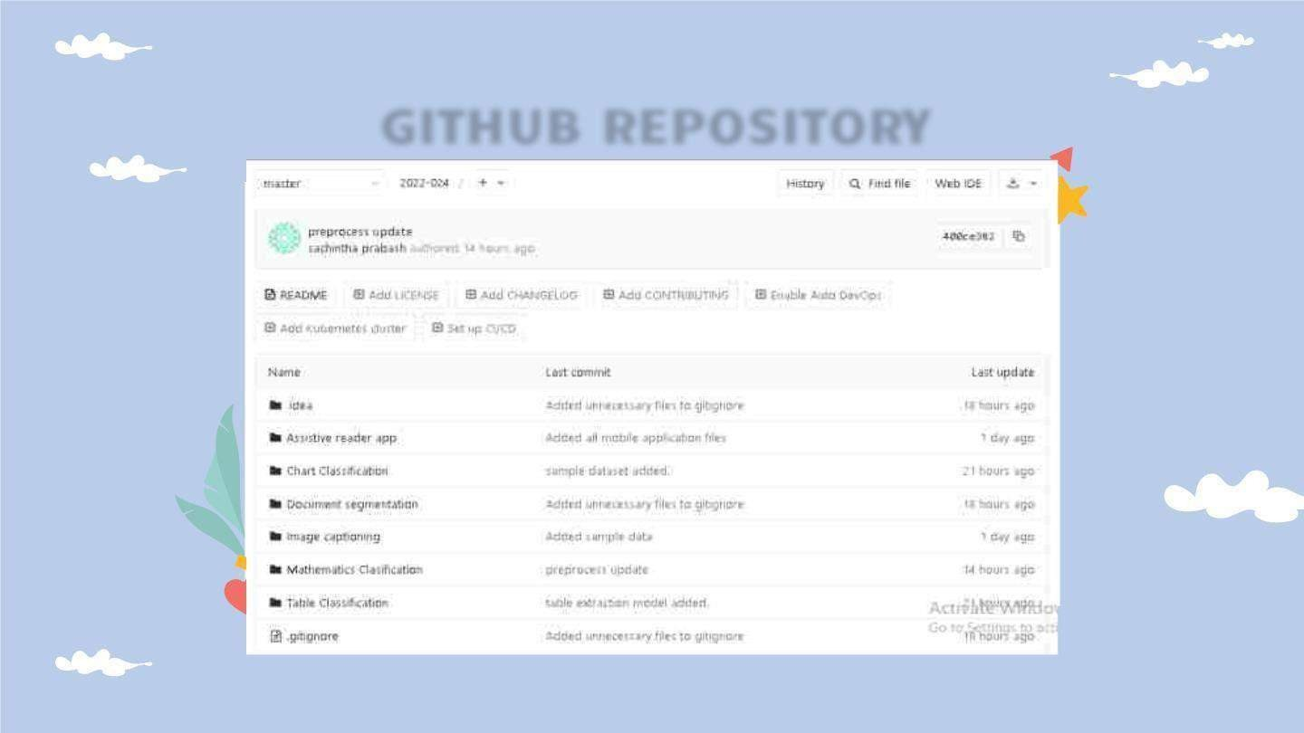
GITHUB REPOSITORY

Slide 70
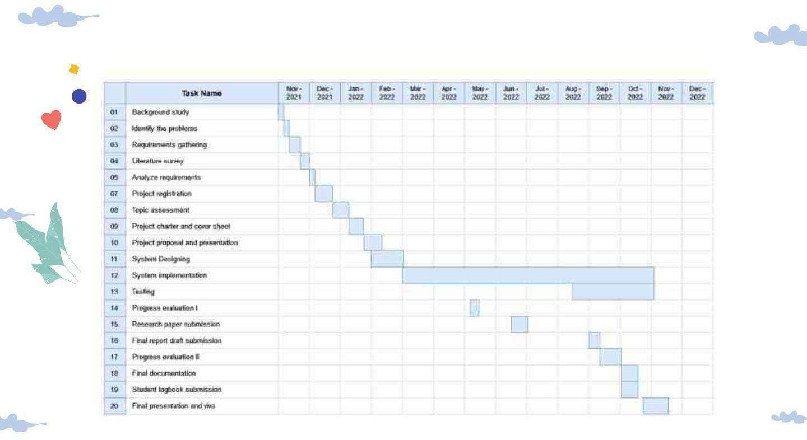
GANTT CHART

Slide 71
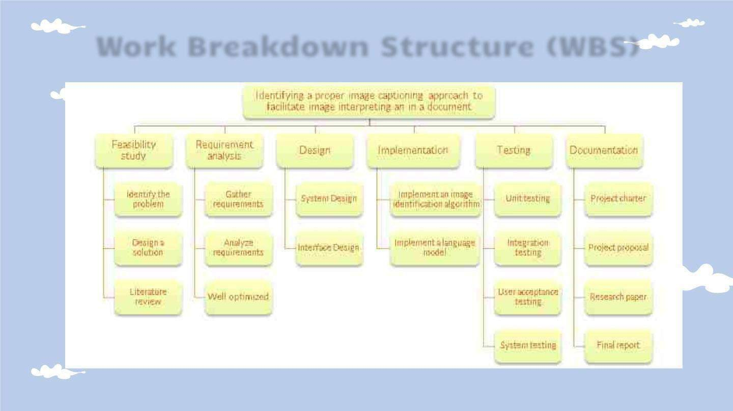
Work Breakdown Structure (WBS)

Slide 72
References
1T.-Y. Lin et al., “Microsoft COCO: Common objects in context,” in Computer Vision – ECCV2014, Cham: Springer International Publishing, 2014, pp. 740–755.
C. Wang et al., “Pulmonary image classification based on inception-v3 transfer learning model,” IEEE Access, vol. 7, pp. 146533
–146541, 2019.
V. Badrinarayanan, A. Kendall, and R. Cipolla, “SegNet: A deep convolutional encoder-decoder architecture for image
segmentation,” IEEETrans. Pattern Anal. Mach. Intell., vol. 39, no. 12,
pp. 2481–2495, 2017.
J.Chorowski, D. Bahdanau, D. Serdyuk, K.Cho, and Y.
Bengio, “At ention-Based Models for Speech Recognition,” arXiv
[cs.CL], 2015.
5K.Xu et al., “Show, attend and tell: Neural image caption generation
with visual at ention,” arXiv [cs.LG], 2015.

Slide 73
Supportive Information

Slide 74

Commercialization
Promote the system on platforms where vision impaired visits the most(Audioboo ks, Radio)
App will be free to use and monetization will be done with advertisements
Make more online presence by creating social media pages for the app
Spread the word around people with disabled communities

Slide 75
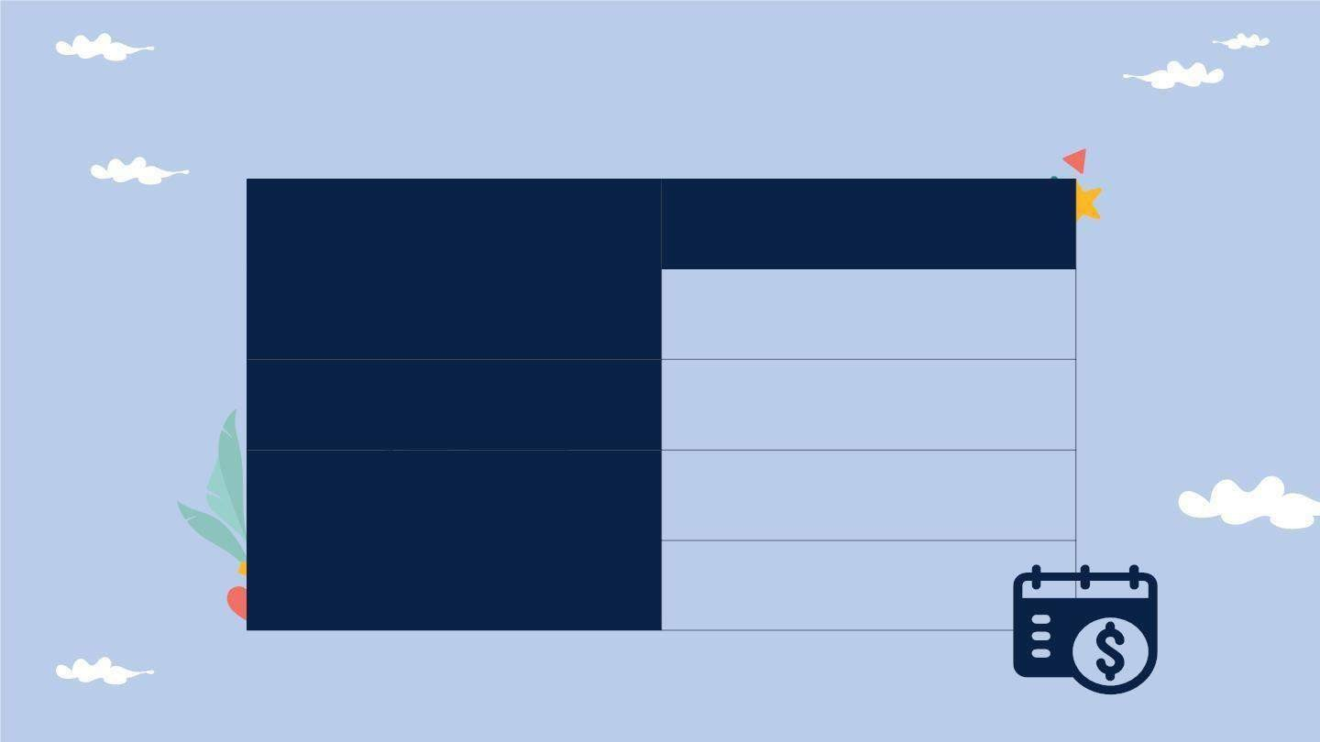
Budget for overall system
Item | Cost(Rs)
App publishing cost on googleplay | 5000.00
Backend hosting cost | 10000.00
Paper publishing cost | 5000.00
Total | 20000.00

Slide 76

References for Overall Project
1“What is print disability,” Visionaustralia.org. [Online]. Available:
https:/ www.visionaustralia.org/services/print-accessibility/what-is-print-
disability. [Accessed: 31-Jan-2022].
2“Blindness and vision impairment,” Who.int. [Online]. Available: https://www.who.int/news-room/fact-sheets/detail/blindness-and-visual- impairment. [Accessed: 31-Jan-2022].
3B. Okpeh, “Towards ending the information poverty among persons with print disabilities: Aproposed draft (amendment) bill for disability diversification of the national library of Nigeria,” SSRNElectron. J.,2021.

Slide 77
Demo Time!

Slide 78
Thank You!
QnA TIME!

