Slide 1

Digital assistant to
aid individuals with
print disabilities to
interpret printed
materials
ProgressPresentationII
Project ID:2022-024
Supervisor:Dr AnuradhaJayakody

Slide 2

Overall
Project
Description

Slide 3

What is print disability?
Aprint disabilityisa difficulty
or inability to read printed
materialdue to a perceptual,
physicalor visualdisability[1].

Slide 4

Research
Problem

Slide 5

2.2 Billion
Peoplehavea near or distancevisionimpairment - WHO[2]
300 Million
Canbe consideredasprint disabled [3]
1% - 7%
Of allbooksare availablein accessibleformats [3]

Slide 6

Problems faced by
print disability
Lackofresourcesavailablein
Canaffecteverydaylife,
educationandwork
accessiblemediums
Braillebookscostmorethan
normalissues
Lackofaccessibilityoptionsin
availabletools
Cannotgetthird party
assistanceforpersonal,
confidentialdocuments

Slide 7

Literature Review
Lackof functionsliketableinterpretation andmathematicalequationinterpretation
i n availabletools[4],[5]
Lackof accessibilityoptionsinavailabletools
Unavailabilityof the user guidancein the materialcapturingprocess
Lackof practicalityin the availabletoolsfor blind people (Eg:Wearabledevices)[6]

Slide 8

Research Objectives

Slide 9

To explore and identify the feasible solutions to
develop an assistive application to aid individuals
with print disabilities to interpret printed
materials
01
02
03
04
Document
zone
Table and
diagram
inter pr etatio
n
Text and
mathematic
expression
interpretation
Image
captioning
se gmentatio n
, classification
and chart
inter pr etation

Slide 10
Overall
System
Diagram

Slide 11
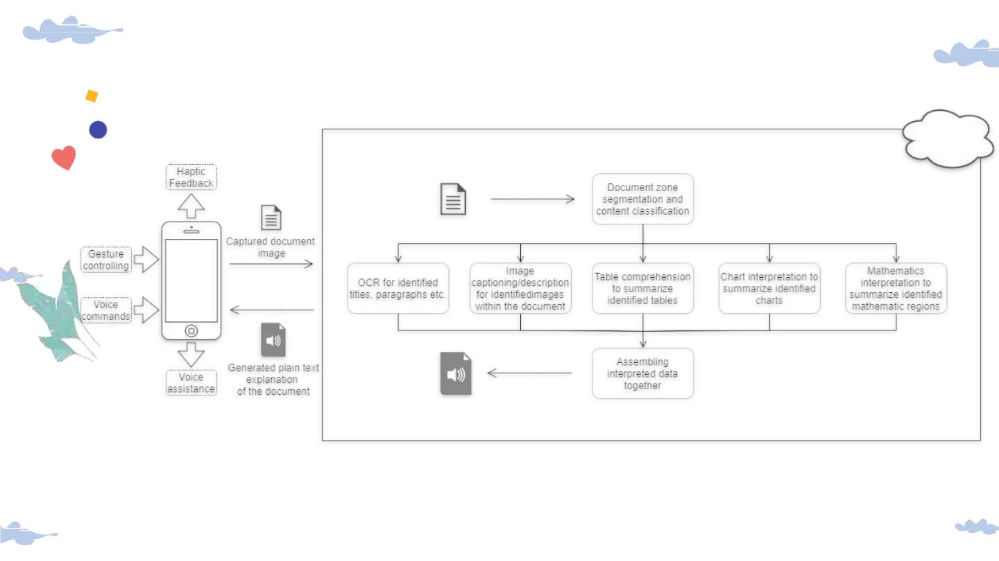

Slide 12

Document zone segmentation,
classification and chart
interpretation
IT19187242
Priyashan Sandunhetti S. H. S.

Slide 13

Research Problem
Howwill the disabled user
scanthedocumentwiththe
camera?
Howwill the disabled user
scanthedocumentwiththe
camera?
Howwill the disabled user
scanthe document withthe
camera?
Howwill the disabled user
scanthedocumentwiththe
camera?

Slide 14

Objectives
Todevelop the document
content segmentation,
classification methods
Toassistthe user withthe document
capturingprocess
Tosegmentand classifythe regionsof the
document
and the interpretation of
the identified charts
wi thi n the document.
Toclassifythedetectedchartsfurthermore
intodifferenttypesof charts
Toextractthe datafrom the chartsand turn
the extracted data into plain English
sentencesin a meaningfulway

Slide 15

Methodology

Slide 16
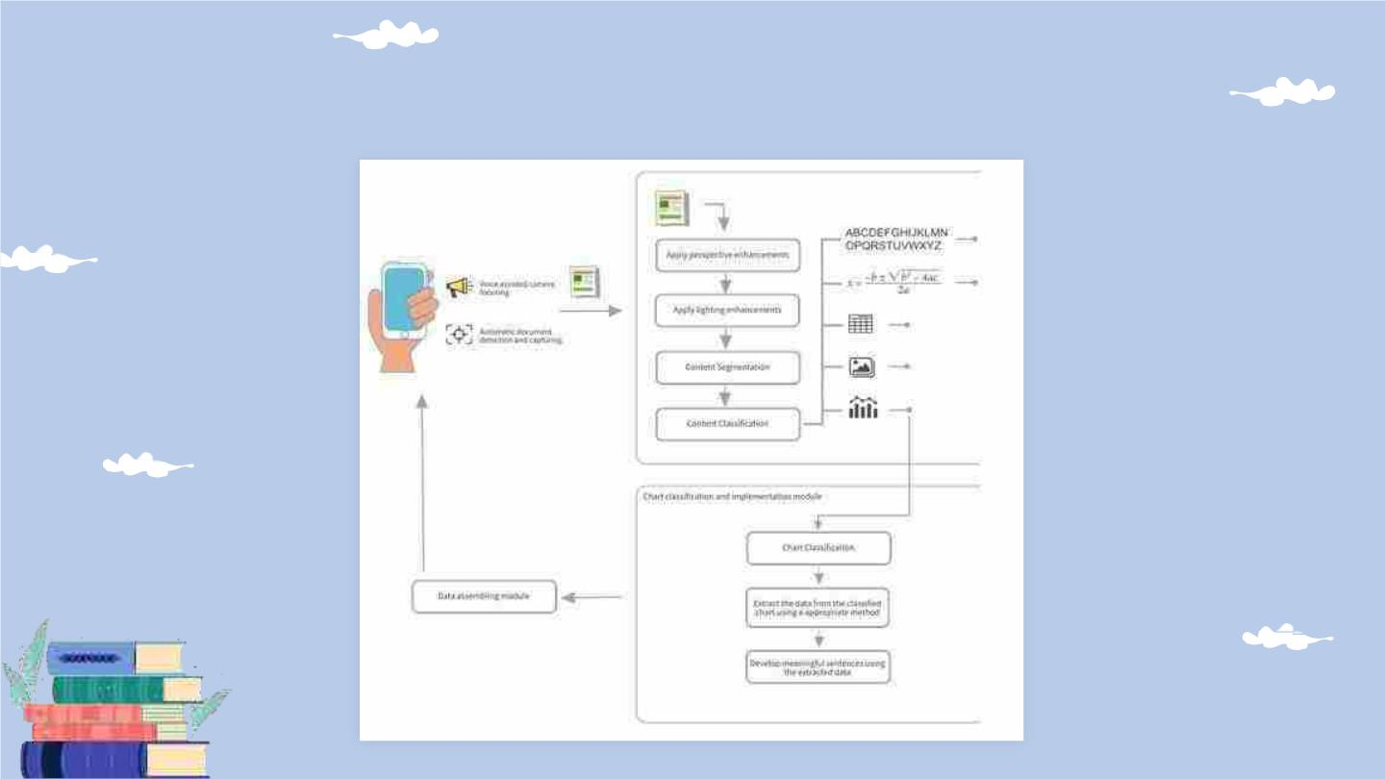
System Overview Diagram

Slide 17

Technologies
● Flutter/Dart
● Python
● Tensorflow+Keras
● OpenCV

Slide 18

Evidences for the
Completion

Slide 19

Assistive document
capturing
● Developed using flutter and
OpenCV native JNIlibs[1] for
android
● Edgedetectionmethod isin place
todetect documents.
★Needs further improvements to
identifyonlydocuments.

Slide 20
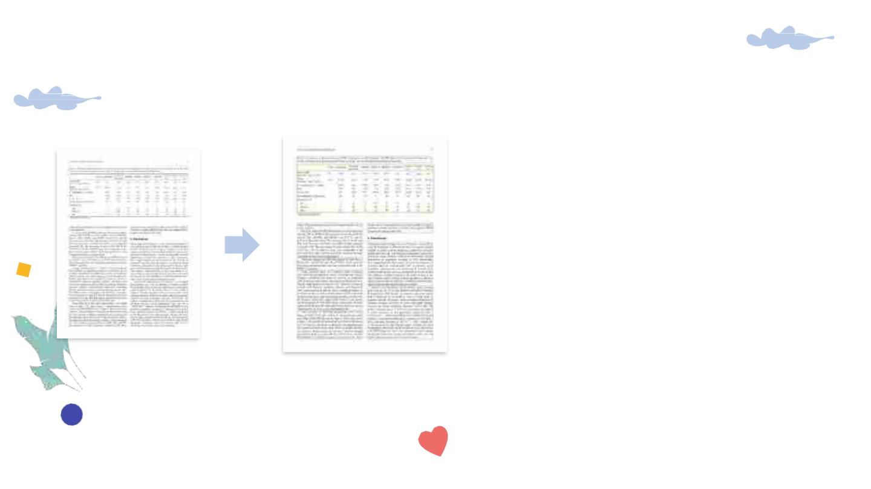
Document segmentation and classification
● Developedusingpython
● UsingLayoutParser[2]and
detectron2[3]library
● Datasets:
PubLayNet[4]
PRImALayoutAnalysis
Dataset[5]
★ Needs to further improve the
algorithm with identification of
mathematicalexpressions.

Slide 21
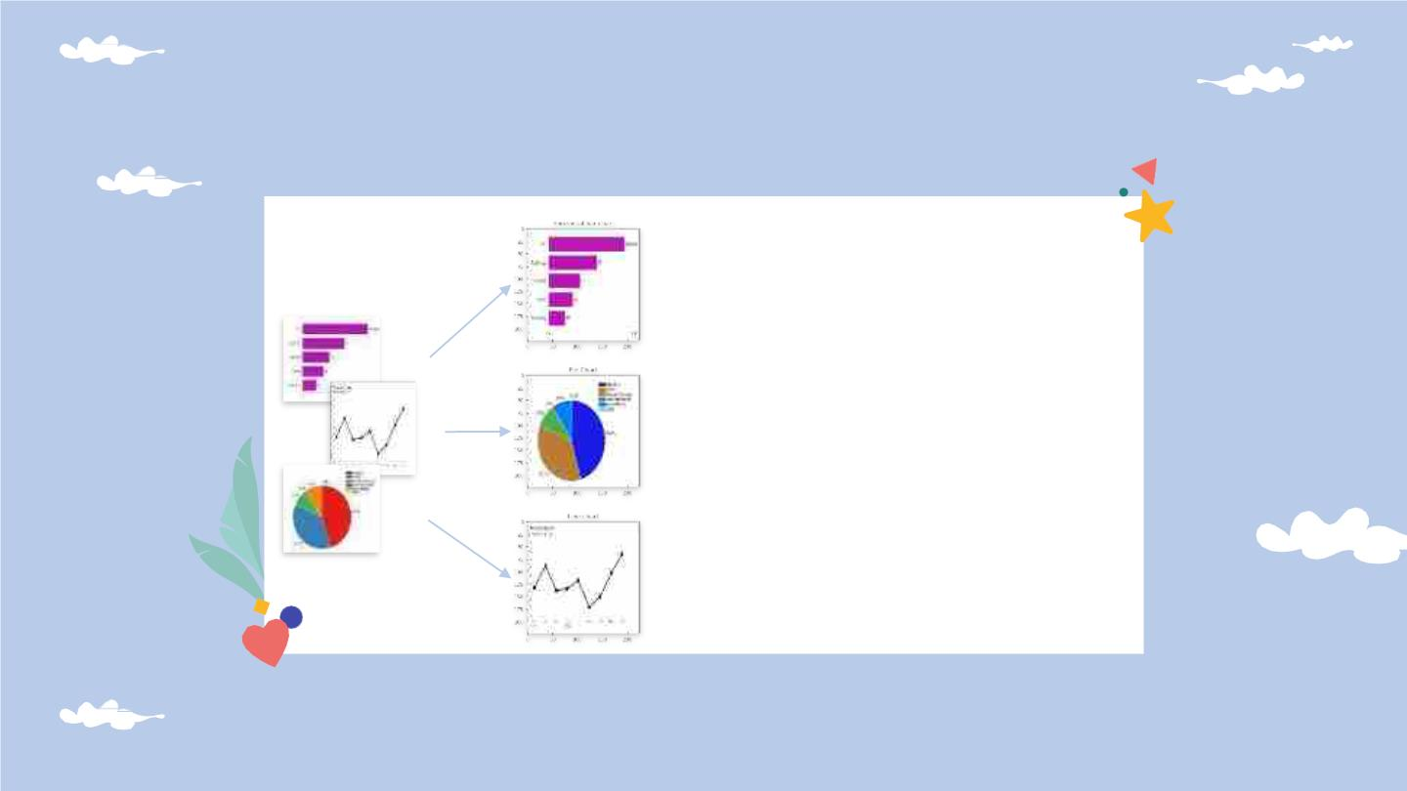
Chart Classification
● Modelimplemented
using convolutional
neural network
● According toVGG-16
architecture
● Trained using custom
dataset with 4000 images
● Classifieswith99%
accuracy

Slide 22
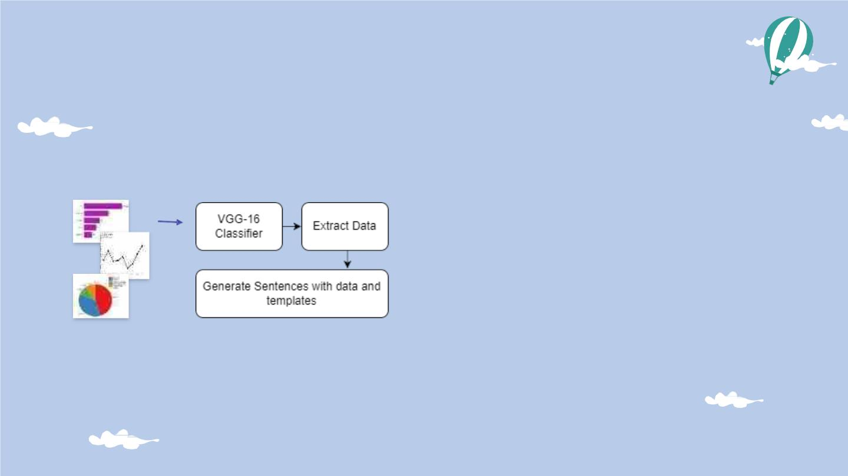
Chart Classification and
Segmentation
● First,ClassifythechartswithVGG-
16 classifier trained with 4000
customchartsdataset
● Used rule-based techniques to
extractdatafrom chartimages
● Generatemeaningfulsentences
with pre-defined templates for
charts

Slide 23
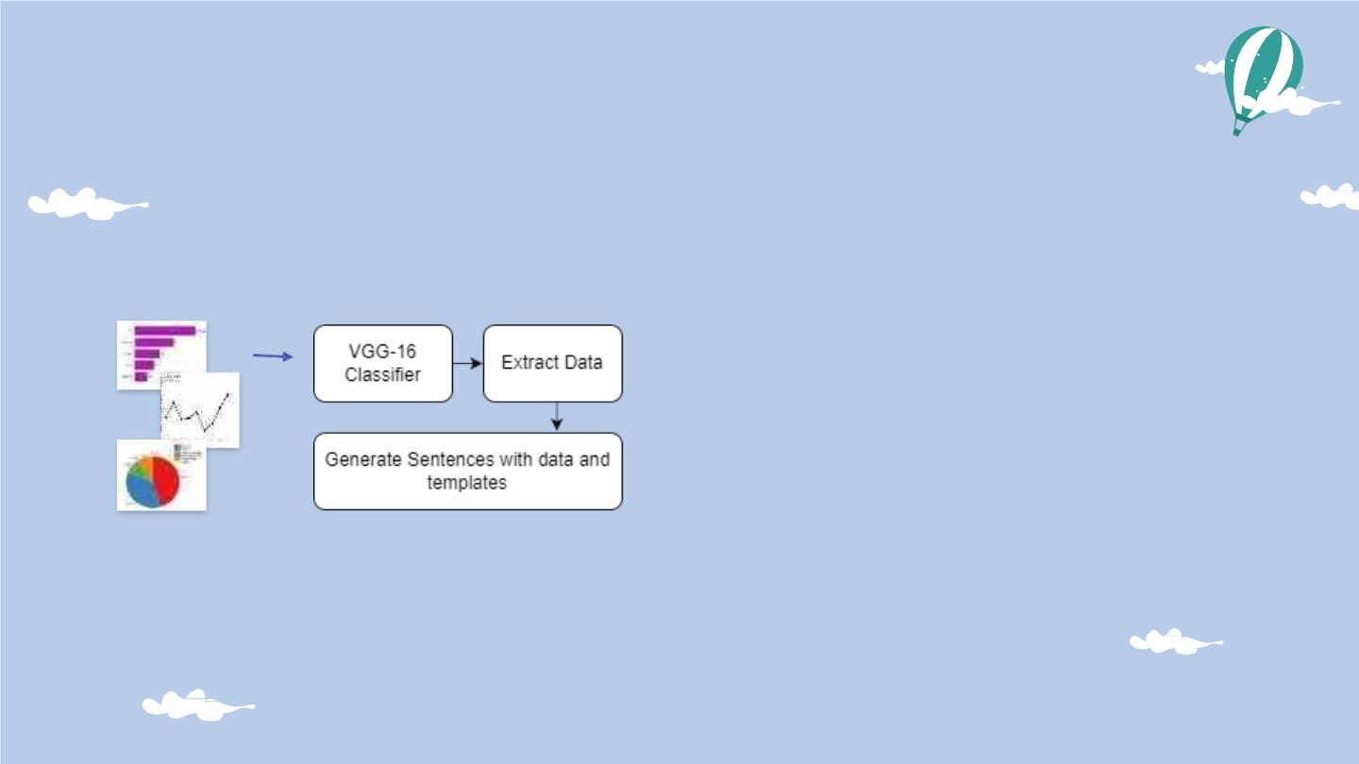
Chart Interpretation
● Usedrule-basedtechniquesto
extractdatafrom chartimages
● Generatemeaningfulsentences
with pre-defined templatesfor
charts

Slide 24

Tasks to be completed
Integrate
and test the
whole
Commercialize
the
system
application
together

Slide 25
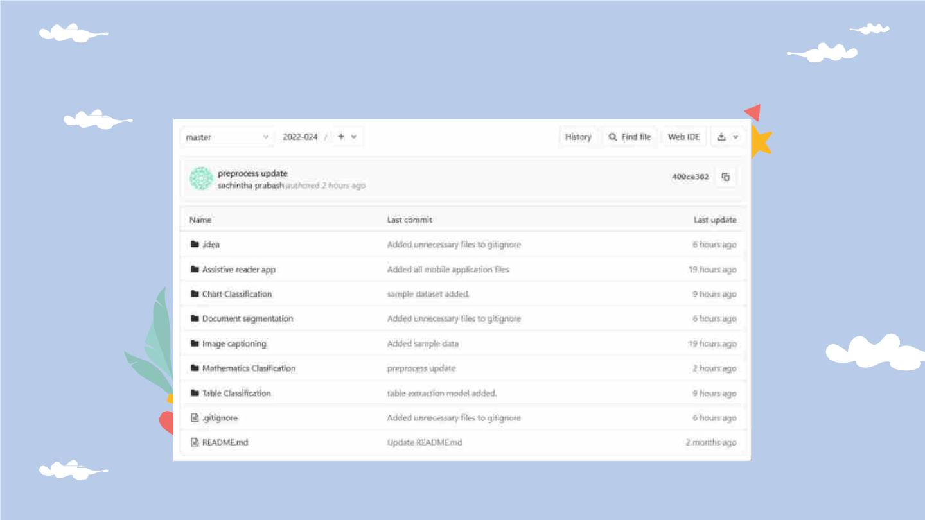
GitLab Repository

Slide 26
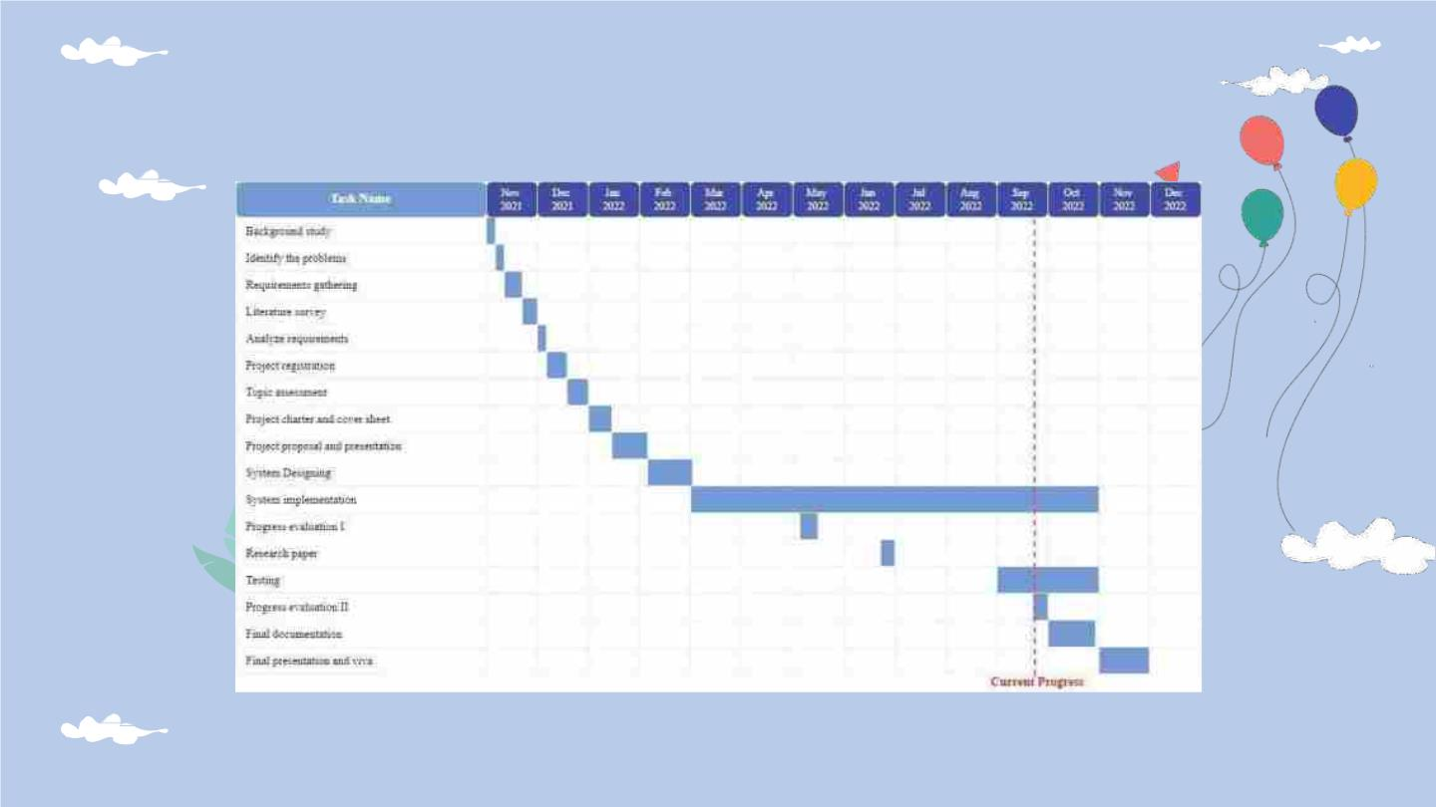
Gantt Chart

Slide 27
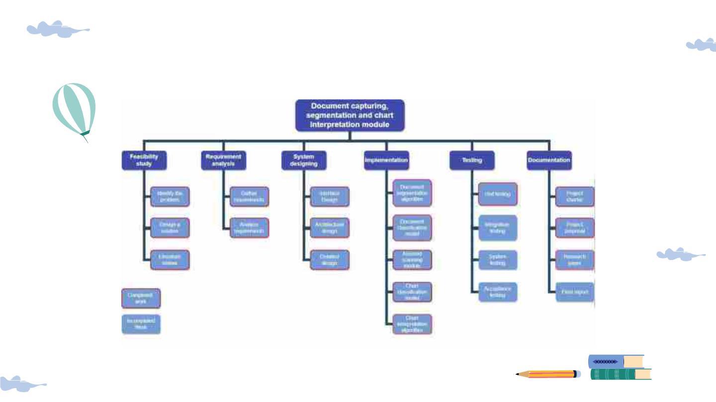
Work Breakdown Structure

Slide 28

References
1L. Rai, Z. Wang, A. Rodrigo, Z. Deng, and H. Liu, “Software
developmentframeworkforreal-timefacedetectionandrecognition
in mobile devices,”Int.J.Interact.Mob. Technol.,vol.14,no. 04, p.
103, 2020.
2Z. Shen, R. Zhang, M. Dell, B. C. G. Lee, J.Carlson, and W. Li,
“LayoutParser:Aunifiedtoolkitfordeeplearningbaseddocument
imageanalysis,”arXiv[cs.CV],2021.
3V.Pham, C. Pham, and T.Dang,“Road damage detection and
classificationwith Detectron2 and faster R-CNN,” in 2020 IEEE
InternationalConferenceonBigData(BigData),2020,pp.5592–
5601.
4X.Zhong,J.Tang,andA.J.Yepes,“PubLayNet:largestdataset
everfordocumentlayoutanalysis,”arXiv[cs.CL],2019.
5C.Clausner,“PRImAcontemporary dataset,” Primaresearch.org.
[Online]. Available:https:/www.primaresearch.org/dataset/.
[Accessed:25-May-2022].
6
K.Simonyan and A.Zisserman, “Verydeep convolutional
networksforlarge-scaleimagerecognition,”arXiv[cs.CV],2014.

Slide 29
Table identification and
interpretation model within the
system
IT19156484
Dilitha Ranjuna G.P.

Slide 30

Research Problem
For visually impaired
There is no assistant
tool that scanstables in
a waythat a blind
person canuse.
people, there isno such
thingasaseparatetable
identifyingtool.
Rare to find that
explainingtablesfor
blind or visually
impairedperson.
All the documents are
not inbraillelanguage.

Slide 31

Objectives
To identify a proper
model to read a Table
identification and
interpretation model
wi thi n the system
Createa model to identifytabledatain a
printed document.
Createa model to generatethe explanation
of the table data as a summarized
description.
Createaspeechenginetoprovideguide
and informationto the user.

Slide 32
Methodology

Slide 33
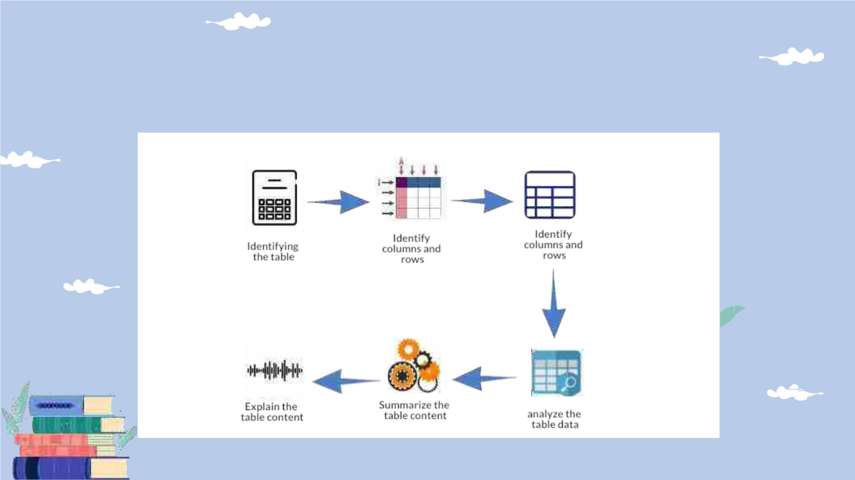
System Diagram

Slide 34
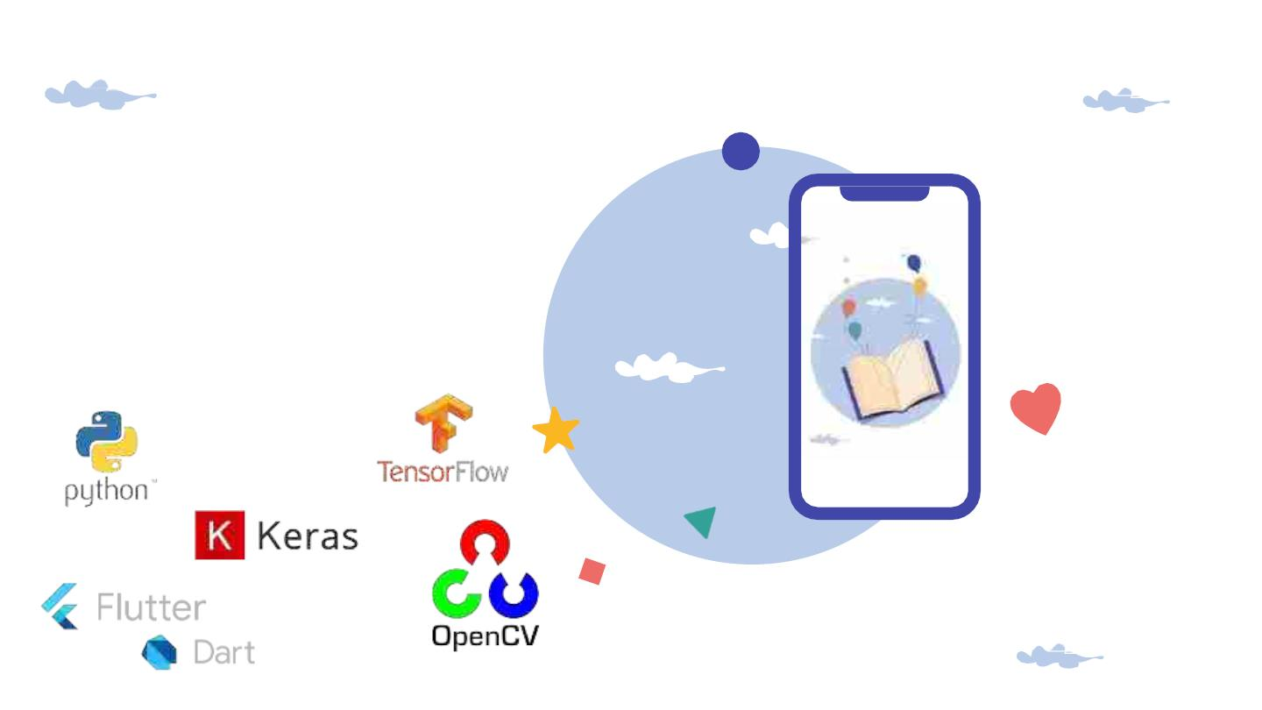
Technologies
● Flutter/Dart
● Python
● Tensorflow/Keras
● Opencv/pytesseract

Slide 35
Evidences for the
Completion

Slide 36
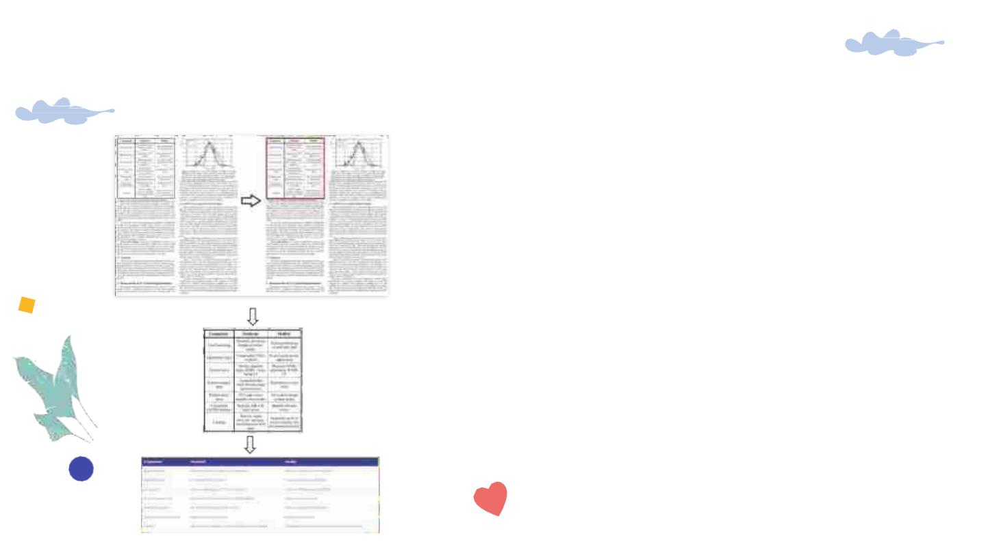
Table Identification and Classification
● Developedusingpython
● Usingpytesseractandnumpy
libraries
● Usedpandas libraryfor analysing
data
● Modelimplementedusingruled
basedmethod
● Generatingtablesummarywitha
explaination.
★ Needstooptimizetheresults

Slide 37

Tasks to be completed
Integrate
and test the
whole
Commercialize
the
system
application
together

Slide 38
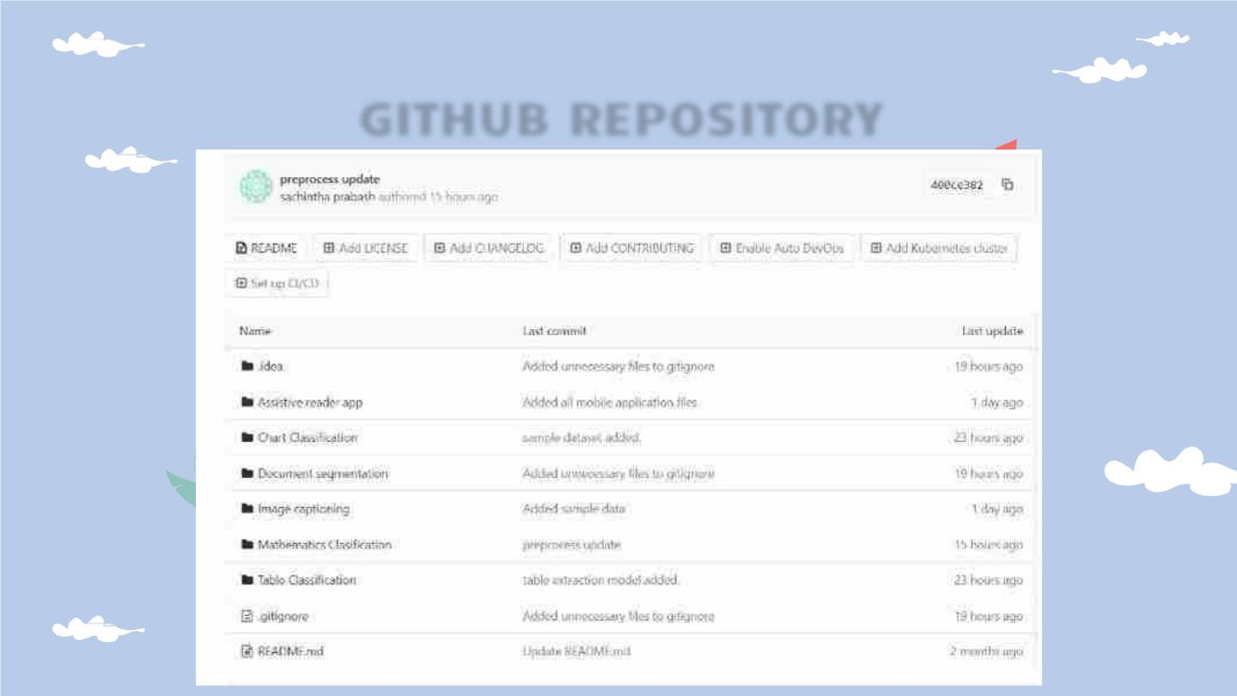
GITHUB REPOSITORY

Slide 39
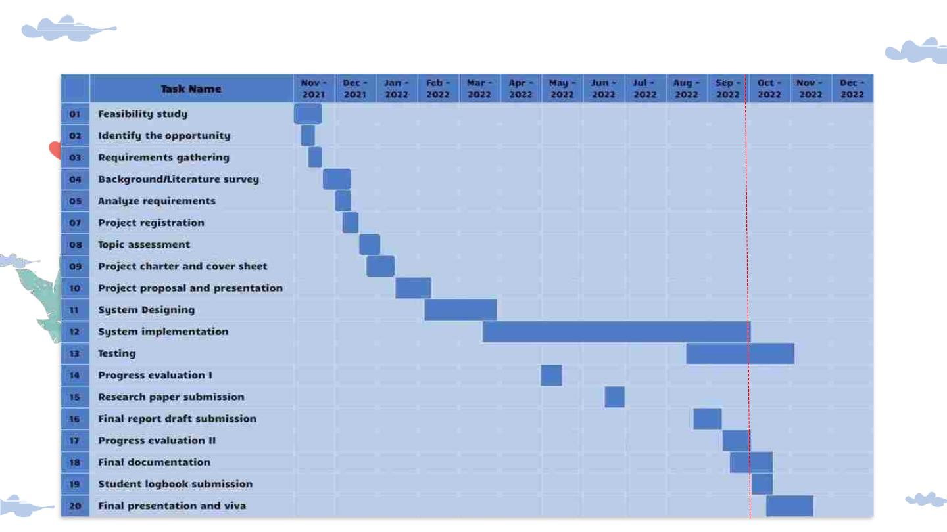
GANTT CHART

Slide 40
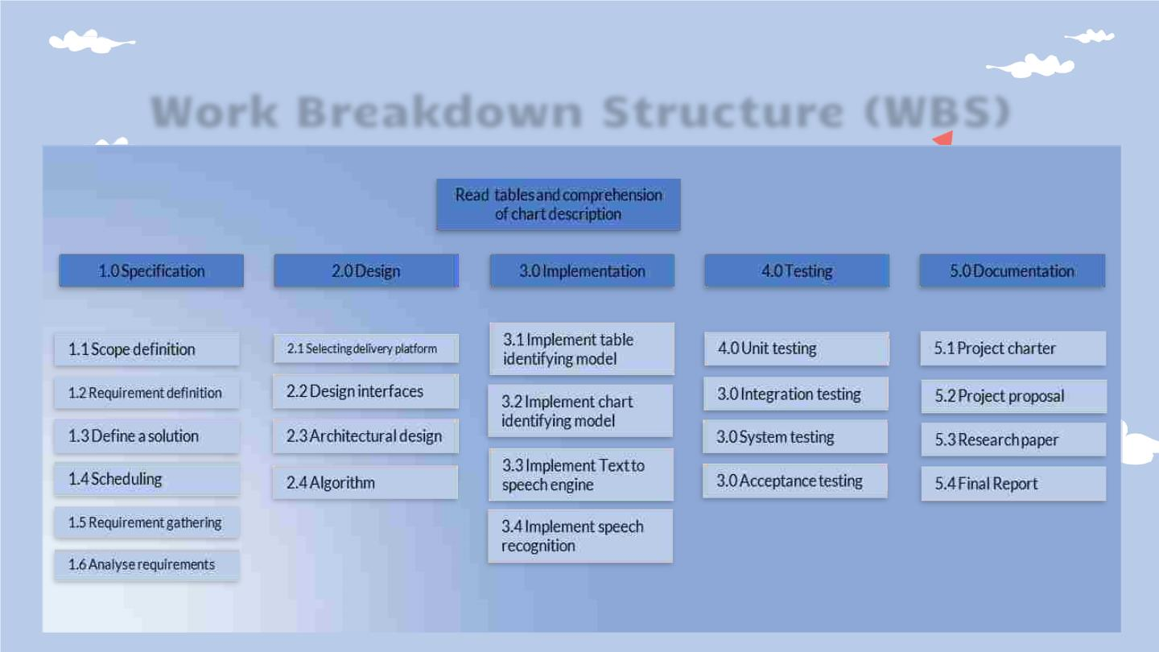
Work Breakdown Structure (WBS)

Slide 41
References
1 Paliwal, S. S., Vishwanath, Rahul, R., Sharma, M.,
& Vig, L. (2019). TableNet: Deep learning model for
end-to-end table detection and tabular data
extraction from scanned document images. 2019
International Conference on Document
Analysisand Recognition (ICDAR), 128–133.
2Hashmi, K. A., Liwicki, M., Stricker, D., Afzal, M. A.,
Afzal, M. A., & Afzal, M. Z. (2021). Current status
and performance analysis of table recognition in
document images wi th deep neural networks. IEEE
Access: Practical Innovations, Open Solutions, 9,
87663–87685.
https://doi.org/10.1109/access.2021.3087865
3 Namysl, M., Esser, A. M., Behnke, S., & Köhler,
J. (2021). Flexible table recognition and semantic
interpretation system. In arXiv [cs.CV].
https://www.ais.uni-
bonn.de/papers/VISAPP_2022_Namysl.pdf

Slide 42
Explain complex mathematical
expressions to the user in a
meaningfulway
IT19117492
Sachintha Prabhash K.V.A.

Slide 43

Research Problem
Mathematicalequationnot
clearlyidentified
Mathematicsinbraillanguage
alsohardtocomprehend
Howwillthevisionimpaired
usersreadthemaths
equations?

Slide 44

Objectives
To explore and identify
an algorithm to
explain text and
Improvetheidentifyingthemath's
complex mathematical
expressions to the user
in meaningful way.
Mathematics equationread mathematics
way

Slide 45
METHODOLOGY

Slide 46
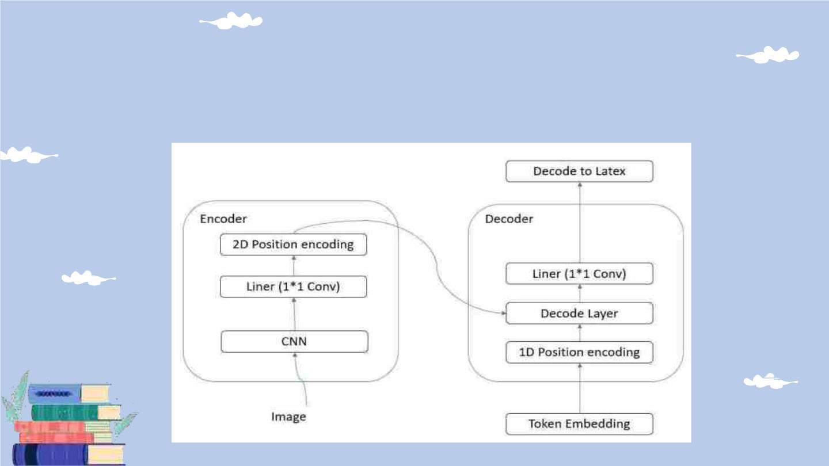
Model Diagram

Slide 47

Technologies
● Python: v-3.9.7
● PyTorch
Used Libraries
● Flutter/Dart
● Numpy
● Pillow
● Nltk
● Tqdm
● Distance

Slide 48
COMPLETION

Slide 49
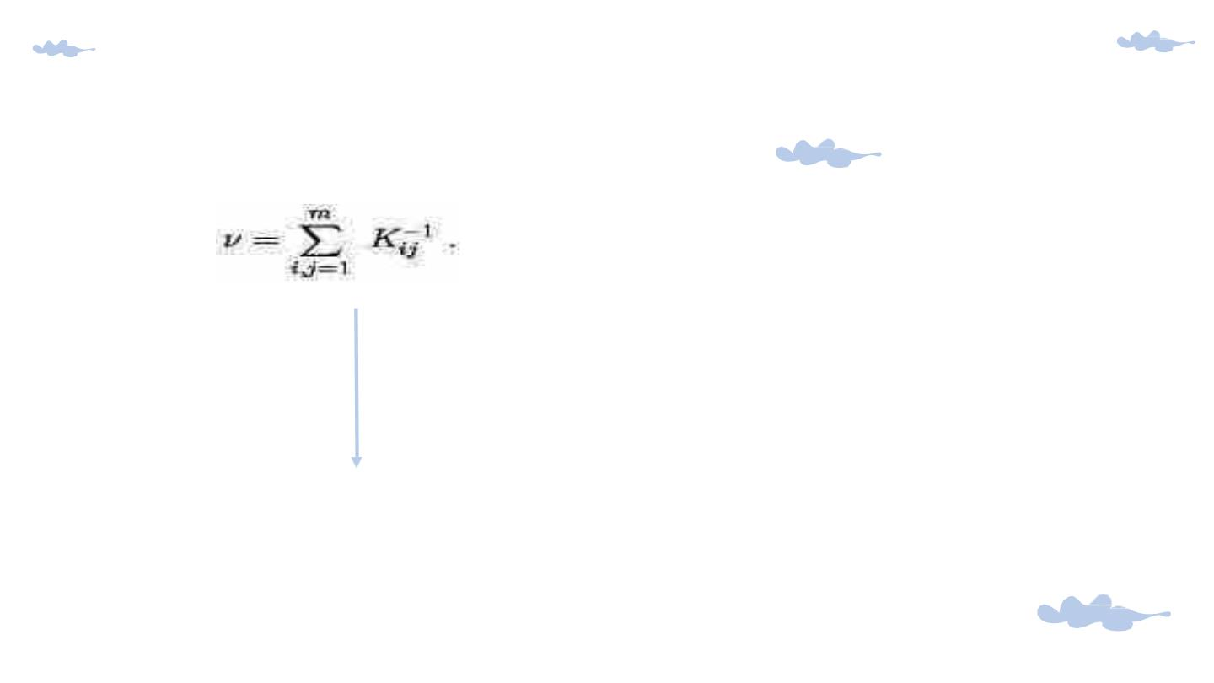
● Developedusingpython
● ConvertimagestoLatex
● Useddataset:
im2latex-100k
● The method for identifying
mathematicalexpressionshasto
beimproved further.
v= sum_ { i,j=1} ^{ m} K_{ ij} ^{ -1}

Slide 50
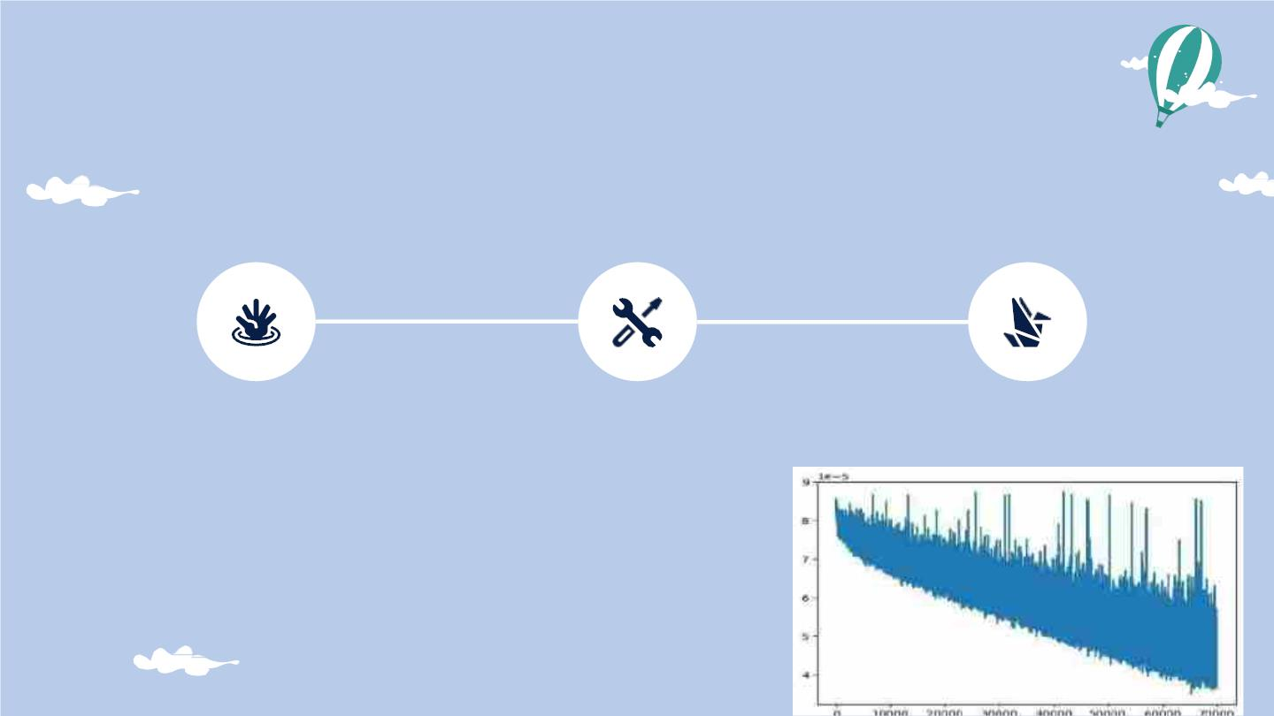
TIMELINE OF COMPLETION
Preprocessing
Model
Evaluate
Trani n n i ng
Latex maths for mula
pre-process

Slide 51
Evidences for the
Completion

Slide 52

Task to be Completed
Improve the app
Commercialization the app

Slide 53
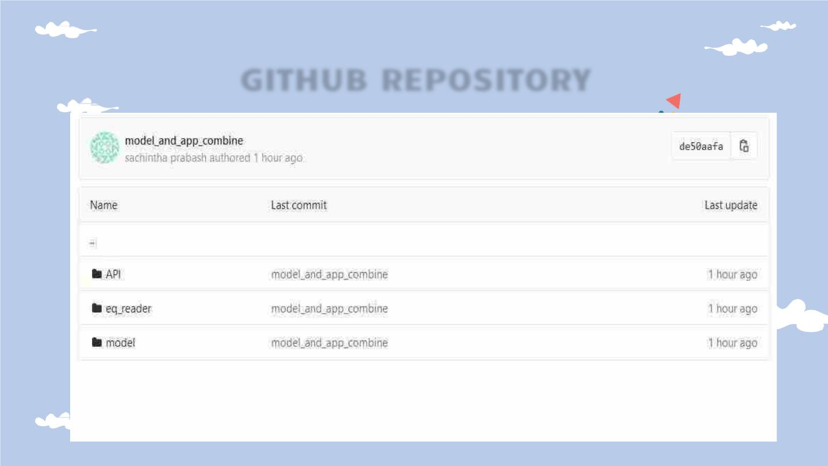
GITHUB REPOSITORY

Slide 54
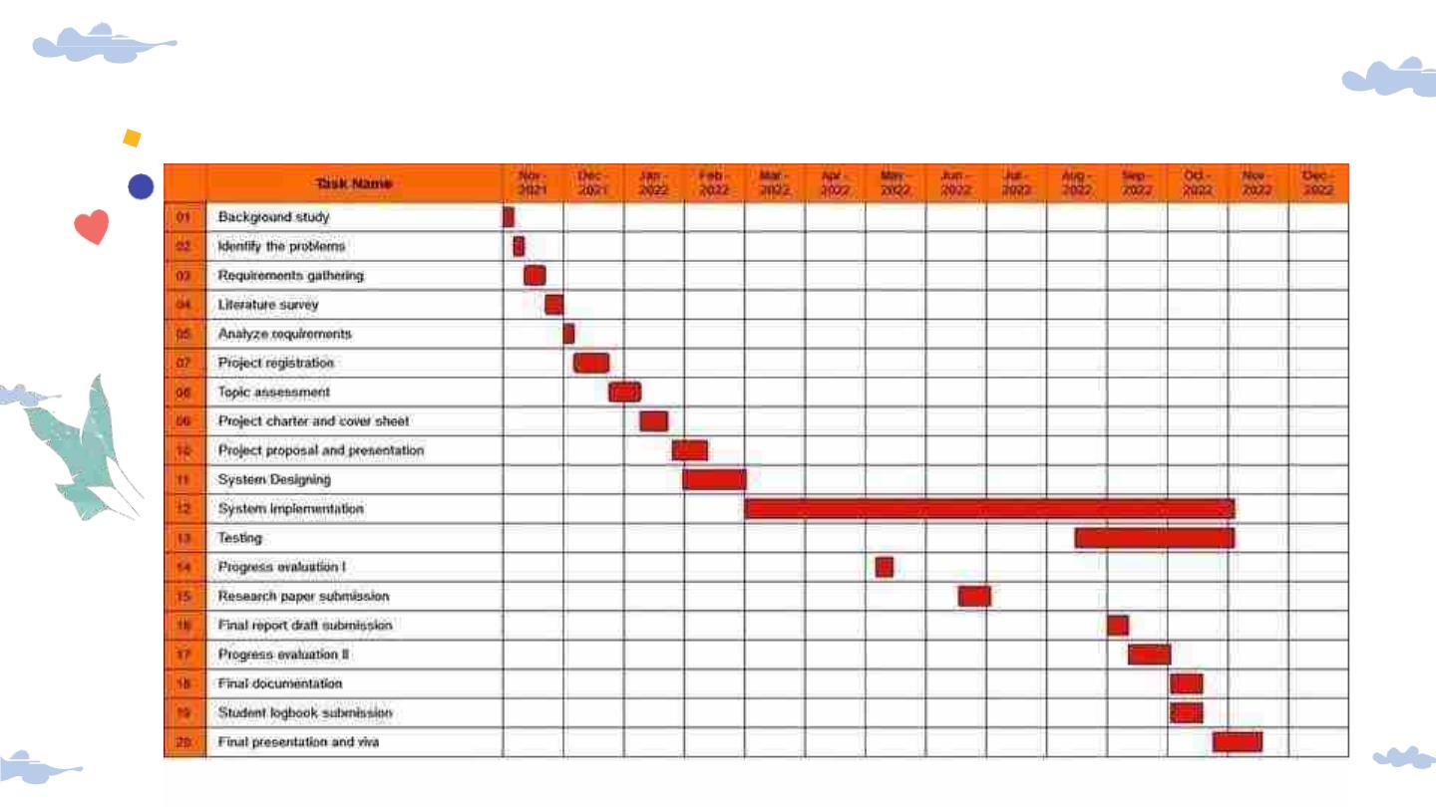
GANTT CHART

Slide 55
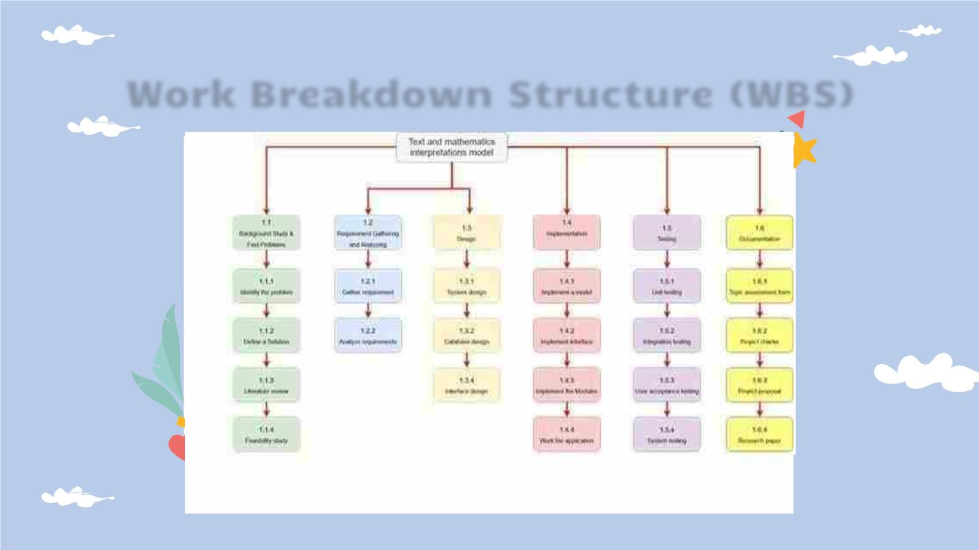
Work Breakdown Structure (WBS)

Slide 56
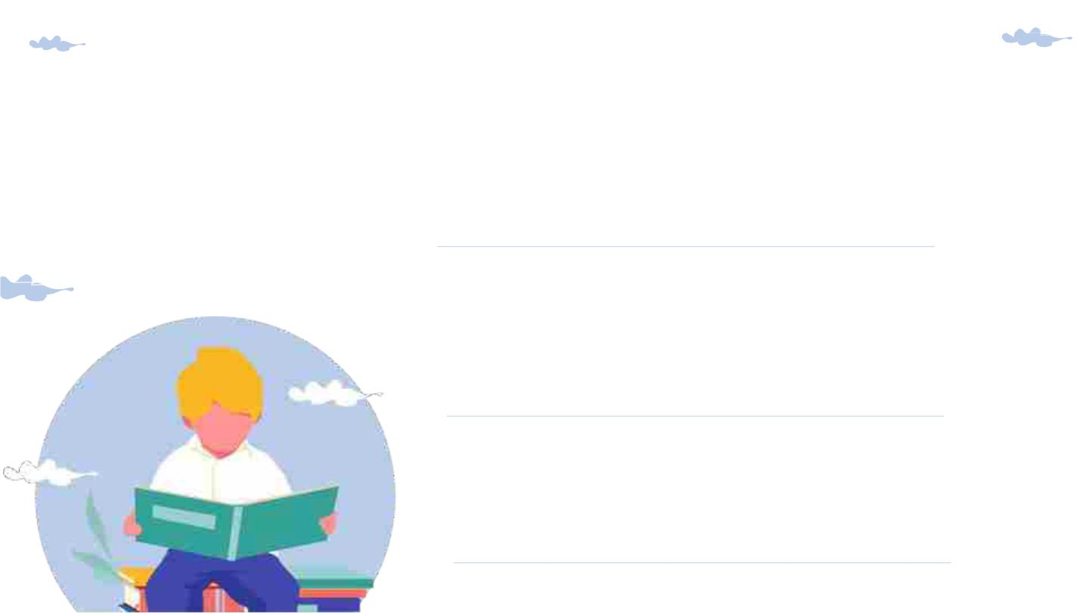
References
1.R. Noor, K. Mejbaul Islam and M. J. Rahimi,
" Handwritten Bangla Numeral Recognition Using
Ensembling of Convolutional Neural Network," 2018
21st International Conference of Computer and
Information Technology (ICCIT), 2018, pp. 1-6, doi:
10.1109/ICCITECHN.2018.8631944.
2.S. Bender, M. Haurilet, A. Roitberg and R.
Stiefelhagen, "Learning Fine-Grained Image
Representations for Mathematical Expression
Recognition," 2019 International Conference on
Document Analysis and Recognition Workshops
(ICDARW), 2019, pp. 56-61, doi:
10.1109/ICDARW.2019.00015.
3.DBian, X., Qin, B., Xin, X., Li, J., Su, X., & Wang, Y.
(2021). Handwritten mathematical expression
recognition via attention aggregation based Bi-
directional mutual learning. In arXiv [cs.CV].
http://arxiv.org/abs/2112.03603

Slide 57
Identifying a proper image
captioning approach to
facilitateinterpreting a n image
in a document
IT19392172
Sanduni Madara P.G.

Slide 58
Research
Problem

Slide 59

Research Problem
Inabilitytointerpretanimage
in aprinted documentwithout
others’assistance
Everytime,cannotgetathird-
partyassistantforimage
identification.
Cannothaveadescriptive
explanationofanimage
throughbraille
Existingtoolslackthe
accessibilityoptionsforprint
disabledindividuals
Lackofunderstanding/
sufficientexplanation of the
imagesin existingtools

Slide 60
Research Objectives

Slide 61
Objectives
To explore and identify
the feasible system
Toidentifyaproper imageidentification
model to extractimagefeatures.
with a proper image
interpretation model
to facilitate reading a
printed document.
Toidentifyaproper language model to
generateadescriptiveexplanation.
To develop a gesture-controlled process
withahapticfeedbacksysteminthemobile
application.

Slide 62
Methodology

Slide 63
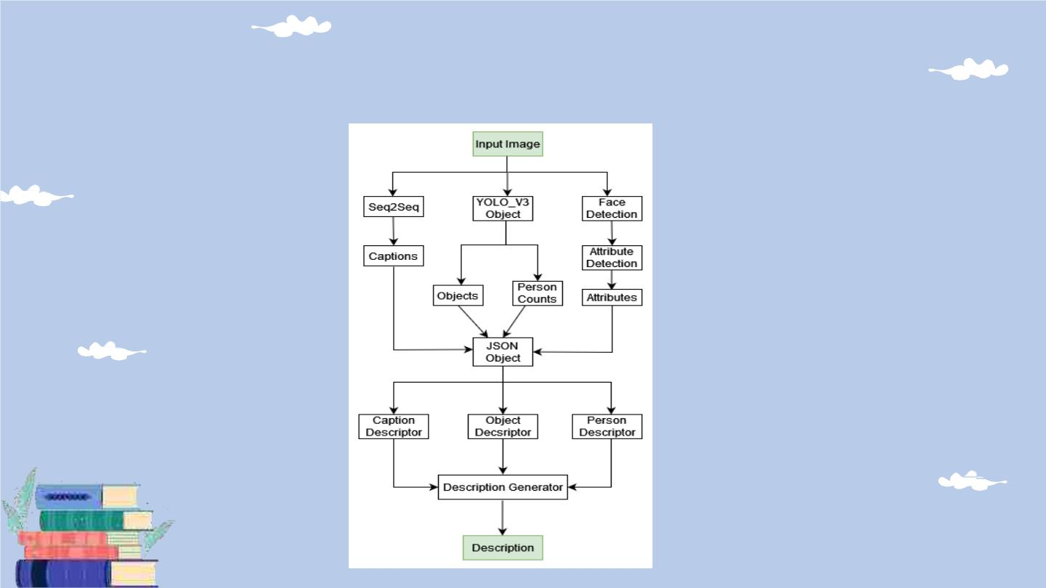
System Overview Diagram

Slide 64

Technologies
● Python
● Tensorflow+Keras
● InceptionV3
● Numpy

Slide 65
Evidences for the
Completion

Slide 66

Image Captioning
● Dataset
○ MSCOCOdataset[1]
○ Large-scaleobjectdetection,segmentation,
andcaptioning dataset
○ DevelopedbyMicrosoft
○ Consistsof 82,783images
○ With atleast5 different captionsfor a image

Slide 67
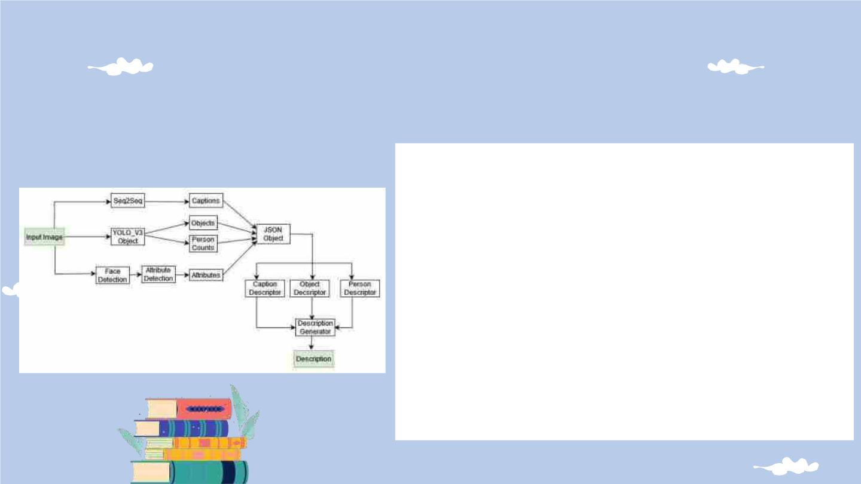
Image Captioning
● Combination of multipleNNs
● Seq-2-Seqmodel for generalcaptioning
● YOLOv3todetectobjectsandhumans
● Featuresof detectedhumans are extracted
with efficientv2 implemented as a multi
output model
● Sentencesaregeneratedwithpre-defined
templates

Slide 68

Tasks to be completed
Integrate
and test the
whole
Commercialize
the
application
system
together

Slide 69
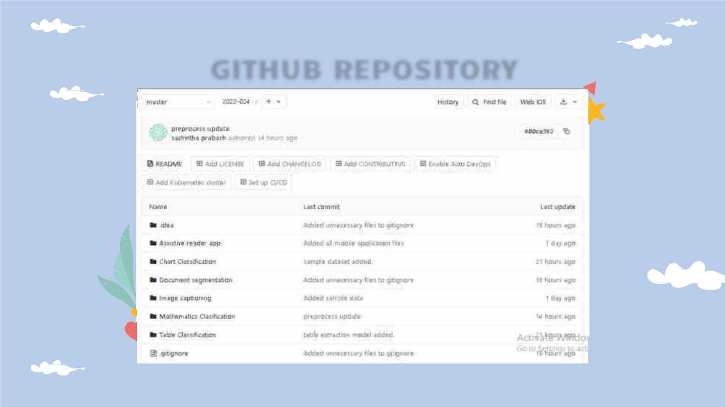
GITHUB REPOSITORY

Slide 70
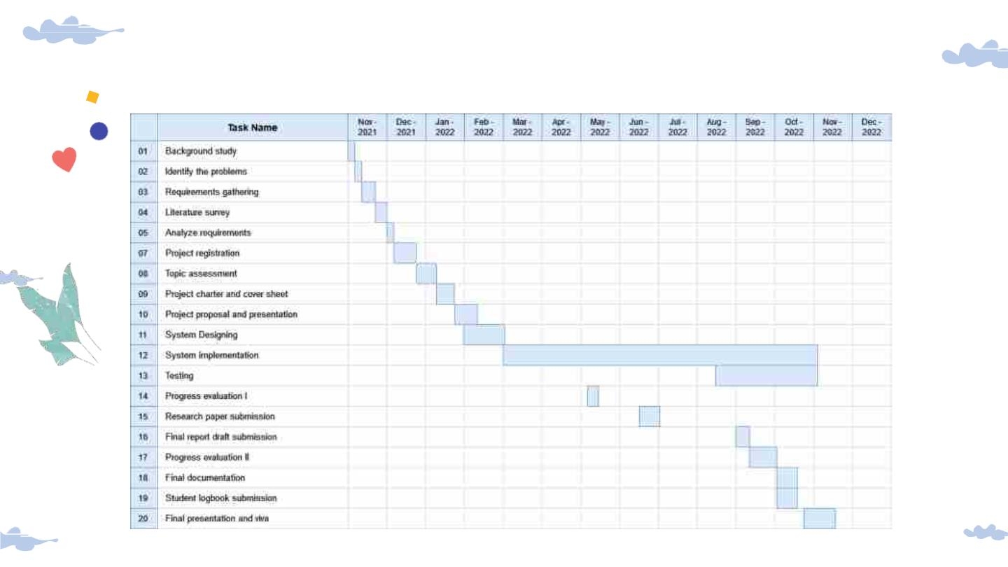
GANTT CHART

Slide 71
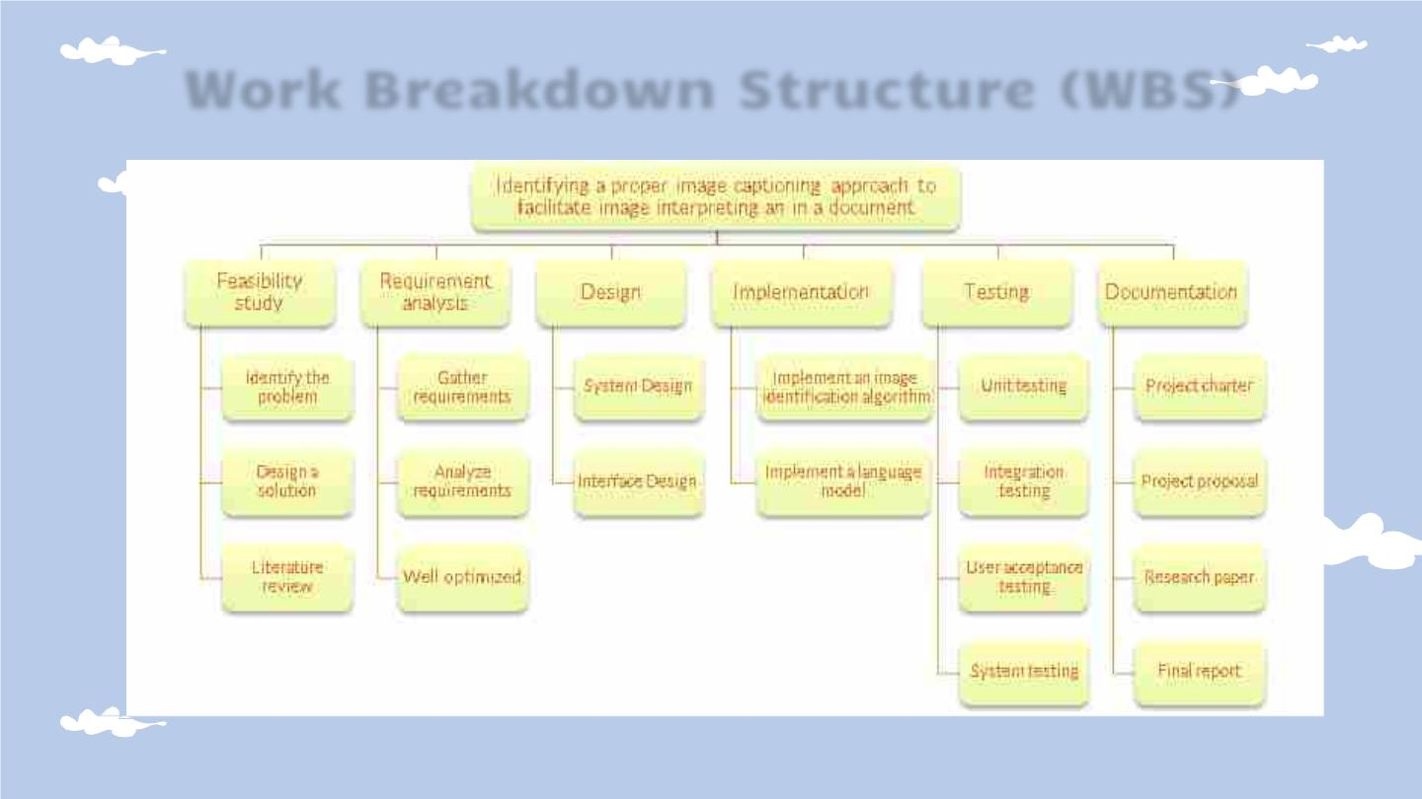
Work Breakdown Structure (WBS)

Slide 72
References
1T.-Y.Linetal., “MicrosoftCOCO: Common objectsin context,”in
Computer Vision – ECCV2014, Cham: Springer International
Publishing, 2014,pp. 740–755.
2C.Wanget al., “Pulmonary imageclassificationbasedon inception-
v3transferlearningmodel,”IEEEAccess,vol.7,pp. 146533–146541,
2019.
3V.Badrinarayanan,A.Kendall,and R.Cipolla,“SegNet:A deep
convolutional encoder-decoder architecture for image
segmentation,”IEEETrans.PatternAnal.Mach.Intell.,vol.39,no.12,
pp. 2481–2495,2017.
4J.Chorowski,D. Bahdanau, D. Serdyuk, K.Cho, and Y.Bengio,“At
ention-Based Models for Speech Recognition,” arXiv [cs.CL],
2015.
5K.Xuet al., “Show,attendandtell:Neuralimagecaption generation
withvisualat ention,”arXiv [cs.LG], 2015.

Slide 73
Supportive
Information

Slide 74

Commercialization
Promote the
App will be
free to use
and
system on
platforms
Make more
online presence
by creating
social media
pages for the
app
Spread the
word around
people with
disabled
where vision
impaired
monetization
will be done
with
visits the
communities
most(Audiobo
oks, Radio)
advertisement
s

Slide 75
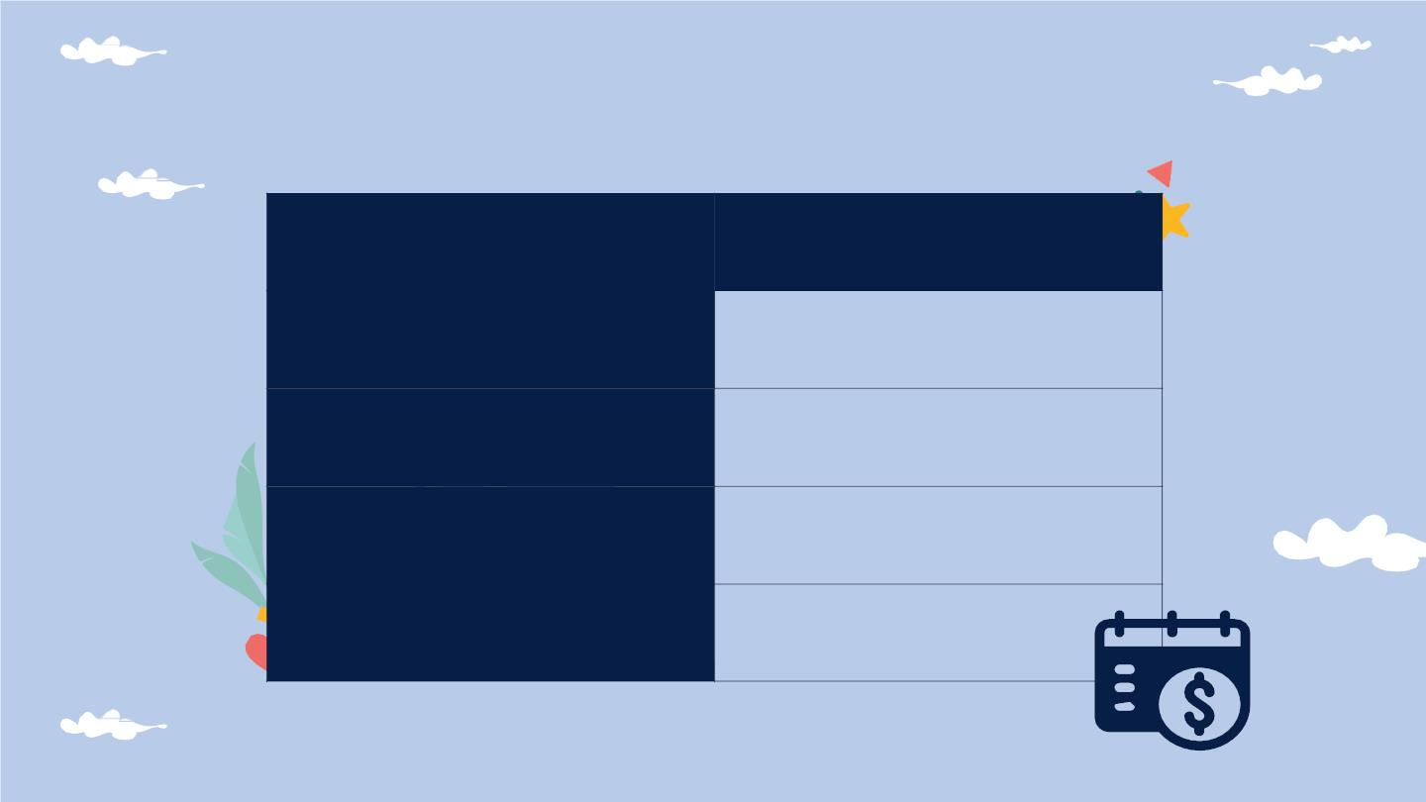
Budget for overall system
Item
Cost(Rs)
App publishing cost on googleplay
5000.00
Backend hostingcost
Paper publishingcost
10000.00
48000.00
Total
63000.00

Slide 76
References for Overall Project
1“What
is print disability,” Visionaustralia.org. [Online]. Available:
https://www.visionaustralia.org/services/print-accessibility/what-is-print-
disability.[Accessed:31-Jan-2022].
2
“Blindness and vision impairment,” Who.int. [Online]. Available:
https://www.who.int/news-room/fact-sheets/detail/blindness-and-visual-
impairment. [Accessed:31-Jan-2022].
3B. Okpeh, “Towards ending the information poverty among persons with
print disabilities: A proposed draft (amendment) bill for disability
diversificationof thenational library of Nigeria,”SSRNElectron. J.,2021.
4N. D. U. Gamage,K. W.C. Jayadewa,and J.A. D. C. A. Jayakody,“Document
reader for vision impaired elementary school children to identify printed
images,” in 2019 International Conference on Advancements in Computing
(ICAC),2019.
5 S.Muralidharan, D. Venkatesh,J.Pritmen,R.Purushothaman, S. J.
Anusuya,and V.Saravanaperumal,“ReadingAidfor VisuallyImpaired
People,”InternationalJournalof AdvanceResearch,vol. 4, no. 2, 2018.
6R. Shilkrot, J. Huber, W. Meng Ee, P.Maes, and S. C. Nanayakkara,
“FingerReader: A wearable device to explore printed text on the go,” in
Proceedings of the 33rd Annual ACM Conference on Human Factors in
ComputingSystems- CHI’15, 2015.

Slide 77
Demo Time!

Slide 78
Thank You!
QnA TIME!

