Slide 1
SE4030 – Secure Software Development
Lecture 04
Implementing Integrity and Message Authentication
Dr. Harinda Fernando

Slide 2
Learning Outcomes
What is data integrity?
How can data integrity be implemented?
What is a hash function and what are its uses?
Features of cryptographic hash functions
Common hash functions
message authenticity and integrity
Attacks on hashing

Slide 3
Integrity
One of the three key requirements in information security
Process of ensuring that data has not been altered while in transit or in storage either accidentally or maliciously
Two main areas
Accuracy – data must not be changed
Completeness – data must be complete

Slide 4
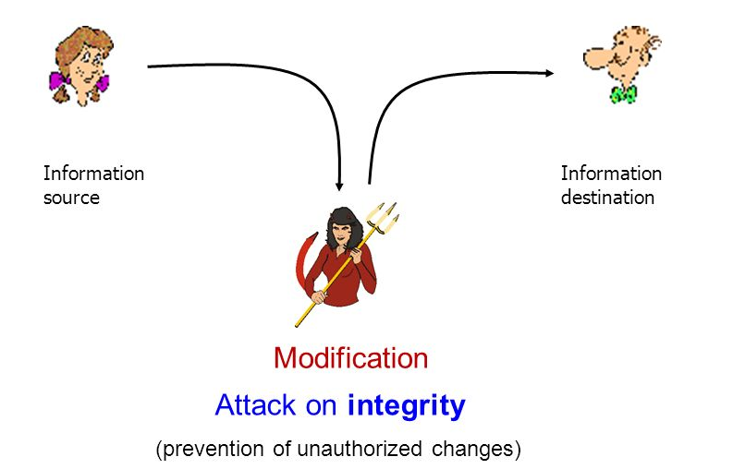
Integrity Compromise

Slide 5
Integrity Compromise
Can happen in two ways
Accidental – a bit gets swapped while the packet is being sent over the cable due to interference
Malicious – A threat agent exploits a vulnerability to change data to his advantage

Slide 6
Case Study
Financial - February 2016 when cyber thieves generated $1-billion in fraudulent withdrawals from the account of the central bank of Bangladesh at the Federal Reserve Bank of New York.
Cyber warfare – Stuxnet: worm used by USA to sabotage the centrifuges used in the Iranian nuclear weapons program

Slide 7
Impact
Is a lot more damaging than attacks on availability and confidentiality
May not even know you have been attacked
Data is no longer safe and cannot be trusted
Has the potential to cripple the processes that rely on the data to execute

Slide 8
Can it be stopped?
Question – can you ensure the integrity of the messages you send over the internet?

Slide 9
Can it be stopped?
At the most basic level all data on the internet is represented as either ones or zeros
Once data is beyond your network you have no control over who or which devices it goes through
Therefore, you cannot ensure that the data is not changed

Slide 10
What can be done?
While you cannot ensure data is not changed you can detect if such changes have occurred
If changes are detected you need to request for the data to be retransmitted again!

Slide 11
Hash Functions

Slide 12
Hash Function
Is an example of a cryptographic primitive
low-level cryptographic algorithms that are used to build more complex security systems.
Hash Function
Mathematical algorithm that maps data of arbitrary size ("message") to a bit string of a fixed size ("hash value" or "message digest").
Is a one-way function
Eg:- CRC in ethernet

Slide 13
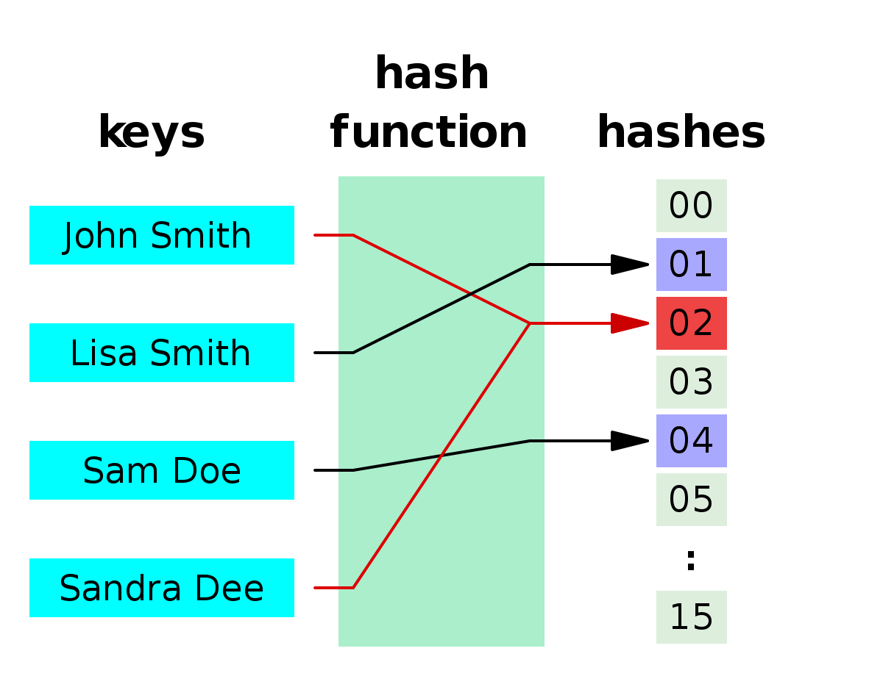
Hash Function

Slide 14
Cryptographic Hash Function
Meets other requirements and is suitable for use in security systems to protect against malicious attacks
it is deterministic, meaning that the same message always results in the same hash (No random effects)
a small change to a message should change the hash value extensively (avalanche effect)
it is quick to compute the hash value for any given message (Efficient)

Slide 15
Cryptographic Hash Function
it is difficult to generate a message that yields a given hash value (Pre-image resistance)
It is also difficult to find a message that matches a given messages hash (Second Pre-image resistance)
it is difficult to find two different messages with the same hash value (Collision Resistance)
Informally, these properties mean that a malicious adversary cannot replace or modify the input data without changing its digest. Thus, if two strings have the same digest, one can be very confident that they are identical

Slide 16
Degree of difficulty
In cryptographic practice "difficult" generally means "almost certainly beyond the reach of any adversary who must be prevented from breaking the system for as long as the security of the system is deemed important"

Slide 17
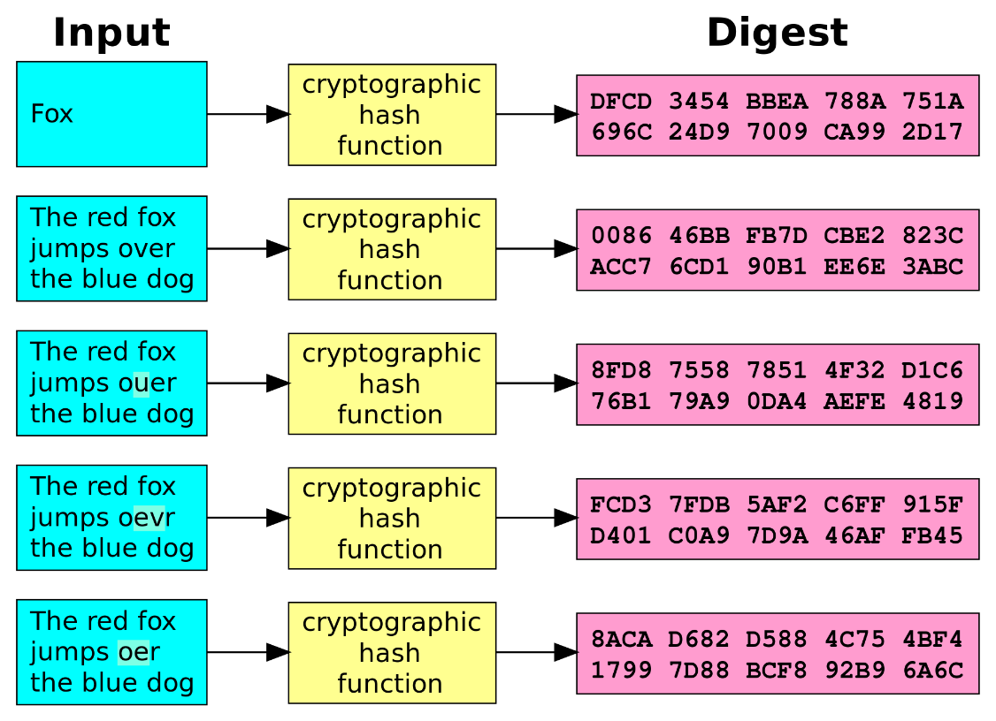
Example

Slide 18
Uses of Hash functions
Verifying the integrity of messages and files
Digital signature generation and verification
Password verification
Proof-of-work in block chains
File or data identifier using hash tables or

Slide 19
Examples

Slide 20
Hash Functions – MD2 family
MD2 – (Message Digest)
Developed in 1989 by Ronald Rivest for 8 bit processors
Works on messages of multiples of 16 bits and creates a 128 bit digest
Was proven to be non one-way

Slide 21
Hash Functions – MD2 family
MD4
Enhanced version of MD2 from 1990 for 32 bit processors
Uses messages with length (512)N-64 and creates a 128 bit hash
Is no longer secure

Slide 22
Hash Functions – MD2 family
MD5
Released in 1991
Has same length requirements as MD4
Also processes 512 bit block if input
Uses four rounds of computation to produce 128 bit hash
Was proven to be subject to collisions
No longed considered safe for cryptographic use

Slide 23
Hash Functions – SHA family
SHA-1 (Secure Hash Algorithm)
Developed by the NIST (national Institute of Standards and technology) in 1995
Internally similar to the MD5 algorithm
Takes a message on any length and produces a 160 bit hash
Processes 512 bit block
Is no longer considered secure

Slide 24
Hash Functions – SHA family
SHA-2
Published in 2001 and has 4 major variants
Considered secure by cryptographic community but theoretically has same weaknesses as SHA-2
The impact is mitigated by the larget has length
Version | Hash Length | Block Length
SHA2-256 | 256 bit | 512
SHA2-224 | 224 bit | 512
SHA2-512 | 512 bit | 1024
SHA2-384 | 384 bit | 1024

Slide 25
Hash Functions – SHA family
SHA-3
Developed in 2015
Part of the SHA family and has drop-in support to replace SHA-2
But internally very different from the MD5 and previous SHA versions

Slide 26
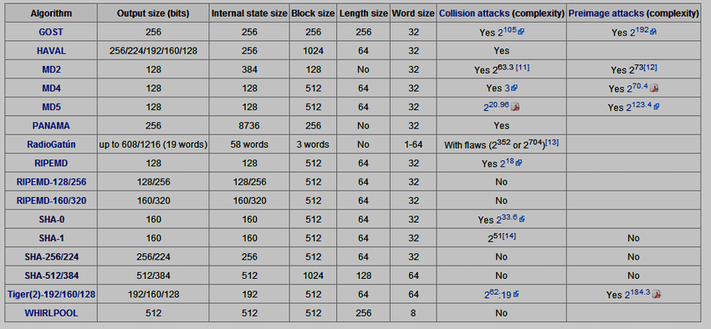
Comparison

Slide 27
Unsafe Hash Functions?
Some software supports “unsecure” hash functions
Remember the definition of difficult
The security required of the hash function depends on the users, systems and potential attackers of that system
What is considered unsecure for some uses might be secure for some others

Slide 28
Application

Slide 29
Message Authentication
Integrity verification uses just a hash and function does not provide any indication of the source
Eg:- If Bob is expecting a message from Alice with bank details Claire can send her details with a hash
Therefore, a Message Authentication Code (MAC) is used to provide both authenticity and integrity

Slide 30
MAC
MAC uses a keyed hash algorithm when generating the hash
A symmetric key is input in addition to the message when generating the hashes
The key must be shared in secret between the sender and receiver
This does not provide Confidentiality!!

Slide 31
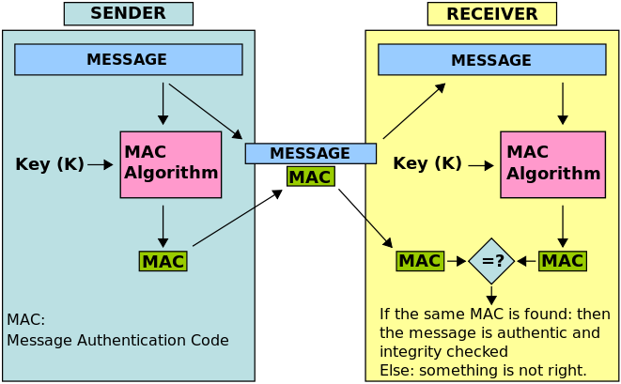
MAC

Slide 32
Non Repudiation

Slide 33
Non Repudiation
Is used to create trust between communicators
Integrity only verifies that the message has not been changed
MAC only assures who the sender is
Non-repudiation – ensure that the original sender cannot deny sending the message

Slide 34
Example
Bob owns Claire money as he is unable to go to the bank he tells her to send him het bank details so he can transfer the money
Next day Bob receives an email from Claire with her bank details and he transfers the money
Bob calls to tell Claire he transferred the money

Slide 35
Example
When Bob says he has already transferred the money to the bank account he received Claire claims she did not send such an email
Non–repudiation is a mechanism that makes sure that such incidents cannot occur

Slide 36
How to Implement
There must be something included in messages that is available only to the sender.
Cannot be shared with even the receiver!!
So shared key will not work

Slide 37


Historical Examples
Sealing wax used by nobility

Slide 38
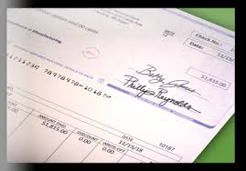
Historical Examples
Written signature

Slide 39

Historical Examples
Company seals

Slide 40
Digital Signature

Slide 41
Digital Signatures
Relatively new method of repudiation developed for electronic (digital) communication
Significantly more robust and secure than historical methods
Relies on cryptographic primitives
Hashes
Encryption algorithms

Slide 42
Classes of Digital Signatures
Class 1: Cannot be used for legal business documents as they are validated based only on an email ID and username. Class 1 signatures provide a basic level of security and are used in environments with a low risk of data compromise.

Slide 43
Classes of Digital Signatures
Class 2: Often used for e-filing of tax documents, including income tax returns and Goods and Services Tax (GST) returns. Class 2 digital signatures authenticate a signee’s identity against a pre-verified database. Class 2 digital signatures are used in environments where the risks and consequences of data compromise are moderate.

Slide 44
Classes of Digital Signatures
Class 3: The highest level of digital signatures. Class 3 signatures require a person or organization to present in front of a certifying authority to prove their identity before signing. Class 3 digital signatures are used for e-auctions, e-tendering, e-ticketing, court filings and in other environments where threats to data or the consequences of a security failure are high.

Slide 45
Digital Signature
Relies on asymmetric key encryption and hashing as key must only be known by sender
Sender first hashes the message and then encrypts it using his private key.
Corresponding certificate (issues by a certificate authority) is attached
Receiver uses public key in certificate to decrypt the hash and compare

Slide 46
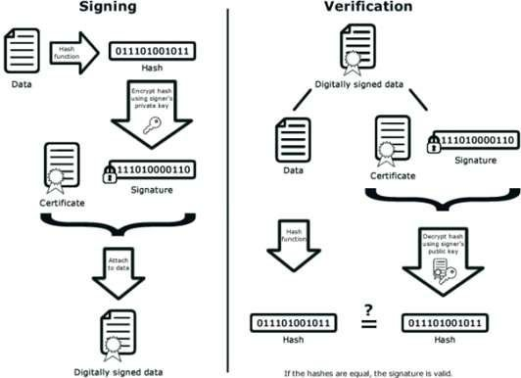
Creating a Digital Signature

Slide 47
Public Key Infrastructure
The keys are generated and corresponding certificate is issued by a trusted third party key/certificate authority*
Receiver can check with this authority to verify the identity and authenticity of sender

Slide 48
Advantages
Allows unknown people to authenticate and their messages to each other
Provides
Integrity
Authentication (message and sender)
Non repudiation
Overhead is minimized by hashing the message before signing

Slide 49
Disadvantages
Requires the considerably more resource intensive asymmetric key encryption
Requires a robust digital key infrastructure
Requires a trusted third party to act as key/certificate authority

Slide 50


