Slide 1
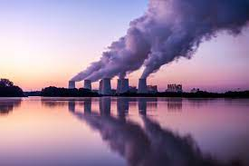
Carbon Emissions Across the United States Unveiling Regional Disparities and Key Contributors
Team Members
Supriya Vadakkeveetil
Garrett Stiehl
Riptapan Singh Johal

Slide 2

Project Introduction
The project on Carbon emissions across United States aims to perform an Exploratory Data Analysis to investigate the Carbon Emissions in United States, focusing mainly on region wise analysis and the contributors for Carbon Emissions.
We will be exploring public datasets, employ data analysis methods to dig deeper into the environmental impact and mainly its impact on health of people in United states.
The motivation for this project comes from the desire to understand the challenges to the environment caused mainly by carbon emissions and the sustainability initiatives being undertaken to curb these emissions.

Slide 3
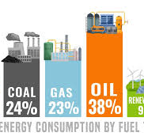
What Are Carbon Emissions?
Carbon emissions are by products of numerous actions humans have done to advance. These actions include the burning of fossil fuels for energy and manufacturing material, machines, and buildings.
Fossil fuels including gas, oil, and coal are the leading sources for producing usable energy that power our world.
These fuels are responsible for nearly 90 percent of all carbon emissions worldwide.
Source: https://www.un.org/en/climatechange/science/causes-effects-climate-change#:~:text=Fossil%20fuels%20–%20coal%2C%20oil%20and,of%20all%20carbon%20dioxide%20emissions.

Slide 4
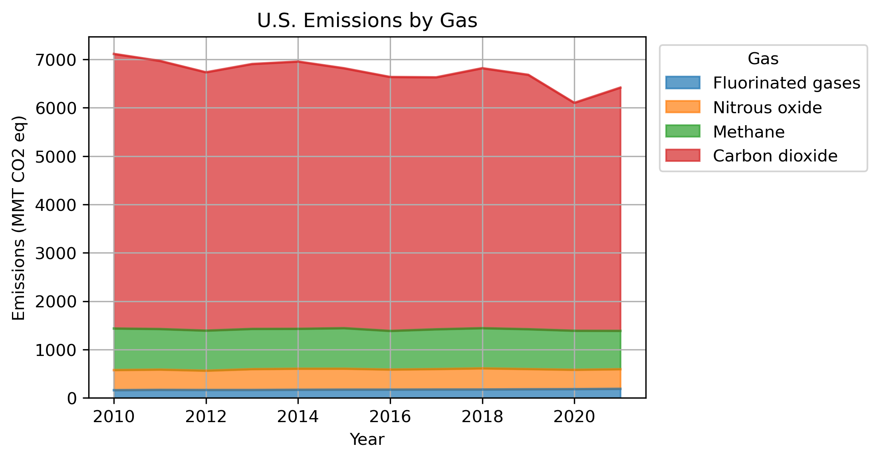
Burning fossil fuels is what releases these various gases into our atmosphere, causing an increase atmospheric temperature and pollution.

Slide 5

Research Questions
What are the overall trends in CO2 emissions across the United States over the past decade?
What part of the overall Greenhouse gasses Gas emissions are CO2?
How do these emissions vary across the country?
What are the factors contributing to these disparities?
What are the major sectors or activities contributing to these emissions?

Slide 6
Research Data
We have taken data through a variety of valuable resources including
US EPA (Environmental Protection Agency) – Data (Historical) on the Greenhouse gas emissions in the United States
US EIA (Energy Information Administration) – Data on State level emissions, Energy production and Electricity Generation Source.

Slide 7

Data Exploration, Cleanup, and Visualization
Import Libraries (Pandas, Matplotlib etc.)
Load Data into the Data Frame
Preliminary Data Examination
Data Cleaning
Handling missing values
Checking for duplicates
Removal on unnecessary data
Quality check on data
Data Visualization

Slide 8
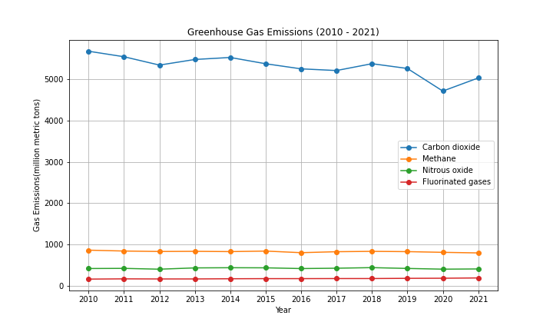
Emission Types
Carbon dioxide consistently sits nearly five times higher than methane, nitrous oxide, or fluorinated gases.

Slide 9
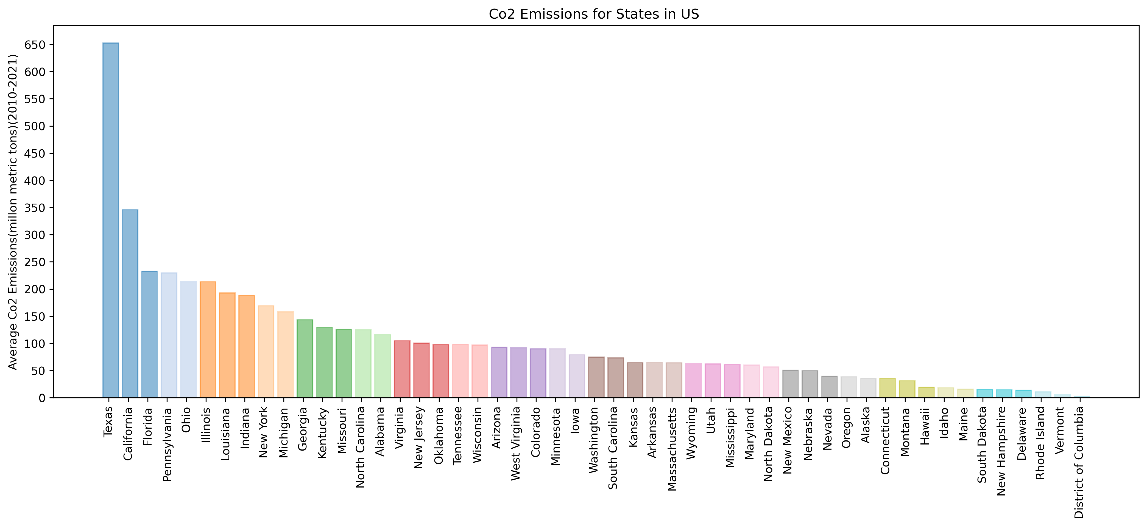
Co2 Emissions for States in the US
Texas and California, two of the largest states in the US, are the two highest producers of Co2 Emissions, followed by Florida, Pennsylvania, Illinois, and Ohio
Texas’ emissions are significantly higher than any other state

Slide 10
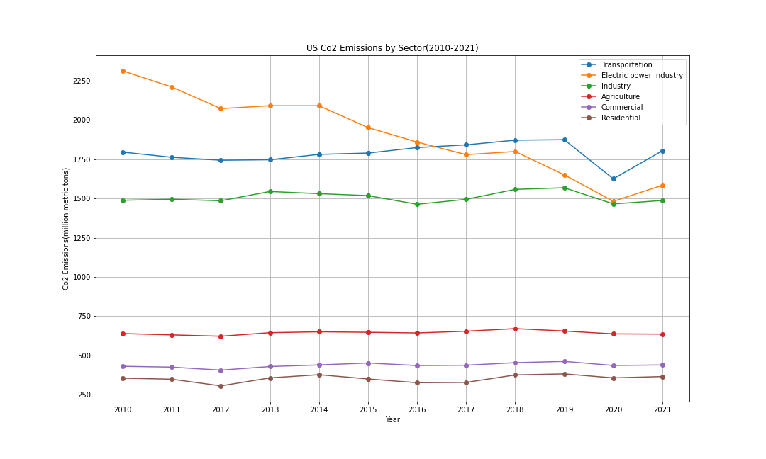
Emissions By Sector
Electric power industry, transportation, and industry sectors have remained the three highest producers of Co2 emissions
In recent years, the top three producers have decreased emissions to be between 1500 to approximately 1800 mmt
A significant gap has remained between the top three sectors and the bottom three
This is because of the heavy reliance on fossil fuels for operations, high energy intensity demand for the top sectors
Electricity sector significant decrease is probably due to use of Renewable sources
Agriculture emissions are mainly Methane and Nitrous Oxide

Slide 11
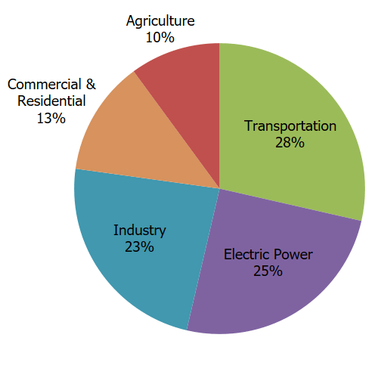
United States Sectors
The top sectors in America for CO2 emissions include
- Transportation
Electrical Power Industry
Industry
These sectors all rely on various forms of fossil fuels (carbon emissions) to produce goods and services.
https://www.epa.gov/ghgemissions/sources-greenhouse-gas-emissions

Slide 12
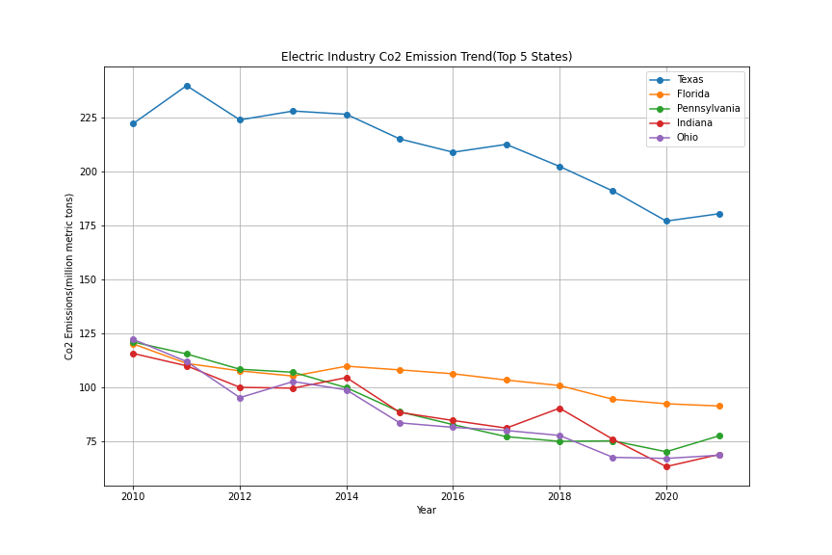
Electric CO2 Emissions
Texas’ electric industry Co2 emissions is around 100 mmt more than four out of the top five Co2 producing states
There has been a gradual downward trend in all five of the top five Co2 producing states in the last 10 years
These states rank high due to their heavy reliance on Coal and Natural gas plants producing electricity which contribute to the high CO2 emissions
Indiana has seen a downward trend possibly due to Environmental Regulations, transitions away from coal, increased renewable energy integration
Texas has seen a decrease due to reasons like closure oof Coal plants , Transition to Natural Gas, and Renewable sources of energy, and other policies and regulations (Air Quality)

Slide 13
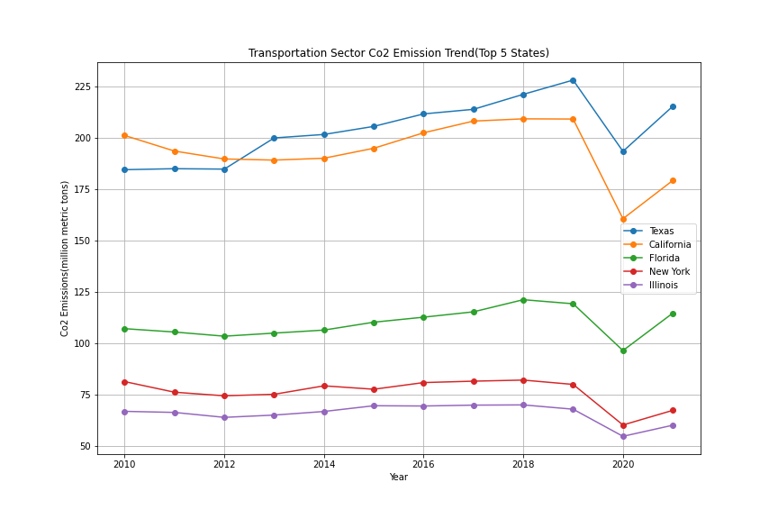
Transportation CO2
The top five CO2 producers change for the transportation sector, with Texas and Florida remain
Texas and California are the highest Co2 contributors in the transportation sector and both follow similar trends over the past 10 years
All five states experiences a sharp rise in emissions after 2020 (Post Covid)
Reasons: High in Texas and California due to factors like Traffic congestion, heavy reliance on personal vehicles and limited public transport.
Sharp decline is possibly due to Covid

Slide 14
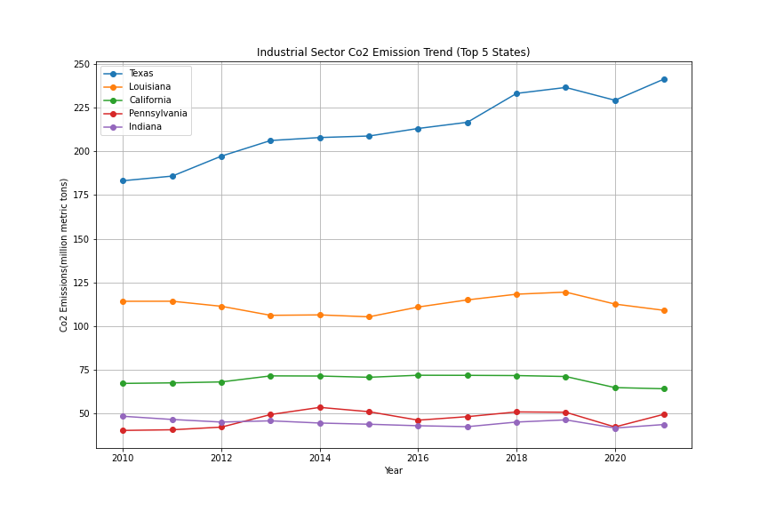
Industrial CO2
Texas’ industrial sector is also the highest contributor among the top five states
Texas also displays a gradual upward trend in industrial Co2 emissions, whereas other states remain steady
Texas currently sits above 225 mmt, whereas the other four states are all below 125 mmt
Heavy industrial presence is related to the higher emissions in these states that encompass oil and gas plants, chemical manufacturing, and other production activities.

Slide 15

Let’s Look at the Top State Contributors

Slide 16
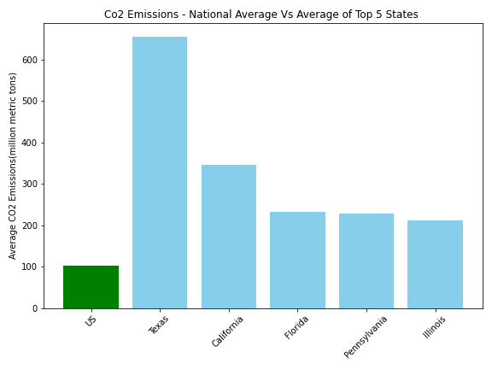
National VS State
The national average of CO2 emissions is minimal compared to the top 5 producing states.
Texas, California, Florida, Pennsylvania and Illinois are the leading states in CO2 emissions.
The gap between the leading state, Texas, and California in CO2 emissions accurately show the difference between California's push to quadruple clean energy production while Texas so no current goals.
Higher presence of industries, population, and economic factors, Energy production and consumption, Transportation and Infrastructure, Electricity Generation mix, Climate and Geographical factors, Industrial composition contribute to the varied difference

Slide 17
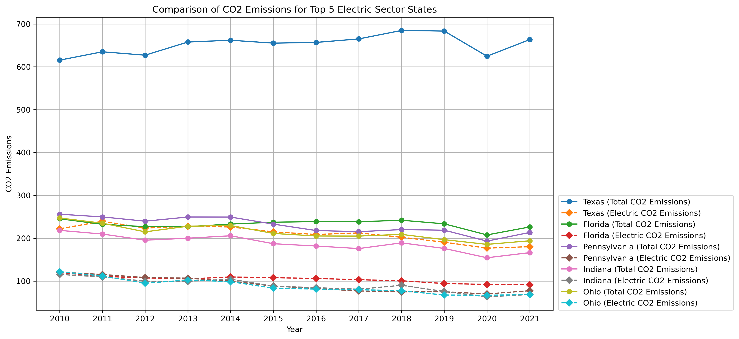
Comparison of CO2 Emissions for Top 5 Electric Sector States
CO2 emissions produced by electric have a minimal contribution to each states average CO2 emission total.
Electric produces the least amount of emissions. This is due to the fact that electric requires very little fossil fuels to produce great amounts of electrical energy compared to other forms of energy.

Slide 18
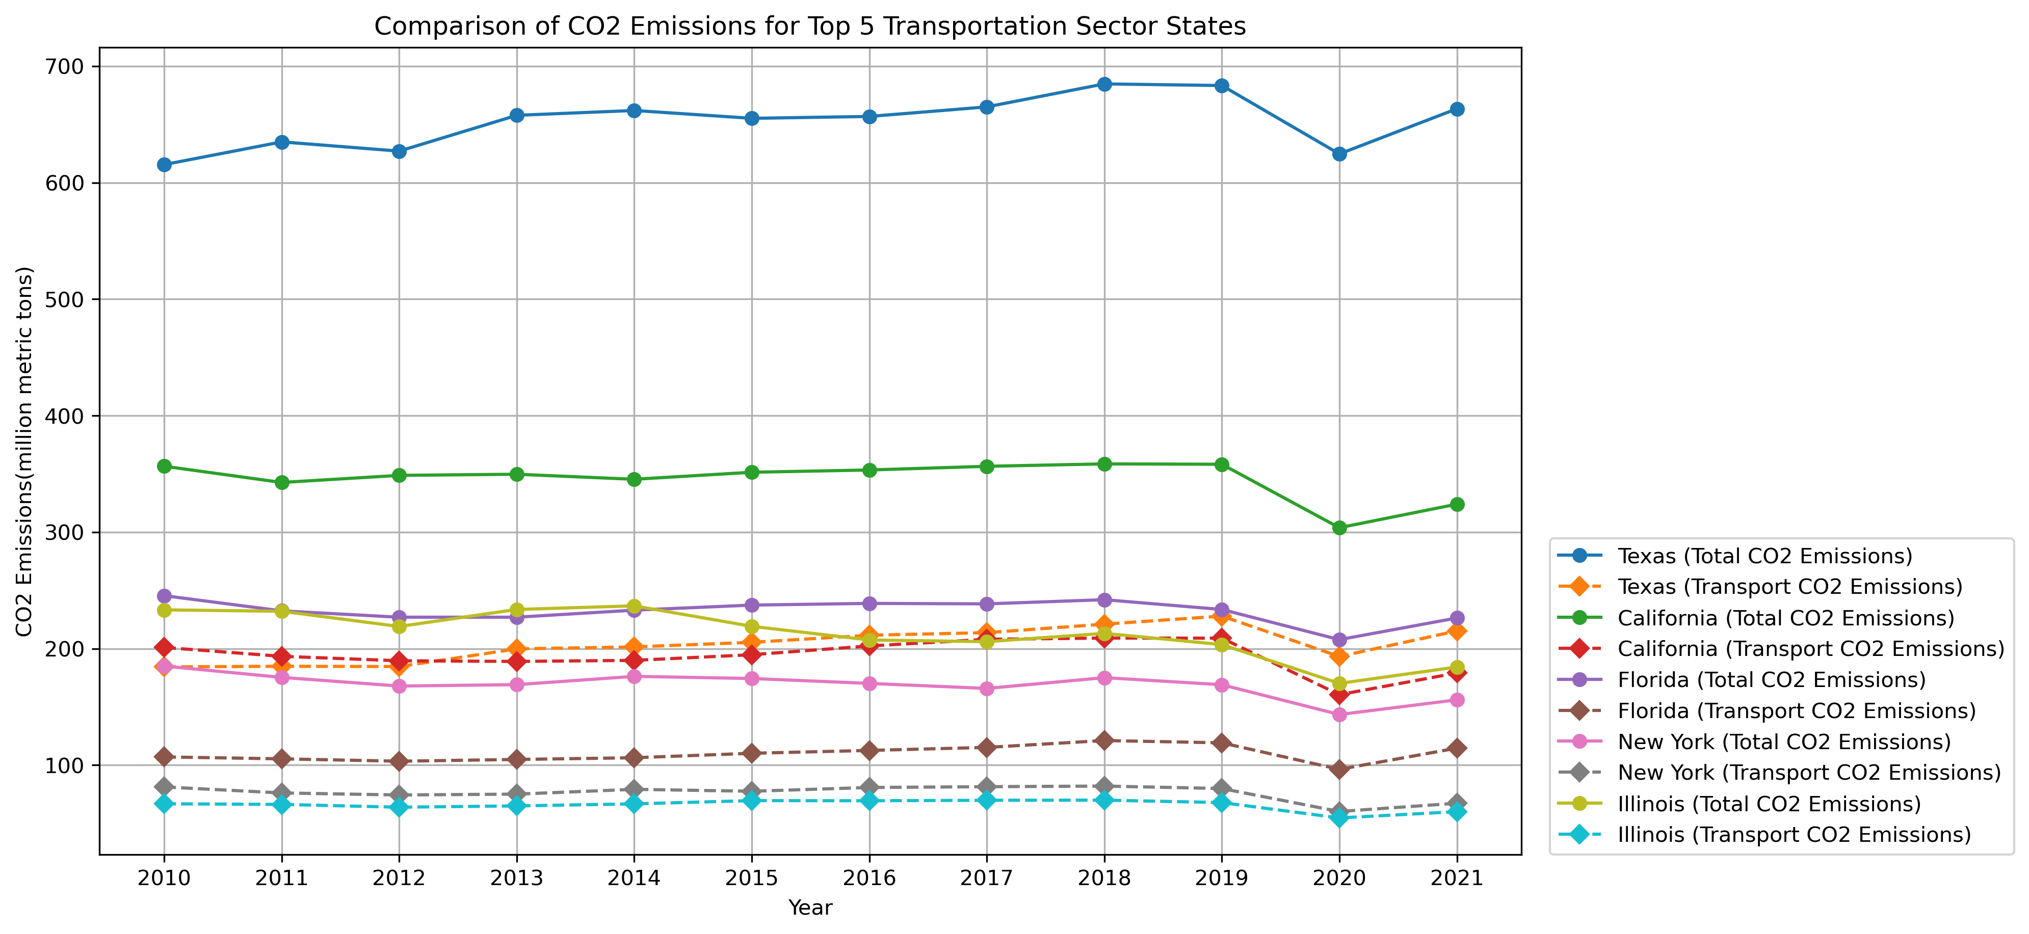
Top 5 Transportation CO2 States
Texas and California are still the leaders in the CO2 emission production but, even still, electrical transportation produces less CO2 emissions.

Slide 19
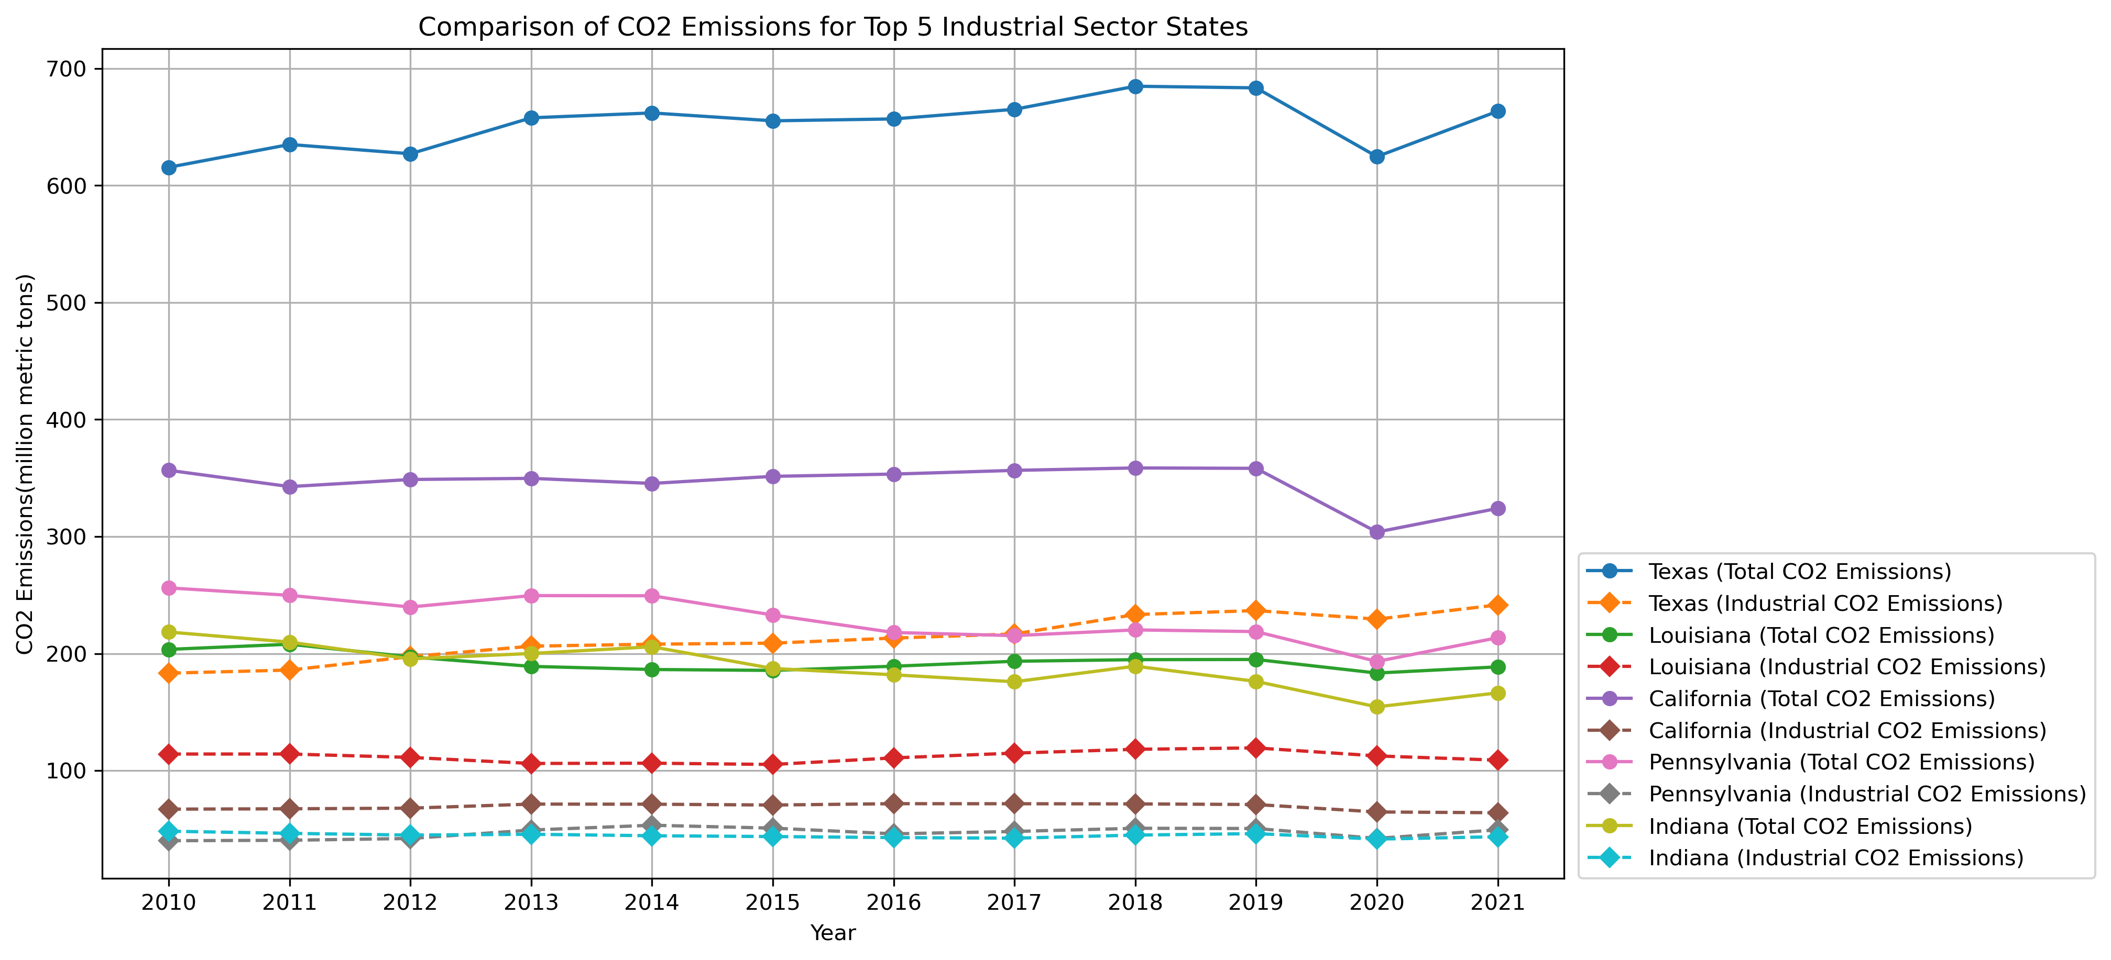
Top 5 Industrial CO2 States
Texas is the leading state in Industrial CO2 emissions.
While California’s average CO2 emissions is ranked 2nd, the same is not true for their Industrial emissions.
This is related to California’s goal to go electric over the years. Industrial tasks that usually require gas and oil California is working to make it electric.

Slide 20
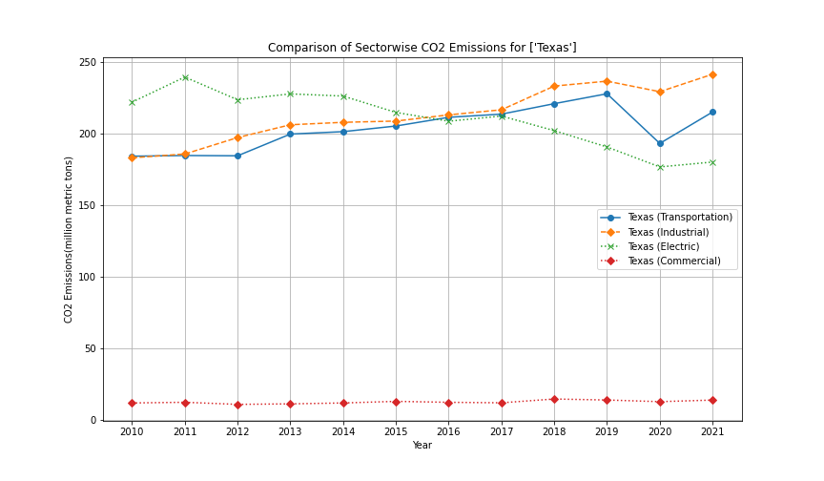
Deeper Dive Into Texas
Although Texas seems to be a powerhouse in CO2 emissions they did experience a decline in emissions.
From 2019 to 2020 Texas experienced a sudden decrease in all sectors CO2 emissions.
But why?

Slide 21
BUT WHY?
Energy Mix: Texas is a significant contributor to carbon emissions due to its large energy sector, including fossil fuel production and consumption. Changes in the energy mix, such as an increase in natural gas and renewable energy sources, can affect carbon emissions. Texas has been transitioning to a greater reliance on natural gas and renewable energy, which tends to have lower emissions compared to coal.
Economic Activity: Carbon emissions are closely linked to economic activity. If there was a slowdown or recession in 2020, as was the case with the global economic impact of the COVID-19 pandemic, it could have led to a temporary reduction in emissions as industrial production and transportation decreased.
Weather Variability: Weather patterns, such as milder winters or increased use of air conditioning in hot summers, can affect energy consumption and carbon emissions. In Texas, weather conditions can influence energy demand.
Policies and Regulations: State and federal policies and regulations aimed at reducing carbon emissions may have played a role during this period. Texas has implemented some measures to promote cleaner energy sources and improve energy efficiency.
Technological Advances: Advances in energy-efficient technologies, improved industrial processes, and changes in energy consumption patterns can also impact carbon emissions.

Slide 22
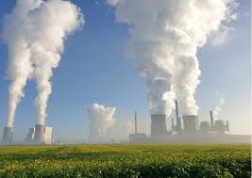
Impacts Analysis
The analysis revealed several key insights
The steady increase in CO2 emissions for United States at the national level, indicates a need for mitigation strategies.
The analysis of the Sectoral contributions across states emphasizes specific sectors demands targeted interventions
Disparities between states and the national average signals the need for tailored policies at the state level.

Slide 23
Conclusions
Resource Depletion: Large carbon footprints, whether on a country-wide scale due to activities like deforestation or on an individual level through increased use of resources like air conditioning, can deplete natural resources. Deforestation, for example, leads to the loss of vital ecosystems and biodiversity, while increased use of air conditioning contributes to higher energy consumption.
Greenhouse Gas Emissions: The release of greenhouse gases, such as carbon dioxide (CO2), methane (CH4), and nitrous oxide (N2O), is a direct consequence of human activities. These emissions result from burning fossil fuels, deforestation, industrial processes, and other human-driven actions.
Climate Change: Increased greenhouse gas emissions contribute to climate change by trapping heat in the Earth's atmosphere. This leads to global warming, shifts in weather patterns, more frequent and severe weather events, and disruptions to ecosystems and biodiversity. Climate change poses serious challenges for human societies, the environment, and the economy.
Carbon Footprint: A person's carbon footprint measures the amount of greenhouse gases they are responsible for producing through their daily activities, including energy consumption, transportation, and lifestyle choices. Reducing one's carbon footprint is essential in mitigating the impacts of climate change.
Human Contribution to Greenhouse Gas Emissions: While greenhouse gases do occur naturally, human activities significantly increase their presence in the atmosphere. The burning of fossil fuels for energy and transportation, deforestation, industrial processes, and agricultural practices all contribute to these emissions.

Slide 24
Thank you

