Slide 1
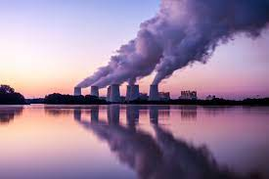
Carbon Emissions Across the United States Unveiling Regional Disparities and Key Contributors
Team Members
Supriya Vadakkeveetil
Garrett Stiehl
Riptapan Singh Johal

Slide 2

Project Introduction
The project on Carbon emissions across United States aims to perform an Exploratory Data Analysis to investigate the Carbon Emissions in United States, focusing mainly on region wise analysis and the contributors for Carbon Emissions.
We will be exploring public datasets, employ data analysis methods to dig deeper into the environmental impact and mainly its impact on health of people in United states.
The motivation for this project comes from the desire to understand the challenges to the environment caused mainly by carbon emissions and the sustainability initiatives being undertaken to curb these emissions.

Slide 3
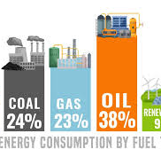
What Are Carbon Emissions?
Carbon emissions are by products of numerous actions humans have done to advance. These actions include the burning of fossil fuels for energy and manufacturing material, machines, and buildings.
Fossil fuels including gas, oil, and coal are the leading sources for producing usable energy that power our world.
These fuels are responsible for nearly 90 percent of all carbon emissions worldwide.
Source: https://www.un.org/en/climatechange/science/causes-effects-climate-change#:~:text=Fossil%20fuels%20–%20coal%2C%20oil%20and,of%20all%20carbon%20dioxide%20emissions.

Slide 4
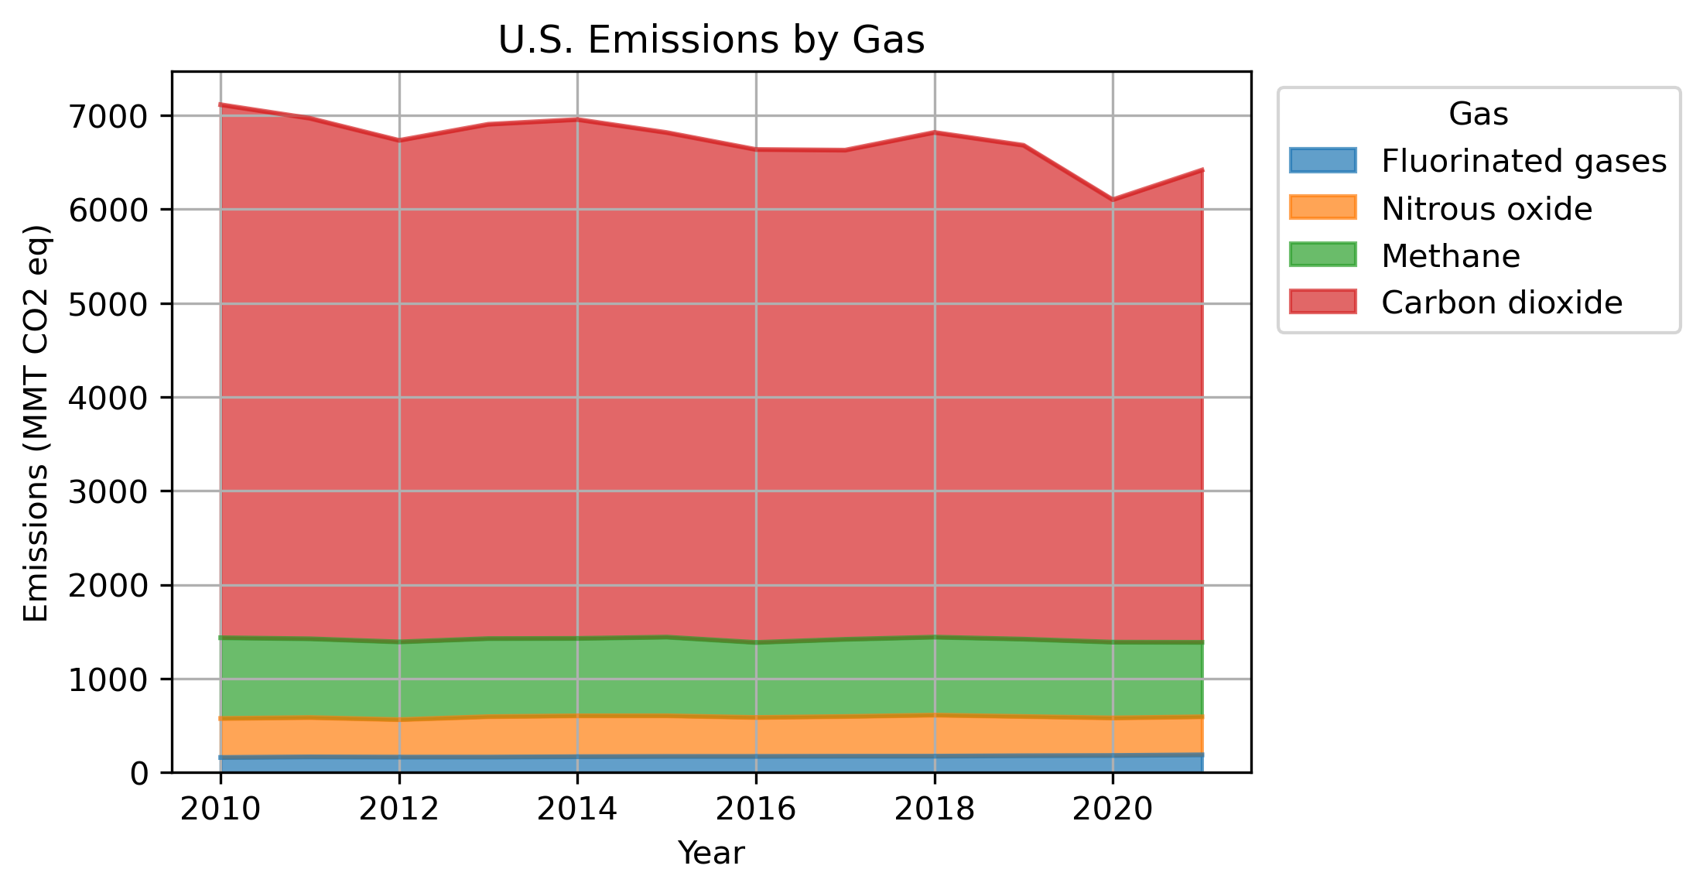
Burning fossil fuels is what releases these various gases into our atmosphere, causing an increase atmospheric temperature and pollution.

Slide 5

Research Questions
What are the overall trends in CO2 emissions across the United States over the past decade?
What part of the overall Greenhouse gasses Gas emissions are CO2?
How do these emissions vary across the country?
What are the factors contributing to these disparities?
What are the major sectors or activities contributing to these emissions?

Slide 6
Research Data
We have taken data through a variety of valuable resources including
US EPA (Environmental Protection Agency) – Data (Historical) on the Greenhouse gas emissions in the United States
US EIA (Energy Information Administration) – Data on State level emissions, Energy production and Electricity Generation Source.

Slide 7

Data Exploration, Cleanup, and Visualization
Import Libraries (Pandas, Matplotlib etc.)
Load Data into the Data Frame
Preliminary Data Examination
Data Cleaning
Handling missing values
Checking for duplicates
Removal on unnecessary data
Quality check on data
Data Visualization

Slide 8
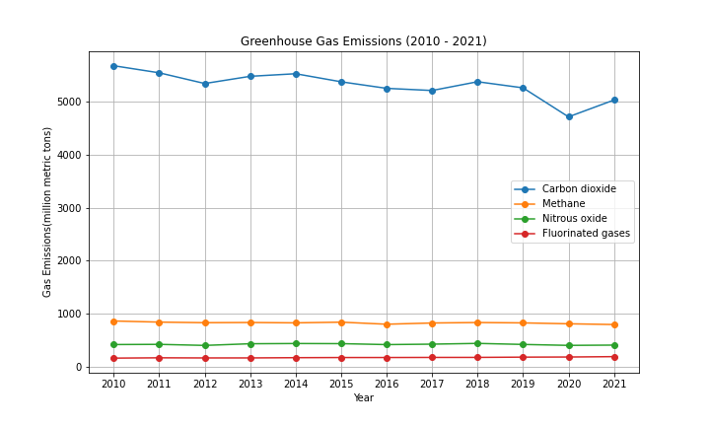
Emission Types
Carbon dioxide consistently sits nearly five times higher than methane, nitrous oxide, or fluorinated gases.

Slide 9
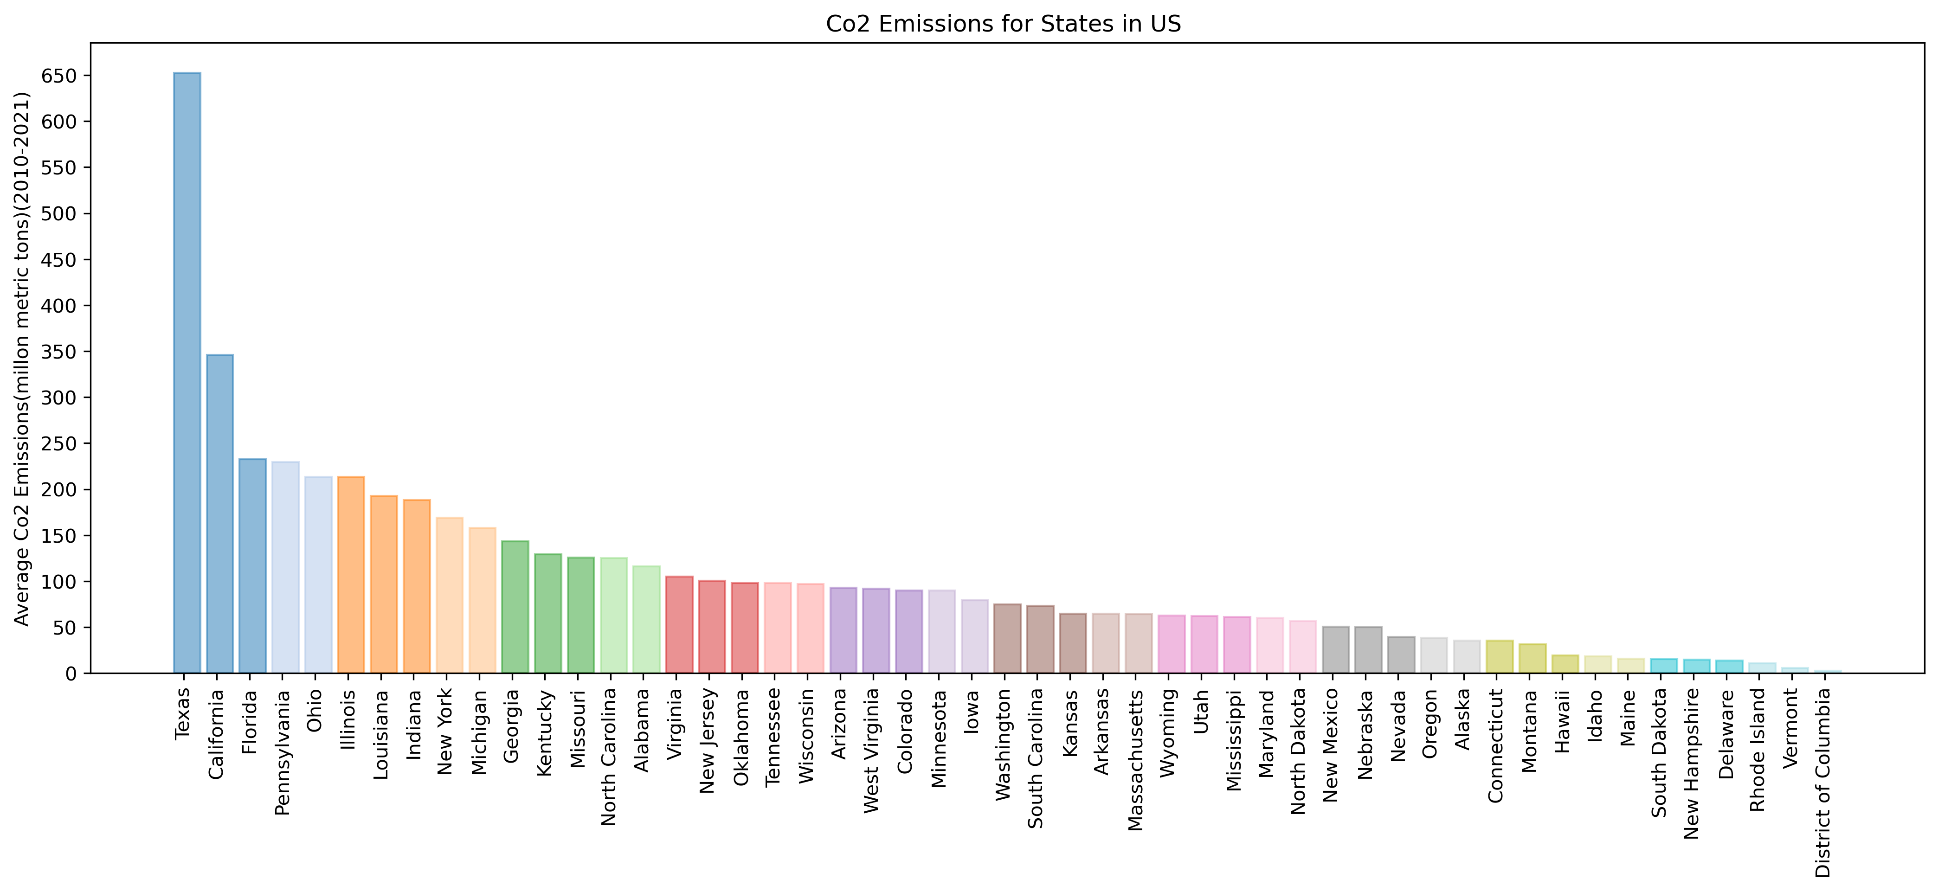
Co2 Emissions for States in the US
Texas and California, two of the largest states in the US, are the two highest producers of Co2 Emissions, followed by Florida, Pennsylvania, Illinois, and Ohio
Texas’ emissions are significantly higher than any other state
Notes:
How do the emissions vary across regions /states in US
A bar chart was created to display the average CO2 Emissions for each state. This visualization allowed for a comparison of emission levels across different states. We took the average for each state for the period(2010-2021)
Texas and California, two of the largest states in the US, are the two highest producers of Co2 Emissions, followed by Florida, Pennsylvania, Illinois, and Ohio. This could be because they are both rank in the top 2 states for population and economic size.
Texas’ emissions are significantly higher than any other state. Appx 650 million metric tons
States with Significantly lower emissions- These states often exhibit a combination of lower population density, less energy-intensive industries, cleaner energy sources, and proactive environmental policies contributing to their reduced carbon footprint.

Slide 10
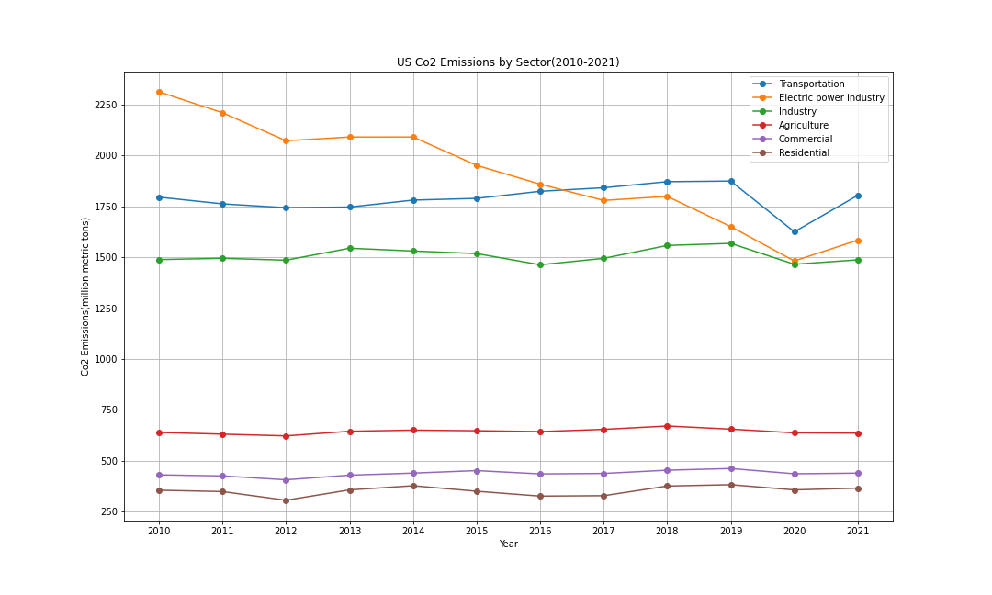
Emissions By Sector
Electric power industry, transportation, and industry sectors have remained the three highest producers of Co2 emissions
In recent years, the top three producers have decreased emissions to be between 1500 to approximately 1800 mmt
A significant gap has remained between the top three sectors and the bottom three
This is because of the heavy reliance on fossil fuels for operations, high energy intensity demand for the top sectors
Electricity sector significant decrease is probably due to use of Renewable sources
Agriculture emissions are mainly Methane and Nitrous Oxide
Notes:
4. What are the major sectors or activities contributing to the emissions in US and how is it different regionally?
Trendline showing emissions across Sectors
Sectoral emissions were explored through a trendline chart, illustration the variations in CO2 emissions across sectors- Transportation, Electric Power, Industrial and others over the specified period.
Electric power industry, transportation, and industry sectors have remained the three highest producers of Co2 emissions
In recent years, the top three producers have decreased emissions to be between 1500 to approximately 1800 mmt (million metric tons)
A significant gap has remained between the top three producers and the bottom three
Sources say that this could be because of
Heavy reliance on fossil fuels for operations especially in Transportation and Industrial, and Electrical
Higher energy intensity demand for powering equipment’s and machinery
Electricity sector has seen a significant decrease possibly due to the use of renewable sources of energy
Agriculture produces more of methane and Nitrous Oxide and emissions are significantly less
Residential and commercial contribute mainly through energy consumption for heating, electricity uses etc. there have been advancements in energy efficient technologies so this explains why it is lower compared to the top 3

Slide 11
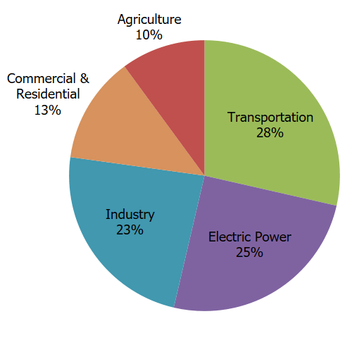
United States Sectors
The top sectors in America for CO2 emissions include
- Transportation
Electrical Power Industry
Industry
These sectors all rely on various forms of fossil fuels (carbon emissions) to produce goods and services.
https://www.epa.gov/ghgemissions/sources-greenhouse-gas-emissions

Slide 12
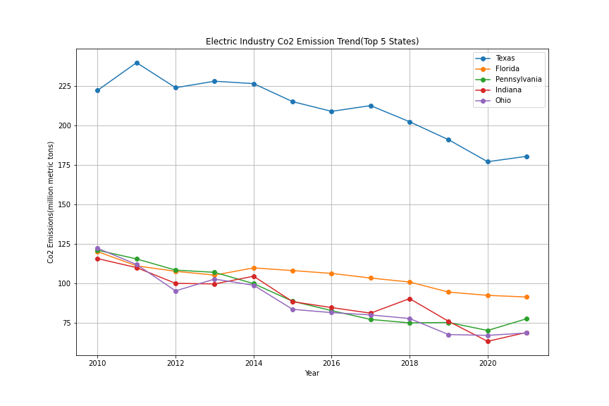
Electric CO2 Emissions
Texas’ electric industry Co2 emissions is around 100 mmt more than four out of the top five Co2 producing states
There has been a gradual downward trend in all five of the top five Co2 producing states in the last 10 years
These states rank high due to their heavy reliance on Coal and Natural gas plants producing electricity which contribute to the high CO2 emissions
Indiana has seen a downward trend possibly due to Environmental Regulations, transitions away from coal, increased renewable energy integration
Texas has seen a decrease due to reasons like closure oof Coal plants , Transition to Natural Gas, and Renewable sources of energy, and other policies and regulations (Air Quality)
Notes:
Top 5 States in Each Sector
An analysis was conducted to identify the top 5 states with the highest emissions in each sector. This analysis provided insights into the regional variations and emphasized the significant contributors in each sector

Slide 13
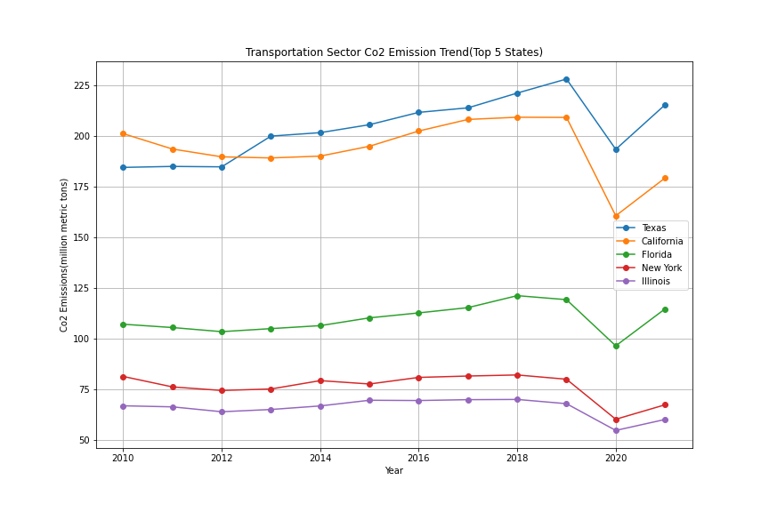
Transportation CO2
The top five CO2 producers change for the transportation sector, with Texas and Florida remain
Texas and California are the highest Co2 contributors in the transportation sector and both follow similar trends over the past 10 years
All five states experiences a sharp rise in emissions after 2020 (Post Covid)
Reasons: High in Texas and California due to factors like Traffic congestion, heavy reliance on personal vehicles and limited public transport.
Sharp decline is possibly due to Covid
Notes:
According to the U.S Environmental Protection Agency (EPA), and the U.S Energy Information Administration (EIA), these states rank high due to factors such as traffic congestion, reliance on personal vehicles, limited public transportation alternatives and in the case of California significant port and trade activities.
These states continue to work on various initiatives to reduce transportation emissions such as promoting Electric Vehicles (EV), enhancing fuel efficiency standards, developing an infrastructure to support cleaner and sustainable transport options. However, the challenge is due to the scale of their populations and economic activities, reducing the emissions significantly remains a challenge

Slide 14
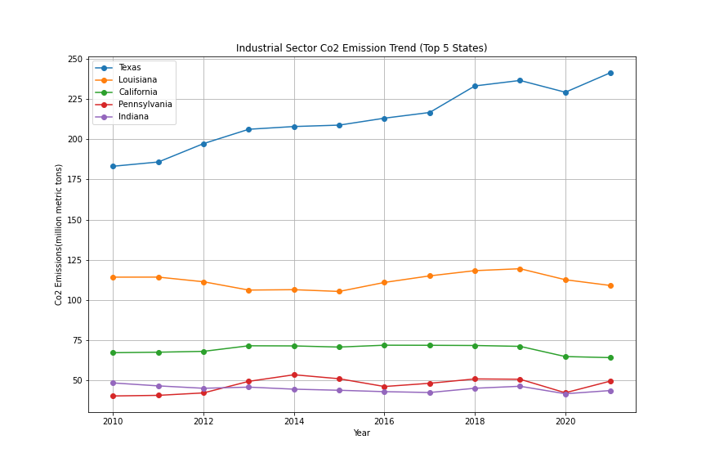
Industrial CO2
Texas’ industrial sector is also the highest contributor among the top five states
Texas also displays a gradual upward trend in industrial Co2 emissions, whereas other states remain steady
Texas currently sits above 225 mmt, whereas the other four states are all below 125 mmt
Heavy industrial presence is related to the higher emissions in these states that encompass oil and gas plants, chemical manufacturing, and other production activities.
Notes:
Presence of Energy Intensive industries (Oil and Gas refining, chemical manufacturing, steel production), Fossil fuel extraction and processing(Texas,Lousiana,Pennsylvania) , Chemical and Petro chemical manufacturing(Texas and Louisiana), Steel and Metal production(Pennsylvania and Indiana), Large Power Plants, the inherent nature of these industries in these specific states contribute to the Co2 emissions
Between 2010 and 2011, Texas experienced economic expansion, leading to higher industrial production, manufacturing, and overall economic activities.
Texas hosts a significant portion of the nation's petrochemical and refining industry.
Texas has a diverse manufacturing base, including machinery, electronics, food processing, and more.
California's industrial sector is diverse and includes technology, aerospace, manufacturing, and biotech, all of which have high energy demands and contribute to CO2 emissions. The state has oil refineries and industrial centers concentrated in areas like Los Angeles and the San Francisco Bay Area, contributing to higher industrial emissions.

Slide 15

Let’s Look at the Top State Contributors

Slide 16
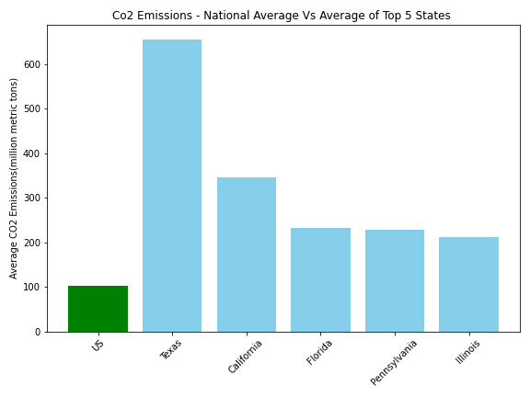
National VS State
The national average of CO2 emissions is minimal compared to the top 5 producing states.
Texas, California, Florida, Pennsylvania and Illinois are the leading states in CO2 emissions.
The gap between the leading state, Texas, and California in CO2 emissions accurately show the difference between California's push to quadruple clean energy production while Texas so no current goals.
Higher presence of industries, population, and economic factors, Energy production and consumption, Transportation and Infrastructure, Electricity Generation mix, Climate and Geographical factors, Industrial composition contribute to the varied difference
Notes:
How do total CO2 emissions for the Top 5 states compare against the National Average of the total CO2 Emissions?
Bar Chart Comparison for the Top 5 States Vs National Average
A bar chart was presented to compare the average CO2 emissions for the top 5 states with the national average. This comparison shed light on the states that surpassed or the national average in CO2 emissions
The higher presence of industries, population and economic factors (some of the populous states in the country have high levels of economic activity compared to the Smaller states), Energy production and consumption, transportation and infrastructure, Electricity generation mix, Climate and Geographical factors, Industrial composition all contribute to the varied difference with the State Average.
Texas has a large energy sector, including oil, natural gas, and coal production, which contributes to higher CO2 emissions. Similarly, Pennsylvania has a substantial coal mining history and still relies on coal for a significant portion of its electricity generation.
Electricity Generation: some of these states, like California, have made significant strides in renewable energy and energy efficiency, they also have significant energy demands due to their large populations and economic activities. In states with diverse energy sources, the reliance on fossil fuels may still be considerable, contributing to higher emissions.

Slide 17
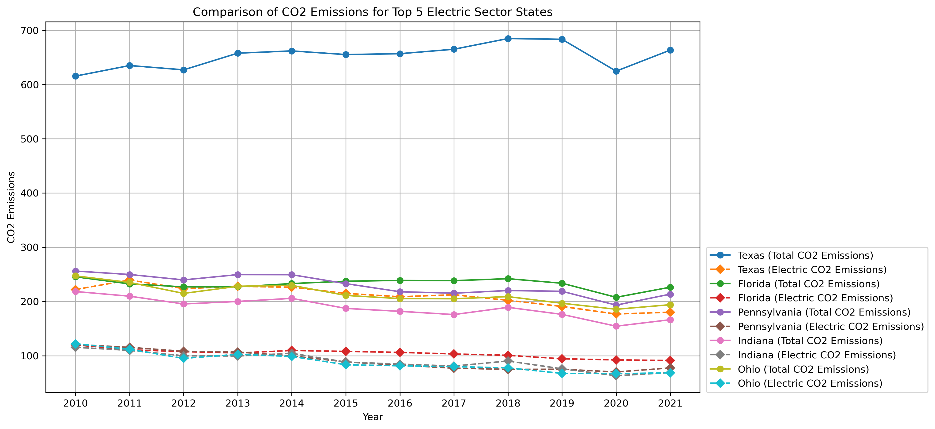
Comparison of CO2 Emissions for Top 5 Electric Sector States
CO2 emissions produced by electric have a minimal contribution to each states average CO2 emission total.
Electric produces the least amount of emissions. This is due to the fact that electric requires very little fossil fuels to produce great amounts of electrical energy compared to other forms of energy.

Slide 18
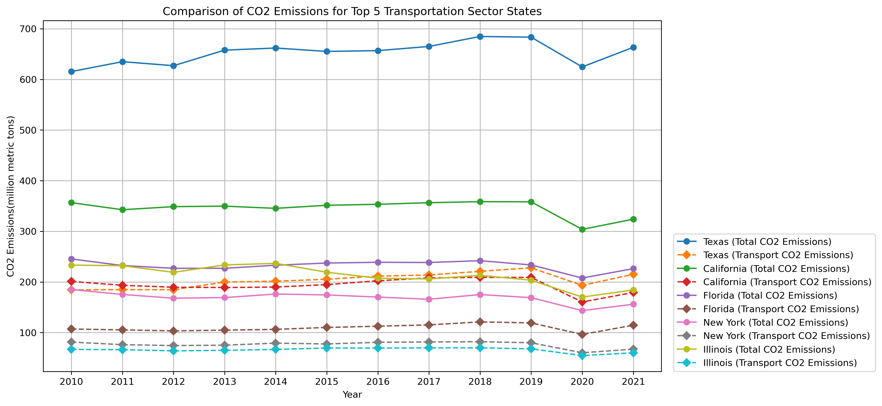
Top 5 Transportation CO2 States
Texas and California are still the leaders in the CO2 emission production but, even still, electrical transportation produces less CO2 emissions.

Slide 19
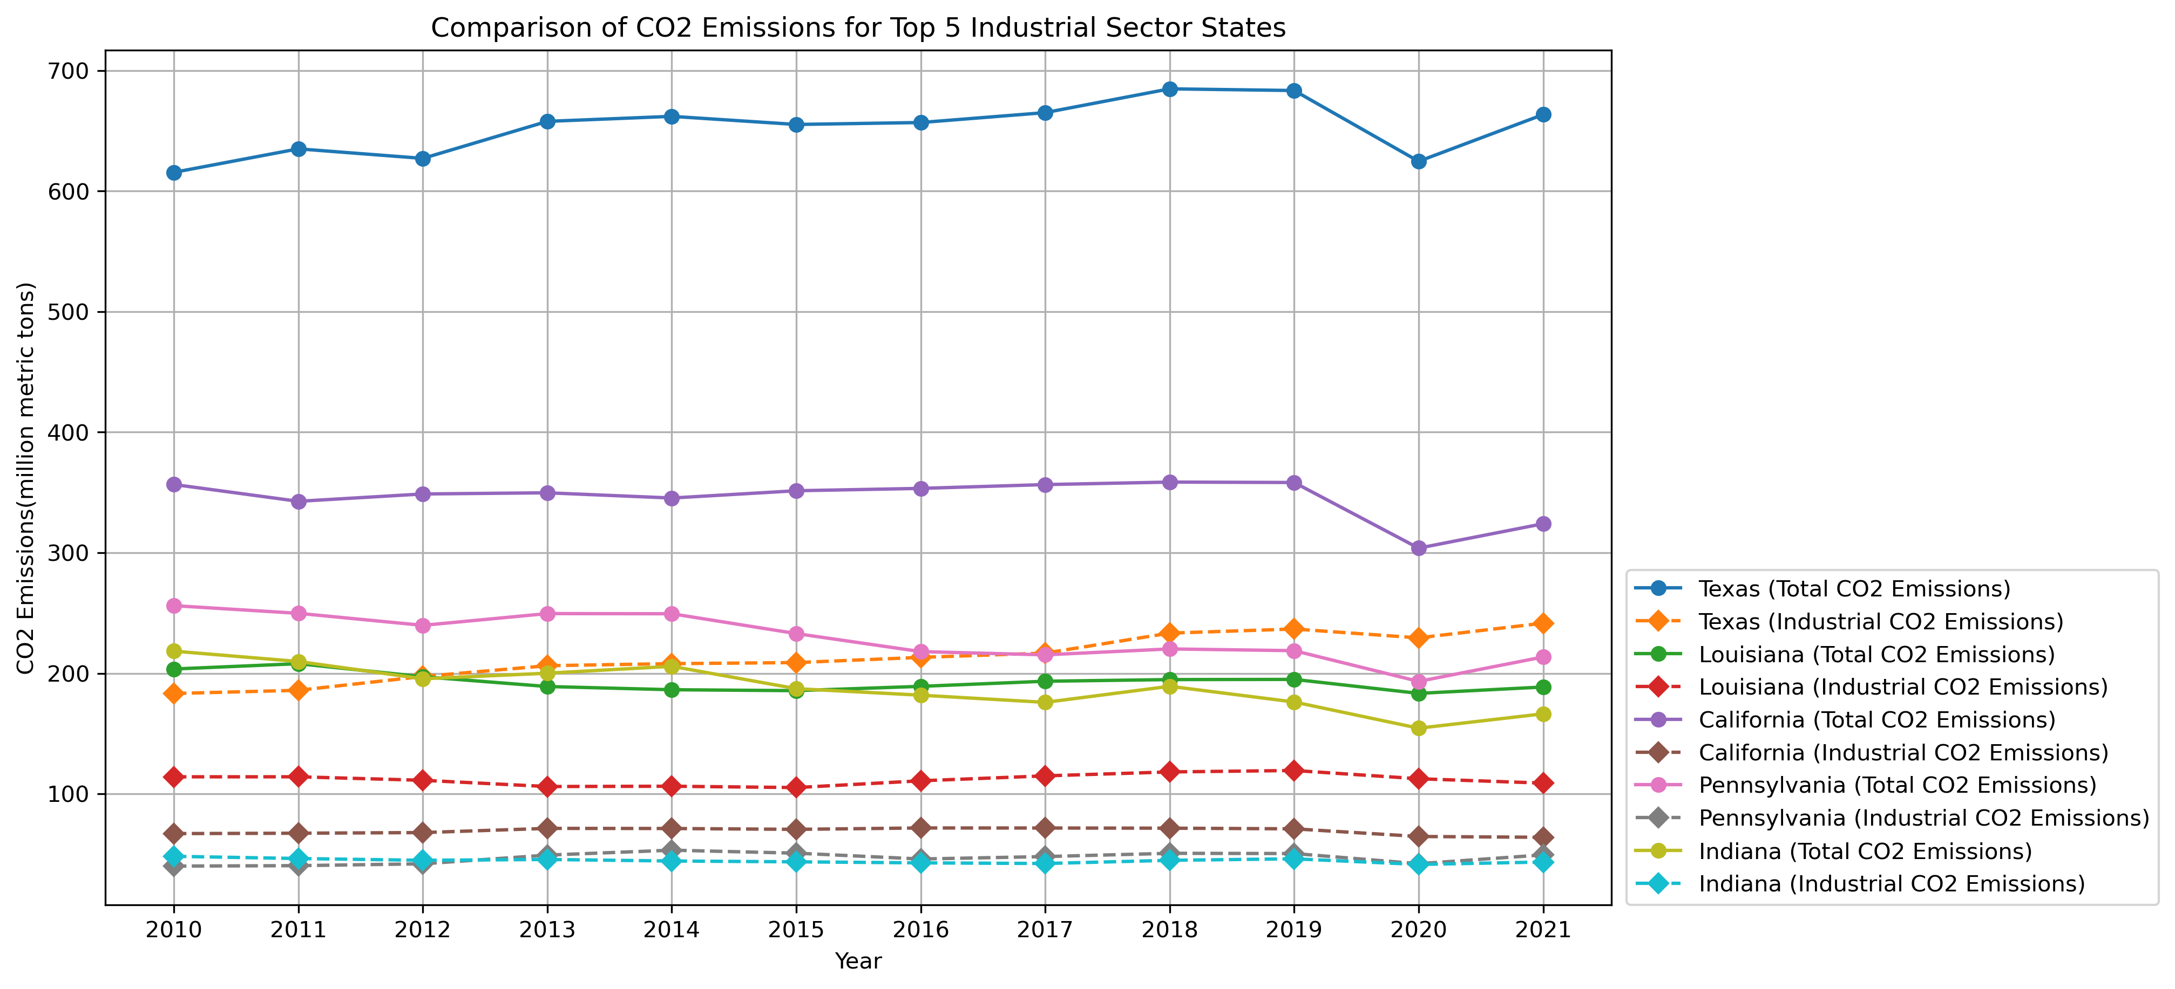
Top 5 Industrial CO2 States
Texas is the leading state in Industrial CO2 emissions.
While California’s average CO2 emissions is ranked 2nd, the same is not true for their Industrial emissions.
This is related to California’s goal to go electric over the years. Industrial tasks that usually require gas and oil California is working to make it electric.

Slide 20
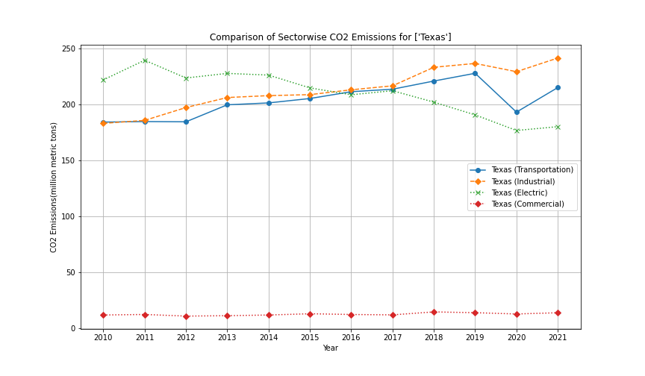
Deeper Dive Into Texas
Although Texas seems to be a powerhouse in CO2 emissions they did experience a decline in emissions.
From 2019 to 2020 Texas experienced a sudden decrease in all sectors CO2 emissions.
But why?

Slide 21
BUT WHY? The period from 2019 to 2020 saw some fluctuations in carbon emissions, including in Texas. While it's essential to consult the latest and most comprehensive data from authoritative sources, such as the U.S. Environmental Protection Agency (EPA) or the U.S. Energy Information Administration (EIA), to get precise information, I can provide a general overview of the factors that might have contributed to changes in carbon emissions during this time:
Energy Mix: Texas is a significant contributor to carbon emissions due to its large energy sector, including fossil fuel production and consumption. Changes in the energy mix, such as an increase in natural gas and renewable energy sources, can affect carbon emissions. Texas has been transitioning to a greater reliance on natural gas and renewable energy, which tends to have lower emissions compared to coal.
Economic Activity: Carbon emissions are closely linked to economic activity. If there was a slowdown or recession in 2020, as was the case with the global economic impact of the COVID-19 pandemic, it could have led to a temporary reduction in emissions as industrial production and transportation decreased.
Weather Variability: Weather patterns, such as milder winters or increased use of air conditioning in hot summers, can affect energy consumption and carbon emissions. In Texas, weather conditions can influence energy demand.
Policies and Regulations: State and federal policies and regulations aimed at reducing carbon emissions may have played a role during this period. Texas has implemented some measures to promote cleaner energy sources and improve energy efficiency.
Technological Advances: Advances in energy-efficient technologies, improved industrial processes, and changes in energy consumption patterns can also impact carbon emissions.

Slide 22
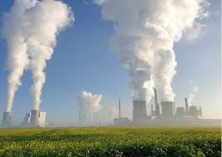
Impacts Analysis
Without carbon dioxide, Earth's natural greenhouse effect would be too weak to keep the average global surface temperature above freezing.
By adding more carbon dioxide to the atmosphere, people are supercharging the natural greenhouse effect, causing global temperature to rise.
Analyzing the impact of carbon dioxide (CO2) emissions in the United States involves considering various aspects, including their environmental, economic, and social consequences.

Slide 23
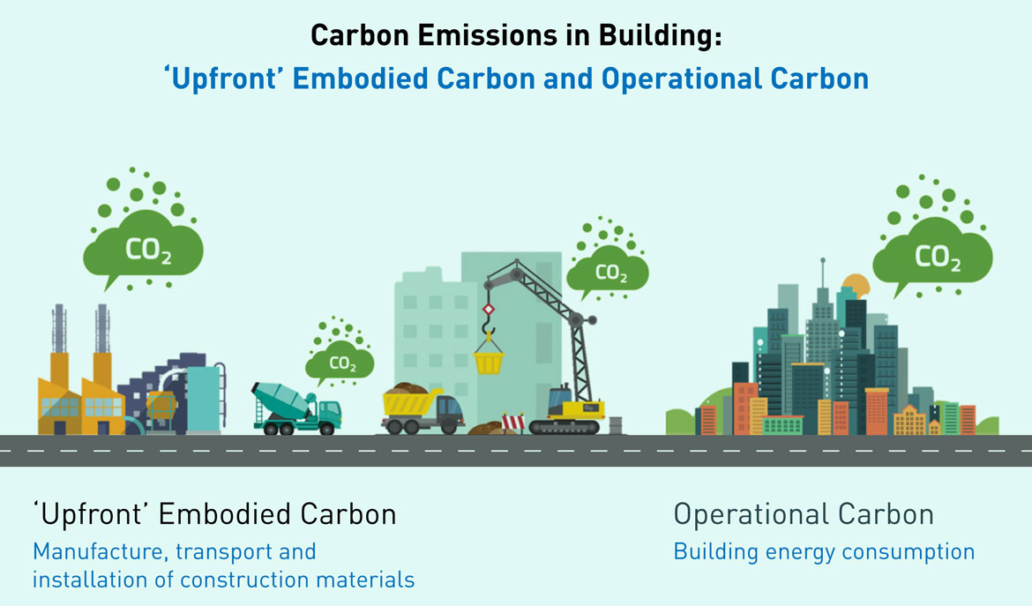
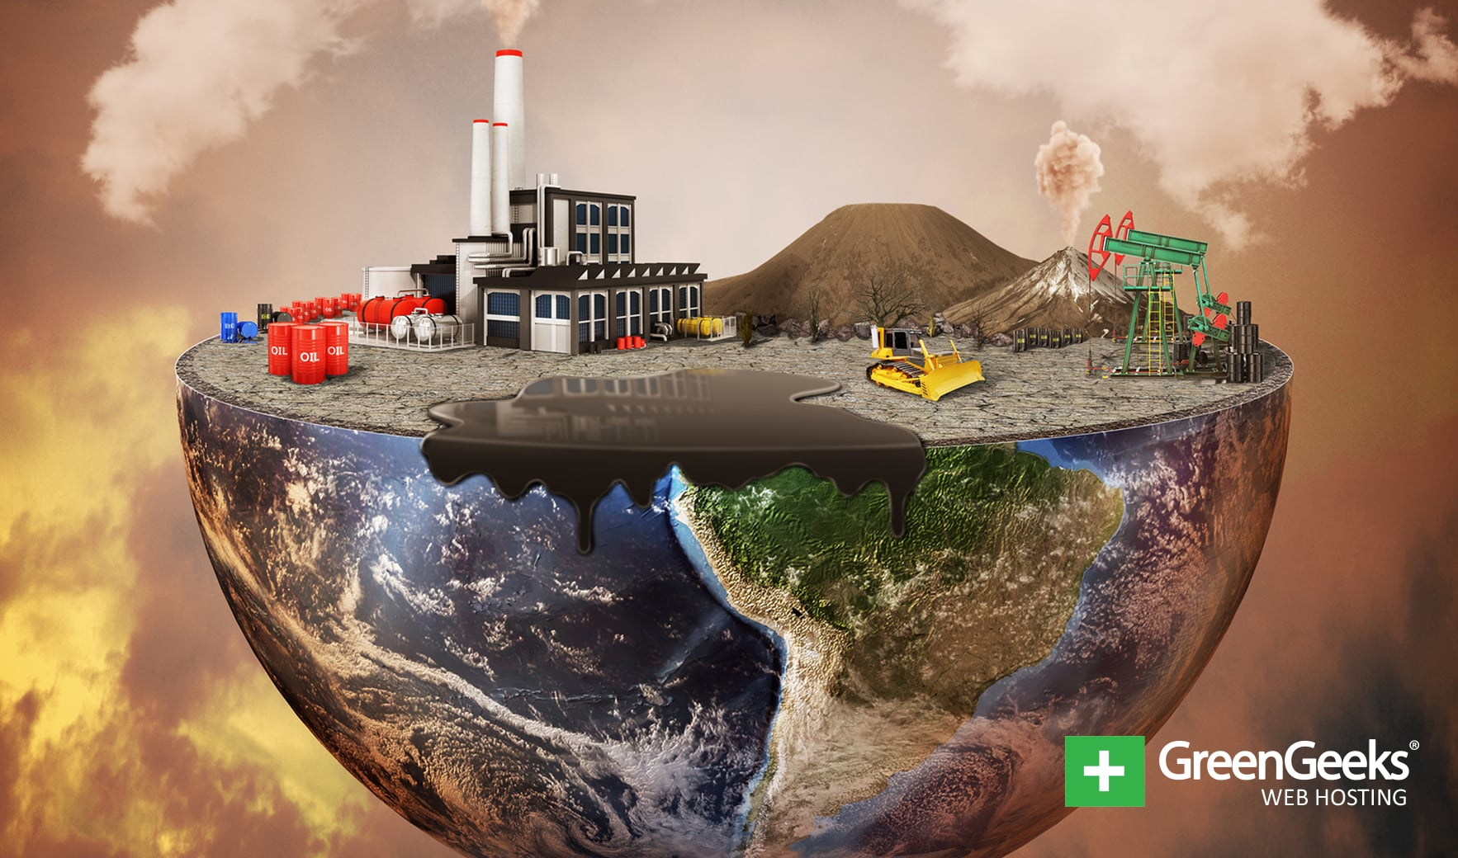
1.Economic Impact: Infrastructure Damage: Severe weather events and rising sea levels resulting from climate change can damage infrastructure, such as roads, bridges, and coastal properties. Repairing and adapting infrastructure can be costly. Health Care Costs: Poor air quality caused by CO2 emissions can increase healthcare costs due to more cases of respiratory diseases and other health issues.
2.Environmental Impact:
Climate Change: Excess CO2 emissions contribute to global climate change by trapping heat in the Earth's atmosphere. This leads to rising temperatures, more frequent and severe weather events, and disruptions in ecosystems and biodiversity.
Air Quality: CO2 emissions often accompany other pollutants, leading to poor air quality, which can harm human health and the environment. This includes respiratory problems, smog formation, and acid rain.

Slide 24
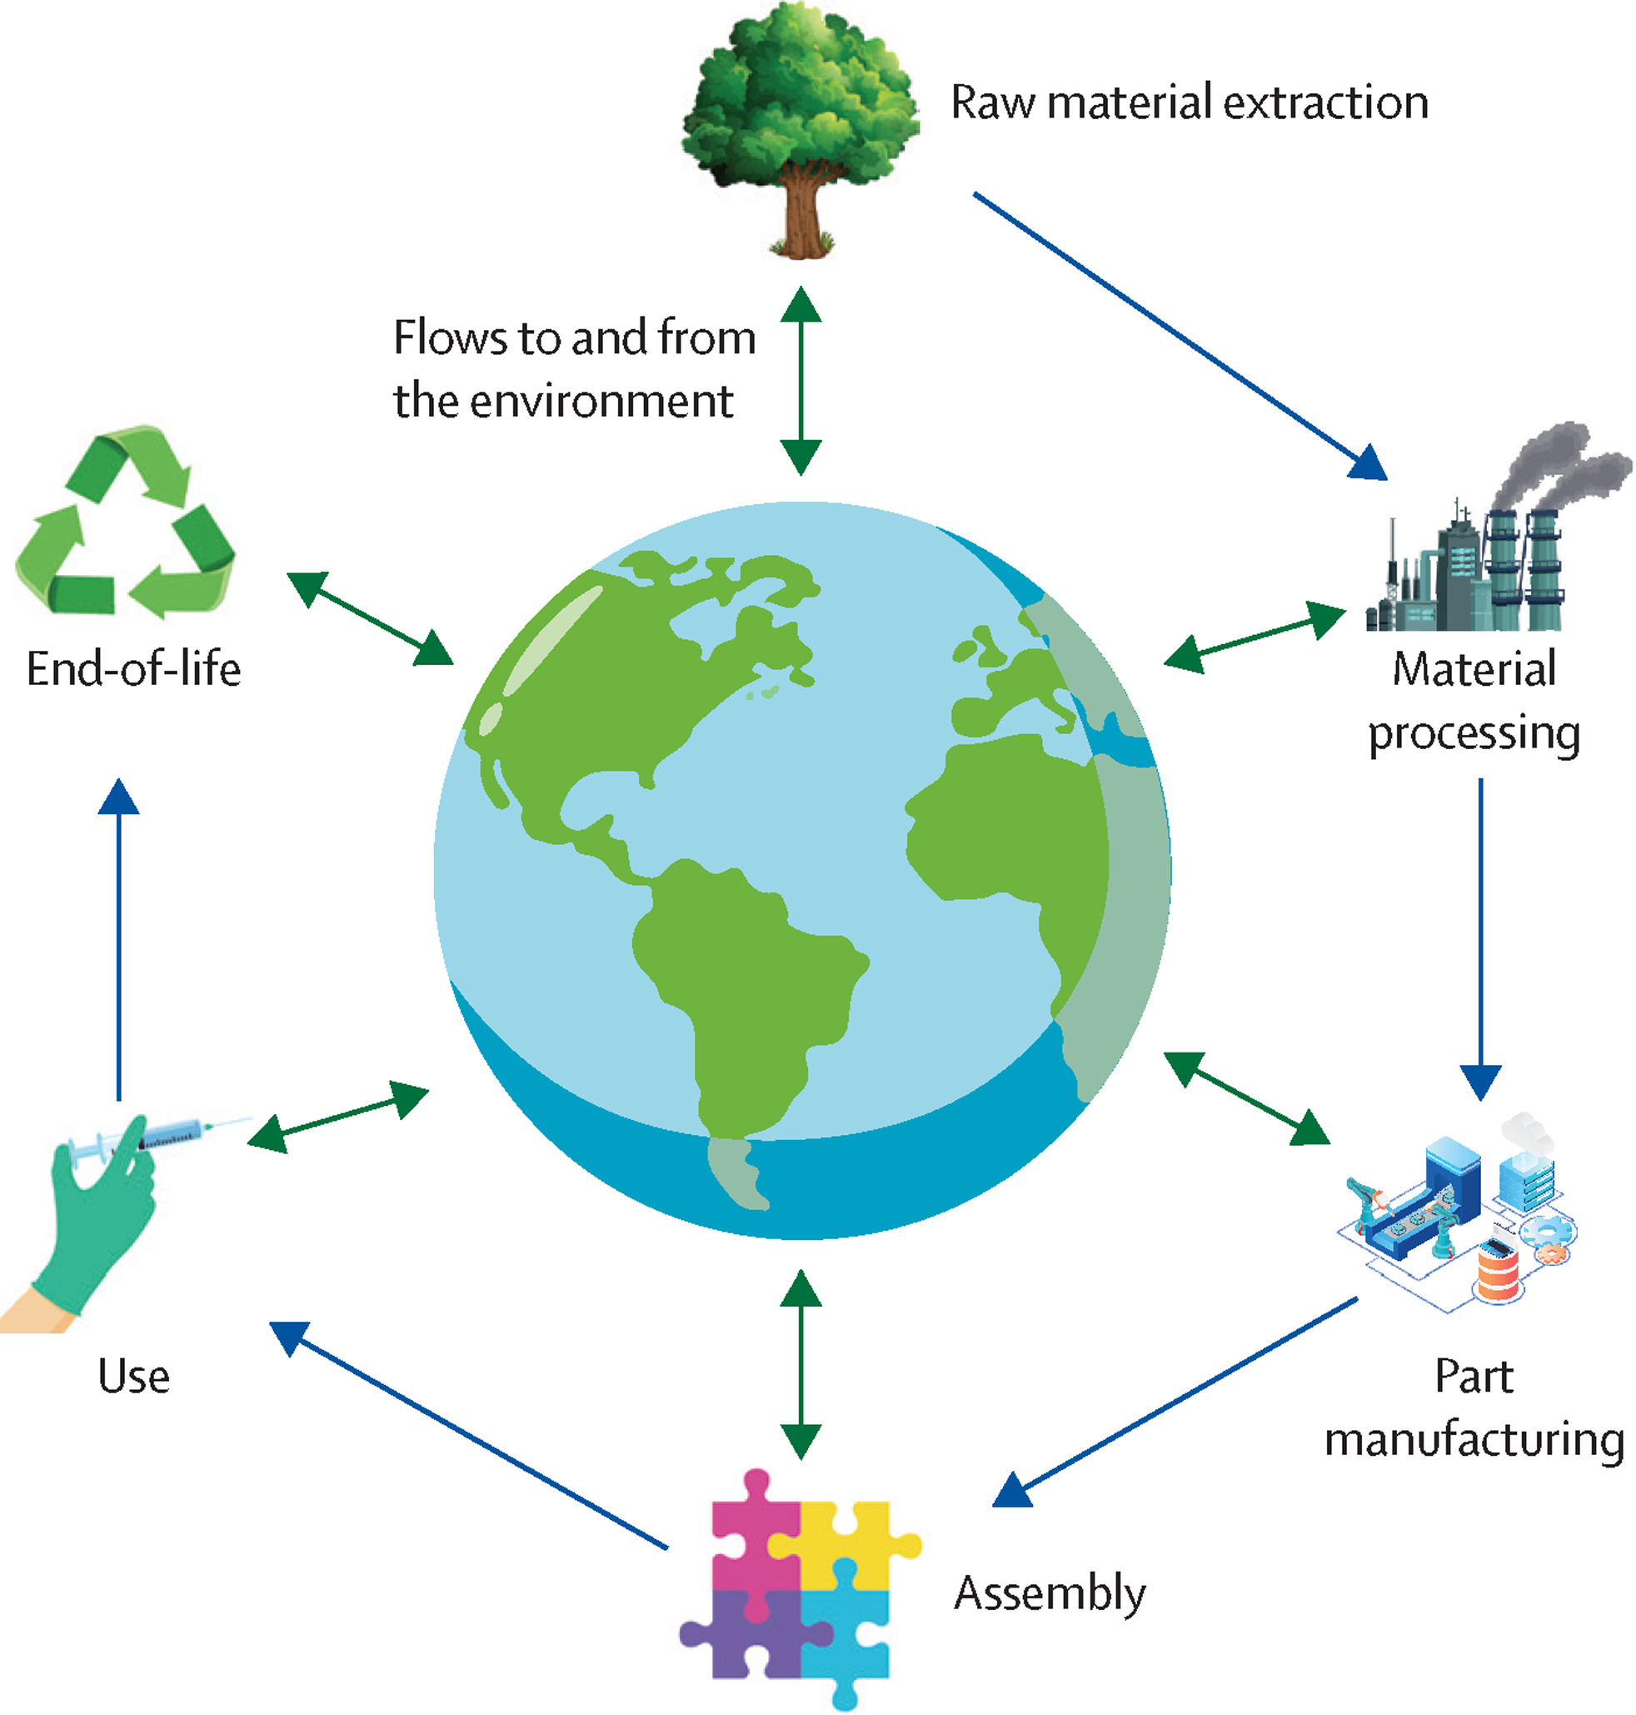
3. Social Impact:
Health: Poor air quality resulting from CO2 emissions can lead to respiratory problems, cardiovascular diseases, and heat-related illnesses, disproportionately affecting vulnerable populations.
Displacement: Climate change impacts, such as sea-level rise and extreme weather events, can displace communities and create climate refugees.
Environmental Justice: Low-income communities and communities of color often bear a disproportionate burden of environmental impacts, including CO2 emissions, due to the location of polluting industries and limited access to resources.
4. National Security:
Climate change can exacerbate existing conflicts and create new ones, as resource scarcity and environmental stress can lead to instability and displacement, affecting global security.

Slide 25
Conclusions
Resource Depletion: Large carbon footprints, whether on a country-wide scale due to activities like deforestation or on an individual level through increased use of resources like air conditioning, can deplete natural resources. Deforestation, for example, leads to the loss of vital ecosystems and biodiversity, while increased use of air conditioning contributes to higher energy consumption.
Greenhouse Gas Emissions: The release of greenhouse gases, such as carbon dioxide (CO2), methane (CH4), and nitrous oxide (N2O), is a direct consequence of human activities. These emissions result from burning fossil fuels, deforestation, industrial processes, and other human-driven actions.
Climate Change: Increased greenhouse gas emissions contribute to climate change by trapping heat in the Earth's atmosphere. This leads to global warming, shifts in weather patterns, more frequent and severe weather events, and disruptions to ecosystems and biodiversity. Climate change poses serious challenges for human societies, the environment, and the economy.
Carbon Footprint: A person's carbon footprint measures the amount of greenhouse gases they are responsible for producing through their daily activities, including energy consumption, transportation, and lifestyle choices. Reducing one's carbon footprint is essential in mitigating the impacts of climate change.
Human Contribution to Greenhouse Gas Emissions: While greenhouse gases do occur naturally, human activities significantly increase their presence in the atmosphere. The burning of fossil fuels for energy and transportation, deforestation, industrial processes, and agricultural practices all contribute to these emissions.

Slide 26
Thank you

