Slide 1
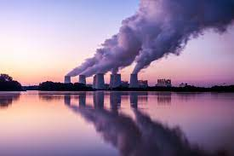
Carbon Emissions Across the United States
Team Members: Supriya Vadakkeveetil, Riptapan Singh Johal, and Garrett Stiehl

Slide 2
Project Introduction
The project on Carbon emissions across United States aims to perform an Exploratory Data Analysis to investigate the Carbon Emissions in United States, focusing mainly on region wise analysis and the contributors for Carbon Emissions.
We will be exploring public datasets, employ data analysis methods to dig deeper into the environmental impact and mainly its impact on health of people in United states.
The motivation for this project comes from the desire to understand the challenges to the environment caused by carbon emissions and the sustainability initiatives being undertaken to curb these emissions.

Slide 3
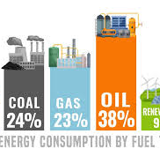
What Are Carbon Emissions?
Carbon emissions are by products of numerous actions humans have done to advance. These actions include the burning of fossil fuels for energy and manufacturing material, machines, and buildings.
Fossil fuels including gas, oil, and coal are the leading sources for producing usable energy that power our world.
These fuels are responsible for nearly 90 percent of all carbon emissions worldwide.
Source: https://www.un.org/en/climatechange/science/causes-effects-climate-change#:~:text=Fossil%20fuels%20–%20coal%2C%20oil%20and,of%20all%20carbon%20dioxide%20emissions.

Slide 4
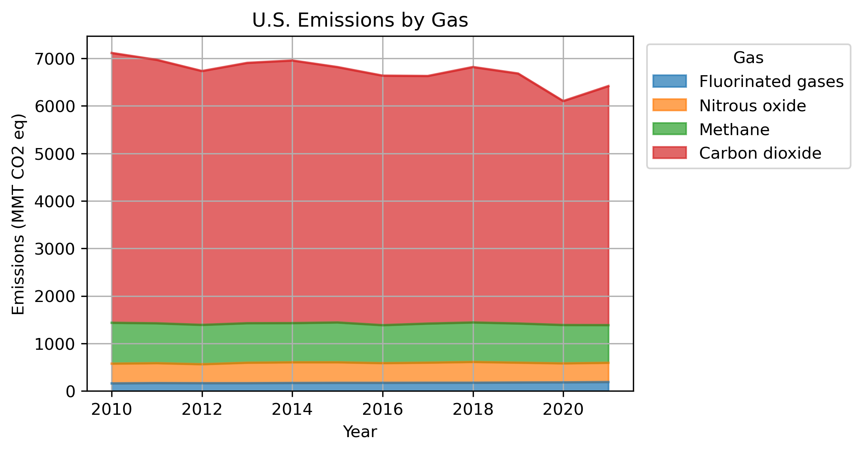
Burning fossil fuels is what releases these various gases into our atmosphere, causing an increase atmospheric temperature and pollution.

Slide 5

Research Questions
What are the overall trends in CO2 emissions across the United States over the past decade?
What part of the overall Greenhouse gasses Gas emissions are CO2?
How do these emissions vary across the country?
What are the factors contributing to these disparities?
What are the major sectors or activities contributing to these emissions?

Slide 6
Research Data
We have taken data through a variety of valuable resources including,
US EPA (Environmental Protection Agency) – Data (Historical) on the Greenhouse gas emissions in the United States
US EIA (Energy Information Administration) – Data on State level emissions, Energy production and Electricity Generation Source.
The Dataset comprises of detailed Co2 emissions across different sectors including Transportation, Electric Power, Industrial Sectors, and others. The data spans a timeline from 2010 to 2021 covering both national and state-level analysis. 1. US EPA (Environmental Protection Agency – Data (Historical) on the Greenhouse gas emissions in the United States. 2. US EIA (Energy Information Administration) – Data on State level emissions, Energy production and Electricity Generation Source.

Slide 7
Data Exploration, Cleanup, and Visualization
Import Libraries (Pandas, Matplotlib etc.)
Load Data into the Data Frame
Preliminary Data Examination
Data Cleaning
Handling missing values
Checking for duplicates
Removal on unnecessary data
Quality check on data
Data Visualization

Slide 8
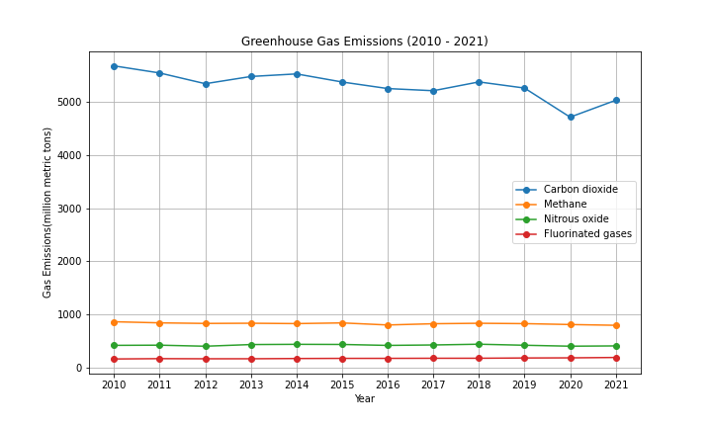
Emission Types
Carbon dioxide consistently sits nearly five times higher than methane, nitrous oxide, or fluorinated gases.

Slide 9
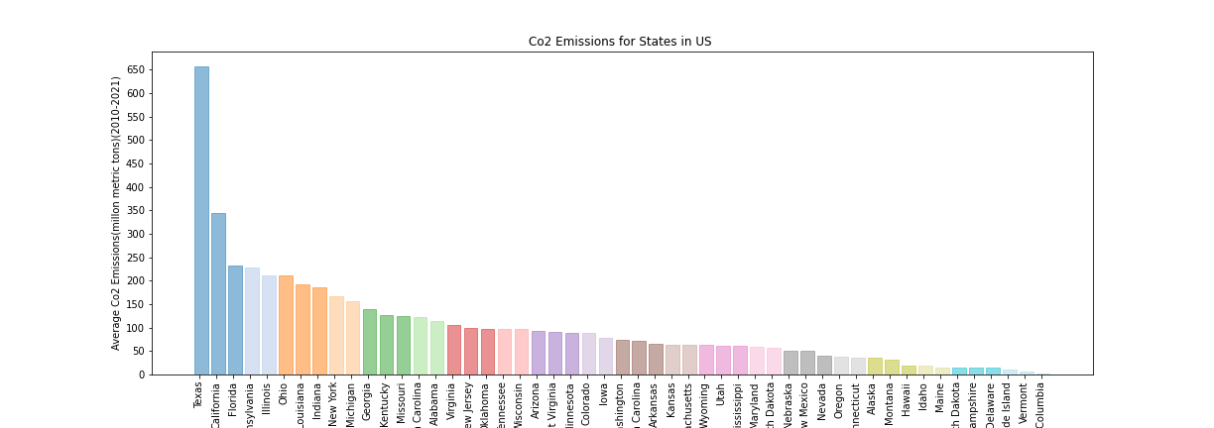
Co2 Emissions for States in the US
Texas and California, two of the largest states in the US, are the two highest producers of Co2 Emissions, followed by Florida, Pennsylvania, Illinois, and Ohio
Texas’ emissions are significantly higher than any other state

Slide 10
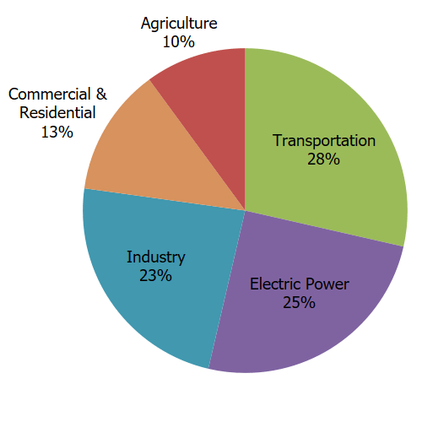
United States Sectors
Sectors are areas of the economy in which business share the same or a related product or service.
The top energy sectors in America include
- Transportation
- Electrical Power Industry
- Industry
- Agricultural and more
These sectors all rely on various forms of fossil fuels (carbon emissions) to produce goods and services.
https://www.epa.gov/ghgemissions/sources-greenhouse-gas-emissions

Slide 11
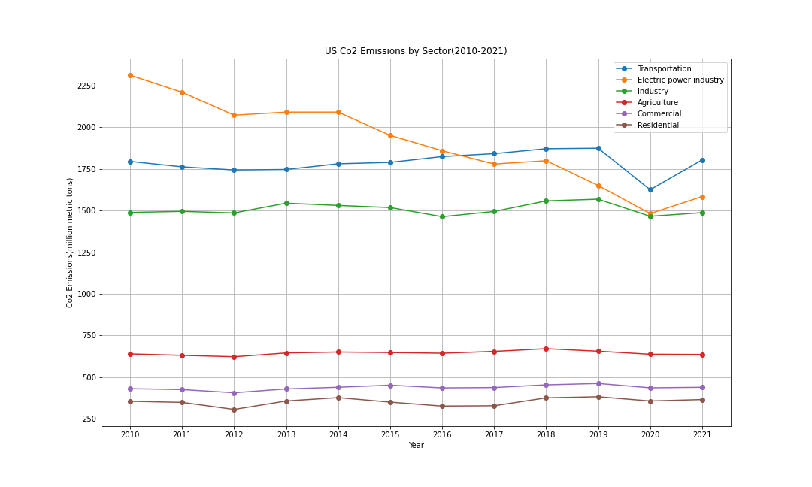
Emissions By Sector
Electric power industry, transportation, and industry sectors have remained the three highest producers of Co2 emissions
In recent years, the top three producers have decreased emissions to be between 1500 to approximately 1800 mmt
A significant gap has remained between the top three producers and the bottom three, with nearly a 3500 mmt difference

Slide 12
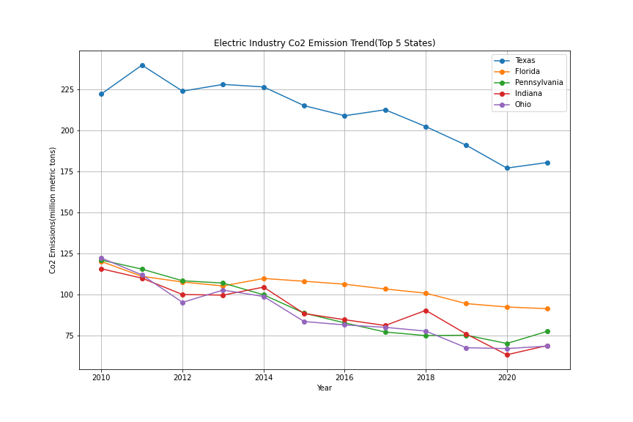
Electric CO2 Emissions
Texas’ electric industry Co2 emissions is around 100 mmt more than four out of the top five Co2 producing states
There has been a gradual downward trend in all five of the top five Co2 producing states in the last 10 years

Slide 13
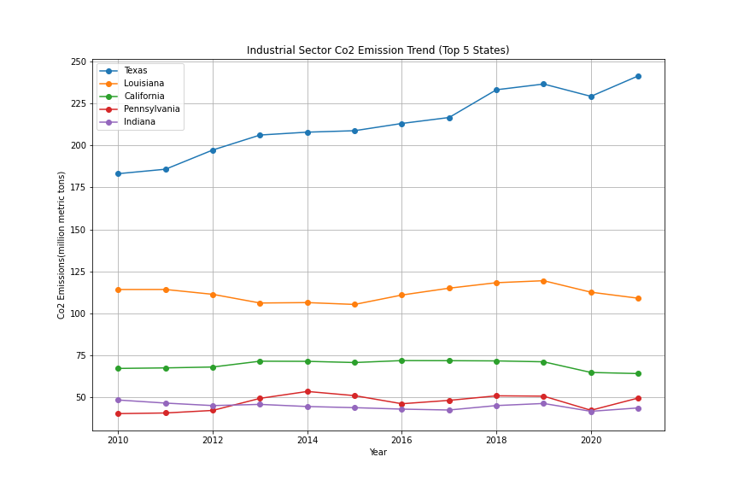
Industrial CO2
Texas’ industrial sector is also the highest contributor among the top five states
Texas also displays a gradual upward trend in industrial Co2 emissions, whereas other states remain steady
Texas currently sits above 225 mmt, whereas the other four states are all below 125 mmt

Slide 14
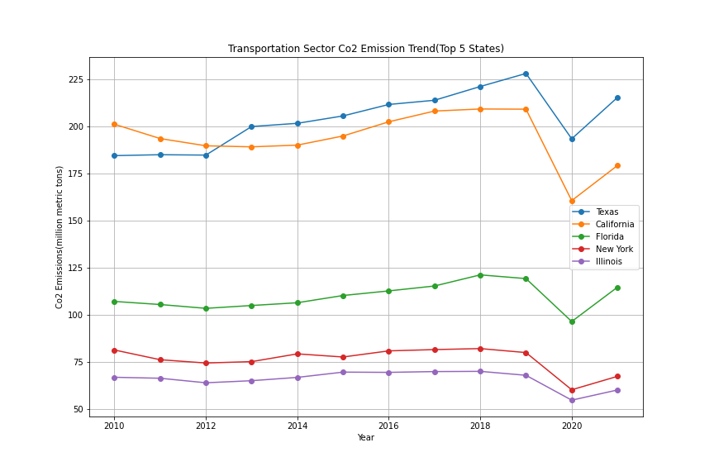
Transportation CO2
The top five Co2 producers change for the transportation sector, with Texas being the only to remain
Texas and California are the highest Co2 contributors in the transportation sector and both follow similar trends over the past 10 years
All five states experiences a sharp rise in emissions after 2020

Slide 15

Lets Look at the Top State Contributors

Slide 16
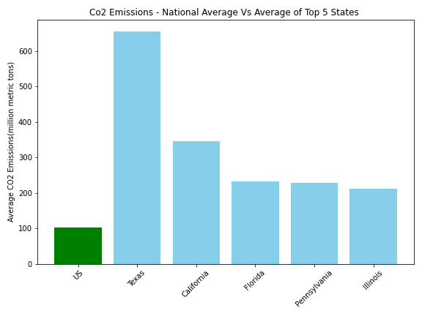
National VS State
The national average of CO2 emissions is minimal compared to the top 5 producing states.
Texas, California, Florida, Pennsylvania and Illinois are the leading states in CO2 emissions.
The gap between the leading state, Texas, and California in CO2 emissions accurately show the difference between California's push to quadruple clean energy production while Texas so no current goals.
Source: https://calmatters.org/environment/2023/01/california-electric-cars-grid/#:~:text=A%20new%20state%20mandate%20requires,to%20the%20California%20Energy%20Commission.

Slide 17
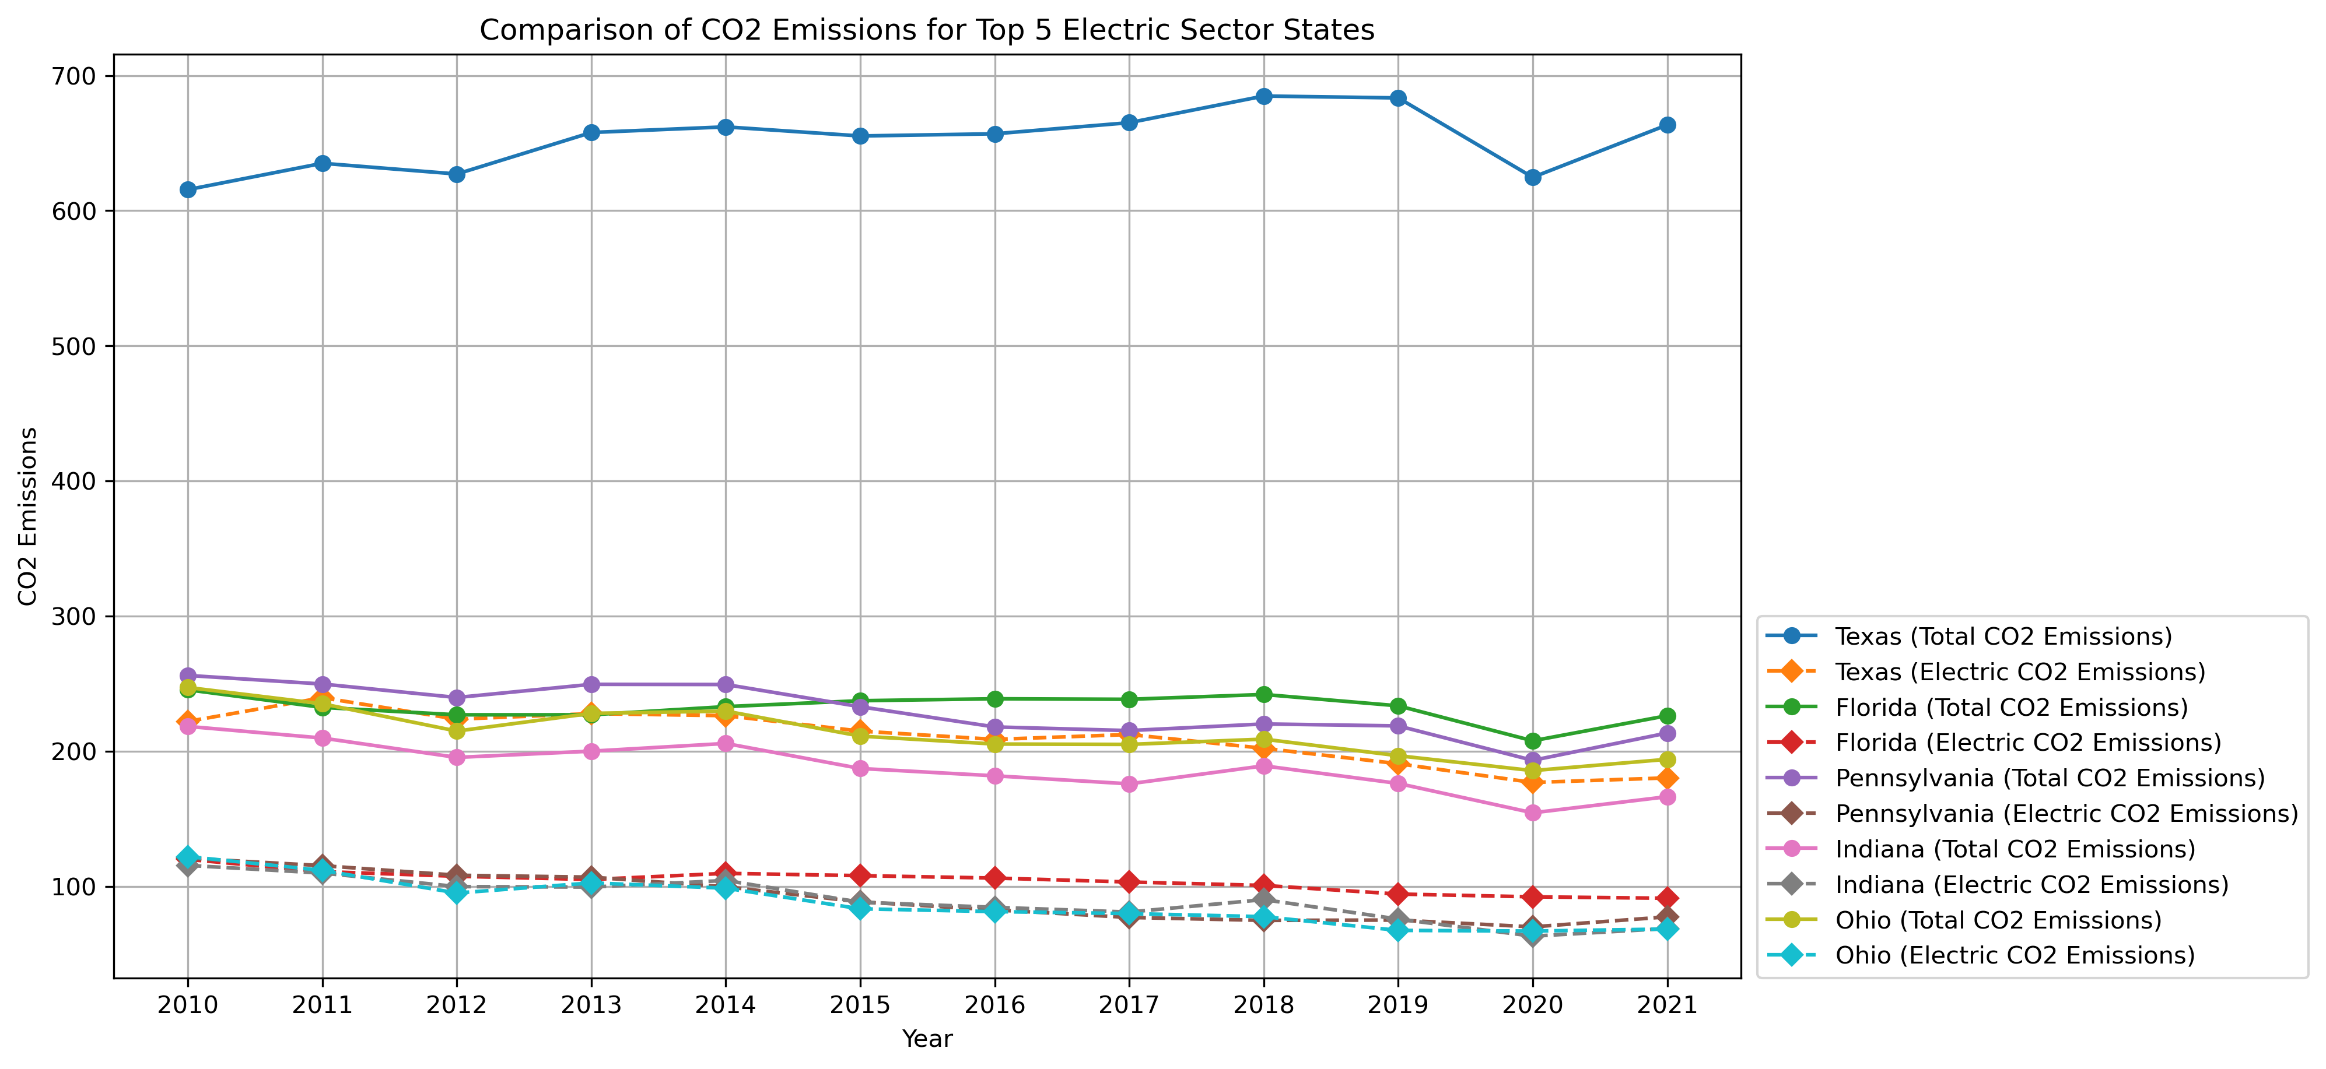
Comparison of CO2 Emissions for Top 5 Electric Sector States
CO2 emissions produced by electric have a minimal contribution to each states average CO2 emission total.
Electric produces the least amount of emissions. This is due to the fact that electric requires very little fossil fuels to produce great amounts of electrical energy compared to other forms of energy.

Slide 18
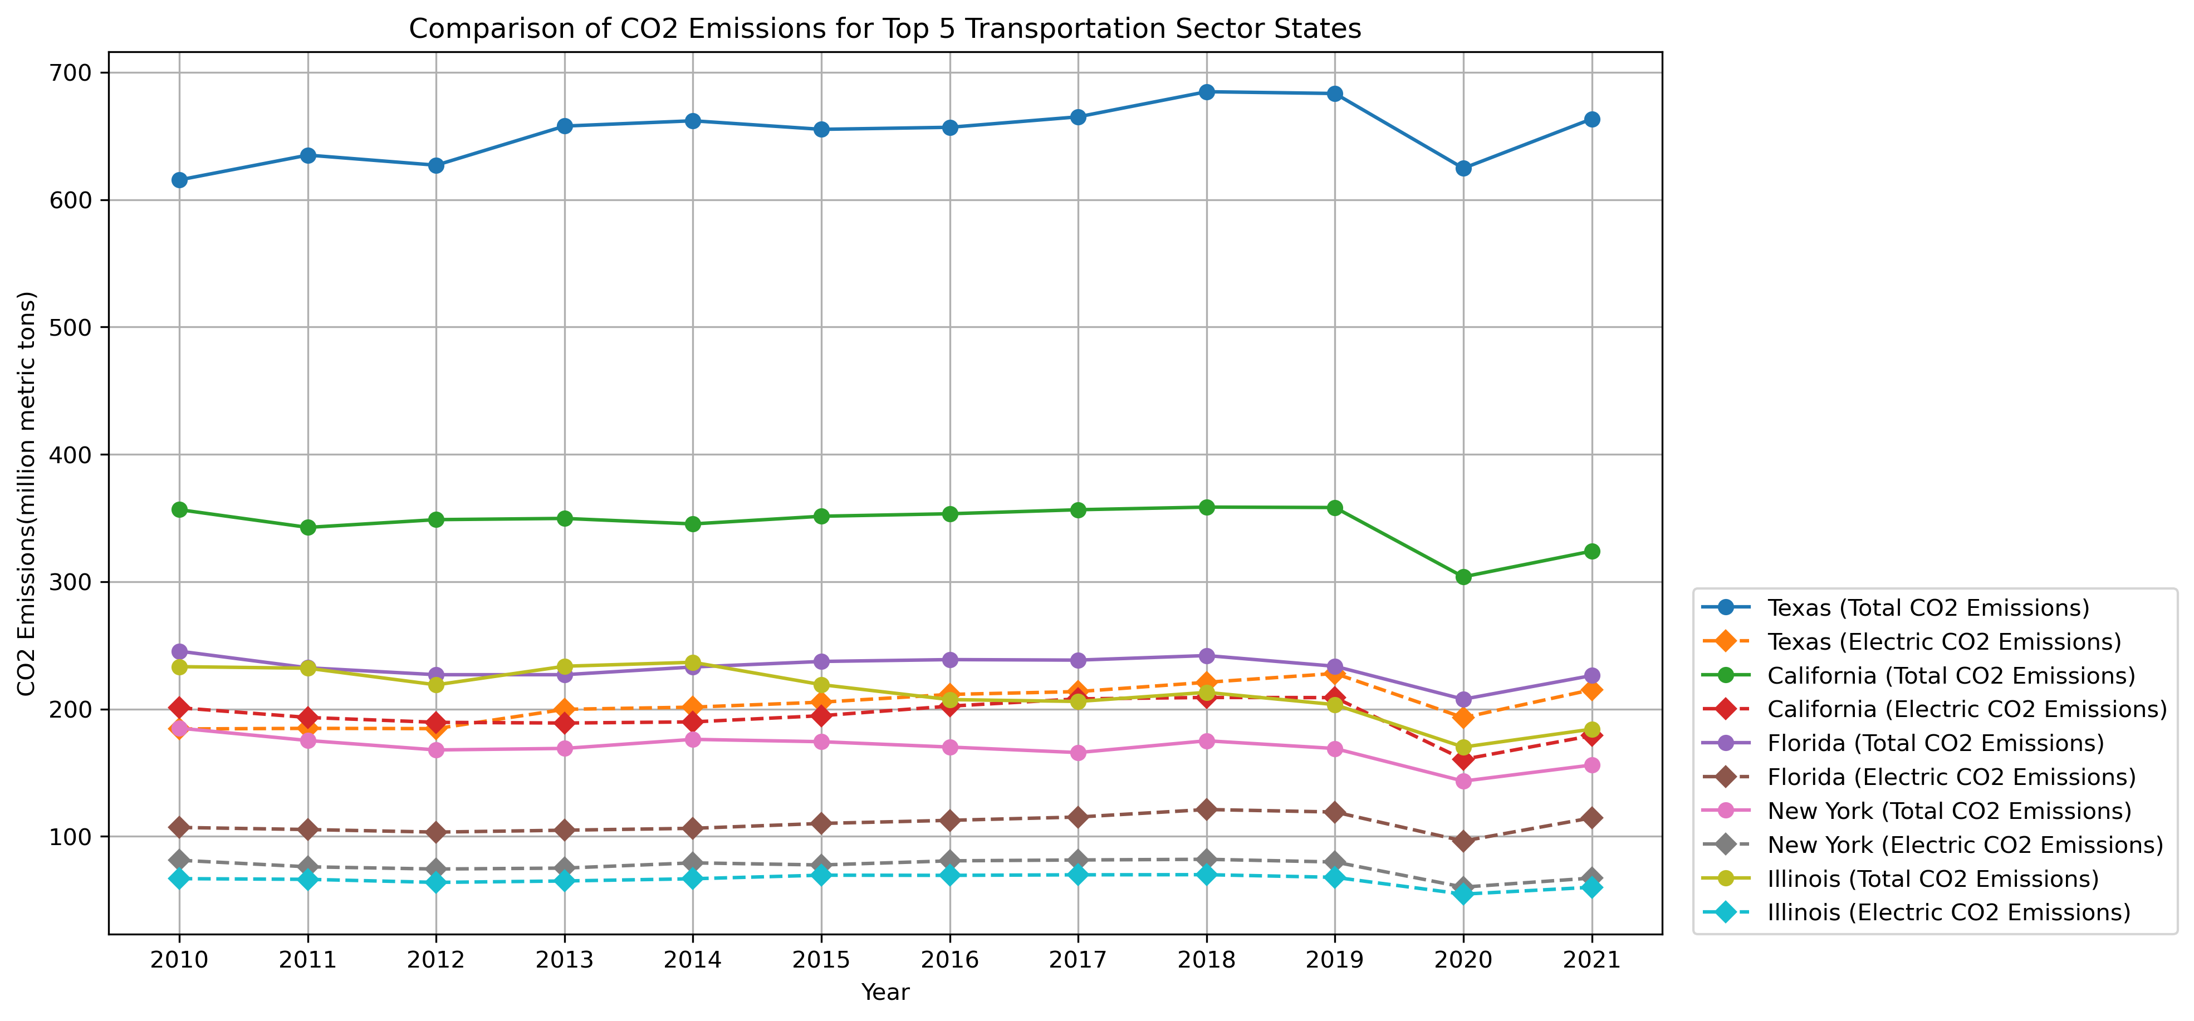
Top 5 Transportation CO2 States
Texas and California are still the leaders in the CO2 emission production but, even still, electrical transportation produces less CO2 emissions.

Slide 19
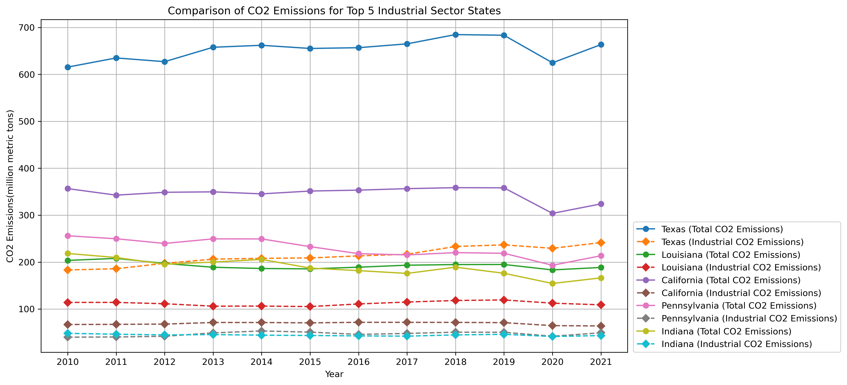
Top 5 Industrial CO2 States
Texas is the leading state in Industrial CO2 emissions.
While California’s average CO2 emissions is ranked 2nd, the same is not true for their Industrial emissions.
This is related to California’s goal to go electric over the years. Industrial tasks that usually require gas and oil California is working to make it electric.

Slide 20
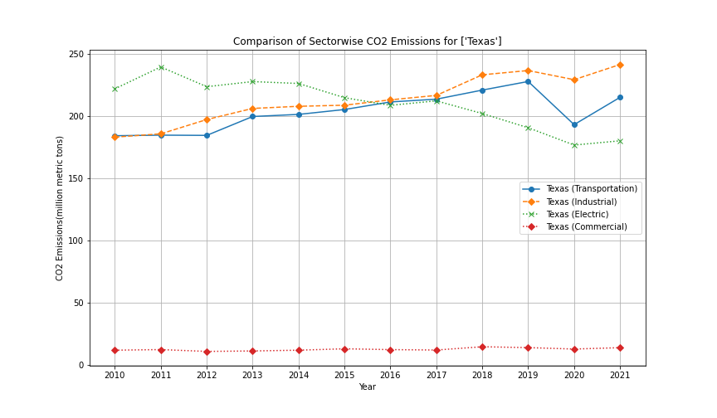
Deeper Dive Into Texas
Although Texas seems to be a powerhouse in CO2 emissions they did experience a decline in emissions.
From 2019 to 2020 Texas experienced a sudden decrease in all sectors CO2 emissions.
But why?

Slide 21
Impacts Analysis

Slide 22
Conclusions

