Slide 1
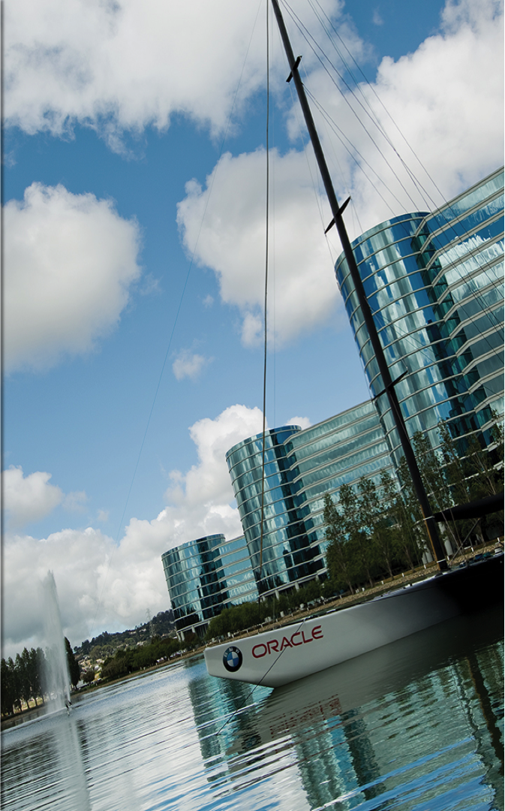
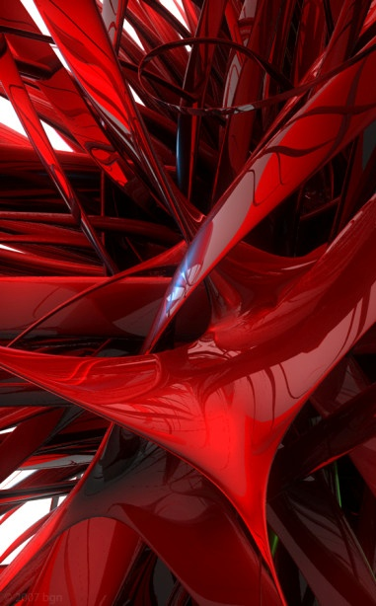
Docker
Introduction to Docker

Slide 2
Agenda
What is Docker
Docker Architecture
Container & images
Container Vs Vms
Deep Dive
Docker in a nutshell
Useful Commands
Links
Q&A

Slide 3
What is Docker
Docker is an open-source project that automates the deployment of applications inside software containers, by providing an additional layer of abstraction and automation of operating system–level virtualization on Linux.

Slide 4
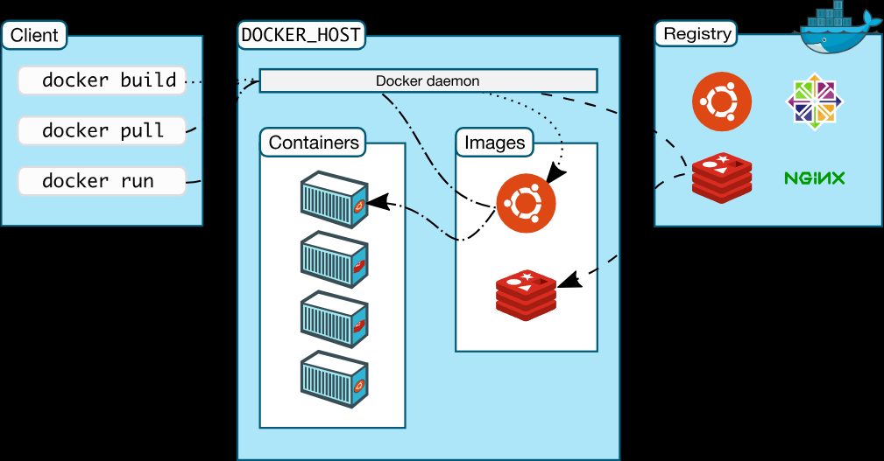
Docker Architecture

Slide 5
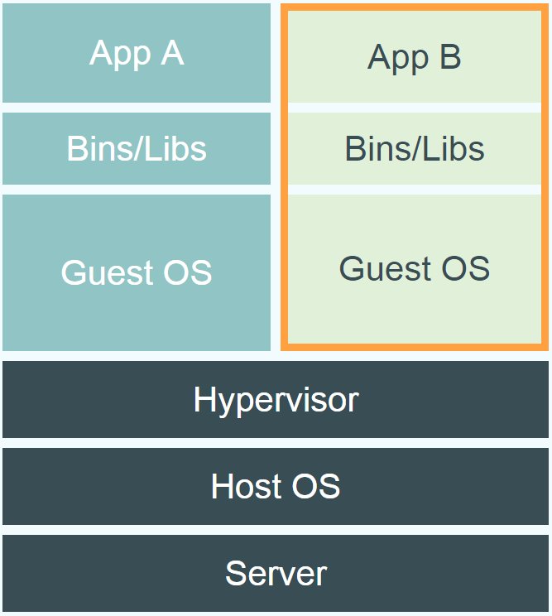
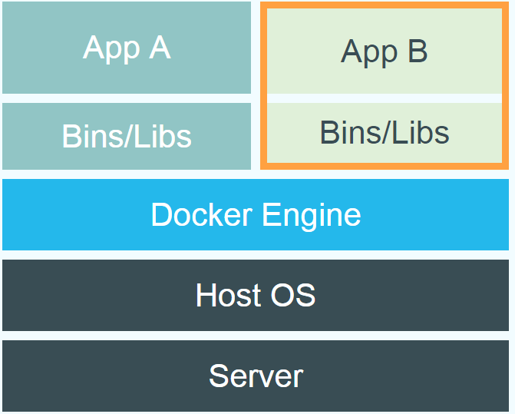
Docker vs. Virtual Machine

Slide 6
Docker Workflow
Everything starts with the Dockerfile. The Dockerfile is the source code of the Image.
Once the Dockerfile is created, you build it to create the image of the container. The image is just the "compiled version" of the "source code" which is the Dockerfile.
Once you have the image of the container, you should redistribute it using the registry. The registry is like a git repository -- you can push and pull images.
Next, you can use the image to run containers. A running container is very similar, in many aspects, to a virtual machine (but without the hypervisor).

Slide 7
Docker in a Nutshell

Slide 8
Useful Commands
docker images - List all the images in the Docker machine
docker pull - pull the image from Docker Hub registry.
docker ps - Lists running containers.
docker run - Run a docker container based on an image
docker build - The docker build command builds Docker images from a Dockerfile
docker logs - Use this command to display the logs of a container
docker volume ls - This lists the volumes
docker rm - Removes containers
docker rmi - Removes images. docker rmi my_image
docker kill $(docker ps -q) - kill all running containers with docker
docker rm $(docker ps -a -q) - delete all stopped containers
docker rmi $(docker images -q) - delete all images

Slide 9
Useful links
Docker homepage: https://www.docker.com/
Introduction: https://www.docker.com/whatisdocker/
Online tutorial: https://www.docker.com/tryit/
Installation and user guide: https://docs.docker.com/

