Slide 1
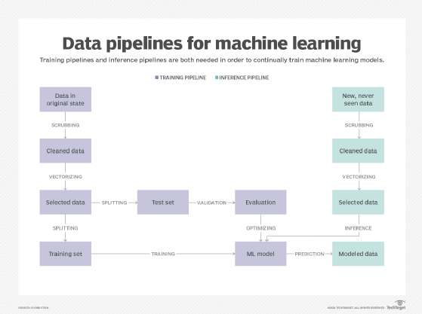
Recommender System Data Pipeline

Slide 2
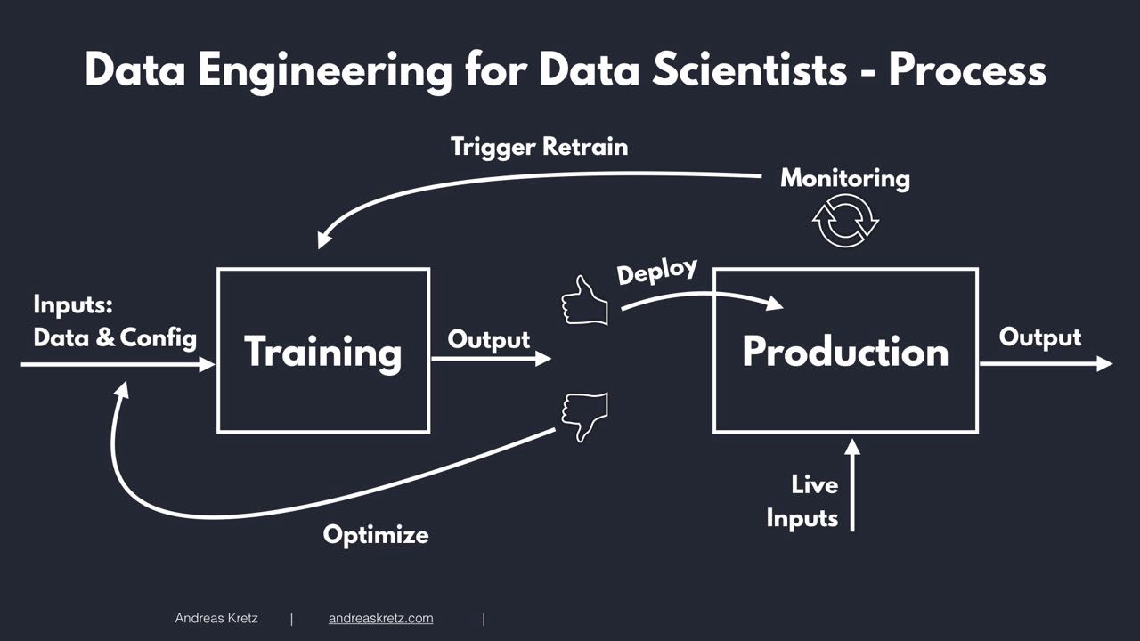

Slide 3
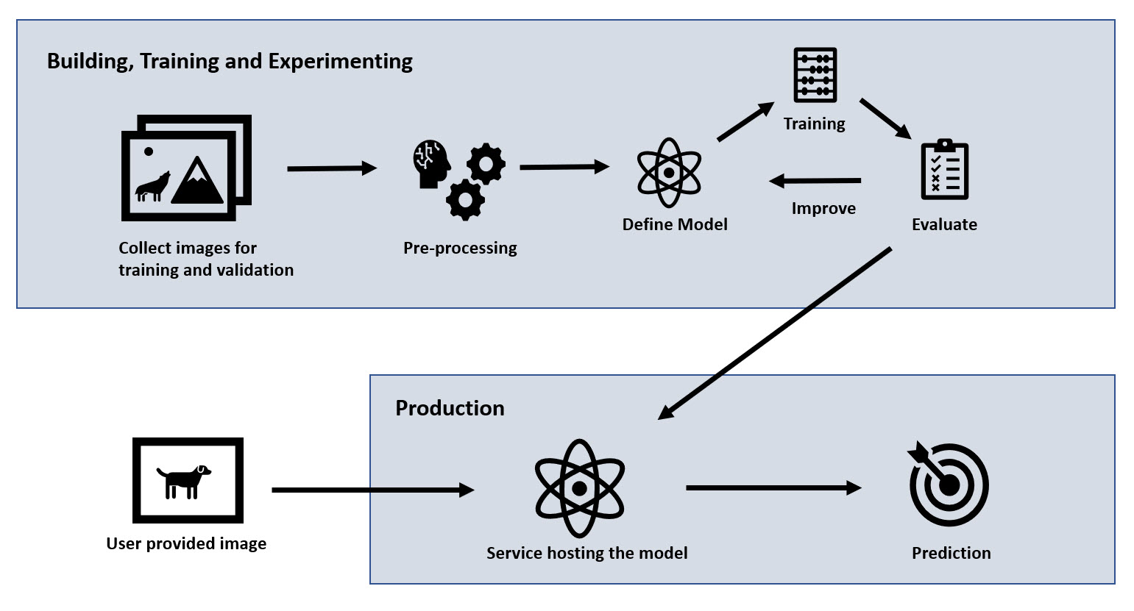

Slide 4
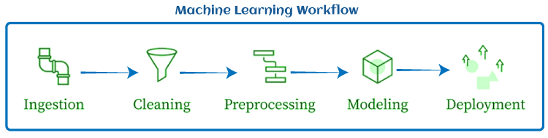

Slide 5
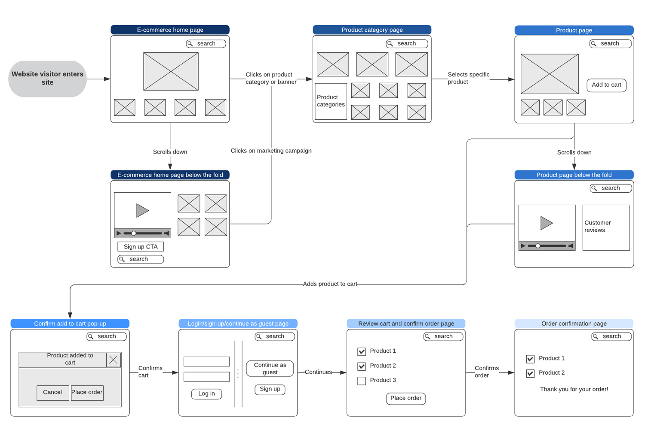

Slide 6


Machine Learning Model Workflow
Retrain
Monitoring
Deploy
Inputs:
Data & Config
Output
Output
Training
Production
Live
Inputs
Optimise

Slide 7




Historical data
Random Forest Model
Trained
Model
Wristband data
K-means Clustering
Model
Historical data
Trained
Model

