Slide 1
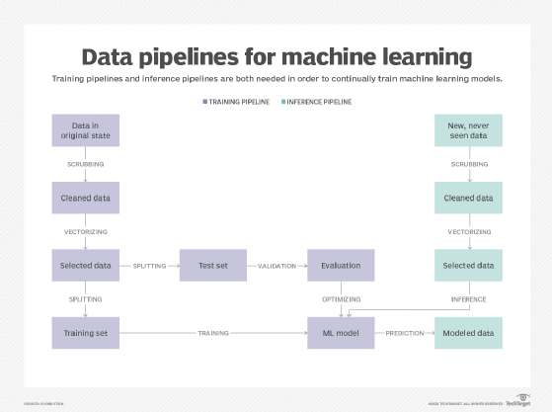
Recommender System Data Pipeline

