Slide 1


Team Details · Project: Ananta – Adaptive AI Tutor
  Team name: [Add team name as registered on Hack2skill]
  Team leader name: Suri [add full name as registered]
  Problem Statement: Media, Content & Digital Experiences (education) – an AI tutor that checks how a child reasons, not just whether the answer is right, and backs every mastery claim with evidence.

Slide 2
Brief about the idea
A voice-first AI tutor that checks how a child thinks, not just what they answer.
The problem
The idea
Where it stands
• Children often don't ask in class: embarrassment, not knowing what to ask, fear of looking slow.
• A teacher cannot give every child unlimited, individual explanations.
• Quiz software only marks right or wrong, so a right answer from a wrong method counts as mastery.
• A judgment-free voice tutor teaches from the child's own textbook, line by line on a chalkboard.
• After each answer it diagnoses the reasoning, names the likely misconception, and re-teaches a different way.
• Mastery needs evidence of understanding, not one lucky answer.
• Working prototype, deployed on Google Cloud Run, built on Gemini.
• Textbook PDF in, structured curriculum out (concepts, prerequisites, misconceptions).
• Parents see the exact question and answer behind every claim. Built to work alongside teachers, not replace them.
Central principle: optimise for “the child understands it and can apply it”, not for “the AI answered the question”.

Slide 3
Opportunities
Most tutors answer questions. Ananta tests whether the child understands the answer.
How different is it from existing ideas?
How will it solve the problem?
USP of the proposed solution
• Chatbot tutors respond to questions; quiz apps check answers. Neither questions a correct answer.
• Ananta asks the child to explain, then classifies the reasoning against a closed catalogue of misconceptions taken from the textbook.
• A plain prompt to Gemini scored 9/10 on our hidden-misconception cases; the Ananta assessor scored 10/10 (small test, see slide 12).
• Private, unlimited, judgment-free asking by voice. One tap says “I don't get it”, “Another way”, “Too fast” or “I guessed”.
• Loop: teach, ask, diagnose, adapt, re-assess, record. The tutor switches representation (real-world, shape, 3D, chalkboard) using what has worked for this child.
• Never gives up: if a child is stuck it pivots to a worked example.
• Evidence-gated mastery: Bayesian Knowledge Tracing, plus at least two demonstrations of understanding.
• A deterministic teaching-plan compiler decides what to teach next, so planning is auditable, not hallucinated.
• Parent “See why” replay: the exact question, the child's own words, and how it was diagnosed.

Slide 4
List of features offered by the solution
Eight capabilities, each one visible in the live prototype.
Voice-guided chalkboard lesson
Gemini Live teaches by voice while one board fills line by line with chalk marks. Questions are written on the board first.
Reasoning diagnosis
Every answer is classed: clear reasoning, right answer / broken method, wrong, too thin, or none. Runs async, so the voice never waits.
Misconception ledger
Suspected, then confirmed after two independent observations, then resolved only by a sound transfer answer.
Adaptive re-teaching
Representation order ranked per child from what worked before: real-world, shape, 3D or chalkboard. Pace: slow, steady, quick.
Evidence-gated mastery
Bayesian Knowledge Tracing. Mastery needs pKnown of at least 0.80 and two level-3 demonstrations. A bare quiz click is capped at “recognised”.
Textbook PDF to curriculum
Upload via Files API. Gemini extracts concepts, prerequisites, worked examples and known misconceptions. Admin library included.
Quality-gated content
Lints, then an independent critic model, then repair. Anything that still fails is quarantined and never shown to a child.
Parent view
Plain-language report, misconception ledger, home activity, and “See why” evidence replay. Each sentence is checked against the child's real answers.

Slide 5
Process flow diagram or Use-case diagram
Content is prepared once; every live answer is diagnosed and fed back.
A. Before the lesson (once per textbook)
Upload textbook PDF + syllabus
Admin library
Gemini extracts curriculum
Concepts, prerequisites, misconceptions
Generate lessons + visuals
Chalkboard script, diagrams, photos
Critic review + lints
Fail = quarantine, never served
B. During the lesson (every answer)
Compile teaching plan
Deterministic rules from the child's history
Tutor teaches by voice
Board fills line by line
Child answers aloud
Or taps: not sure, another way
Diagnose reasoning
Gemini Flash, closed catalogue
Update mastery + ledger
BKT, evidence event saved
Loop: next move chosen from the evidence: probe a prerequisite, re-teach with a different representation, ask a transfer question, or advance. Then back to the plan.
C. After the session A profiler (Gemini Flash) proposes claims about the child. Deterministic code accepts only claims backed by the child's own evidence. The Parent View shows them with a “See why” replay.

Slide 6
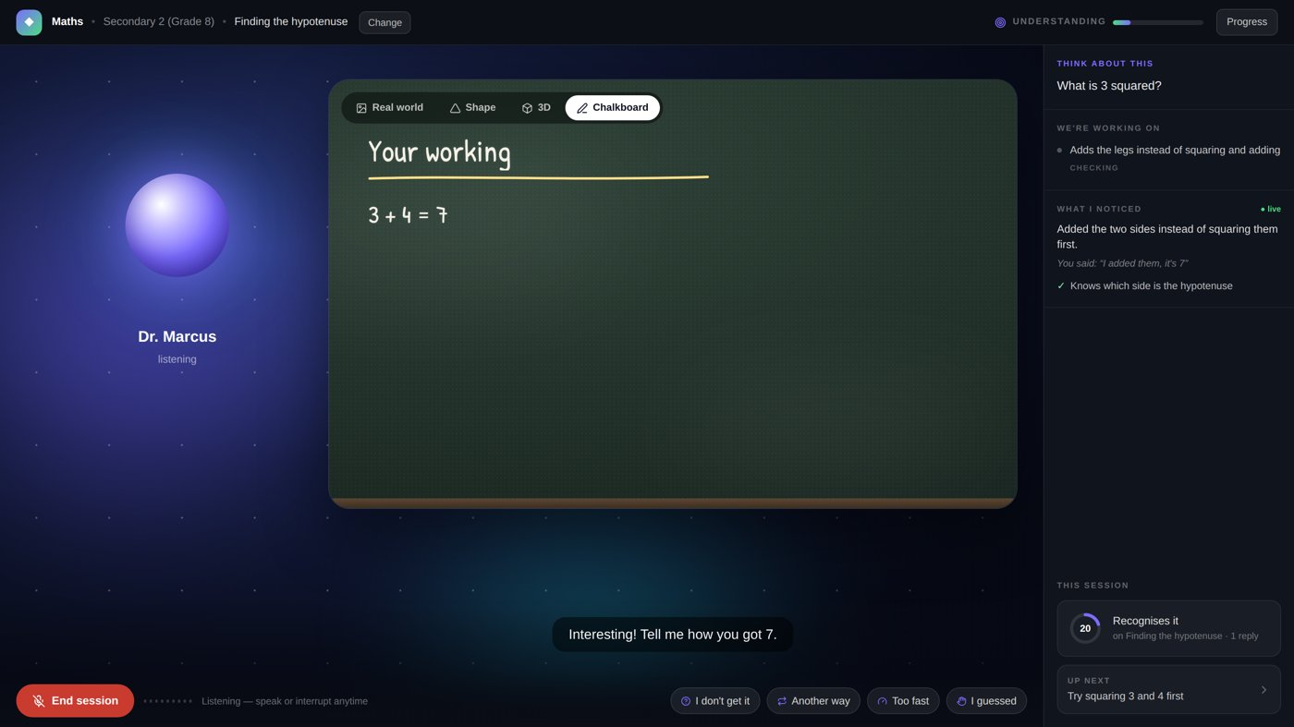
Wireframes/Mock diagrams of the proposed solution (optional)
The learning screen: what the child sees while the tutor diagnoses.
1
Chalkboard
Tutor writes while it speaks. Tabs switch representation: Real world, Shape, 3D, Chalkboard.
4
2
1
2
Think about this
Questions are asked on the right, answered by voice or tap.
3
3
We're working on
Live misconception card: confirmed, probing or resolved.
4
Understanding meter
Mastery shown as evidence-based levels, not a score.
5
Confusion buttons
I don't get it, Another way, Too fast, I guessed.
5
Parent Portal and Admin Library are separate screens reached from the start page.

Slide 7
Architecture diagram of the proposed solution
Gemini does the language work; deterministic code makes the decisions.
Browser
React + Vite app
Guided chalkboard, SVG + Three.js visuals
Mic in / audio out (PCM)
Parent View, Admin Library
Cloud Run: Node / Express (REST + /ws/live)
Google AI and Cloud services
Persona composer + Teaching Plan compiler
Deterministic: no model decides what to teach
Gemini Live
Real-time voice tutoring + function calling
Gemini Flash / Flash-Lite
Assessor, profiler, lesson + curriculum generation, critic
Guided session + tool dispatch
Server owns the board; 13 live tools
Gemini Vision + image generation
Photos are reviewed before use
WS
Diagnosis, BKT, misconception ledger
Async; evidence events saved
Files API
Textbook PDF ingestion
Profiler + claim validator
Model proposes, code verifies
Firestore + Cloud Storage
Learners, evidence, plans, curricula, cached lessons, photos
Gemini gateway
Timeouts, structured JSON, fallback cascade, logging
Firebase Auth
Accounts (demo mode skips sign-in)

Slide 8
Technologies to be used in the solution
Google Cloud AI at every layer, in the roles each is best at.
Gemini 3.8 Live
Real-time two-way voice, voice activity detection, 13 function-calling tools for the board, quiz and assessment
Gemini 3.8 Flash
Textbook ingestion (60-page chunks via Files API), lesson generation, session profiler, parent narrative, independent critic
Gemini 3.6 Flash
Per-answer reasoning diagnosis with a time budget
Gemini 3.1 Flash-Lite
Fallback for diagnosis and generation (resilience); used for the evaluation run
Gemini Vision / image
Generates real-world photos; the critic inspects each one before it can be served
Structured outputs
JSON schema on every model call; invalid output is rejected or repaired
Cloud Run
REST + WebSocket proxy + built app on one service; 3600 s timeout, session affinity, scale to zero
Firestore, Storage, Auth
Learner data is server-only (security rules deny client access); photos in Cloud Storage
Application: TypeScript, Node 22, Express, WebSocket, React, Vite, SVG and Three.js visuals, Docker. Built directly on the Google Gen AI SDK; agentic by design (tool calling, shared state in Firestore, multi-model orchestration).

Slide 9
Estimated implementation cost (optional)
Cost is designed in; a measured per-student figure comes from the first billing data.
Scale to zero
Cloud Run charges only while sessions run. Cold start on first request is the trade-off.
Generate once, serve many
Lessons, board pictures and photos are made at upload time, cached in Firestore / Storage and reused by every child.
Cheap model on the hot path
Diagnosis uses a fast Flash model; the profiler runs once per session, not per answer.
Gate before spend
Failed content is quarantined, not regenerated in a live session; repeat photo requests hit the cache.
What we know today
A long textbook is a paid, one-off generation job (several model calls per concept: draft, critic, repair).
Gemini free tier was used for the prototype and has rate limits.
To do: record Cloud Run + Gemini spend over a pilot and report cost per student-hour.

Slide 10
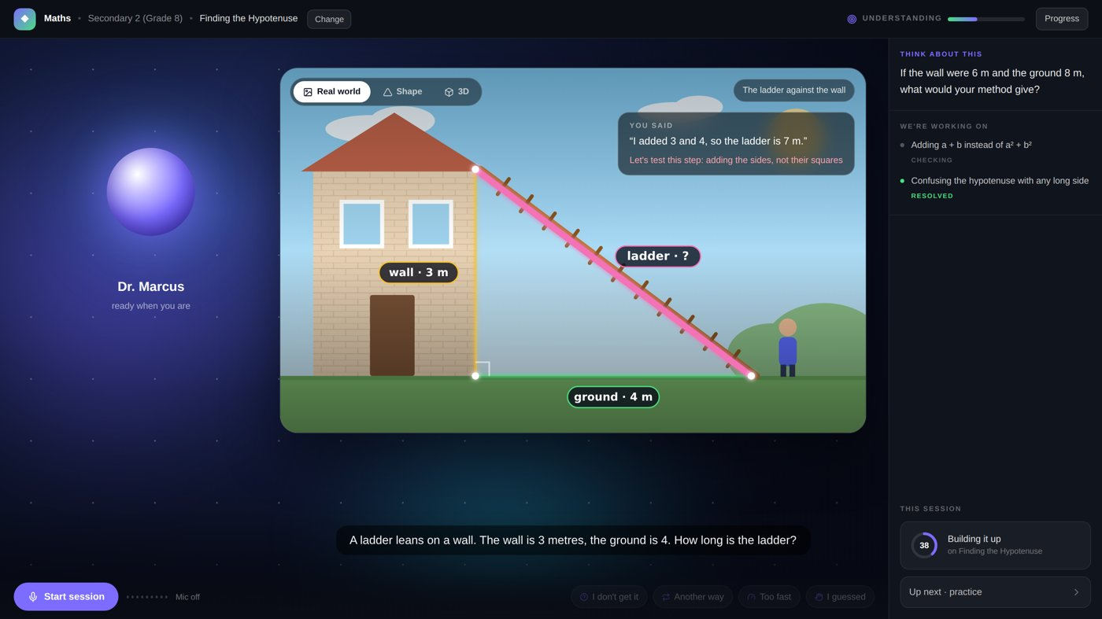
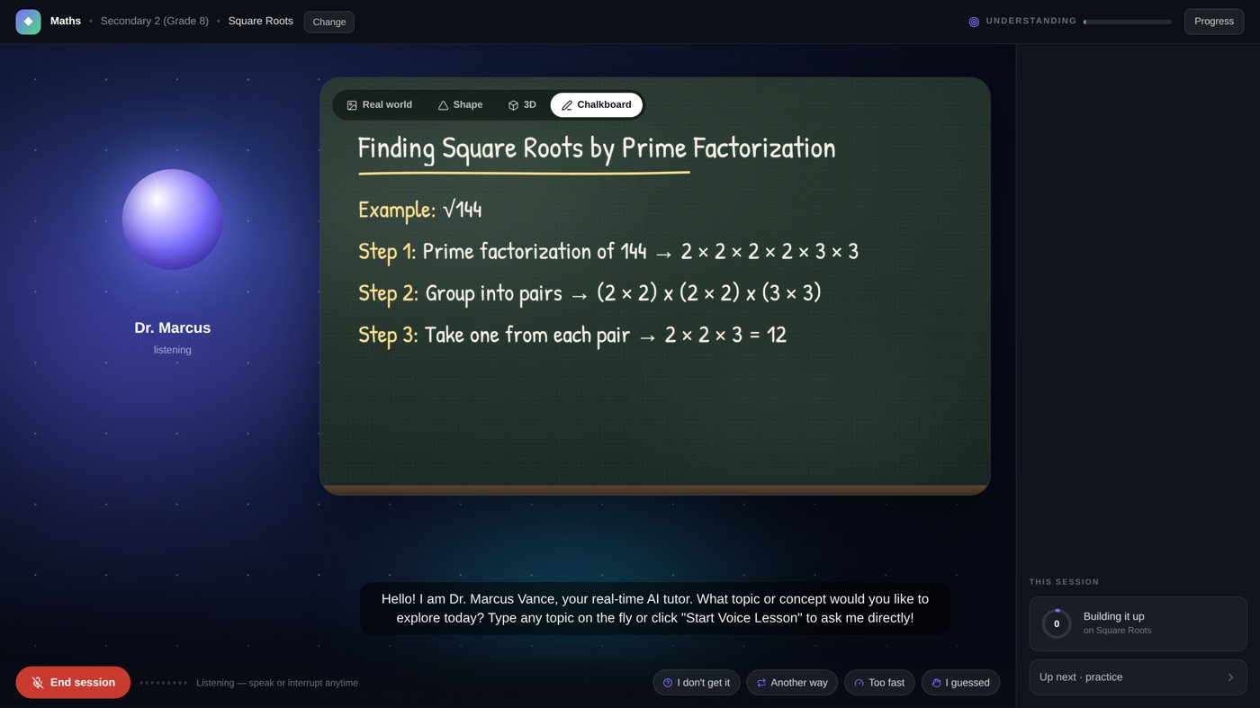
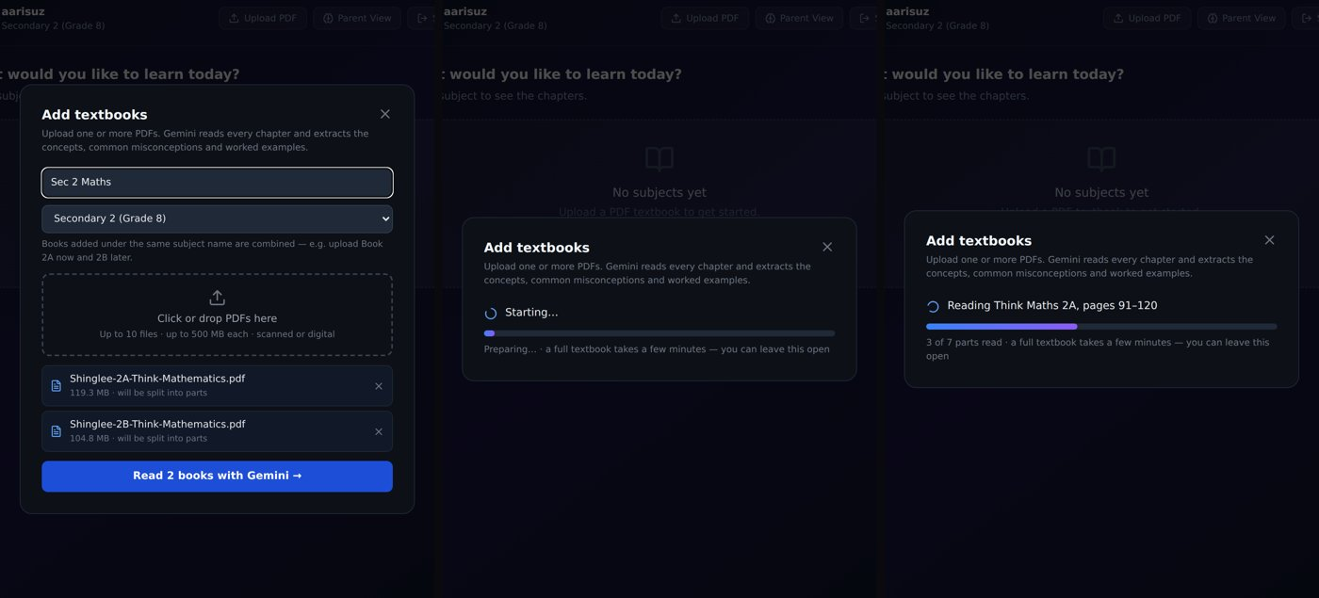
Snapshots of the prototype
Real screens from the running app.
Real-world view: the child's ladder problem, with the tutor's question
Chalkboard view: worked steps written as the tutor speaks
Diagnosis in view: “3 + 4 = 7” flagged as adding instead of squaring
Admin: upload textbook PDFs, Gemini reads them into a curriculum
Live app: https://ananta-ivczdbgbja-as.a.run.app/ · no sign-in: pick “Priya (Simulated)”, Mathematics, Start Lesson

Slide 11
Prototype Performance report/Benchmarking
Diagnosis accuracy on 45 labelled exchanges (run 2026-10-15).
Catches a right answer reached by a broken method (10 cases)
Honest numbers
Latency per diagnosis in this run: p50 6.8 s, p95 21.8 s. That is above our 4 s design target, so diagnosis runs async and the voice never waits on it. Tightening it is next.
Flags are precise but not perfect: 10 of 11 flags were right (plain prompt: 9 of 11).
Answer-checking only
0/10
Plain Gemini prompt
9/10
Ananta assessor
10/10
93%
exact class, 42/45
0/10
false alarms on sound reasoning
How to read this
Run on gemini-3.1-flash-lite. 45 hand-written cases by the team, not independent annotators or real children.
Only 10 hidden-misconception cases: 95% CI for 10/10 is 72–100%. One case moves a rate by 10 points.
Tests the single-answer assessor, not learning gains.
Also verified: app shell loads in about 100 ms; learner data server-only; unit tests for quality gates, BKT, plan compiler and claim validator.
10/10
right misconception named
2/2
prompt-injection cases held

Slide 12
Additional Details/Future Development (if any)
Next: prove learning gains with real children and teachers.
Next 3 months
Scale
Limits to know about
• Pilot with a teacher and a small class; measure learning gain against a control.
• Independent annotators re-label the evaluation set; grow it past 40 cases per concept.
• Bring diagnosis latency down toward the 4 s target.
• Spaced-review scheduling and decay of old mastery.
• Teacher view: class-level misconception heatmap.
• Any curriculum: upload a textbook PDF and syllabus. Boards in the library: IGCSE, Cambridge, CBSE, US Common Core.
• More subjects beyond Mathematics and Biology.
• Preferred language captured at onboarding; broaden voice languages.
• Supports SDG 4, quality education, by making individual explanation available outside class hours.
• Voice needs a microphone, a quiet room, and Chrome or Firefox.
• Pause briefly between sentences (voice activity detection).
• Gemini free tier has rate limits; if replies slow, wait a few seconds.
• First load can take 10–20 s (Cloud Run cold start).
• Photo generation may fall back to diagrams if image quota runs out.
• Demo learners are simulated and labelled so.

Slide 13
Provide links to your:
GitHub Public Repository: https://github.com/sur2rock1/AI_Builder_cup_2026
Demo Video Link (3 Minutes): [add public YouTube / Drive link]
Final Product Link: https://ananta-ivczdbgbja-as.a.run.app/
For evaluators: test in under a minute
1. Open the product link. No sign-in is needed (demo mode).
2. Click “Priya (Simulated)”, choose Mathematics, pick a concept, press Start Lesson and allow the microphone.
3. Try a wrong-method answer, e.g. add the two legs instead of squaring them, and watch the diagnosis panel respond.
4. Open the Parent Portal from the start page and click “See why” on any claim to see the exact question and answer.
First load may take 10–20 s. Chrome or Firefox recommended.

Slide 14


