Slide 1
K. S. Institute of Technology Department of Computer Science and Engineering
Analysis and Design and of Algorithm - BCS401
Faculty Name: Vijayalaxmi Mekali
Professor, Dept of CSE
KSIT, Bangalore

Slide 2


MODULE 2 : Exhaustive Search
Exhaustive Search (Brute Force) – Definition:
Exhaustive search is a problem-solving technique in which all possible solutions are systematically generated and checked, and the best or correct solution is selected.
Simple definition:
Exhaustive search is an algorithmic method that tries every possible solution to find the correct or optimal one.
Key points:
It checks each and every possible combination of the problem. Also called brute-force method or generate-and-test approach. Guarantees finding the correct/optimal solution if one exists. Usually time-consuming for large problems (high complexity).
Example:
Trying all subsets in Knapsack problem
Checking all routes in Travelling Salesman Problem (TSP)

Slide 3
MODULE 2 : Exhaustive Search
Exhaustive Search (Brute Force) – Definition:
The Knapsack problem is a problem of selecting a subset of items, each with a given weight and value, to maximize the total value (profit) without exceeding the capacity of the knapsack.
Formal Definition
Given:
A set of n items
Each item has:
Weight w_{i​}
Value (profit) v_{i}
A knapsack with capacity M
Goal: Select a subset of items such that:
Total selected weight ≤ M

Slide 4
MODULE 2 : Exhaustive Search
Exhaustive Search (Brute Force) – Definition:
Solve Knapsack problem using Exhaustive Search for the following
Knapsack Capacity m=10 and number of items n=4
Item | Weight | Value/Profit
1 | 7 | 42
2 | 3 | 12
3 | 4 | 40
4 | 5 | 25

Slide 5
MODULE 2 : Exhaustive Search
Item | Weight | Value/Profit
1 | 7 | 42
2 | 3 | 12
3 | 4 | 40
4 | 5 | 25
Solve Knapsack problem using Exhaustive Search for the following
Knapsack Capacity m=10 and number of items n=4
Step 1: Generate All Possible Subsets (Exhaustive Search) :2^4=16 subsets:
Subset | Items Chosen | Total Weight | Total Value | Valid (≤10)?
1 | {} | 0 | 0 | ✔
2 | {1} | 7 | 42 | ✔
3 | {2} | 3 | 12 | ✔
4 | {3} | 4 | 40 | ✔
5 | {4} | 5 | 25 | ✔
6 | {1,2} | 10 | 54 | ✔
7 | {1,3} | 11 | 82 | ✘
8 | {1,4} | 12 | 67 | ✘
9 | {2,3} | 7 | 52 | ✔
10 | {2,4} | 8 | 37 | ✔
Subset | Items Chosen | Total Weight | Total Value | Valid (≤10)?
11 | {3,4} | 9 | 65 | ✔
12 | {1,2,3} | 14 | 94 | ✘
13 | {1,2,4} | 15 | 79 | ✘
14 | {1,3,4} | 16 | 107 | ✘
15 | {2,3,4} | 12 | 77 | ✘
16 | {1,2,3,4} | 19 | 119 | ✘
Optimal solution {3,4} = 65

Slide 6
MODULE 2 : Exhaustive Search
The Travelling Salesman Problem (TSP) asks for the shortest possible tour that visits each city exactly once and returns to the starting city.
Formal Definition
Given:
A set of n cities
The distance (cost) between every pair of cities
Goal:
Find a minimum-cost Hamiltonian circuit, i.e.:
Visit each city exactly once
Return to the starting city
Minimize the total travel cost

Slide 7
MODULE 2 : Exhaustive Search
TSP using Exhaustive Search
From the given graph (cities a, b, c, d), the edge weights are:
a–b = 2
b–d = 3
d–c = 1
c–a = 5
a–d = 7
b–c = 8
Step 1: List All Possible Tours
Fix starting city as a (to avoid duplicates). Total tours = (n−1)!=3!=6(n-1)! = 3! = 6(n−1)!=3!=6
Tour | Path | Cost Calculation | Total Cost
1 | a → b → c → d → a | 2 + 8 + 1 + 7 | 18
2 | a → b → d → c → a | 2 + 3 + 1 + 5 | 11 ✅
3 | a → c → b → d → a | 5 + 8 + 3 + 7 | 23
4 | a → c → d → b → a | 5 + 1 + 3 + 2 | 11 ✅
5 | a → d → b → c → a | 7 + 3 + 8 + 5 | 23
6 | a → d → c → b → a | 7 + 1 + 8 + 2 | 18
Optimal solution
a → b → d → c → a = 11
a → c → d → b → a = 11

Slide 8
Analysis and Design and of Algorithm - BCS401 MODULE 2 : DIVIDE AND CONQUER
Divide and Conquer is best known algorithm design technique.
Divide and Conquer algorithm works according to the following general plan
A problem instance is divided into several smaller instances of the same problem (smaller sub problems of same size)
Smaller instances are solved (recursively)
Solution obtained from smaller instances are combined to get the solution for the original problem.

Slide 9
MODULE 2 : DIVIDE AND CONQUER- Introduction
Divide and Conquer Methodology-Example
Detecting Counterfeit coin problem
Collection of 16 COINS, in that one is counterfeit coin. Problem to detect counterfeit coin (Duplicate coin with light weight)
Solution:
16 COINS- one is counterfeit coin
Check the weight
Check the weight
8 COINS Set B
Let weight of A< B, so Set A contains counterfeit coin
8 COINS-Set A
4 COINS
Set A1
4 COINS
Set A2
Let weight of A1< A2, so Set A1 contains counterfeit coin
2 COINS
Set A3
2 COINS
Set A4
Let weight of A3< A4, so Set A3 contains counterfeit coin
1 COINS
Set A5
1 COINS
Set A6
Let weight of A5< A6, so Set A5 is counterfeit coin

Slide 10
MODULE 2 : DIVIDE AND CONQUER- Introduction
Fig1.1 Divide and Conquer Technique
Problem of size n
Sub Problem 1 of size n/2
Sub Problem 2 of size n/2
Solution to
Sub Problem 1
Solution to
Sub Problem 2
Solution to
Original Problem

Slide 11
MODULE 2 : DIVIDE AND CONQUER- Introduction
Control Abstraction of Divide and Conquer
Type DandC (P)
{
if small (P)
return S(P);
else
{
Divide P into smaller instances P1, P2, …..Pn, n≥1
Apply DandC each of smaller instances
Return Combine (DandC(P1), DandC(P2), ….. DandC(Pn)),
}
}
Where P is problem,
small (P) Boolean valued function, returns true if P is very small.

Slide 12
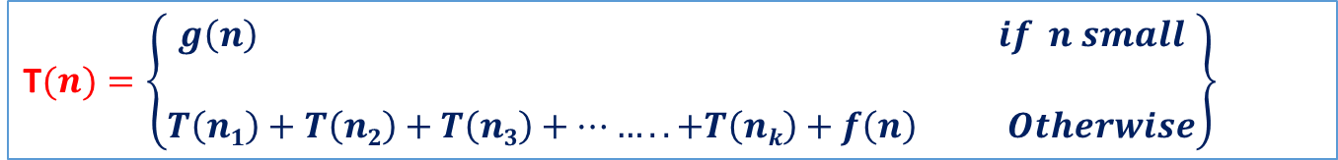
MODULE 2 : DIVIDE AND CONQUER- Introduction
The recurrence relation
T$(n)=\left\{\begin{aligned}g\left(n\right) if n small \\ \\ T\left(n1\right)+T\left(n2\right)+T\left(n3\right)+……..+T\left(nk\right)+f\left(n\right) Otherwise\end{aligned}\right\}$
Where,
T(n)→ time for DandC,
n → input size is problem,
g(n) → Time to compute answer directly from small input
f(n) → Time to divide the problem and combining the solution.

Slide 13
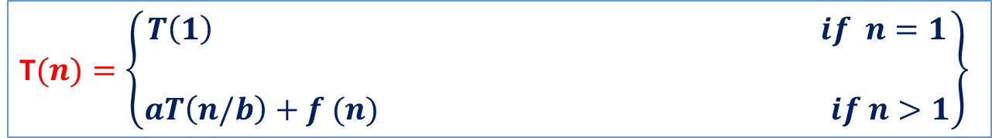
MODULE 2 : DIVIDE AND CONQUER- Introduction
Masters theorem
In divide and conquer technique problem instance of size n is divided into two instances of size n/2.
More generally, an instance of size n can be divided into b instances of size n/b, with a of them needing to be solved. (Here, a and b are constants; a ≥ 1 and b > 1.) Assuming that size n is a power of b to simplify our analysis, we get the following recurrence
The recurrence relation for divide and conquer
T$(n)=\left\{\begin{aligned}T\left(1\right) if n=1 \\ \\ aT\left(n/b\right)+f (n) if n>1\end{aligned}\right\}$
This recurrence relation is called general divide and conquer recurrence relation.
The order of growth of its solution T (n) depends on the values of the constants a and b and the order of growth of the function f (n).
Where,
a and b → known as constants.
T(1) → assume that its value is known,
n → power of b ie n=b^{k}
f(n) → Time to divide the problem and combining the solution.

Slide 14
MODULE 2 : DIVIDE AND CONQUER- Introduction
The efficiency analysis of many divide-and-conquer algorithms is greatly simplified by the following master theorem
Master theorem: If f(n) Є Θ(n^{d}) where d ≥ 0 in the recurrence relation then
T(n) Є
Analogous results hold for the O and Ω notations, too.

Slide 15


MODULE 2 : DIVIDE AND CONQUER- Introduction
Example let us consider algorithm for which a=2 and b=2, Let T(1)=2 and f(n)=n Find the recurrence relation.
Solution:
f(n)=n i e f(n) Є n^{d} (in this case n¹ means d=1)
T(n)= 2 . T($\frac{n}{2})+n$
= 2 . (2 . T($\frac{n}{4})+\frac{n}{2})+n$
= 4T($\frac{n}{4})+n+n$
= 4T($\frac{n}{4})+2n$
= 4 . [2 . T($\frac{n}{8})+\frac{n}{4}]+2n$
= 8 . T($\frac{n}{8})+3n$
;
;
2^{i} . T($\frac{n}{2i})+i.n$
To obtain initial condition let 2^{i} =n
Take log both a side i= $\text{log}\text{2}\text{n}$
For any log₂n ≥ i ≥ 1
${\text{2}}^{\text{log}\text{2}\text{n} }$ . T($\frac{n}{{\text{2}}^{\text{log}\text{2}\text{n} }})+n$ $.\text{log}\text{2}\text{n}$
T(n)=nT(1)+ $n$ $.\text{log}\text{2}\text{n}$
T(n)=2n$+n$ $.\text{log}\text{2}\text{n}$
T(n)=$O(n$ $.\text{log}\text{2}\text{n}$)

Slide 16
MODULE 2 : DIVIDE AND CONQUER- Introduction
Example: Binary Search;
Let A is a list of elements that are in sorted order. Problem is determining the whether the given key element present in A.
If key = A[j],
key present at position j+1
else
key not presents in the list

Slide 17
MODULE 2 : DIVIDE AND CONQUER- Introduction
Binary Search;
 | best | Average | Worst
Linear search | O(1) | O(n). when the item to be searched is in some where middle of the Array | O(n). Since the target element is present in the extremitites (first or last index),
Binary Search | O(1) | O(logn) | O(log n) Since the target element is present in the extremitites (first or last index), there are logn comparisons in total.
Merge sort | O(n logn) | O(n logn) | O(n logn) Time complexity of Merge Sort is O(n*Log n) in all the 3 cases (worst, average and best) as merge sort always divides the array in two halves and takes linear time to merge two halves.
Quick sort | O(n logn) | O(n logn) | O(N²).

Slide 18
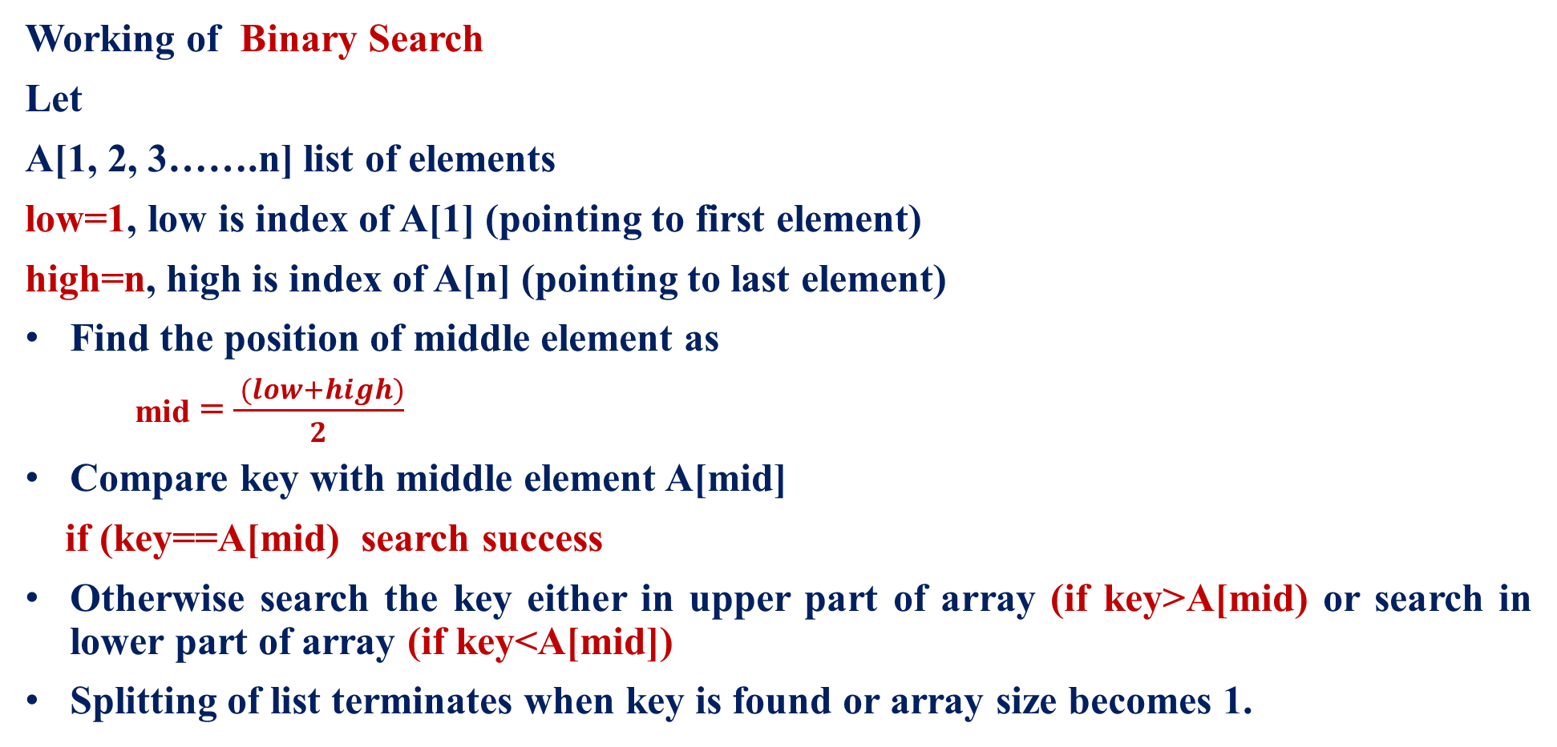
MODULE 2 : DIVIDE AND CONQUER- Introduction
Working of Binary Search
Let
A[1, 2, 3…….n] list of elements
low=1, low is index of A[1] (pointing to first element)
high=n, high is index of A[n] (pointing to last element)
Find the position of middle element as
mid = $\frac{ (low+high)}{2}$
Compare key with middle element A[mid]
if (key==A[mid) search success
Otherwise search the key either in upper part of array (if key>A[mid) or search in lower part of array (if key<A[mid])
Splitting of list terminates when key is found or array size becomes 1.
A
1
low
n
high
key<A[mid]
Search in lower part
mid
Key>A[mid]
Search in lower part

Slide 19


MODULE 2 : DIVIDE AND CONQUER- Introduction
Recursive Binary search algorithm
int BinSear(Type A[ ], int low, int high, type key)
{
if (low==high)
{
if (key==A[low])
return low;
else
return 0;
}
else
{
int mid = $\frac{ (low+high)}{2}$
if (key ==A[mid])
return mid;
else if (key < A[mid])
return BinSear(A, low, mid-1, key);
else
return BinarySearch(A, mid+1,high, key);
}
1
low
n
high
Key==A[mid]
1
low
high is mid-1
n
high
low is mid+1

Slide 20
MODULE 2 : DIVIDE AND CONQUER- Introduction
Example Binary search algorithm: Consider List A with 14 elements, search for the key=151 in the list
A
Solution:
-15 | -6 | 0 | 7 | 9 | 23 | 54 | 82 | 101 | 112 | 125 | 131 | 142 | 151
Index
1 | 2 | 3 | 4 | 5 | 6 | 7 | 8 | 9 | 10 | 11 | 12 | 13 | 14
-15 | -6 | 0 | 7 | 9 | 23 | 54 | 82 | 101 | 112 | 125 | 131 | 142 | 151
low=1
High=14

Slide 21
MODULE 2 : DIVIDE AND CONQUER- Introduction
Example Binary search algorithm: Consider List A with 14 elements, search for the key=151 in the list
Solution:
Index
1 | 2 | 3 | 4 | 5 | 6 | 7 | 8 | 9 | 10 | 11 | 12 | 13 | 14 | low | High | mid | compare
-15 | -6 | 0 | 7 | 9 | 23 | 54 | 82 | 101 | 112 | 125 | 131 | 142 | 151 | 1 | 14 | (1+14)/2=7 | 151>54
low=1
mid=7
high=14
Index
1 | 2 | 3 | 4 | 5 | 6 | 7 | 8 | 9 | 10 | 11 | 12 | 13 | 14 | low | High | mid | compare
-15 | -6 | 0 | 7 | 9 | 23 | 54 | 82 | 101 | 112 | 125 | 131 | 142 | 151 | 8 | 14 | (8+14)/2=11 | 151>125
low=8
mid=11
high=14

Slide 22
MODULE 2 : DIVIDE AND CONQUER- Introduction
Example Binary search algorithm: Consider List A with 14 elements, search for the key=151 in the list
Solution:
Index
1 | 2 | 3 | 4 | 5 | 6 | 7 | 8 | 9 | 10 | 11 | 12 | 13 | 14 | low | High | mid | compare
-15 | -6 | 0 | 7 | 9 | 23 | 54 | 82 | 101 | 112 | 125 | 131 | 142 | 151 | 12 | 14 | (12+14)/2=13 | 151>142
low=12
mid=13
high=14
1 | 2 | 3 | 4 | 5 | 6 | 7 | 8 | 9 | 10 | 11 | 12 | 13 | 14 | low | High | mid | compare
-15 | -6 | 0 | 7 | 9 | 23 | 54 | 82 | 101 | 112 | 125 | 131 | 142 | 151 | 14 | 14 | Low=high | 151=151
low=14
high=14
Key=151 is found at position 14, search is successful

Slide 23
MODULE 2 : DIVIDE AND CONQUER- Introduction
Example Binary search algorithm: Consider List A with 14 elements, search for the key=-14 in the list
Solution:
Index
1 | 2 | 3 | 4 | 5 | 6 | 7 | 8 | 9 | 10 | 11 | 12 | 13 | 14 | low | High | mid | compare
-15 | -6 | 0 | 7 | 9 | 23 | 54 | 82 | 101 | 112 | 125 | 131 | 142 | 151 | 1 | 14 | (1+14)/2=7 | -14<54
low=1
mid=7
high=14
Index
1 | 2 | 3 | 4 | 5 | 6 | 7 | 8 | 9 | 10 | 11 | 12 | 13 | 14 | low | High | mid | compare
-15 | -6 | 0 | 7 | 9 | 23 | 54 | 82 | 101 | 112 | 125 | 131 | 142 | 151 | 1 | 6 | (1+6)/2=3 | -14<0
low=1
mid=3
high=6

Slide 24
MODULE 2 : DIVIDE AND CONQUER- Introduction
Example Binary search algorithm: Consider List A with 14 elements, search for the key=151 in the list
Solution:
Index
1 | 2 | 3 | 4 | 5 | 6 | 7 | 8 | 9 | 10 | 11 | 12 | 13 | 14 | low | High | mid | compare
-15 | -6 | 0 | 7 | 9 | 23 | 54 | 82 | 101 | 112 | 125 | 131 | 142 | 151 | 1 | 2 | (1+2)/2=1 | -14>-15
low=1
mid=1
high=2
Index
1 | 2 | 3 | 4 | 5 | 6 | 7 | 8 | 9 | 10 | 11 | 12 | 13 | 14 | low | High | mid | compare
-15 | -6 | 0 | 7 | 9 | 23 | 54 | 82 | 101 | 112 | 125 | 131 | 142 | 151 | 12 | 14 | (2+2)/2=2 | -6≠-14
low=2
high=2
Key = -14 is not found unsuccessful

Slide 25
MODULE 2 : DIVIDE AND CONQUER- Introduction
Example Binary search algorithm: Consider List A with 14 elements, search for the key=9 in the list
A
Solution:
-15 | -6 | 0 | 7 | 9 | 23 | 54 | 82 | 101 | 112 | 125 | 131 | 142 | 151
Index
1 | 2 | 3 | 4 | 5 | 6 | 7 | 8 | 9 | 10 | 11 | 12 | 13 | 14
-15 | -6 | 0 | 7 | 9 | 23 | 54 | 82 | 101 | 112 | 125 | 131 | 142 | 151
low=1
High=14

Slide 26
MODULE 2 : DIVIDE AND CONQUER- Introduction
Example Binary search algorithm: Consider List A with 14 elements, search for the key=9 in the list
Solution:
Index
1 | 2 | 3 | 4 | 5 | 6 | 7 | 8 | 9 | 10 | 11 | 12 | 13 | 14 | low | High | mid | compare
-15 | -6 | 0 | 7 | 9 | 23 | 54 | 82 | 101 | 112 | 125 | 131 | 142 | 151 | 1 | 14 | (1+14)/2=7 | 9<54
low=1
mid=7
high=14
Index
1 | 2 | 3 | 4 | 5 | 6 | 7 | 8 | 9 | 10 | 11 | 12 | 13 | 14 | low | High | mid | compare
-15 | -6 | 0 | 7 | 9 | 23 | 54 | 82 | 101 | 112 | 125 | 131 | 142 | 151 | 1 | 6 | (1+6)/2=3 | 9>0
low=1
mid=3
high=6

Slide 27
MODULE 2 : DIVIDE AND CONQUER- Introduction
Example Binary search algorithm: Consider List A with 14 elements, search for the key=9 in the list
Solution:
Index
1 | 2 | 3 | 4 | 5 | 6 | 7 | 8 | 9 | 10 | 11 | 12 | 13 | 14 | low | High | mid | compare
-15 | -6 | 0 | 7 | 9 | 23 | 54 | 82 | 101 | 112 | 125 | 131 | 142 | 151 | 4 | 6 | (4+6)/2=5 | 9=9
low=4
high=6
mid=5
Key=9 is found at position 5, search is successful

Slide 28
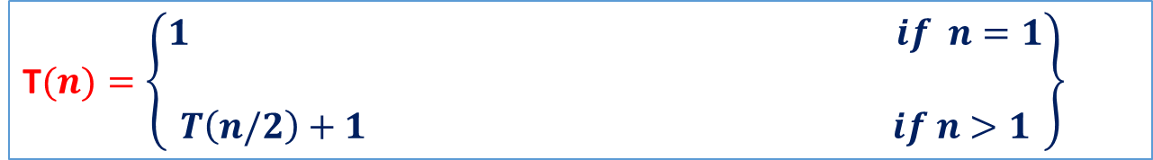
MODULE 2 : DIVIDE AND CONQUER- Introduction
Example: Binary Search- Time complexity analysis
Time complexity analysis of binary search is done for all the three case. Let T(n) indicates time efficiency
Best case – If the input array contains the key element at the middle position, then search becomes success by performing only comparison. Thus the best case efficiency is
t(n)_{best} ≈ (1)
2. Worst case efficiency – The worst efficiency of binary search occurs when the algorithm takes maximum number of comparisons. The time complexity is given by recurrence relation
T$(n)=\left\{\begin{aligned}1 if n=1 \\ \\ T\left(n/2\right)+1 if n>1\end{aligned}\right\}$
Time required to search key element in either upper part or lower part of array
Time required to compare key with middle element

Slide 29
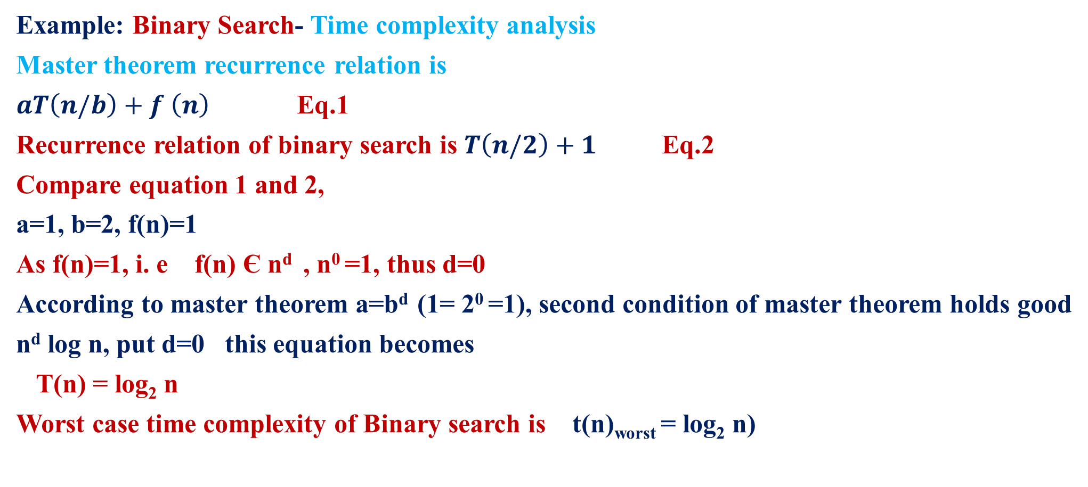
MODULE 2 : DIVIDE AND CONQUER- Introduction
Example: Binary Search- Time complexity analysis
Master theorem recurrence relation is
$aT\left(n/b\right)+f \left(n\right)$Eq.1
Recurrence relation of binary search is $T\left(n/2\right)+1$ Eq.2
Compare equation 1 and 2,
a=1, b=2, f(n)=1
As f(n)=1, i. e f(n) Є n^{d} , n⁰ =1, thus d=0
According to master theorem a=b^{d} (1= 2⁰ =1), second condition of master theorem holds good
n^{d} log n, put d=0 this equation becomes
T(n) = log₂ n
Worst case time complexity of Binary search is t(n)_{worst} = log₂ n)

Slide 30
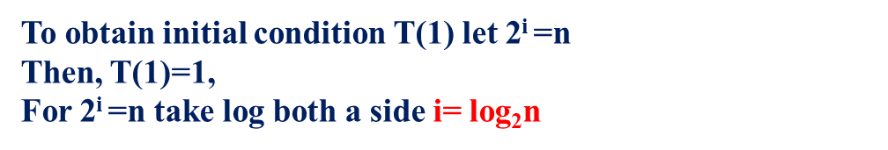
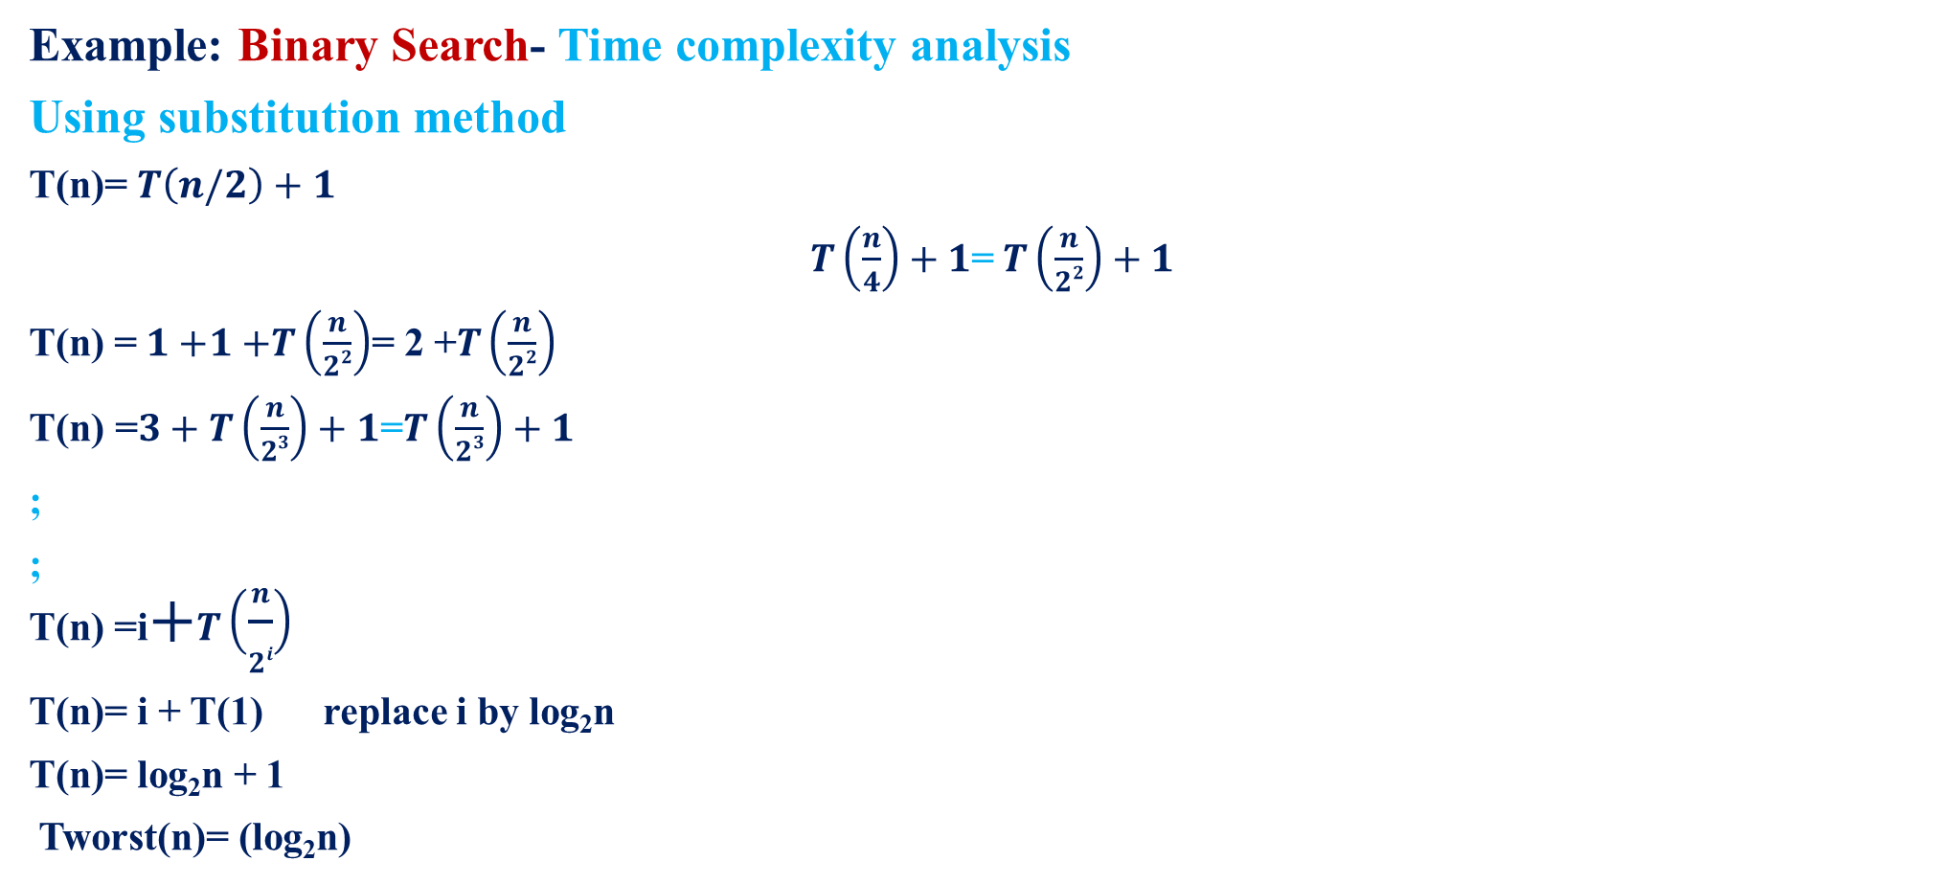


MODULE 2 : DIVIDE AND CONQUER- Introduction
Example: Binary Search- Time complexity analysis
Using substitution method
T(n)= $T\left(n/2\right)+1$
$T\left(\frac{n}{4}\right)+1$= $T\left(\frac{n}{22}\right)+1$
T(n) =$1$ $+1$ $+T\left(\frac{n}{22}\right)$= 2 +$T\left(\frac{n}{22}\right)$
$\text{T}\text{(}\text{n}\text{) =}3+T\left(\frac{n}{23}\right)+1$=$T\left(\frac{n}{23}\right)+1$
;
;
T(n) =i$+T\left(\frac{n}{2i}\right)$
T(n)= i + T(1) replace i by $\text{log}\text{2}\text{n}$
T(n)= $\text{log}\text{2}\text{n}$ + 1
Tworst(n)= ($\text{log}\text{2}\text{n}$)
Replace$T\left(\frac{n}{2}\right)$ by $T\left(\frac{n}{4}\right)+1$
Replace$T\left(\frac{n}{22}\right)byT\left(\frac{n}{23}\right)$+1
To obtain initial condition T(1) let 2^{i} =n
Then, T(1)=1,
For 2^{i} =n take log both a side i= $\text{log}\text{2}\text{n}$

Slide 31
MODULE 2 : DIVIDE AND CONQUER- Introduction
Example: Binary Search- Time complexity analysis
When binary search is applied on the elements, we must determine
Required number of comparisons
Average number of key comparisons for both successful search and unsuccessful search
Required number of comparisons, Average number of key comparisons for both successful search
and unsuccessful search can be determined by Decision tree.
In Decision tree
Circles are used to represent an internal nodes. internal nodes represents successful search
Rectangles are used to represent an external nodes. External nodes represents unsuccessful search
Time complexity for the average case in both successful and unsuccessful search is proportional to
height of the tree i e T(n)= (log₂n)

Slide 32
MODULE 2 : DIVIDE AND CONQUER- Introduction
Example: Binary Search- Time complexity analysis
Theorem: If n (size of list ) is in the range (2^{k-1}, 2^{k}), then binary search algorithm makes at most
k elements comparisons for a successful search and either k-1 or k comparisons for unsuccessful search.
[Time complexity for both successful and unsuccessful search is height of the tree i e T(n)= (log₂n)
Proof:
Consider the binary decision tree describing the action of binary search algorithm on n elements.
All successful search end at a circular node whereas all unsuccessful searches end at a Square node.
If 2^{k-1} ≤ n ≤ 2^{k}, then all the circular nodes are at level 1, 2, …..k, where as all the square nodes are at
level k and k+1 (root at the level 1).
The number of elements comparisons needed to terminate at a circular node on level i is i,
whereas the number of element comparisons needed to terminate at a square node at level i is only i-1.
The theorem follows
Successful searches Unsuccessful searches
(log₂n), (log₂n) and (1) (log₂n), (log₂n) and (log₂n)
(Worst, average, best) (Worst, average, best)

Slide 33
MODULE 2 : DIVIDE AND CONQUER- Introduction
Example: Binary Search- Time complexity analysis
Example: Write a binary decision tree for the following five elements and also find the average number of comparisons in both successful and unsuccessful search.
List A is 10, 15, 19, 25, 96
Solution:
L=1
H=5
Level -1
3
L=4
L=1
19
H=5
Level -2
H=2
1
Index | 1 | 2 | 3 | 4 | 5
A | 10 | 15 | 19 | 25 | 96
NOC | 2 | 3 | 1 | 2 | 3
4
L=1
10
L=4
L=5
H=0
L=2
H=3
25
H=5
H=2
5
2
Level -3
L=6
L=2
15
L=5
96
H=4
H=5
H=1
L=3
Level -4
H=2

Slide 34

MODULE 2 : DIVIDE AND CONQUER- Introduction
Example: Binary Search- Time complexity analysis
To determine the successful cases
Average number of comparisons in successful cases = $\frac{Total number of comparisions}{Total number of successful nodes}$
= $\frac{11}{5}$ = 2.2
Number of nodes Level number*Number of successful nodes in each level | Comparisons
1*1 | 1
2*2 | 4
3*2 | 6
Total comparisons = 11

Slide 35

MODULE 2 : DIVIDE AND CONQUER- Introduction
Example: Binary Search- Time complexity analysis
To determine the unsuccessful cases
Average number of comparisons in unsuccessful cases = $\frac{Total number of comparisions}{Total number of unsuccessful nodes}$
= $\frac{16}{6}$ = 2.6
Number of nodes Number of unsuccessful nodes in each level * Level number-1 | Comparisons
2*(3-1) | 4
4*(4-1) | 12
Total comparisons = 16

Slide 36
MODULE 2 : DIVIDE AND CONQUER- Introduction
Example: Binary Search- Time complexity analysis
Example: Write a binary decision tree for the following five elements and also find the average number of comparisons in both successful and unsuccessful search.
List A is -15, -6, 0, 7, 9, 23, 24, 82, 101
Solution:
Index | 1 | 2 | 3 | 4 | 5 | 6 | 7 | 8 | 9
A | -15 | -6 | 0 | 7 | 9 | 23 | 24 | 82 | 101
NOC

Slide 37
MODULE 2 : DIVIDE AND CONQUER- Introduction
Index | 1 | 2 | 3 | 4 | 5 | 6 | 7 | 8 | 9
A | -15 | -6 | 0 | 7 | 9 | 23 | 24 | 82 | 101
NOC | 3 | 2 | 3 | 4 | 1 | 3 | 2 | 3 | 4
Solution:
L=1
Level -1
H=9
5
L=6
L=1
H=9
Level -2
H=4
9
2
7
-6
L=6
L=8
L=3
H=6
24
H=9
Level -3
L=1
1
H=4
6
8
H=1
3
L=6
L=2
L=3
L=7
L=8
L=9
-15
H=1
H=2
0
L=4
H=5
23
H=6
H=7
82
H=9
H=4
9
Level -4
L=1
4
H=0
L=4
101
H=3
7
L=5
L=9
L=10
H=4
H=8
H=9
Level -5

Slide 38

MODULE 2 : DIVIDE AND CONQUER- Introduction
Example: Binary Search- Time complexity analysis
To determine the successful cases
Average number of comparisons in successful cases = $\frac{Total number of comparisions}{Total number of successful nodes}$
= $\frac{25}{9}$ = 2.77
Number of nodes Level number*Number of successful nodes in each level | Comparisons
1*1 | 1
2*2 | 4
3*4 | 12
4*2 | 8
Total comparisons = 25

Slide 39

MODULE 2 : DIVIDE AND CONQUER- Introduction
Example: Binary Search- Time complexity analysis
To determine the unsuccessful cases
Average number of comparisons in unsuccessful cases = $\frac{Total number of comparisions}{Total number of unsuccessful nodes}$
= $\frac{34}{10}$ = 3.4
Number of nodes Number of unsuccessful nodes in each level * Level number-1 | Comparisons
6*(4-1) | 18
4*(5-1) | 16
Total comparisons = 34

Slide 40
MODULE 2 : DIVIDE AND CONQUER- Introduction
Index | 1 | 2 | 3 | 4 | 5 | 6 | 7 | 8 | 9
A | -15 | -6 | 0 | 7 | 9 | 23 | 24 | 82 | 101
NOC | 3 | 2 | 3 | 4 | 1 | 3 | 2 | 3 | 4
Solution:
L=1
Level -1
H=14
7
L=8
L=1
H=14
Level -2
H=6
54
3
11
L=8
L=12
0
L=4
H=10
125
H=14
Level -3
L=1
9
H=2
1
5
H=6
13
L=2
L=6
L=8
L=10
L=12
L=14
-15
H=2
L=4
9
H=6
H=8
101
H=10
H=12
142
H=14
L=1
2
H=4
Level -4
4
6
8
10
12
14
H=0
L=2
-6
L=6
151
L=3
L=4
23
L=7
82
112
131
L=14
H=1
H=3
7
H=5
H=6
L=15
H=2
H=13
H=14
Level -5
L=5
L=8
L=9
L=10
L=11
L=12
L=13
H=4
H=7
H=8
H=9
H=10
H=11
H=12

Slide 41

MODULE 2 : DIVIDE AND CONQUER- Introduction
Example: Binary Search- Tim complexity analysis
To determine the successful cases
Average number of comparisons in successful cases = $\frac{Total number of comparisions}{Total number of successful nodes}$
= $\frac{45}{14}$ = 3.21
Number of nodes Level number*Number of successful nodes in each level | Comparisons
1*1 | 1
2*2 | 4
3*4 | 12
4*7 | 28
Total comparisons = 45

Slide 42

MODULE 2 : DIVIDE AND CONQUER- Introduction
Example: Binary Search- Tim complexity analysis
To determine the unsuccessful cases
Average number of comparisons in unsuccessful cases = $\frac{Total number of comparisions}{Total number of unsuccessful nodes}$
= $\frac{59}{15}$ = 3.93
Number of nodes Number of unsuccessful nodes in each level * Level number-1 | Comparisons
1*(4-1) | 3
14*(5-1) | 56
Total comparisons = 59

Slide 43
MODULE 2 : DIVIDE AND CONQUER- Introduction
Example: Binary Search- Time complexity analysis
Theorem: Prove that Binary search tree has more comparisons in unsuccessful search that in successful search
Proof :
Assume E=I+2n
Where
E is sum of distances of the external nodes to the root node
I is sum of distances of the internal nodes to the root node
n is number of elements
Level 1
Level 2
Level 3
Level 4

Slide 44
MODULE 2 : DIVIDE AND CONQUER- Introduction
I=0+2*1+4*2=0+2+8=10
E=3*8=24
n=7
Substituting in I+2n we get
10+2*7=24=E
S(n) is average no of comparison in successful search is S(n)= 1+I/n
U(n) is average no of comparison in unsuccessful search is U(n) = E/(n+1)
Thus average no of comparisons in successful case is
S(n)= 1+10/7 =17/7 = 2.43
Thus average no of comparisons in unsuccessful case is
U(n)= 24/(1+7) =24/8 = 3

Slide 45


MODULE 2 : DIVIDE AND CONQUER- Introduction
Substituting 1 in 4 we get
S(n)= 1+ $\frac{\text{U}\text{(}\text{n}\text{) ∗ (}\text{n}\text{+1)}−2n}{\text{n} }$
S(n)= $\frac{\text{n}\text{+}\text{U}\text{(}\text{n}\text{) ∗ (}\text{n}\text{+1)}−2n}{\text{n} }$
S(n)= $\frac{\text{U}\text{(}\text{n}\text{) ∗ (}\text{n}\text{+1)}−n}{\text{n} }$
S(n)= $\frac{\text{U}\text{(}\text{n}\text{) ∗ (}\text{n}\text{+1)}}{\text{n} }$ - 1
S(n)= $\text{U}\text{(}\text{n}\text{) ∗ (1+}\frac{1}{\text{n} }$ ) – 1
S(n) + 1 = $\text{U}\text{(}\text{n}\text{) ∗ (1+}\frac{1}{\text{n} }$ )
i e S(n) < U(n)
Thus average no of comparison in successful search S(n) is always less than average no of comparison in unsuccessful search U(n)
We have
U(n) = $\frac{E}{\text{(}\text{n}\text{+1) }}$
E=U(n) * (n+1) Eq. 1
We have
E=I+2n
I= E - 2n Eq. 2
We have
S(n)= 1+ $\frac{I}{\text{n} }$ Eq. 3
Substituting 2 in 3 we get
S(n)= 1+ $\frac{E−2n}{\text{n} }$ Eq. 4

Slide 46

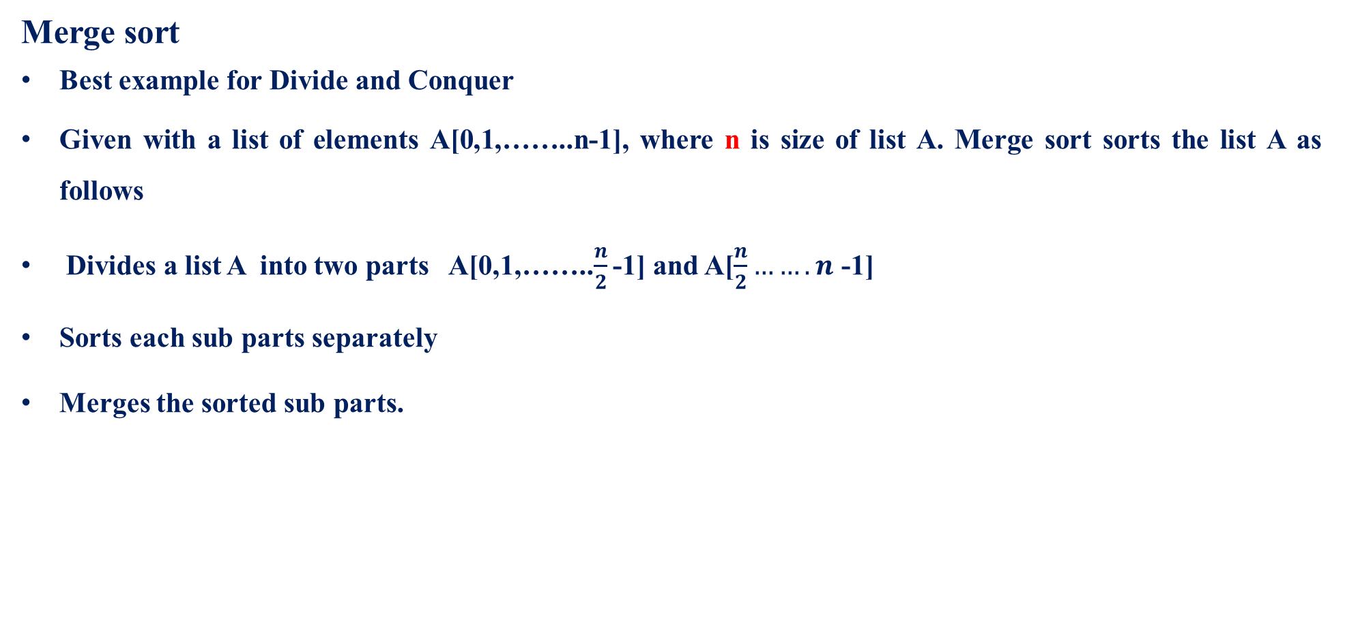
MODULE 2 : DIVIDE AND CONQUER- Merge sort
Merge sort
Best example for Divide and Conquer
Given with a list of elements A[0,1,……..n-1], where n is size of list A. Merge sort sorts the list A as follows
Divides a list A into two parts A[0,1,……..$\frac{n}{2}$ -1] and A[$\frac{n}{2}…….n$ -1]
Sorts each sub parts separately
Merges the sorted sub parts.

Slide 47
MODULE 2 : DIVIDE AND CONQUER- Merge sort
ALGORITHM
Merge (B[0..p − 1], C[0..q − 1], A[0..p + q − 1])
//Merges two sorted arrays into one sorted array
//Input: Arrays B[0..p − 1] and C[0..q − 1] both sorted
//Output: Sorted array A[0..p + q − 1] of the elements of B and C
i ←0; j ←0; k←0
while i <p and j <q do
if B[i]≤ C[j ]
A[k]←B[i]; i ←i + 1
else
A[k]←C[j ]; j ←j + 1
k←k + 1
if i = p
copy C[j..q − 1] to A[k..p + q − 1]
else
copy B[i..p − 1] to A[k..p + q − 1]
Merge sort
ALGORITHM
Mergesort (A[0..n − 1])
//Sorts array A[0..n − 1] by recursive mergesort
//Input: An array A[0..n − 1] of orderable elements
//Output: Array A[0..n − 1] sorted in nondecreasing order
if n > 1
copy A[0..n/2 − 1] to B[0..n/2 − 1]
copy A[n/2..n − 1] to C[0..n/2 − 1]
Mergesort(B[0..n/2 − 1])
Mergesort(C[0..n/2 − 1])
Merge(B, C, A)

Slide 48
MODULE 2 : DIVIDE AND CONQUER- Merge sort
Merge sort- Example
Trace the merge sort algorithm for a given list of elements
8, 3, 2, 9, 7, 1, 5, 4
Solution:
Array size is n=8
A
Index
0 | 1 | 2 | 3 | 4 | 5 | 6 | 7
8 | 3 | 2 | 9 | 7 | 1 | 5 | 4

Slide 49
MODULE 2 : DIVIDE AND CONQUER- Merge sort
0 | 1 | 2 | 3 | 4 | 5 | 6 | 7
8 | 3 | 2 | 9 | 7 | 1 | 5 | 4
Dividing
8 | 3 | 2 | 9
7 | 1 | 5 | 4
8 | 3
2 | 9
7 | 1
5 | 4
8
3
2
9
7
1
5
4
1 | 7
4 | 5
3 | 8
2 | 9
Conquering
2 | 3 | 8 | 9
1 | 4 | 5 | 7
Sorted list
0 | 1 | 2 | 3 | 4 | 5 | 6 | 7
1 | 2 | 3 | 4 | 5 | 7 | 8 | 9
This tree is called recursive tree call

Slide 50
MODULE 2 : DIVIDE AND CONQUER- Merge sort
Merge sort- Example
Trace the merge sort algorithm for a given list of elements (Dec 2019/Jan 2020)
60, 50, 25, 10, 35, 25, 75, 30
Solution:
Array size is n=8
A
Index
0 | 1 | 2 | 3 | 4 | 5 | 6 | 7
60 | 50 | 25 | 10 | 35 | 25 | 75 | 30

Slide 51
MODULE 2 : DIVIDE AND CONQUER- Merge sort
0 | 1 | 2 | 3 | 4 | 5 | 6 | 7
60 | 50 | 25 | 10 | 35 | 25 | 75 | 30
Dividing
60 | 50 | 25 | 10
35 | 25 | 75 | 30
60 | 50
25 | 10
35 | 25
75 | 30
60
50
25
10
35
25
75
30
25 | 35
30 | 75
50 | 60
10 | 25
Conquering
10 | 25 | 50 | 60
25 | 30 | 35 | 75
Sorted list
0 | 1 | 2 | 3 | 4 | 5 | 6 | 7
10 | 25 | 25 | 30 | 35 | 50 | 60 | 75
This tree is called recursive tree call

Slide 52
MODULE 2 : DIVIDE AND CONQUER- Merge sort
Merge sort- Example
Trace the merge sort algorithm for a given list of elements
5, 1, 3, 2, 100, 8, 17
Solution:
Array size is n=7
A
Index
0 | 1 | 2 | 3 | 4 | 5 | 6
5 | 1 | 3 | 2 | 100 | 8 | 17

Slide 53
MODULE 2 : DIVIDE AND CONQUER- Merge sort
0 | 1 | 2 | 3 | 4 | 5 | 6
5 | 1 | 3 | 2 | 100 | 8 | 17
Dividing
5 | 1 | 3 | 2
100 | 8 | 17
5 | 1
3 | 2
100 | 8
17
5
1
3
2
100
8
8 | 100
17
1 | 5
2 | 3
Conquering
1 | 2 | 3 | 5
8 | 17 | 100
Sorted list
0 | 1 | 2 | 3 | 4 | 5 | 6
1 | 2 | 3 | 5 | 8 | 17 | 100
This tree is called recursive tree call

Slide 54
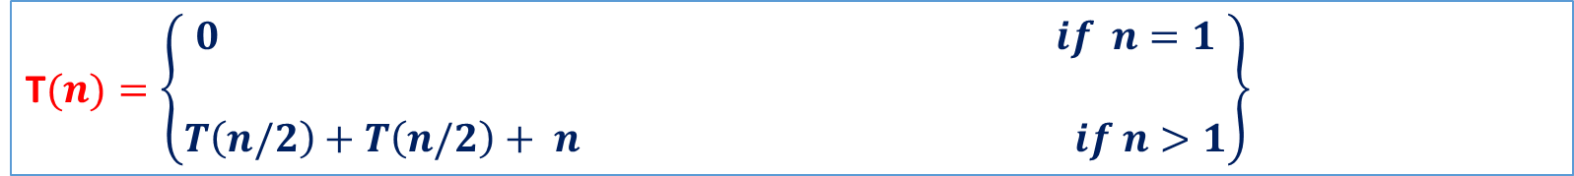
MODULE 2 : DIVIDE AND CONQUER- Merge sort
Time complexity Analysis of Merge sort
Input size- n
Basic operation- Divide and merge of n elements
As basic operation depends only on input size either worst, average or best case can be computed, let os consider worst case complexity
Recurrence relation for merge sort is
T$(n)=\left\{\begin{aligned}0 if n=1 \\ \\ T\left(n/2\right)+T\left(n/2\right)+ n if n>1\end{aligned}\right\}$
Time required to sort left part of the array
Time required to sort right part of the array
Time required to divide and merge list with n elements

Slide 55
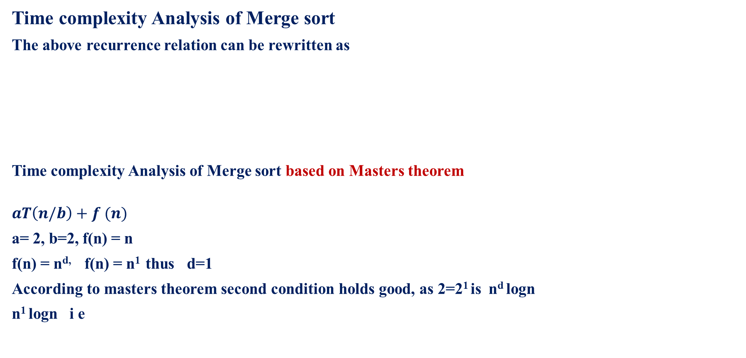

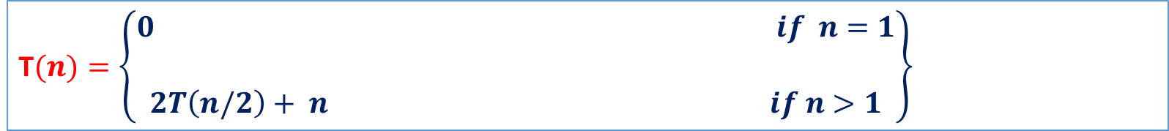
MODULE 2 : DIVIDE AND CONQUER- Merge sort
Time complexity Analysis of Merge sort
The above recurrence relation can be rewritten as
Time complexity Analysis of Merge sort based on Masters theorem
$$aT\left(n/b\right)+f (n)$$
a= 2, b=2, f(n) = n
f(n) = n^{d,} f(n) = n¹ thus d=1
According to masters theorem second condition holds good, as 2=2¹ is $\text{n}\text{d} \text{logn}$
$\text{n}\text{1} \text{logn}$ i e
T$(n)=\left\{\begin{aligned}0 if n=1 \\ \\ 2T\left(n/2\right)+ n if n>1\end{aligned}\right\}$
T(n) Є $\left\{\begin{aligned}\text{Θ}\text{(}\text{nd}\text{) }\text{if} \text{a}\text{ < }\text{bd} \\ \\ \text{Θ}\text{(}\text{nd} \text{logn}\text{) }\text{if} \text{a}\text{ = }\text{bd} \\ \\ \text{Θ}{(n}^{logab}) \text{if} \text{a}\text{ > }\text{bd}\end{aligned}\right\}$
T(n)_{worst} = (n logn)

Slide 56
MODULE 2 : DIVIDE AND CONQUER- Quick sort
Quick sort
Quicksort is the other important sorting algorithm that is based on the divide-and conquer approach.
Quicksort divides input elements according to their value.
A partition is an arrangement of the array’s elements so that
All the elements to the left of some element A[S] are less than or equal to A[S],
and all the elements to the right of A[S] are greater than or equal to A[S],
Specifically it rearranges the elements of a given array A[0……n-1] to achieve its partition, a situation where all the elements before some position S are less than or equal to A[S], and all the elements after position S are greater than or equal to A[S]
After partition of A[0,1, 2,…….n-1]
A[0,1, 2,…….S-1] A[S] A[S+1, S+2, ……..n-1]
After partition A[S] will be in its final position in the sorted array and continue the sorting of the two sub arrays of elements preceding A[S] i e A[0,1, 2,…….S-1] and following A[S] i e
A[S+1, S+2, ……..n-1]
All are ≤ A[S]
All are ≥ A[S]

Slide 57
MODULE 2 : DIVIDE AND CONQUER- Quick sort
Quick sort Algorithm
ALGORITHM Quicksort(A[l . . . . . r])
//Sorts a subarray by quicksort
//Input: Subarray of array A[0..n − 1], defined by its left indices l and right indices r
//Output: Subarray A[l . . . . . r] sorted in nondecreasing order
if l < r
s ←Partition(A[l. . . .r]) //s is a split position
Quicksort(A[l. . . s − 1])
Quicksort(A[s + 1. . . . r])

Slide 58
MODULE 2 : DIVIDE AND CONQUER- Quick sort
Quick sort Algorithm
Quicksort(A[s + 1. . . . r])
ALGORITHM Partition(A[l..r])
//Partitions a subarray by Hoare’s algorithm, using the first element as a pivot
//Input: Subarray of array A[0..n − 1], defined by its left and right indices l and r (l<r)
//Output: Partition of A[l..r], with the split position returned as this function’s value
p←A[l]
i ←l; j ←r + 1
repeat
repeat i ←i + 1 until A[i]≥ p
repeat j ←j − 1 until A[j ]≤ p
swap(A[i], A[j ])
until i ≥ j
swap(A[i], A[j ]) //undo last swap when i ≥ j
swap(A[l], A[j ]) // swap pivot p with A[j]
return j

Slide 59
MODULE 2 : DIVIDE AND CONQUER- Quick sort
Quick sort Example
Trace the quick sort algorithm for the following data set and also construct tree for a recursive call
5, 3, 1, 9, 8, 2, 4, 7
Solution:
n=8
l=0, r=7
i=l i.e i=0
j=r+1
A
Index
0 | 1 | 2 | 3 | 4 | 5 | 6 | 7
5 | 3 | 1 | 9 | 8 | 2 | 4 | 7
Array elements

Slide 60
MODULE 2 : DIVIDE AND CONQUER- Quick sort
First element is pivot
Initially i=0 and j=8 , increment i and decrement j
Now i points second element and j points to last element
i
j
5
 | 3 | 1 | 9 | 8 | 2 | 4 | 7
pivot
i
j
5
3 is less than 5 (pivot), so i++
7 is great than 5 (pivot), so j--
 | 3 | 1 | 9 | 8 | 2 | 4 | 7
3 < 5
7 > 5
i
j
5
1 is less than 5( pivot), so i++
4 is not great than 5 (pivot), so no change in j
 | 3 | 1 | 9 | 8 | 2 | 4 | 7
1 < 5
4 > 5
i
j
9 is not less than 5, so no change in i , Increment of i and decrement of j stopped
i<j swap A[i] and A[j] i e 9 and 4
5
 | 3 | 1 | 9 | 8 | 2 | 4 | 7
9 < 5
i
j
5
i++ and j--
 | 3 | 1 | 4 | 8 | 2 | 9 | 7

Slide 61
MODULE 2 : DIVIDE AND CONQUER- Quick sort
i
j
5
8 is not less than 5, so no change in i , 2 is not greater than 5 so no change in j
i<j swap A[i] and A[j] i e 8 and 2
 | 3 | 1 | 4 | 8 | 2 | 9 | 7
8 < 5
2 > 5
j
i
5
i++ and j--
j > i swap A[j] and pivot.
 | 3 | 1 | 4 | 2 | 8 | 9 | 7
After swap A[j] and pivot, pivot is in its final position, all the elements before pivot are lesser than it and all the elements after pivot are greater than it, thus array is partitioned into two parts
5
2 | 3 | 1 | 4 |  | 8 | 9 | 7
i
j
s=4
2
3 | 1 | 4
4 > 2
3 < 2
i
j
Consider first part in that 2 is pivot, 3 is not less than pivot, so no change in i , 4 is greater than pivot so j--
2
3 | 1 | 4
1 is not greater than pivot so no change in j

Slide 62
MODULE 2 : DIVIDE AND CONQUER- Quick sort
Second part of array
i
j
i
j
8
8 is pivot, 9 is not less
than 8 so change in i and
7 is not greater than
8 so no change in j,
swap A[i] and A[j]
2
3 | 1 | 4
 | 9 | 7
i<j, swap A[i] and A[j] i e 3 and 1
3 < 2
1 > 2
9 < 8
7 > 8
j
i
2
8
1 | 3 | 4
1< 2, so i++, j>2, j++
j > i, swap A[j] and pivot.
 | 7 | 9
j > i,
swap A[j] and pivot
j
i
8
After swapping pivot is in its final position array is divided into two parts
7 |  | 9
2
8 < 5
1 | 3 | 4
s=6
s=1
i j
3 is pivot, i and j points to 4, 4 >3, j++, j>I pivot is less than A[i[ no swap
3
Final sorted array is
1 2 3 4 5 7 8 9
 | 4
j
i
 | 4
s=2
3
 | 4

Slide 63
MODULE 2 : DIVIDE AND CONQUER- Quick sort
Recursive tree call for the example considered in previous slide is
Initially entire array is considered thus l=0 and r=7 (l is index for first element and r is index for last element of array) and s is partition index that pivot occupies and it is it’s sorted final index.
l=0, r=7
s=4
l=0, r=3
s=1
l=5, r=7
s=6
l=0, r=0
l=2, r=3
s=2
l=5, r=5
l=7, r=7
l=2, r=1
l=3, r=3

Slide 64
MODULE 2 : DIVIDE AND CONQUER- Quick sort
Quick sort Example
Trace the quick sort algorithm for the following data set and also construct tree for a recursive call
65, 70, 75, 80, 85, 60, 55, 50, 45
Solution:
n=9
l=0, r=7
i=l i.e i=0
j=r+1
A
Index
0 | 1 | 2 | 3 | 4 | 5 | 6 | 7 | 8
65 | 70 | 75 | 80 | 85 | 60 | 55 | 50 | 45
Array elements

Slide 65
MODULE 2 : DIVIDE AND CONQUER- Quick sort
i
j
65 First element is pivot
Increment I and decrement j. i points to second element and j to last element
65
70 | 75 | 80 | 85 | 60 | 55 | 50 | 45
pivot
j
i
70 is not less than 65, so no change in i
45 is not great than 65, so no change in j,
i<j, swap A[i] and A[j], i++ and j--
65
70 | 75 | 80 | 85 | 60 | 55 | 50 | 45
45 > 65
70 < 65
i
j
75 is not less than 65, so no change in i
50 is not great than 65, so no change in j,
i<j, swap A[i] and A[j], i++ and j--
45 | 75 | 80 | 85 | 60 | 55 | 50 | 70
65
50 > 65
75 < 65
50 > 65
i
j
80 is not less than 65, so no change in i
55 is not great than 65, so no change in j,
i<j, swap A[i] and A[j], i++ and j--
65
45 | 50 | 80 | 85 | 60 | 55 | 75 | 70
55 > 65
80 < 65

Slide 66
MODULE 2 : DIVIDE AND CONQUER- Quick sort
i
j
85 is not less than 65, so no change in i
60 is not great than 65, so no change in j,
i<j, swap A[i] and A[j], i++ and j--
65
45 | 50 | 55 | 85 | 60 | 80 | 75 | 70
85 < 65
60 > 65
pivot
j
i
i ≥ j
Swap 65 (Pivot) and A[j]. all the elements before pivot are lesser than it and all the elements after pivot are greater than it, thus array is partitioned into two parts
65
45 | 50 | 55 | 60 | 85 | 80 | 75 | 70
60 | 45 | 50 | 55 | 85 | 80 | 75 | 70
65
65-Pivot is in final position.
S=4

Slide 67
MODULE 2 : DIVIDE AND CONQUER- Quick sort
Consider first part apply quick sort
i
j
60
 | 45 50 | 55
60 is pivot element
45 is less than 60, so i++
55 is not great than 60, so no change in j,
45 < 60
55 > 60
pivot
i
j
60
50 is less than 60, so i++
45 50 | 55
50 < 60
i
j
i ≥ j
Swap 60 and A[j]. all the elements before 60 are lesser than it and no elements towards right of 60
60
45 50 | 55
i
j
55 45 50
60
60 is in final position.
S=3

Slide 68
MODULE 2 : DIVIDE AND CONQUER- Quick sort
Consider first part apply quick sort
i
j
55
45 50
55 is pivot 45 is less than pivot, so i++
50 is not great than pivot, so no change in j,
45 < 55
50 > 55
pivot
j
i ≥ j
Swap Pivot and A[j]. all the elements before pivot are lesser than it and no elements towards right of pivot
i
55
45 50
j
i
50 45
55
Pivot is in final position.
i
i ≥ j
Swap Pivot and A[j]. all the elements before pivot are lesser than it and no elements towards right of pivot
j
S=2
50
45
45
50
S=1
Pivot is in final position.

Slide 69
MODULE 2 : DIVIDE AND CONQUER- Quick sort
Consider second part apply quick sort
i
j
85
80 | 75 | 70
85 is pivot 80 is less than pivot, so i++
70 is not great than pivot, so no change in j,
70 > 85
pivot
80 < 85
i
j
75 is less than pivot, so i++
70 is not great than pivot, so no change in j,
85
80 | 75 | 70
75 < 85
i
j
i ≥ j
Swap Pivot and A[j]. all the elements before pivot are lesser than it and no elements towards right of pivot
85
80 | 75 | 70
70 | 80 75
85
Pivot is in final position.
S=8

Slide 70
MODULE 2 : DIVIDE AND CONQUER- Quick sort
Consider second part apply quick sort
i
j
70
80 75
70 is pivot80 is not less than pivot so no change in i
75 is great than pivot, so j--,
pivot
80 < 70
75 > 70
j
i
80 is great than pivot, so j--,
Final sorted array is
45, 50, 55, 60, 65, 70, 75, 80, 85
70
80 75
75 < 85
j
70
80 75
Pivot is in final position.
i ≥ j
Swap Pivot and A[j]. all the elements before pivot are lesser than it and no elements towards right of pivot
j
S=5
i
80
75
75
80
Pivot is in final position.
S=7

Slide 71
MODULE 2 : DIVIDE AND CONQUER- Quick sort
Recursive tree call for the example considered in previous slide is
l=0, r=8
s=4
Array elements
l=0, r=3
s=3
l=5, r=8
s=8
Index
l=0, r=2
s=2
l=9, r=8
l=4, r=3
l=5, r=7
s=5
l=0, r=1
s=1
l=3, r=2
l=5, r=4
l=6, r=7
s=7
l=0, r=0
l=2, r=1
l=6, r=6
l=8, r=7

Slide 72
MODULE 2 : DIVIDE AND CONQUER- Quick sort
Quick sort Example
Trace the quick sort algorithm for the following data set and also construct tree for a recursive call
E X A M P L E
Solution:
n=7
A
Index
0 | 1 | 2 | 3 | 4 | 5 | 6
E | X | A | M | P | L | E
Array elements

Slide 73
MODULE 2 : DIVIDE AND CONQUER- Quick sort
i
j
First element is pivot
Initialize i to second element and j to last element
E
X | A | M | P | L | E
pivot
i
j
X is not less than pivot, so no change in i
E is not great than pivot, so no change in j,
i<j, swap A[i] and A[j],
i++ and j--
E
X | A | M | P | L | E
X < E
E > E
i
j
E
E | A | M | P | L | X
A is less than pivot, so i++
Lis great than pivot, so j--
A < E
L > E
i
j
E
E | A | M | P | L | X
M is not less than pivot, so no change in i
P is great than pivot, so j--
M < E
P > E

Slide 74
MODULE 2 : DIVIDE AND CONQUER- Quick sort
j
i
E
E | A | M | P | L | X
M is not less than pivot, so no change in i
M is great than pivot, so j–
i ≥ j, swap A[j] and pivot
M > E
pivot
A | E | M | P | L | X
E
Pivot is in final position.
S=2
Consider first part apply quick sort
j
i
A
E
A
E
Pivot is in final position.
j
i
S=0

Slide 75
MODULE 2 : DIVIDE AND CONQUER- Quick sort
j
i
j
Consider first part apply quick sort
i
P
X
M
L | P | X
L is less than pivot, so i++
X is great than pivot, so j–
X > M
S=5
L < M
j
Pivot is in final position.
i
P (A[i]) is not less than pivot, so no change in i
P (A[j]) is great than pivot, so j–
Final sorted array is
A E E L M P X
M
L | P | X
j
i
j
i
i ≥ j
Swap Pivot and A[j]. all the elements before pivot are lesser than it and no elements towards right of pivot
M
L | P | X
X
M
L | P | X
X (A[i]) is not less than pivot, so no change in i
X (A[j]) is great than pivot, so j–
S=4
i
j
P
X

Slide 76
MODULE 2 : DIVIDE AND CONQUER- Quick sort
Recursive tree call for the example considered in previous slide is
l=0, r=6
s=2
Array elements
l=0, r=1
s=0
l=3, r=6
s=4
Index
l=0, r=-1
l=5, r=6
s=5
l=1, r=1
l=3, r=3
l=5, r=4
l=6, r=6

Slide 77

MODULE 2 : DIVIDE AND CONQUER- Quick sort
Time complexity Analysis of Quick sort
Input size- n
Basic operation- Divide and merge of n elements
As basic operation depends only on input size and also values of list, thus worst, average and best case all can be computed. let us consider
Best case complexity
This case occurs when the pivot is at the centre and divides the array into two equal parts. The recurrence relation is given as
T$(n)=\left\{\begin{aligned}0 if n=1 \\ \\ T\left(n/2\right)+T\left(n/2\right)+ n if n>1\end{aligned}\right\}$
No sorting required
Time required to divide and merge list with n elements
Time required to sort left part of the array
Time required to sort right part of the array

Slide 78
MODULE 2 : DIVIDE AND CONQUER- Merge sort
Time complexity Analysis of Quick sort
Input size- n
Basic operation- Divide and merge of n elements
As basic operation depends only on input size and also values of list, thus worst, average and best case all can be computed. let us consider
Best case complexity
This case occurs when the pivot is at the centre and divides the array into two equal parts. The recurrence relation is given as
T$(n)=\left\{\begin{aligned}0 if n=1 \\ \\ T\left(n/2\right)+T\left(n/2\right)+ n if n>1\end{aligned}\right\}$
No sorting required
Time required to divide and merge list with n elements
Time required to sort left part of the array
Time required to sort right part of the array

Slide 79
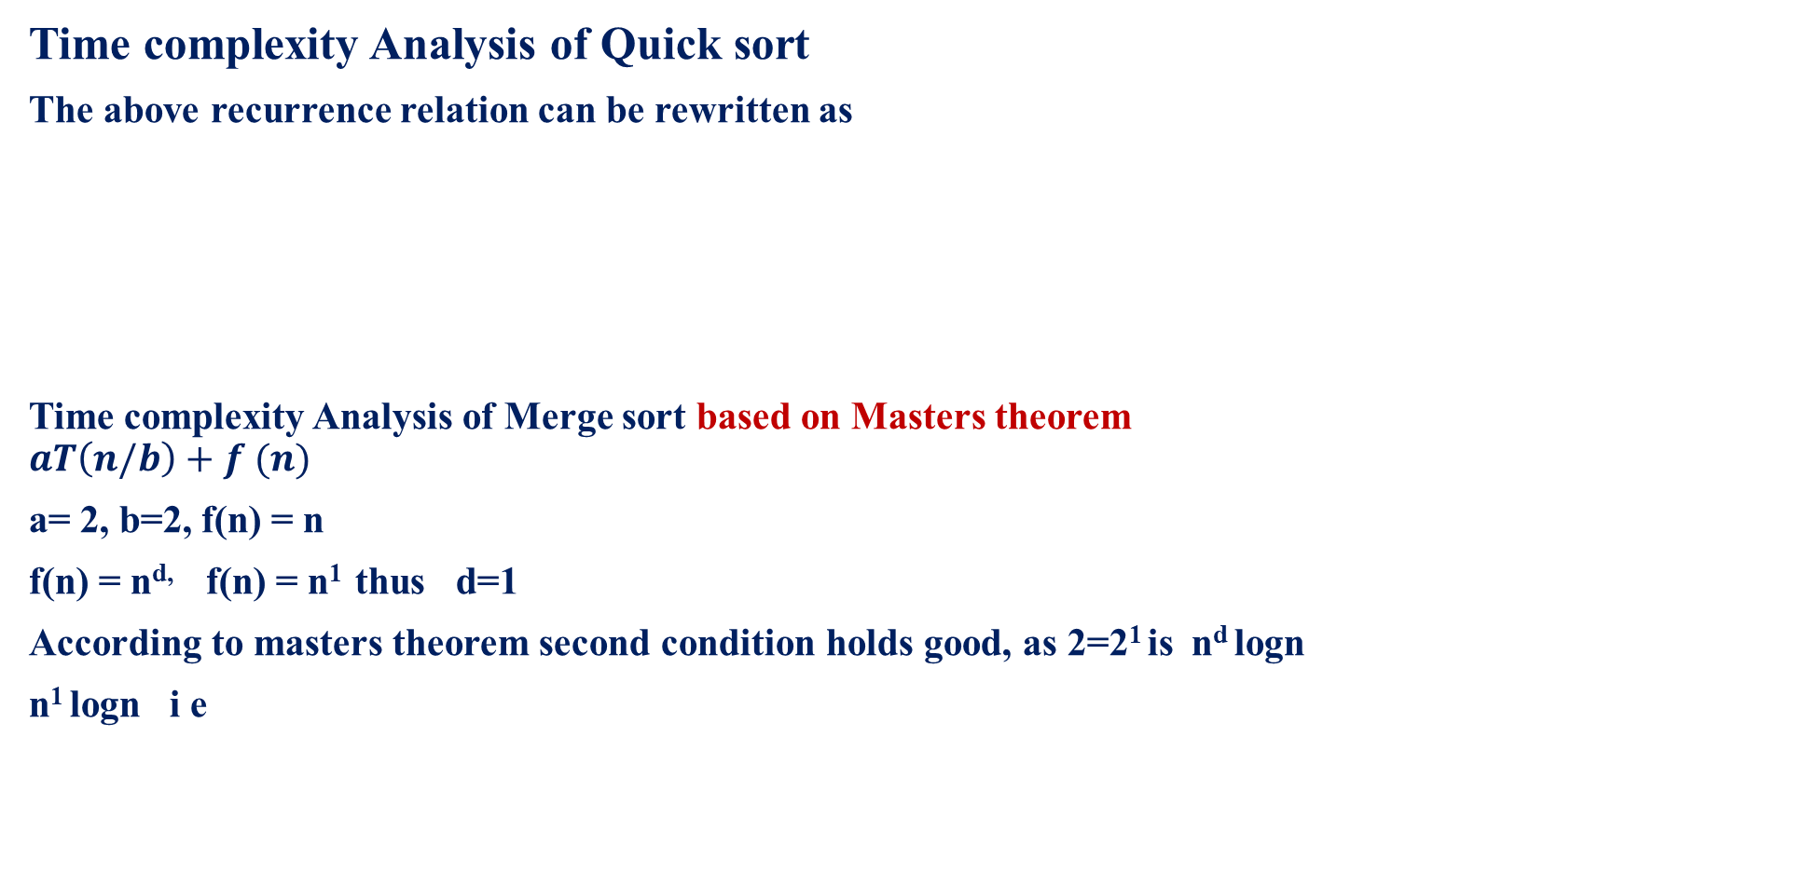
MODULE 2 : DIVIDE AND CONQUER- Merge sort
Time complexity Analysis of Quick sort
The above recurrence relation can be rewritten as
Time complexity Analysis of Merge sort based on Masters theorem
$$aT\left(n/b\right)+f (n)$$
a= 2, b=2, f(n) = n
f(n) = n^{d,} f(n) = n¹ thus d=1
According to masters theorem second condition holds good, as 2=2¹ is $\text{n}\text{d} \text{logn}$
$\text{n}\text{1} \text{logn}$ i e
T$(n)=\left\{\begin{aligned}0 if n=1 \\ \\ 2T\left(n/2\right)+ n if n>1\end{aligned}\right\}$
The best case time complexity is T(n)_{best} = (n logn)

Slide 80
MODULE 2 : DIVIDE AND CONQUER- Quick sort
Time complexity Analysis of Quick sort
Worst case complexity
This case occurs when at the each invocation of the quick sort, the current array is partitioned into two sub array in that one is completely empty. Another contains all the elements for sorting.
This situation occurs if all the input elements are in ascending or descending order.
Example
22, 33, 44, 55, 66 input array
22, 33, 44, 55, 66
22, 33, 44, 55, 66
i
j
33<22
66>22, j--
pivot
i
j
55>22, j--

Slide 81
MODULE 2 : DIVIDE AND CONQUER- Merge sort
Time complexity Analysis of Quick sort
22, 33, 44, 55, 66
22, 33, 44, 55, 66
22, 33, 44, 55, 66
i
j
44>22, j--
i
j
33>22, j--
Pivot in final position
And no elements towards left of pivot, and there are n-1 elements at right, same problem continue with other elements
j
i
In general if array has n elements, after partioning, in the worst case (n-1) elements appears towards right and 0 elements towards left (if input array is in ascending order) of pivot element.

Slide 82


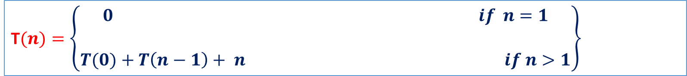
MODULE 2 : DIVIDE AND CONQUER- Quick sort
Time complexity Analysis of Quick sort
The above recurrence relation can be rewritten as
The above recurrence relation becomes
$0+T\left(n−1\right)+ n$ = $T\left(n−1\right)+ n$
Apply substitution method
T(n)=T(n-1)+n replace T(n-1) by T(n-2)+n-1
T(n)=T(n-2)+n-1+n replace T(n-2) by T(n-3)+n-2
T(n)= T(n-3)+(n-2)+(n-1)+n
T$(n)=\left\{\begin{aligned}0 if n=1 \\ \\ T(0)+T\left(n−1\right)+ n if n>1\end{aligned}\right\}$
Zero number of elements left part of the array, thus T(0)=0)
(n-1) number of elements right part of the array, thus T(n-1))
divide and sort the elements
On continuing the above equation
;
;
T(n)= T(n-n)+1+2+3……+ (n-2)+(n-1)+n
T(n)= 1+2+3……+ (n-2)+(n-1)+n
= $\frac{n\left(n+1\right)}{2}$ = $\frac{n2}{2}$ + $\frac{n}{2}$
≈ O(n²)
i
The worst case time complexity is T(n)worst = (n²)

Slide 83
MODULE 2 : DIVIDE AND CONQUER- Merge sort
Time complexity Analysis of Quick sort
Average case complexity
This case occurs when the given array may not be exactly portioned into subarray or may not be skewed as in worst case.
The pivot appears at any arbitrary position in the array ranging from 0 to n-1
Let us consider k is partition position
A[0] | A[1] | ………….. | A[k] | A[k+1] | A[k+2] | ……. | A[n-1]
left part of the array
With k-1 elements
Right part of array
n-k elements
Partition position

Slide 84
MODULE 2 : DIVIDE AND CONQUER- Quick sort
Time to sort left part of the array
In left part
Lower bound = 0
Upper bound = k-1
Thus no of elements in left part are obtained as
Upper bound - lower bound+1
k-1-0+1=k
As there k no of elements in left part, time to sort left part is T(k) Eq 1.
2. Time to sort right part of the array
Lower bound = k+1
Upper bound = n-1
Thus no of elements in right part are obtained as
Upper bound - lower bound +1
n-1-(k+1)+1
= n – k
As there n – k no of elements in right part, time sort right part is T(n-k) Eq 2.

Slide 85
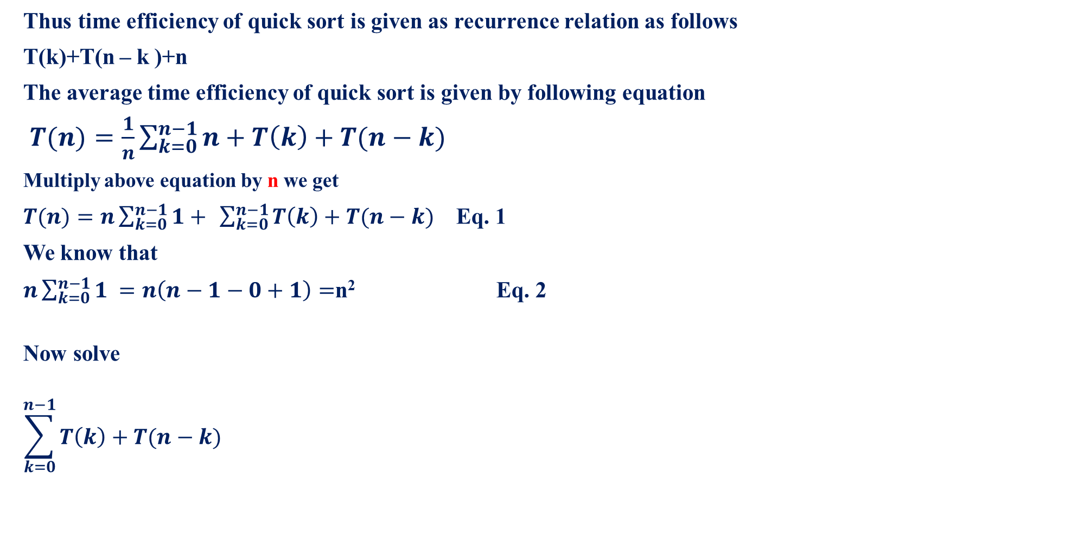
MODULE 2 : DIVIDE AND CONQUER- Quick sort
Thus time efficiency of quick sort is given as recurrence relation as follows
T(k)+T(n – k )+n
The average time efficiency of quick sort is given by following equation
$T(n)=\frac{1}{n}\sum_{k=0}^{n−1}{n+T\left(k\right)+T(n−k) }$
Multiply above equation by n we get
$T(n)=n\sum_{k=0}^{n−1}{1+} \sum_{k=0}^{n−1}{T\left(k\right)+T(n−k) }$ Eq. 1
We know that
$n\sum_{k=0}^{n−1}{1 =n\left(n−1−0+1\right)=}$n² Eq. 2
Now solve
$$\sum_{k=0}^{n−1}{T\left(k\right)+T(n−k) }$$

Slide 86
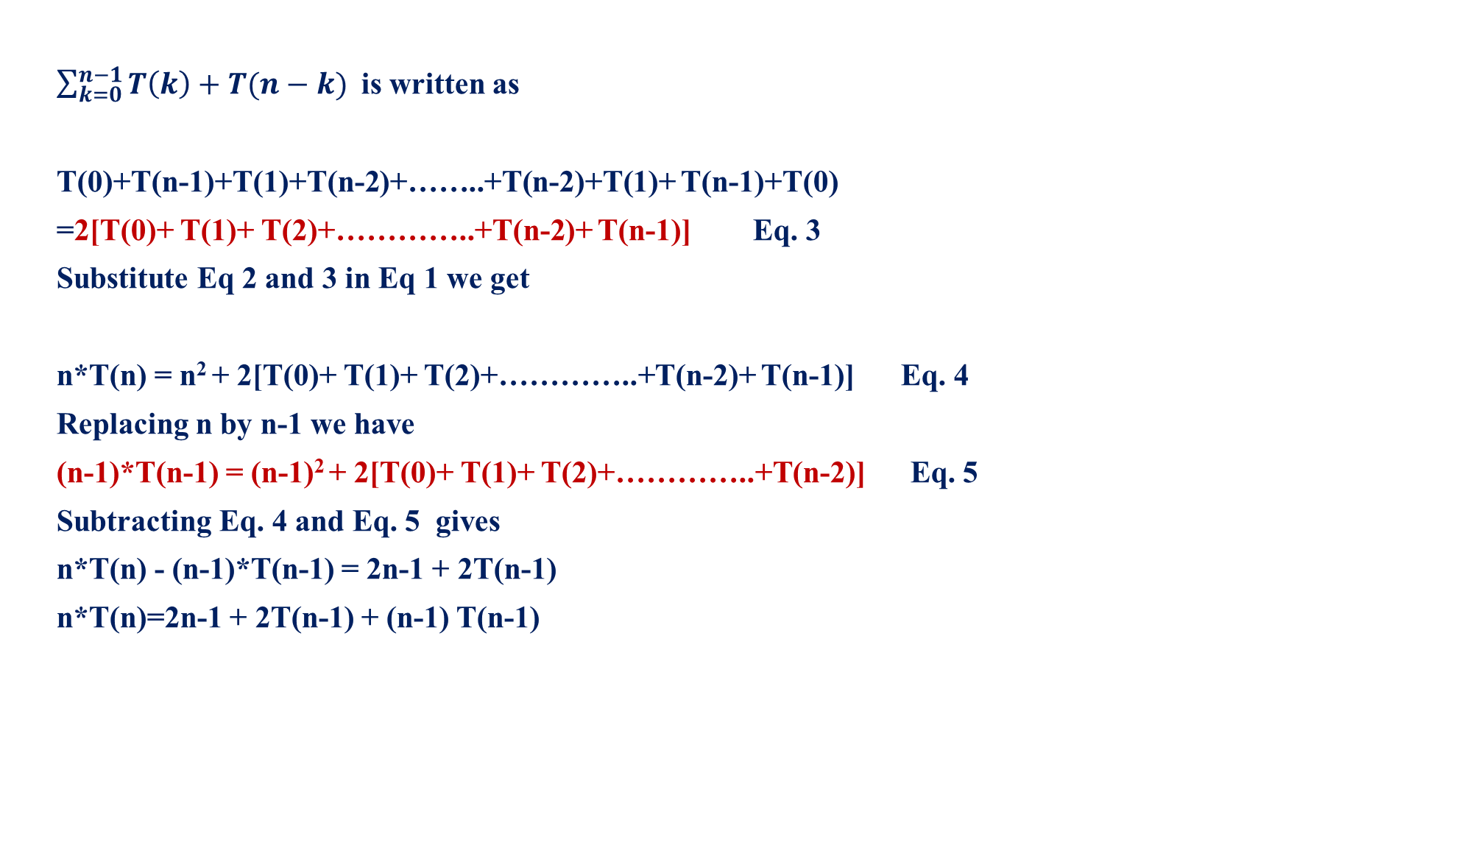
MODULE 2 : DIVIDE AND CONQUER- Quick sort
$\sum_{k=0}^{n−1}{T\left(k\right)+T(n−k) }$ is written as
T(0)+T(n-1)+T(1)+T(n-2)+……..+T(n-2)+T(1)+ T(n-1)+T(0)
=2[T(0)+ T(1)+ T(2)+…………..+T(n-2)+ T(n-1)] Eq. 3
Substitute Eq 2 and 3 in Eq 1 we get
n*T(n) = n² + 2[T(0)+ T(1)+ T(2)+…………..+T(n-2)+ T(n-1)] Eq. 4
Replacing n by n-1 we have
(n-1)*T(n-1) = (n-1)² + 2[T(0)+ T(1)+ T(2)+…………..+T(n-2)] Eq. 5
Subtracting Eq. 4 and Eq. 5 gives
n*T(n) - (n-1)*T(n-1) = 2n-1 + 2T(n-1)
n*T(n)=2n-1 + 2T(n-1) + (n-1) T(n-1)

Slide 87

MODULE 2 : DIVIDE AND CONQUER- Quick sort
n*T(n)=2n-1 + 2T(n-1) + (n-1) T(n-1)
n*T(n)= 2T(n-1) + 2n-1 + nT(n-1) - T(n-1)
n*T(n)= T(n-1) + 2n-1 + nT(n-1)
n*T(n)= (n+1) T(n-1) + 2n-1 Eq. 6
Divide Eq 6 by n(n+1) we get
$\frac{\text{n}\text{∗}\text{T}\text{(}\text{n}\text{)}}{n(n+1)}$= $\frac{\text{(}\text{n}\text{+1) }\text{T}\text{(}\text{n}\text{−1) + 2}\text{n}\text{−1 }}{n(n+1)}$
$\frac{\text{T}\text{(}\text{n}\text{)}}{(n+1)}$= $\frac{ \text{T}\text{(}\text{n}\text{−1) }}{n}$ + $\frac{\text{2}\text{n}\text{−1}}{n(n+1)}$
approximate value of $\frac{\text{2}\text{n}\text{−1}}{n(n+1)}$ is $\frac{\text{2}}{n}$
$\frac{\text{T}\text{(}\text{n}\text{)}}{(n+1)}$= $\frac{ \text{T}\text{(}\text{n}\text{−1) }}{n}$ + $\frac{\text{2}}{n}$

Slide 88

MODULE 2 : DIVIDE AND CONQUER- Quick sort
Let us assume, d(n) is $\frac{\text{T}\text{(}\text{n}\text{)}}{(n+1)}$
$d(n)$= $\frac{ \text{T}\text{(}\text{n}\text{−1) }}{n}$ + $\frac{\text{2}}{n}$
$d(n)$= d(n-1) + $\frac{\text{2}}{n}$
By substitution method we have
d(n) = d(n-i) + $\frac{\text{2}}{(n−(i−1)}$ +………+ $\frac{\text{2}}{n}$
Initial condition , d(1)=0, d(n-i)=d(1) [ as i=n-1]
d(n) = d(n-n+1) + 2[$\frac{\text{1}}{2}$ +………+ $\frac{\text{1}}{n}$]
d(n) = 0+1+……..+$\frac{\text{2}}{n−1}$ +$\frac{\text{2}}{n}$

Slide 89

MODULE 2 : DIVIDE AND CONQUER- Quick sort
d(n) ≈ 2ln(n)-2
≈ 2ln(n)
d(n) ≈ 2*0.69 log₂n
d(n) ≈ 1.38 log₂n
Where d(n) is $\frac{\text{T}\text{(}\text{n}\text{)}}{(n+1)}$
$\frac{\text{T}\text{(}\text{n}\text{)}}{(n+1)}$≈ 1.38 log₂n
T(n) ≈ (n+1) *1.38 log₂n
T(n) ≈ n log₂n
Thus Average time complexity is (n log₂n)

Slide 90
MODULE 2 : DIVIDE AND CONQUER- Max-Min algorithm
Max-Min algorithm
It is algorithm used to find the maximum and minimum element in the given list of elements.
Different situations are possible.
If list contains only one element, then that element itself is Max or Min element.
When there are only two elements in the list, then simple comparison is sufficient to determine the Max and min element.
if(a[0]< a[1])
{
min=a[0]
max=a[1]
}
else
{
min=a[1]
max=a[0]
}

Slide 91
MODULE 2 : DIVIDE AND CONQUER- Max-Min algorithm
3. When there are more number of elements in the list, then Maxmin( ) algorithm is applied recursively to find maximum and minimum elements in the array.
Algorithm
maxmin( int i, int j, type max, type min)
// array A[0….n-1] is input array.
// i and j are 0 ≤ i ≤ j ≤ (n-1)
// Algorithm set the maximum and minimum element of a[0…n-1] to max and min variable respectively.
{
if (i = j) max=min=a[i];// array with only one element.
else if (i = j-1) // array with only two element.
{
if(a[i]< a[j])
{
min=a[i]
max=a[j]
}
else
{
min=a[j]
max=a[i]
}}

Slide 92
MODULE 2 : DIVIDE AND CONQUER- Max-Min algorithm
else
{
// array is not small, split the array
mid=(i+j)/2
maxmin(i, mid, max, min);
maxmin(mid+1, j, max1, min1)
// combine the solution
if(max< max1)
max= max1]
if(min> min1)
min=min1;
}
}

Slide 93
MODULE 2 : DIVIDE AND CONQUER- Maxmin algorithm
Maxmin algorithm Example
Trace the Maxmin algorithm for a given list of elements and also construct the recursive calls tree
22, 13, -5, -8, 15, 60, 17, 31, 47
Solution:
Array size is n=9
A
Index
0 | 1 | 2 | 3 | 4 | 5 | 6 | 7 | 8
22 | 13 | -5 | -8 | 15 | 60 | 17 | 31 | 47

Slide 94
MODULE 2 : DIVIDE AND CONQUER- Maxmin algorithm
0 | 1 | 2 | 3 | 4 | 5 | 6 | 7 | 8
22 | 13 | -5 | -8 | 15 | 60 | 17 | 31 | 47
0, 8
5, 8
0, 4
Dividing
Max=15
Max=47
Min=-8
Min=17
Min=31
0, 2
Max=60
7, 8
3, 4
Max=-5
5, 6
Max=22
Min=13
Max=-5
Min=-5
0, 1
2, 2
Max=60
Max=22
0, 2
Min=17
5, 8
Max=-5
Max=22
0, 4
Merging
Min=-8
Max=60
Min=-8
0, 8

Slide 95
MODULE 2 : DIVIDE AND CONQUER- Maxmin algorithm
Maxmin algorithm Example
Trace the Maxmin algorithm for a given list of elements and also construct the recursive calls tree
65, 70, 75, 80, 85, 60, 55, 50, 45.
Solution:
Array size is n=9
A
Index
0 | 1 | 2 | 3 | 4 | 5 | 6 | 7 | 8
65 | 70 | 75 | 80 | 85 | 60 | 55 | 50 | 45
Min=-8

Slide 96
MODULE 2 : DIVIDE AND CONQUER- Maxmin algorithm
0 | 1 | 2 | 3 | 4 | 5 | 6 | 7 | 8
65 | 70 | 75 | 80 | 85 | 60 | 55 | 50 | 45
0, 8
5, 8
0, 4
Dividing
Max=85
Max=50
Min=80
Min=55
Min=45
0, 2
Max=60
7, 8
3, 4
Max=-5
5, 6
Max=70
Min=65
Max=75
Min=75
0, 1
2, 2
Max=60
Max=75
0, 2
Min=45
5, 8
Min=65
Max=85
0, 4
Merging
Min=65
Max=85
Min=45
0, 8

Slide 97
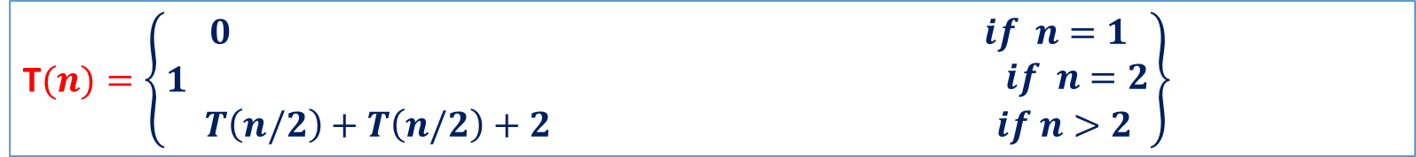
MODULE 2 : DIVIDE AND CONQUER- Merge sort
Time complexity Analysis of Maxmin
Input size- n
Basic operation- Divide and merge of n elements
As basic operation depends only on input size
Case 1: when list has only one element, that element itself is max and min T(1)=0
Case 2: when list has only two element, that element one is max and other is min and only comparison is required T(2)=1
Case 3: when list has only more number of elements n>2, that list is divided into two parts of equal size, thus recurrence relation is
T$(n)=\left\{1\begin{aligned}0 if n=1 \\ if n=2 \\ T\left(n/2\right)+T\left(n/2\right)+2 if n>2\end{aligned}\right\}$
Time required to sort left part of the array
Time required to sort right part of the array

Slide 98
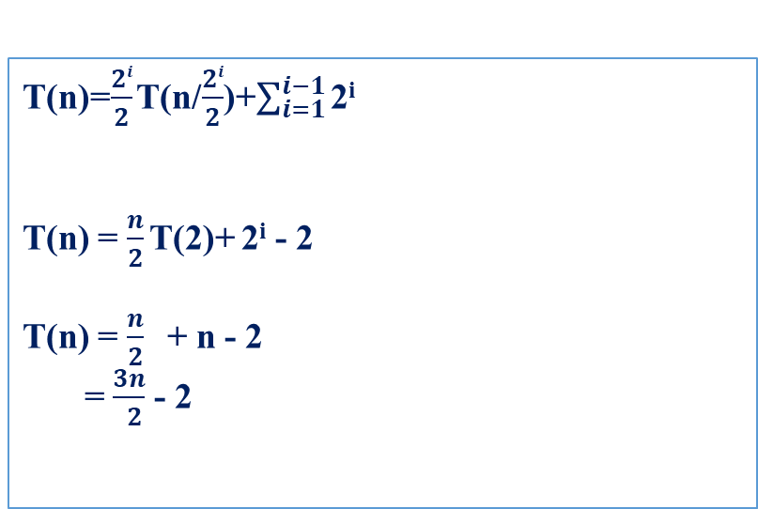

MODULE 2 : DIVIDE AND CONQUER- Quick sort
Time complexity Analysis
The above recurrence relation can be rewritten as
Apply substitution method
T(n)=2T(n/2)+2 replace T(n/2) by 2T(n/4)+2
T(n)=2[2T(n/4)+2]+2 replace T(n/4) by 2T(n/8)+2
T(n)=4[2T(n/8)+2]+4+2
T(n)=2³ T(n/2³)+2³ +2² +2
;
;
T(n)=2^{i-1} T(n/2^{i-1})+2^{i-1} +2^{i-2} +……+2³ +2² +2
Let us assume 2^{i} = n, take log on both sides
Log₂2 = log₂n
i=log₂n
T(n)=$\frac{2i}{2}$ T(n/$\frac{2i}{2}$)+$\sum_{i=1}^{i−1}{\text{2}\text{i}}$
T(n) = $\frac{n}{2}$ T(2)+ $\text{2}\text{i}$ - 2
T(n) = $\frac{n}{2}$ + n - 2
= $\frac{3n}{ 2}$ - 2
The time complexity is T(n) = $\frac{3n}{ 2}$ - 2

Slide 99
MODULE 2 : DIVIDE AND CONQUER- Strassens Matrix Multiplication
Traditional matrix multiplication algorithm
for i← 1 to n do
for j← 1 to n do
C(i, j) = 0
for k← 1 to n do
C(i, j) = C(i, j) + A (i, k)*B(k, j)
repeat
repeat
repeat
Time complexity of above algorithm is Θ(n³) (three for loops).

Slide 100
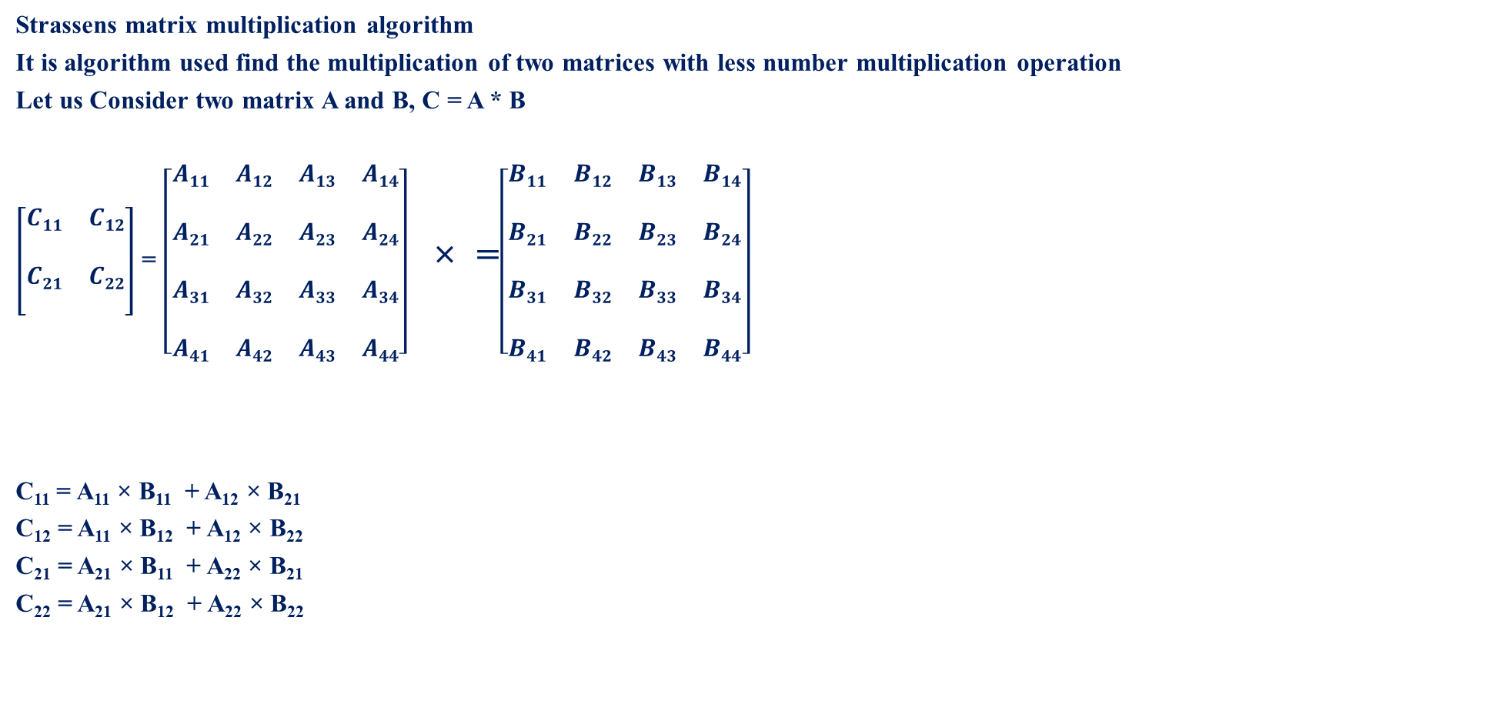
MODULE 2 : DIVIDE AND CONQUER- Strassens Matrix Multiplication
Strassens matrix multiplication algorithm
It is algorithm used find the multiplication of two matrices with less number multiplication operation
Let us Consider two matrix A and B, C = A * B
$\left[\begin{aligned}\begin{matrix}C11 & C12 \\ \begin{aligned} \\ C21\end{aligned} & \begin{aligned} \\ C22\end{aligned}\end{matrix} \\ \end{aligned}\right]$ = $\left[\begin{matrix}A11 & A12 & A13 & A14 \\ \begin{aligned} \\ A21\end{aligned} & \begin{aligned} \\ A22\end{aligned} & \begin{aligned} \\ A23\end{aligned} & \begin{aligned} \\ A24\end{aligned} \\ \begin{aligned} \\ A31\end{aligned} & \begin{aligned} \\ A32\end{aligned} & \begin{aligned} \\ A33\end{aligned} & \begin{aligned} \\ A34\end{aligned} \\ \begin{aligned} \\ A41\end{aligned} & \begin{aligned} \\ A42\end{aligned} & \begin{aligned} \\ A43\end{aligned} & \begin{aligned} \\ A44\end{aligned}\end{matrix}\right]$ × =$\left[\begin{matrix}B11 & B12 & B13 & B14 \\ \begin{aligned} \\ B21\end{aligned} & \begin{aligned} \\ B22\end{aligned} & \begin{aligned} \\ B23\end{aligned} & \begin{aligned} \\ B24\end{aligned} \\ \begin{aligned} \\ B31\end{aligned} & \begin{aligned} \\ B32\end{aligned} & \begin{aligned} \\ B33\end{aligned} & \begin{aligned} \\ B34\end{aligned} \\ \begin{aligned} \\ B41\end{aligned} & \begin{aligned} \\ B42\end{aligned} & \begin{aligned} \\ B43\end{aligned} & \begin{aligned} \\ B44\end{aligned}\end{matrix}\right]$
C₁₁ = A₁₁ × B₁₁ + A₁₂ × B₂₁
C₁₂ = A₁₁ × B₁₂ + A₁₂ × B₂₂
C₂₁ = A₂₁ × B₁₁ + A₂₂ × B₂₁
C₂₂ = A₂₁ × B₁₂ + A₂₂ × B₂₂
Apply divide and conquer method on the matrices, ie divide the matrix into small equal size matrix
This requires eight multiplications

Slide 101
MODULE 2 : DIVIDE AND CONQUER- Strassens Matrix Multiplication
Strassens Matrix Multiplication
C₁₁ = P + S – T + V
C₁₂ = R + T
C₂₁ = Q + S
C₂₂ = P + R – Q + U
Where
P = ( A₁₁ + A₂₂ ) (B₁₁ + B₂₂)
Q = ( A₂₁ + A₂₂ ) (B₁₁)
R = ( A₁₁ ) (B₁₂ - B₂₂)
S = ( A₂₂ ) (B₂₁ - B₁₁)
T = ( A₁₁ + A₁₂ ) (B₂₂)
U = ( A₂₁ – A₁₁ ) (B₁₁ + B₁₂)
V = ( A₁₂ - A₂₂ ) (B₂₁ + B₂₂)
From the Strassens matrix multiplication we need to perform only SEVEN multiplication operations

Slide 102
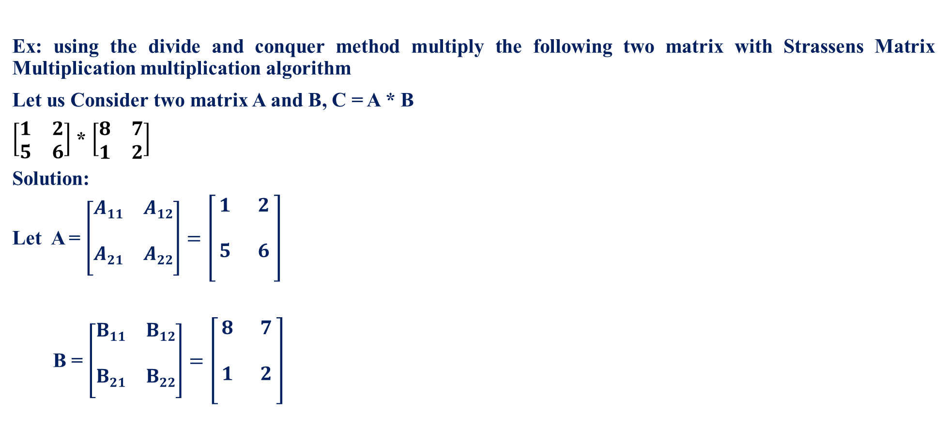
MODULE 2 : DIVIDE AND CONQUER- Strassens Matrix Multiplication
Ex: using the divide and conquer method multiply the following two matrix with Strassens Matrix Multiplication multiplication algorithm
Let us Consider two matrix A and B, C = A * B
$\left[\begin{matrix}1 & 2 \\ 5 & 6\end{matrix}\right]$ * $\left[\begin{matrix}8 & 7 \\ 1 & 2\end{matrix}\right]$
Solution:
Let A = $\left[\begin{aligned}\begin{matrix}A11 & A12 \\ \begin{aligned} \\ A21\end{aligned} & \begin{aligned} \\ A22\end{aligned}\end{matrix} \\ \end{aligned}\right]=\left[\begin{aligned}\begin{matrix}1 & 2 \\ \begin{aligned} \\ 5\end{aligned} & \begin{aligned} \\ 6\end{aligned}\end{matrix} \\ \end{aligned}\right]$
B = $\left[\begin{aligned}\begin{matrix}B11 & B12 \\ \begin{aligned} \\ B21\end{aligned} & \begin{aligned} \\ B22\end{aligned}\end{matrix} \\ \end{aligned}\right]=\left[\begin{aligned}\begin{matrix}8 & 7 \\ \begin{aligned} \\ 1\end{aligned} & \begin{aligned} \\ 2\end{aligned}\end{matrix} \\ \end{aligned}\right]$

Slide 103
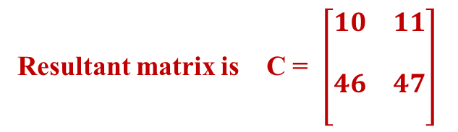
MODULE 2 : DIVIDE AND CONQUER- Strassens Matrix Multiplication
Strassens Matrix Multiplication
P = ( A₁₁ + A₂₂ ) (B₁₁ + B₂₂) = (1 + 6) × (8 + 2) = 7 × 10 = 70
Q = ( A₂₁ + A₂₂ ) (B₁₁) = (5 + 6) × 8 = 11 × 8 = 88
R = ( A₁₁ ) (B₁₂ - B₂₂) = 1 × (7 – 2) = 1 × 5 = 5
S = ( A₂₂ ) (B₂₁ - B₁₁) = ( 6 ) × (1 - 8) =6 × -7 = -42
T = ( A₁₁ + A₁₂ ) (B₂₂) = ( 1 + 2 ) × (2) = 3 × 2 = 6
U = ( A₂₁ – A₁₁ ) (B₁₁ + B₁₂) = ( 5 – 1 ) × (8 + 7) = 4 × 15 = 60
V = ( A₁₂ - A₂₂ ) (B₂₁ + B₂₂) = (2 - 6 ) × (1 + 2) = -4 × 3 = -12
WKT
C₁₁ = 70 – 42 – 6 – 12 = 10
C₁₂ = 5 + 6 = 11
C₂₁ = 88 – 42 = 46
C₂₂ = 70 + 5 – 88 + 60 = 47
Resultant matrix is C = $\left[\begin{aligned}\begin{matrix}10 & 11 \\ \begin{aligned} \\ 46\end{aligned} & \begin{aligned} \\ 47\end{aligned}\end{matrix} \\ \end{aligned}\right]$

Slide 104
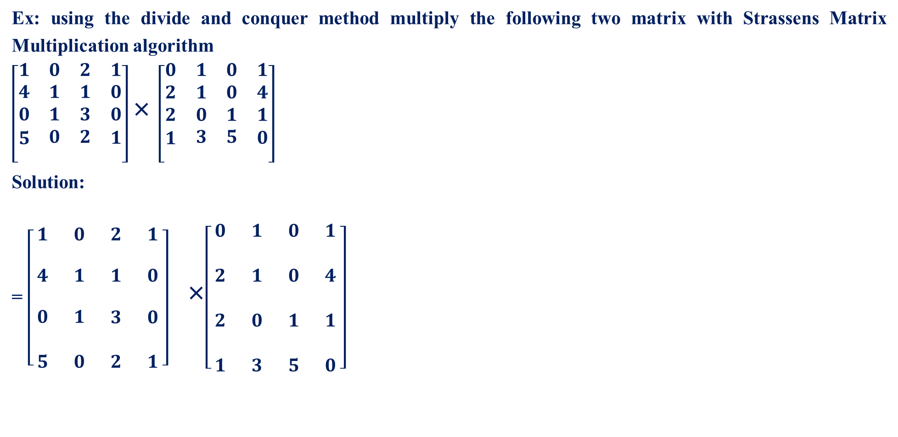
MODULE 2 : DIVIDE AND CONQUER- Strassens Matrix Multiplication
Ex: using the divide and conquer method multiply the following two matrix with Strassens Matrix Multiplication algorithm
$\left[\begin{aligned}\begin{matrix}1 & 0 & 2 & 1 \\ 4 & 1 & 1 & 0 \\ 0 & 1 & 3 & 0 \\ \begin{aligned}5\end{aligned} & 0 & 2 & \begin{aligned}1\end{aligned}\end{matrix} \\ \end{aligned}\right]$ × $\left[\begin{aligned}\begin{matrix}0 & 1 & 0 & 1 \\ 2 & 1 & 0 & 4 \\ 2 & 0 & 1 & 1 \\ \begin{aligned}1\end{aligned} & 3 & 5 & \begin{aligned}0\end{aligned}\end{matrix} \\ \end{aligned}\right]$
Solution:
= $\left[\begin{matrix}\begin{aligned}1 \\ \end{aligned} & \begin{aligned}0 \\ \end{aligned} & \begin{aligned}2 \\ \end{aligned} & \begin{aligned}1 \\ \end{aligned} \\ \begin{aligned}4 \\ \end{aligned} & \begin{aligned}1 \\ \end{aligned} & \begin{aligned}1 \\ \end{aligned} & \begin{aligned}0 \\ \end{aligned} \\ \begin{aligned}0 \\ \\ 5\end{aligned} & \begin{aligned}1 \\ \\ 0\end{aligned} & \begin{aligned}3 \\ \\ 2\end{aligned} & \begin{aligned}0 \\ \\ 1\end{aligned}\end{matrix}\right]$ ×$\left[\begin{matrix}0 & 1 & 0 & 1 \\ & & & \\ 2 & 1 & 0 & 4 \\ & & & \\ 2 & 0 & 1 & 1 \\ & & & \\ 1 & 3 & 5 & 0\end{matrix}\right]$
A₁₁
A₁₂
B₁₁
B₁₂
A₂₁
A₂₂
B₂₁
B₂₂

Slide 105

MODULE 2 : DIVIDE AND CONQUER- Strassens Matrix Multiplication
Strassens Matrix Multiplication
P = ( A₁₁ + A₂₂ ) (B₁₁ + B₂₂) = $\left(\left[\begin{aligned}\begin{matrix}1 & 0 \\ \begin{aligned} \\ 4\end{aligned} & \begin{aligned} \\ 1\end{aligned}\end{matrix} \\ \end{aligned}\right]\text{ + }\left[\begin{aligned}\begin{matrix}3 & 0 \\ \begin{aligned} \\ 2\end{aligned} & \begin{aligned} \\ 1\end{aligned}\end{matrix} \\ \end{aligned}\right]\right)$ × $\left(\left[\begin{aligned}\begin{matrix}0 & 1 \\ \begin{aligned} \\ 2\end{aligned} & \begin{aligned} \\ 1\end{aligned}\end{matrix} \\ \end{aligned}\right]\text{ + }\left[\begin{aligned}\begin{matrix}1 & 1 \\ \begin{aligned} \\ 5\end{aligned} & \begin{aligned} \\ 0\end{aligned}\end{matrix} \\ \end{aligned}\right]\right)$ = $\left(\left[\begin{aligned}\begin{matrix}4 & 0 \\ \begin{aligned} \\ 6\end{aligned} & \begin{aligned} \\ 2\end{aligned}\end{matrix} \\ \end{aligned}\right]\text{×}\left[\begin{aligned}\begin{matrix}1 & 2 \\ \begin{aligned} \\ 7\end{aligned} & \begin{aligned} \\ 1\end{aligned}\end{matrix} \\ \end{aligned}\right]\right)$
LET C =$\left[\begin{aligned}\begin{matrix}4 & 0 \\ \begin{aligned} \\ 6\end{aligned} & \begin{aligned} \\ 2\end{aligned}\end{matrix} \\ \end{aligned}\right]and D=\left[\begin{aligned}\begin{matrix}1 & 2 \\ \begin{aligned} \\ 7\end{aligned} & \begin{aligned} \\ 1\end{aligned}\end{matrix} \\ \end{aligned}\right]$

Slide 106


MODULE 2 : DIVIDE AND CONQUER- Strassens Matrix Multiplication
Strassens Matrix Multiplication
P = ( A₁₁ + A₂₂ ) (B₁₁ + B₂₂) = (4 + 2) × (1 + 1) = 6× 2 = 12
Q = ( A₂₁ + A₂₂ ) (B₁₁) = (6 + 2) × 1 = 8 × 1 = 8
R = ( A₁₁ ) (B₁₂ - B₂₂) = 4 × (2 – 1) = 4 × 1 = 4
S = ( A₂₂ ) (B₂₁ - B₁₁) = ( 2 ) × (7 - 1) =2 × 6= 12
T = ( A₁₁ + A₁₂ ) (B₂₂) = ( 4 + 0 ) × (1) = 4× 1 = 4
U = ( A₂₁ – A₁₁ ) (B₁₁ + B₁₂) = ( 6 – 4 ) × (1+ 2) = 2 × 3= 6
V = ( A₁₂ - A₂₂ ) (B₂₁ + B₂₂) = (0 - 2 ) × (7 + 1) = -2× 8 = -16
C₁₁ = P + S – T + V = 12 +12 – 4 -16 = 4
C₁₂ = R + T = 4 + 4 = 8
C₂₁ = Q + S = 8 + 12 = 20
C₂₂ = P + R – Q + U = 12 + 4 -8 + 6 = 14
P = $\left[\begin{aligned}\begin{matrix}4 & 8 \\ \begin{aligned} \\ 20\end{aligned} & \begin{aligned} \\ 14\end{aligned}\end{matrix} \\ \end{aligned}\right]$
$$\left(\left[\begin{aligned}\begin{matrix}4 & 0 \\ \begin{aligned} \\ 6\end{aligned} & \begin{aligned} \\ 2\end{aligned}\end{matrix} \\ \end{aligned}\right]\text{×}\left[\begin{aligned}\begin{matrix}1 & 2 \\ \begin{aligned} \\ 7\end{aligned} & \begin{aligned} \\ 1\end{aligned}\end{matrix} \\ \end{aligned}\right]\right)$$

Slide 107
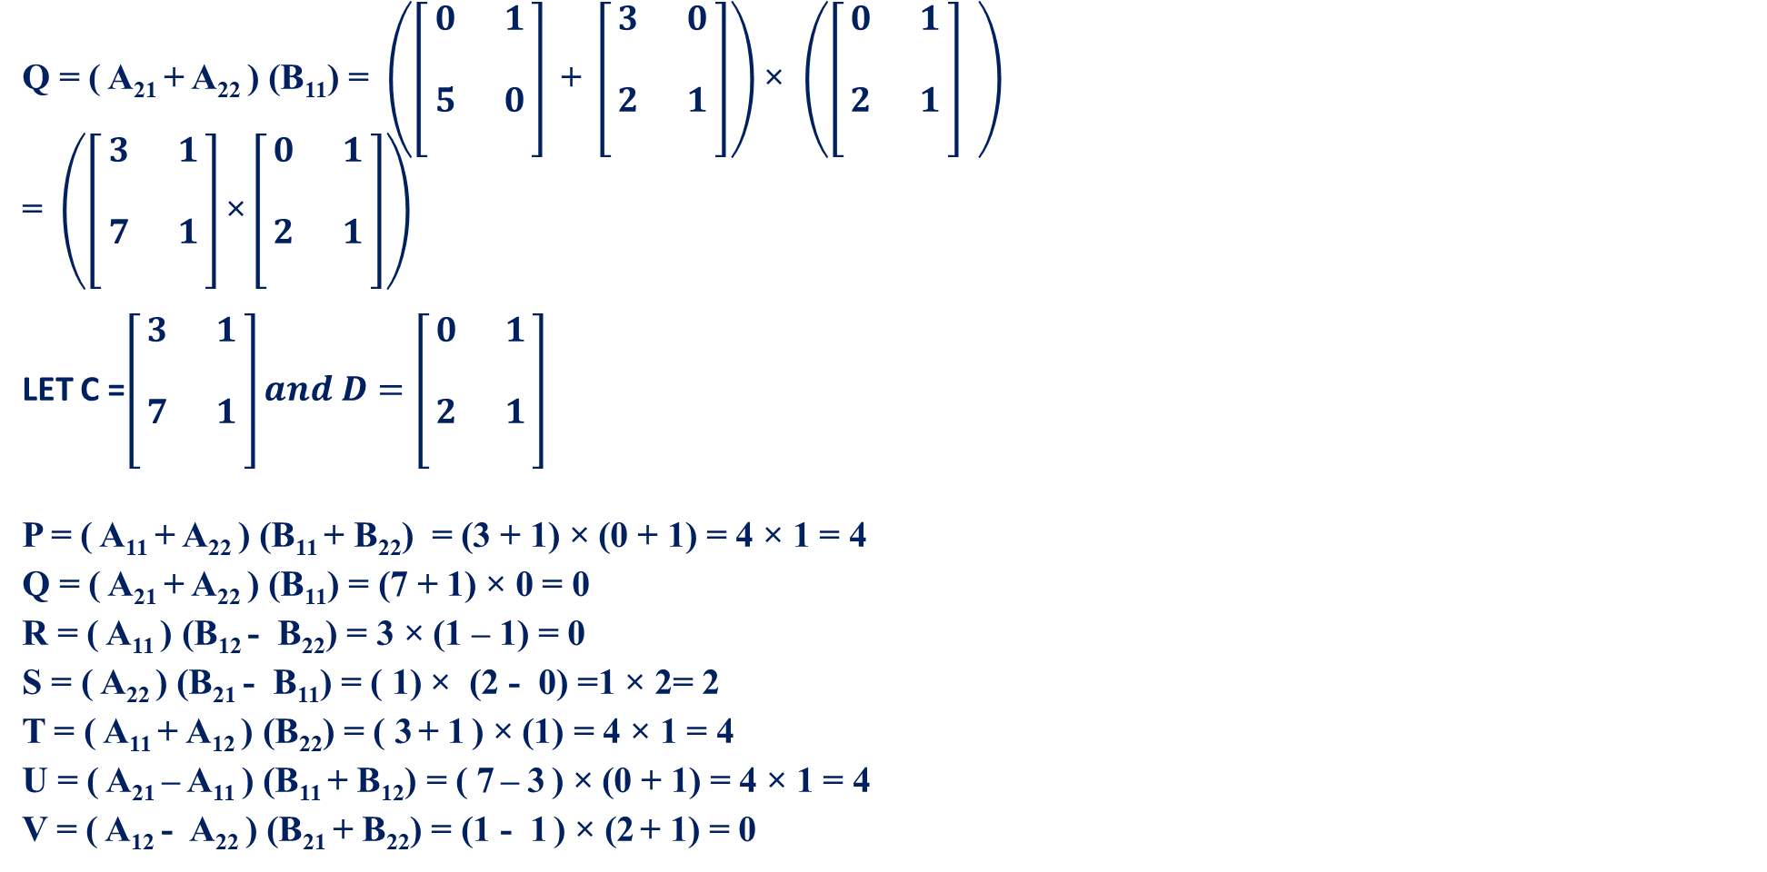

MODULE 2 : DIVIDE AND CONQUER- Strassens Matrix Multiplication
Q = ( A₂₁ + A₂₂ ) (B₁₁) = $\left(\left[\begin{aligned}\begin{matrix}0 & 1 \\ \begin{aligned} \\ 5\end{aligned} & \begin{aligned} \\ 0\end{aligned}\end{matrix} \\ \end{aligned}\right] \text{+ }\left[\begin{aligned}\begin{matrix}3 & 0 \\ \begin{aligned} \\ 2\end{aligned} & \begin{aligned} \\ 1\end{aligned}\end{matrix} \\ \end{aligned}\right]\right)$ × $\left(\left[\begin{aligned}\begin{matrix}0 & 1 \\ \begin{aligned} \\ 2\end{aligned} & \begin{aligned} \\ 1\end{aligned}\end{matrix} \\ \end{aligned}\right] \right)$
= $\left(\left[\begin{aligned}\begin{matrix}3 & 1 \\ \begin{aligned} \\ 7\end{aligned} & \begin{aligned} \\ 1\end{aligned}\end{matrix} \\ \end{aligned}\right]\text{×}\left[\begin{aligned}\begin{matrix}0 & 1 \\ \begin{aligned} \\ 2\end{aligned} & \begin{aligned} \\ 1\end{aligned}\end{matrix} \\ \end{aligned}\right]\right)$
LET C =$\left[\begin{aligned}\begin{matrix}3 & 1 \\ \begin{aligned} \\ 7\end{aligned} & \begin{aligned} \\ 1\end{aligned}\end{matrix} \\ \end{aligned}\right]and D=\left[\begin{aligned}\begin{matrix}0 & 1 \\ \begin{aligned} \\ 2\end{aligned} & \begin{aligned} \\ 1\end{aligned}\end{matrix} \\ \end{aligned}\right]$
P = ( A₁₁ + A₂₂ ) (B₁₁ + B₂₂) = (3 + 1) × (0 + 1) = 4 × 1 = 4
Q = ( A₂₁ + A₂₂ ) (B₁₁) = (7 + 1) × 0 = 0
R = ( A₁₁ ) (B₁₂ - B₂₂) = 3 × (1 – 1) = 0
S = ( A₂₂ ) (B₂₁ - B₁₁) = ( 1) × (2 - 0) =1 × 2= 2
T = ( A₁₁ + A₁₂ ) (B₂₂) = ( 3 + 1 ) × (1) = 4 × 1 = 4
U = ( A₂₁ – A₁₁ ) (B₁₁ + B₁₂) = ( 7 – 3 ) × (0 + 1) = 4 × 1 = 4
V = ( A₁₂ - A₂₂ ) (B₂₁ + B₂₂) = (1 - 1 ) × (2 + 1) = 0
C₁₁ = P + S – T + V = 4 +2 – 4 + 0 = 2
C₁₂ = R + T = 0 + 4 = 4
C₂₁ = Q + S = 0 + 2 = 2
C₂₂ = P + R – Q + U = 4 + 0 -0 + 4 = 8
Resultant matrix is Q = $\left[\begin{aligned}\begin{matrix}2 & 4 \\ \begin{aligned} \\ 2\end{aligned} & \begin{aligned} \\ 8\end{aligned}\end{matrix} \\ \end{aligned}\right]$

Slide 108



MODULE 2 : DIVIDE AND CONQUER- Strassens Matrix Multiplication
R = ( A₁₁ ) (B₁₂ - B₂₂)
= $\left(\left[\begin{aligned}\begin{matrix}1 & 0 \\ \begin{aligned} \\ 4\end{aligned} & \begin{aligned} \\ 1\end{aligned}\end{matrix} \\ \end{aligned}\right] \right)$ × $\left(\left[\begin{aligned}\begin{matrix}0 & 1 \\ \begin{aligned} \\ 0\end{aligned} & \begin{aligned} \\ 4\end{aligned}\end{matrix} \\ \end{aligned}\right]−\left[\begin{aligned}\begin{matrix}1 & 1 \\ \begin{aligned} \\ 5\end{aligned} & \begin{aligned} \\ 0\end{aligned}\end{matrix} \\ \end{aligned}\right] \right)$
= $\left(\left[\begin{aligned}\begin{matrix}1 & 0 \\ \begin{aligned} \\ 4\end{aligned} & \begin{aligned} \\ 1\end{aligned}\end{matrix} \\ \end{aligned}\right]\text{×}\left[\begin{aligned}\begin{matrix}−1 & 0 \\ \begin{aligned} \\ −5\end{aligned} & \begin{aligned} \\ 4\end{aligned}\end{matrix} \\ \end{aligned}\right]\right)$
LET C =$\left[\begin{aligned}\begin{matrix}1 & 0 \\ \begin{aligned} \\ 4\end{aligned} & \begin{aligned} \\ 1\end{aligned}\end{matrix} \\ \end{aligned}\right]and D=\left[\begin{aligned}\begin{matrix}−1 & 0 \\ \begin{aligned} \\ −5\end{aligned} & \begin{aligned} \\ 4\end{aligned}\end{matrix} \\ \end{aligned}\right]$
P = ( A₁₁ + A₂₂ ) (B₁₁ + B₂₂) = (1 + 1) × (-1 + 4) = 2 × 3 = 6
Q = ( A₂₁ + A₂₂ ) (B₁₁) = (4 + 1) × -1 = - 5
R = ( A₁₁ ) (B₁₂ - B₂₂) = 1 × (0 – 4) = -4
S = ( A₂₂ ) (B₂₁ - B₁₁) = ( 1) × (-5 + 1) =1 × -4= -4
T = ( A₁₁ + A₁₂ ) (B₂₂) = ( 1 + 0) × (4) = 1 × 4 = 4
U = ( A₂₁ – A₁₁ ) (B₁₁ + B₁₂) = ( 4 – 1 ) × (-1 + 0) = 3 × -1 = -3
V = ( A₁₂ - A₂₂ ) (B₂₁ + B₂₂) = (0 - 1 ) × (-5 + 4) = -1 × -1 = 1
= $\left[\begin{matrix}\begin{aligned}1 \\ \end{aligned} & \begin{aligned}0 \\ \end{aligned} & \begin{aligned}2 \\ \end{aligned} & \begin{aligned}1 \\ \end{aligned} \\ \begin{aligned}4 \\ \end{aligned} & \begin{aligned}1 \\ \end{aligned} & \begin{aligned}1 \\ \end{aligned} & \begin{aligned}0 \\ \end{aligned} \\ \begin{aligned}0 \\ \\ 5\end{aligned} & \begin{aligned}1 \\ \\ 0\end{aligned} & \begin{aligned}3 \\ \\ 2\end{aligned} & \begin{aligned}0 \\ \\ 1\end{aligned}\end{matrix}\right]$ ×$\left[\begin{matrix}0 & 1 & 0 & 1 \\ & & & \\ 2 & 1 & 0 & 4 \\ & & & \\ 2 & 0 & 1 & 1 \\ & & & \\ 1 & 3 & 5 & 0\end{matrix}\right]$
C₁₁ = P + S – T + V = 6 -4 – 4 +1 = -1
C₁₂ = R + T = -4 + 4 = 0
C₂₁ = Q + S = -5 -4= -9
C₂₂ = P + R – Q + U = 6 -4+5 -3 = 4
Resultant matrix is R = $\left[\begin{aligned}\begin{matrix}−1 & 0 \\ \begin{aligned} \\ −9\end{aligned} & \begin{aligned} \\ 4\end{aligned}\end{matrix} \\ \end{aligned}\right]$

Slide 109


MODULE 2 : DIVIDE AND CONQUER- Strassens Matrix Multiplication
S = ( A₂₂ ) (B₂₁ - B₁₁)
= $\left(\left[\begin{aligned}\begin{matrix}3 & 0 \\ \begin{aligned} \\ 2\end{aligned} & \begin{aligned} \\ 1\end{aligned}\end{matrix} \\ \end{aligned}\right] \right)$ × $\left(\left[\begin{aligned}\begin{matrix}2 & 0 \\ \begin{aligned} \\ 1\end{aligned} & \begin{aligned} \\ 3\end{aligned}\end{matrix} \\ \end{aligned}\right]−\left[\begin{aligned}\begin{matrix}0 & 1 \\ \begin{aligned} \\ 2\end{aligned} & \begin{aligned} \\ 1\end{aligned}\end{matrix} \\ \end{aligned}\right] \right)$
= $\left(\left[\begin{aligned}\begin{matrix}3 & 0 \\ \begin{aligned} \\ 2\end{aligned} & \begin{aligned} \\ 1\end{aligned}\end{matrix} \\ \end{aligned}\right]\text{×}\left[\begin{aligned}\begin{matrix}2 & −1 \\ \begin{aligned} \\ −1\end{aligned} & \begin{aligned} \\ 2\end{aligned}\end{matrix} \\ \end{aligned}\right]\right)$
LET C =$\left[\begin{aligned}\begin{matrix}3 & 0 \\ \begin{aligned} \\ 2\end{aligned} & \begin{aligned} \\ 1\end{aligned}\end{matrix} \\ \end{aligned}\right]and D=\left[\begin{aligned}\begin{matrix}2 & −1 \\ \begin{aligned} \\ −1\end{aligned} & \begin{aligned} \\ 2\end{aligned}\end{matrix} \\ \end{aligned}\right]$
P = ( A₁₁ + A₂₂ ) (B₁₁ + B₂₂) = (3 + 1) × (2 + 2) = 4 × 4 = 16
Q = ( A₂₁ + A₂₂ ) (B₁₁) = (2 + 1) × 2= 6
R = ( A₁₁ ) (B₁₂ - B₂₂) = 3 × (-1 – 2) = 3 × -3 = -9
S = ( A₂₂ ) (B₂₁ - B₁₁) = ( 1) × (-1 - 2) =1 × -3= -3
T = ( A₁₁ + A₁₂ ) (B₂₂) = ( 3 + 0) × (2) = 3 × 2 = 6
U = ( A₂₁ – A₁₁ ) (B₁₁ + B₁₂) = ( 2 – 3 ) × (2 -1) = -1 × 1 = -1
V = ( A₁₂ - A₂₂ ) (B₂₁ + B₂₂) = (0 - 1 ) × (-1 + 2) = -1 × 1 = -1
= $\left[\begin{matrix}\begin{aligned}1 \\ \end{aligned} & \begin{aligned}0 \\ \end{aligned} & \begin{aligned}2 \\ \end{aligned} & \begin{aligned}1 \\ \end{aligned} \\ \begin{aligned}4 \\ \end{aligned} & \begin{aligned}1 \\ \end{aligned} & \begin{aligned}1 \\ \end{aligned} & \begin{aligned}0 \\ \end{aligned} \\ \begin{aligned}0 \\ \\ 5\end{aligned} & \begin{aligned}1 \\ \\ 0\end{aligned} & \begin{aligned}3 \\ \\ 2\end{aligned} & \begin{aligned}0 \\ \\ 1\end{aligned}\end{matrix}\right]$ ×$\left[\begin{matrix}0 & 1 & 0 & 1 \\ & & & \\ 2 & 1 & 0 & 4 \\ & & & \\ 2 & 0 & 1 & 1 \\ & & & \\ 1 & 3 & 5 & 0\end{matrix}\right]$
C₁₁ = P + S – T + V = 16 -3 – 6 -1 = 6
C₁₂ = R + T = -9 + 6 = -3
C₂₁ = Q + S = 6 -3= 3
C₂₂ = P + R – Q + U = 16 -9-6 -1 = 0
Resultant matrix is S = $\left[\begin{aligned}\begin{matrix}6 & −3 \\ \begin{aligned} \\ 3\end{aligned} & \begin{aligned} \\ 0\end{aligned}\end{matrix} \\ \end{aligned}\right]$

Slide 110
MODULE 2 : DIVIDE AND CONQUER- Strassens Matrix Multiplication
S = ( A₂₂ ) (B₂₁ - B₁₁)
= $\left(\left[\begin{aligned}\begin{matrix}3 & 0 \\ \begin{aligned} \\ 2\end{aligned} & \begin{aligned} \\ 1\end{aligned}\end{matrix} \\ \end{aligned}\right] \right)$ × $\left(\left[\begin{aligned}\begin{matrix}2 & 0 \\ \begin{aligned} \\ 1\end{aligned} & \begin{aligned} \\ 3\end{aligned}\end{matrix} \\ \end{aligned}\right]−\left[\begin{aligned}\begin{matrix}0 & 1 \\ \begin{aligned} \\ 2\end{aligned} & \begin{aligned} \\ 1\end{aligned}\end{matrix} \\ \end{aligned}\right] \right)$
= $\left(\left[\begin{aligned}\begin{matrix}3 & 0 \\ \begin{aligned} \\ 2\end{aligned} & \begin{aligned} \\ 1\end{aligned}\end{matrix} \\ \end{aligned}\right]\text{×}\left[\begin{aligned}\begin{matrix}2 & −1 \\ \begin{aligned} \\ −1\end{aligned} & \begin{aligned} \\ 2\end{aligned}\end{matrix} \\ \end{aligned}\right]\right)$
LET C =$\left[\begin{aligned}\begin{matrix}3 & 0 \\ \begin{aligned} \\ 2\end{aligned} & \begin{aligned} \\ 1\end{aligned}\end{matrix} \\ \end{aligned}\right]and D=\left[\begin{aligned}\begin{matrix}2 & −1 \\ \begin{aligned} \\ −1\end{aligned} & \begin{aligned} \\ 2\end{aligned}\end{matrix} \\ \end{aligned}\right]$
P = ( A₁₁ + A₂₂ ) (B₁₁ + B₂₂) = (3 + 1) × (2 + 2) = 4 × 4 = 16
Q = ( A₂₁ + A₂₂ ) (B₁₁) = (2 + 1) × 2= 6
R = ( A₁₁ ) (B₁₂ - B₂₂) = 3 × (-1 – 2) = 3 × -3 = -9
S = ( A₂₂ ) (B₂₁ - B₁₁) = ( 1) × (-1 - 2) =1 × -3= -3
T = ( A₁₁ + A₁₂ ) (B₂₂) = ( 3 + 0) × (2) = 3 × 2 = 6
U = ( A₂₁ – A₁₁ ) (B₁₁ + B₁₂) = ( 2 – 3 ) × (2 -1) = -1 × 1 = -1
V = ( A₁₂ - A₂₂ ) (B₂₁ + B₂₂) = (0 - 1 ) × (-1 + 2) = -1 × 1 = -1
= $\left[\begin{matrix}\begin{aligned}1 \\ \end{aligned} & \begin{aligned}0 \\ \end{aligned} & \begin{aligned}2 \\ \end{aligned} & \begin{aligned}1 \\ \end{aligned} \\ \begin{aligned}4 \\ \end{aligned} & \begin{aligned}1 \\ \end{aligned} & \begin{aligned}1 \\ \end{aligned} & \begin{aligned}0 \\ \end{aligned} \\ \begin{aligned}0 \\ \\ 5\end{aligned} & \begin{aligned}1 \\ \\ 0\end{aligned} & \begin{aligned}3 \\ \\ 2\end{aligned} & \begin{aligned}0 \\ \\ 1\end{aligned}\end{matrix}\right]$ ×$\left[\begin{matrix}0 & 1 & 0 & 1 \\ & & & \\ 2 & 1 & 0 & 4 \\ & & & \\ 2 & 0 & 1 & 1 \\ & & & \\ 1 & 3 & 5 & 0\end{matrix}\right]$
C₁₁ = P + S – T + V = 16 -3 – 6 -1 = 6
C₁₂ = R + T = -9 + 6 = -3
C₂₁ = Q + S = 6 -3= 3
C₂₂ = P + R – Q + U = 16 -9-6 -1 = 0
Resultant matrix is S = $\left[\begin{aligned}\begin{matrix}6 & −3 \\ \begin{aligned} \\ 3\end{aligned} & \begin{aligned} \\ 0\end{aligned}\end{matrix} \\ \end{aligned}\right]$

Slide 111


MODULE 2 : DIVIDE AND CONQUER- Strassens Matrix Multiplication
T= ( A₁₁ + A₁₂ ) (B₂₂)
= $\left(\left[\begin{aligned}\begin{matrix}1 & 0 \\ \begin{aligned} \\ 4\end{aligned} & \begin{aligned} \\ 1\end{aligned}\end{matrix} \\ \end{aligned}\right]+\left[\begin{aligned}\begin{matrix}2 & 1 \\ \begin{aligned} \\ 1\end{aligned} & \begin{aligned} \\ 0\end{aligned}\end{matrix} \\ \end{aligned}\right]\right)$ × $\left(\left[\begin{aligned}\begin{matrix}1 & 1 \\ \begin{aligned} \\ 5\end{aligned} & \begin{aligned} \\ 0\end{aligned}\end{matrix} \\ \end{aligned}\right] \right)$
= $\left(\left[\begin{aligned}\begin{matrix}3 & 1 \\ \begin{aligned} \\ 5\end{aligned} & \begin{aligned} \\ 1\end{aligned}\end{matrix} \\ \end{aligned}\right]\text{×}\left[\begin{aligned}\begin{matrix}1 & 1 \\ \begin{aligned} \\ 5\end{aligned} & \begin{aligned} \\ 0\end{aligned}\end{matrix} \\ \end{aligned}\right]\right)$
LET C = $\left[\begin{aligned}\begin{matrix}3 & 1 \\ \begin{aligned} \\ 5\end{aligned} & \begin{aligned} \\ 1\end{aligned}\end{matrix} \\ \end{aligned}\right]and D=\left[\begin{aligned}\begin{matrix}1 & 1 \\ \begin{aligned} \\ 5\end{aligned} & \begin{aligned} \\ 0\end{aligned}\end{matrix} \\ \end{aligned}\right]$
P = ( A₁₁ + A₂₂ ) (B₁₁ + B₂₂) = (3 + 1) × (1 + 0) = 4 × 1 = 4
Q = ( A₂₁ + A₂₂ ) (B₁₁) = (5 + 1) × 1= 6
R = ( A₁₁ ) (B₁₂ - B₂₂) = 3 × (1 – 0) = 3 × 1= 3
S = ( A₂₂ ) (B₂₁ - B₁₁) = ( 1) × (5- 1) =4
T = ( A₁₁ + A₁₂ ) (B₂₂) = ( 3 + 1) × (0) = 0
U = ( A₂₁ – A₁₁ ) (B₁₁ + B₁₂) = ( 5 – 3 ) × (1 +1) = 4
V = ( A₁₂ - A₂₂ ) (B₂₁ + B₂₂) = (1 - 1 ) × (5+ 0) = 0
= $\left[\begin{matrix}\begin{aligned}1 \\ \end{aligned} & \begin{aligned}0 \\ \end{aligned} & \begin{aligned}2 \\ \end{aligned} & \begin{aligned}1 \\ \end{aligned} \\ \begin{aligned}4 \\ \end{aligned} & \begin{aligned}1 \\ \end{aligned} & \begin{aligned}1 \\ \end{aligned} & \begin{aligned}0 \\ \end{aligned} \\ \begin{aligned}0 \\ \\ 5\end{aligned} & \begin{aligned}1 \\ \\ 0\end{aligned} & \begin{aligned}3 \\ \\ 2\end{aligned} & \begin{aligned}0 \\ \\ 1\end{aligned}\end{matrix}\right]$ ×$\left[\begin{matrix}0 & 1 & 0 & 1 \\ & & & \\ 2 & 1 & 0 & 4 \\ & & & \\ 2 & 0 & 1 & 1 \\ & & & \\ 1 & 3 & 5 & 0\end{matrix}\right]$
C₁₁ = P + S – T + V = 4 +4 – 0 +0 =8
C₁₂ = R + T = 3 + 0 = 3
C₂₁ = Q + S = 6 +4= 10
C₂₂ = P + R – Q + U = 4 + 3-6 +4 = 5
Resultant matrix is T = $\left[\begin{aligned}\begin{matrix}8 & 3 \\ \begin{aligned} \\ 10\end{aligned} & \begin{aligned} \\ 5\end{aligned}\end{matrix} \\ \end{aligned}\right]$

Slide 112


MODULE 2 : DIVIDE AND CONQUER- Strassens Matrix Multiplication
U = ( A₂₁ – A₁₁ ) (B₁₁ + B₁₂)
= $\left(\left[\begin{aligned}\begin{matrix}0 & 1 \\ \begin{aligned} \\ 5\end{aligned} & \begin{aligned} \\ 0\end{aligned}\end{matrix} \\ \end{aligned}\right]− \left[\begin{aligned}\begin{matrix}1 & 0 \\ \begin{aligned} \\ 4\end{aligned} & \begin{aligned} \\ 1\end{aligned}\end{matrix} \\ \end{aligned}\right]\right)$ × $\left(\left[\begin{aligned}\begin{matrix}0 & 1 \\ \begin{aligned} \\ 2\end{aligned} & \begin{aligned} \\ 1\end{aligned}\end{matrix} \\ \end{aligned}\right]\text{+}\left[\begin{aligned}\begin{matrix}0 & 1 \\ \begin{aligned} \\ 0\end{aligned} & \begin{aligned} \\ 4\end{aligned}\end{matrix} \\ \end{aligned}\right]\right)$
= $\left(\left[\begin{aligned}\begin{matrix}−1 & 1 \\ \begin{aligned} \\ 1\end{aligned} & \begin{aligned} \\ −1\end{aligned}\end{matrix} \\ \end{aligned}\right]\text{×}\left[\begin{aligned}\begin{matrix}0 & 2 \\ \begin{aligned} \\ 2\end{aligned} & \begin{aligned} \\ 5\end{aligned}\end{matrix} \\ \end{aligned}\right]\right)$
LET C = $\left[\begin{aligned}\begin{matrix}−1 & 1 \\ \begin{aligned} \\ 1\end{aligned} & \begin{aligned} \\ −1\end{aligned}\end{matrix} \\ \end{aligned}\right]and D=\left[\begin{aligned}\begin{matrix}0 & 2 \\ \begin{aligned} \\ 2\end{aligned} & \begin{aligned} \\ 5\end{aligned}\end{matrix} \\ \end{aligned}\right]$
P = ( A₁₁ + A₂₂ ) (B₁₁ + B₂₂) = (-1 -1) × (0 + 5) = -2 × 5 = -10
Q = ( A₂₁ + A₂₂ ) (B₁₁) = (1 -1) × 0= 0
R = ( A₁₁ ) (B₁₂ - B₂₂) = -1 × (2 – 5) = -1 × -3= 3
S = ( A₂₂ ) (B₂₁ - B₁₁) = ( -1) × (2- 0) =-2
T = ( A₁₁ + A₁₂ ) (B₂₂) = ( -1 + 1) × (5) = 0
U = ( A₂₁ – A₁₁ ) (B₁₁ + B₁₂) = ( 1 +1 ) × (0 +2) = 4
V = ( A₁₂ - A₂₂ ) (B₂₁ + B₂₂) = (1 +1 ) × (2+ 5) = 14
= $\left[\begin{matrix}\begin{aligned}1 \\ \end{aligned} & \begin{aligned}0 \\ \end{aligned} & \begin{aligned}2 \\ \end{aligned} & \begin{aligned}1 \\ \end{aligned} \\ \begin{aligned}4 \\ \end{aligned} & \begin{aligned}1 \\ \end{aligned} & \begin{aligned}1 \\ \end{aligned} & \begin{aligned}0 \\ \end{aligned} \\ \begin{aligned}0 \\ \\ 5\end{aligned} & \begin{aligned}1 \\ \\ 0\end{aligned} & \begin{aligned}3 \\ \\ 2\end{aligned} & \begin{aligned}0 \\ \\ 1\end{aligned}\end{matrix}\right]$ ×$\left[\begin{matrix}0 & 1 & 0 & 1 \\ & & & \\ 2 & 1 & 0 & 4 \\ & & & \\ 2 & 0 & 1 & 1 \\ & & & \\ 1 & 3 & 5 & 0\end{matrix}\right]$
C₁₁ = P + S – T + V = -10 -2 +0+14 =2
C₁₂ = R + T = 3 + 0 = 3
C₂₁ = Q + S = 0 -2= -2
C₂₂ = P + R – Q + U = -10 + 3-0 +4 = -3
Resultant matrix is U = $\left[\begin{aligned}\begin{matrix}2 & 3 \\ \begin{aligned} \\ −2\end{aligned} & \begin{aligned} \\ −3\end{aligned}\end{matrix} \\ \end{aligned}\right]$

Slide 113


MODULE 2 : DIVIDE AND CONQUER- Strassens Matrix Multiplication
V = ( A₁₂ - A₂₂ ) (B₂₁ + B₂₂)
= $\left(\left[\begin{aligned}\begin{matrix}2 & 1 \\ \begin{aligned} \\ 1\end{aligned} & \begin{aligned} \\ 0\end{aligned}\end{matrix} \\ \end{aligned}\right]− \left[\begin{aligned}\begin{matrix}3 & 0 \\ \begin{aligned} \\ 2\end{aligned} & \begin{aligned} \\ 1\end{aligned}\end{matrix} \\ \end{aligned}\right]\right)$ × $\left(\left[\begin{aligned}\begin{matrix}2 & 0 \\ \begin{aligned} \\ 1\end{aligned} & \begin{aligned} \\ 3\end{aligned}\end{matrix} \\ \end{aligned}\right]\text{+}\left[\begin{aligned}\begin{matrix}1 & 1 \\ \begin{aligned} \\ 5\end{aligned} & \begin{aligned} \\ 0\end{aligned}\end{matrix} \\ \end{aligned}\right]\right)$
= $\left(\left[\begin{aligned}\begin{matrix}−1 & 1 \\ \begin{aligned} \\ −1\end{aligned} & \begin{aligned} \\ −1\end{aligned}\end{matrix} \\ \end{aligned}\right]\text{×}\left[\begin{aligned}\begin{matrix}3 & 1 \\ \begin{aligned} \\ 6\end{aligned} & \begin{aligned} \\ 3\end{aligned}\end{matrix} \\ \end{aligned}\right]\right)$
LET C =$\left[\begin{aligned}\begin{matrix}−1 & 1 \\ \begin{aligned} \\ −1\end{aligned} & \begin{aligned} \\ −1\end{aligned}\end{matrix} \\ \end{aligned}\right]and D=\left[\begin{aligned}\begin{matrix}3 & 1 \\ \begin{aligned} \\ 6\end{aligned} & \begin{aligned} \\ 3\end{aligned}\end{matrix} \\ \end{aligned}\right]$
P = ( A₁₁ + A₂₂ ) (B₁₁ + B₂₂) = (-1 -1) × (3 + 3) = -2 × 6 = -12
Q = ( A₂₁ + A₂₂ ) (B₁₁) = (-1 -1) × 3= -6
R = ( A₁₁ ) (B₁₂ - B₂₂) = -1 × (1 – 3) = -1 × -2= 2
S = ( A₂₂ ) (B₂₁ - B₁₁) = ( -1) × (6- 3) =-3
T = ( A₁₁ + A₁₂ ) (B₂₂) = ( -1 + 1) × (3) = 0
U = ( A₂₁ – A₁₁ ) (B₁₁ + B₁₂) = ( -1 +1 ) × (3 +1) = 0
V = ( A₁₂ - A₂₂ ) (B₂₁ + B₂₂) = (1 +1 ) × (6+ 3) = 18
= $\left[\begin{matrix}\begin{aligned}1 \\ \end{aligned} & \begin{aligned}0 \\ \end{aligned} & \begin{aligned}2 \\ \end{aligned} & \begin{aligned}1 \\ \end{aligned} \\ \begin{aligned}4 \\ \end{aligned} & \begin{aligned}1 \\ \end{aligned} & \begin{aligned}1 \\ \end{aligned} & \begin{aligned}0 \\ \end{aligned} \\ \begin{aligned}0 \\ \\ 5\end{aligned} & \begin{aligned}1 \\ \\ 0\end{aligned} & \begin{aligned}3 \\ \\ 2\end{aligned} & \begin{aligned}0 \\ \\ 1\end{aligned}\end{matrix}\right]$ ×$\left[\begin{matrix}0 & 1 & 0 & 1 \\ & & & \\ 2 & 1 & 0 & 4 \\ & & & \\ 2 & 0 & 1 & 1 \\ & & & \\ 1 & 3 & 5 & 0\end{matrix}\right]$
C₁₁ = P + S – T + V = -12 -3 +0+18 =3
C₁₂ = R + T = 2 + 0 = 2
C₂₁ = Q + S = -6 -3= -9
C₂₂ = P + R – Q + U = -12 + 2+6 +0 = -4
Resultant matrix is V = $\left[\begin{aligned}\begin{matrix}3 & 2 \\ \begin{aligned} \\ −9\end{aligned} & \begin{aligned} \\ −4\end{aligned}\end{matrix} \\ \end{aligned}\right]$

Slide 114


MODULE 2 : DIVIDE AND CONQUER- Strassens Matrix Multiplication
Resultant matrix C is given as
$$\left[\begin{aligned}\begin{matrix}C11 & C12 \\ \begin{aligned} \\ C21\end{aligned} & \begin{aligned} \\ C22\end{aligned}\end{matrix} \\ \end{aligned}\right]$$
C₁₁ = P + S – T + V= $\left[\begin{aligned}\begin{matrix}4 & 8 \\ \begin{aligned} \\ 20\end{aligned} & \begin{aligned} \\ 14\end{aligned}\end{matrix} \\ \end{aligned}\right]$ + $\left[\begin{aligned}\begin{matrix}6 & −3 \\ \begin{aligned} \\ 3\end{aligned} & \begin{aligned} \\ 0\end{aligned}\end{matrix} \\ \end{aligned}\right]$ - $\left[\begin{aligned}\begin{matrix}8 & 3 \\ \begin{aligned} \\ 10\end{aligned} & \begin{aligned} \\ 5\end{aligned}\end{matrix} \\ \end{aligned}\right]$ +$\left[\begin{aligned}\begin{matrix}3 & 2 \\ \begin{aligned} \\ −9\end{aligned} & \begin{aligned} \\ −4\end{aligned}\end{matrix} \\ \end{aligned}\right]$ = $\left[\begin{aligned}\begin{matrix}5 & 4 \\ \begin{aligned} \\ 4\end{aligned} & \begin{aligned} \\ 5\end{aligned}\end{matrix} \\ \end{aligned}\right]$
C₁₂ = R + T= $\left[\begin{aligned}\begin{matrix}−1 & 0 \\ \begin{aligned} \\ −9\end{aligned} & \begin{aligned} \\ 4\end{aligned}\end{matrix} \\ \end{aligned}\right]$ +$\left[\begin{aligned}\begin{matrix}8 & 3 \\ \begin{aligned} \\ 10\end{aligned} & \begin{aligned} \\ 5\end{aligned}\end{matrix} \\ \end{aligned}\right]$=$\left[\begin{aligned}\begin{matrix}7 & 3 \\ \begin{aligned} \\ 1\end{aligned} & \begin{aligned} \\ 9\end{aligned}\end{matrix} \\ \end{aligned}\right]$
C₂₁ = Q + S = $\left[\begin{aligned}\begin{matrix}2 & 4 \\ \begin{aligned} \\ 2\end{aligned} & \begin{aligned} \\ 8\end{aligned}\end{matrix} \\ \end{aligned}\right]$ +$\left[\begin{aligned}\begin{matrix}6 & −3 \\ \begin{aligned} \\ 3\end{aligned} & \begin{aligned} \\ 0\end{aligned}\end{matrix} \\ \end{aligned}\right]$ = $\left[\begin{aligned}\begin{matrix}8 & 1 \\ \begin{aligned} \\ 5\end{aligned} & \begin{aligned} \\ 8\end{aligned}\end{matrix} \\ \end{aligned}\right]$
C₂₂ = P + R – Q + U= $\left[\begin{aligned}\begin{matrix}4 & 8 \\ \begin{aligned} \\ 20\end{aligned} & \begin{aligned} \\ 14\end{aligned}\end{matrix} \\ \end{aligned}\right]$ + $\left[\begin{aligned}\begin{matrix}−1 & 0 \\ \begin{aligned} \\ −9\end{aligned} & \begin{aligned} \\ 4\end{aligned}\end{matrix} \\ \end{aligned}\right]$ - $\left[\begin{aligned}\begin{matrix}2 & 4 \\ \begin{aligned} \\ 2\end{aligned} & \begin{aligned} \\ 8\end{aligned}\end{matrix} \\ \end{aligned}\right]$ + $\left[\begin{aligned}\begin{matrix}2 & 3 \\ \begin{aligned} \\ −2\end{aligned} & \begin{aligned} \\ −3\end{aligned}\end{matrix} \\ \end{aligned}\right]$ = $\left[\begin{aligned}\begin{matrix}3 & 7 \\ \begin{aligned} \\ 7\end{aligned} & \begin{aligned} \\ 7\end{aligned}\end{matrix} \\ \end{aligned}\right]$
Resultant matrix C is
C= $\left[\begin{matrix}\begin{aligned}5 \\ \end{aligned} & \begin{aligned}4 \\ \end{aligned} & \begin{aligned}7 \\ \end{aligned} & \begin{aligned}3 \\ \end{aligned} \\ \begin{aligned}4 \\ \end{aligned} & \begin{aligned}5 \\ \end{aligned} & \begin{aligned}1 \\ \end{aligned} & \begin{aligned}9 \\ \end{aligned} \\ \begin{aligned}8 \\ \\ 5\end{aligned} & \begin{aligned}1 \\ \\ 8\end{aligned} & \begin{aligned}3 \\ \\ 7\end{aligned} & \begin{aligned}7 \\ \\ 7\end{aligned}\end{matrix}\right]$

Slide 115

MODULE 2 : DIVIDE AND CONQUER- Strassens Matrix Multiplication
Time complexity Analysis
Strassens Matrix Multiplication algorithm is efficient for large value of n, not for small value of n.
In this algorithm, if all seven computations are performed recursively then the recurrence relation is given as follows
The above recurrence relation can be rewritten as
Apply substitution method
T(n)=7T(n/2) replace T(n/2) by 7T(n/4)
T(n)=7[7T(n/4)] replace T(n/2) by 7T(n/8)
T(n)=7²[7T(n/8)]
T(n)=7³T(n/8)]
;
;
T(n)=7^{i}T(n/2^{i})
To get terminal condition Let us assume 2^{i} = n,
T(n)=7^{i}T(n/n) = 7^{i}T(1) = 7^{i}
T(n) = 7^{i}
We have 2^{i} = n, take log both sides
i = log₂n
T(n) = 7^{log2n} = n log ₂7 = n^{2.087}
T$(n)=\left\{\begin{aligned}1 if n=1 \\ \\ 7×T\left(n/2\right) if n>2\end{aligned}\right\}$
The time complexity is T(n) = Θ(n^{2.087})

Slide 116
MODULE 2 : DIVIDE AND CONQUER- Strassens Matrix Multiplication
Advantages of Divide and Conquer
Easier to obtain the solution
It uses cache memory

Slide 117

MODULE 2 : DIVIDE AND CONQUER- Decrease and Conquer
Decrease and Conquer Technique
The decrease and conquer technique is similar to divide and conquer, except instead of partitioning a problem into multiple subproblems of smaller size, we use some technique to reduce our problem into a single problem that is smaller than the original. The smaller problem might be:
• Decreased by some constant
• Decreased by some constant factor
• Variable decrease

Slide 118
MODULE 2 : DIVIDE AND CONQUER- Decrease and Conquer
Decrease and Conquer Technique
• Decreased by some constant
In the decrease-by-a-constant variation, the size of an instance is reduced by the same constant on each iteration of the algorithm.
Typically, this constant is equal to one although other constant size reductions do happen occasionally.
Consider, as an example, the exponentiation problem of computing a^{n} where a ≠ 0 and n is a nonnegative integer. The relationship between a solution to an instance of size n and an instance of size n − 1 is obtained by the obvious formula
an = a^{n−1} . a. So the function f (n) = a^{n} can be computed either “top down” by using its recursive definition or “bottom up” by multiplying 1 by a n times

Slide 119

MODULE 2 : DIVIDE AND CONQUER- Decrease and Conquer
Decrease and Conquer Technique
• Decreased by some constant

Slide 120
MODULE 2 : DIVIDE AND CONQUER- Decrease and Conquer
Decrease and Conquer Technique
• Decreased by some constant factor
The decrease-by-a-constant-factor technique suggests reducing a problem instance by the same constant factor on each iteration of the algorithm.
In most applications, this constant factor is equal to two. (Can you give an example of such an algorithm?) For an example, let us revisit the exponentiation problem. If the instance of size n is to compute a^{n}, the instance of half its size is to compute a^{n/2}, with the
obvious relationship between the two: an = (a^{n/2})². But since we consider here instances with integer exponents only, the former does not work for odd n. If n is odd, we have to compute a^{n−1} by using the rule for even-valued exponents and then multiply the result by a. To summarize, we have the following formula:

Slide 121


MODULE 2 : DIVIDE AND CONQUER- Decrease and Conquer
Decrease and Conquer Technique
• Decreased by some constant factor

Slide 122
MODULE 2 : DIVIDE AND CONQUER- Decrease and Conquer
Decrease and Conquer Technique
• variable-size-decrease
Finally, in the variable-size-decrease variety of decrease-and-conquer, the size-reduction pattern varies from one iteration of an algorithm to another. Euclid’s algorithm for computing the greatest common divisor provides a good example of such a situation. Recall that this algorithm is based on the formula
gcd(m, n) = gcd(n, m mod n).
Decrease and conquer problems can be solved using top town approach(recursive approach) or bottom up approach(iterative approach)

Slide 123

MODULE 2 : DIVIDE AND CONQUER- Decrease and Conquer
Topological sorting
Topological sorting is applied only for Directed graphs or Digraph.
Directed graph or digraph is a graph with directions specified for all the edges. The adjacency matrix and adjacency lists are still two principal means of representing a digraph. Below shows the example of directed graph.
Directed Cycle in Digraph: A directed cycle in a digraph is a sequence of three or more of its vertices that starts and ends with the same vertex. Below graph has directed cycle a→b→a.

Slide 124
MODULE 2 : Decrease and Conquer
Insertion sort
This is a technique to sort an array A[0…..n-1] using decrease and conquer technique
In this we assume that the smaller problem of sorting the array A[0…n-2] has already been solved to give us a sorted array of size n-1 i. e
A[0]≤A[1]…..A[n-2] has already been solved to give us a sorted array of size n-1:
A[0] ≤…. A[n-2].
Three alternatives for insertion sort
Scan the sorted subarray from left to right untill the first element greater than or equal to A[n-1] is encountered and then insert A[n-1] right before that element.
Scan the sorted subarray from right to left untill the first element smaller than or equal to A[n-1] is encountered and then insert A[n-1] right after that element.
First and second methods are called straight insertion sort or simply insertion sort.
3. In third method use binary search to find an appropriate position for A[n-1] in the sorted portion of the array. This called binary insertion sort.

Slide 125
MODULE 2 : Decrease and Conquer
Insertion sort: It can be implemented with bottom up approach i.e iteratively.
Starting with A[1] and ending with A[n-1], A[i] is inserted in its appropriate place among the first I elements of the array that have been already sorted
A[0] ≤ … … A[j]<A[j+1]≤….. ≤A[i-1] A[i]…..A[n-1]
Smaller than greater than A[i]
or equal to A[i]

Slide 126
MODULE 2 : Decrease and Conquer
Insertion sort: It can be implemented with bottom up approach i.e iteratively.
Starting with A[1] and ending with A[n-1], A[i] is inserted in its appropriate place among the first I elements of the array that have been already sorted
A[0] ≤ … … A[j]<A[j+1]≤….. ≤A[i-1] A[i]…..A[n-1]
Smaller than greater than A[i]
or equal to A[i]

Slide 127
MODULE 2 : Decrease and Conquer
Insertion sort example
To perform the insertion sort
Assume that first element A[0] is sorted, check weather the second element is in its proper place by comparing with sorted subarray element from left to right. And insert second element in its proper place.
Apply the same procedure for remaining elements of the unsorted list.
Ex: Apply the insertion sort for the following list of elements
89 45 68 90 29 34 17

Slide 128
MODULE 2 : Decrease and Conquer
Insertion sort example
Ex: Apply the insertion sort for the following list of elements
45 68 90 29 34 17
Sol:
Assume that first element is sorted
89 45 68 90 29 34 17 check 45 is its proper place, this is done by comparing 45 with 89, as 45<89 insert 45 before 89
45 89 68 90 29 34 17 check 68 is its proper place, this is done by comparing 68 with all the sorted subarray as 68<89 and
68>45 proper place to insert 68 is after 68
45 68 89 90 29 34 17
45 68 89 90 29 34 17
29 45 68 89 90 34 17
17 29 34 45 68 89 90
Red color elements indicate sorted subarray

Slide 129

MODULE 2 : Decrease and Conquer
Insertion Algorithm
InsertionSort(A[0…..n-1])
//input an array A[0….n-1]
//Output sorted array A[0….n-1]
for i← 1 to n-1 do
v←A[i]
j←i-1
while j ≥ 0 and A[j]>v do
A[j+1]←A[j]
j←j-1
A[j+1]←v
Time complexity
C(n) $=\sum_{i=1}^{n−1}{\sum_{j=0}^{i−1}{1}}$
=$\sum_{i=1}^{n−1}{i}=\frac{n(n−1) }{2}$
Time complexity is O(n²)

Slide 130
MODULE 2 : DIVIDE AND CONQUER- Decrease and Conquer (Topological sorting)
Topological sorting
Directed Acyclic Graph (DAG) is a directed graph with no directed cycles. That is, it consists of vertices and edges with each edge directed from one vertex to another, such that following those directions will never form a closed loop.
Topological sorting is performed only on Directed Acyclic Graph (DAG)
Definition of Topological sorting
Given with a DAG listing the vertices in such an order that for every edge in the graph, the vertex where the edge starts is listed before the vertex where the edge ends.
OR
Topological sorting for Directed Acyclic Graph (DAG) is a linear ordering of vertices such that for every directed edge u v, vertex u comes before v in the ordering.
There can be more than one topological sorting for a graph.

Slide 131
MODULE 2 : DIVIDE AND CONQUER- Decrease and Conquer (Topological sorting)
Topological sorting of DAG is performed with two methods
Depth-First Search (DFS) traversal
Source removal method
Topological sorting with Depth-First Search (DFS) traversal
Steps to perform Topological sorting with Depth-First Search
Step 1: select any arbitrary vertex in a given graph
Step 2: When a vertex is visited first time, it is pushed on to the stack
Step 3: When vertex becomes dead end (not possible to proceed further from that vertex) it is removed from the stack
Step 4: Repeat the step 2 and 3 for all the vertices in the graph
Step 5: Reverse the order of deleted items to get the topological sequence

Slide 132

MODULE 2 : DIVIDE AND CONQUER- Decrease and Conquer (Topological sorting)
Problem1: Apply Depth-First Search based algorithm to solve Topological sorting problem for the following graph.
Solution: Let us consider start with a vertex a
Consider the table like this

Slide 133
MODULE 2 : Decrease and Conquer (Topological sorting)
Stack | V=adj(S[top]) | Nodes Visited (S) | Pop (stack)
---
---
a
(a is visited push a on stack)
a
b
(b is adjacent to a)
a, b
(b is visited push b on stack)
e
(e is adjacent to b)
a, b, e
(e is visited push e on stack)
a, b
No node is adjacent to e
a, b, e
a, b, e
e
g
(g is adjacent to b)
a, b, e, g
(g is visited push g on stack)
a, b

Slide 134
MODULE 2 : Decrease and Conquer (Topological sorting)
Stack | V=adj(S[top]) | Nodes Visited (S) | Pop (stack)
---
f
(f is adjacent to g)
a, b, e, g, f
(f is visited push f on stack)
a, b, g
a, b, g, f
No node is adjacent to f
a, b, e, g, f
f
No node is adjacent to g
a, b, e, g, f
a, b, g
g
No node is adjacent to b
a, b, e, g, f
b
a, b
c
(c is adjacent to a)
a, b, e, g, f, c
(c is visited push c on stack)
a

Slide 135
MODULE 2 : Decrease and Conquer (Topological sorting)
Stack | V=adj(S[top]) | Nodes Visited (S) | Pop (stack)
No node is adjacent to c
c
a, c
a, b, e, g, f, c
No node is adjacent to a
a
a
a, b, e, g, f, c
now stack is empty, next consider any unvisited node which is not visited
all nodes adjacent d are already visited
a, b, e, g, f, c, d
d
d
The poped order is: e, f, g, b, c, a, d (reverse of poped order is Topological sorting)
Resultant Topological sorting is : d, a, c, b, g, f, e

Slide 136

MODULE 2 : Decrease and Conquer (Topological sorting)
Problem2: Apply the DFS-based algorithm to solve the topological sorting problem for the following digraph:
June/July-2019 (17CS43)
Solution: Let us consider start with a vertex 1
Consider the table like this

Slide 137
MODULE 2 : Decrease and Conquer (Topological sorting)
Stack | V=adj(S[top]) | Nodes Visited (S) | Pop (stack)
now stack is empty, next consider any unvisited node which is not visited, let us consider node 2
now stack is empty, next consider any unvisited node which is not visited, let us consider node 3
1
(1 is visited push 1 on stack)
---
---
1
No node is adjacent to 1
1
1
1, 2
No node is adjacent to 2
2
1, 2
2
1, 2, 3

Slide 138
MODULE 2 : Decrease and Conquer (Topological sorting)
Stack | V=adj(S[top]) | Nodes Visited (S) | Pop (stack)
The poped order is: 1, 2, 4, 3 (reverse of poped order is Topological sorting) Resultant Topological sorting is : 3, 4, 2, 1
---
4
(4 is adjacent to 3)
1, 2, 3, 4
(4 is visited push 4 on stack)
3
3, 4
No node is adjacent to 4
1, 2, 3, 4
4
No node is adjacent to 3
1, 2, 3, 4
3
3

Slide 139
MODULE 2 : Decrease and Conquer (Topological sorting)
Problem2: Apply the DFS-based algorithm to solve the topological sorting problem for the following digraph:
June/July-2019 (17CS43) (same problem with different vertex as starting vertex
Solution: Let us consider start with a vertex 3
Consider the table like this

Slide 140
MODULE 2 : Decrease and Conquer (Topological sorting)
Stack | V=adj(S[top]) | Nodes Visited (S) | Pop (stack)
---
---
3
(3 is visited push 3 on stack)
3
1
(1 is adjacent to 3)
3, 1
( 1 is visited push 1 on stack)
No node is adjacent to 1
3, 1
1
3, 1
4
(4 is adjacent to 3)
3, 1, 4
( 4 is visited push 4 on stack)
3
2
(2 is adjacent to 4)
3, 1, 4, 2
( 2 is visited push 2 on stack)
3, 4

Slide 141
MODULE 2 : Decrease and Conquer (Topological sorting)
Stack | V=adj(S[top]) | Nodes Visited (S) | Pop (stack)
The poped order is: 1, 2, 4, 3 (reverse of poped order is Topological sorting) Resultant Topological sorting is : 3, 4, 2, 1
---
No node is adjacent to 2
3, 1, 4, 2
2
3, 4, 2
No node is adjacent to 4
3, 1, 4, 2
3, 4
4
No node is adjacent to 3
3, 1, 4, 2
3
3

Slide 142

MODULE 2 : Decrease and Conquer (Topological sorting)
Problem2: Apply the DFS-based algorithm to solve the topological sorting problem for the following digraph:
Solution: Let us consider start with a vertex e
Consider the table like this

Slide 143
MODULE 2 : Decrease and Conquer (Topological sorting)
Stack | V=adj(S[top]) | Nodes Visited (S) | Pop (stack)
now stack is empty, next consider any unvisited node which is not visited, let us consider node a
---
---
e
(e is visited push a on stack)
e
f
(f is adjacent to e)
e, f
(f is visited push f on stack)
e, f
No node is adjacent to f
e, f
f
e
No node is adjacent to e
e, f
e

Slide 144
MODULE 2 : Decrease and Conquer (Topological sorting)
Stack | V=adj(S[top]) | Nodes Visited (S) | Pop (stack)
---
---
e, f, a
(a is visited push a on stack)
(c is adjacent to a)
a
e, f, a, c
( c is visited push c on stack)
(d is adjacent to c)
e, f, a, c, d
( d is visited push d on stack)
a, c
No node is adjacent to d
e, f, a, c, d
d
a, c, d
a, c
No node is adjacent to c
e, f, a, c, d
c

Slide 145
MODULE 2 : Decrease and Conquer (Topological sorting)
Stack | V=adj(S[top]) | Nodes Visited (S) | Pop (stack)
now stack is empty, next consider any unvisited node which is not visited, let us consider node b
The poped order is: f, e, d, c, a, b (reverse of poped order is Topological sorting) Resultant Topological sorting is : b, a, c, d, e, f
a
No node is adjacent to a
e, f, a, c, d
a
---
e, f, a, c, d, b
( b is visited push b on stack)
---
No node is adjacent to b
e, f, a, c, d, b
b
b

Slide 146

MODULE 2 : Decrease and Conquer (Topological sorting)
Source removal method
In a given graph, for every vertex ingree and outdegree is defined
Indegree: No of incoming edges to the vertex is know as indegree
Outdegree: No of outgoing edges
Vertex | Indegree | Outdegree
1 | 0 | 1
2 | 0 | 1
3 | 2 | 2
4 | 1 | 1
5 | 2 | 0

Slide 147
MODULE 2 : Decrease and Conquer (Topological sorting)
Source removal method
Source removal method is based on decrease and conquer technique.
In this method, a vertex who’s indegree is zero is selected and deleted along with the its all out going edges.
If there are several vertices with indegree zero, arbitrarily a vertex is selected.
This procedure repeated unitill all vertices are deleted
The order in which the vertices are visited and deleted one by one is Topological sorting.

Slide 148

MODULE 2 : Decrease and Conquer (Topological sorting)
Source removal method
Apply the Source removal method algorithm to solve the topological sorting problem for the following digraph
Solution:

Slide 149


MODULE 2 : Decrease and Conquer (Topological sorting)
Source removal method
Solution:
Delete 1
Delete 2
Identify vertices with indegree zero, they are 1 and 2, let select 1
Identify vertices with inderee zero, it is 2
Identify vertices with indegree zero, it is 3

Slide 150


MODULE 2 : Decrease and Conquer (Topological sorting)
Source removal method
Solution:
Delete 3
Delete 4
Delete 5
Identify vertices with indegree zero, it is 4
Topological sorting is 1, 2, 3, 4, 5
Another solution is if first selected arbitrary vertex is 2
2, 1, 3, 4, 5

Slide 151
MODULE 2 : Decrease and Conquer (Topological sorting)
Source removal method
Step 1: Find the vertices u with indegree zero and place them on stack.
Step 2: Pop the top most vertex from the stack.
Step 3: Find the vertex v which is adjacent to poped vertex, decrement the indegree of v by 1,
Step 4. Repeat the steps 1 to 3

Slide 152
MODULE 2 : Decrease and Conquer (Topological sorting)
Source removal method
Apply the Source removal method algorithm to solve the topological sorting problem for the following digraph
Solution: Write a indegree of all nodes in given graph
Node | indegree
a | 0
b | 0
c | 1
d | 2
e | 1
f | 3

Slide 153





MODULE 2 : Decrease and Conquer (Topological sorting)
Select the node with indegree 0, let us consider a. Delete node a from the graph along with it delete its out going edges. By this indegree of c and d decreases by 1
Delete c
Delete d
Delete a
Delete b
Delete e
Topological sorting is a,b,c,d,e,f
Another solution is if first selected arbitrary vertex is b
b,a,c,d,e,f
Delete f

Slide 154
MODULE 2 : Brute force (Exhaustive Search)
Exhaustive Search is brute force algorithm design technique, it suggests generating each and every element of problem domain by selecting those of them that satisfy all the constraints and then finding a desired element.
Knapsack problem

Slide 155


MODULE 2 : Brute force (Exhaustive Search)
Exhaustive Search is brute force algorithm design technique, it suggests generating each and every element of problem domain by selecting those of them that satisfy all the constraints and then finding a desired element.
Knapsack problem
Definition
We are given with
n objects (x₁, x₂, x₃, ….. x_{n}) and every Object i has a weight w_{i.} and Profit Pi
knapsack (bag or container) of capacity m.
If a fraction of object x_{i} is placed into the knapsack, then profit of p_{i}x_{i} is earned.
The objective of knapsack problem is to fill the knapsack completely such that the total profit gained is maximum.
Note: as the capacity of knapsack is m, we require the total weight of all the chosen objects to be less than or equal to m.
Formally the problem can be stated as
maximize : $\sum_{1≤i≤n}{\text{p}\text{i}\text{x}\text{i}}$ Eq 1
Subjected to$: \sum_{1≤i≤n}{\text{w}\text{i}\text{x}\text{i}}$ ≤ m Eq 2
And 0 ≤ x_{i} ≤ 1, and 0 ≤ i ≤ n, Eq 3

Slide 156
MODULE 2 : Brute force (Exhaustive Search)
Knapsack problem
The profit and weights are positive numbers
A feasible solution is any set of (x₁, x₂, ……x_{n}) that satisfies Eq. 2 and Eq. 3
The optimal solution is a feasible solution for which Eq. 1 is maximized

Slide 157
MODULE 2 : Brute force (Exhaustive Search)
_{Example 1: using} Exhaustive Search Find the optimal solution to the knapsack instance
n=4, m=20n=3, m=10
Profits (p₁, p₂, p₃) = (42, 12, 40, 25) and
Weights (w₁, w₂, w₃ ) = (7, 3, 4, 5)
Subset | Total weight | Total value
Null set | 0 | 0
{1} | 7 | 42
{2} | 3 | 12
{3} | 4 | 40
{4} | 5 | 25
{1, 2} | 10 | 52
{1,3} | 11 | Not feasible
{1, 4} | 12 | Not feasible
{2,3} | 7 | 52
{2, 4} | 8 | 37
{3,4} | 9 | 65

Slide 158
MODULE 2 : Brute force (Exhaustive Search)
_{Example 1: using} Exhaustive Search Find the optimal solution to the knapsack instance
n=4, m=20n=3, m=10
Profits (p₁, p₂, p₃) = (42, 12, 40, 25) and
Weights (w₁, w₂, w₃ ) = (7, 3, 4, 5)
Subset | Total weight | Total value
Null set | 0 | 0
{1} | 7 | 42
{2} | 3 | 12
{3} | 4 | 40
4} | 5 | 25
{1, 2} | 10 | 52
{1,3} | 11 | Not feasible
{1, 4} | 12 | Not feasible
{2,3} | 7 | 52
{2, 4} | 8 | 37
{3,4} | 9 | 65

Slide 159

MODULE 2 : Brute force (Exhaustive Search)
Travelling salesmen problem (TSP)

