Slide 1
Make My Figure
One dataset, many controlled views - publication figures with the researcher in control
Desktop tutorial and demonstration
Version 1.2.0 - 45 plot types
Suresh Poudel

Slide 2
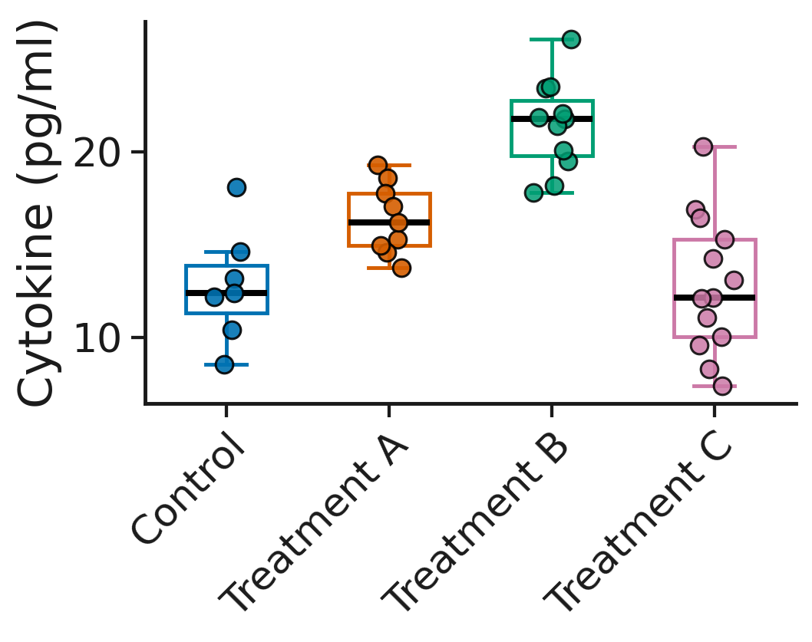
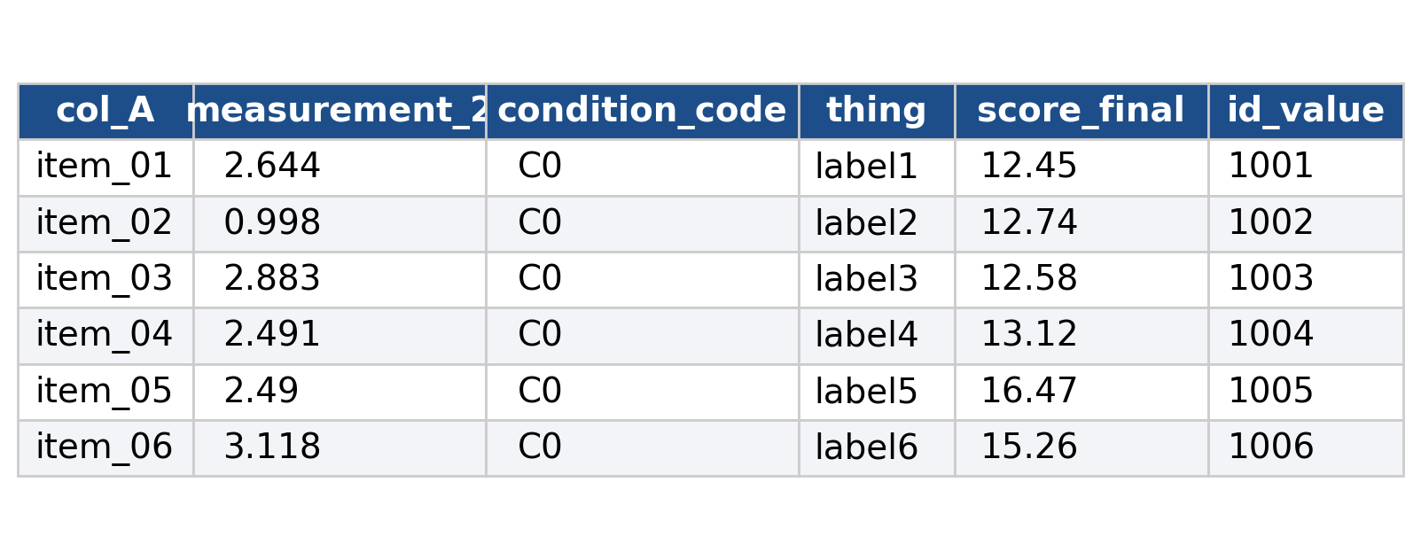
A real table rarely arrives ready to plot
→
Column names like col_A and measurement_2 are fine: you tell the application what each column means, and the figure follows.
Make My Figure - desktop tutorial | 2

Slide 3
What Make My Figure is
• A desktop application (and a browser version) that draws 45 publication-style plot types from CSV, TSV and Excel tables
• Runs entirely on your computer - no upload, no account
• Proposes column roles, figures and tests; every proposal can be changed
• Statistics on the figure: 19 tests, corrections, brackets, effect sizes, a methods sentence
• Individual observations with controllable size, jitter, fill, edge and arrangement
• Publication presets previewed on your own data before they are applied (experimental library)
• Reproducibility: PlotSpec, StatsSpec, Figure Package (.mmfpackage) with frozen data and checksums
• Multi-panel Figure Builder; open source, Python, Matplotlib and Qt
Make My Figure - desktop tutorial | 3

Slide 4
The application suggests. The researcher decides.
It proposes
You decide
It records
Detects column types, recommends figures with a match score, proposes a column for every role, suggests a test from the design.
Every role is a drop-down of your own columns. Change any of them; the figure follows. Choose the test; the panel runs and documents it.
PlotSpec for the specification, StatsSpec for the test, Figure Package for specification plus frozen data. Nothing recomputed behind your back.
“The data do not belong to one plot.”
Make My Figure - desktop tutorial | 4

Slide 5
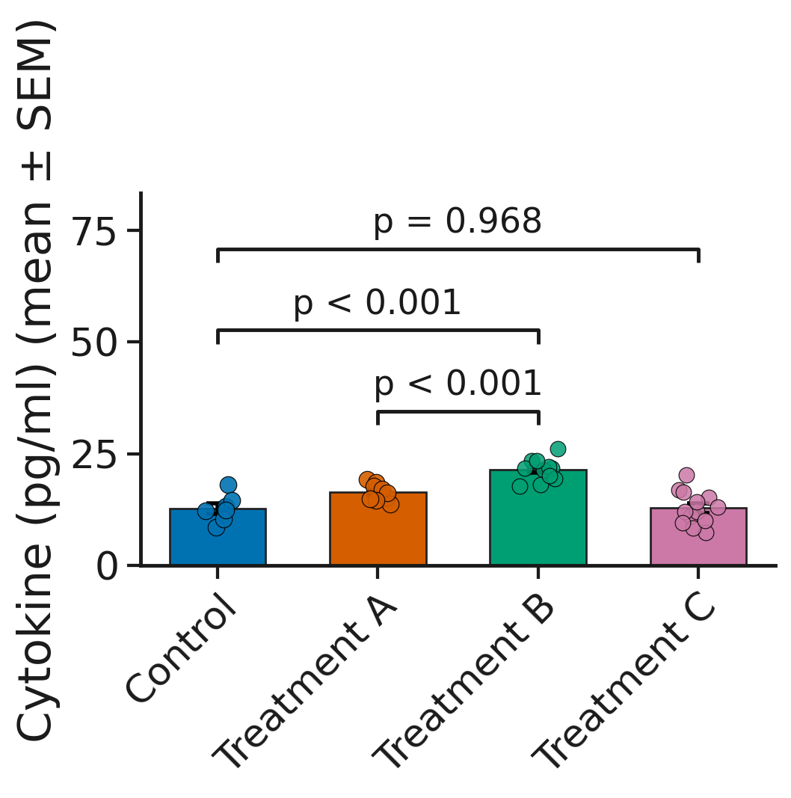
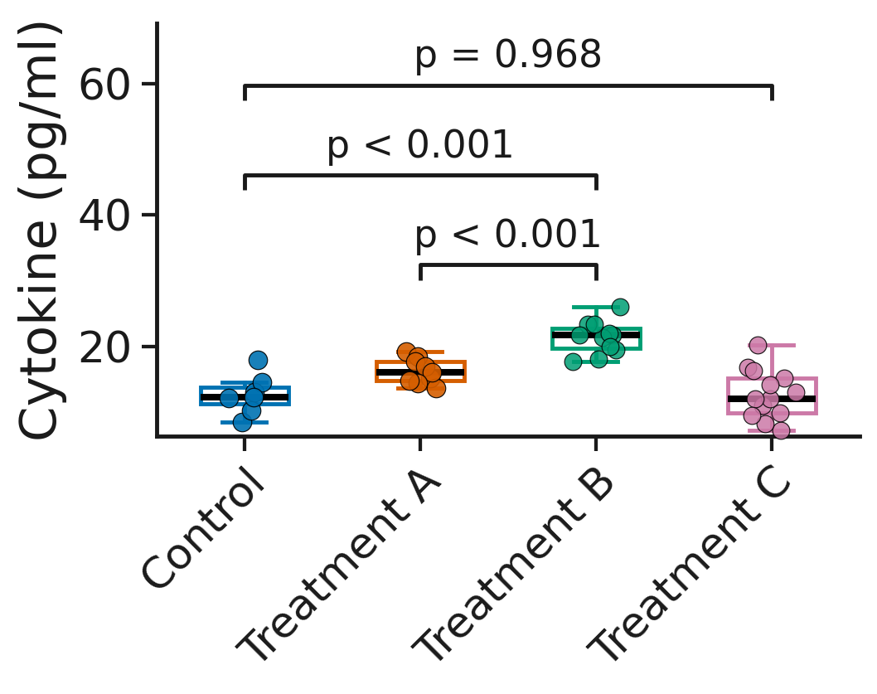
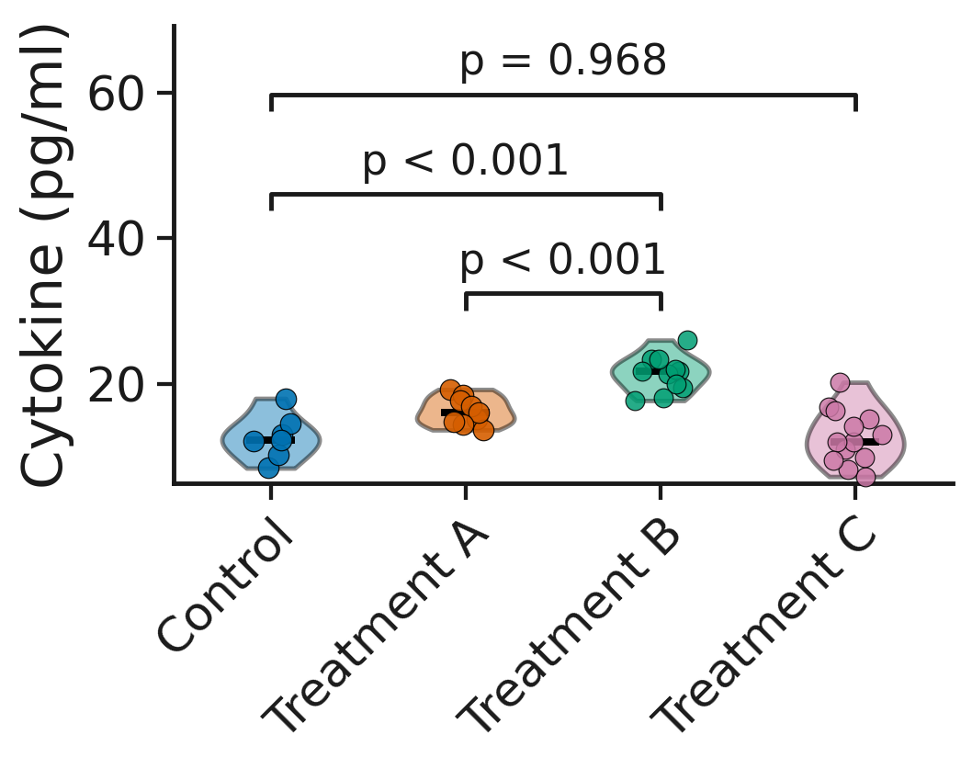
One dataset, multiple publication-ready views
Box + observations (outline)
Violin + observations
Bar + observations (jittered)
Same 40 observations (n = 7, 9, 11, 13), same Welch tests and P values - three experimental publication presets.
Make My Figure - desktop tutorial | 5

Slide 6
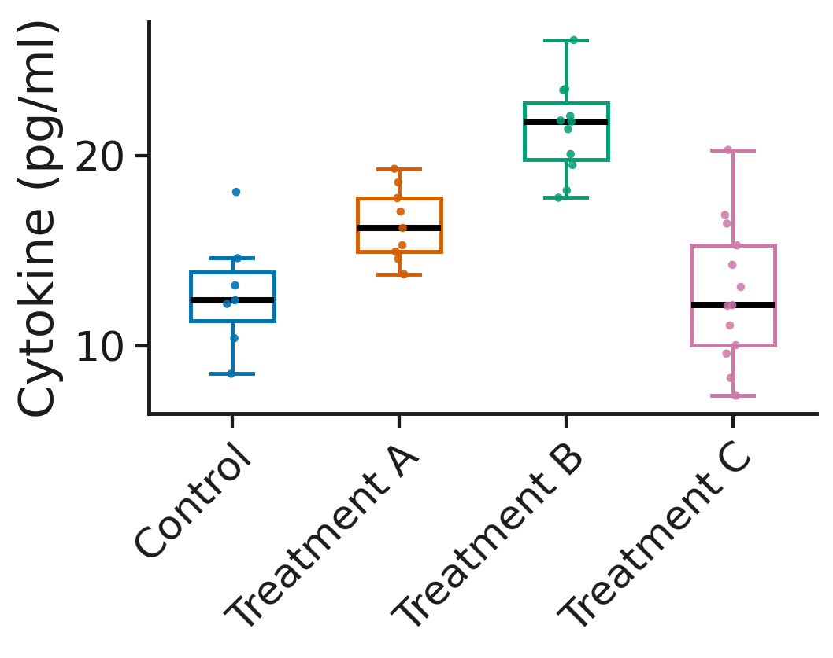

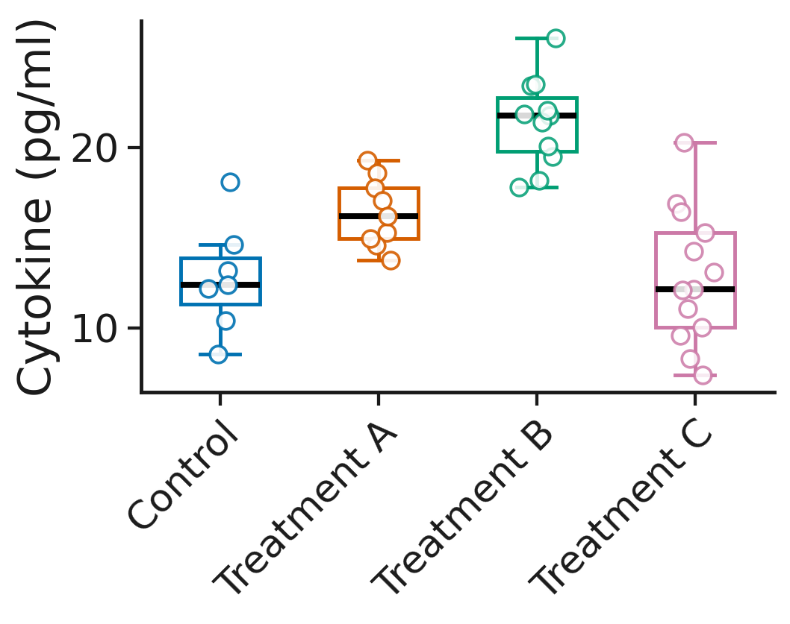
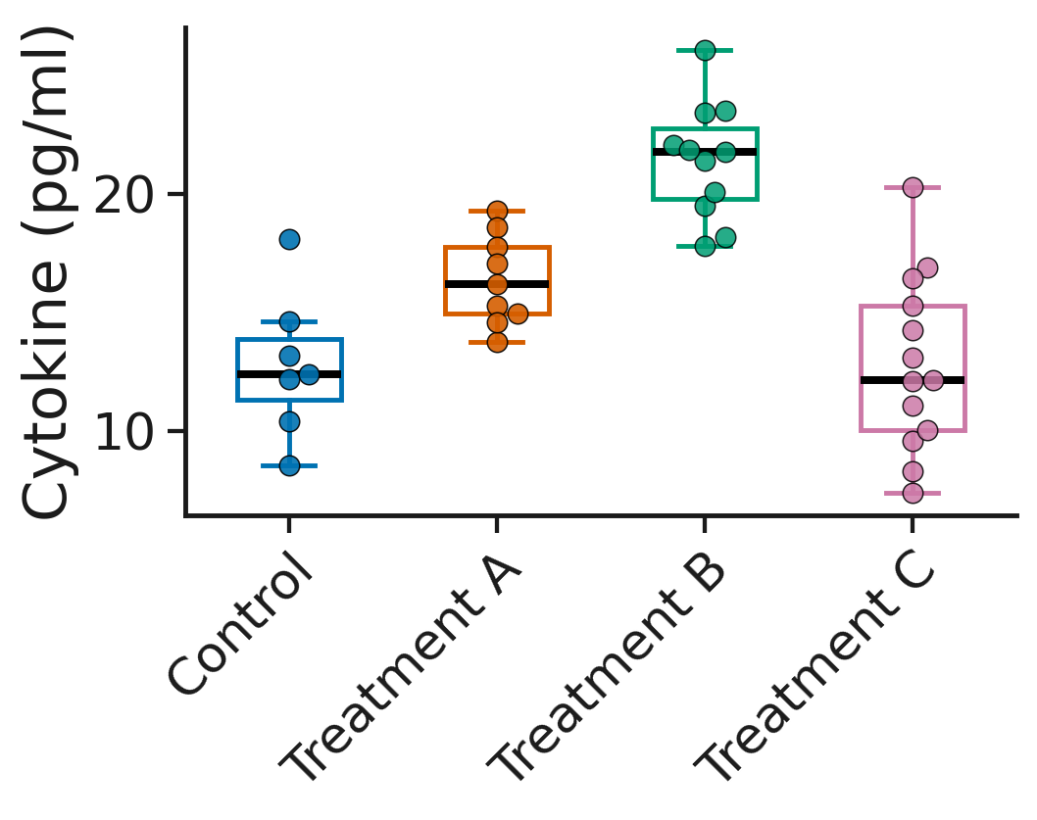
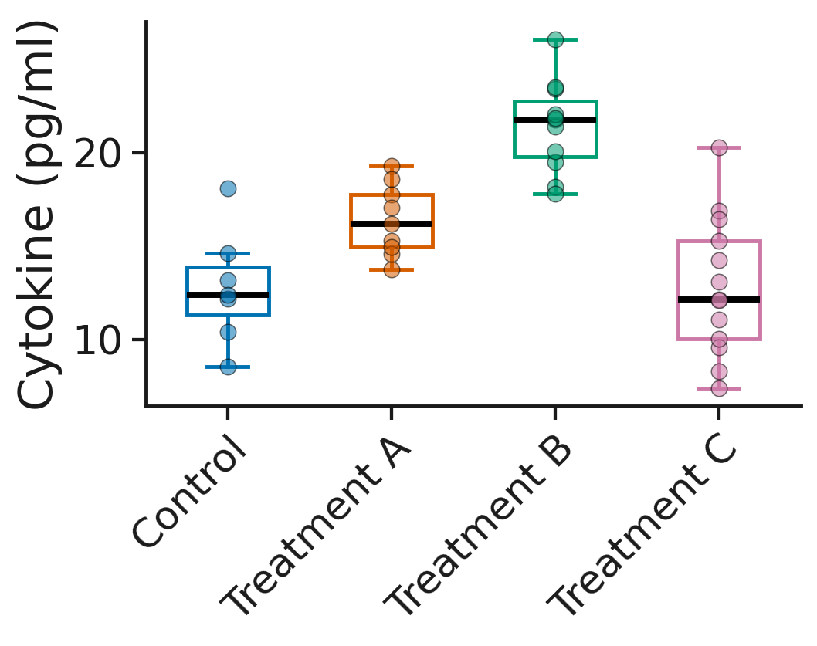
The observations are yours to show - size, jitter, fill, edge, arrangement
small, narrow jitter
large, moderate jitter
open circles
filled, dark edge
beeswarm
centred, translucent, no jitter
The scientific data do not change. The presentation can.
Make My Figure - desktop tutorial | 6

Slide 7
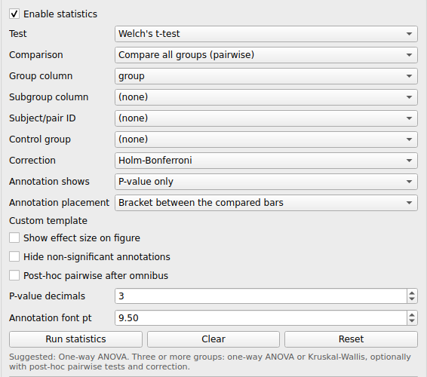
Statistics on the figure - chosen by you, documented by the application
Welch's t-test, selected pairs, Holm correction: brackets with exact P, a results table, and the methods sentence to paste.
Make My Figure - desktop tutorial | 7

Slide 8
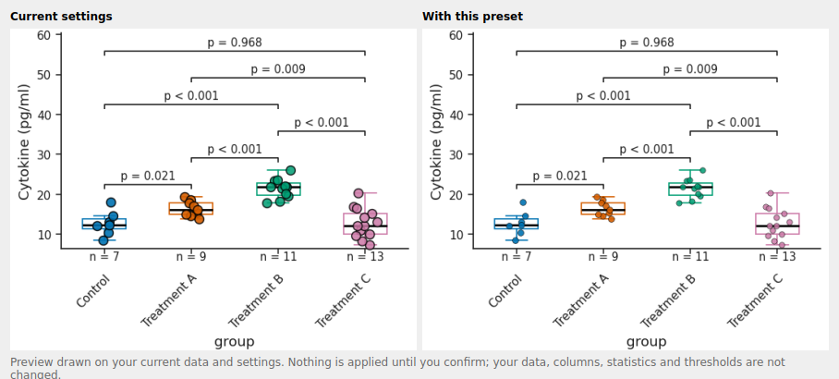
Publication presets are previewed on your own data
Before and after, drawn on the loaded table - nothing is applied until you confirm.
Make My Figure - desktop tutorial | 8

Slide 9
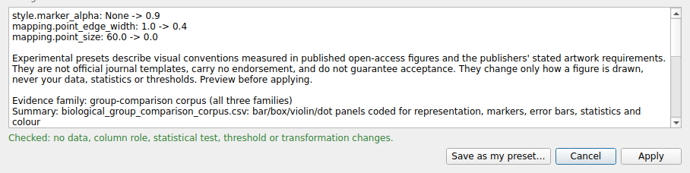
The preview lists what changes and checks what must not
• Twelve experimental presets derived from published open-access figures and publishers' stated requirements; the letter in a name, (N) (S) (C), is the evidence set, not an approval
• Every setting that would change is listed (here marker opacity, point edge width, point size)
• Green line: no data, column role, statistical test, threshold or transformation changes - a preset that would is refused
• Apply, Cancel, or Save as my preset - a preset is a starting configuration, not a locked template
Make My Figure - desktop tutorial | 9

Slide 10
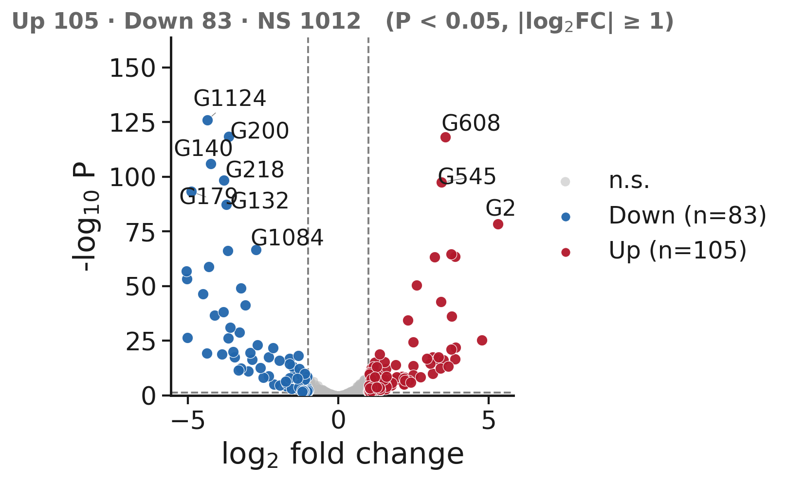
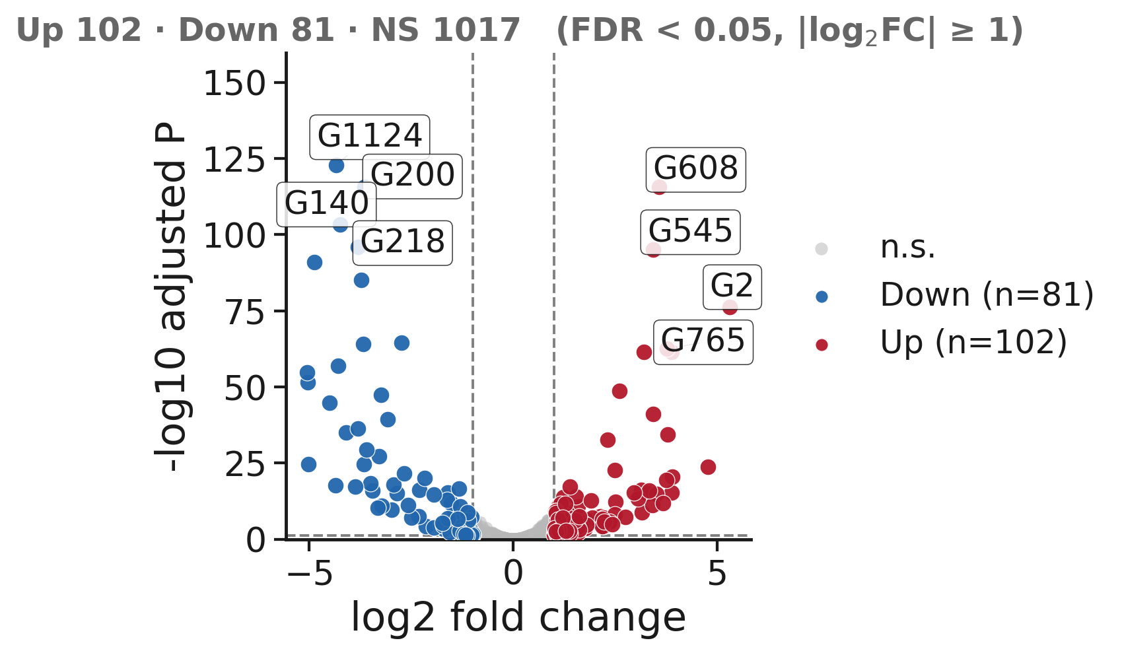
Same data, different presentation - volcano
default: raw P, ten labels
refined: adjusted P (FDR), boxed labels, larger markers
1,200 features, identical values; the axis, labels and markers changed, the numbers did not.
Make My Figure - desktop tutorial | 10

Slide 11
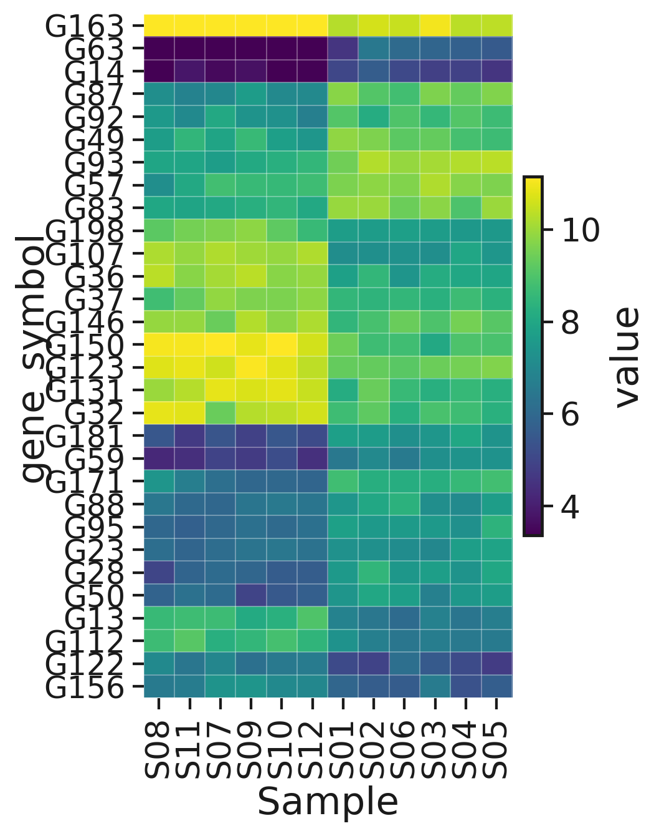
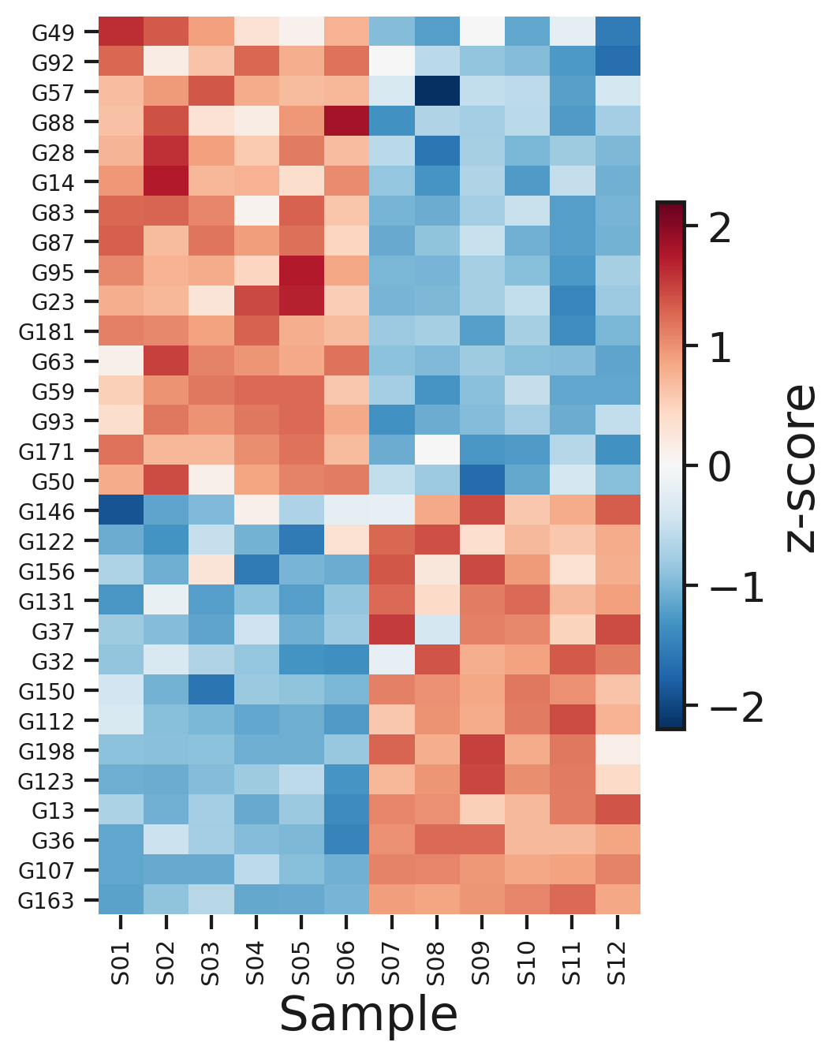
Same data, different presentation - clustered heatmap
basic: unscaled values, auto colormap, clustered columns
refined: row z-score, RdBu_r, samples in file order
The same 30 most variable features. Scaling and colormap are presentation choices the reader must be told about.
Make My Figure - desktop tutorial | 11

Slide 12
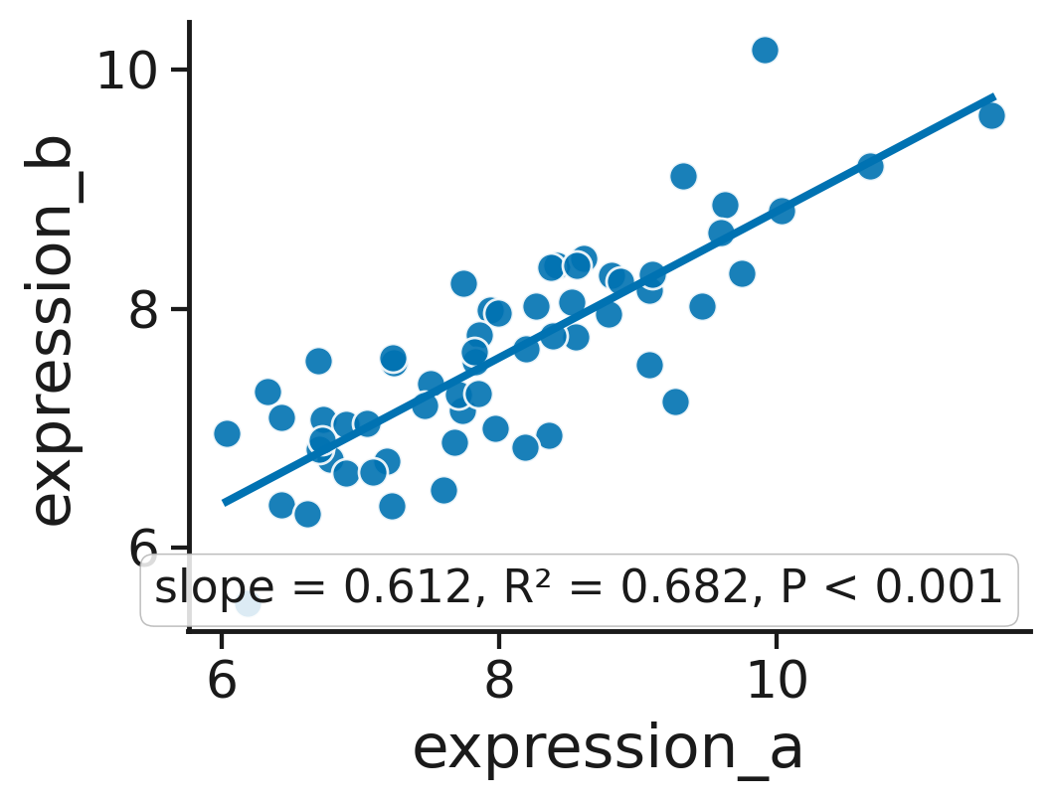
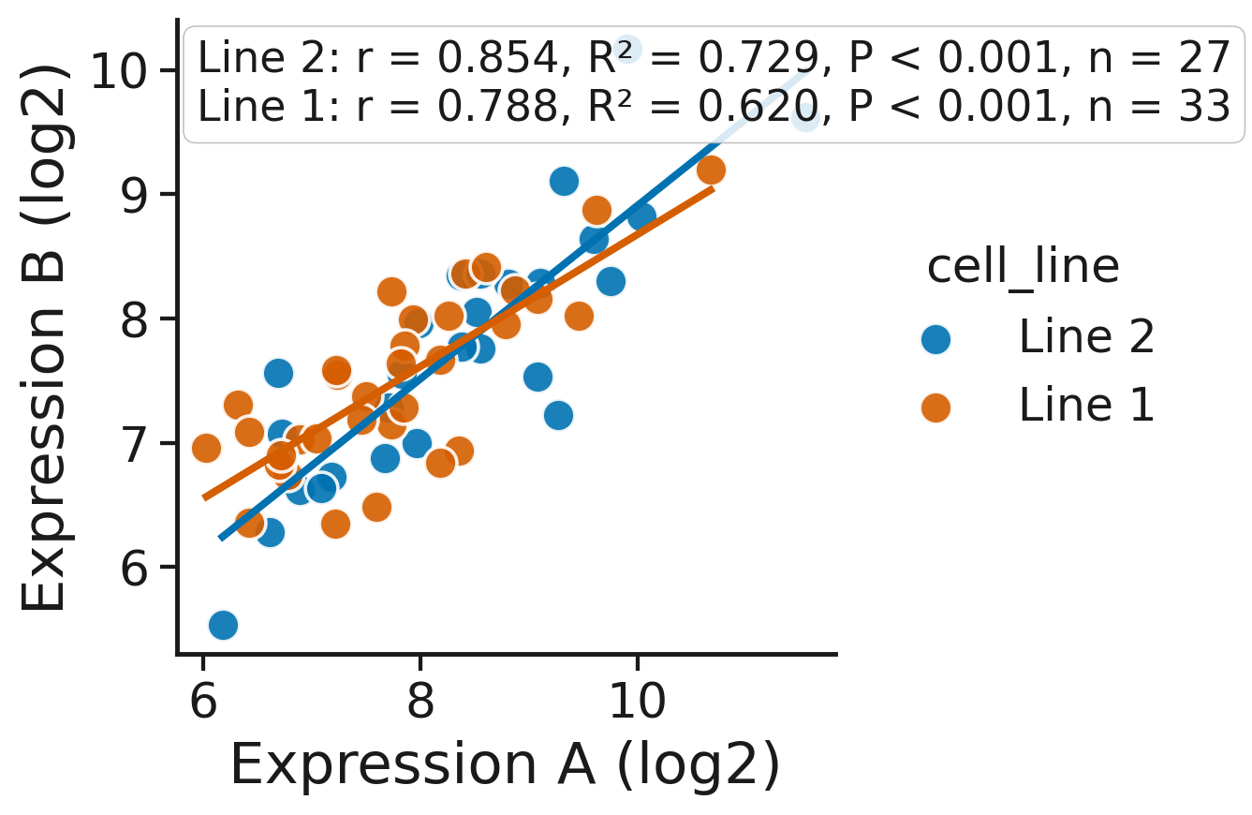
Same data, different presentation - scatter with regression
basic: two roles, one fit
refined: colour by cell line, per-group fit, r / R² / P / n
Adding a colour role turns one regression into one per group; the sixty points are the same.
Make My Figure - desktop tutorial | 12

Slide 13
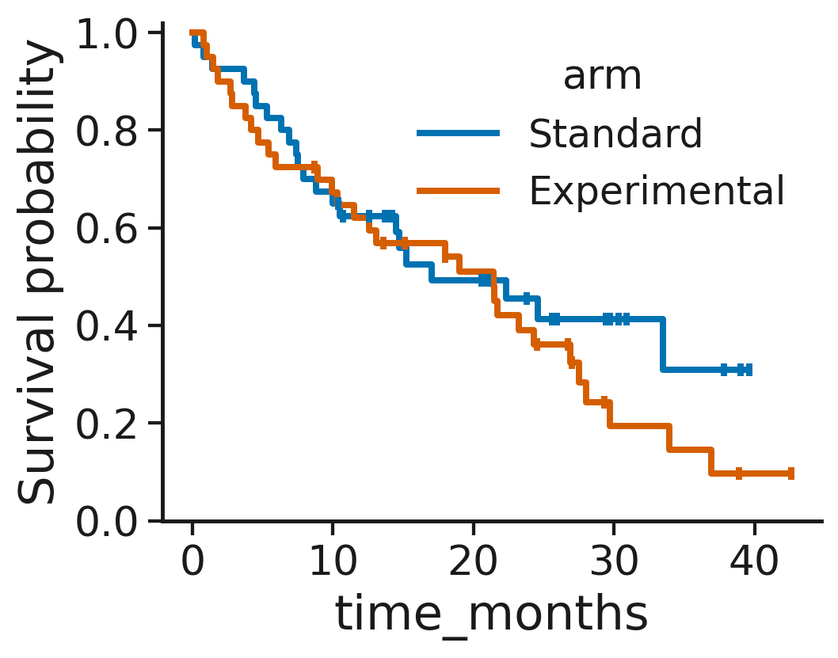
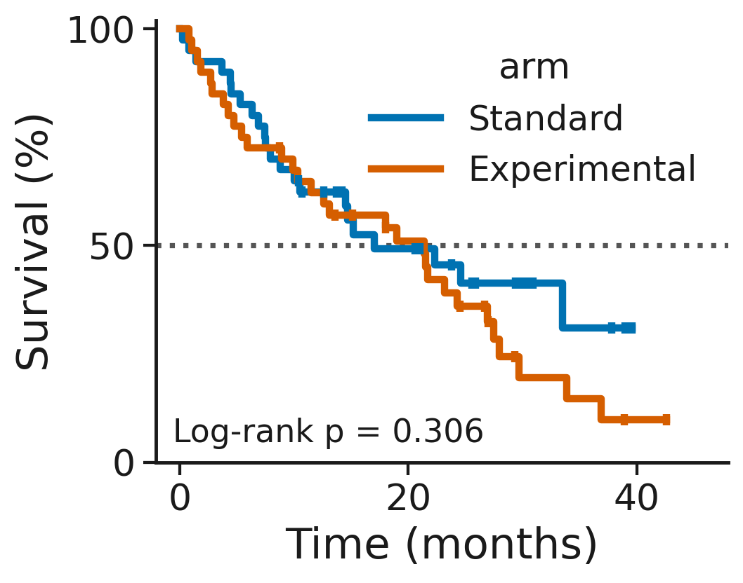
Same data, different presentation - Kaplan-Meier
default: fraction, auto ticks
refined: percent, 50 % reference, log-rank P on the figure
Eighty subjects, the same curves; the log-rank test is written on the figure and stored with it.
Make My Figure - desktop tutorial | 13

Slide 14
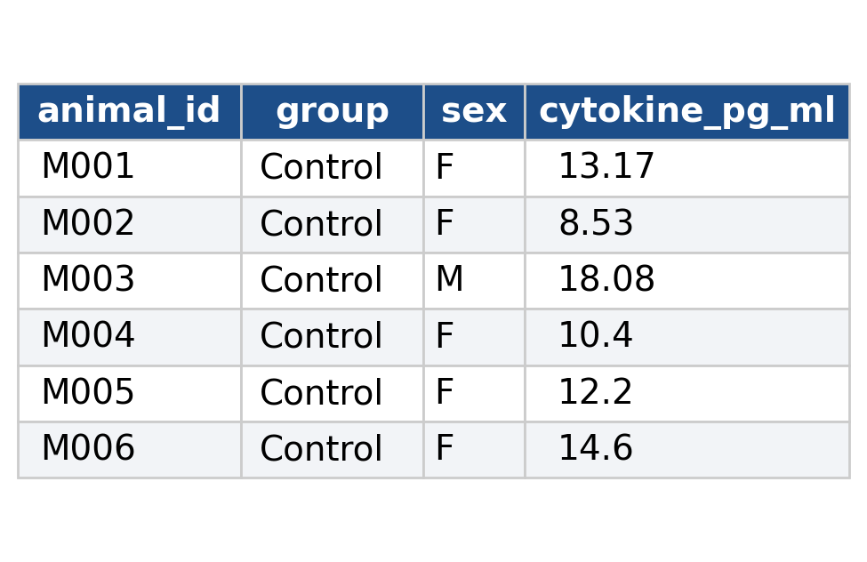
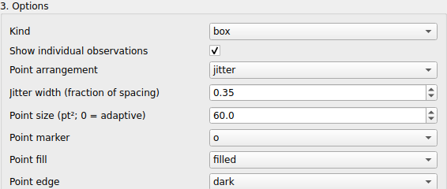
From an ambiguous table to a publication figure
→
1 open the table: 40 animals, 4 groups, unequal n
2 map the roles; choose how the observations are drawn
Open, map, draw, test, preset, export.
Five minutes from a table with unnamed columns to a figure with brackets, a methods sentence, its PlotSpec and a Figure Package.
3 statistics, publication preset, export
Make My Figure - desktop tutorial | 14

Slide 15
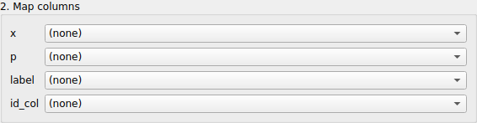
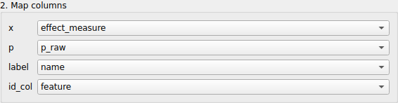
When the detector does not know your headers, you assign the roles
every role starts at (none): the detector does not know these headers
x, p, label, id_col assigned by hand
The Messages tab names the missing roles; four drop-downs later the volcano renders - P values read from the table, never recomputed.
Make My Figure - desktop tutorial | 15

Slide 16
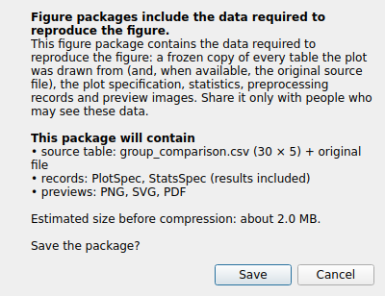
Reproducibility - a Figure Package carries the figure and its frozen data
• What is inside one .mmfpackage
  – plot_spec.json, stats_spec.json (settings and results), render_metadata.json
  – data/source.csv and the typed table; the original file when available
  – preview/figure.png, .svg, .pdf; environment/environment.json
  – manifest.json with a SHA-256 for every member - verified before drawing
• PlotSpec alone is the recipe; it needs the data file to redraw
Move the one file anywhere, open it: integrity verified, mapping, options and brackets restored.
Make My Figure - desktop tutorial | 16

Slide 17
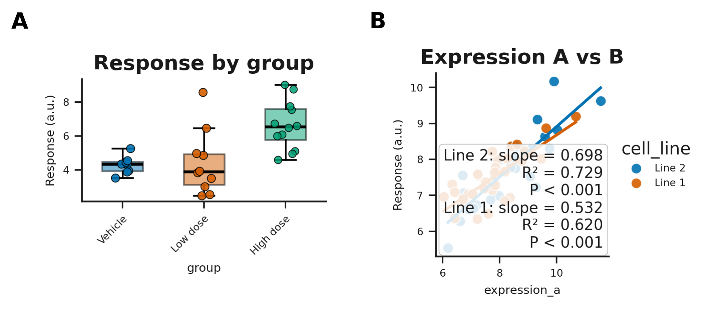
Figure Builder - panels carry their own data
Panel letters, width in millimetres, fonts for all panels; the composite exports as PNG, PDF, SVG and as a Figure Package.
Make My Figure - desktop tutorial | 17

Slide 18
The tutorial is generated from the real application and checked by running it
tutorial action script
→
driver operates the real MainWindow
→
screenshots (offscreen) or video (on screen)
→
validation record PASS / FAIL
No mock-ups: every screenshot is a grab of the production widgets; every step is a step a user can click; every claim was executed.
• Same script, two modes: deterministic screenshots, or a visible window for video recording (recording kept separate)
• Same-data showcases rendered by the application's renderer; presets applied from their files; data integrity recorded per pair
Make My Figure - desktop tutorial | 18

Slide 19
Every tutorial instruction executed against the application
Tutorial | Status | Checks
Figure Builder: a two-panel composite | PASS | 8 checks, 3 captures
Reproducibility: PlotSpec and Figure Package | PASS | 9 checks, 7 captures
Figure presets: style travels, data stays | PASS | 8 checks, 6 captures
Getting started with the desktop application | PASS | 0 checks, 6 captures
Box / violin plot with points and statistics | PASS | 8 checks, 8 captures
Clustered heatmap from a feature-by-sample matrix | PASS | 5 checks, 6 captures
Kaplan-Meier survival curve | PASS | 6 checks, 7 captures
Column mapping with ambiguous column names | PASS | 7 checks, 11 captures
Master replay: from an ordinary table to a reproducible multi-panel figure | PASS | 48 checks, 27 captures
Showing individual observations and controlling jitter | PASS | 20 checks, 17 captures
Publication presets: preview, apply, keep adjusting | PASS | 13 checks, 9 captures
Scatter plot with regression line | PASS | 6 checks, 8 captures
Volcano plot: automatic detection and manual role mapping | PASS | 8 checks, 10 captures
Make My Figure - desktop tutorial | 19

Slide 20
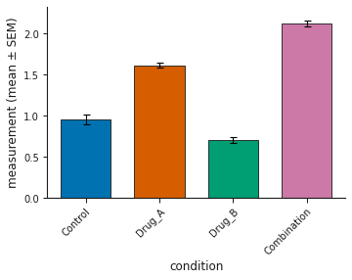
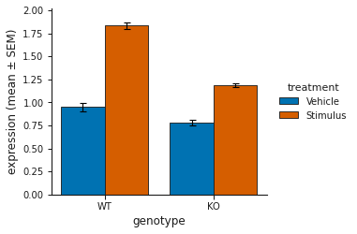
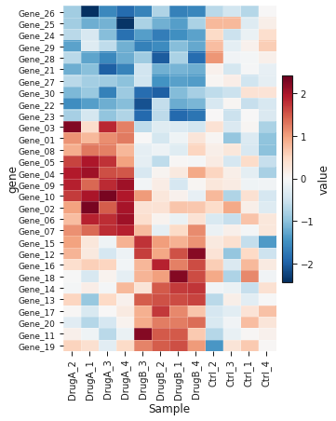
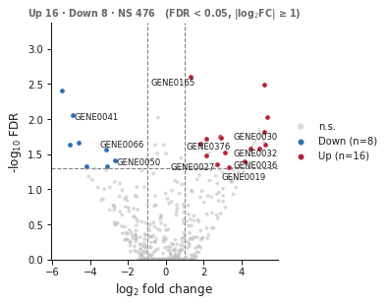
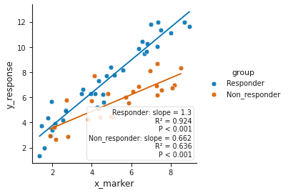
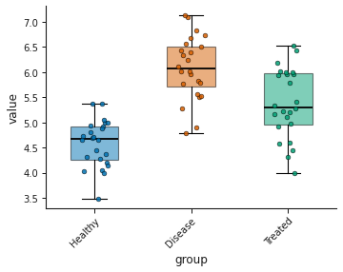
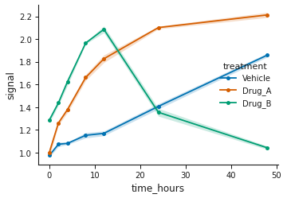
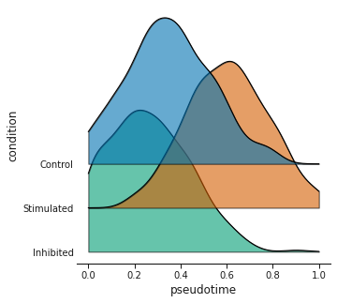
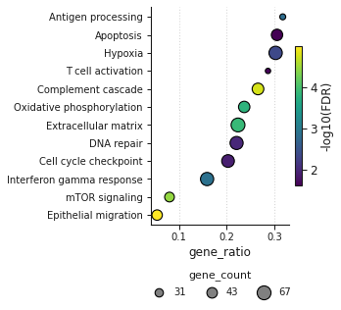
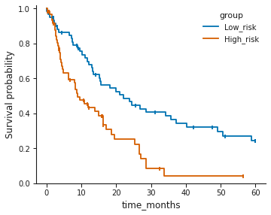
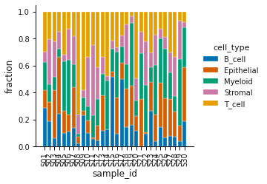
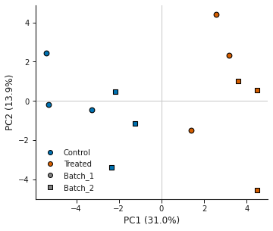
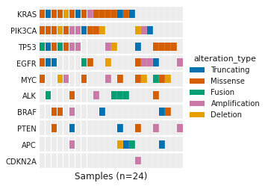
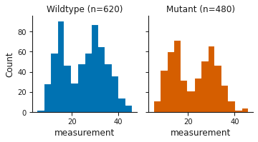
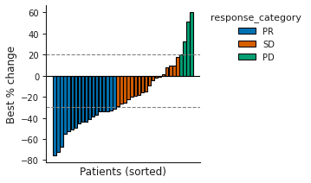
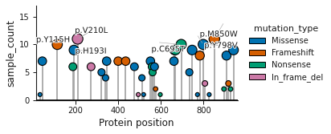
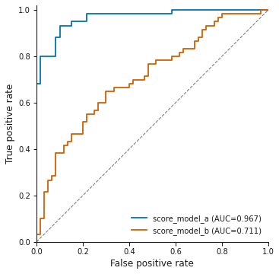
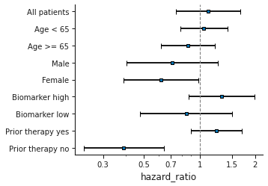
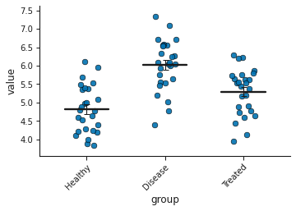
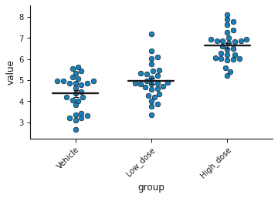
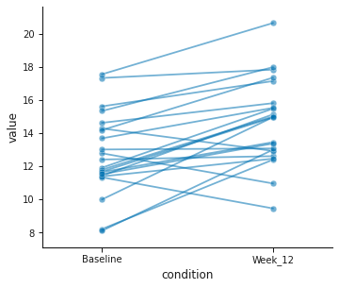
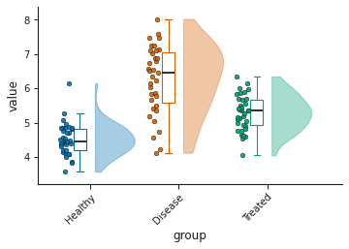
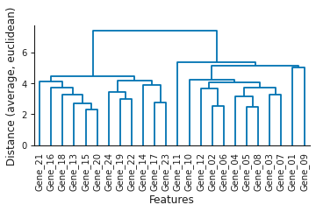
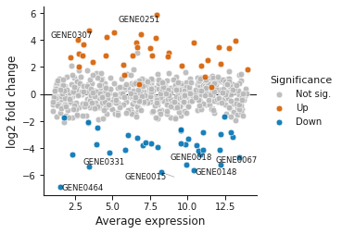
















45 plot types, one workflow
Thumbnails for breadth only - each is a real render of the bundled synthetic example (tutorial/PLOT_GALLERY.md)
Make My Figure - desktop tutorial | 20

Slide 21

New in 1.2.0 - spatial analysis
Six plot types on one spatial core. Checked against published results, not against itself: CNTools Fig 3A reproduced exactly, and again by a hand-check importing no project code.
Make My Figure - desktop tutorial | 21

Slide 22

New in 1.2.0 - the width you ask for is the width you get
Three layers used to overrule a requested width - a network graph returned 132 mm whatever you picked. All 45 plot types now honour all five settings exactly.
Make My Figure - desktop tutorial | 22

Slide 23
New in 1.2.0 - what else changed
• One typography system
  – one font setting gives one size on the page - four panels of one figure used to come out at 69%, 71%, 98% and 66% of the size asked for
• Error bars say which statistic they are
  – SEM, SD, 95% CI (normal and t), IQR - and a whisker that does not describe its bar is corrected and reported, not drawn as though it were intended
• The clustered heatmap's cluster bars got the colourbar's controls
  – thickness, padding, side, labels, palette, legend placement, and separators between groups
• Every render is reproducible
  – three plot types drew a different figure on each run from identical input; the label solver was given a wall-clock budget and now gets a fixed number of passes
• Every control on every plot type was exercised by measuring the output
  – 1,689 controls; the ones that changed nothing were fixed
Experimental publication presets ship opt-in and off by default. They are not journal templates and claim no compliance, endorsement or acceptance.
Make My Figure - desktop tutorial | 23

Slide 24
Where this goes next
• Reviewed and rebuilt
  – tutorial and slides re-evaluated as visual demonstrations; observations, jitter and publication presets shown at readable size
• After author review
  – remaining plot tutorials with the same template; matrix workflow tutorial and video; master and plot videos recorded live
• Released as v1.2.0
  – the observation controls and the experimental presets were merged and released, so these chapters ship
  – built on Windows, macOS and Linux from one commit, each smoke-tested on its own runner; Windows and macOS were not validated interactively by a person
• This tutorial branch is not merged into main
Make My Figure - desktop tutorial | 24

Slide 25
Summary
• Open any table; the application detects, recommends and proposes - and you assign every role yourself
• One dataset, many controlled representations: summary plus every observation, with the test on the figure
• Publication presets are previewed on your data and remain a starting point
• PlotSpec carries the recipe; a Figure Package carries recipe and ingredients, verified
• The tutorial is generated from the real application and validated by running it
github.com/surPoudel/make-my-figure - tutorial/ on the pilot branch (not yet published)
Make My Figure - desktop tutorial | 25

