Slide 1

Ali Murtadho
Simple Prediction Diabetes Using Flask

Slide 2
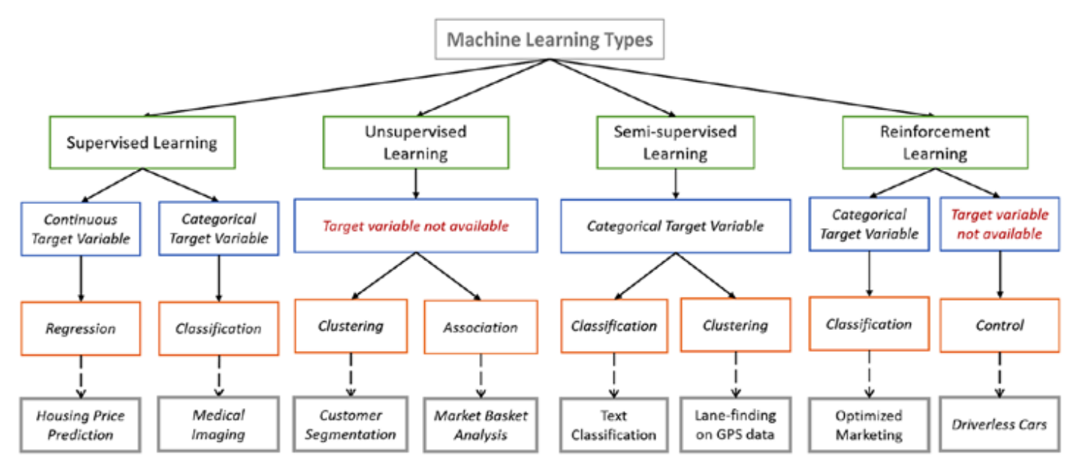
supervised learning, has two main functions, classification and regression for the method I use is K-NN, Logistic Regression, Decision Tree, Random Forest, Gradient Boasting
https://www.quora.com/What-are-the-commonly-used-Machine-Learning-Algorithms-one-has-to-know-when-working-with-R-or-Python

Slide 3
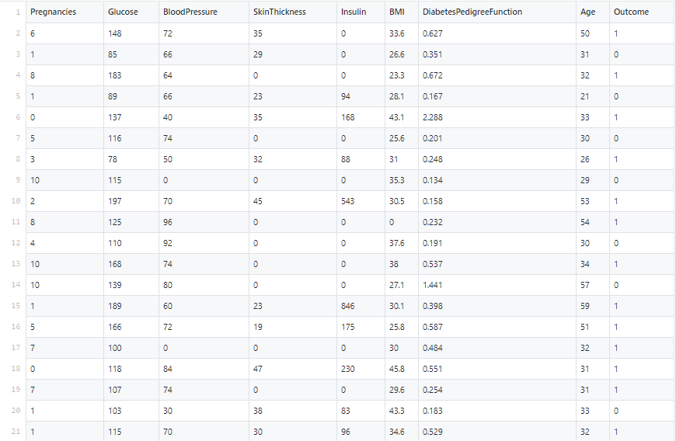
Overview Dataset Pima-Indian-diabetes
https://www.kaggle.com/uciml/pima-indians-diabetes-database/

Slide 4
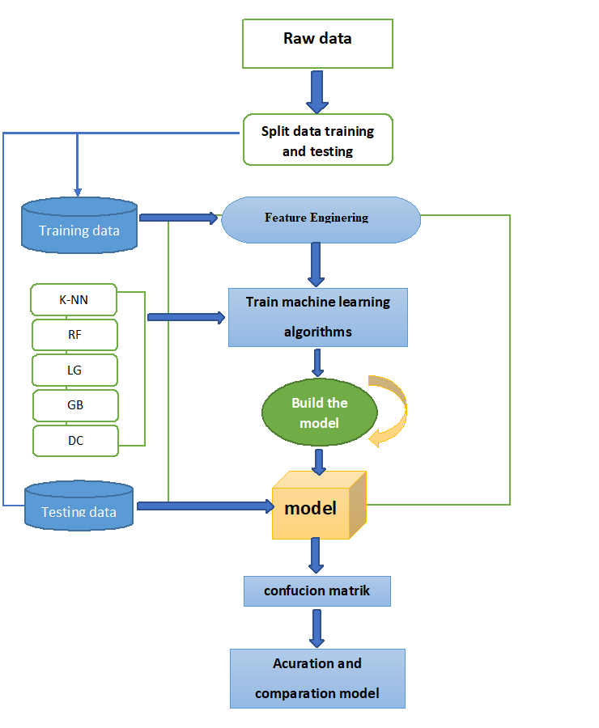
Flow model

Slide 5
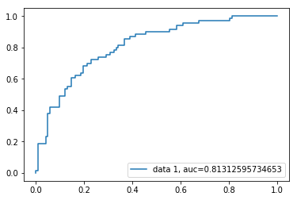
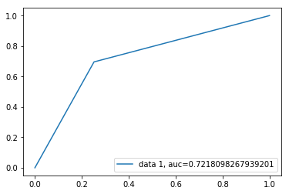
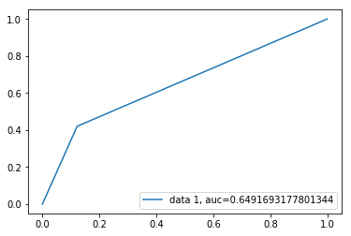
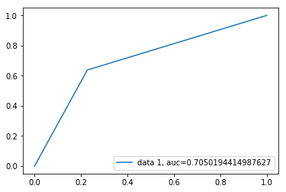
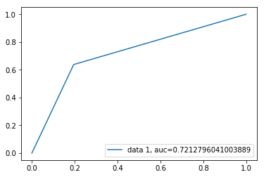
Curve roc_auc
GB
DC
K-NN
LG
RF

Slide 6
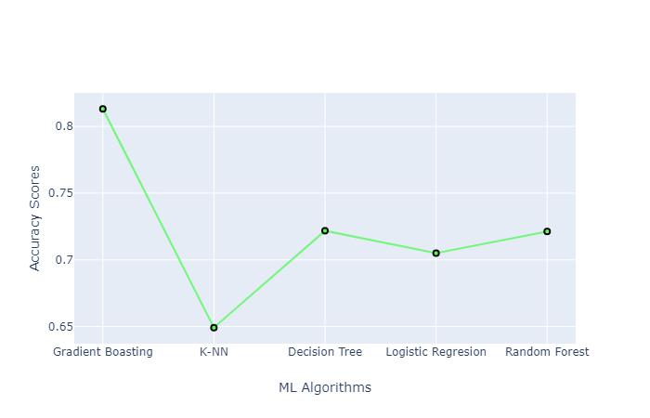
Ploty result compare

Slide 7
ESSENTIAL LEARNING PROCESS TO DEVELOP A MODEL
Feature Extraction :
1.Data preprocesing
2. Scaling feature
3. Split dataset
4. Feature selection
Cunfusion matrik and Result acuration
roc,auc result
Clasification report
START
END
01
03
02
04
Raw data :
1.Structured data and unstructured data
2. Overview data
Hyperparameter and tunning
Parameter evalution
Adjusting thereshold
Buildig model and validation

Slide 8
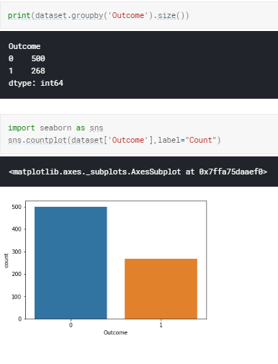
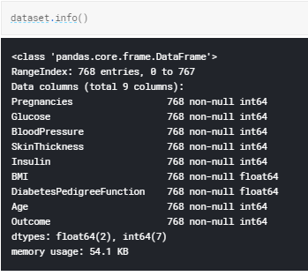
01

Slide 9
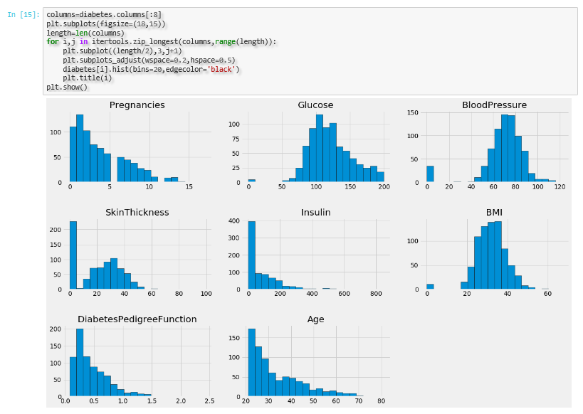
Brief Analysis of the data

Slide 10
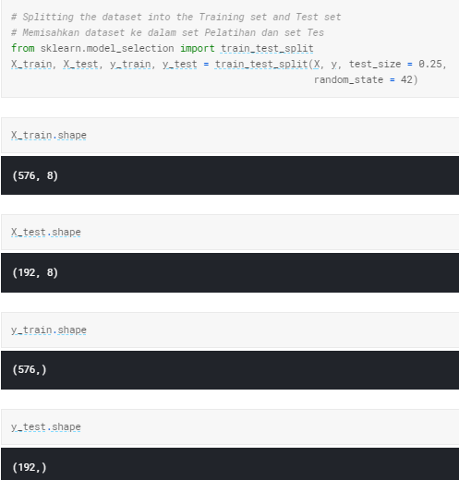
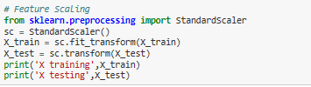
02

Slide 11
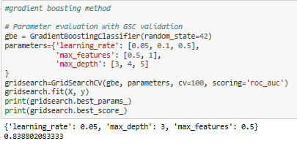
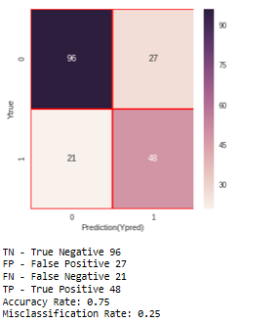
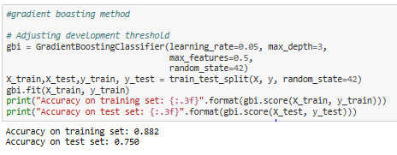
03
Gradient Boasting

Slide 12
Let’s to coding

Slide 13
Thank you

Slide 14
Dalam pelatihan menggunakan gradient descent, aturan pembaruannya adalah
𝑤←𝑤−𝜂∇𝐸(𝑤)w←w−η∇E(w)
dengan 𝑤w adalah parameter model, 𝜂η adalah learning rate, dan ∇𝐸(𝑤)∇E(w) adalah turunan fungsi eror 𝐸(⋅)E(⋅) saat nilai parameter adalah 𝑤w. Nilai learning rate 𝜂η mengatur seberapa besar update/pembaruan yang dilakukan terhadap nilai parameter saat ini yaitu 𝑤w. Jika 𝜂η cukup kecil, maka nilai fungsi eror dijamin turun setelah pembaruan. Oleh karena itu, nilai 𝜂η biasanya diset kecil. Namun, jika terlalu kecil, meski eror dijamin turun pada setiap iterasi, pelatihan akan berjalan lambat sekali. Jadi, perlu dicari nilai learning rate yang tidak terlalu besar ataupun kecil, biasanya dilakukan dengan grid search atau random search

Slide 15
Conclusion
Based on the results of trials of supervised learning techniques with a comparison of 5 methods namely K-NN, Logistic Regression, Random Forest, Decision Tree, Gradient Boosting we can see the results of the accuracy of the 5 methods, that the most accurate method for prediction of diabetes with supervised learning techniques is Pima -Indian is the Gradient Boosting method and for the worst accuracy the accuracy is the K-NN method, and for the prediction results of the decision tree method, logistic regression, and random forest results, it is almost the same. Henceforth,
we should use more data to train the model because it is in the machine learning the more data used in training the model, the better the model will be.

