Slide 1
Comprehensive Banking Analytics
By Surabhi Yadav

Slide 2
“Data is a precious thing and will last longer than the systems themselves.”
- Tim Berners-Lee

Slide 3
Introduction
Let's delve into the details by exploring the following key points:
Overview of Banking Analytics: Banking analytics involves leveraging data and statistical analysis to gain insights into banking operations, customer behavior, and financial trends.
Importance of Data in Banking: Data is critical for making informed decisions, managing risks, and enhancing customer experiences in the banking sector.
Objective of the Project: The goal is to analyze banking data to understand customer segments, assess credit risk, and predict performance.
Exploratory Data Analysis (EDA): EDA helps in understanding the data distribution, identifying outliers, and visualizing relationships between different variables.
Feature Importance Analysis: Determining the key features that influence credit scores aids in prioritizing data that impacts decision-making.
Customer Segmentation: Using clustering techniques like K-means to categorize customers into distinct groups based on their banking behaviors and characteristics.
Credit Risk Assessment: Implementing classification models to predict credit scores, which helps in evaluating the likelihood of customer defaults.
Performance Prediction: Employing regression models to forecast future credit scores, aiding in proactive customer management and financial planning.

Slide 4
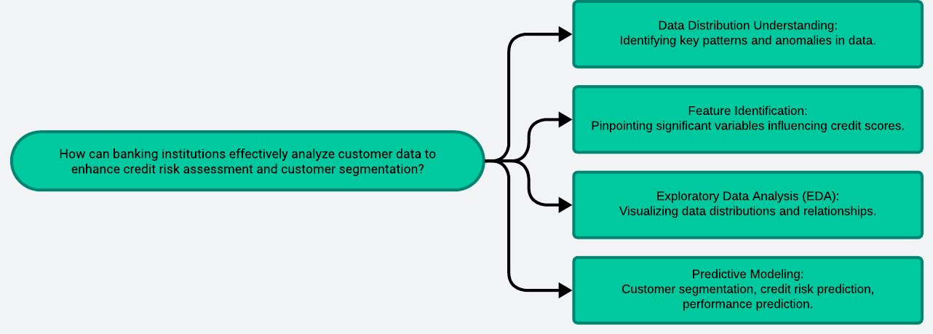
Problem Statement

Slide 5
Solution
Gather banking data.
Handle missing values.
Create relevant features.
Visualize data insights.
Identify important variables.
Train classification and regression models.
Customer segmentation, risk, performance prediction.
Assess model performance.
Outline
Data Collection
Data Cleaning
Feature Engineering
Exploratory Data Analysis
Feature Selection
Model Training
Advanced Analytics
Model Evaluation
Visualize data insight.
Feature Selection

Slide 6
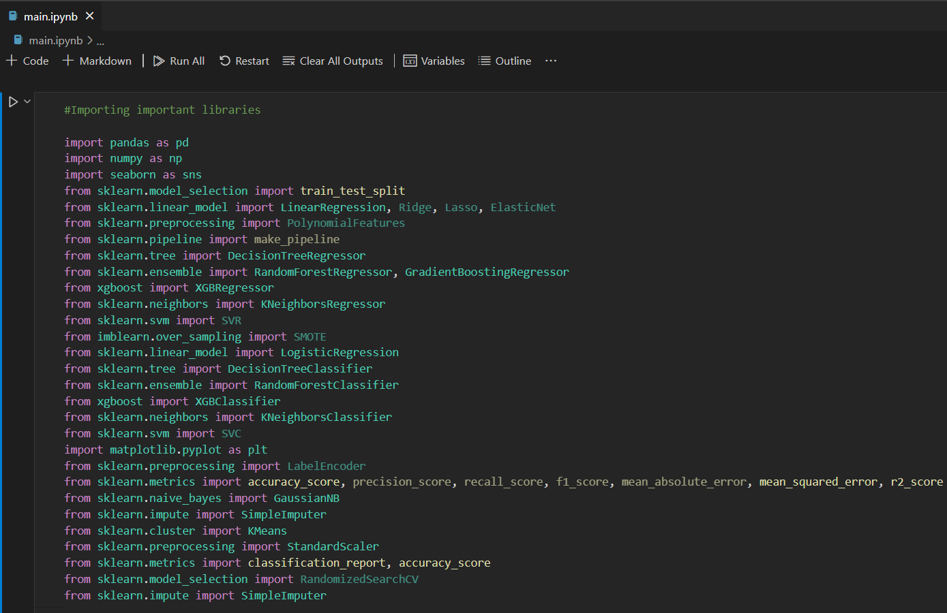
Codebody preview

Slide 7
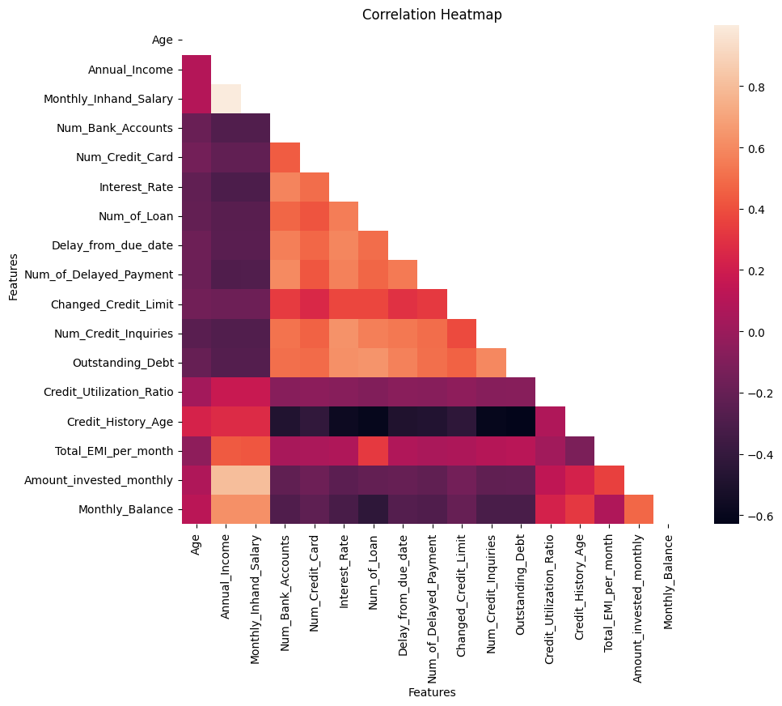
Graph preview

Slide 8
Why do we need this?
Future trends of this project
This project is essential for banking institutions to enhance their decision-making processes by leveraging data analytics. By conducting comprehensive analysis, banks can gain valuable insights into customer behaviors, identify key factors affecting credit scores, and accurately segment customers. This leads to improved credit risk assessment, enabling banks to minimize defaults and optimize lending strategies. Additionally, performance prediction models help in proactive customer management, ensuring better financial planning and personalized services, ultimately increasing customer satisfaction and loyalty.
Future trends of this project include integrating artificial intelligence and machine learning for more accurate predictions and real-time analytics. Enhanced data integration from various sources, including social media and transaction data, will provide deeper insights. Predictive maintenance of financial health and automated personalized financial advice are emerging areas. Additionally, the use of blockchain technology for secure and transparent data handling, along with advancements in data privacy regulations, will shape the future of banking analytics.

Slide 9
20-30%
This is by how much banking sector can benefit from this project. This improvement encompasses enhanced credit risk assessment, more effective customer segmentation, increased operational efficiency, and optimized revenue growth strategies.

Slide 10
Banking analytics significantly enhances decision-making, reduces risks, improves customer segmentation, and boosts operational efficiency and revenue growth.
Key takeaway

Slide 11

Thanks!
Contact me:
Surabhi Yadav
sy09012000@gmail.com
https://github.com/surabhi0901
https://www.linkedin.com/in/surabhi-yadav-9100sy/

