Slide 1
Airbnb Data Analysis
By Surabhi Yadav

Slide 2
"The greatest value of a picture is when it forces us to notice what we never expected to see."
- John Tukey

Slide 3
Introduction
Let's delve into the details by exploring the following key points:
Introduction to Airbnb: Introduce Airbnb as a global platform connecting travelers with unique lodging options.
Data Source: Highlight the wealth of data available from Airbnb listings, including property details, pricing, and availability.
Objective: Outline the project's goal to analyze Airbnb data using MongoDB Atlas and extract actionable insights.
Data Cleaning: Emphasize the importance of cleaning and preparing the dataset for accurate analysis.
Interactive Visualization: Discuss the use of interactive geospatial visualizations to showcase distribution and pricing trends.
Pricing Dynamics: Explore variations in pricing across locations, property types, and seasons through dynamic plots.
Availability Patterns: Analyze occupancy rates and demand fluctuations to uncover seasonal booking trends.
Key Insights: Summarize the project's aim to provide valuable insights for hosts and travelers through comprehensive analysis and visualization.

Slide 4
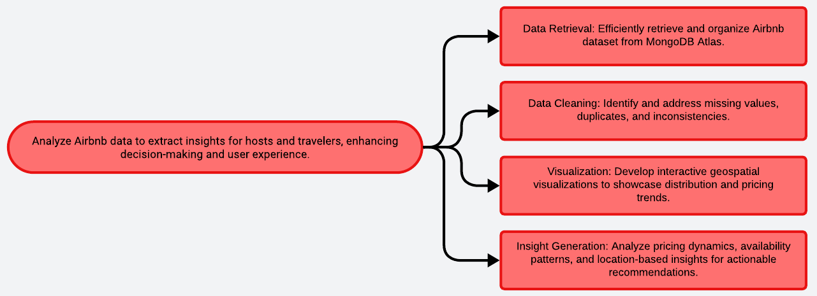
Problem Statement

Slide 5
Solution
Establish MongoDB connection, retrieve Airbnb dataset efficiently.
Address missing values, duplicates, ensure data accuracy.
Create interactive maps, dynamic plots for insights.
Explore price variations based on location, property type.
Visualize occupancy rates, demand fluctuations across seasons.
Extract and visualize data for specific regions/neighborhoods.
Enable user filtering, drill-down capabilities for exploration.
Integrate various visualizations, present key insights comprehensively.
Outline
Data Retrieval
Data Cleaning
Visualization Development
Pricing Analysis
Availability Patterns
Location Insights
Interactive Visualization
Dashboard Creation

Slide 6
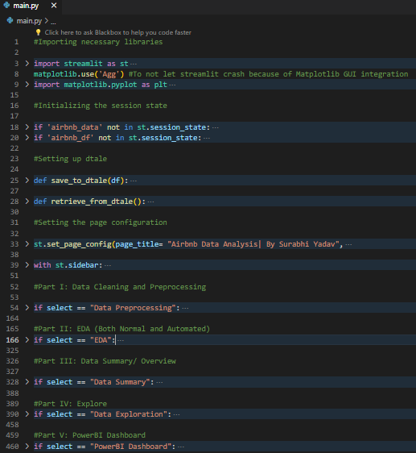
Codebody preview

Slide 7
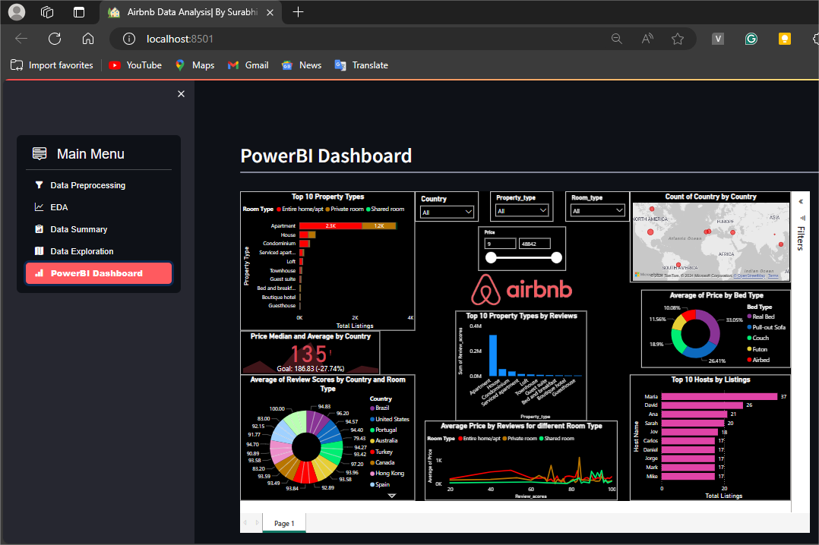
Streamlit preview

Slide 8
Why do we need this?
Future trends of this project
This project is vital for understanding Airbnb data trends, optimizing property management, and enhancing user experience. By analyzing pricing variations, availability patterns, and location-based insights, we can tailor marketing strategies, improve pricing strategies, and optimize resource allocation. The interactive visualizations and comprehensive dashboard empower stakeholders to make informed decisions, enhance customer satisfaction, and maximize revenue potential. This project serves as a powerful tool for data-driven decision-making, fostering growth and competitiveness in the dynamic hospitality industry.
In the future, this project could extend its predictive analytics capabilities, broaden its scope to include global datasets, and incorporate advanced visualization techniques for deeper insights. Collaborations with tourism boards and city planners could leverage the data for urban development initiatives. Moreover, the project may explore emerging trends in the sharing economy and adapt its analysis to accommodate evolving user preferences and market dynamics.

Slide 9
15-30%
This is by how much airbnb can benefit by improvement in various aspects such as pricing optimization, listing visibility, and user experience enhancements.

Slide 10
Data-driven insights optimize pricing, enhance listing visibility, and elevate user experience, fostering Airbnb's growth and competitive edge.
Key takeaway

Slide 11

Thanks!
Contact me:
Surabhi Yadav
sy09012000@gmail.com
https://github.com/surabhi0901
https://www.linkedin.com/in/surabhi-yadav-9100sy/

