Slide 1
BizCardX: Extracting Business Card Data with OCR
By Surabhi Yadav

Slide 2
"A business card is the most powerful tool in the world."
- Tan Le

Slide 3
Introduction
Let's delve into the details by exploring the following key points:
Introduction to BizCardX: Streamlining business card data management.
Effortless Data Extraction: Utilizing OCR technology for seamless text extraction.
Dynamic Modification: Easily modify and update contact details as needed.
Convenient Deletion: Remove unnecessary entries with a simple click.
Secure Storage: Safely store and organize extracted information.
User-Friendly Interface: Intuitive design for smooth navigation and operation.
Enhanced Efficiency: Transforming traditional networking into a digital advantage.
Empowering Networking: Empowering professionals to make meaningful connections effortlessly.

Slide 4
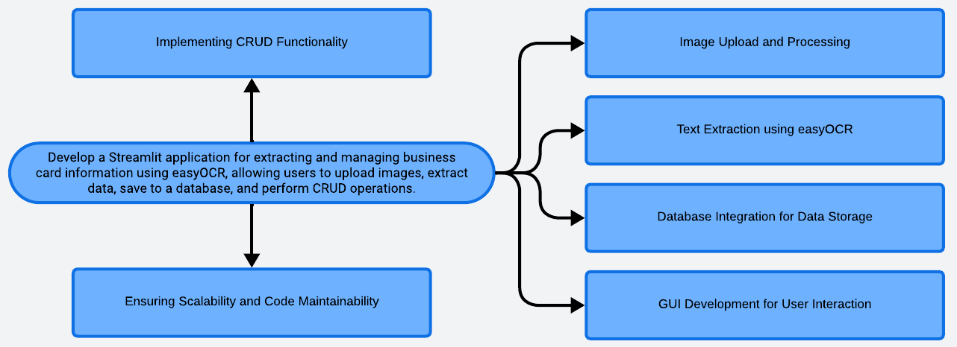
Problem Statement

Slide 5
Solution
Accept user-uploaded business card images.
Utilize easyOCR to extract relevant information from the uploaded images.
Structure the extracted information into key-value pairs for easy access.
Implement SQLite database to store extracted information along with the uploaded image.
Develop a Streamlit GUI for user interaction and data visualization.
Enable Create, Read, Update, and Delete operations on the stored data.
Ensure that the extracted information and uploaded images persist across sessions.
Implement error handling mechanisms and data validation to enhance application robustness.
Outline
Input Processing
Text Extraction
Data Organization
Database Integration
Graphical User Interface (GUI)
CRUD Functionality
Data Persistence
Error Handling and Validation

Slide 6
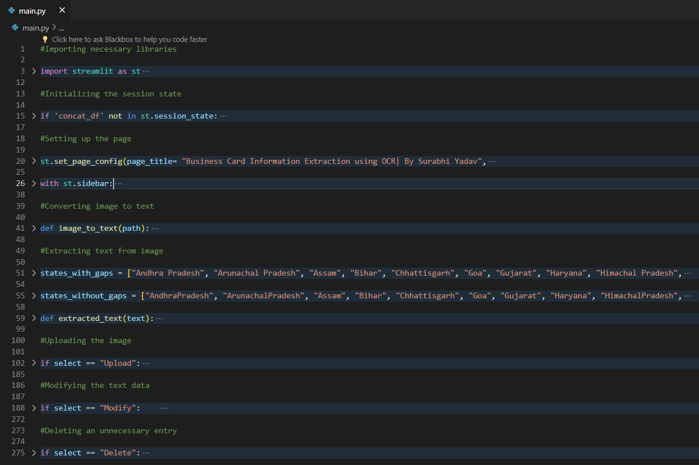
Codebody preview

Slide 7
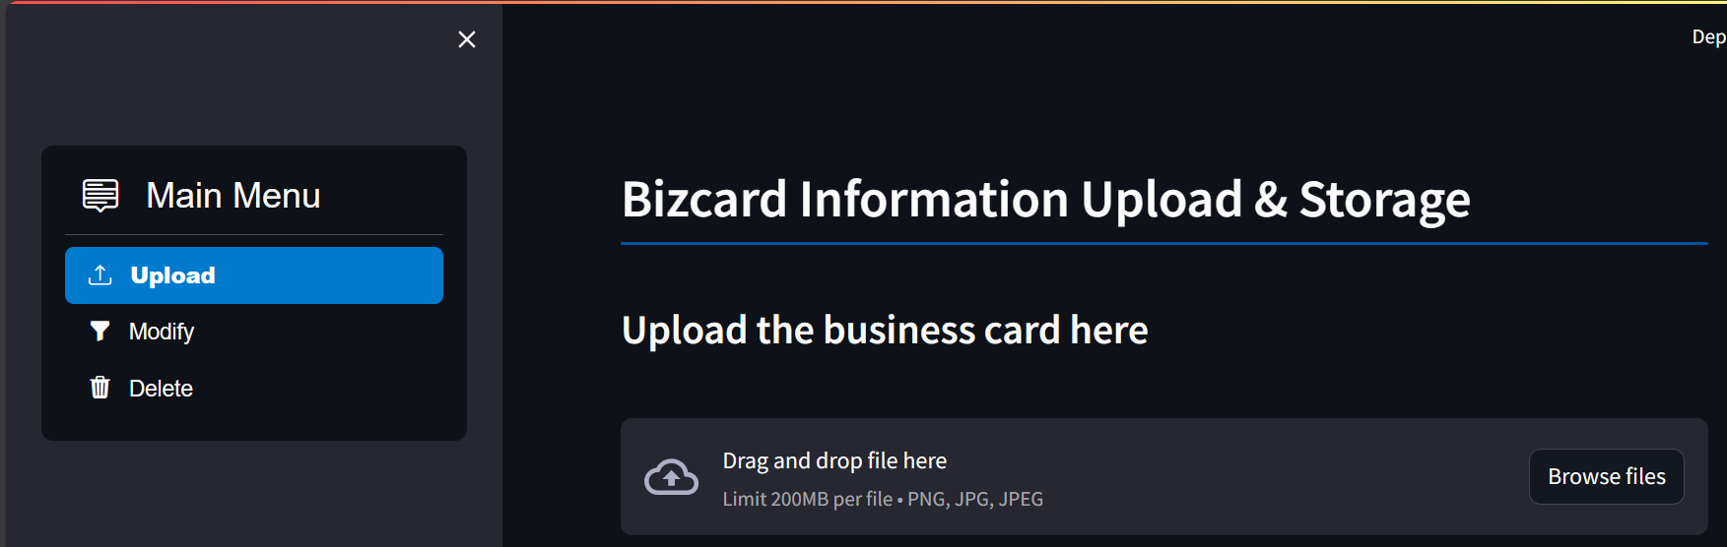
Streamlit preview

Slide 8
Why do we need this?
Future trends of this project
In a fast-paced business environment, managing numerous business cards efficiently is crucial for effective networking and relationship building. This project provides a solution by automating the process of extracting and storing relevant information from business cards. It saves time and effort, allowing professionals to focus on building connections rather than manually organizing data. Additionally, it facilitates seamless access to contact details and enhances productivity in networking endeavors, ultimately fostering stronger professional relationships and opportunities for collaboration and growth.
Future trends of this project may include integration with advanced OCR technologies for more accurate text extraction, incorporation of machine learning algorithms to improve data classification and organization, implementation of cloud-based storage for scalability and accessibility, development of mobile applications for on-the-go business card management, and integration with contact management systems for seamless synchronization of data. Additionally, potential advancements in augmented reality could enable real-time recognition and digitization of business card information, further enhancing user experience and efficiency.

Slide 9
70-80%
This is an estimate of percentage of businesses which could potentially benefit from this project considering the ubiquitous nature of networking and the need for efficient contact management across various industries.

Slide 10
Streamlining business card management enhances networking efficiency, saves time, and fosters stronger professional relationships for sustainable growth and success.
Key takeaway

Slide 11
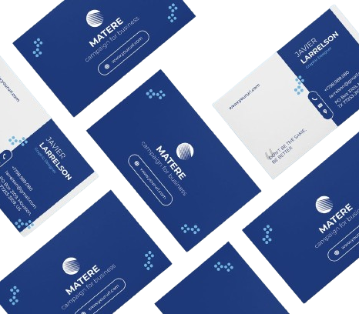
Thanks!
Contact me:
Surabhi Yadav
sy09012000@gmail.com
https://github.com/surabhi0901
https://www.linkedin.com/in/surabhi-yadav-9100sy/

