Slide 1
Chicago Crime Data Analyzer
By Surabhi Yadav

Slide 2
"What gets measured gets managed."
- Peter Drucker

Slide 3
Introduction
Let's delve into the details by exploring the following key points:
Address the increase in crime in Chicago by analyzing historical and recent data.
Utilize a comprehensive dataset of reported crimes with details on type, location, and arrest status.
Identify patterns, trends, and hotspots to support strategic decision-making and public safety.
Conduct temporal analysis to observe crime trends over time and peak crime hours.
Perform geospatial analysis to pinpoint crime hotspots and compare crime rates across districts and wards.
Analyze crime types to understand their distribution and severity.
Apply machine learning models to predict future crime incidents and assess risk.
Deliver interactive dashboards, visualizations, and detailed reports with actionable insights.

Slide 4
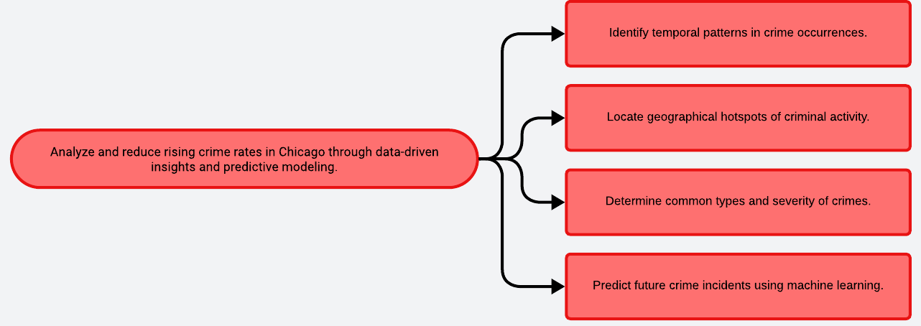
Problem Statement

Slide 5
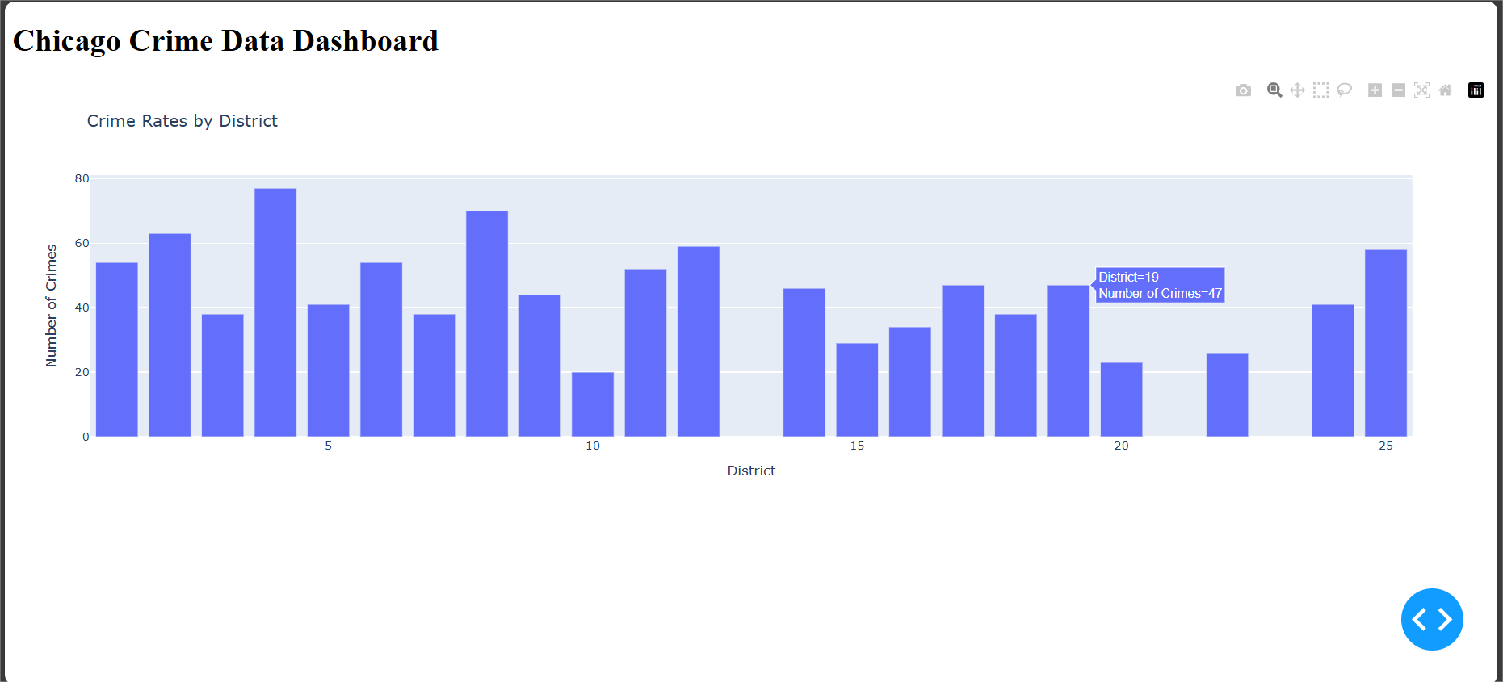
HTML Dashboard

Slide 6
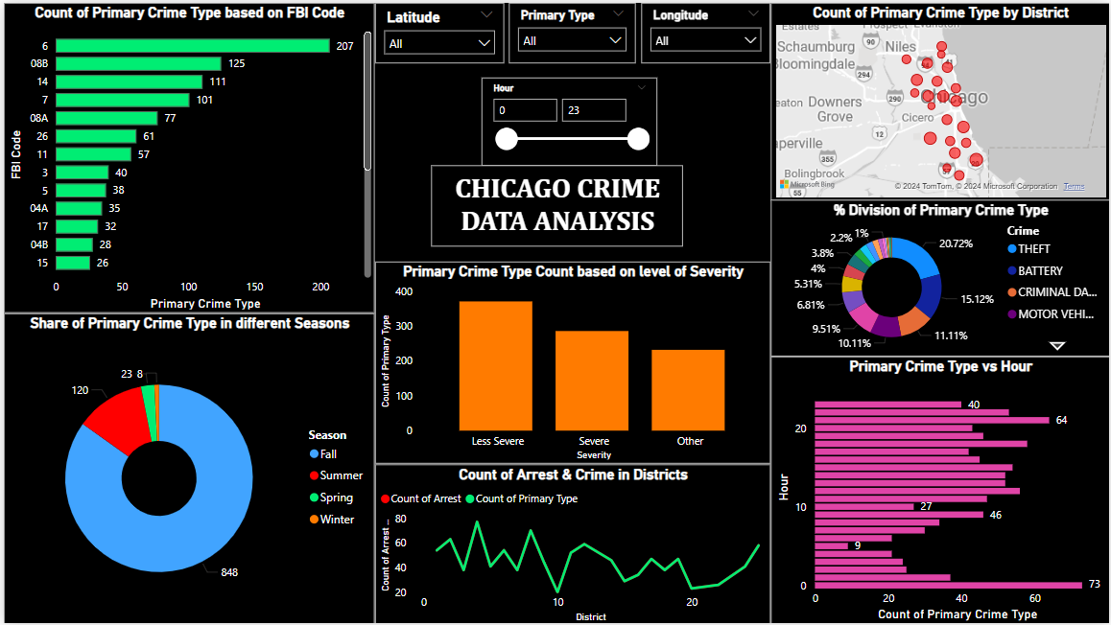
PowerBI Dashboard

Slide 7
Solution
Outline
Data Collection
Data Preprocessing
Temporal Analysis
Geospatial Analysis
Crime Type Analysis
Predictive Modeling
Visualization
Reporting
Gather crime data from Chicago's database.
Clean and prepare data for analysis.
Examine crime trends over time.
Identify high-crime areas using heatmaps.
Analyze frequency and severity of crime types.
Develop models to forecast future crimes.
Create interactive dashboards for insights.
Generate detailed reports for law enforcement.

Slide 8
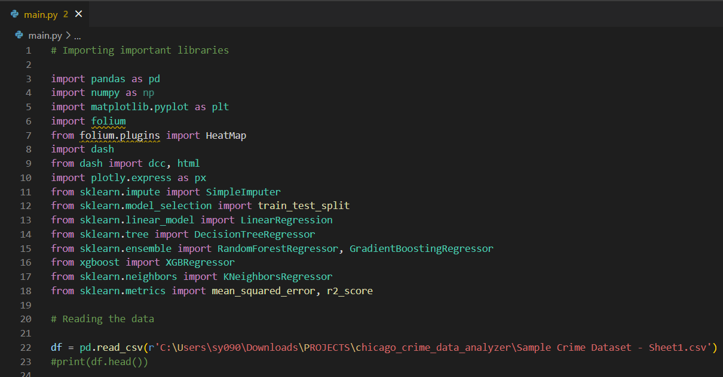
Codebody preview

Slide 9
Why do we need this?
Future trends of this project
This project is essential due to the recent surge in crime in Chicago. By leveraging historical and recent crime data, we aim to identify patterns, trends, and hotspots. This analysis will support strategic decision-making, enhance resource allocation, and improve crime prevention strategies. Ultimately, our goal is to reduce crime rates and enhance public safety, making Chicago a safer community. The insights gained from this project will be instrumental in aiding law enforcement operations and boosting their overall effectiveness.
Future trends of this project include the integration of advanced machine learning algorithms for more accurate crime prediction and risk assessment. Incorporating real-time data from IoT devices and surveillance systems can provide immediate insights and proactive measures. Expanding the analysis to include socio-economic factors will enhance understanding of crime causation. Additionally, fostering community engagement through accessible dashboards and reports will empower residents to participate in crime prevention, ultimately contributing to a safer and more secure Chicago.

Slide 10
20-40%
This is by how much operational efficiency and crime prevention strategies can improve.

Slide 11
Harnessing data analytics can transform law enforcement strategies, enhancing safety by pinpointing crime patterns and optimizing resource allocation effectively.
Key takeaway

Slide 12

Thanks!
Contact me:
Surabhi Yadav
sy09012000@gmail.com
https://github.com/surabhi0901
https://www.linkedin.com/in/surabhi-yadav-9100sy/

