Slide 1
Copper Industry Data Modeling
By Surabhi Yadav

Slide 2
"Machine learning is the last invention that humanity will ever need to make."
- Nick Bostrom

Slide 3
Introduction
Let's delve into the details by exploring the following key points:
The project focuses on building and deploying machine learning models for predictive analytics in the copper industry, targeting both regression and classification tasks.
Utilizes a variety of powerful Python libraries including pandas, numpy, seaborn, sklearn, and dtale for data manipulation, visualization, and model building.
Implements comprehensive data preprocessing steps including handling missing values, treating outliers with Isolation Forest, addressing skewness, and scaling features using StandardScaler.
Enhances the dataset by creating new features like delivery time in days and transforming date fields into separate day, month, and year components to improve model performance.
Conducts both manual and automated EDA, generating insightful visualizations like histograms, box plots, heatmaps, pie charts, and count plots to uncover data patterns and correlations.
Develops and trains a suite of machine learning models for regression (Linear Regression, Decision Tree, Random Forest, Gradient Boosting) and classification (Logistic Regression, Decision Tree, Random Forest, Naive Bayes).
Evaluates model performance using various metrics (e.g., accuracy, precision, recall, mean squared error, R2 score) and deploys the models to predict outcomes such as selling price and status.
Integrates with Streamlit to create an interactive web application, allowing users to upload data, preprocess it, perform EDA, engineer features, and make predictions using trained models.

Slide 4
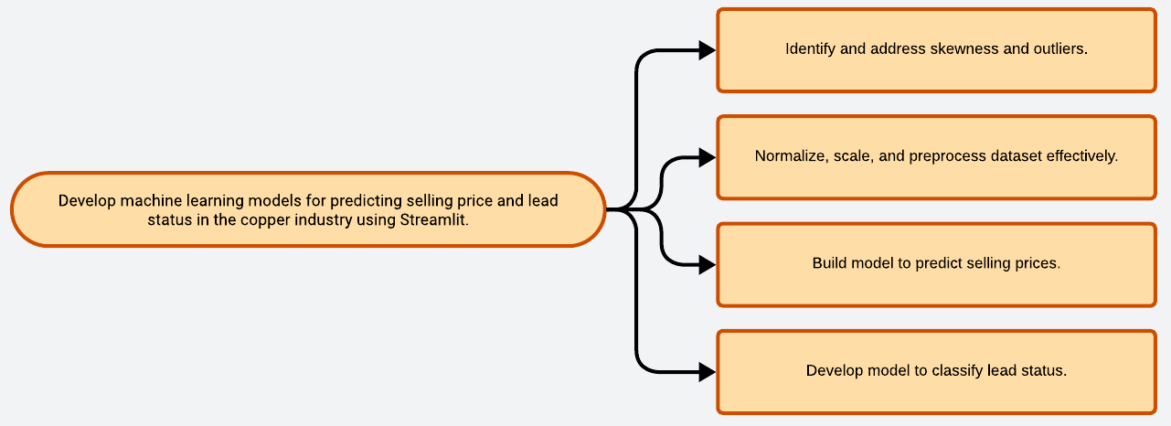
Problem Statement

Slide 5
Solution
Create file upload feature to import dataset into Streamlit.
Impute missing values using median strategy to maintain data integrity.
Use Isolation Forest algorithm to identify and remove outliers.
Apply StandardScaler to normalize and scale numerical features uniformly.
Create new features like delivery time from existing date fields.
Generate visualizations such as histograms and heatmaps for insights.
Develop regression and classification models for price prediction and lead status.
Implement Streamlit page for user input and model predictions display.
Outline
Data Uploading
Handling Missing Values
Outlier Detection
Data Transformation:
Feature Engineering
Exploratory Data Analysis
Model Building
Interactive Interface:

Slide 6
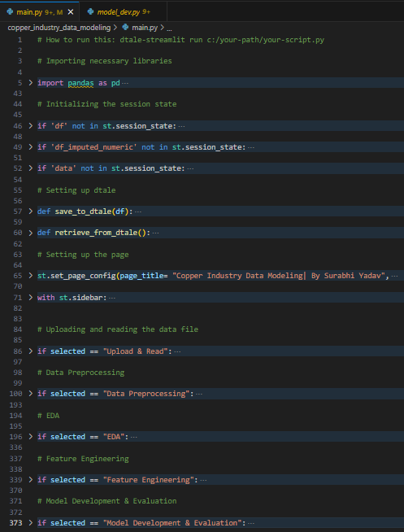
Codebody preview

Slide 7
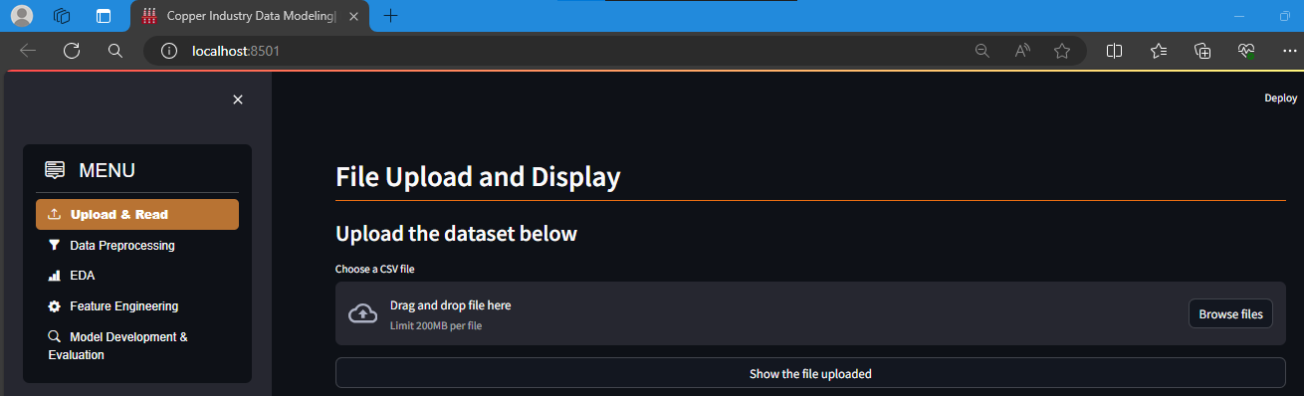
Streamlit preview

Slide 8
Why do we need this?
Future trends of this project
This project is essential for the copper industry to improve the accuracy and efficiency of sales pricing and lead evaluation. Manual methods are time-consuming and prone to errors, especially with skewed and noisy data. By leveraging machine learning, we can automate data normalization, feature scaling, and outlier detection, leading to optimal pricing decisions and effective lead classification. The interactive Streamlit interface allows for easy user input and real-time predictions, enhancing decision-making processes and business outcomes.
Future trends for this project include the integration of more advanced machine learning techniques, such as deep learning and reinforcement learning, to further enhance prediction accuracy. Real-time data processing and predictive analytics could offer instant insights, while the use of big data technologies will handle larger datasets more effectively. Additionally, incorporating AI-driven automation in sales and lead management can streamline operations, and predictive maintenance can reduce downtime and improve efficiency in the copper industry.

Slide 9
10-15%
This is by how much growth in efficiency and revenue could be expected. This estimation is due to improved pricing accuracy, faster decision-making, and better lead conversion rates.

Slide 10
Implementing ML in the copper industry enhances pricing accuracy, lead classification, and operational efficiency for sustainable growth.
Key takeaway

Slide 11
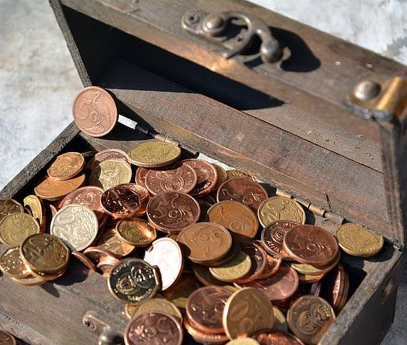
Thanks!
Contact me:
Surabhi Yadav
sy09012000@gmail.com
https://github.com/surabhi0901
https://www.linkedin.com/in/surabhi-yadav-9100sy/

