Slide 1
Phonepe Pulse Data Visualization and Exploration:
A User-Friendly Tool Using Streamlit and Plotly
By Surabhi Yadav

Slide 2
"Data analysis is a powerful tool in the world of finance, unlocking insights that drive informed decision-making and pave the way for financial success."
- Warren Buffett

Slide 3
Introduction
Let's delve into the details by exploring the following key points:
Objective: Develop an interactive dashboard for visualizing and exploring Phonepe Pulse data using Streamlit and Plotly.
Key Features:
User-Friendly Interface: Intuitive controls for selecting criteria such as year, quarter, and type.
Interactive Visualizations: Pie charts, bar graphs, and sliders for dynamic data exploration.
Insightful Analysis: Top 10 rankings based on transaction amount, count, and user statistics.
Benefits: Efficient data exploration, customizable viewing, and enhanced decision-making.
Conclusion: Empowers users to uncover meaningful insights from Phonepe Pulse data, driving informed decisions and strategies. Continued development for further enhancements and user feedback integration.
Next Steps: Live demonstration, feedback collection, and deployment planning.

Slide 4
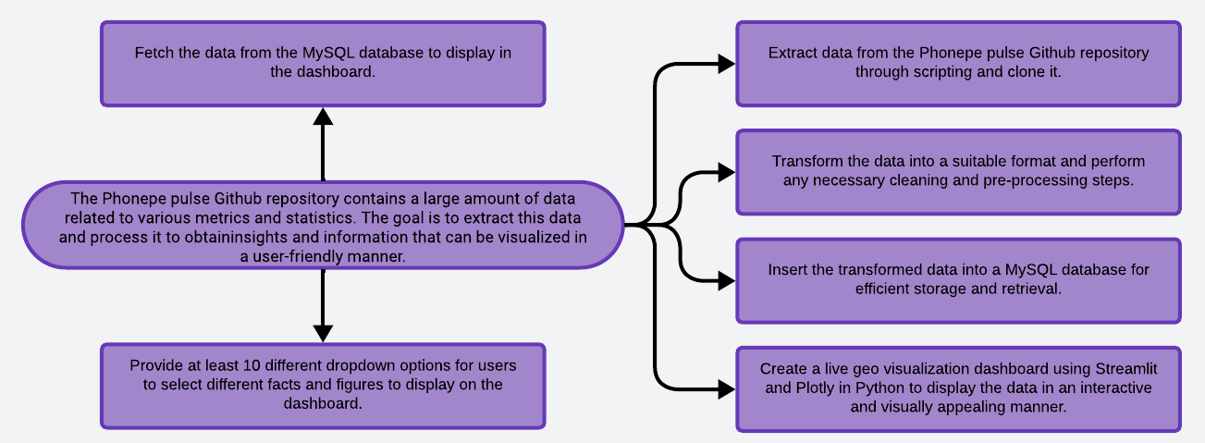
Problem Statement

Slide 5
Solution
Enhance the user interface for intuitive navigation and improved user experience.
Develop an interactive dashboard to facilitate dynamic data exploration and analysis.
Integrate Plotly and Streamlit to create visually engaging and interactive data visualizations.
Optimize database queries to ensure efficient and speedy data retrieval for a seamless user experience.
Implement a responsive design to ensure compatibility across various devices, offering accessibility to a wider audience.
Expand the range of features to enable users to delve deeper into data analysis and gain actionable insights.
Provide comprehensive documentation and robust user support to assist users in effectively utilizing the tool.
Incorporate a feedback mechanism to gather user input and continuously improve the tool based on user suggestions and needs.
Outline
User Interface Enhancement
Interactive Dashboard Development
Data Visualization Integration
Query Optimization
Responsive Design Implementation
Feature Expansion
Documentation and Support
Feedback Integration

Slide 6
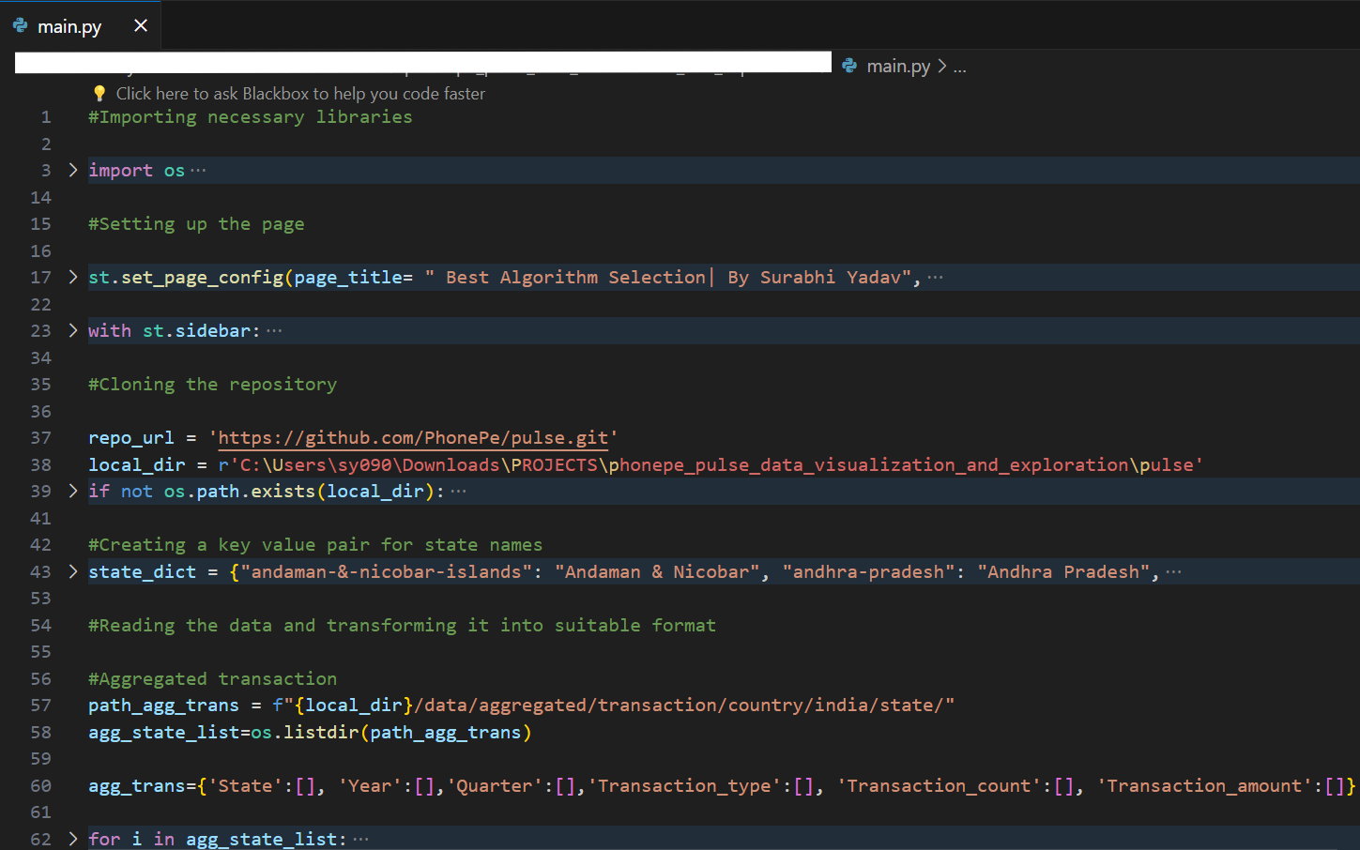
Codebody preview

Slide 7
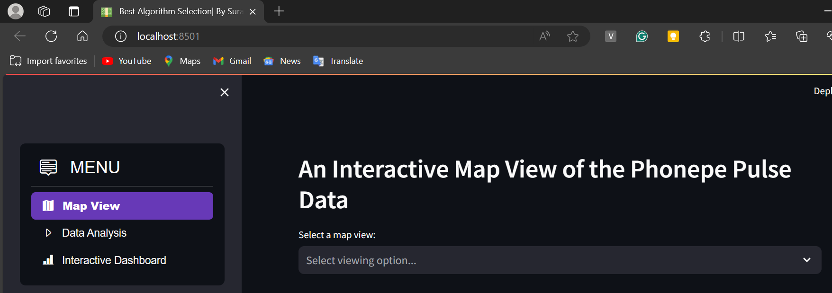
Streamlit preview

Slide 8
Why do we need this?
Future trends of this project
This project is essential to provide users with a comprehensive and user-friendly tool for visualizing and exploring PhonePe Pulse data. With the exponential growth of digital transactions and the increasing complexity of financial data, there is a growing demand for intuitive tools that enable users to understand and analyze data effectively. By developing this project, we aim to empower users to gain actionable insights from PhonePe Pulse data, facilitating informed decision-making and enhancing their overall experience with financial data analysis.
In the future, this project will advance with more sophisticated visualization tools, predictive analytics, and mobile integration for on-the-go access. Real-time data streaming and machine learning algorithms will enable up-to-the-minute analysis and trend identification. Cross-platform compatibility, customization options, and robust security measures will ensure continued user satisfaction. The project will expand its scope to include emerging fintech trends, such as blockchain integration and AI-powered financial services, positioning itself as a leading tool for comprehensive financial data exploration and analysis.

Slide 9
30-50%
This is by how much potentially enhance a fintech app's overall value proposition.

Slide 10
Unlocking actionable insights from financial data can drive strategic decision-making and enhance user engagement in fintech apps.
Key takeaway

Slide 11

Thanks!
Contact me:
Surabhi Yadav
sy09012000@gmail.com
https://github.com/surabhi0901
https://www.linkedin.com/in/surabhi-yadav-9100sy/

