Slide 1
Singapore Resale Flat Prices Prediction
By Surabhi Yadav

Slide 2
"AI is the new electricity. Just as electricity transformed many industries over the past century, AI will transform many industries, including real estate."
- Andrew Ng

Slide 3
Introduction
Let's delve into the details by exploring the following key points:
Objective: Develop a machine learning model to predict resale prices of flats in Singapore.
Motivation: Assist buyers and sellers in making informed decisions in a competitive market.
Data Source: Utilize historical resale transaction data from multiple CSV files.
Key Features: Include town, flat type, storey range, floor area, flat model, and flat age.
Preprocessing: Combine datasets, calculate flat age, label-encode categorical features, and standardize numerical features.
Model Training: Train and evaluate models like Linear Regression, Decision Tree, Random Forest, Gradient Boosting, XGBoost, and K-Neighbors.
Web Application: Build a user-friendly interface with Streamlit for easy interaction and predictions.
Benefits: Provide accurate price estimates to help buyers and sellers make informed decisions.

Slide 4
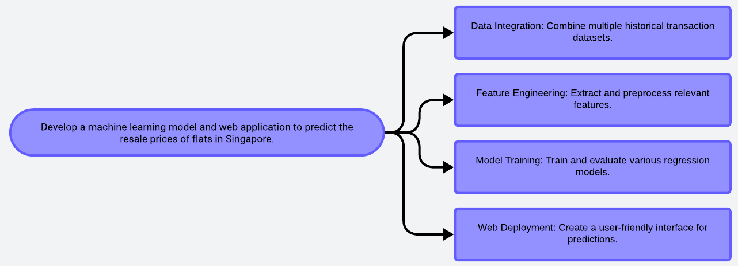
Problem Statement

Slide 5
Solution
Gather historical transaction data.
Handle missing values.
Create and preprocess features.
Choose regression models.
Train on historical data.
Assess model performance.
Build with Streamlit.
Integrate into web app.
Outline
Data Collection
Data Cleaning
Feature Engineering
Model Selection
Model Training
Model Evaluation
Web Interface
Model Deployment

Slide 6
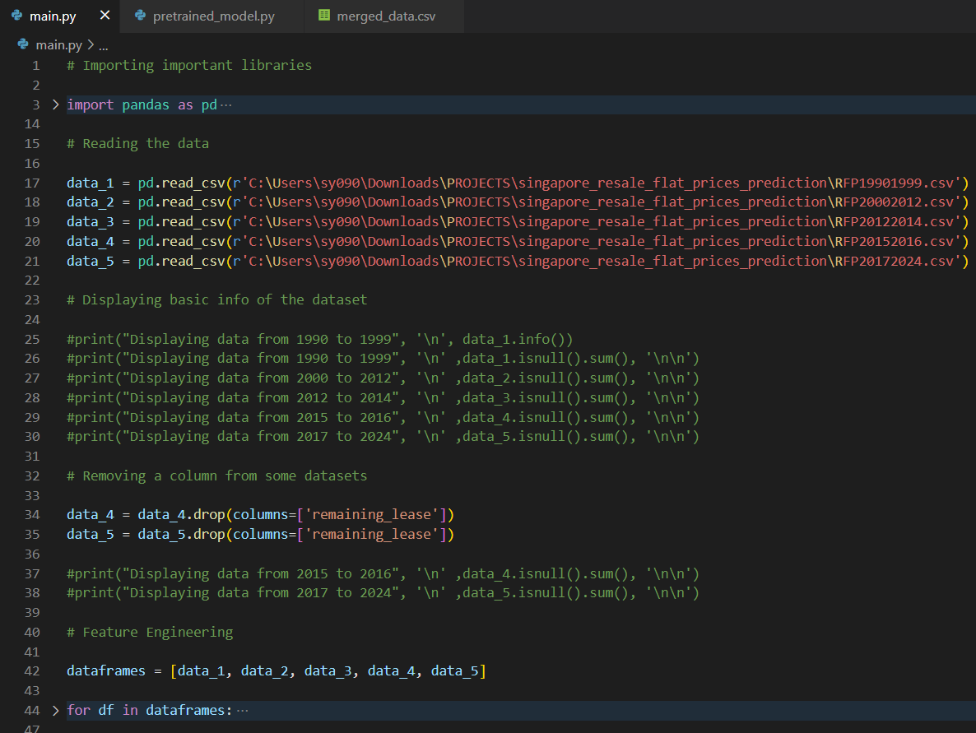
Codebody preview

Slide 7
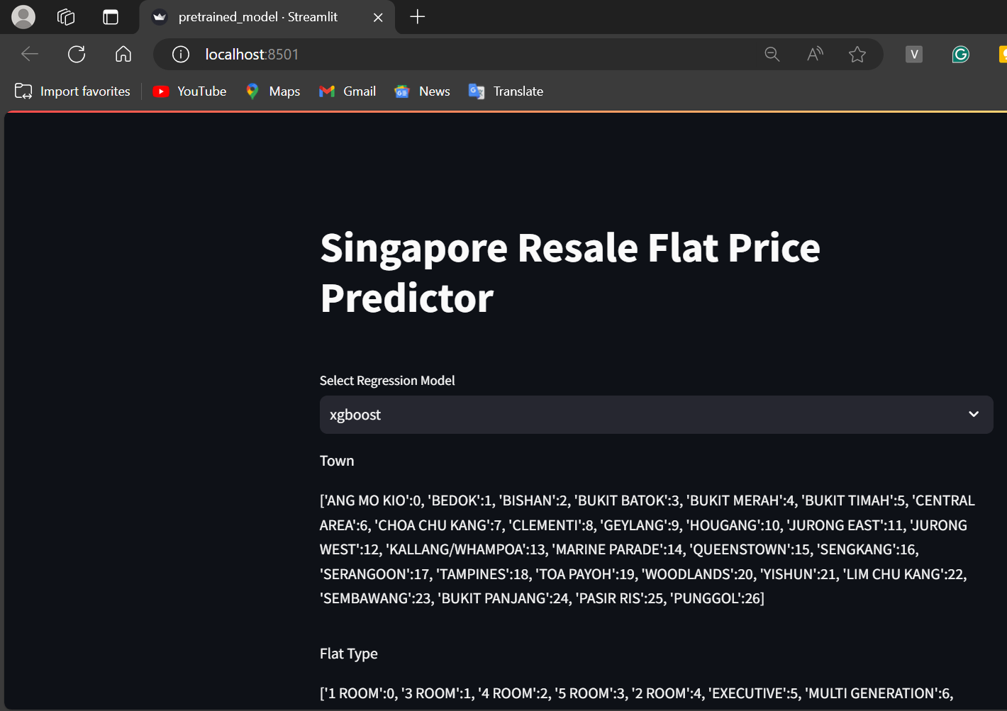
Streamlit preview

Slide 8
Why do we need this?
Future trends of this project
The Singapore resale flat market is highly competitive, making it difficult to accurately estimate flat values. This project addresses the challenge by developing a machine learning model to predict resale prices based on historical data. The resulting web application provides users with reliable price estimates, aiding both buyers and sellers in making informed decisions. By leveraging data and advanced analytics, the project enhances market transparency and demonstrates the practical application of machine learning in real estate, benefiting the entire housing market ecosystem.
In the future, this project is poised to evolve alongside advancements in machine learning and real estate technology. Predictive models could become more sophisticated, incorporating additional data sources and employing advanced algorithms for enhanced accuracy. Integration with real-time market data and geospatial analysis may further refine predictions. Additionally, the web application could expand its features to offer personalized insights and recommendations tailored to individual user preferences. As technology continues to advance, this project will remain at the forefront of innovation, revolutionizing the way buyers and sellers navigate the Singapore resale flat market.

Slide 9
10-20%
This is by how much the project has the potential to significantly aid Singapore flat reselling by providing users with reliable price estimates and insights into market trends.

Slide 10
This project leverages machine learning to provide accurate resale price estimates, enhancing decision-making and transparency in the Singapore flat market.
Key takeaway

Slide 11

Thanks!
Contact me:
Surabhi Yadav
sy09012000@gmail.com
https://github.com/surabhi0901
https://www.linkedin.com/in/surabhi-yadav-9100sy/

