Slide 1

HealthCheck AI — Intelligent Patient Assessment
Automated insights and diagnostics support for clinicians
Name: Surabhi Yadav
LinkedIn · GitHub
CLINICAL AI PLATFORM
ML/NLP POWERED

Slide 2

The Problem We're Solving
Clinician Overload
Clinicians face mounting workloads and intense time pressure when reviewing patient histories, lab results, and clinical documents — leaving little room for deep analysis.
Missed Patterns
Critical patterns buried in patient data are frequently overlooked or take too long to surface through manual review, increasing the risk of diagnostic errors.
Inconsistent Assessments
Manual, siloed workflows lead to delayed or inconsistent patient assessments — creating variability in care quality that can directly impact patient outcomes.
No Intelligent Triage
There is no assistive layer to automatically summarize, prioritize, and highlight actionable findings — leaving clinicians to do this work entirely on their own.

Slide 3
Introducing HealthCheck AI
HealthCheck AI automates clinical document analysis and patient assessment workflows using state-of-the-art machine learning and natural language processing — delivering concise, explainable insights directly to clinicians at the point of care.
Accelerate Review
Smarter Triage
Explainable AI
Dramatically reduce time spent reading through medical records and patient histories by surfacing the most relevant findings instantly.
Improve prioritization by automatically scoring and ranking cases based on clinical urgency and diagnostic indicators.
Every insight is backed by traceable, auditable reasoning — keeping clinicians informed and in control of every decision.

Slide 4

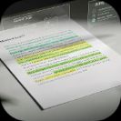
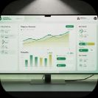

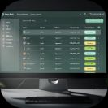
Core Features
Document Ingestion
NLP Summarization
Diagnostic Suggestions
Patient Dashboard
Accepts medical records, PDFs, and structured clinical reports from multiple sources — including manual uploads and EHR integrations.
Extracts key findings, symptoms, medications, dosages, and clinical timelines from unstructured text using transformer-based NLP models.
Generates likely diagnoses ranked by confidence scores, giving clinicians a data-driven starting point while preserving their clinical judgment.
Aggregates full patient history, AI assessments, and follow-up reminders in a single, clean interface designed for fast clinical review.
Audit Logs
Comprehensive logs track every AI output viewed, reviewed, and acted upon by clinicians — ensuring full traceability and compliance readiness.

Slide 5
Tech Stack — High Level Overview
Backend & Infrastructure
AI / ML & Frontend
Backend: Django 6.0 (Python) — routing, APIs, user management, and templates
Database: SQLite for development; PostgreSQL recommended for production
NLP/ML: Hugging Face transformer models, custom fine-tuned models, Ollama/Gemma integrations
Frontend: Django Templates + Bootstrap — responsive and accessible clinical UI
Deployment: Docker, Gunicorn, Nginx — containerized and production-ready
Storage: Local media/ for development; AWS S3 for production document storage(suggested)
Background Tasks: Celery workers for long-running ML analysis jobs
Monitoring: Sentry for error tracking; Prometheus for performance metrics

Slide 6
Technology Details — Under the Hood
1
2
Django Framework
Celery Workers
Handles user authentication, role-based access, URL routing, API endpoints, and server-side rendered templates for a unified application layer.
Asynchronous task queues manage long-running NLP analysis jobs, ensuring the UI remains responsive while heavy ML inference runs in the background.
3
4
NLP Models
Document Parsing
Transformer-based models (BERT, BioMedBERT, Gemma) handle summarization, named entity recognition, and diagnostic inference from clinical text.
PDF and DOCX parsers extract structured text; integrated OCR handles scanned or low-quality clinical documents with high fidelity.

Slide 7
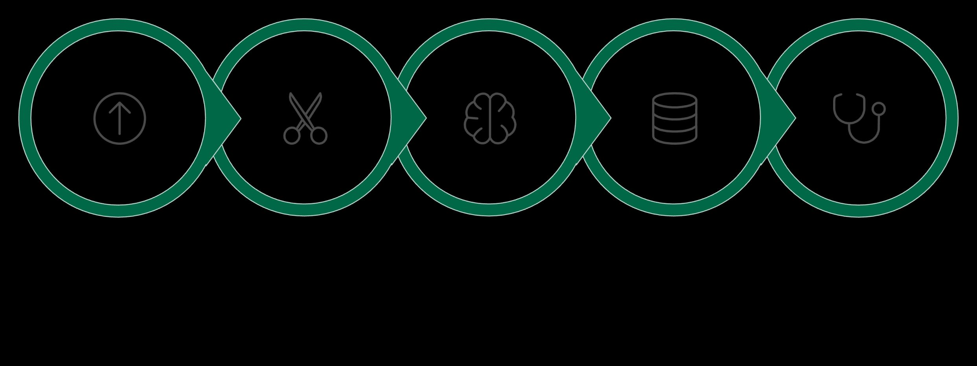

System Architecture & Data Flow
Clinician Review
Ingest
Preprocess
Analyze
Persist
Every document entering HealthCheck AI follows a structured, auditable pipeline — from raw ingestion through intelligent analysis to clinician-verified output. Each step is logged, traceable, and designed for seamless integration into existing clinical workflows.

Slide 8
System Users & Role Architecture
HealthCheck AI uses a custom user model with four distinct role types, each tailored to a specific function within the clinical or administrative workflow.
Super Admin
Admin
Highest-level system authority. Controls global configurations, system-wide settings, and corresponds to Django's built-in superuser role.
Manages hospital or clinic-level operations, oversees user onboarding, and configures system-wide data parameters and access policies.
Doctor
Patient
The primary clinical user. Reviews AI-generated patient insights, validates diagnostic suggestions, and finalizes assessments within their purview.
The end-user of the patient-facing portal. Accesses their own health dashboard, medical history, and assessment summaries in a secure, read-only view.

Slide 9

Conclusion
Faster, More Accurate Reviews
HealthCheck AI significantly reduces the time clinicians spend reviewing patient histories and documents — surfacing critical findings faster and reducing the risk of oversight.
Augmentation, Not Replacement
The system is designed as a clinical co-pilot. It enhances and supports clinician decision-making, preserving human judgment at every step of the diagnostic process.
Built for Trust & Integration
Explainability, traceability, and audit-readiness are core to the system's architecture — making it straightforward to integrate into existing clinical and compliance workflows.

Slide 10
Future Scope & Roadmap
EHR Integration
1
Direct ingestion from major EHR platforms (Epic, Cerner) via HL7 FHIR APIs for seamless, real-time data access.
2
Model Refinement
Improved model calibration through localized clinical fine-tuning — adapting to specialty-specific terminology and regional diagnostic patterns.
Multi-Language & OCR
3
Expanded language support and enhanced OCR pipelines to handle low-quality, handwritten, or non-English clinical documents with greater accuracy.
4
Clinician Feedback Loop
A continuous learning mechanism where clinician edits and corrections are fed back into model training to improve precision over time.
HIPAA Compliance
5
Full HIPAA-compliant deployment architecture with role-based access controls, data encryption at rest and in transit, and BAA-ready infrastructure.

Slide 11
Appendix & References
Project Repository
References & Resources
The full source code for HealthCheck AI is available in the project repository:
Clinical practice guidelines and diagnostic reference standards used for model validation
Anonymized and de-identified sample patient datasets for development and testing
Hugging Face model cards for all integrated transformer-based NLP models
HIPAA Security Rule technical safeguards documentation
HL7 FHIR R4 API specification for future EHR integration planning
Repo:healthcheck_ai
Core modules include users (authentication & profiles), diagnoses (assessment logic), and core (primary routing and configuration).

