Slide 1
Chocolate
Chocolate is a usually sweet, brown food preparation of roasted and ground cacao seeds.

Slide 2
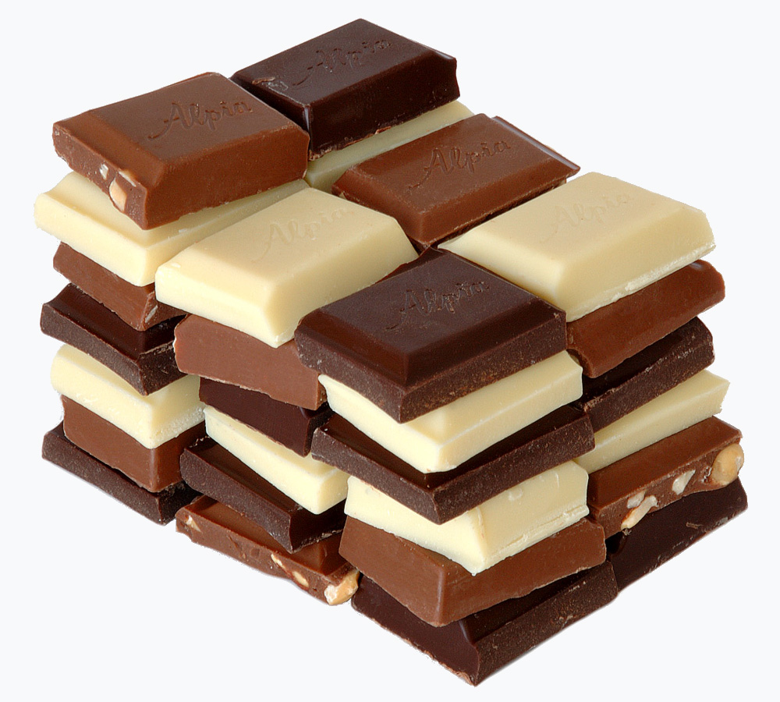

Slide 3
ABOUT

Slide 4
The earliest evidence of use traces to the Olmecs (Mexico), with evidence of chocolate beverages dating to 1900 BC.

Slide 5
An early Classic-period (460–480 AD) Mayan tomb from the site in Rio Azul had vessels with the Maya glyph for cacao on them with residue of a chocolate drink, suggests the Maya were drinking chocolate around 400 AD.

Slide 6
They say they make diverse sorts of it, some hot, some cold, and some temperate, and put therein much of that 'chili'; yea, they make paste thereof, the which they say is good for the stomach and against the catarrh.While Columbus had taken cacao beans with him back to Spain, chocolate made no impact until Spanish friars introduced it to the Spanish court.

Slide 7
Unfortunately, these spices had the tendency to unsettle the European constitution; the Encyclopédie states, "The pleasant scent and sublime taste it imparts to chocolate have made it highly recommended; but a long experience having shown that it could potentially upset one's stomach", which is why chocolate without vanilla was sometimes referred to as "healthy chocolate".

Slide 8
The new craze for chocolate brought with it a thriving slave market, as between the early 1600s and late 1800s, the laborious and slow processing of the cacao bean was manual.

Slide 9
Known as "Dutch cocoa", this machine-pressed chocolate was instrumental in the transformation of chocolate to its solid form when, in 1847, English chocolatier Joseph Fry discovered a way to make chocolate moldable when he mixed the ingredients of cocoa powder and sugar with melted cocoa butter.

Slide 10
In 1893, Milton S. Hershey purchased chocolate processing equipment at the World's Columbian Exposition in Chicago, and soon began the career of Hershey's chocolates with chocolate-coated caramels.

Slide 11
In the UK and Ireland, milk chocolate must contain a minimum of 20% total dry cocoa solids; in the rest of the European Union, the minimum is 25%.

Slide 12
Chocolate is made from cocoa beans, the dried and fermented seeds of the cacao tree (Theobroma cacao), a small, 4–8 m tall (15–26 ft tall) evergreen tree native to the deep tropical region of the Americas.

Slide 13
The three main varieties of cacao beans used in chocolate are criollo, forastero, and trinitario.

Slide 14
Representing only 5% of all cocoa beans grown as of 2008, criollo is the rarest and most expensive cocoa on the market, and is native to Central America, the Caribbean islands and the northern tier of South American states.

Slide 15
The source of most chocolate marketed, forastero cocoas are typically strong in classic "chocolate" flavor, but have a short duration and are unsupported by secondary flavors, producing "quite bland" chocolate.

Slide 16
The beans with their surrounding pulp are removed from the pods and placed in piles or bins, allowing access to micro-organisms so fermentation of the pectin-containing material can begin.

Slide 17
Chocolate liquor is blended with the cocoa butter in varying quantities to make different types of chocolate or couvertures.

Slide 18
The more expensive chocolate tends to be processed longer and thus have a smoother texture and mouthfeel, regardless of whether emulsifying agents are added.

Slide 19
The uniform sheen and crisp bite of properly processed chocolate are the result of consistently small cocoa butter crystals produced by the tempering process.

Slide 20
Once heated, the crystals of the polymorphic cocoa butter are able to break apart from the rigid structure and allow the chocolate to obtain a more fluid consistency as the temperature increases – the melting process.

Slide 21
In general, molten chocolate coming in at 40–50 °C is cooled in heat exchangers to crystallization temperates of about 26–30 °C, passed through a tempering column consisting of spinning plates to induce shear, then warmed slightly to re-melt undesirable crystal formations.

Slide 22
To distinguish between different types of bloom, one can rub the surface of the chocolate lightly, and if the bloom disappears, it is fat bloom.

Slide 23
The glossy shine, snap, aroma, texture, and taste of the chocolate can show the quality and if it was stored well.

Slide 24
Chocolate contains alkaloids such as theobromine and phenethylamine, which have physiological effects in humans, but the presence of theobromine renders it toxic to some animals, such as dogs and cats.

Slide 25
However, reports from 2014 indicate that "chocolate might be a significant source" of lead ingestion for children if consumption is high, and "one 10 g cube of dark chocolate may contain as much as 20% of the daily lead oral limit."

Slide 26
Chocolate and cocoa are under preliminary research to determine if consumption affects the risk of certain cardiovascular diseases or cognitive abilities.

Slide 27
Excessive consumption of large quantities of any energy-rich food, such as chocolate, without a corresponding increase in activity to expend the associated calories, can cause weight gain and possibly lead to obesity.

Slide 28
In June 2007, as a response to consumer concern after the proposed change, the FDA reiterated "Cacao fat, as one of the signature characteristics of the product, will remain a principal component of standardized chocolate."

Slide 29
Despite the expanding reach of the chocolate industry internationally, cocoa farmers and labourers in the Ivory Coast are unaware of the uses of the beans.

Slide 30
The high cost of chocolate in the Ivory Coast also means that it is inaccessible to the majority of the population, who are unaware of what it tastes like.

Slide 31
In 2009, Salvation Army International Development (SAID) UK stated that 12,000 children have been trafficked on cocoa farms in the Ivory Coast of Africa, where half of the world's chocolate is made.

Slide 32
The International Cocoa Initiative involving major cocoa manufacturers established the Child Labor Monitoring and Remediation System intended to monitor thousands of farms in Ghana and Côte d'Ivoire for child labor conditions, but the program reached less than 20% of the child laborers.

Slide 33
In April 2018, the Cocoa Barometer report stated: "Not a single company or government is anywhere near reaching the sectorwide objective of the elimination of child labour, and not even near their commitments of a 70% reduction of child labour by 2020".

Slide 34
Numerous types of candy and snacks contain chocolate, either as a filling (e.g., M&M's) or as a coating (e.g., chocolate-coated raisins or chocolate-coated peanuts).

Slide 35
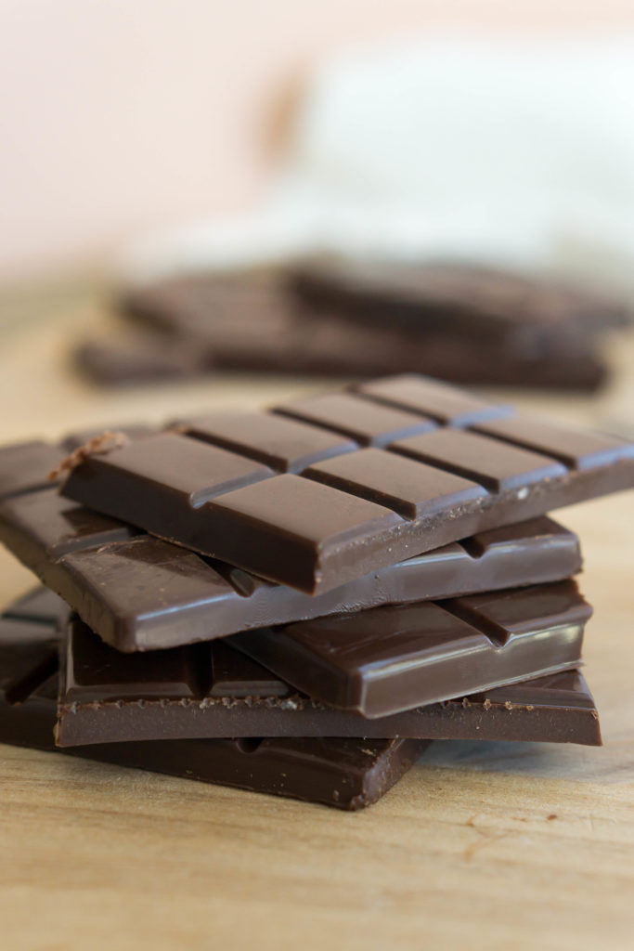

Slide 36
ADVANTAGES

Slide 37
Chocolate is a usually sweet, brown food preparation of roasted and ground cacao seeds.

Slide 38
Much of the chocolate consumed today is in the form of sweet chocolate, a combination of cocoa solids, cocoa butter or added vegetable oils, and sugar.

Slide 39
They associated chocolate with Quetzalcoatl, who, according to one legend, was cast away by the other gods for sharing chocolate with humans, and identified its extrication from the pod with the removal of the human heart in sacrifice.

Slide 40
In contrast to the Maya, who liked their chocolate warm, the Aztecs drank it cold, seasoning it with a broad variety of additives, including the petals of the Cymbopetalum penduliflorum tree, chile pepper, allspice, vanilla, and honey.

Slide 41
The Spanish royal chronicler Gonzalo Fernández de Oviedo described a chocolate drink he had seen in Nicaragua in 1528, mixed with achiote: "because those people are fond of drinking human blood, to make this beverage seem like blood, they add a little achiote, so that it then turns red.

Slide 42
A few years thereafter, in 1828, he created a press to remove about half the natural fat (cocoa butter or cacao butter) from chocolate liquor, which made chocolate both cheaper to produce and more consistent in quality.

Slide 43
Subsequently, his chocolate factory, Fry's of Bristol, England, began mass-producing chocolate bars, Fry's Chocolate Cream, launched in 1866, and they became very popular.

Slide 44
Due to concerns about global warming effects on lowland climate in the narrow band of latitudes where cacao is grown (20 degrees north and south of the equator), the commercial company Mars, Incorporated and the University of California, Berkeley are conducting genomic research in 2017–18 to improve the survivability of cacao plants in hot climates.

Slide 45
The basic blends of ingredients for the various types of chocolate (in order of highest quantity of cocoa liquor first), are: Usually, an emulsifying agent, such as soy lecithin, is added, though a few manufacturers prefer to exclude this ingredient for purity reasons and to remain GMO-free, sometimes at the cost of a perfectly smooth texture.

Slide 46
In 2007, the Chocolate Manufacturers Association in the United States, whose members include Hershey, Nestlé, and Archer Daniels Midland, lobbied the Food and Drug Administration (FDA) to change the legal definition of chocolate to let them substitute partially hydrogenated vegetable oils for cocoa butter, in addition to using artificial sweeteners and milk substitutes.

Slide 47
According to Canadian Food and Drug Regulations, a "chocolate product" is a food product that is sourced from at least one "cocoa product" and contains at least one of the following: "chocolate, bittersweet chocolate, semi-sweet chocolate, dark chocolate, sweet chocolate, milk chocolate, or white chocolate".

Slide 48
The temperature in which the crystals obtain enough energy to break apart from their rigid conformation would depend on the milk fat content in the chocolate and the shape of the fat molecules, as well as the form of the cocoa butter fat.

Slide 49
In the United States, some large chocolate manufacturers lobbied the federal government to permit confections containing cheaper hydrogenated vegetable oil in place of cocoa butter to be sold as "chocolate".

Slide 50
Nestlé acquired Rowntree's in 1988 and now markets chocolates under their own brand, including Smarties (a chocolate candy) and Kit Kat (a candy bar); Kraft Foods through its 1990 acquisition of Jacobs Suchard, now owns Milka and Suchard.

Slide 51
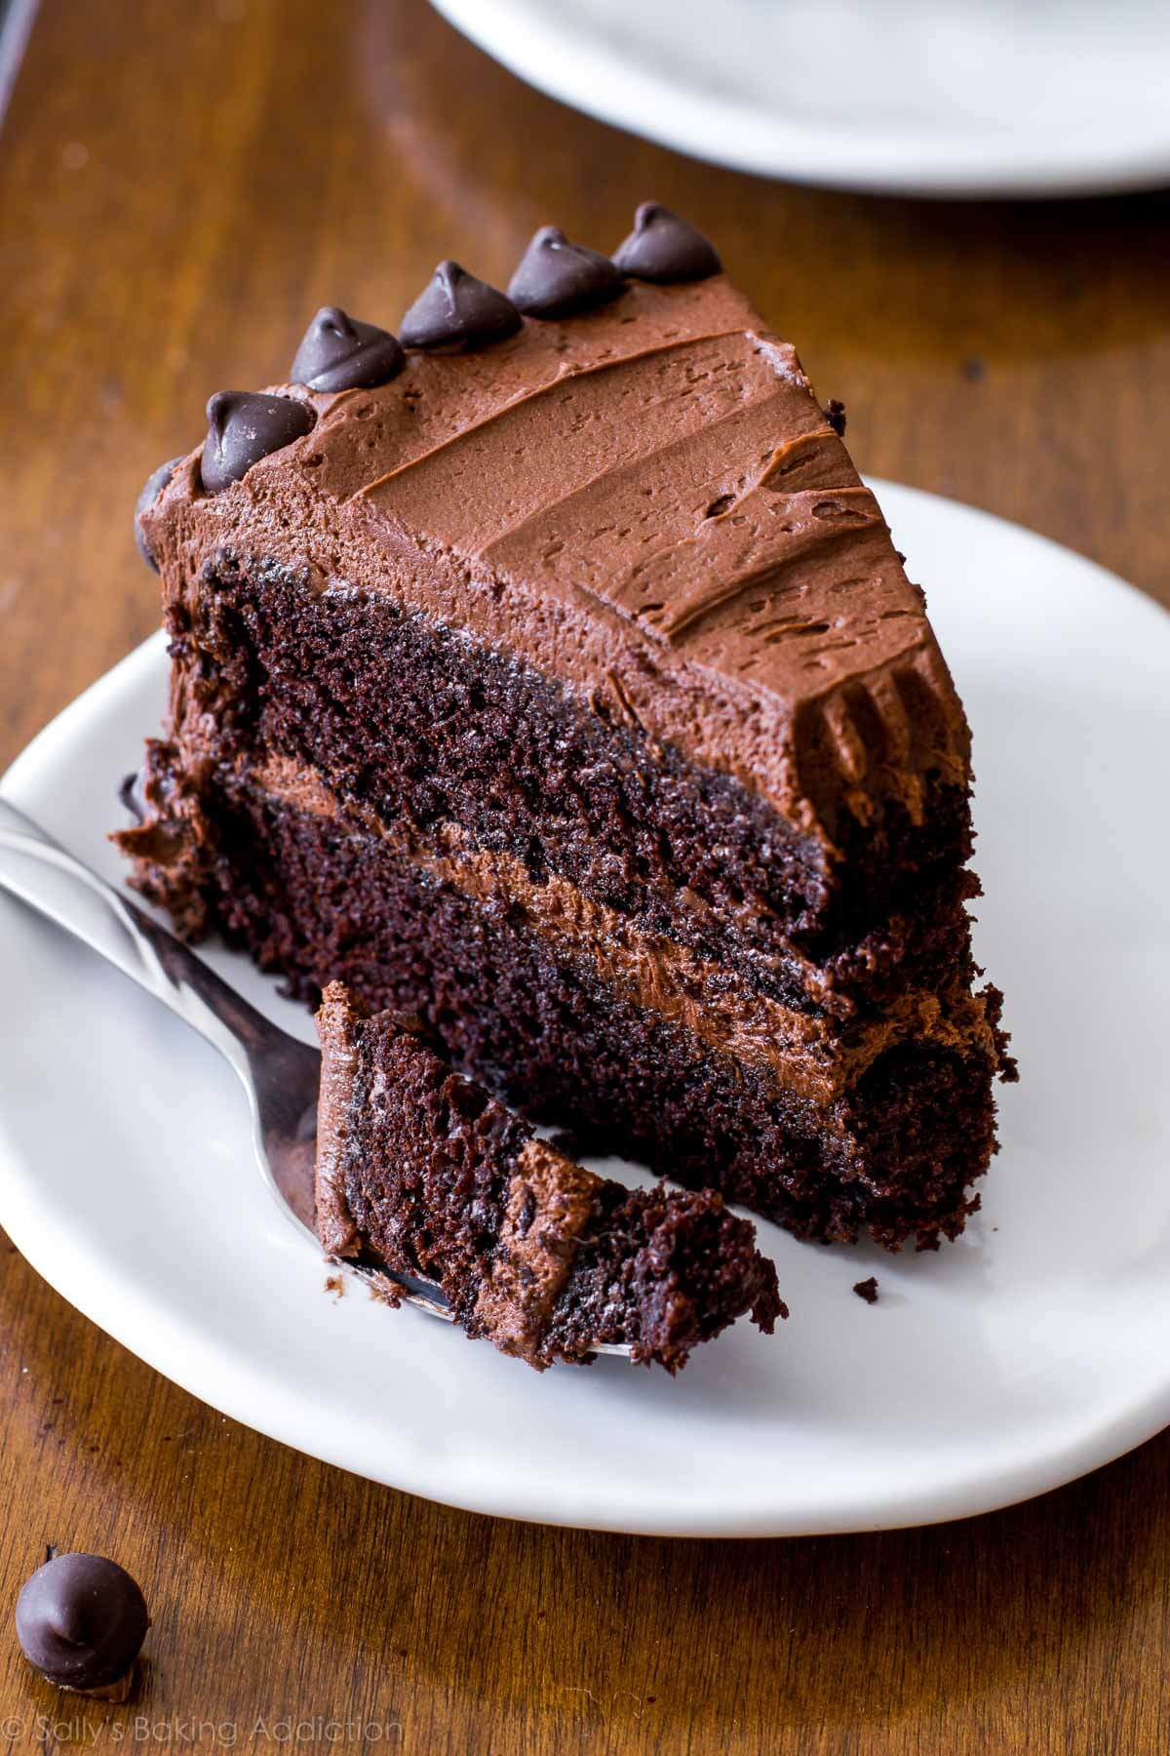

Slide 52
DISADVANTAGES

Slide 53
It is made in the form of a liquid, paste, or in a block, or used as a flavoring ingredient in other foods.

Slide 54
Jose de Acosta, a Spanish Jesuit missionary who lived in Peru and then Mexico in the later 16th century, wrote of its growing influence on the Spaniards: Loathsome to such as are not acquainted with it, having a scum or froth that is very unpleasant to taste.

Slide 55
Poorly tempered or untempered chocolate may have whitish spots on the dark chocolate part, called chocolate bloom; it is an indication that sugar and/or fat has separated due to poor storage.

Slide 56
Cocoa growers object to allowing the resulting food to be called "chocolate", due to the risk of lower demand for their crops.

Slide 57
The chocolate is then heated to about 31 °C (88 °F) to eliminate any type IV crystals, leaving just type V. After this point, any excessive heating of the chocolate will destroy the temper and this process will have to be repeated.

Slide 58
The widespread use of children in cocoa production is controversial, not only for the concerns about child labor and exploitation, but also because up to 12,000 of the 200,000 children working in Côte d'Ivoire, the world's biggest producer of cocoa, may be victims of trafficking or slavery.

Slide 59
SAID UK states that it is these child slaves who are likely to be working in "harsh and abusive" conditions for the production of chocolate, and an increasing number of health-food and anti-slavery organisations are highlighting and campaigning against the use of trafficking in the chocolate industry.

Slide 60
Despite these efforts, goals to reduce child labor in West Africa by 70% before 2020 are frustrated by persistent poverty, absence of schools, expansion of cocoa farmland, and increased demand for cocoa.

