Slide 1



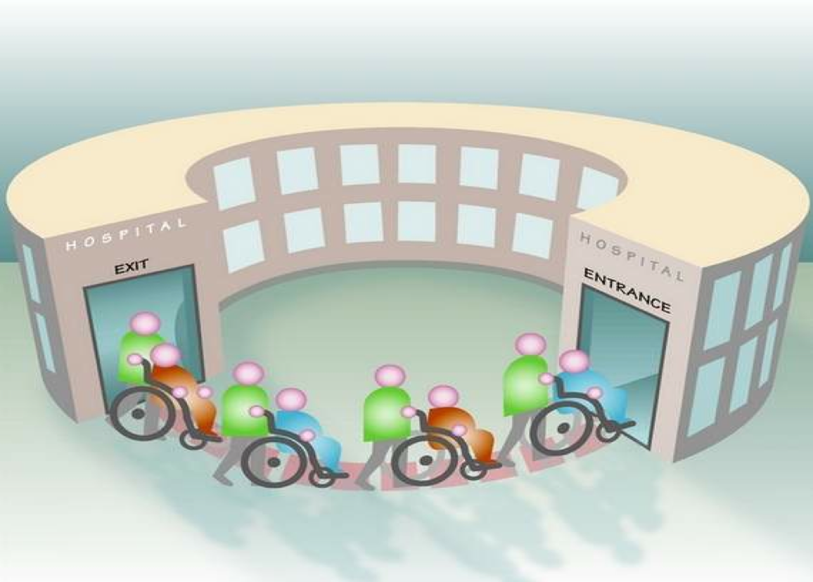
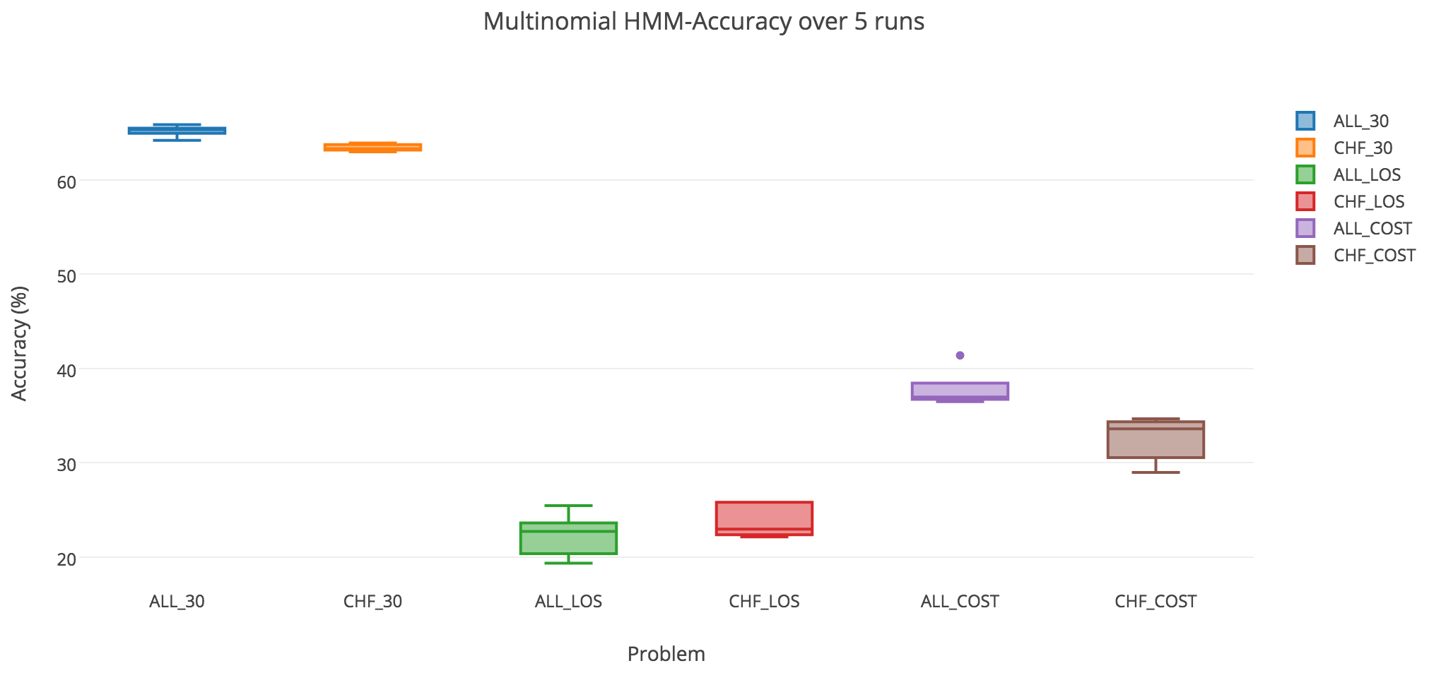
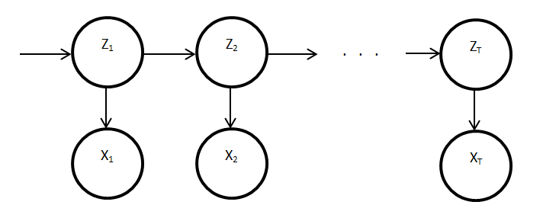
Sequence Based Prediction of Hospital Readmissions
Surabhi Agrawal
agraws@uw.edu
Chun Pan Hon
darrencp@uw.edu
Swati Garg
swatig1@uw.edu
Aadarsh Sampath
aadsam@uw.edu
Shanu Sushmita
sshanu@uw.edu
Martine De Cock
mdecock@uw.edu
Problem
Methods
Results
Importance of the Problem:
Research Goals:
Given the admission history of a patient, predict:
Cohorts:
Example:
Patient Anna has the following admission history. Given the history, we need to predict whether she will be readmitted within 30 days, her length of stay and cost.
Emphasis on Sequence Based Prediction:
Given a sequence of previous patient encounters (e.g. hospital visits), predict one or more aspects about future encounters for the same patient.
Data:
OSHPD data from California-licensed hospitals where each row
corresponds to one admission record of a patient (2009-2013).
After preprocessing, we converted the original OSHPD data into
sequences. The only input features used are the values of 30-Day,
LOS and COST for all prior admissions of the same patient.
E.g.: For patient Anna (as mentioned earlier), while predicting risk of readmission(30-Day), we convert her admission records to a sequence of the form: ‘0, 0, 1, 0, 1’. This symbolizes that the patient has 5 hospital admissions, 2 of which were within 30 days. Similarly, we create sequences for LOS, namely ‘4, 2, 4, 1, 6’, and for cost, namely ‘4, 3, 3, 1, 4’.
The OSHPD data has actual LOS and COST values as shown in Anna’s admission history. We convert those values to symbols as shown in the table below.
Data Statistics:
N-gram method:
We add the symbol -1 in front of all the training and test sequences to mark the beginning of a sequence.
TRAINING: The frequencies of all possible grams (1-gram,2-gram, etc.) in the training sequences are computed and stored in a dictionary. E.g. the training sequence ‘-1, 2, 1, 0, 3, 2, 0’ will lead to the following frequency increments (3gram approach): (-1):1, (2):2, (1):1,(0):2, (3):1, (-1,2):1, (2,1):1, (1,0):1, (0,3):1, (3,2):1, (2,0):1, (-1,2,1): 1, (2,1,0):1, (1,0,3):1, (0,3,2):1, (3,2,0):1
TESTING: Given the last M symbols (a₁, a₂…a_{M}), we look up the most frequent M+1 gram (3-gram approach in this case) (a₁, a₂….a_{M}, b) and predict b as the next symbol in the sequence.
Hidden Markov Model (HMM):
HMM is a statistical Markov Model in which the system being
modeled is assumed to be a Markov Process with unobserved
(hidden) states.
In simpler Markov Models (Markov Chain), the state is directly visible to the observer, and therefore the state transition probabilities are the only parameters. In a hidden Markov model, the state is not directly visible, but the output, dependent on the state, is visible.
In this study we obtained results using Multinomial HMMs, i.e. HMMs with discrete emissions.
(http://hmmlearn.readthedocs.io/en/latest/api.html#multinomialhmm)
Observations:
The N-gram models consistently perform best for all prediction tasks.
Increasing longitudinal information (longer sequence, hence larger N) will not necessarily improve the performance.
The performance of the 4-gram models is comparable to, and sometimes even better than, that of 5 and 6-gram models.
HMM on the other hand, has very fluctuating results. It performs better than the baseline methods for the 30 day risk prediction problem (both cohorts), and the cost prediction (‘all cause’ cohort).
Results:
Accuracy results for predicting the last symbol in a sequence of length 4 or more
Multinomial HMM accuracy results across 5 runs
Future Work:
Comparison with recurrent neural networks (RNNs)
Incorporating other static and dynamic features from discharge records
There are about 34 million hospital admissions annually in the U.S., with 1 in 5 patients being readmitted to the hospital within 30 days of being discharged.
Being able to stratify patients according to 30-day hospital readmission risk, anticipated length and cost of stay can guide clinicians in discharge planning and intervention recommendation, leading to an increase of quality of care, and a decrease of healthcare cost.
LOS Symbols | LOS Values (Days)
1 | 1
2 | 2
3 | 3
4 | 4-6
5 | 7-13
6 | 14+
Method | ALL 30 | CHF 30 | ALL LOS | CHF LOS | ALL COST | CHF COST
Random | 50.00 | 50.00 | 16.67 | 16.67 | 25.00 | 25.00
Majority | 0.648 | 0.623 | 0.255 | 0.258 | 0.356 | 0.325
2-gram | 0.621 | 0.606 | 0.266 | 0.258 | 0.381 | 0.336
3-gram | 0.659 | 0.640 | 0.272 | 0.267 | 0.408 | 0.342
4-gram | 0.659 | 0.640 | 0.273 | 0.269 | 0.418 | 0.348
5-gram | 0.662 | 0.642 | 0.274 | 0.269 | 0.416 | 0.353
6-gram | 0.662 | 0.642 | 0.271 | 0.262 | 0.417 | 0.347
HMM | 0.652 | 0.634 | 0.222 | 0.238 | 0.378 | 0.325
Cost Symbols | Cost Values (ALL)($$) | Cost Values (CHF)($$)
1 | 0-19,080 | 0-27,660
2 | 19,080-35,690 | 27,660-49,810
3 | 35,690-70,450 | 49,810-98,500
4 | 70,450+ | 98,500+
Task to predict | Abbrev.
Will the patient get readmitted within 30 days? Yes/No | 30
How long will the patient stay in the hospital if readmitted? (Days) | LOS
What will be the cost of this readmission? ($$) | COST
Problem | #Seq | Min-Max Seq Length | Avg Seq Length (SD)
ALL Train | 390,900 | 4-255 | 7.0 (5.3)
ALL Test | 43,475 | 4-155 | 7.0 (5.1)
CHF Train | 168,576 | 4-255 | 7.5 (5.6)
CHF Test | 18,534 | 4-164 | 7.5 (5.5)
Cohort Description | Abbrev.
Patient population considered as a whole | ALL
Congestive Heart Failure patients only | CHF
Admission Date | 30Day | LOS | COST
Jan 22, 2009 | 0 | 6 | $75099
Mar 30, 2012 | 0 | 2 | $37531
Apr 15, 2012 | 1 | 5 | $49657
Oct 1, 2013 | 0 | 1 | $14107
Oct 20, 2013 | 1 | 14 | $259616
??? | ??? | ??? | ???

