Slide 1

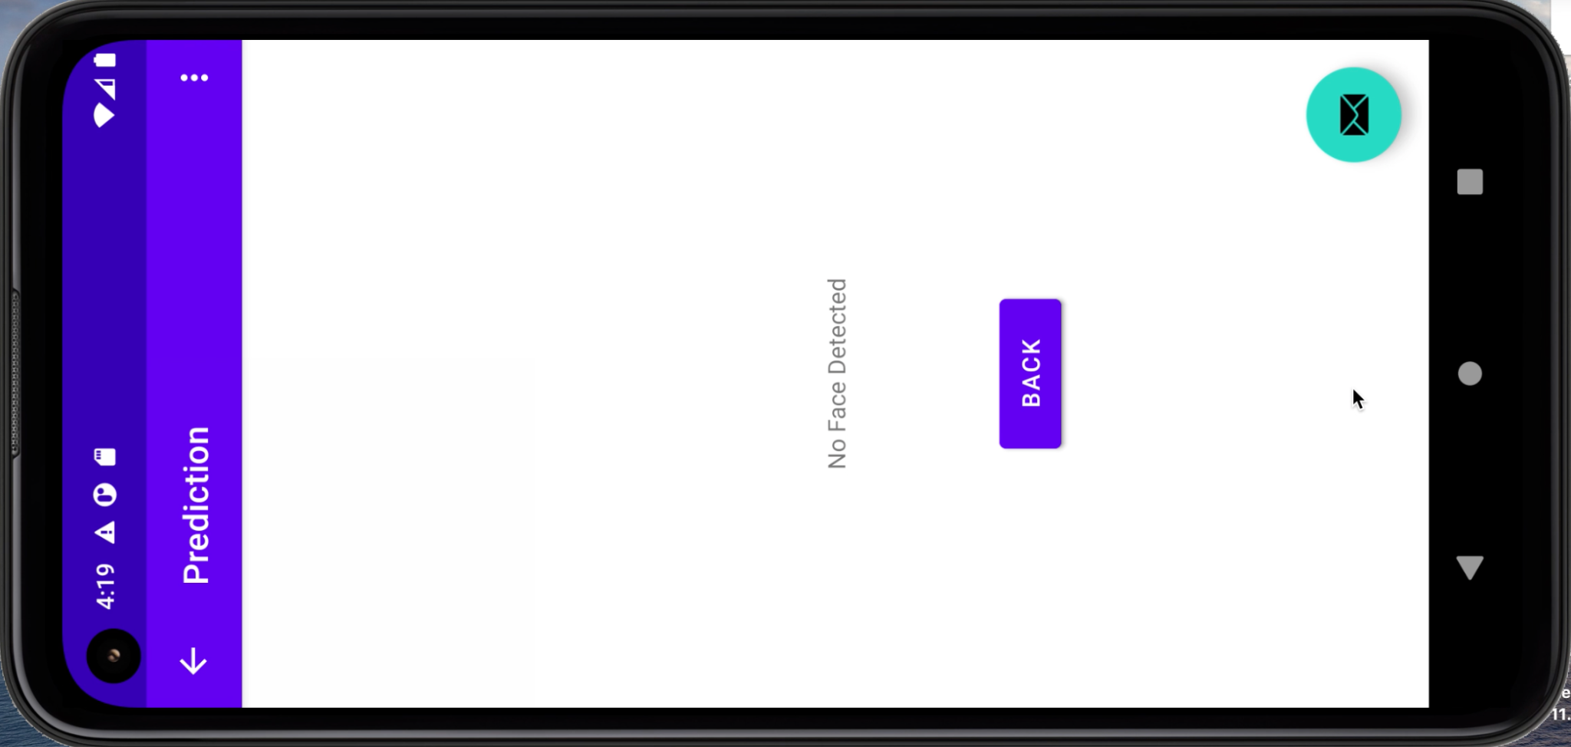
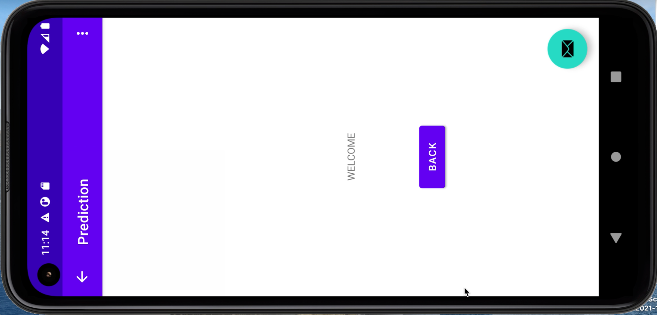
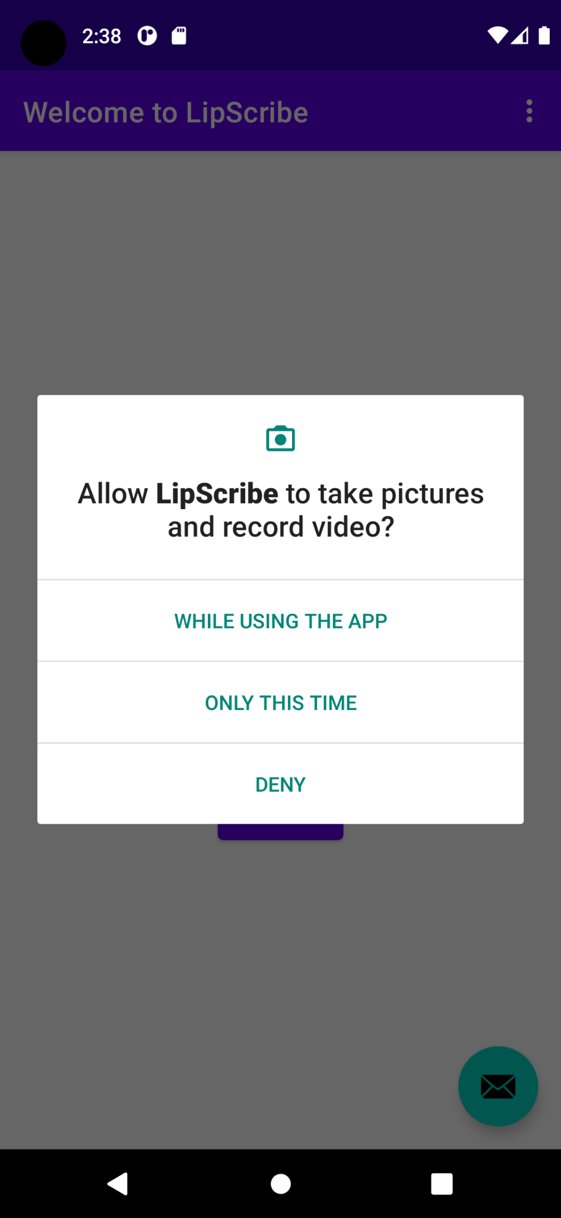
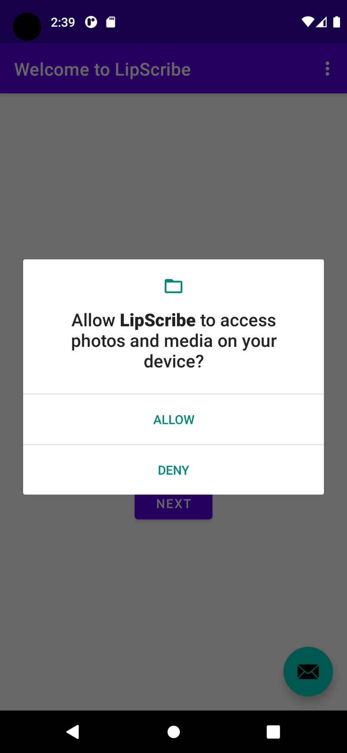
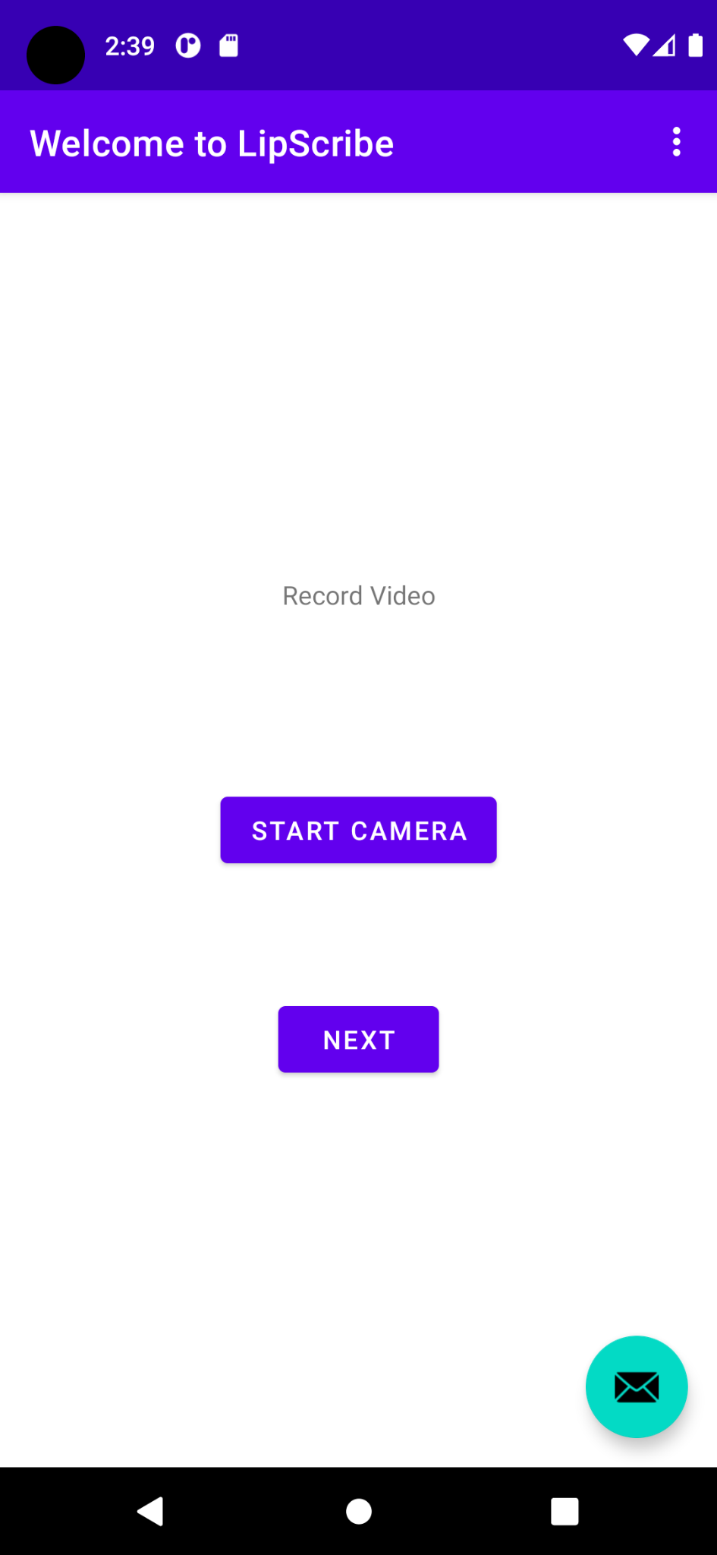
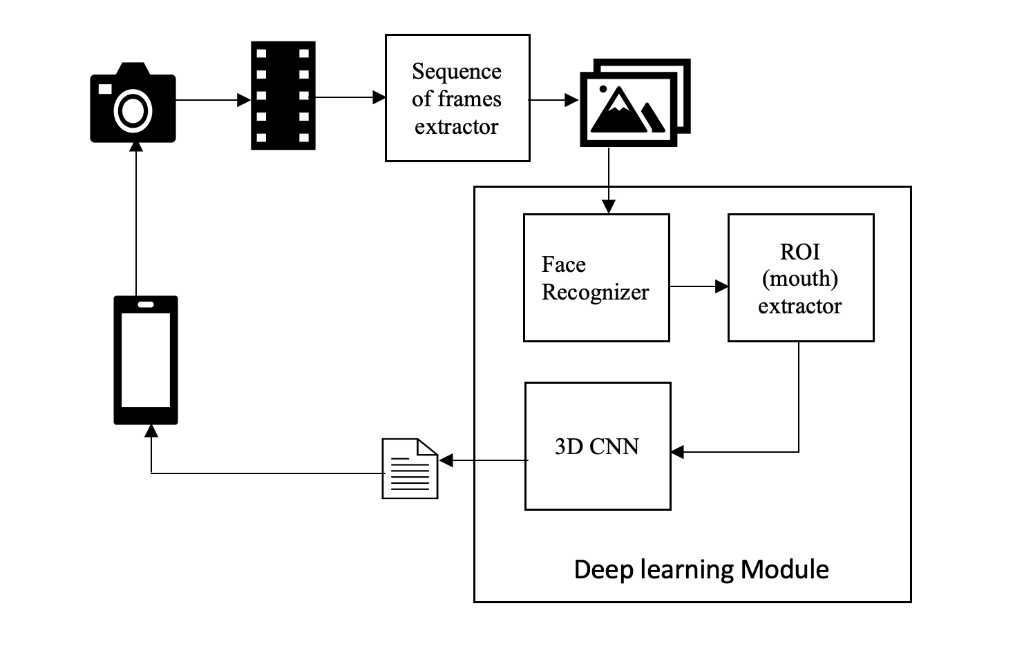
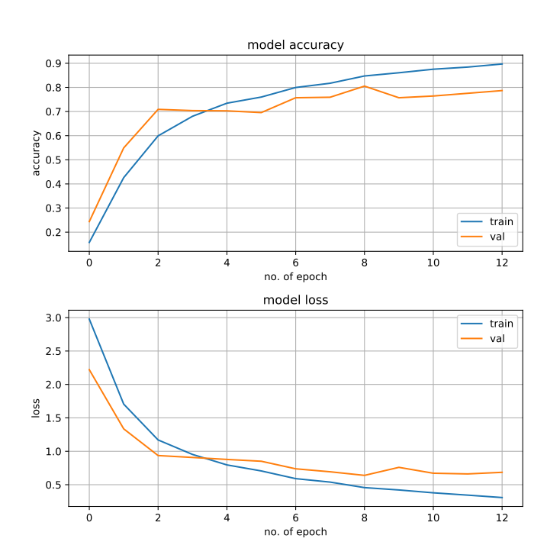
Software Engineering Department
LipScribe
Project Advisor: Gopinath Vinodh
Bandi, Rishitha (MS Software Engineering) Govil, Surabhi (MS Software Engineering)
Goyal, Shreya (MS Software Engineering)
Pulagam, Gayathri (MS Software Engineering)
Introduction
Application flow and deep learning model
As there are a lot of cases where voice or hearing loss inhibits communication, it is important to research ways of improving communication.
The World Health Organization states that about 5% of the world’s population are born with hearing loss . Apart from this, it has been observed that 25% of people over the age of 60 can be affected by hearing loss. In certain cases of serious accidents and illnesses, people can lose their voice temporarily making it difficult to communicate with others. Other cases where people might not know sign language, limiting their ability to have a conversation with hearing-impaired people. In such cases, this application can be used by hearing-impaired people to understand what the other person is saying.
By deciphering the lip movements of the speaker, the application aims to generate text phrases. The proposed application might prove beneficial to people with hearing loss or temporary voice loss to communicate with others better.
Using the proposed application, hearing, and voice impaired people can have more involved and meaningful conversations with other people.
Application launcher page
After each convolution layer a batch normalization, max-pooling 3D, and a dropout were added. Batch normalization acts like a regularization where it normalizes the output of the previous layer to reduce overfitting. Max Pooling 3D layer is specifically used for 3D data (spatial or Spatio-temporal). It downsampled the data. Dropout is used to avoid overfitting by switching off some neurons during training and not making them specialized. Dropout is added. All of these layers constitute the model. In the end, a fully connected dense layer is added to classify each video in one of the categories using Softmax which assigns decimal probabilities for multiclass classification.
The deep learning model used in the this application is trained on the LRW dataset which has videos of people speaking various words. Below are the steps to be performed in the training and testing phase.
Dataset
LRW (Lip Reading in the Wild) dataset is used to train the model.
This dataset contains over 1000 utterances of 500 different words, spoken by hundreds of different speakers.
All videos are 29 frames (1.16) seconds in length, and the word occurs in the middle of the video.
To train the dataset, we used about 150 different words from the dataset. The list of words we used to train the model can be found here.
The word predicted by the model is displayed on the screen and if no face is detected in the video it displays ‘no face detected’.
Summary/Conclusions
The project from the beginning aims to address a need which has not been researched much. Although existing applications prove beneficial to people with hearing loss or temporary voice loss to communicate with others better our project works on a wider set of commonly spoken set of words.
On launching the application, it requests for the permission to access media and also to capture images and record videos.
Start camera button in the launch page starts the activity of camera to record the video.
The android phone inbuilt camera is used to capture video and stored at external storage.
The video is accessed from storage and processed by deep learning module. After the prediction is returned by deep learning module the video from external storage is deleted.
The 3D CNN model is trained locally and imported to the android application to asset folder along with haar cascade xml files.
The prediction of the word with the 3D-CNN model happens in the background and the loading screen activity runs in the foreground until the model predicts the word.
[1] “TOWARDS PRACTICAL LIPREADING WITH DISTILLED AND EFFICIENT MODELS” https://arxiv.org/pdf/2007.06504v3.pdf
[2] “LEARN AN EFFECTIVE LIP READING MODEL WITHOUT PAINS” https://arxiv.org/pdf/2011.07557v1.pdf
[3] J. S. Chung, A. Senior, O. Vinyals and A. Zisserman, "Lip Reading Sentences in the Wild," 2017 IEEE Conference on Computer Vision and Pattern Recognition (CVPR), 2017, pp. 3444-3453, doi: 10.1109/CVPR.2017.367
[4] B. Lin, Y. Yao, C. Liu, C. Lien and B. Lin, "Development of Novel Lip-Reading Recognition Algorithm," in IEEE Access, vol. 5, pp. 794-801, 2017, doi: 10.1109/ACCESS.2017.2649838
Key References
Methodology
Preprocessing Video
The aim of preprocessing in this project is to get the region of interest i.e. mouth, as lip movement determines the each alphabet in the english dictionary.
A video was first accessed from external storage using ffmpeg and then split into frames.
Open CV library’s Haar Cascade Classifiers were then used for efficient extraction of features like the mouth, face, ans profile face from the frames.
Getting coordinates of mouth from the extracted face lips were extracted from frames in a video,
The extracted lips in a frame were converted to an array of pixels that were to be fed to the neural network in our case that being the 3D Convolution Neural Network.
Deep learning model testing and Results
In the graphs below we depict the loss and accuracy in each epoch for training and validation sets. We can see the loss went down and the accuracy improved over epochs.To evaluate the model, LRW dataset has been split into train, test and validation splits. The training accuracy was about 0.88, while the validation accuracy was 0.79. We have tested the trained model with the test dataset and observed an accuracy of 0.80. We observed that the validation loss decreased with each epoch while the training and validation accuracies improved.
Acknowledgements
Technology Stack
Deep learning model
Python
OpenCV library
Keras
Android app
Java
Chaquopy library for Integration of python in Android app
Deep Learning model
A simple 3D convolutional neural network (CNN) was selected to model the application. 3D convolutions are generally used when dealing with video type input data. They work by applying a 3 dimensional filter to the dataset which moves in 3-directions (x, y, z) to calculate the low level feature representations. The 3 dimensions in case of a video are it’s Height, Width, and Time. Their output shape is a 3-dimensional volume space such as cube or cuboid.
The authors are deeply indebted to Professor Vinodh Gopinath for his invaluable guidance throughout the course of the project.

