Slide 1
DATA SCIENCE AND MACHINE LEARNING
20-08-2026 MAL

Slide 2
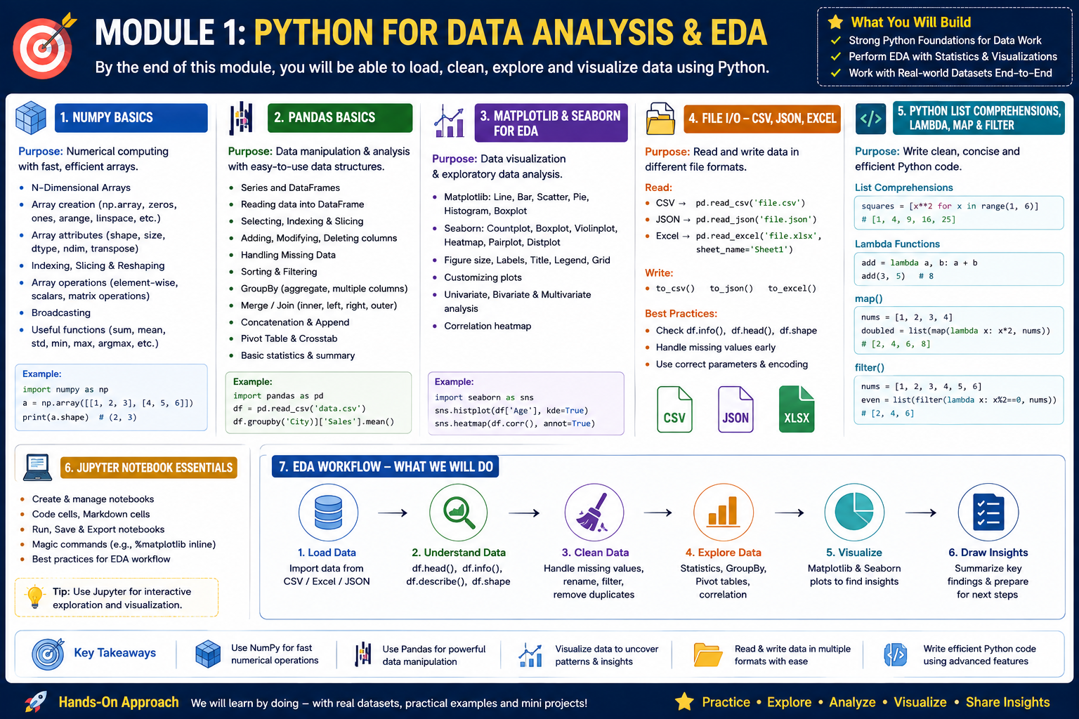

Slide 3
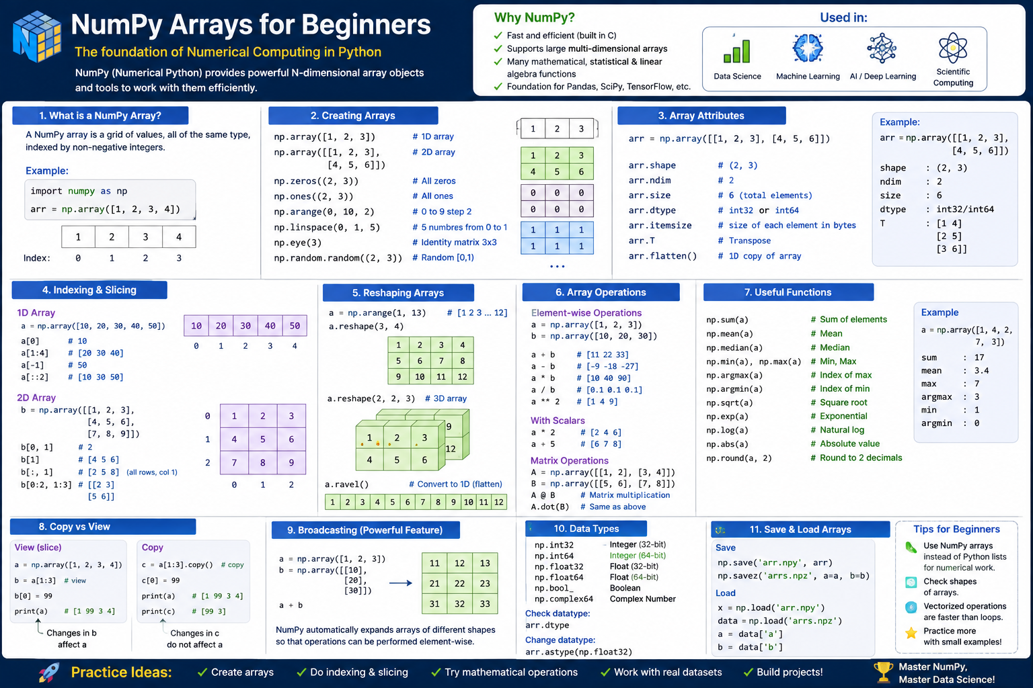

Slide 4
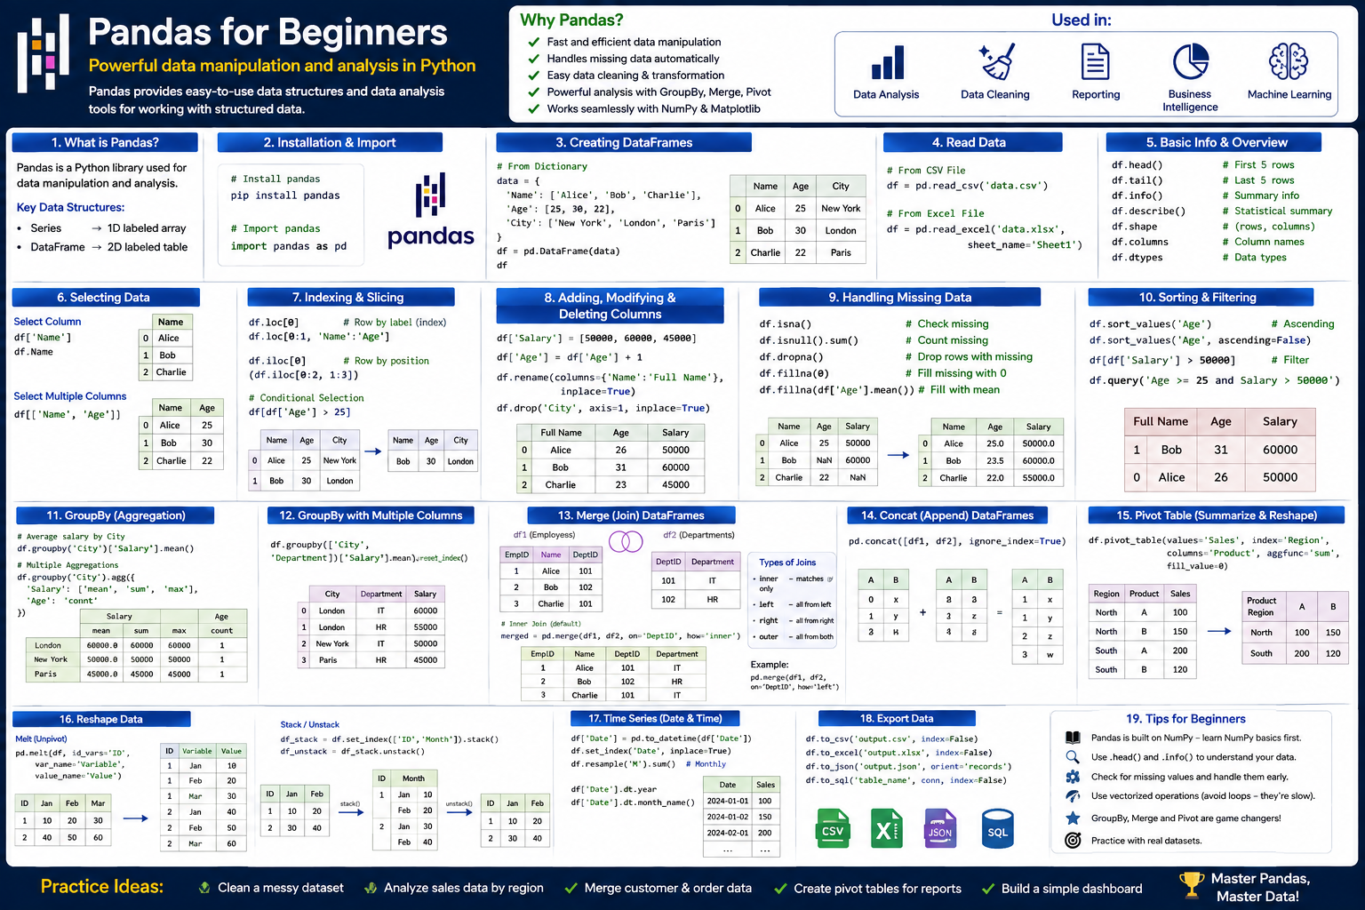

Slide 5
PANDAS
MAL

Slide 6
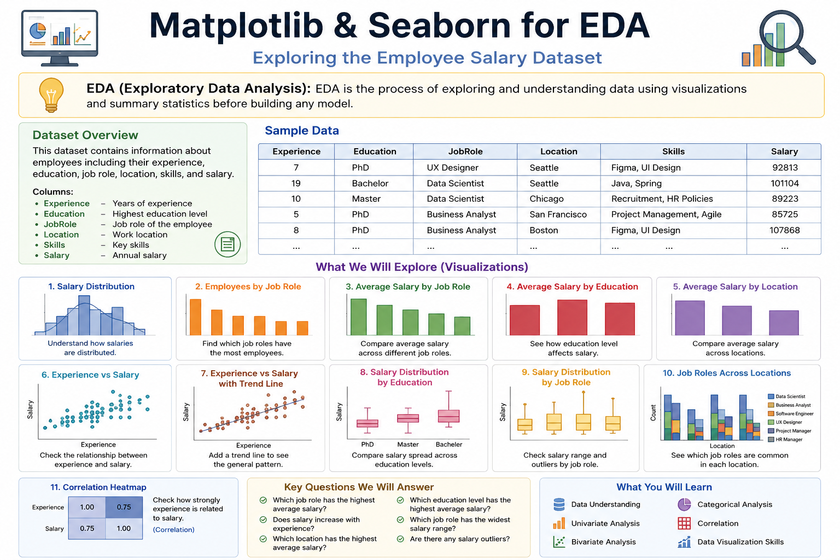

Slide 7
