Slide 1
NUTRINERVE
Predictive Neuro-Wellness through Data-Driven Nutrition

Slide 2
Project Goal
Predicts possible future diseases (e.g., diabetes, hypertension, liver issues, neural decline, etc.)
Recommends a personalized diet plan
Alerts for medical attention if high risk is detected

Slide 3
Health Data Collection
Vitals (BP, sugar, BMI, cholesterol, etc.)
Dietary habits, physical activity
Family history, lifestyle factors (smoking, alcohol)
Blood reports and symptoms
Data Processing & Visualization
Correlation heatmaps between parameters and disease likelihood
Timeline health deterioration predictions
Risk distribution by demographics
ML-Powered Disease Prediction
Classification models (Random Forest, SVM, Logistic Regression)
Output: Potential future disease(s) + confidence score
Severity Analyzer
Mild to Critical scale using probability thresholds
Alerts generated accordingly
Smart Recommendation System
Suggests personalized, balanced diets for improvement
Recommends doctor consultation if risk is beyond dietary intervention
Interactive Dashboard
User-friendly insights via Power BI, Tableau, or Python Dash
Things that are seen..

Slide 4
Suggested Tools & Tech Stack:
Python: Pandas, Scikit-learn, XGBoost, Matplotlib/Seaborn
NLP (optional): For symptom text analysis
Visualization: Power BI / Tableau / Plotly
Web Interface: Streamlit / Flask / Dash
Database: MySQL / Firebase / CSV for demo

Slide 5
Computational intelligence in neuroinformatics: Technologies and data analytics
Anand Deshpande Vania Vieira Estrela
Jude Hemanth
Anitha Jude

Slide 6
Summary
The fusion of computational intelligence (CI) and neuroinformatics is transforming brain research by enabling powerful data analytics and visualization of complex neural data. This Special Issue highlights how AI, machine learning (ML), and deep learning (DL) are driving innovations in brain imaging, EEG analysis, and clinical diagnostics. Techniques like CNNs and GRUs are used for tumor segmentation, seizure detection, and motor imagery classification, enhancing accuracy through spatial-temporal pattern recognition. Data-driven methods such as EEMD improve EEG signal clarity, while bibliometric and statistical analyses uncover trends in neuroscience research and cognitive load assessment. Advanced data visualization—via connectivity graphs, segmentation overlays, and fNIRS time-series plots—makes neural data more interpretable for clinical and research applications. Natural language processing (NLP) is applied to radiology reports for stroke feature extraction, and telehealth systems using EEG and Kinect data support remote care for elderly and disabled patients. Additionally, neural signal compression using autoencoders ensures efficient IoT transmission. Overall, this issue underscores the critical role of CI in managing, analyzing, and visualizing neural data, paving the way for improved diagnostics, assistive technologies, and a deeper understanding of the human brain.

Slide 7
KEY Points
CI Enables Neural Data Analysis
Advanced ML/DL Applications
Data-Driven Feature Extraction
Data Visualization
Bibliometric and Statistical Analysis
NLP in Clinical Reports
Telehealth and Assistive Tech
Signal Compression & IoT
Integration & Future Trends
Overall Impact
~Medapati Harshitha Reddy

Slide 8
Personalized Nutrition Recommendations for Arab Communities: Transforming Diet and Health through Machine Learning
Author: Khalfan Aldoobi
Date: May, 2025

Slide 9
Summary
Arab communities, such as those in the UAE and Saudi Arabia, are examples of regions where nutrition-related data is limited. This project uses data analytics to fill that gap by collecting and analyzing personal inputs like height, weight, age, and past health problems. By identifying trends and patterns in this data, the system helps recognize health issues and create more accurate, data-driven diet plans tailored to individual needs.
Using AI and machine learning, the system suggests personalized meal plans based on each person’s health profile. It adjusts recommendations in real time depending on dietary restrictions and taste preferences. While the AI handles the initial planning, health experts review the output to ensure it is medically safe and effective.
Beyond individual use, the system also supports community nutrition research, helping track health trends and improve overall dietary awareness. This project shows how smart use of data can make nutrition more personal, useful, and accurate for everyone.

Slide 10
VOICE ASSISTANTS FOR HEALTH SELF-MANAGEMENT: DESIGNING FOR AND WITH OLDER ADULTS
Author: Amama Mahmood
Date: April, 2025

Slide 11
Summary
Supporting older adults in managing their health is vital for independent aging, especially as healthcare systems face increasing pressure. While voice assistants (VAs) offer promise, they often lack personalization and usability. Through a five-stage design process involving older adults, we developed a high-fidelity, LLM-powered VA prototype to improve health awareness and medication adherence. It interprets doctor visit summaries and provides tailored reminders. Feedback from interviews, co-design workshops, and in-home studies shaped its design. Our findings emphasize the importance of personalization, contextual adaptation, and user autonomy in health-focused VAs.

Slide 12
The Impact of Big Data on Predictive Analytics in Healthcare
Author: Muhammed Busari
Date: March, 2025

Slide 13
Summary
Benefits of Big Data and Predictive Analytics in Healthcare
Improved Patient Outcomes
Reduced Medical Errors:
Cost Reduction
Preventive Care
Challenges and Ethical Considerations:
Data Privacy and Security Concerns
Data Quality and Accuracy Issues
Integration of Disparate Data
Regulatory and Ethical Issues
Future Outlook
Genomics and Personalized Medicine
Real-Time Monitoring with IoT and Wearables
Global Healthcare Impact
Applications of Predictive Analytics
Patient Risk Prediction
Early Disease Detection and Diagnosis
Readmission Prediction
Resource Allocation and Healthcare Optimization:

Slide 14
DATASETS
Links for the datasets that we will be using:
DATASET FOR DIET
DATASET FOR PATIENT RECORDS

Slide 15
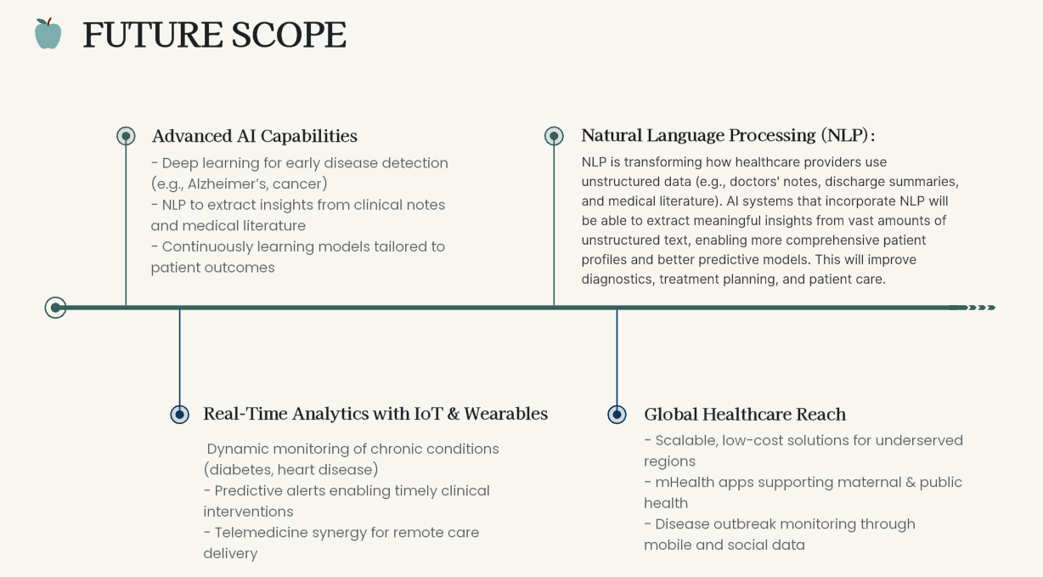

Slide 16
THANK YOU!
2410030001 – Harshitha
2410030059 – Jahnavi
2410030122 – T. Rishika
2410030123 – Surabhi Sarda

