Slide 1

Differentiation and Classification of
Diabetes, Pre-diabetes and Non-diabetes
Aditya Adhikary, Anjali Dhall, Ramya Y S, Surabhi S Nath, Vaibhav Mittal
Code available here

Slide 2
CONTENTS
Introduction
Paper Analysis
Overview
Methodology
Results
Our Work
Mid-review Work
Mid-review Results
Challenges
Proposed Extension
Further Work
Data Refining
Classification Schemes
Classifiers Implemented
Final Results
Conclusion

Slide 3

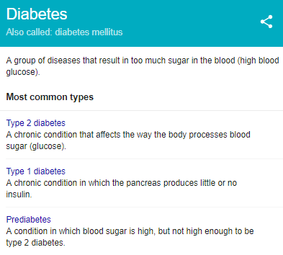
INTRODUCTION
50 million people in India suffer from type-2 diabetes
India has more people with type-2 diabetes than any other nation
India is witnessing alarming rise in the incidence of diabetes
Timely detection and proper management can significantly help all diabetes patients
Diabetes classification algorithms can aid diagnosis of the disease

Slide 4
PAPER ANALYSIS
Application of support vector machine modeling for prediction of common diseases: the case of diabetes and pre-diabetes
Yu W¹, Liu T, Valdez R, Gwinn M, Khoury MJ.

Slide 5
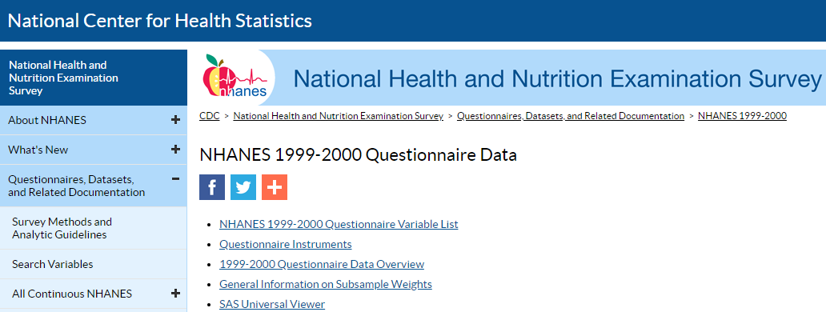
OVERVIEW
SVM based approach to detect people with diabetes and pre-diabetes
Public dataset - National Health and Nutrition Examination Survey (NHANES) Questionnaire data for 5 years, 1999-2004
Classification Scheme 1 - diagnosed or undiagnosed diabetes vs pre-diabetes or no diabetes
Classification Scheme 2 - undiagnosed diabetes or pre-diabetes vs no diabetes
Obtained an AUC ROC of 83.5% for Classification Scheme 1 and 73.2% for Classification Scheme 2

Slide 6
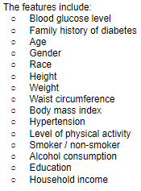
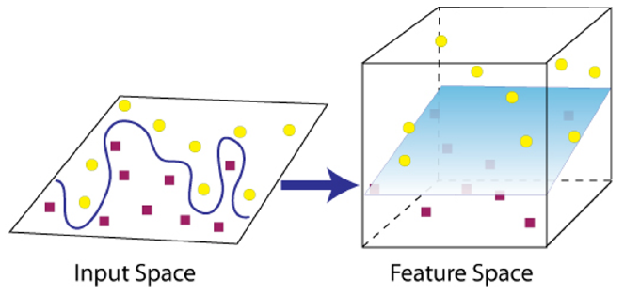
METHODOLOGY
14 features -
Participants - above 20, non pregnant women
Question: “Have you been told by a doctor that you
have diabetes?”
Yes - Diagnosed diabetes
No -
If glucose level >= 126 - Undiagnosed diabetes
Else If glucose level > 100 - Pre-diabetes
Else - No diabetes
Binary classification - using Machine Learning Technique, 14 features on Classification Scheme 1 and Classification Scheme 2

Slide 7
METHODOLOGY
Classification Scheme 1 - vs
Classification Scheme 2 - vs
SVM Implementation - LibSVM, best kernel/gamma/C chosen, 5 fold cross validation, linear/polynomial.sigmoid/rbf kernel functions used
Multiple logistic regression modelling (MLR) performed
Diagnosed, undiagnosed diabetes
Pre-diabetes,
Non diabetes
Undiagnosed diabetes,
Pre-diabetes
Non diabetes

Slide 8
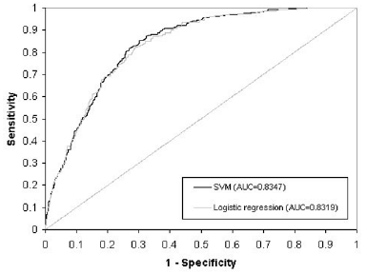
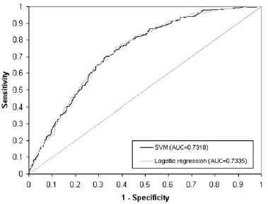
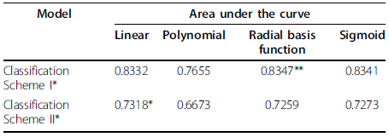
RESULTS
Classification Scheme 1 - RBF kernel,
AUC - SVM 83.47%, logistic regression 83.19%
Classification Scheme 2 - Linear kernel,
AUC - SVM 73.18%, logistic regression 73.35%

Slide 9
OUR WORK

Slide 10
MID-REVIEW WORK
Mined data from NHANES for all years
Converted questionnaire data of 1999-2004 into label form - diabetes vs no diabetes vs borderline
Generated CSV file with 15 features for 6993 patients
Implemented SVM for tri-class classification
Evaluated results using precision, recall, f1 score, confusion matrix, ROC curves

Slide 11
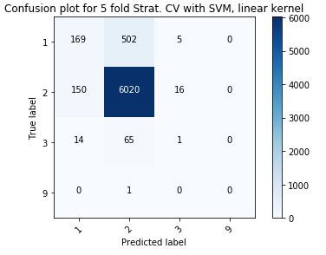
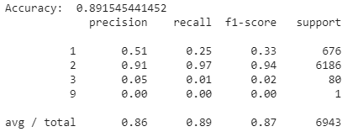
MID-REVIEW RESULTS

Slide 12
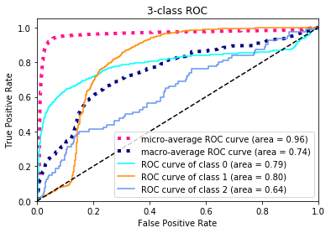
CMC Curve for multiclass classification

Slide 13
CHALLENGES
Less data
Inconvenient file naming - names of csv files containing the features have been indiscriminately changed over the years
Complicated structure of data - demographics, dietary, examination, laboratory and questionnaire
Highly imbalanced data, with 89% samples of class 2 (no diabetes)
Missing values, incomplete information

Slide 14

PROPOSED EXTENSION
Increase data - 1999 to 2017
Tackle class imbalance issue
Fill NAs with suitable values
Use Decision Trees to select the best features
Attempt DL based approach - too less features
Feature Selection
Data Mining from NHANES
Machine Learning Models

Slide 15
FURTHER WORK

Slide 16
DATA REFINEMENT
Collected data for entire 16 years - increased data to 23,000 samples
For missing data NA values, performed the following two workarounds:
Replaced them with -1
Removed those rows entirely - ignored those data samples
Performed Oversampling and Undersampling to tackle the class imbalance issue:
Generated synthetic data to equalize samples in each class
Randomly generated data points near the actual data points in the Euclidean plane
Removed samples randomly from class with excess data

Slide 17
CLASSIFICATION SCHEMES
We developed two classification schemes as used in the paper:
Classification Scheme 1 | Classification Scheme 2
vs | vs
Diabetes
Pre-diabetes,
No diabetes
Pre-diabetes
No diabetes

Slide 18
FINAL RESULTS
Classification Scheme 1 SVM
 |  | Precision | Recall | F1-Score | Acc | MCC
Validation |  | 91.00 | 90.00 | 90.00 | 89.88 | 81.22
DT
Validation |  | 100.00 | 100.00 | 100.00 | 100.00 | 1
RF
Validation |  | 100.00 | 100.00 | 100.00 | 99.92 | 99.85
MLP
Validation |  | 93.00 | 98.00 | 73.00 | 62.89 | 0.35

Slide 19
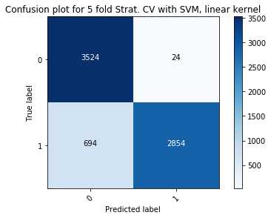
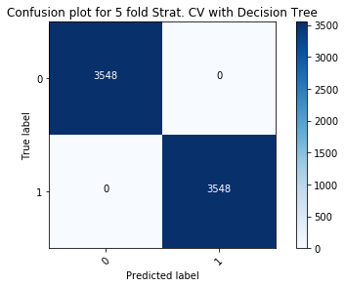
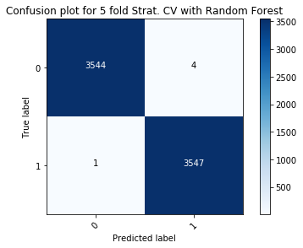

Slide 20
FINAL RESULTS
Classification Scheme 2 KNN
 |  | Sens | Spec | Acc | AUC | MCC
Training |  | 67.34 | 48.61 | 60.05 | 62.00 | 0.16
Validation |  | 67.46 | 47.73 | 59.78 | 61.00 | 0.15
MLP
Training |  | 87.76 | 86.51 | 87.27 | 95.00 | 0.74
Validation |  | 88.76 | 85.76 | 87.59 | 95.00 | 0.74
DT
Training |  | 97.45 | 96.74 | 97.17 | 99.00 | 0.94
Validation |  | 96.7 | 94.82 | 95.97 | 99.00 | 0.92
RF
Training |  | 98.00 | 99.17 | 99.68 | 100.00 | 0.95
Validation |  | 97.00 | 99.27 | 99.72 | 100.00 | 0.93

Slide 21
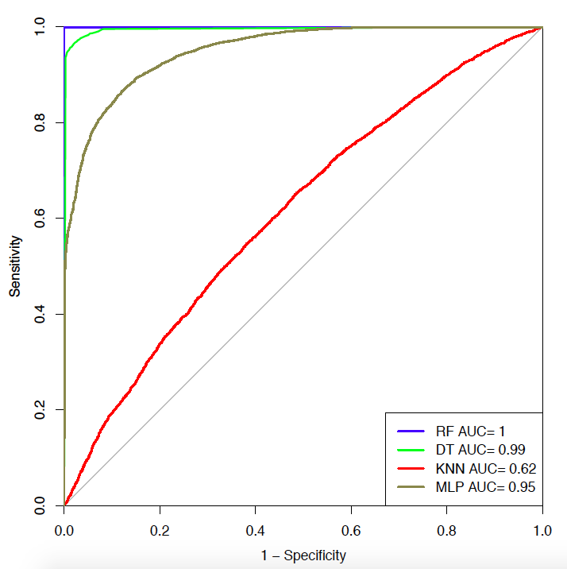
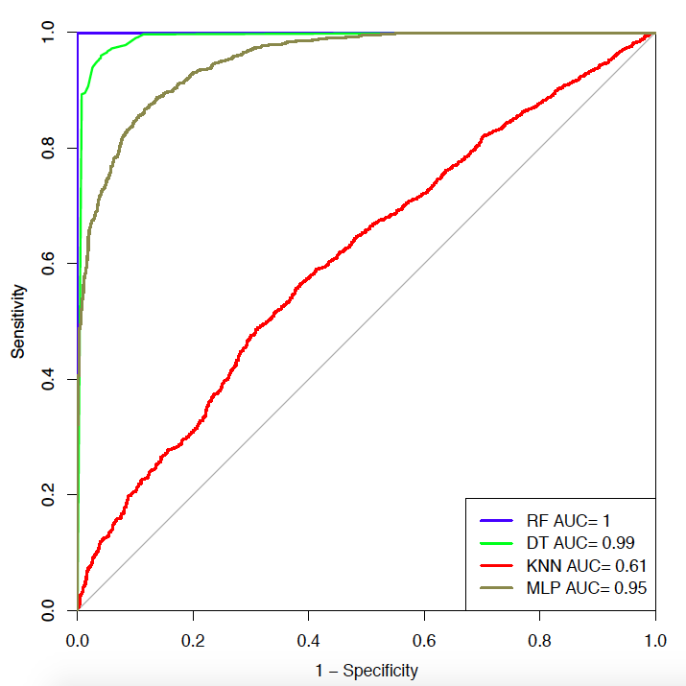
Training
Validation

Slide 22
CONCLUSION
Various Machine Learning techniques were used for the classification of persons with common diseases such as diabetes and pre-diabetes in the population
Decision Tree proves to be very effective for such analysis
This approach should be further explored in other complex diseases using common variables

Slide 23
THANK YOU

