Slide 1
Uber Demand Supply Gap Assignment SUBMISSION
Submitted By:
Name: Surabhi Varshney
Roll No: DDA1720204

Slide 2
Abstract
Uber is a leading global cab providing service. But recently they have identified that there is some issue with respect to availability of cars especially at the airport in one specific city where the airport is far away from the city.
They want to use the historical data to identify the reasons for issues like cancellation of rides and non availability of cars and suggest proper solutions as well. This task includes the identification of the cause behind this demand supply gap issue and to provide suitable measures.
Business objective:
The objective is to analyse the data given and identify the reasons behind common issues being faced by customers like non availability of cars and requests getting cancelled especially when the ride is between airport and a specific city. Also, we need to provide appropriate measures to result in a better profitable customer service.
Strategy to be followed :
Study the historical data
Study the hourly frequency of the cab requests
Further deep dive to find out peak hours for both city and airport
Find out which part of day has more demand supply gap wrt both city and airport
Suggest possible solutions for this gap

Slide 3
Problem solving methodology
Study historical data + cleaning/formatting
Study the historical data provided and perform necessary data cleaning or formatting, eg: formatting of date columns
Visualization to find Demand supply gap peaks
Represent the data in proper forms of graphs so as to have a better understanding of hourly demand – supply gap of cabs at both city and airport
Possible steps
Suggest possible and affordable business solutions to reduce the above observed demand supply gap

Slide 4
Analysis
Data provided for analysis:
Uber Request Data.csv: It is a masked data set which is similar to what data analysts at Uber handle.
Assumptions made:
Trip statuses are only among : completed/ cancelled/no cars available
Pick up area pocket for all cab requests is be either city or airport
Attributes:
Following are the attributes provided in the historical data given:
Attributes | Description
Request id | Unique ID of rides
Pick point | Pick point (airport/city)
driver id | ID of the cab driver
status | Status of the ride (cancelled/no cars available/trip completed)
Request timestamp | Date timestamp when the request was made
Drop timestamp | Date timestamp when the drop happened

Slide 5
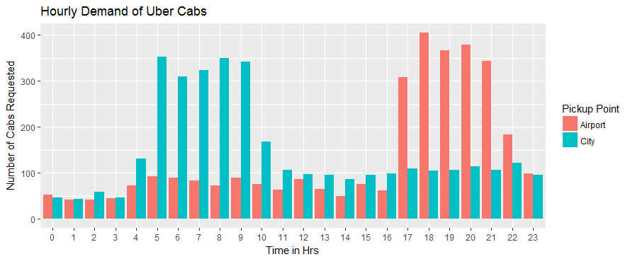
Analysis 1
Hourly Frequency of Cabs requested :
Study the frequency of cabs requested against each hour for all 5 days of the week in order to find out the peak time from airport as well as city.
CONCLUSION : From the plot shown below, it is clear that the peak demand is faced during morning hours (from 5AM to 10 AM) in City and during evening hours (from 5 PM to 10 PM) in Airport.
So, to manage this demand efficiently cabs should be made available appropriately at city and airport

Slide 6
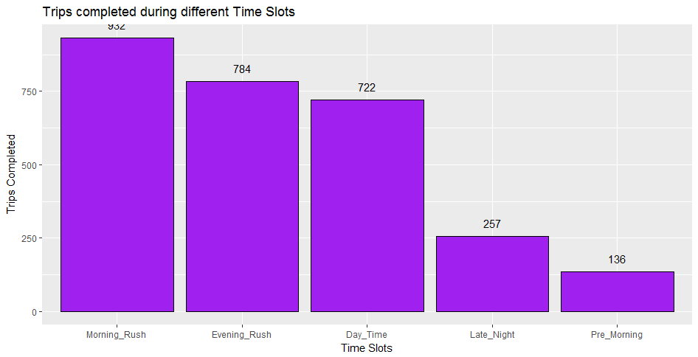
Analysis 2
Trips Completed v/s part of day :
First we shall divide the entire day into following five time slots and then map each request hour to below buckets
pre morning - before 3AM
morning rush - between 4 AM to 9 AM
Day time - between 10 AM to 4 PM
evening rush - between 5 PM to 9 PM
Late night - between 10 PM to 12 AM
CONCLUSION : From the below graph it is clear that more number of trips completed during morning rush hours i.e 4AM to 9 AM

Slide 7
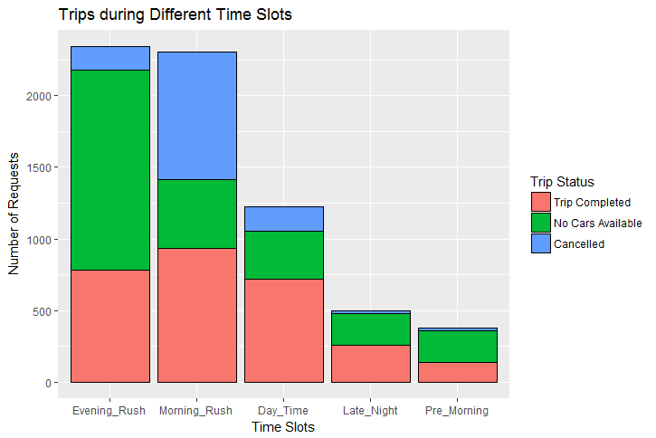
Analysis 3
Ratio of trips status against different time slots:
Find the frequency of trips against time slots clearly differentiating each of the trip status (Completed/No cars Available/Cancelled)
CONCLUSION: from the below plot it is evident that many customers faced no cars available during evening hours (5PM to 9PM) and majority of trips got cancelled in morning rush hours (4 AM to 9 AM)
Need to dig further and analysis which pocket of the area has this less supply of cabs because of which customers were facing these issues

Slide 8
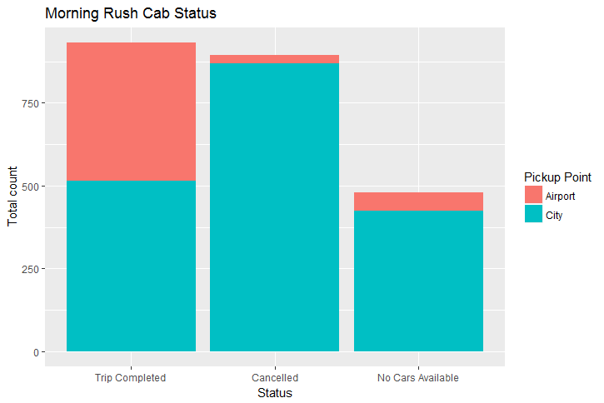
Analysis 4.1
Statuses of trips during morning rush hour
Find the distribution of cab requests during the morning rush hours across different statuses and the pick up area pocket
CONCLUSION: from the below plot it is evident that during morning rush hours majority of customers face cancellation of requests in the city i.e demand of cabs is more in city during morning rush hours but the supply is less

Slide 9
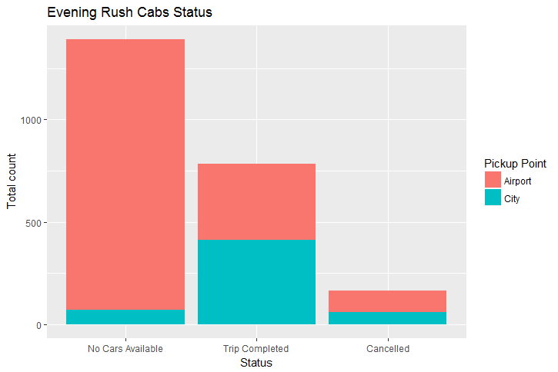
Analysis 4.2
Statuses of trips during evening rush hour
Find the distribution of cab requests during the evening rush hours across different statuses and the pick up area pocket
CONCLUSION: from the below plot it is evident that during evening rush hours majority of customers face unavailability of cars in the airport i.e demand of cabs is more in airport during evening rush hours but the supply is less

Slide 10
Issues & Probable Solution Steps
Cabs unavailable in evening rush hours at airport
Probably drivers choose to take rides within city in the evening because if they accept trip to airport idle time is more i.e drivers will have to wait at airport to get a trip back to city, and they wont prefer coming back to city without a customer as it will directly affect their daily profit.
Request cancelled in morning rush hours in city
because majority of cars are at airports, completing trips as drivers tend to accept trips to airport in morning rush hours.
Steps:
Introduce policy to give lucrative commission to cab drivers if they make trips to airport in the evening.
Try to give early heads up to drivers to tell them in which are pocket demand is predicted to increase so that appropriate supply can be maintained

