Slide 1
Programming II
Project on Dama
With start-up code.

Slide 2
Problem Statement
Given a starting code, you will be expected to produce the complete code for “dama” game.

Slide 3
Important
The project to be done with a group of three students
All project members must participate actively on all part
Submission date: A week after your final exam
Defense dates: To be announced
Deadline must be respected
Project must be done according to the specification

Slide 4
Important Decisions
Players
The game is to be played by two players
Player 1 has id of 1
Player 2 has id of 2

Slide 5
Important Decisions
Cell
A cell is a bar object with the following properties
Row: row position of a cell
Col : column position of a cell
Type : the type of object on cell
0 : empty cell
1 : player 1 solider
2 : player 1 king
3 : player 2 solider
4 : player 2 king

Slide 6
Important Decisions…
Quarki
A cell contain quarki(solider or king)
A quarki can move
About the possible move learn the game first

Slide 7
Important Decisions…
Playing Board
Board Dimensions
Board Width
Board Height
Board Position
Left Corner
Top Corner
Grid Dimensions
Number of Rows
Number of Columns
Cell size

Slide 8
Important Decisions…
Color
Cell Fill Color
An empty board have two type of cell
Cell1 fill color
Cell2 fill color
Players Color
The game has two player
Player1 color
Player2 color

Slide 9
Important Decisions…
Information Display Area
Display message(error, instruction, player turn)
Information Board Dimensions
Information Width
Information Height
Information Board Position
Left Corner
Top Corner

Slide 10
Important Decisions…
Status Display Area(2)
Display status for each player(no of soldiers, king …)
Status Board Dimensions
Status Width
Status Height
Status Board Position
Left Corner
Top Corner

Slide 11
Important Decisions…
Keys for playing game
Mouse
Select Quarki Click Right mouse button
Move Quarki Click left mouse button
Keyboard
Esc exit
y/Y Confirm exit
n restart game

Slide 12
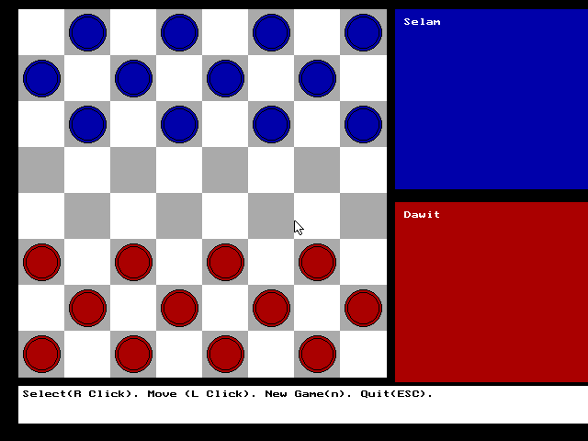
The Game Screen Snapshoot

Slide 13
Break down and Start-up code
Game functions
int getCellColor(cell c);
returns cell back color
void putQuarki(cell, int &);
put quarki on board
void makeKing(cell qurki);
makes a given soilder king (not implemented}
void putQuarkis(cell quarkis[], int n, int c[][8]);
put several quarkis
drawBoard(); //draw board

Slide 14
Break down and Start-up code
void displayInfo(char *msg);
display message in the information area
void displayStatus1(char *msg);
display playe1 status
void displayStatus2(char *msg);
display player2 status
void initialize(game & g, int & turn,int newGame); initialize new or saved game
cell getCell(int x, int y, int cells[][8]);
get cell from pixel position
void moveQuarki(cell startCell, cell destCell, int & c);
move quarki

Slide 15
Expected Work
Validating move
Making king
Displaying status
Displaying points
Displaying turns
Starting new game
Starting Saved Game
Saving game
Checking win
Any additional feature is welcome

Slide 16
Optional Work
Playing against the computer!!!
At least think about it.

