Slide 1
Programming II
Project on Tetris
With start-up code.

Slide 2
Problem Statement
Given a starting code, you will be expected to produce the complete code for tetris game.

Slide 3
Important Decisions
Blocks
The game involves up to five block types:
Bar Block
Box Block
Left L Block
Right L Block
T Block

Slide 4
Important Decisions…
A block have orientation
Bar Blocks
Horizontal
Vertical
Box Block
No orientation
T block and L block
Horizontal Left
Horizontal Right
Vertical Top
Vertical Bottom

Slide 5
Important Decisions…
A Block may move in three direction
Left
Right
Down
A Block may rotate in two direction
Clockwise
Anti-Clockwise

Slide 6
Important Decisions…
Playing Board
Board Dimensions
Board Width 180
Board Height 240
Board Position
Left Corner 230
Top Corner 120
Grid Dimensions
Number of Rows 15
Number of Columns 10
Cell size 15

Slide 7
Important Decisions…
Color
Board Color
Background color
Foreground Color
Cell Fill Color
Grid Color
Boarder Color

Slide 8
Important Decisions…
Information Display Area
Information Board Dimensions
Information Width
Information Height
Information Board Position
Left Corner
Top Corner

Slide 9
Important Decisions…
Keys for playing game
Block movement keys
Move Block Left Left Arrow Key
Move Block Right Right Arrow Key
Rotate Block Clockwise Up Arrow
Rotate Block Anti-Clockwise Down Arrow
Other Keys
To start playing Enter Key
To exit game Esc Key

Slide 10
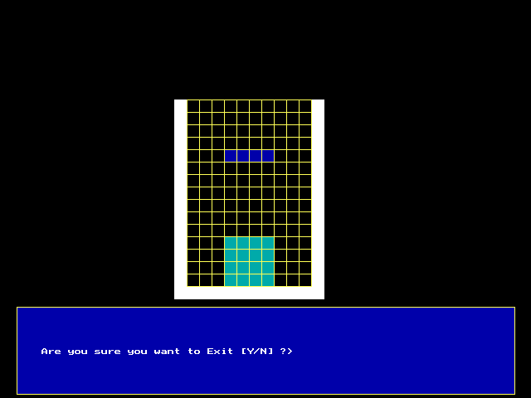
The Game Screen Snapshoot

Slide 11
Break down and Start-up code
Playing Board functions
void initGraphEngine()
Initialize graphic driver
void drawBoard()
Draws playing board and information area
void fillGrid( )
Create the grid
void clearDisplayArea()
Clear the screen
void reDrawCellsGrid()
Redraw cells grid destroyed by the moving block

Slide 12
Break down and Start-up code
Block: Bar block
Generation
void drawBarBlock(…)
Draw a bar block
void generateBarBlock (…)
uses draw block to generate a bar block with random orientation

Slide 13
Break down and Start-up code
Translation
Checking if a bar move to right
, left or down
int checkTranslateBarRoute (…)
Invoke the appropriate checking function for Bar block depending on the direction
void checkTranslateBarRouteLeft(…)
Check if a bar can move to left
Void checkTranslateBarRouteRight(…)
Check if a bar can move to right
void checkTranslateBarRouteDown(…)
Check if a bar can move to down
Translate bar
void translateBarBlock(…)
translate Bar block

Slide 14
Break down and Start-up code
Rotation
Checking if a bar can rotate
int checkRotateClockBarRoute(…)
Check if a bar can rotate clockwise
int checkRotateAntiClockBarRoute(…)
Check if a bar can rotate anti-clockwise
Rotate bar
void rotateBarBlockClock()
rotate bar block clockwise
void rotateBarBlockAntiClock()
rotate bar block anti-clockwise

Slide 15
Break down and Start-up code
Block: Box
Generation
void drawBoxBlock(…)
Uses drawBarBlock to draw a box
void generateBoxBlock (…)
uses draw bar block to generate a box block .

Slide 16
Break down and Start-up code
Translation
Checking if a box move to right
, left or down
int checkTranslateBoxRoute (…)
Invoke the appropriate checking function for Box block depending on the direction
void checkTranslateBoxRouteLeft(…)
Check if a box can move to left
Void checkTranslateBoxRouteRight(…)
Check if a box can move to right
void checkTranslateBoxRouteDown(…)
Check if a box can move to down
Translate box
void translateBoxBlock(…)
translate Box block

Slide 17
Break down and Start-up code
Rotation
Not avaliable

Slide 18
Break down and Start-up code
Block: Left L block
Generation
void drawLeftLBlock(…)
Draw a left L block
void generateLeftLrBlock (…)
uses draw block to generate a left L block with random orientation

Slide 19
Break down and Start-up code
Translation
Checking if a left L block with a specified orientation move to right, left or down
int checkTranslateLeftLRoute (…)
Invoke the appropriate checking function for left L block depending on the direction
void checkTranslateLeftLRouteLeft(…)
Check if a left L can move to left
Void checkTranslateLeftLRouteRight(…)
Check if a bar can move to right
void checkTranslateLeftLRouteDown(…)
Check if a Left L can move to down
Translate Left L Block
void translateLeftLBlock(…)
translate Left L block

Slide 20
Break down and Start-up code
Rotation
Checking if a Left L block with specified orientation can rotate in clockwise or anti-clockwise
int checkRotateClockLeftLRoute(…)
Check if a LeftL can rotate clockwise
int checkRotateAntiClockLeftLRoute(…)
Check if a Left L can rotate anti-clockwise
Rotate Left L Block
void rotateLeftLBlockClock()
rotate Left L block clockwise
void rotateLeftLBlockAntiClock()
rotate Left Lblock anti-clockwise

Slide 21
Break down and Start-up code
Block: Right L block
Generation
void drawRightLBlock(…)
Draw a Right L block
void generateRightLBlock (…)
uses draw block to generate a RightL block with random orientation

Slide 22
Break down and Start-up code
Translation
Checking if a Right L block with a specified orientation move to right, left or down
int checkTranslateRightLRoute (…)
Invoke the appropriate checking function for right L block depending on the direction
void checkTranslateRightLRouteLeft(…)
Check if a Right L block can move to left
Void checkTranslateRightLRouteRight(…)
Check if a Right L block can move to right
void checkTranslateRightLRouteDown(…)
Check if a Right L block can move to down
Translate bar
void translateRightLBlock(…)
translate Right L block

Slide 23
Break down and Start-up code
Rotation
Checking if a Right L block with specified orientation can rotate in clockwise or anti-clockwise
int checkRotateClockRightLRoute(…)
Check if a RightL can rotate clockwise
int checkRotateAntiClockBarRoute(…)
Check if a Right L can rotate anti-clockwise
Rotate Right L Block
void rotateRightLBlockClock()
rotate Right L Block block clockwise
void rotateRightLBlockAntiClock()
rotate Right L Block block anti-clockwise

Slide 24
Break down and Start-up code
Block: T block
Generation
void drawTBlock(…)
Draw a T block
void generateTBlock (…)
uses drawTblock to generate a bar block with random orientation

Slide 25
Break down and Start-up code
Translation
Checking if a T block with a specified orientation move to right, left or down
int checkTranslateTRoute (…)
Invoke the appropriate checking function for T block depending on the direction
int checkTranslateTRouteLeft(…)
Check if a T Block can move to left
int checkTranslateTRouteRight(…)
Check if a T Block can move to right
int checkTranslateTRouteDown(…)
Check if a T Block can move to down
Translate T block
void translateTBlock(…)
translate T block

Slide 26
Break down and Start-up code
Rotation
Checking if a Right L block with specified orientation can rotate in clockwise or anti-clockwise
int checkRotateClockTRoute(…)
Check if a T Block can rotate clockwise
int checkRotateAntiClockTRoute(…)
Check if a T can rotate anti-clockwise
Rotate T Block
void rotateTBlockClock()
rotate T block clockwise
void rotateTBlockAntiClock()
rotate T block anti-clockwise

Slide 27
Break down and Start-up code
Block: All Blocks
Generation
void generateNewBlock (…)
Calls the appropriate generation function based on a block id
Translation
int translateRouteFree(…)
Invoke the appropriate route checking function for translation depending on block Id
void translateBlock(…)
Invoke the appropriate function for translation depending on block Id

Slide 28
Break down and Start-up code
Rotation
int rotateRouteFree(…)
Invoke the appropriate route checking function for rotation depending on block Id
void rotateBlock(…)
Invoke the appropriate function for rotation depending on block Id

Slide 29
Break down and Start-up code
Playing Game
void handleUserInput(…)
Checks the route is free and invokes the translation or rotation function depending on the arrow key pressed
int freeFall(…)
falls a block until it touches "ground"
int gameOver(…)
checks whether or not game is over

Slide 30
Break down and Start-up code
void displayInfo(…)
Display message in the display board
int escapeConfirmed()
checks confirmation of ESCAPE
void playGame()
Controls the overall logic of the game
int main()
Launchs the game

Slide 31
Break down and Start-up code
Graphics function used
void initgraph(int * gdriver, int * mode, char * pathToDriver)
start the graphic system by loading a graphic driver from disk
void setcolor(int color)
sets the current drawing color to color
int getcolor()
returns the current drawing color to color
void setfillstyle(int pattern,int color);
sets the current fill pattern and fill color

Slide 32
Break down and Start-up code
void settextstyle(int font, nt direction,i nt charsize)
sets the text font, the direction in which the text is displayed, and size of the character
void outtextxy(int x, int y, char * text)
displays text at a specified position
void bar(int left, int top, int right, int bottom)
draws a filled-in, rectangular, two dimensional bar.
void rectangle(int left, int top, int right, int bottom)
draws a rectangle in the current line style, thickness, and drawing color.
int getpixel(int x, int y)
gets the color of specified pixel

