Slide 1
PIZZA SALES ANALYTICS
AI-Powered Business Insights from a Year of Sales Data
Prepared for Stakeholder Review | FY2015 Performance

Slide 2
THE BUSINESS PROBLEM
A year of order-level sales data was sitting in our database — but no one was turning it into decisions.
WHY IT MATTERS
Answering these questions manually every week doesn't scale. Leadership needs a repeatable pipeline that turns raw sales data into decisions automatically — every time it's run.
Which pizzas and categories actually drive revenue?
When are we busiest — and are we staffed for it?
Is revenue growing or shrinking, and in which months?
Which menu items are underperforming?

Slide 3
HOW WE SOLVED IT
A five-step automated pipeline — from raw database to boardroom-ready report.
1
2
3
4
5
MySQL Database
→
Python Automation
→
AI Interpretation
→
Visualization
→
Final Report
22 SQL queries: joins, CTEs, window functions
Runs every query, saves structured results
LLM writes insights tied to real numbers
Matplotlib / Seaborn charts of key metrics
Charts + AI narrative compiled into one PDF
Design note: adding a new SQL query automatically flows into the AI report — no other code changes needed.

Slide 4
KEY PERFORMANCE METRICS
FY2015 full-year snapshot
$817,860
21,350
$38.31
138
TOTAL REVENUE
TOTAL ORDERS
AVERAGE ORDER VALUE
AVG. PIZZAS SOLD / DAY
Revenue grew as high as +9.95% (Nov) and fell as low as -8.09% (Dec) month-over-month, showing a business with clear seasonal swings rather than flat, predictable demand.

Slide 5
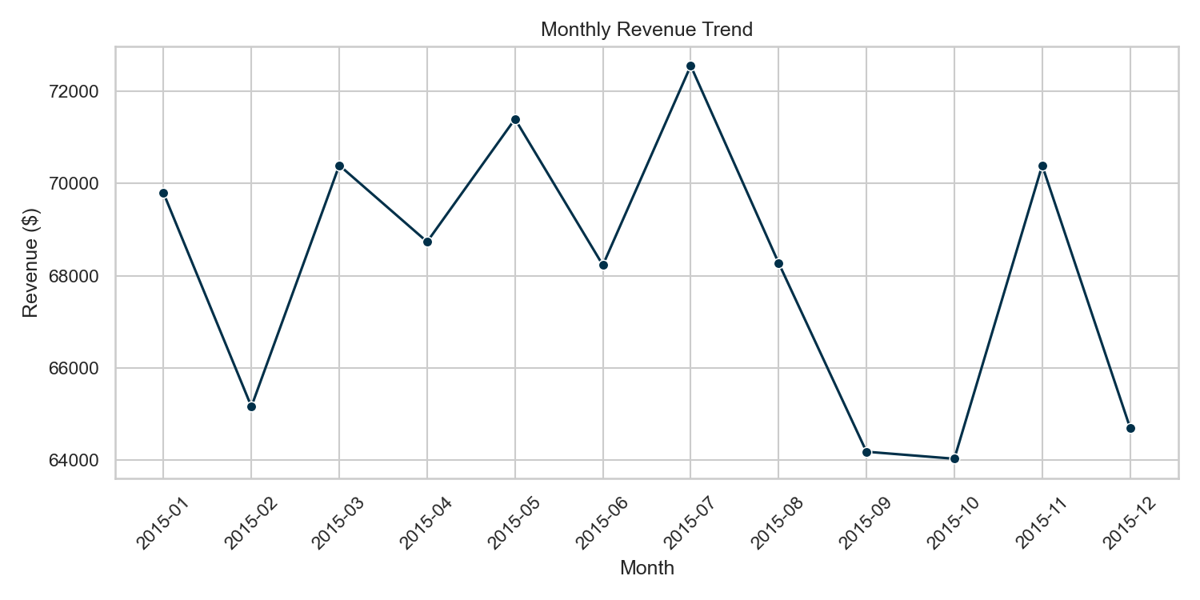
REVENUE TREND OVER THE YEAR
READING THE TREND
Peak month: July ($72,558)
Weakest months: Sept–Oct (~$64,000)
Best growth: Nov (+9.95%)
Sharpest decline: Dec (−8.09%)

Slide 6
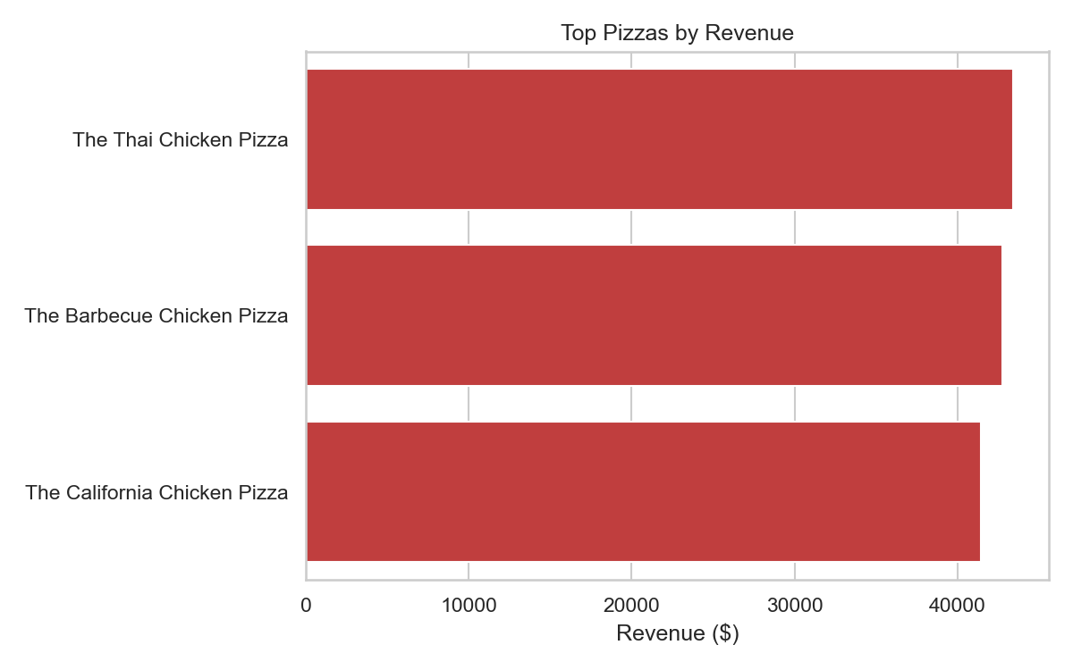
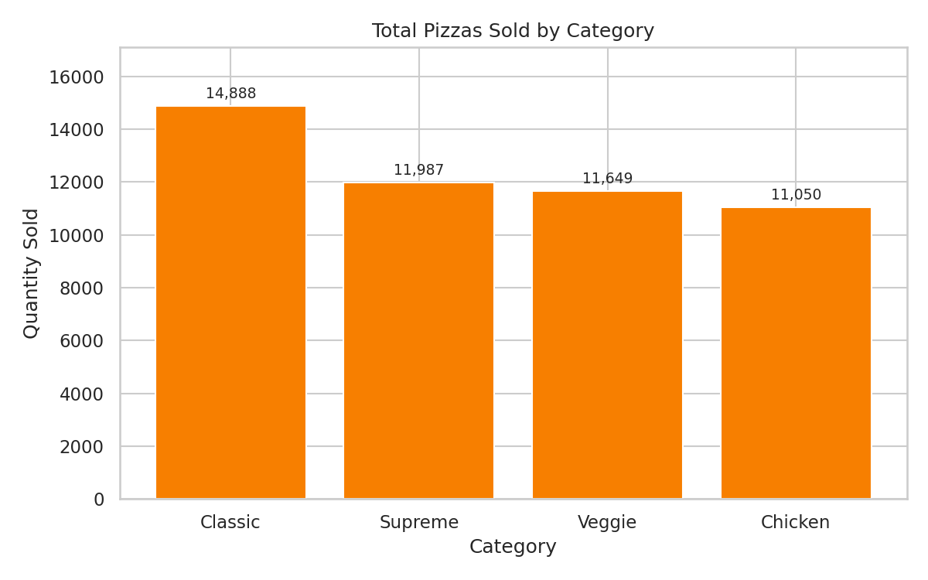
PRODUCT PERFORMANCE
Top Pizzas by Revenue
Volume Sold by Category

Slide 7
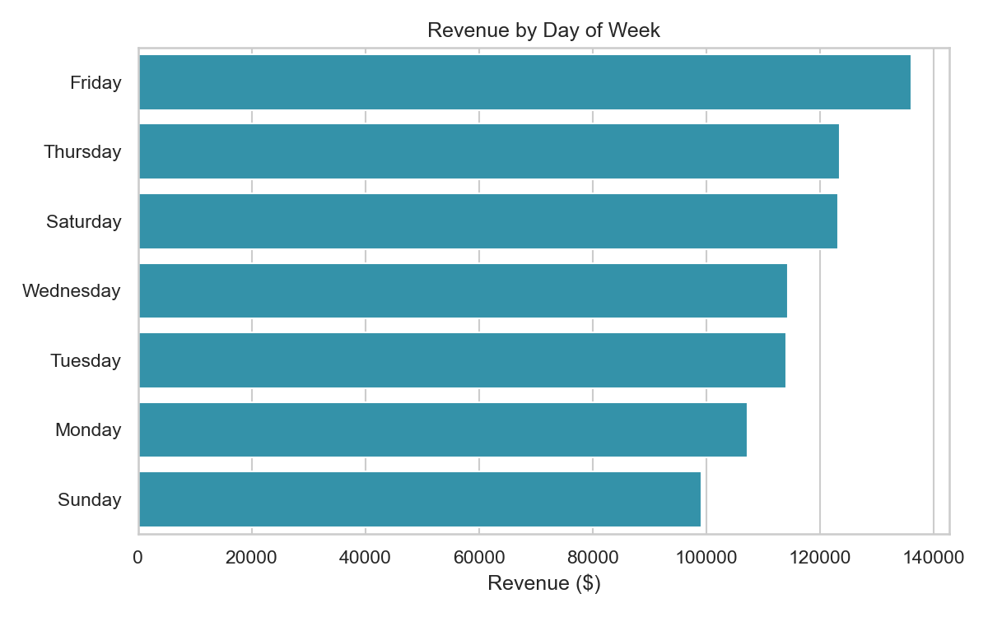
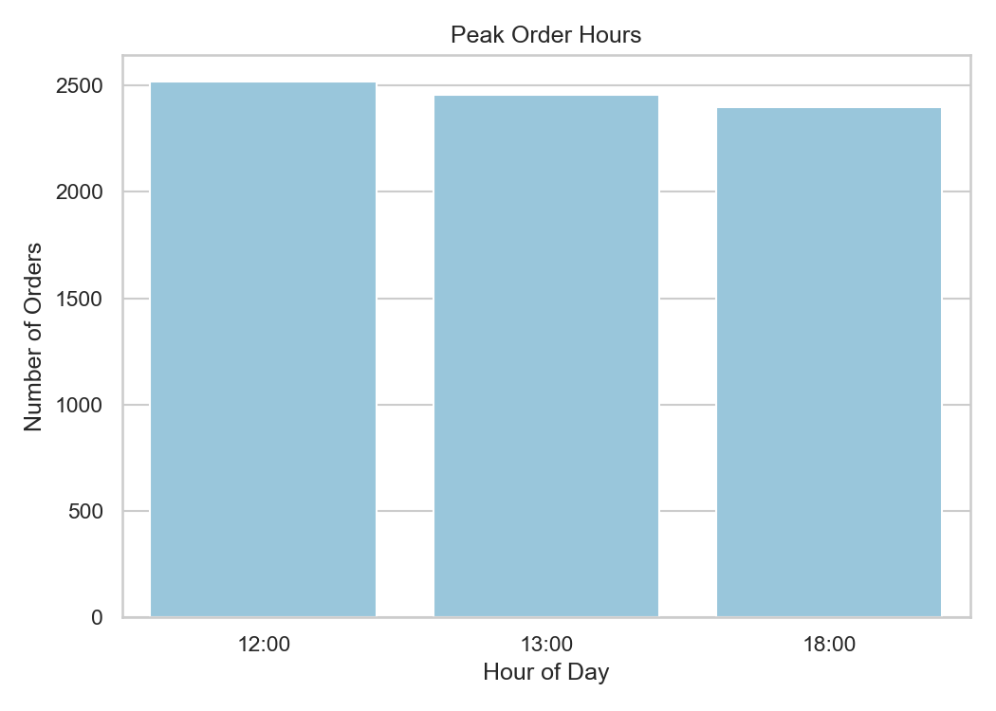
CUSTOMER BEHAVIOR & TIMING
Revenue by Day of Week
Peak Order Hours

Slide 8
WEEKDAY vs. WEEKEND
Weekdays drive most of the volume — weekends convert slightly higher per order.
WEEKDAY
WEEKEND
$595,474
$222,386
15,568 orders
5,782 orders
$38.25 AOV
$38.46 AOV
Takeaway: weekday demand is the volume engine; weekend orders are fewer but slightly larger — a loyalty push could grow weekday frequency further.

Slide 9
RECOMMENDATIONS
AI-generated, tied directly to the KPIs above — not generic advice.
1
Staff up during peak hours
Increase coverage at 12pm, 1pm, and 6pm to match demand.
2
Promote Large pizzas
Large size drives 45.9% of revenue — reinforce upsell prompts.
3
Reassess underperformers
Brie Carre and similar low-volume pizzas may need rebranding or removal.
4
Invest further in Classic category
Highest revenue contributor at 26.9% — protect and grow it.
5
Build weekday loyalty incentives
Weekdays already drive most revenue — reward repeat weekday orders.

Slide 10
RISKS TO WATCH
!
!
!
Seasonal December Dip
Menu Concentration
Underperforming SKUs
Revenue fell 8.09% in December — plan promotions or staffing adjustments ahead of the winter slowdown.
A small number of top pizzas and the Large size drive an outsized share of revenue — a shift in preferences could hurt disproportionately.
Items like The Brie Carre Pizza consistently sell far below average and may be diluting menu focus.

Slide 11
NEXT STEPS
1
Review recommendations with category & marketing leads
2
Pilot Large-size upsell prompts for one month
3
Schedule this report to regenerate monthly as new sales data lands
Thank you

