Slide 1
Question Answering System
by
Surag Suresh Yalaburg
Lakshmi Shankarrao

Slide 2
Introduction
Objective: Build a Question Answering System using neural networks.
What problem are we solving?
Need for QA
Lot of data
Getting right documents
Getting direct and specific answers from those documents.
Advantages of using Neural Network Approach over other ML models.
Feature engineering is needed in conventional machine learning tasks. Whereas it is not needed for neural networks. What happens inside the hidden layers of the neural networks is unknown. It learns all possible features.

Slide 3
Introduction
Area or scope of investigation:
We plan to build a QA system using neural networks to help interprets a question and provide a suitable answer from the document or a story given.
Babi Dataset: This is a dataset released by facebook. It has 20 tasks for testing text understanding and reasoning.
MCTest(Machine Comprehension Test) dataset: This is a dataset from MSR, which contains 660 stories, each story has 4 human asked questions and for each question, there are 4 candidate answers.
Children’s Book Test (CBT): A dataset from FAIR, which contains stories from children’s books.
InsuranceQA dataset:This corpus contains questions and answers collected from the website Insurance Library.
CNN/Daily Mail dataset: This is released by Google DeepMind, which the largest QA dataset.

Slide 4
Theoretical bases and literature review
Theoretical background of the problem
RNN
LSTM
BiLSTM
Pooling
Related Research
Advantages and Disadvantages
Chosen Solution

Slide 5

Recurrent Neural Network
Deals with variable-length sequence input. X = X₁,X₂,..X_{T}.
Useful to tasks such as handwriting recognition or speech recognition.
Single model used to summarizing information from the past and providing it to the next stage.
Inputs:
The input at each stage X_{i}
Summary of all events till now coming from the previous stage. (Weights of the past events decreases exponentially as you go deeper into the network)
Outputs predictions and connects to the next stage.
Drawbacks:
No exploitation of future context
Memory loss due to the Vanishing Gradient Problem.

Slide 6
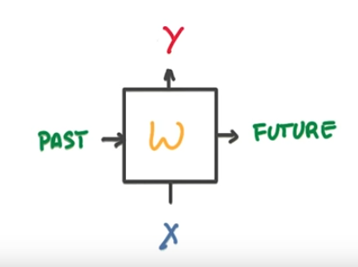
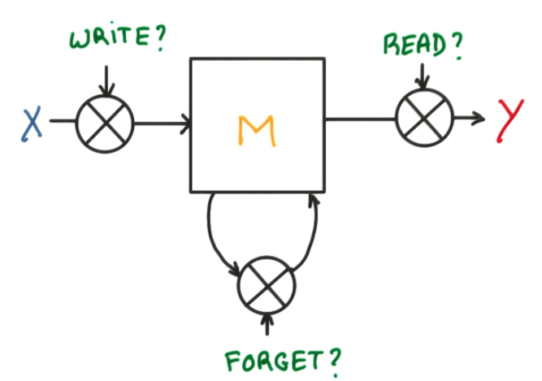
LSTM- Long Short Term Memory
Vanishing Gradient Problem
Memory loss in RNNs → Data from distant past lost.
Difficult to train & exploit long-range dependencies.
LSTM makes RNNs memorize better.
3 gates: Read/Output, Write/Input and Forget Gates.
Output-Input: control flow of information through the cell.
Forget: Reset the cell’s own state.

Slide 7
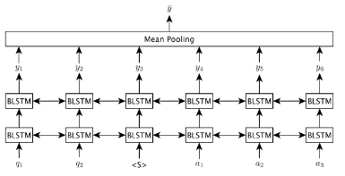
Related Research
Answer Sentence Selection
with Stacked BLSTM
Conversion of words in input sentences to vector representations learned from word2vec.
Special start symbol(<S>) btw Q and A for differentiation.
Q and A word vectors sequentially read by BLSTM from both directions
For each time step in the BLSTM layer, the output vector is generated by combining the cell memory vectors from two LSTM of both sides
The final output of each time step is the label indicating whether the candidate answer sentence should be selected as the correct answer sentence for the input question.
This objective encourages the BLSTMs from this objective learn a weight matrix that outputs a positive label if there is overlapping context information between two LSTM cell memories. Mean pooling is applied to all time step outputs during the training. During the test phase, we collect mean, sum and max poolings as features

Slide 8
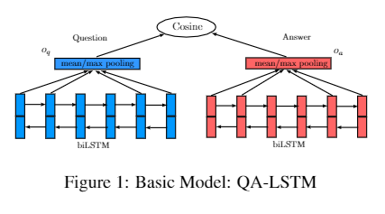
Related Research
QA-LSTM
BLSTM generates distributed representations for both the question and answer independently, and then utilize cosine similarity to measure their distance.
Generate representations based on the word-level BLSTM outputs using
Average pooling or Max pooling or Concatenation of the last vectors on both directions.
Max Pooling provides better performance.
Architectures, in which both question and answer sides share the same network parameters, is significantly better than the one that the question and answer sides own their own parameters separately, and converges much faster

Slide 9
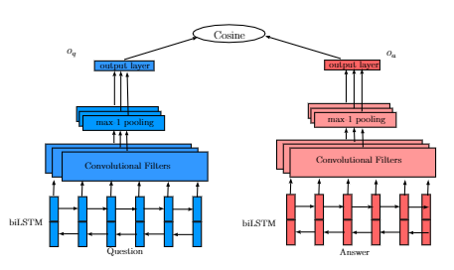
Related Research
QA-LSTM/CNN
a simple pooling layer may suffer from the incapability of keeping the local linguistic information.
generate the question and answer representations using a CNN structure built on the outputs of BLSTM, in order to give a more composite representation of questions and answers
Unlike the traditional forward neural network, where each output is interactive with each input, the convolutional structure only imposes local interactions between the inputs within a filter size m.
Same as typical CNNs, a max-k pooling layer is built on the top of the convolutional layer. Intuitively, we want to emphasize the top-k values from each convolutional filter.
indicate the highest degree that a filter matches the input sequence.
Finally, there are N parallel filters, with different parameter initialization, and the convolutional layer gets N-dimension output vectors. We get two output vectors with dimension of kN for the questions and answers respectively

Slide 10
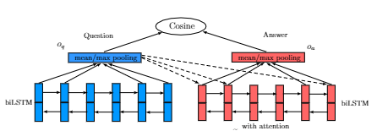
Related Research
Attention-based QA-LSTM
In order to better distinguish candidate answers according to the question, we introduce a simple but efficient attention model to this framework for the answer embedding generation according to the question context.
Prior to the average or mean pooling, each BLSTM output vector will be multiplied by a softmax weight, which is determined by the question embedding from BLSTM

Slide 11
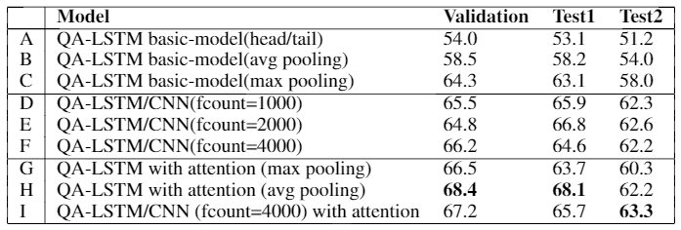
Advantages and
Disadvantages
Comparison of models
A) just concatenating the last vectors from both direction performs the worst.
(B) Max Pooling much better than Average pooling(C):
Max-pooling extracts more local values for each dimension, so that more local information can be reflected on the output embeddings
(D) to (F): CNN layers built on the top of BLSTM with different filter numbers. Increasing the value of filter width(m = 2,3 or 4) did not give us better performance. Row (F) with 4000 filters gets the best validation accuracy.
(G) and (H) : QA-LSTM with the attention model.
Max pooling layers,
mean pooling layers, improvement from attention model(H) is over 8% higher on all datasets compared to (B)

Slide 12
Chosen model
Attention-based QA-LSTM

Slide 13
Hypothesis/Goals
Build a framework which uses bidirectional LSTM
Train on both question and answers data
Measure the distance between the pairs of question and answers

Slide 14
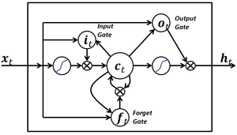
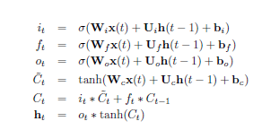
Hypothesis/Goals
LSTM
Avoid vanishing Gradient problem of the RNN
input sequence x = {x(1), x(2),......,x(n)}
x(t) - E-dimensional word vector
h(t) - hidden vector at the time step t
W - input weight matrix
U - recurrent weight matrix
b - bias
σ -logistic sigmoid function

Slide 15
Hypothesis/Goals
biLSTM
Make use of the contextual information from the future input data
Previous and the future state by processing the input in two directions
Generate two independent LSTM output vectors
Output is the concatenation of the two output vectors

Slide 16
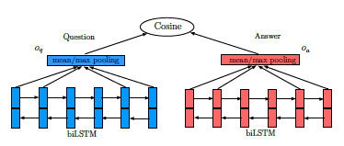
Hypothesis/Goals
QA-LSTM
Question Answer processed separately
Compute cosine similarity

Slide 17
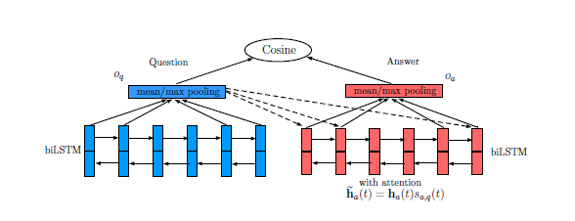
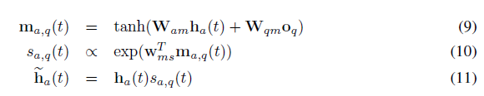
Hypothesis/Goals
ATTENTION QA-LSTM
Attention mechanism
Dynamically aligning the informative part of the the answers to the question

Slide 18
Methodology
Datasets
InsuranceQA
bAbI project
The 20 QA bAbI tasks
The 6 dialog bAbI tasks
The Children's Book Test
The Movie Dialog dataset
The WikiMovies dataset
The Dialog-based Language Learning dataset
The Simple Questions dataset
MCTest(Machine Comprehension Test) dataset
Children’s Book Test (CBT)
CNN/Daily Mail dataset

Slide 19
Methodology
SETUP(how to solve the problem)
Tensorflow on nvidia GeForce GT 730M
Python 3.5
Numpy, Sklearn, Matplotlib, Pandas, Bazel and Many more
Build biLSTM with attention
Compute Accuracies
Best epoch and best hyper-parameters

Slide 20
Implementation - design document and flowchart
The design for our project was divided into 3 parts.
Pre processing
Word2Vec generation(skip -gram)
RNN LSTM

Slide 21
data analysis and discussion
MCTest dataset is a free data set that has
660 stories each of which has approx 1800 questions
multiple questions and the each questions has 4 choices answer choice.
The data was gathered using Mechanical Turk.
Test data set 500 stories with 870 questions

Slide 22
James the Turtle was always getting in trouble. Sometimes he'd reach into the freezer and empty out all the food. Other times he'd sled on the deck and get a splinter. His aunt Jane tried as hard as she could to keep him out of trouble, but he was sneaky and got into lots of trouble behind her back.
One day, James thought he would go into town and see what kind of trouble he could get into. He went to the grocery store and pulled all the pudding off the shelves and ate two jars. Then he walked to the fast food restaurant and ordered 15 bags of fries. He didn't pay, and instead headed home.
His aunt was waiting for him in his room. She told James that she loved him, but he would have to start acting like a well-behaved turtle.After about a month, and after getting into lots of trouble, James finally made up his mind to be a better turtle.
1) What is the name of the trouble making turtle?
A) Fries
B) Pudding
C) James
D) Jane
2) What did James pull off of the shelves in the grocery store?
A) pudding
B) fries
C) food
D) splinters
3) Where did James go after he went to the grocery store?
A) his deck
B) his freezer
C) a fast food restaurant
D) his room
4) What did James do after he ordered the fries?
A) went to the grocery store
B) went home without paying
C) ate them
D) made up his mind to be a better turtle

Slide 23
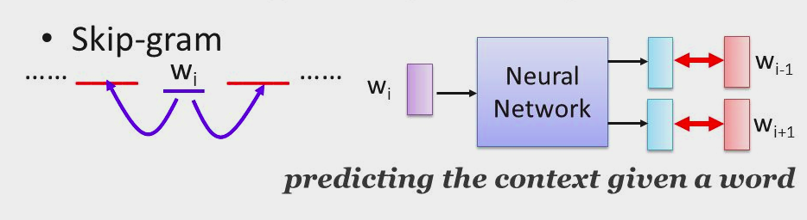
Implementation - design document and flowchart
Data Preprocessing → Data Cleaning, words, count, dict, index-word, data indexed
Word2Vec(skip -gram) - Unsupervised learning
Batch generation → skip_window, num_of_skips, batch_size = 128, embedding_size = 300
Train Word2Vec model → ip → data, labels (batch-wise)

Slide 24
Implementation - design document and flowchart
Output Generation:
SGM
Batch Generation
data: ['anarchism', 'originated', 'as', 'a', 'term', 'of', 'abuse', 'first'] with num_skips = 2 and skip_window = 1: batch: ['originated', 'originated', 'as', 'as', 'a', 'a', 'term', 'term'] labels: ['as', 'anarchism', 'a', 'originated', 'term', 'as', 'a', 'of'] with num_skips = 4 and skip_window = 2: batch: ['as', 'as', 'as', 'as', 'a', 'a', 'a', 'a'] labels: ['anarchism', 'originated', 'term', 'a', 'as', 'of', 'originated', 'term']

Slide 25
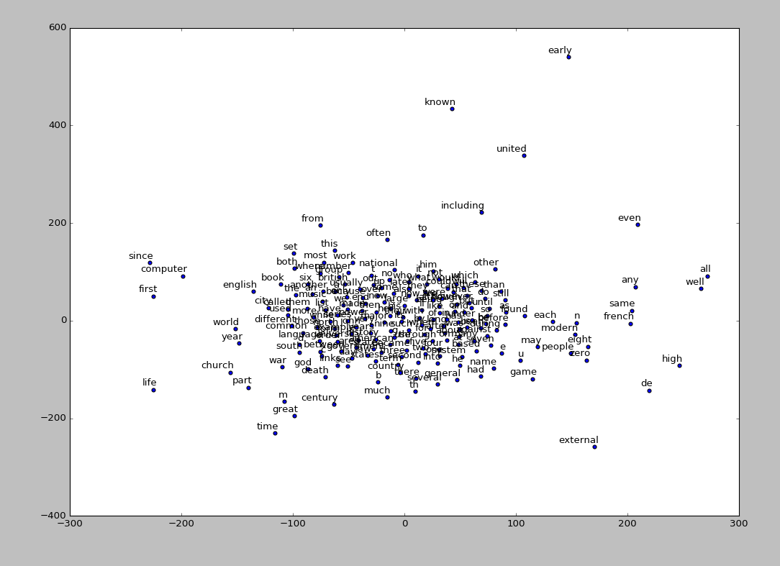
data analysis
and discussion
output analysis

Slide 26
data analysis and discussion
Nearest to eight: seven, nine, six, four, five, three, zero, two,
Nearest to he: she, it, they, there, who, we, this, never,
Nearest to i: we, he, they, mary, james, she, theirs, melanie,
Nearest to she: he, they, it, i, midnight, we, hugo, snowball,
Nearest to back: off, ended, over, down, out, beginning, toward, float,
Nearest to her: his, him, their, margaret, me, its, chili, twisted,
Nearest to this: it, which, he, some, checkerboard, another, the, amritsar,
Nearest to been: become, be, already, was, recently, whispering, successfully,
Nearest to they: we, there, he, you, she, it, i, not,
Nearest to new: different, turkic, boasted, various, neared, stabilizers, deviating,
Nearest to called: named, used, distorted, considered, referred, known, vat,
Nearest to where: what, twist, beneath, artist, toilet, needs, performances, liking,
Nearest to dog: cow, smashing, babysit, hazel, drawing, witch, owner, mouse,

Slide 27
data analysis and discussion - Word Vector
“The” =
[-0.10771623 -0.08713842 0.03231252 -0.04112959 0.12192853 -0.07375532
-0.10610349 -0.07409572 -0.06865577 0.10982385 -0.01932012 -0.01754871
-0.16242403 0.03091805 -0.0236611 0.10541121 -0.07797282 -0.13612035
0.12207355 0.02171865 0.07394247 -0.11968254 0.06995879 0.03491663
-0.03399706 -0.05675896 0.08352144 0.01521992 0.04700584 0.07544895
0.0640968 0.11520148 0.07608264 -0.04500199 -0.00302214 -0.18527462
-0.02382737 -0.05388832 -0.114457 0.10991409 0.02414727 -0.04109648
0.08787432 -0.02101789 0.10125949 0.04609177 0.11370094 0.04372771
-0.0659379 -0.06589786 -0.00867271 0.05946467 0.07290234 0.04426249
0.13086618 -0.08741179 -0.07464718 -0.06333015 0.06026197 0.075174
0.0508201 -0.02082717 0.09218703 -0.10563675 0.04679077 0.11095957
-0.07731143 0.11152226 -0.07129365 0.08438376 0.12295292 0.09770688
-0.00122607 0.12426439 -0.07705146 -0.15394074 -0.16196689 -0.13202338
-0.06771396 0.0601143 0.06370313 0.01014148 0.13391793 -0.0489469
-0.04469048 -0.15215459 -0.0948875 -0.04088889 0.11519375 -0.06214551
-0.01907888 0.08190431 -0.13345332 0.12041677 0.13335384 0.13318285
-0.03807592 0.07797729 -0.03598532 -0.12675062 0.00989356 0.12395485
0.15320043 0.18589878 0.14680894 -0.077112 -0.10406934 0.17178342
-0.04968555 -0.09107879 0.04756921 -0.09697314 -0.120592 -0.04015396
-0.15957788 0.03014262 0.06686283 0.04753253 0.01522197 0.10813337
-0.01357032 -0.05207205 0.04069532 -0.03321727 -0.0258834 0.05395871
0.03483186 -0.08999643]

Slide 28
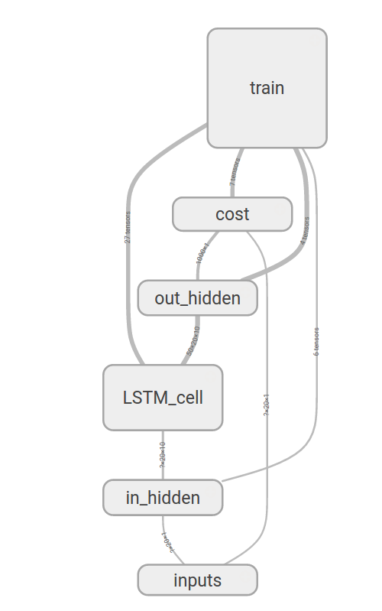
RNN LSTM

Slide 29
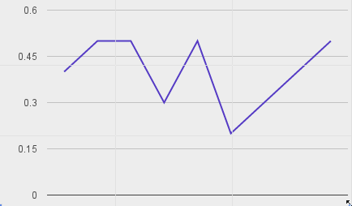
data analysis and discussion - Accuracy

Slide 30
Data analysis and discussion - why it went wrong
Learning curve and background knowledge needed → Huge!
Understanding neural networks. tensor flow learning.
2 RNN models - shared parameters
Tried Bi-lstm in tensor flow but faced lot of problems.
Finding the appropriate data set for our model added to the complexity- TREC-QA, Insurance-QA, BABI and MCTest data sets
Changes in the model design → LSTM model implemented.
The accuracy while training shows fluctuation in the range of 0.2 to & 0.7 instead of showing consistent increment.
Notes:
Hardware support, various rnn models. Which to chose. New field not much support online. The tensor flow bidirectional lstm not able to use as there was error that we were not able to resolve we have raised a bug resolve request to google tensor flow group but given the time frame we were not able to come up with are round about solution for the problem.
Also tried
Learnt neural network from scarcth
The neural network for NLP
Tensor flow
Complicated data sets = all data were indexed == for a question we have multiple answer

Slide 31
Conclusions and recommendations
Given the short time frame we were able to build a normal lstm neural network for answer prediction give a story and a question.
We got a accuracy between 20% to 70% .
We have understood that the neural rnn are the best suited model for question answering system.
future we want to implement stacked - bidirectional LSTM based RNN network to see how the performance of the system Increases.
Instead of using skip-gram model for Word2Vec generation we can probably use ‘GLOVE’ model which is proven to a better vector representation of word embedding.

Slide 32
Bibliography
D. Wang and E. Nyberg. A long short-term memory model for answer sentence selection in question answering. In ACL-IJCNLP, ACL 2015, July 26-31, 2015, Beijing, China, Volume 2: Short Papers, pages 707{712, 2015.
Daniel Cohen and W. Bruce Croft. “End to End Long Short Term Memory Networks for Non-Factoid Question Answering” ICTIR '16 Proceedings of the 2016 ACM International Conference on the Theory of Information Retrieval.
Tan, Ming; dos Santos, Cicero; Xiang, Bing; Zhou and Bowen. “LSTM-BASED DEEP LEARNING MODELS FOR NONFACTOID ANSWER SELECTION“. In eprint arXiv:1511.04108, 11/2015,
H. Palangi, L. Deng, Y. Shen, J. Gao, X. He, J. Chen, X. Song, and R. K. Ward. Deep sentence embedding using the long short term memory network: Analysis and application to information retrieval. CoRR, abs/1502.06922, 2015.
Wikipedia https://en.wikipedia.org/wiki/
Applying Deep Learning to Answer Selection: A Study and An Open Task Minwei Feng, Bing Xiang, Michael R. Glass, Lidan Wang, Bowen Zhou ASRU 2015
Jason Weston, Antoine Bordes, Sumit Chopra, Alexander M. Rush, Bart van Merrienboer, Armand Joulin & Tomas Mikolov “TOWARDS AI-COMPLETE QUESTION ANSWERING : A SET OF PREREQUISITE TOY TASKS”12/2015. https://arxiv.org/pdf/1502.05698v10.pdf

Slide 33
Bibliography
D. Bahdanau, K. Cho, and Y. Bengio, “Neural machine translation by jointly learning to align and translate,” ICLR2015, 2015. [Online]. Available: http://arxiv.org/abs/1409.0473
I. Sutskever, J. Martens, G. E. Dahl, and G. E. Hinton, “On the importance of initialization and momentum in deep learning,” in ICML (3)’13, 2013, pp. 1139–1147.
K. M. Hermann and P. Blunsom, “Multilingual models for compositional distributed semantics,” arXiv preprint arXiv:1404.4641, 2014.
Feng, Minwei, Xiang, Bing, Glass, Michael, Wang, Lidan, and Zhou, Bowen. Applying deep learning to answer selection: A study and an open task. IEEE Automatic Speech Recognition and Understanding Workshop (ASRU), 2015.

Slide 34


