Slide 1
Power Efficient Approximate Booth Multipliers for Error Resilient Applications
Suraj S Prakash , Naren Vilva, U. Anil Kumar and Syed Ershad Ahmed

Slide 2
Introduction
Approximate Computing : An emerging technique to reduce power, area and delay characteristics of computational systems at the expense of accuracy
Suitable for error-resilient applications such as Digital signal processing and Image processing
Multiplication is a fundamental operation in these application
Approximating this can provide significant hardware and power savings
1. El-Harouni, Walaa, Semeen Rehman, Bharath Srinivas Prabakaran, Akash Kumar, Rehan Hafiz, and Muhammad Shafique. ”Embracing approximate computing for energy-efficient motion estimation in high efficiency video coding.” In Design, Automation & Test in E
2. Venkataramani, S. T. Chakradhar, K. Roy and A. Raghunathan, ”Computing approximately, and efficiently,” 2015 Design, Automation & Test in Europe Conference & Exhibition (DATE), 2015, pp. 748-751, doi: 10.7873/DATE.2015.1113.

Slide 3
Introduction
Booth multiplication
Commonly used algorithm for signed multiplication
Scope for approximation in the partial product generation & accumulation stages
Proposed work focuses on
Manipulating the bit-probability of partial products using approximate compressors
Reducing number of accumulation stages by perforation and rounding of partial product bit based on a probability threshold(Probabilistic analysis)

Slide 4
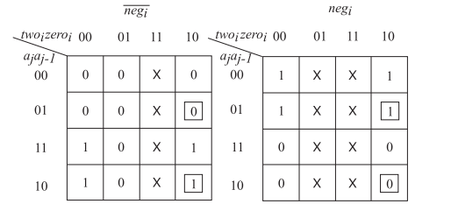
Related Work
ABM & R4ABM
Approximation in the partial product generation stage for Radix-4 Booth encoder
Modified the K-map to produce a simplified generator equation
Used in conjunction with perforation and rounding techniques
Applied only to the LSB portion to minimize error
Fig 1: K-map of the approximate partial product encoder
4. Venkatachalam, Suganthi, Elizabeth Adams, Hyuk Jae Lee, and Seok-Bum Ko. ”Design and analysis of area and power efficient approximate booth multipliers.” IEEE Transactions on Computers 68, no. 11 (2019): 1697-1703.

Slide 5
Related work
Approximate Wallace Tree multiplier (Qian et al, 2016)
Developed an approximate radix-4 booth encoder and one approximate 4:2 compressor.
Bits generated from the approximate encoder are used only in the LSB portion of wallace tree, along with the approximate compressor.
Decreased error while providing reasonable hardware and power savings.
Low-Power Approximate Multipliers (Ansari et al, 2018)
Designed bit-probability aware approximate compressors to for 4x4 multipliers with varying accuracies.
5. L. Qian, C. Wang, W. Liu, F. Lombardi and J. Han, ”Design and evaluation of an approximate Wallace-Booth multiplier,” 2016 IEEE International Symposium on Circuits and Systems (ISCAS), 2016, pp. 1974-1977, doi: 10.1109/ISCAS.2016.7538962.
6. M. S. Ansari, H. Jiang, B. F. Cockburn and J. Han, ”Low-Power Approximate Multipliers Using Encoded Partial Products and Approximate Compressors,” in IEEE Journal on Emerging and Selected Topics in Circuits and Systems, vol. 8, no. 3, pp. 404-416, Sept. 2018, doi: 10.1109/JETCAS.2018.2832204.

Slide 6
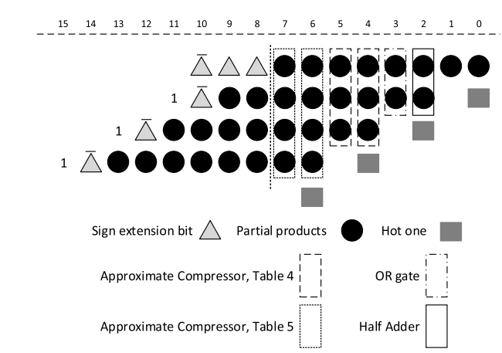
Related work
Fig 2. Using approximate compressors in a wallace tree

Slide 7

Proposed Work
Error-configurable Approximate compressors
Probability of occurrence of partial product bit 0 🡪 ⅝ & 1 🡪 ⅜
Used to compute probability of o/p occurrence given input bits
Equation used:
Alteration of 4:2 compressor K-map based on o/p probability to create 4 novel compressors of varying accuracy and simplification
Higher error rate 🡪 Higher degree of simplification 🡪 Used near LSB region
Lower error rate 🡪 Lower degree of simplification 🡪 Used near MSB region

Slide 8
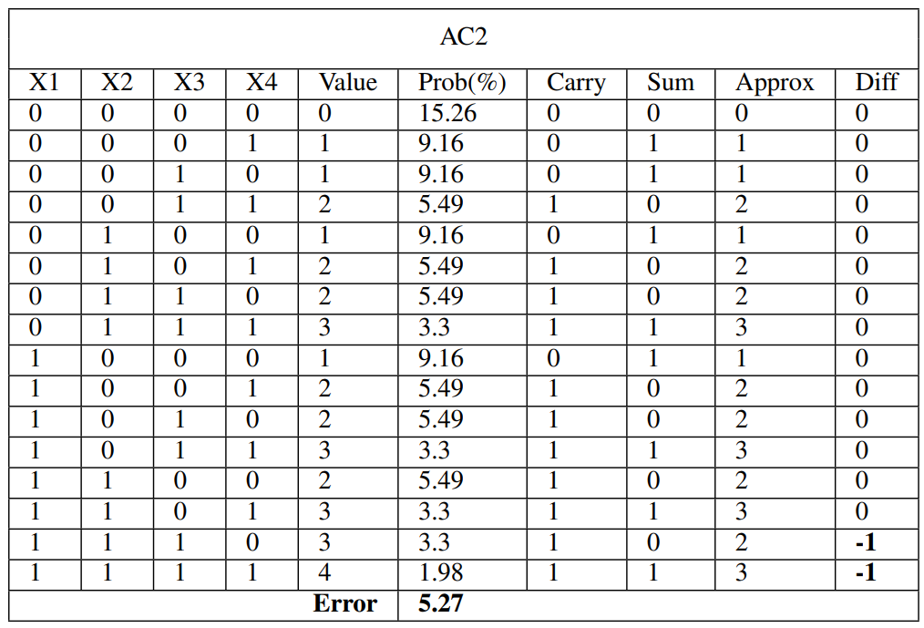
Proposed Work
Example: compressor AC2
2 changes in the K-map : ‘1110’ & ‘1111’ entries
1110 prob = ⅜ * ⅜ * ⅜ * ⅝ = 3.30%
1111 prob = ⅜ * ⅜ * ⅜ * ⅜ = 1.98%
Overall error % = 5.27%
Overall, 4 compressors were designed with error rates 1.98%, 5.27%, 7.47, 10.77%
Fig 3. Approximate compressor AC2, with 2 K-map modifications

Slide 9
Proposed Work
Probabilistic Analysis for Approximation
Significant savings can be achieved by reducing the number of partial product reduction stages
Fewer bits to compress 🡪 Fewer reduction stages
Probability of compressor outputs is known
🡪 Bits with high chance of being 0 can be effectively removed !
Depending on the bits removed, it can result in the removal of an entire partial product reduction stage
Probability threshold for bit removal to be balanced with impact on overall error rate

Slide 10
Proposed Work
Using the previous 2 techniques, 3 multipliers AxBM1, AxBM2, AxBM3 were proposed.
Each design uses a different combination of the 4 compressors and different thresholds for bit removal.
Use of approximate compressors restricted to first p bits of the LSB
AxBM1:
Aggressive use of approximate compressors, with bit removal threshold of 8.3%
2 compression stages removed
AxBM2:
Balanced use of approximate compressors, and no bit removal employed
0 compression stages removed
AxBM3:
Uses approximate compressors, with a low bit removal threshold of 1%
1 compression stage removed

Slide 11
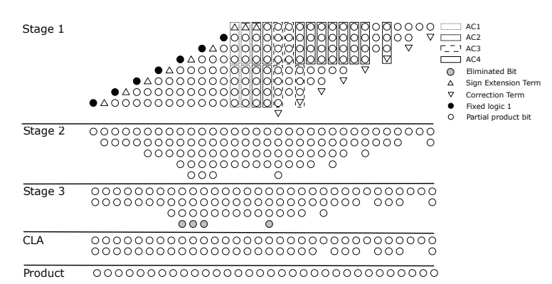
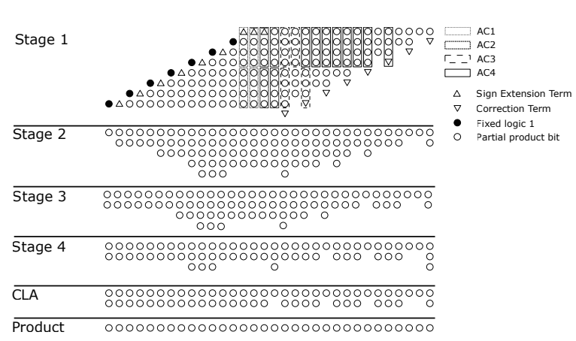
Proposed Work
Fig 4. PP tree for AxBM1
Fig 5. PP tree for AxBM2
Note: Use of different approx compressors results in trees with varied probabilities, which has to be analysed to decide an appropriate bit removal threshold, if required.

Slide 12
Results
Three approximate multiplier designs were proposed, with varying degrees of approximation
Evaluation of the proposed design is done across three domains:
Error Analysis : To test the design accuracy in comparison to a completely accurate model as well as models from related works
Synthesis Results : To calculate the power, area consumed and latency the design produces
Application Analysis: To test the design efficacy by using a standard image processing application

Slide 13
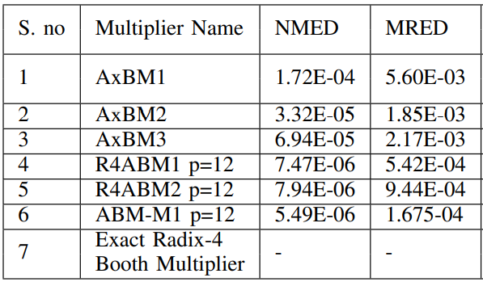
Results (Contd…)
Error Analysis
MATLAB framework used to design the approximate multiplier designs.
10⁶ random input combinations were generated to obtain MRED and NMED
The 3 designs show comparable error rates, albeit marginally higher than the existing works.
Fig 6. Error metrics of proposed approximate multipliers and other existing designs

Slide 14
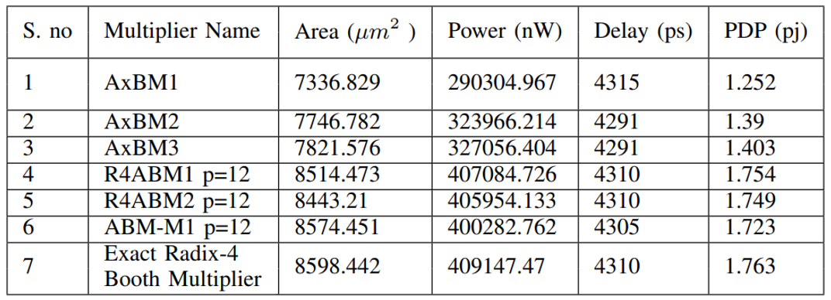
Results (Contd…)
Synthesis Results
Verilog HDL employed to design the proposed approximate multipliers
Hardware synthesis carried out at TSMC 90 nm process node using Cadence RTL compiler v7.1
AxBMs show significant PDP savings over the existing works, with 20% less PDP on average, compared to the maximum savings of 2.26% from ABM-M2.
Marginal increase in error rate outweighed by savings in power and area metrics.
Fig 7. Synthesis results of proposed approximate multipliers and other existing designs

Slide 15
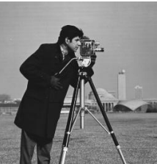
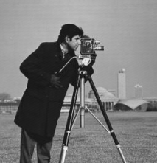
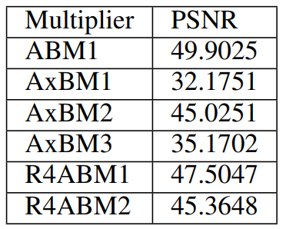
Results (Contd…)
Benchmarking Application: JPEG image compression
To prove efficacy of the proposed design the image processing application : JPEG image compression is employed.
MATLAB framework is used to apply JPEG compression.
Peak Signal to Noise Ratio (PSNR) is sued as the primary metric for comparison.
Proposed design AxBM2 achieves comparable PSNR to existing designs.
Fig 8a. Exact Output
Fig 8b. AxBM2 Output
Fig 9. PSNR of approximate multipliers and other existing multipliers

Slide 16
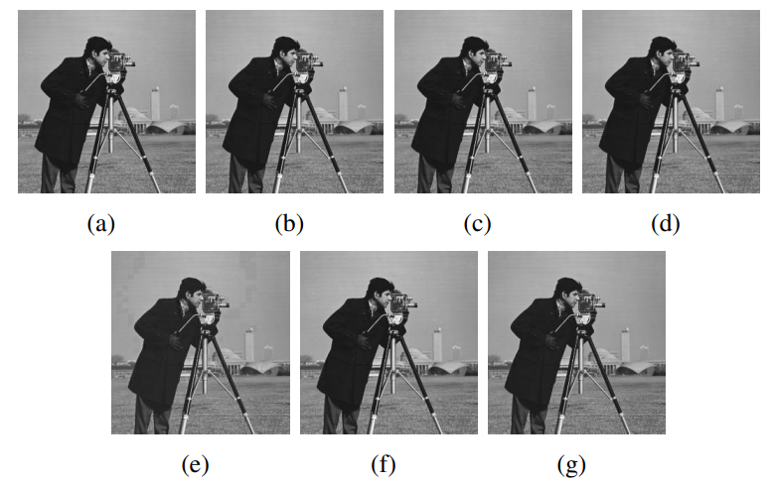
Results (Contd…)
Fig 10. Images generated by using (a) Input image (b) ABM1 (c) R4ABM1 (d) R4ABM2 (e) AxBM1 (f) AxBM2 (g) AxBM3

Slide 17
Conclusions
Approximate multipliers AxBM1, AxBM2, AxBM3 aimed at reducing hardware complexity of signed multiplication with minimal degradation in output quality is proposed.
Exhaustive error and hardware synthesis analysis proved that the proposed design AxBM2 achieves comparable error metrics while providing the best sayings in power,area and delay.
Trade-off between hardware savings and error rate is demonstrated and justified in the JPEG compression algorithm.

