Slide 1
Introduction to C++
C++ programming language was developed in 1980 by Bjarne Stroustrup at bell laboratories of AT&T (American Telephone & Telegraph), located in U.S.A.
Bjarne Stroustrup is known as the founder of C++ language.
C++ was initially known as “C with classes” and was renamed C++ in 1983
C++ language is a superset of C Language.
It was develop for adding a feature of OOP (Object Oriented Programming) in C without significantly changing the C component.

Slide 2
Overview Of C++
C++ is a general purpose, high level, compiler based and object oriented programming language.
Why C++ is called general purpose language. ?
C++ can be used to designing software in wide variety of categories.

Slide 3
OS (Eg:Dos,Windows,Unix,Linux)
Editors (Eg:Notepad,Wordpad)
Commercial Application (Eg:Banking,Super Market,Hotel related softwares)
C++
Translator Software (Eg:Compiler,Interpreter,Assembler)
DataBase (Eg:Oracle,MySql,Sql Sever)
Device Driver(Eg:Printers ,Network cards,Sound cards,Graphic cards)
Protocols (Eg:Http,FTP)
Using C++ we are able to design different types of software. That’s why C++ is called general purpose or multipurpose language.

Slide 4
C++ uses compiler to convert source code into machine or object code, That’s why C++ is called compiler based programming language .
C++ follows object oriented programming concepts.
Object Oriented Programming is a paradigm that provides many concepts such as:
Object
Class
Inheritance
Polymorphism
Abstraction
Encapsulation

Slide 5
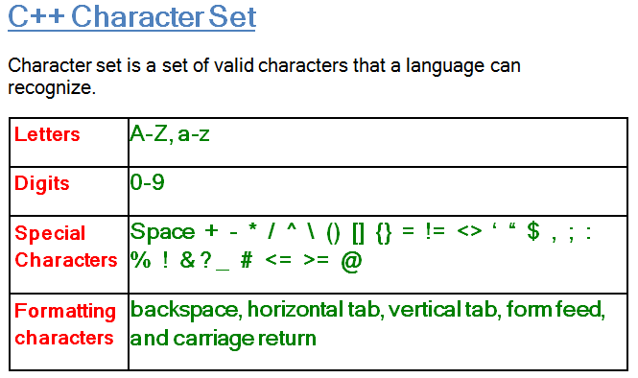
C++ Basic Elements
Programming language is a set of rules, symbols, and special words used to construct programs. There are certain elements that are common to all programming languages.

Slide 6
C++ Tokens
A token is a group of characters that logically belong together. The programmer can write a program by using tokens.
The smallest individual unit in a program is known as Token.
C++ has the following Tokens
Keywords
Identifiers
Literals
Punctuators
Operators.

Slide 7
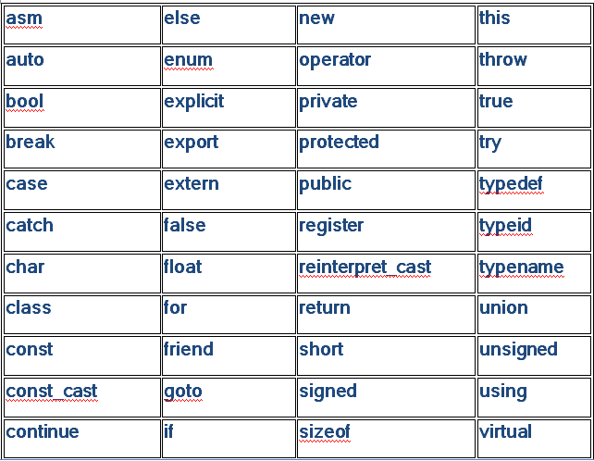
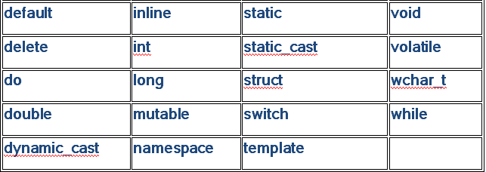
Keywords
These are some reserved words in C++ which have predefined meaning to compiler called keywords.

Slide 8
Identifiers
It is a name used to represent a variable constant, array name, function name, class, object etc.
There are certain rules for defining a valid C++ identifier. These rules must be followed, otherwise we get compile-time error.
An identifier can consist of alphabets([A-Z],[a-z]), digits([0-9]) and ‘_’ (underscore).
Identifiers should not start with digits([0-9]). For example “123stud” is a not a valid C++ identifier.
C++ is case sensitive that is upper case and lower case letters are considered different from each other.
Reserved Words can’t be used as an identifier. For example “int while = 50;” is an invalid statement as while is a reserved word.

Slide 9
Constants
A value which remain constant throughout the program execution is known as constant. An identifier can be declared as a constant as illustrated below:-
# define MAX 100
# define PI 3.14
const int MARKS=70;
const m=35;
Literals
The constant values used in C++ are known as literals.
For Eg:
const int num =7; is a constant expression and the value7 is refered to as constant integer literal.

Slide 10
There are four type of literals namely.
i) Integer constant:- A value written without fraction part is known as integer constant.
Example: 35, -674, 0 etc.
Floating constant:- A value written with fraction part is floating value. Value of this type can be written with or without exponent form.
Example: 2.34, -9.2154, 1.21E10
iii) Character constant:- A single character written within single quotation marks is known as character constant.
Example: ‘a’, ‘9’, ‘$’ , ‘p’ etc
iv) String constant:- It is an array of characters enclosed in double quotation marks. Example: “kukreti”, “09-july-2020”.

Slide 11
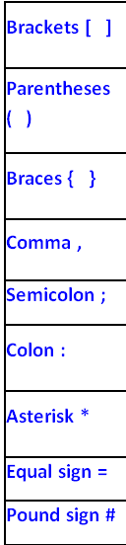
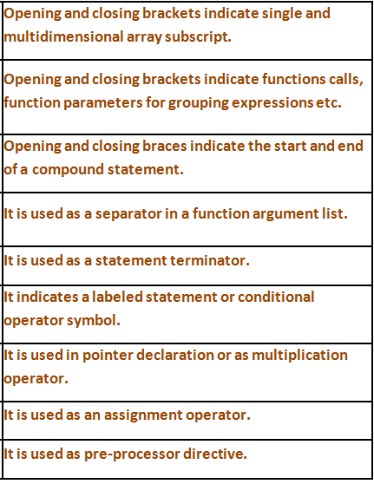
Punctuators
The following characters are used as punctuators (also known as separators) in C++.

Slide 12
Operator
C++ operator is a symbol that is used to perform mathematical or logical manipulations.
Arithmetic Operators
Increment and Decrement Operators
Relational Operators
Logical Operators
Bitwise Operators
Assignment Operators
Misc Operators

