Slide 1
ResearchNode
A GraphRAG Reasoning Engine for Scientific Literature
Team leader: Suraj Singh
Members: Suraj Gupta, Siddhant Singh, Shreya Yadav, Shreyanshi Yadav
Project Id: 26_CS_3A_08
Date: 07-09-2026

Slide 2
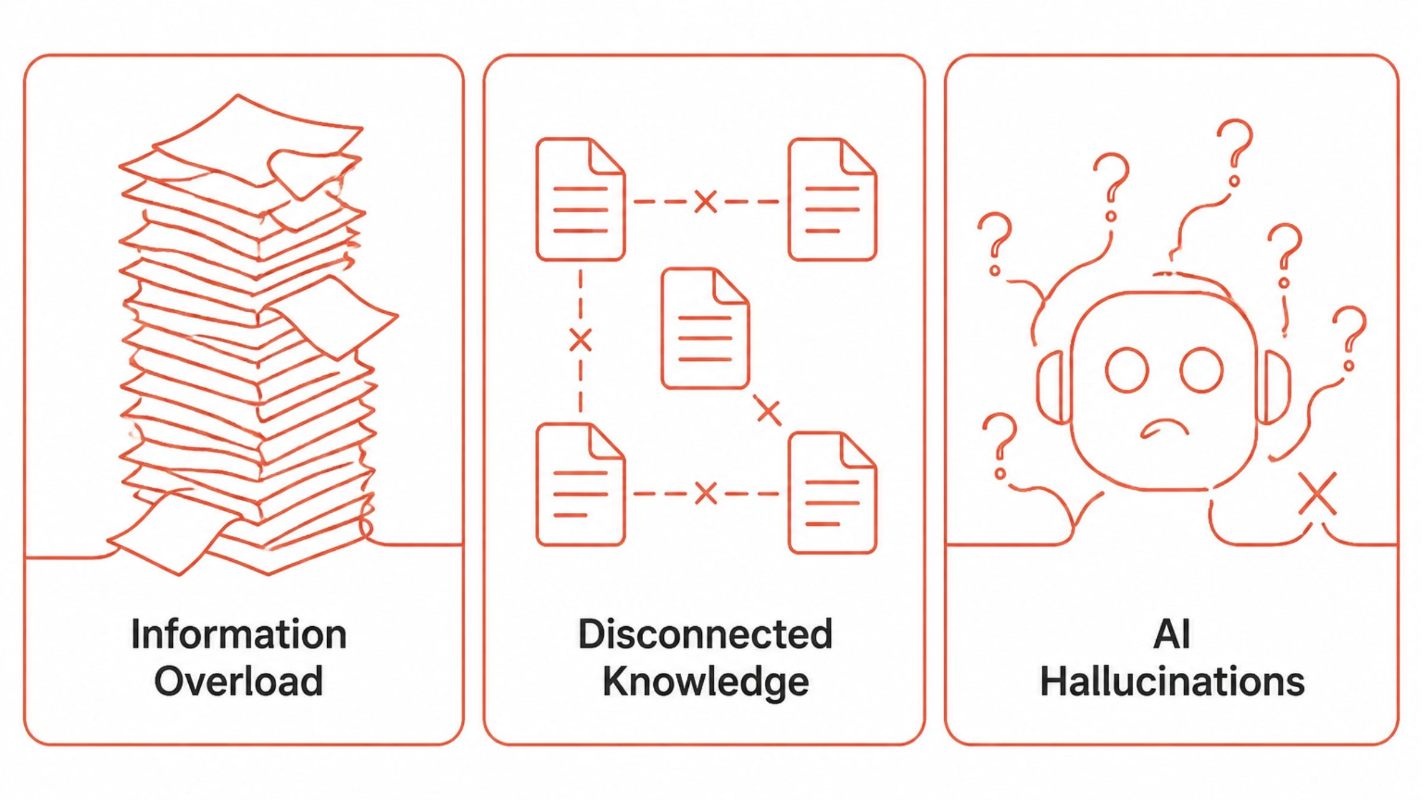
The Problem: Why ResearchNode?
Information Overload: Millions of papers published yearly — impossible to read all
Disconnected Knowledge: Google Scholar finds papers but cannot connect ideas or show relationships
AI Hallucinations: ChatGPT makes up facts, provides no verifiable citations, doesn't work on YOUR papers

Slide 3
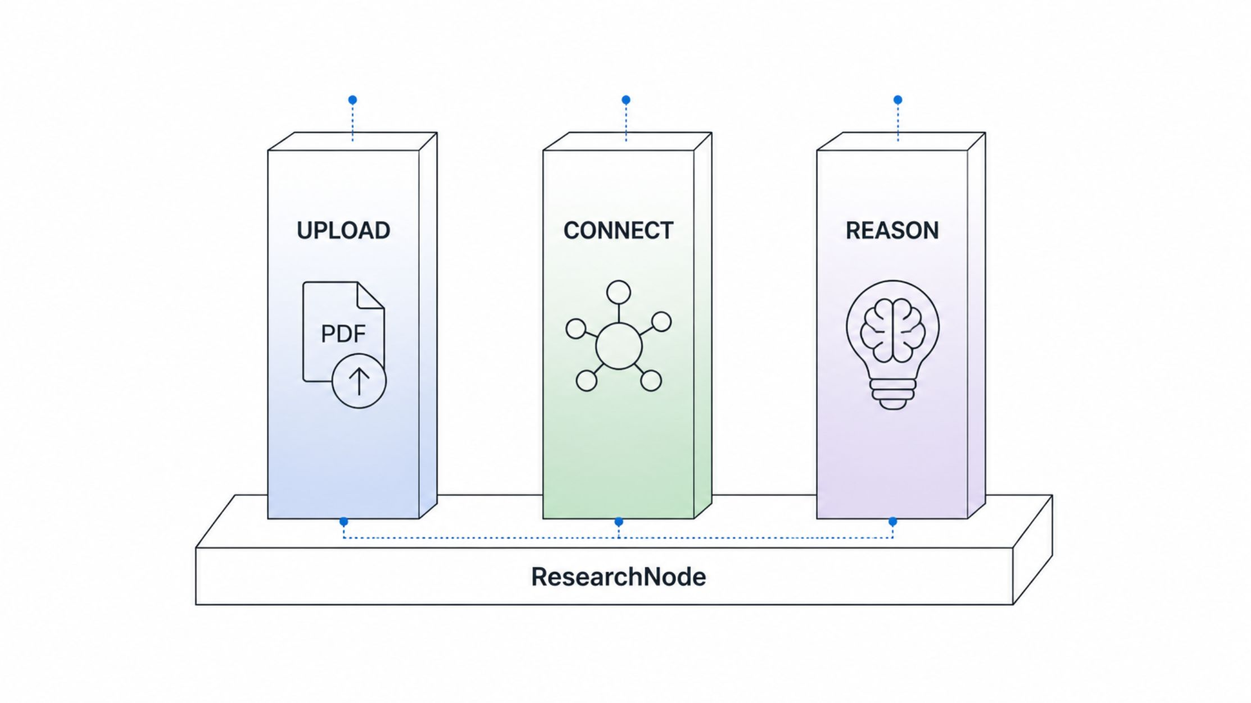
Our Solution Overview
ResearchNode: 3 Pillars
UPLOAD: Extract text and entities from PDFs automatically
CONNECT: Build a persistent visual Knowledge Graph linking all concepts
REASON: Ask questions using GraphRAG and get cited answers + run autonomous agents

Slide 4
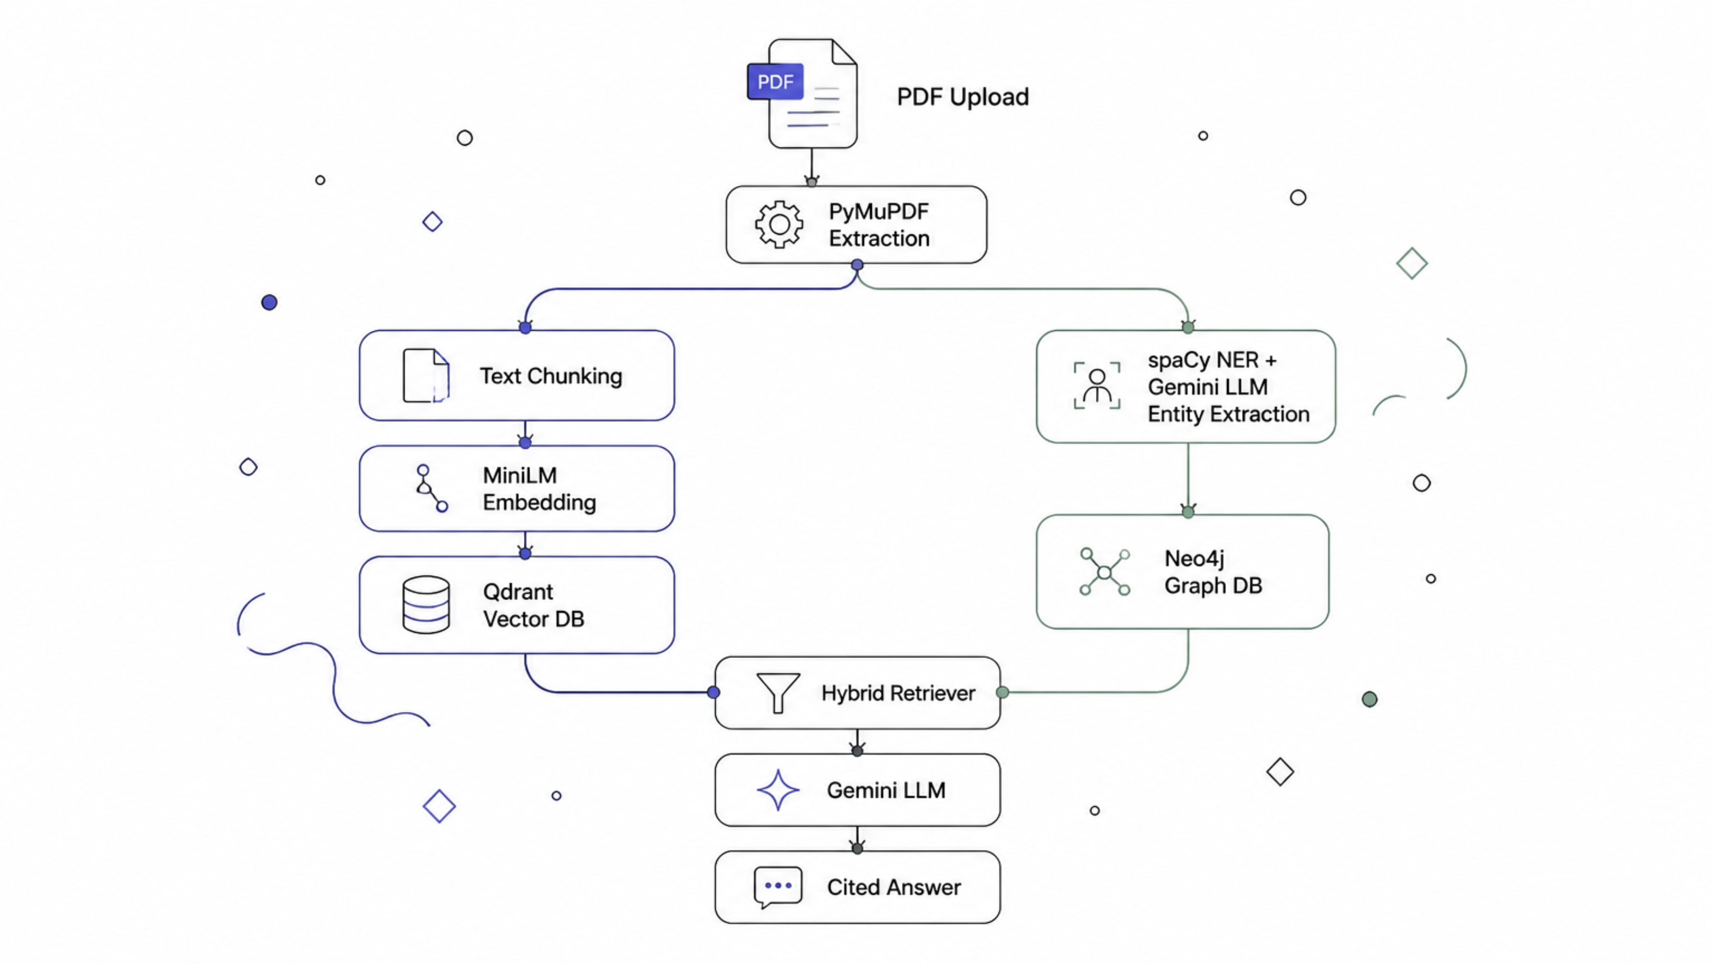
Full Pipeline Architecture

Slide 5
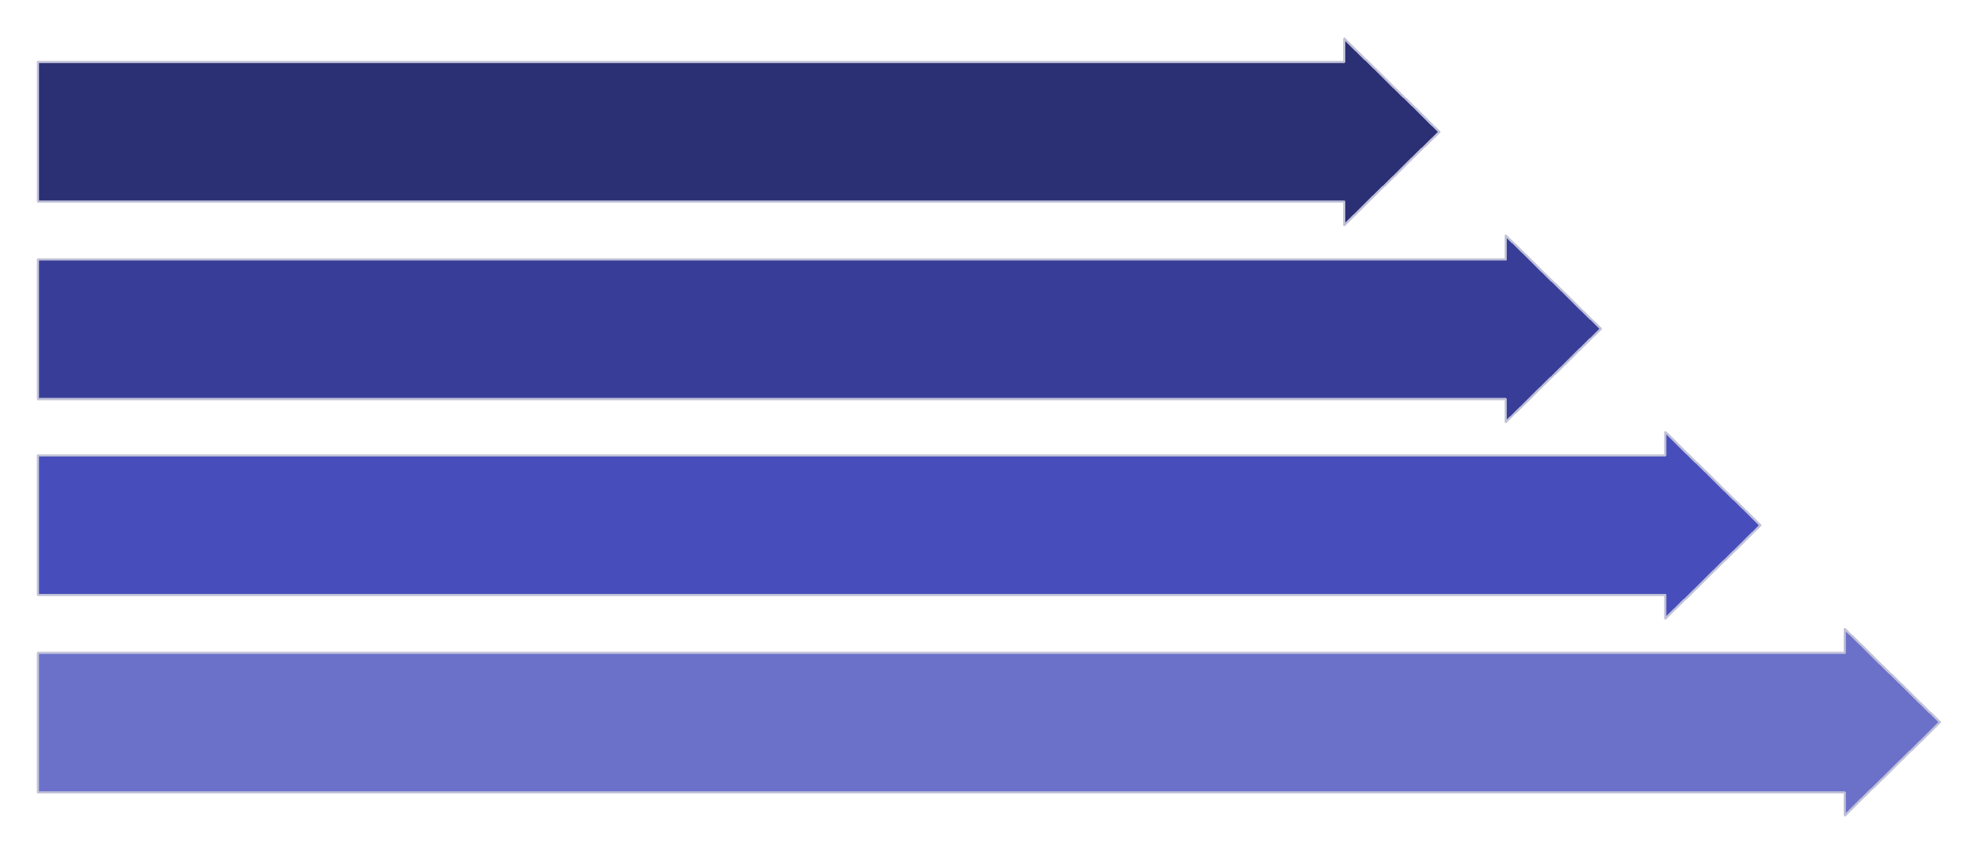
PDF Processing Pipeline
From Raw PDF to Searchable Vectors
Raw PDF → PyMuPDF extracts text
TextCleaner removes noise (headers, footers, special chars)
TextChunker splits into 1000-char chunks with 200-char overlap
Each chunk gets a 384-dimensional embedding vector
Raw PDF
Clean Text
Overlapping Chunks
384‑D Embeddings
This pipeline systematically processes raw PDF documents into structured, searchable vector embeddings,
enabling efficient analysis and retrieval.

Slide 6
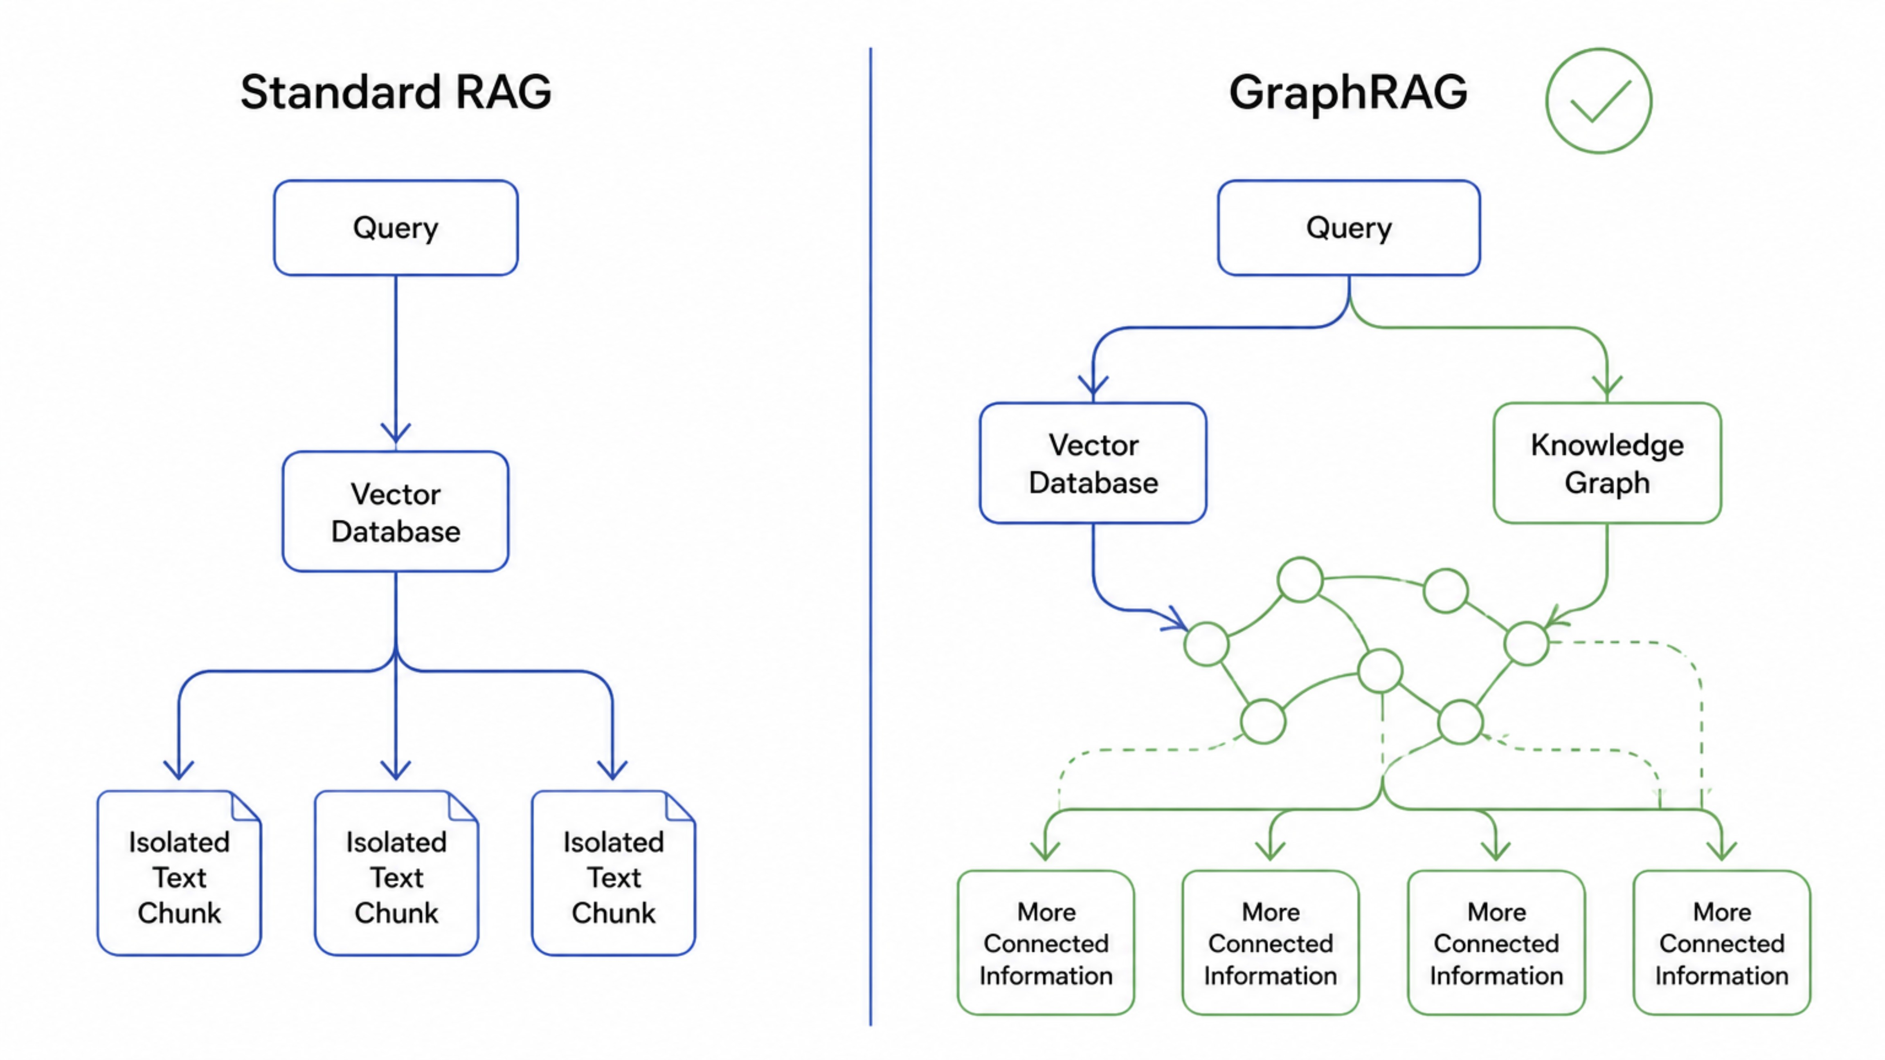
Why GraphRAG? The Innovation

Slide 7
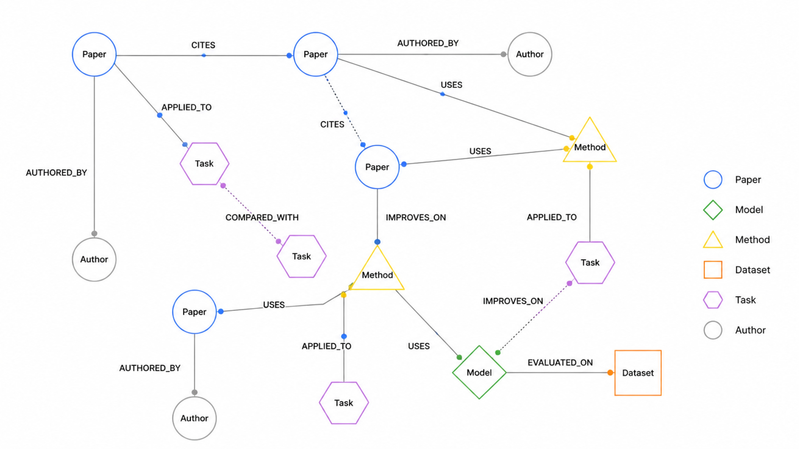
Knowledge Graph: Nodes & Relationships

Slide 8
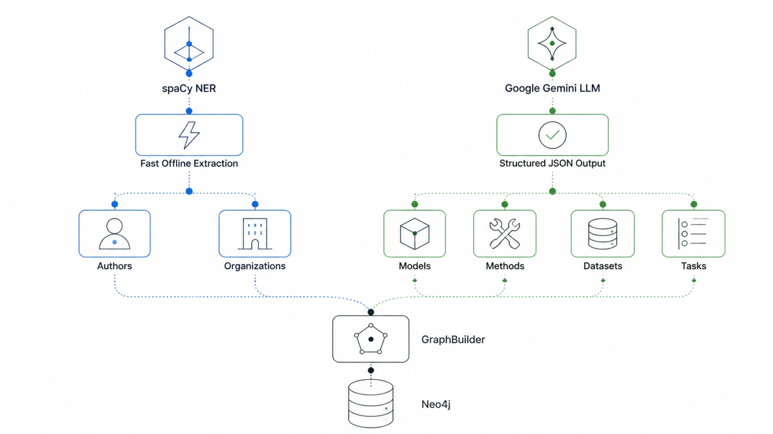
Hybrid Entity Extraction Approach

Slide 9
Multi-Agent System: 3 Autonomous AI Agents
Our system leverages three specialized AI agents working in concert to revolutionize research analysis:
Literature Discovery Agent
Contradiction Detection Agent
Experiment Suggestion Agent
Input topic → outputs related papers, relationship summary, suggested reading order
Scans papers globally → finds conflicting claims → outputs severity (High/Medium/Low)
Analyzes limitations + future work → outputs experiment title, rationale, novelty score (1-10)

Slide 10
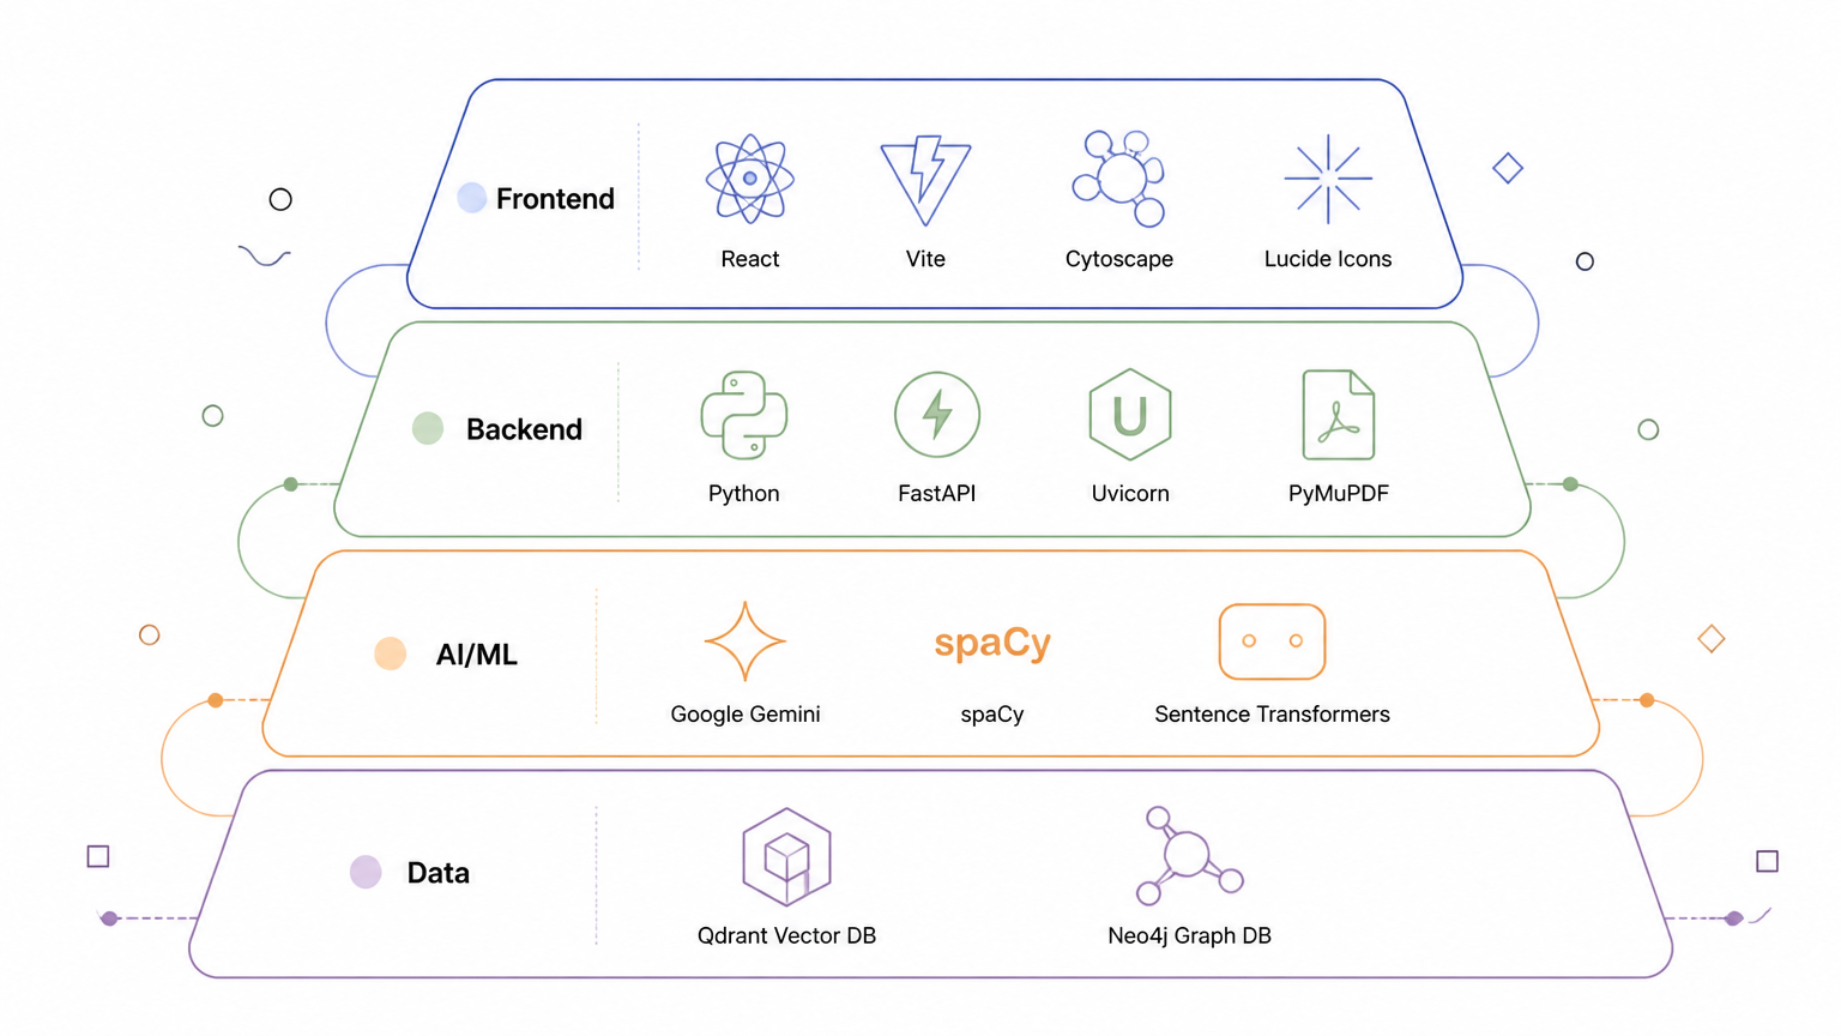
Complete Technology Stack
Our ResearchNode platform is built upon a robust and modern technology stack, ensuring scalability, performance, and advanced functionality across all layers.

Slide 11
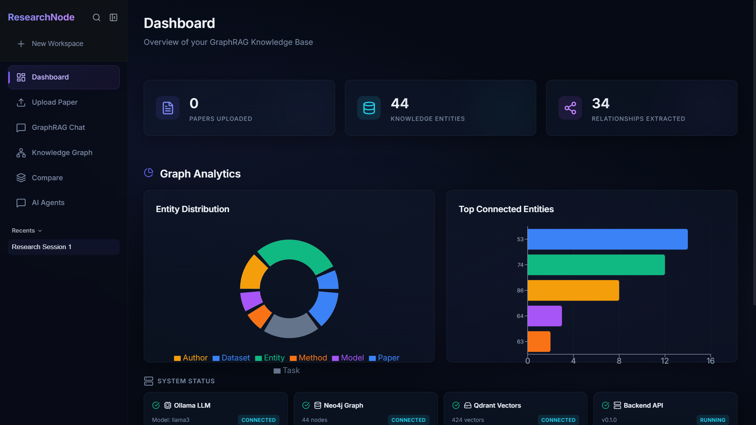
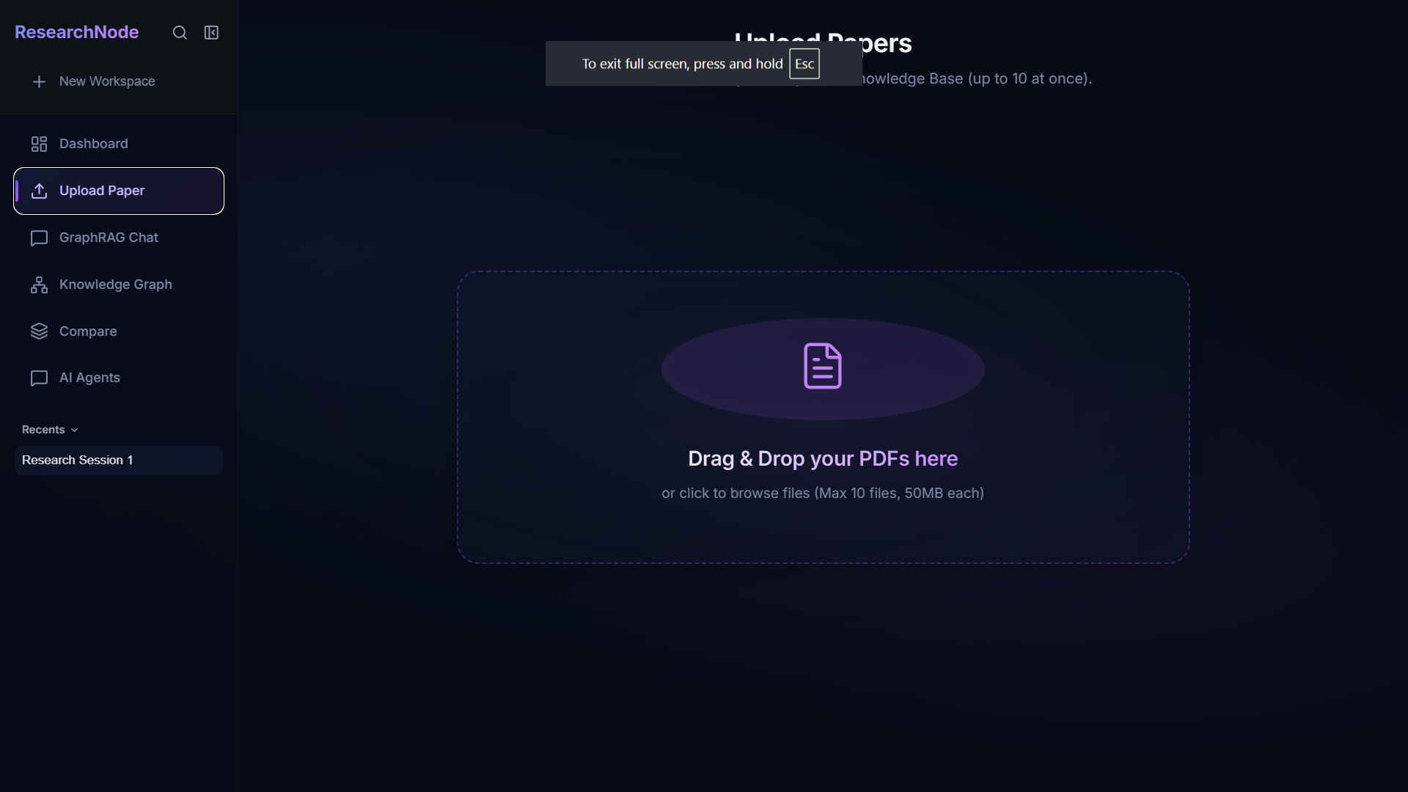
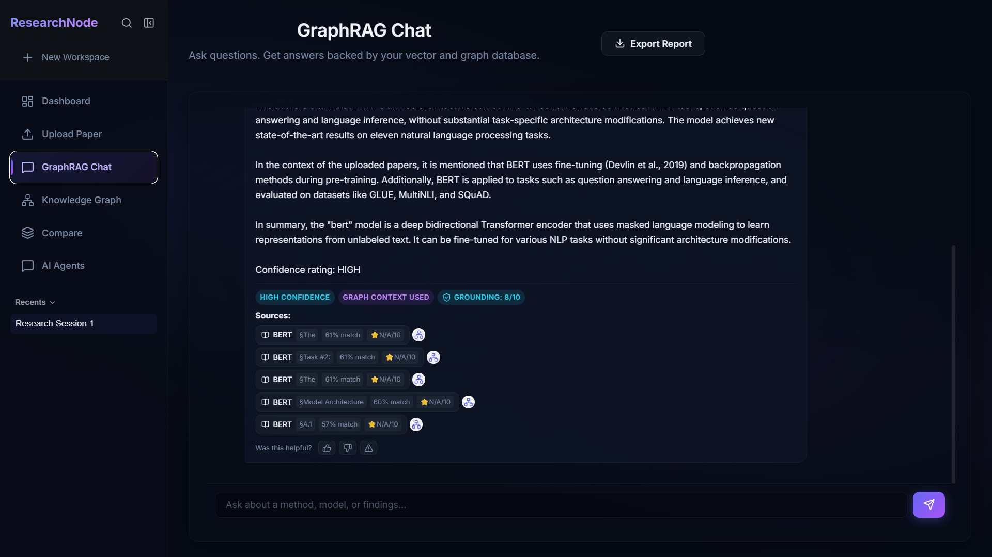
            User Interface: 4 Main Pages

Slide 12
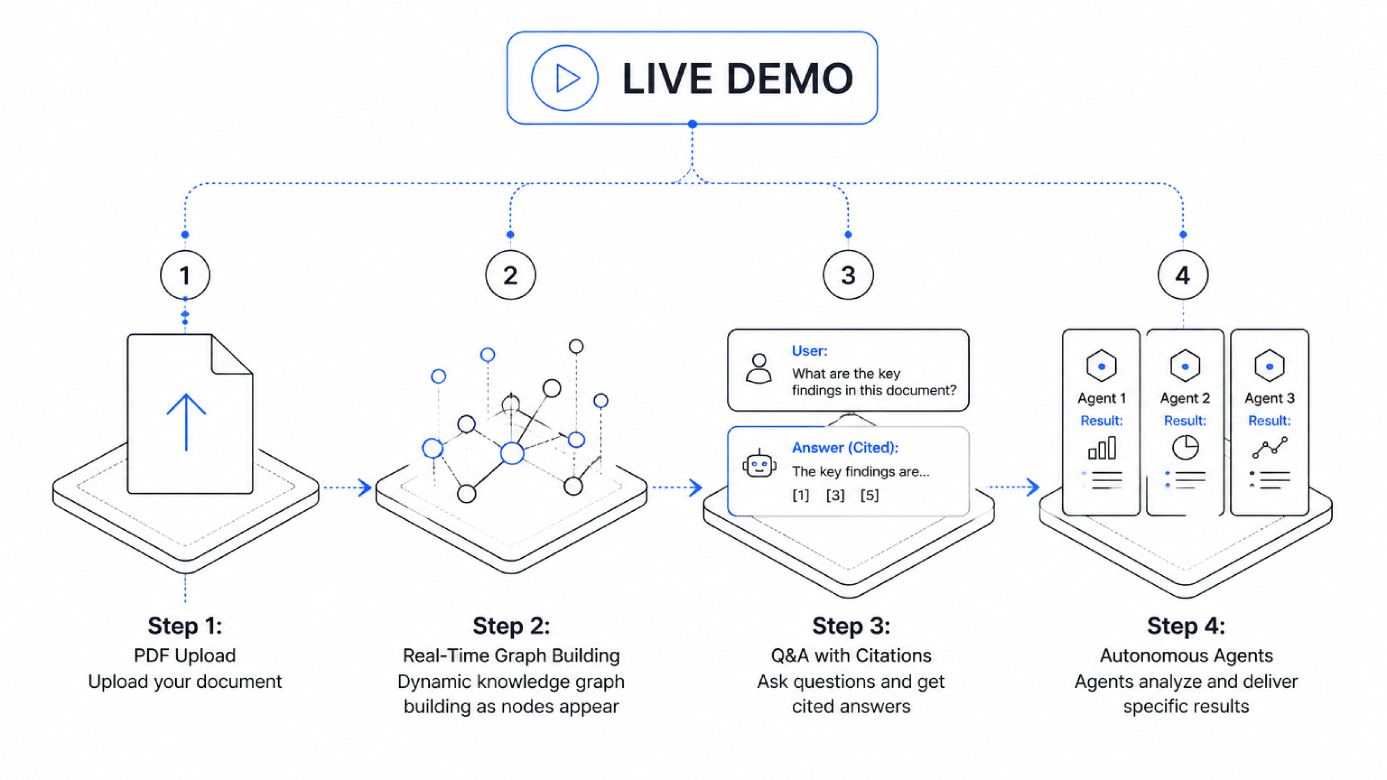

Slide 13
Performance Targets & Benchmarks
Our system consistently meets stringent performance targets, ensuring efficiency and responsiveness across all key operations:
PDF Extraction
Embedding
Vector Search
20 pages: < 5 seconds ✓
50 chunks: < 10 seconds ✓
Top-10: < 500ms ✓
Graph Query
Full RAG Response
< 2 seconds ✓
< 15 seconds ✓
System Specifications & Limits
Metric | Limit
Max PDF size | 50 MB
Max papers | 50
Max vectors | 10,000
UI responsive | ≥ 1024px

Slide 14
Limitations & Future Roadmap
Limitations
Future Scope
Entity extraction not 100% accurate
Real-time arXiv/PubMed integration
Works best with ML/AI papers
Cloud deployment (AWS/GCP)
Requires local database instances
Multi-user collaborative workspaces
English-only support
Fine-tuned domain-specific extraction models
Needs 3-5 papers minimum for meaningful graph
Zotero/Mendeley integration

Slide 15
Thank You!
We're ready for your questions

