Slide 1
CS 725 Project
Music Generation using Deep Learning
Sounak Bhattacharya (183050014)
Suraj Kumar (18305R008)
Sahil Patki (183059002)

Slide 2
INTRODUCTION
The proposed system generates music using sequence-to-sequence models like RNN, LSTM. It uses MIDI music files as training data. Various preprocessing tasks are performed on the MIDI files before feeding to the model. Finally the music of any length can be generated using the trained model.

Slide 3
ARCHITECTURE
MIDI
PIANO ROLL
MODEL SPECIFIC
INPUT
SEQUENCE-SEQUENCE
MODEL (RNN, LSTM)
MIDI
PIANO ROLL
MODEL SPECIFIC
OUTPUT

Slide 4
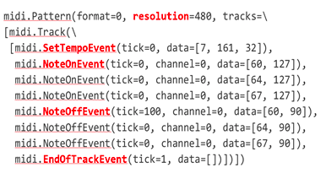
MIDI Format

Slide 5
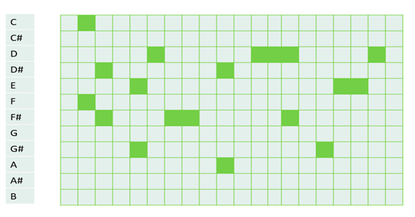
PIANO ROLL
note
time

Slide 6
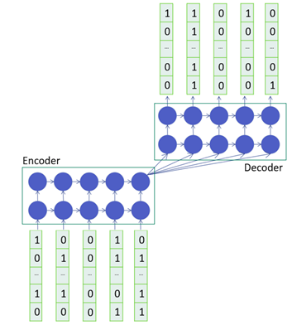
SEQUENCE-SEQUENCE MODEL

Slide 7
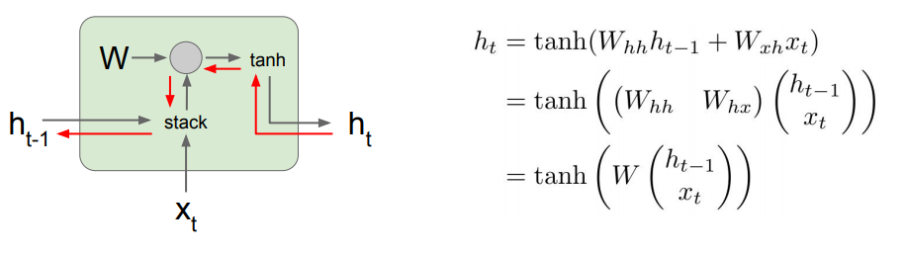
RNN

Slide 8
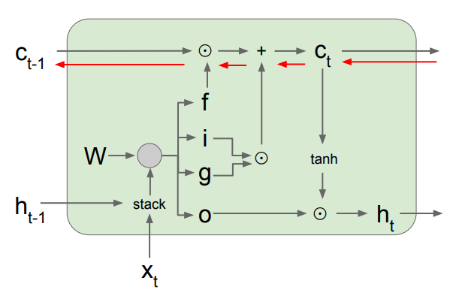
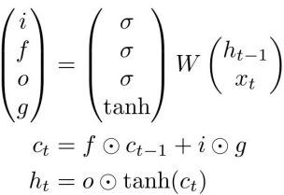
LSTM

Slide 9
COMPARISON (RNN vs LSTM)
Music generated by LSTM is more melodious and smoother than that generatd by RNN.
Vanishing gradient problem observed in RNN.

Slide 10
DATASET
SCALE-CHORDS Dataset
  Contains 156 songs
  Covers 13 most important western scales and modes
  License: https://feelyoursound.com/scale-chords/license/

Slide 11
LIMITATIONS
Same note is being repeated in contiguous manner.
Music generated is of single instrument only (Piano)
Lots of pre-processing and post-processing is required to generate the music

Slide 12
Enjoy Music!
DEMO..

Slide 13
REFERENCES
MIDO Library: https://mido.readthedocs.io/en/latest/midi_files.html
Keras: https://keras.io/
Python: https://docs.python.org/3/

