Slide 1
Product Adoption &
Value Realization
Is what customers bought actually being used —
and what is the gap worth?
Suraj Iyer

Slide 2
INTRODUCTION
Three themes define my career
Senior Product Manager, Microsoft 365 Data Platform. Ten years building data and ML platform products.
Mu Sigma → Bing Ads → Azure Messaging → Microsoft 365. The measurement layer other teams build on.
Customer
Centricity
Platform
Thinking
Learning
“Building large platforms and data products that solve customers' problems, while I keep learning, is what I love — and that's what brings me here today.”

Slide 3
CONTEXT & PROBLEM
Three questions a software business answers precisely. The fourth is the hard one.
What do we sell?
✓
Every SKU, every feature, catalogued
The fourth question is the only one that tells you whether the first three will still be true next year.
How much did we sell?
✓
To the dollar, to the unit
Who did we sell it to?
✓
Segment, region, industry, contract terms
Revenue tells you what a customer bought.
It doesn't tell you whether it mattered.
What are they doing with it?
✗
No shared definition, no shared number
More than half of what customers buy never converts into use — and nobody sees it until the renewal call.
By then the only lever left is a discount. I'll show you exactly how I get to that number — and you should hold me to it.

Slide 4
THE FRAMEWORK
Value Realization Rate (VRR) is occupancy
VRR = % of their features they use × % of their capacity they use
Everything Acme could get from this SKU is a square. They occupy 26% of it.
Acme Financial · $100k/year · 4 features · 10M credits · monthly
all features →
Features they use
1 of 4, value-weighted
33%
unused headroom · $74k a year on this one account
Capacity they use
667k of 833k credits
80%
Share of the square
33% × 80%
26%
26%
They bought a platform and deployed a point tool. Neither number catches that alone.
all capacity →
100% is not the target.
It is not a grade.
An account at 100% has no headroom left — they are under-provisioned, not healthy. It is an upsell signal.
A low score is unclaimed value you have already sold. The empty part of the square is the opportunity.

Slide 5
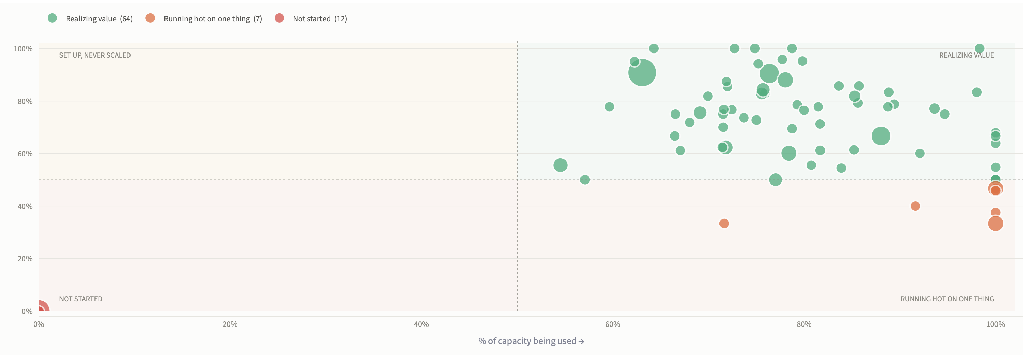
THE FRAMEWORK
The same score, four different problems
A single number tells you an account is at 26%. The two factors tell you which of four conversations to have — and who should have it.
Not started
12 accounts · $3.9M
Deployment rescue · CS leadership
Running hot on one thing
7 accounts · $1.5M
They will hit the cap and renegotiate on price · Sales + Product
Set up, never scaled
thin at this threshold
Enablement — why hasn't volume grown? · Customer Success
Realizing value
64 accounts · $7.8M
Expansion conversation · Sales
Bottom-left is a rescue. Bottom-right is a pricing conversation waiting to happen. Top-left is an enablement gap. Top-right is where expansion comes from.
Live in the dashboard, and the threshold is a slider — so “high” is a dial, not a decree. Bubble size is contract value; hovering gives the account, its score, and what it is worth.

Slide 6
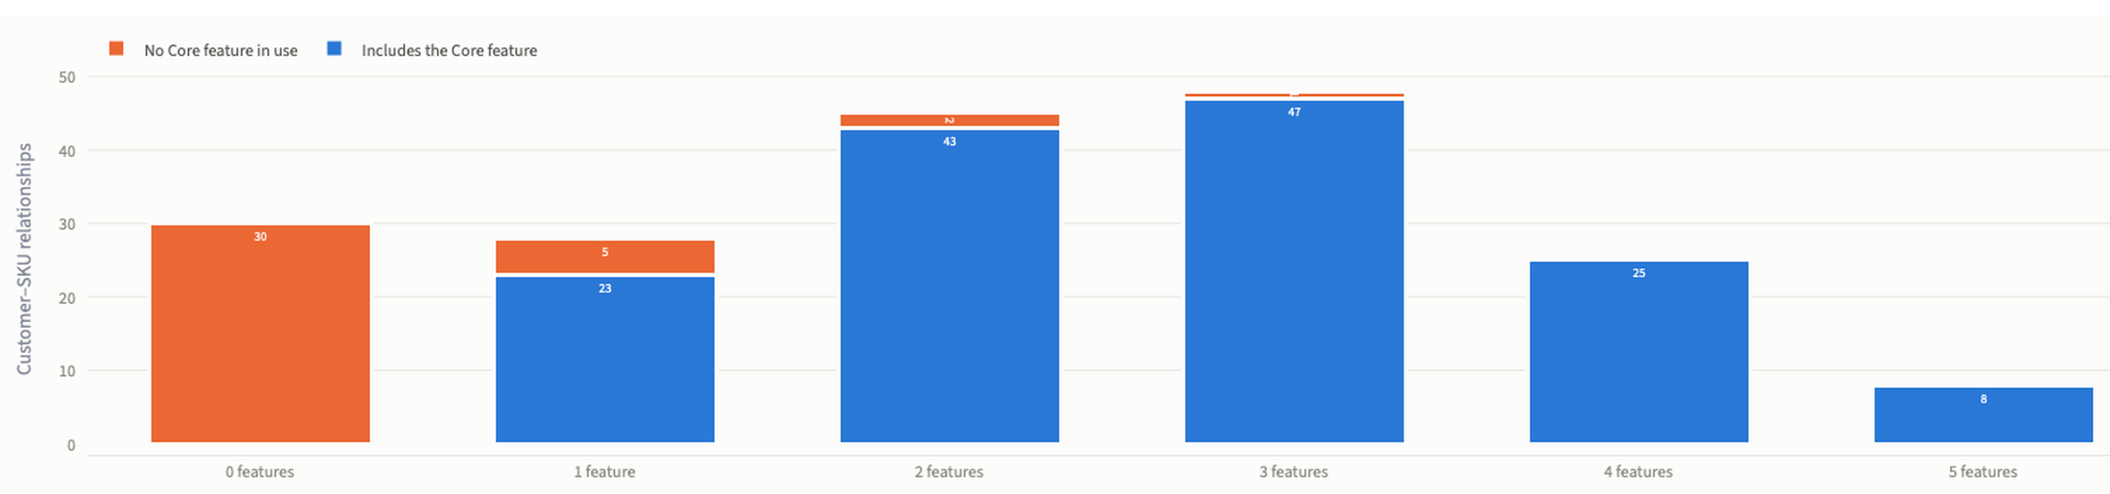
EVALUATION & RESULTS
What it found — and the number that should worry you
4%
Fully deployed on the widest SKU (with 5 features)
32%
use one feature or none
21%
use no Core feature at all
Blue means the Core feature is among those in use; orange means it is not. Counted per customer–SKU relationship, not per customer.

Slide 7
LIVE
Four moves in the dashboard
Everything here is read from the pipeline. Nothing is computed in the app — the dashboard and the tests are looking at the same numbers.
1
Open on the Overview
The trust line first: data complete through July, three internal accounts excluded, eighty-four duplicate rows removed.
2
Move the threshold slider
Every account, plotted. Drag 50% to 70% and watch them redistribute. “High” is a dial, not a decree.
3
Drill into one account
Thirteen named features they are paying for and not using — three of them the reason they bought it. This is what a CSM opens.
4
Open Data Quality
Every row this pipeline dropped, with a reason and a count, appended on every run.
Move 3 is the one that matters — it is where a metric becomes a phone call.

Slide 8
EVALUATION & RESULTS
One metric, three altitudes, one accountable owner
CPO & GMs
Every flag ends in a worklist, not a score
Where to invest, what to repackage
Portfolio score and dollars not converting, cut by segment
What a CSM actually opens:
“Acme Financial is paying for 13 features they did not use this month — 3 of them are the reason the SKU was bought. Roughly $1.8M a year of contract value sits behind this list.”
Product
Which SKU is failing, and in which of the four ways
Feature-level adoption inside each SKU
Then the named features, ranked by how much they matter — Core first.
CSM & Sales
Which account to call this week
Not “this account scores 26%.”
The exact unused features and what they are worth
And it becomes accountable.
Value at Risk = contract value × (1 − VRR). It is in dollars, so it sums by account owner. Quarter over quarter you can see how much at-risk value each owner moved — the bridge from a metric to a motion.

Slide 9
THE ASK
Align on Value Realization Rate as how we measure adoption.
One definition. One calculation. Every team reading the same number.
Agree the metric and the calculation. Everything downstream depends on one number we all accept.
Now
Backtest against real renewal history. Does it predict churn earlier than NRR?
Next quarter
Derive feature weights from outcomes instead of judgment — then, and only then, the incentive conversation.
After that

Slide 10
APPENDIX
Technical details
Architecture and trade-offs · the twelve messy realities · how I know the number is right · what I got wrong
The recommendation ends on the previous slide. Everything past here exists to be challenged.

Slide 11
APPENDIX · ARCHITECTURE
How the data flows
1
2
3
4
5
Generate
Land
Model
Serve
Show
Python + Faker
100 customers · 500 SKUs
2,000 features · 15 months
→
BigQuery Sandbox
7 raw tables
row-count verified on load
→
15 SQL models
staging → intermediate → marts
full-refresh CTAS
→
5 mart tables
customer · SKU · feature
owner · executive
→
Streamlit + Plotly
5 views, read-only
nothing computed in the UI
Four decisions
Full-refresh CTAS, not incremental
The sandbox blocks DML — I verified that with a smoke test rather than reading it in docs. It is also the right call at this volume: idempotent, no state drift.
Ratios diagnose, dollars prioritize
Percentages cannot be summed across customers. Dollars can, so Value at Risk aggregates to any cut of the business.
Streamlit, not React
A deliberate speed trade-off. The deliverable is a decision, not a product.
Nothing hardcoded
Project, dataset, and thresholds all come from config. The pipeline runs against any BigQuery instance by changing one file.

Slide 12
APPENDIX · DATA QUALITY
The hard part: the data is a liar
Twelve realities injected on purpose. Five were specified. Seven I added, because they are what actually breaks adoption metrics in production.
CUSTOMER BEHAVIOUR · 5, SPECIFIED
DATA INTEGRITY · 7, ADDED
Shelfware · burn-and-stop · chronic overage · mid-year expansion · brand-new deployments
Duplicate rows · unlimited contracts · usage on unbought features · lapsed renewals · late-arriving data · internal test accounts · multi-currency
Three of them changed the framework, not just the cleaning rules
Some contracts have no denominator
“Unlimited” deals are scored on feature coverage alone. Substituting 100% would make them look like the healthiest accounts in the portfolio.
There is a third state
A lapsed renewal is not healthy and not at risk — it is not applicable, and produces no row at all. Most frameworks only have two states.
A number can be correct but not final
The current month is marked incomplete and drawn greyed. Hide that, and the first time an exec notices it move, they stop trusting every number.

Slide 13
APPENDIX · VALIDATION
The tests check the answer, not the plumbing
I planted twelve problems in the data, then tested whether the metric found them — without ever letting the pipeline see the labels.
Ground truth the pipeline cannot see
What the last run actually did
The generator secretly labels each customer's intended behaviour in a column no model reads. The tests ask whether the metric independently rediscovered what was planted.
84
duplicate contract-months removed
3
internal test accounts excluded
40 automated tests
usage rows for features never bought
Structure, injection, business-answer correctness, and invariants — including one that simply asserts the portfolio value is plausible.
395
684
months with a contract and no usage — counted as zero, not unknown
144
rows in the current month marked still loading
Every dropped row is on the record
Each cleaning step logs rows in, rows out, and why. Appended per run, so a number that moves can be traced to the step that moved it.
4
months with no active contract — not scored, not shelfware
Every row, every run, with a reason — and shown in the dashboard.
Silent cleaning is how data teams lose trust.
A number moves, nobody can explain it, and after that every number gets questioned. So the dashboard carries a permanent line above the metrics: what was excluded, what was deduplicated, and how current the data is.

Slide 14
APPENDIX · HARD TRUTHS
What went wrong, and what it changed
I read past a wrong number.
An early version reported $1.9B at risk across 97 customers — larger than the business. I had multiplied consumption capacity by unit price instead of the commercial quantity. The pipeline reported success throughout.
There is now a test that asserts the portfolio value is plausible. Structure was never the problem; magnitude was.
My own safety mechanism was never exercised.
The audit's first run showed zero rows zero-filled. My generator was emitting zeros where real telemetry emits nothing, so the anti-shelfware logic had never run and its tests were passing vacuously.
The audit caught it, not the tests. That is the argument for having built it.
Synthetic data validates mechanics, not predictive power.
These tests prove the logic handles twelve messy realities. They cannot prove VRR predicts churn.
That needs a backtest against real history — which is exactly what I am asking for.

