Slide 1
Team Inspire
Team Captain : M.Suraj
Contact No. : 9154156033
Email : surajmaktala609@gmail.com
Team Details:
Thakur-7032670175
Rohan-7569616906
Vishnu-8341652871

Slide 2
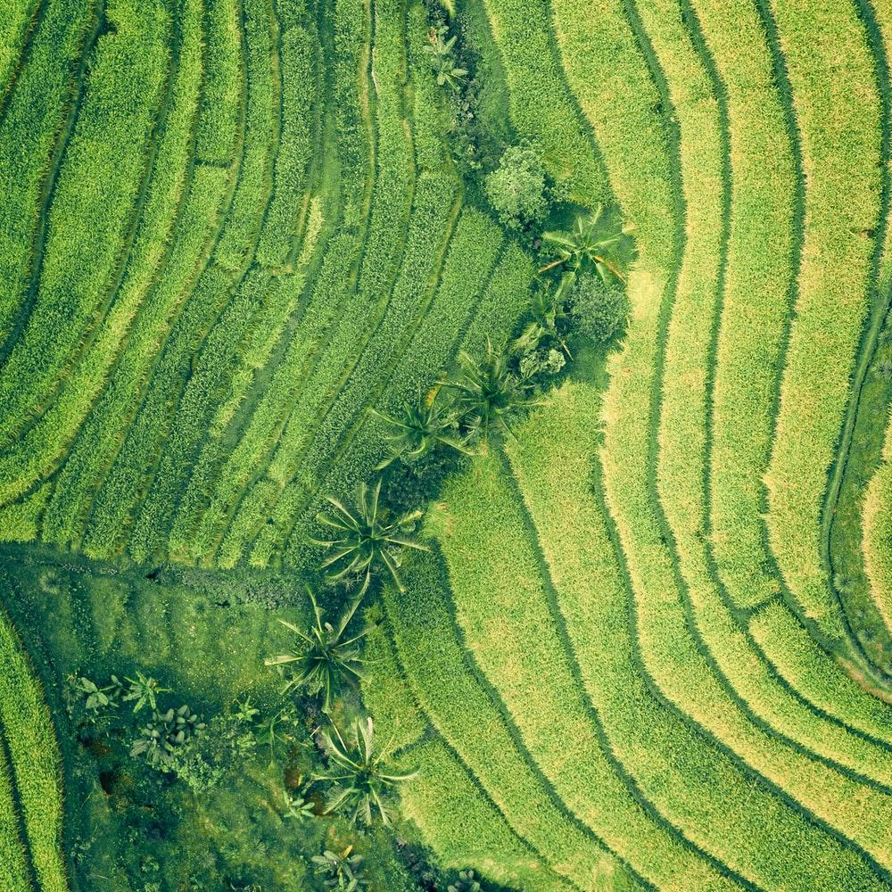
Agrotechnology

Slide 3
PROBLEM STATEMENT
Develop a system to monitor and manage the rate of water, soil fertility, crop growth, pest & diseases, macro & micro-nutrients, etc.

Slide 4
IDEA/SOLUTION TO RESOLVE
THE PROBLEM.

Slide 5
Sensors:
To measure soil moisture, nutrient levels, and crop growth, sensors should be placed in the soil and on the plants themselves. These sensors will collect the data related to soil fertility, water content, and crop height.

Slide 6
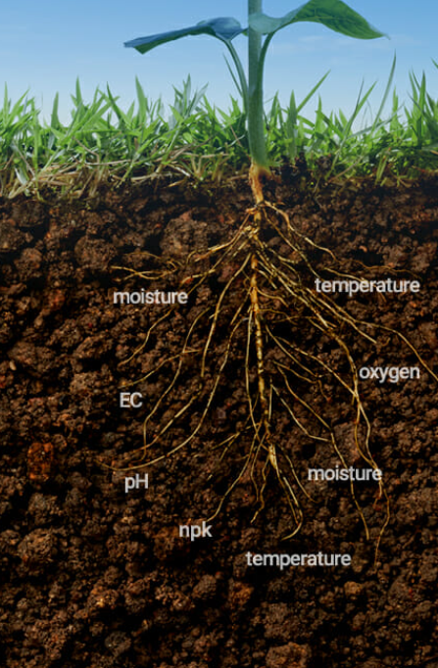
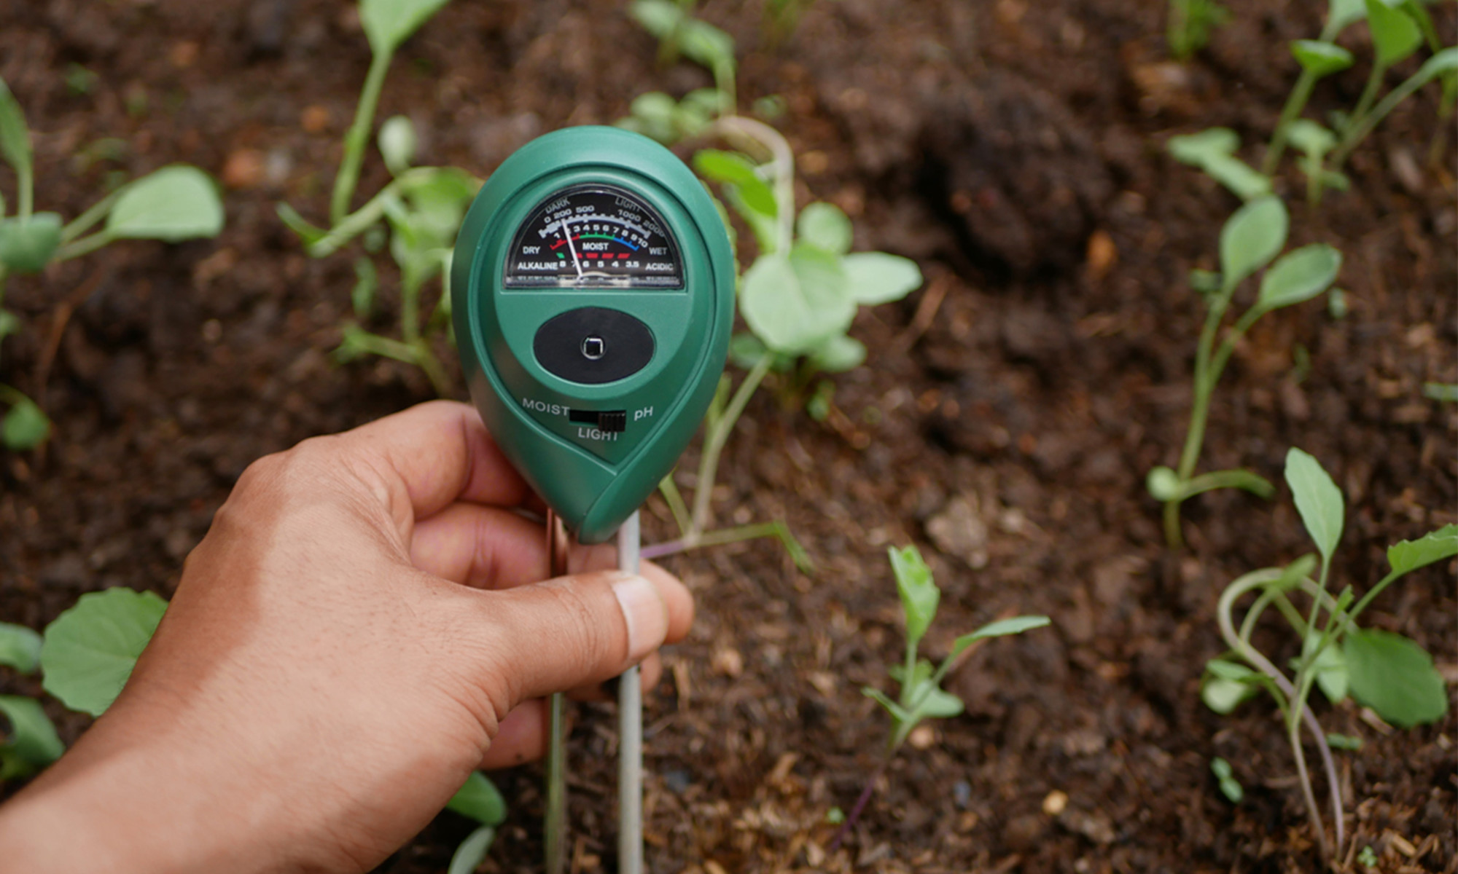
sensor

Slide 7
Data collection and analysis:
Data from the sensors would be transmitted to a central hub where it could be analyzed and used to create real-time maps and graphs of the farm's conditions.
Irrigation and fertilization management:
Based on the data collected, the system could automatically adjust irrigation and fertilization levels to optimize crop growth and reduce water and nutrient waste.

Slide 8
Notification and alert system:
The system could send notifications to farmers via SMS or email if it detects a problem, such as pests, diseases or low soil moisture
Mobile app:
A mobile app could provide farmers with real-time data and allow them to remotely control and adjust the system.

Slide 9
Weather forecast:
Using sensor systems we can gather and analyze weather forecast data to optimize irrigation and fertilization schedule.

Slide 10
MOTIVATION.
Increased crop yields: By monitoring and managing these factors, farmers can optimize crop growth and increase yields.
Cost savings: By using data to manage inputs such as water and fertilizer, farmers can reduce costs and improve their bottom line.
Sustainable agriculture: By monitoring and managing soil fertility, farmers can maintain healthy soil over time, which is essential for sustainable agriculture.
Pest and disease control: By monitoring pests and diseases, farmers can take proactive measures to protect their crops, reducing the need for costly chemical treatments.

Slide 11
5. Climate resilience: By monitoring and managing water, farmers can adapt to changing weather patterns and improve their ability to cope with droughts and floods.
6. Data-driven decision making: By collecting data and using it to inform their decisions, farmers can make more informed decisions about how to best manage their land and crops.

Slide 12
SCOPE OF SOLUTION

Slide 13
Landscaping:
Sensors can be used to monitor soil moisture levels in gardens and other landscaped areas, which can help gardeners and landscapers ensure that plants are getting the water they need.
Environmental monitoring:
Soil moisture sensors can be used to monitor changes in soil moisture over time, which can help scientists understand the effects of climate change and other environmental factors on soil moisture.
Agriculture:
Sensors can be used to monitor soil moisture levels in fields, allowing farmers to optimize irrigation and improve crop yields.
Proper irrigation and fertilization management can help to improve crop yields, reduce the risk of crop failure, and increase the overall efficiency of crop production.

Slide 14
Weather forecasting plays a critical role in agriculture as it helps farmers to make informed decisions about planting, harvesting, and managing their crops. Accurate weather forecasts can help farmers to predict when to plant, when to apply fertilizers and pesticides, and when to harvest their crops and also notifies farmers about extreme weather conditions for protecting their crops.

Slide 15
RESOURCES REQUIRED

Slide 16
Soil moisture sensor: This device measures the amount of water present in the soil.
Tensiometers: These devices measure the tension of water in the soil, which is related to the soil moisture content. They consist of a ceramic cup filled with water that is placed in the soil, connected to a gauge that measures the water tension.
Time domain reflectometry (TDR): TDR uses electromagnetic waves to measure the dielectric constant of the soil, which is related to the soil moisture content. TDR probes consist of two or more electrodes that are inserted into the soil.
Data logger: This device records and stores the data collected by the soil moisture sensor.

Slide 17
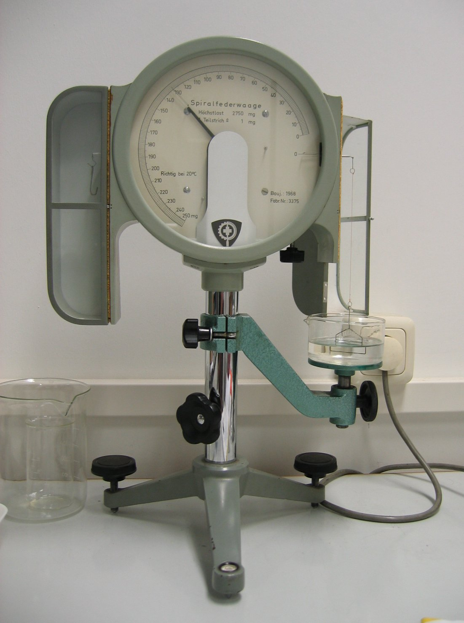
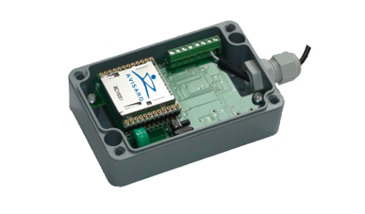
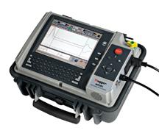
Data Logger
Time Domain Reflector
Tensiometer

Slide 18
Power source: A power source such as batteries or a solar panel may be required to power the sensor and data logger.
Computer or mobile device: A computer or mobile device may be required to access and analyze the data collected by the data logger.
Software: Depending on the sensor and data logger used, specific software may be required to access and analyze the data.

Slide 19
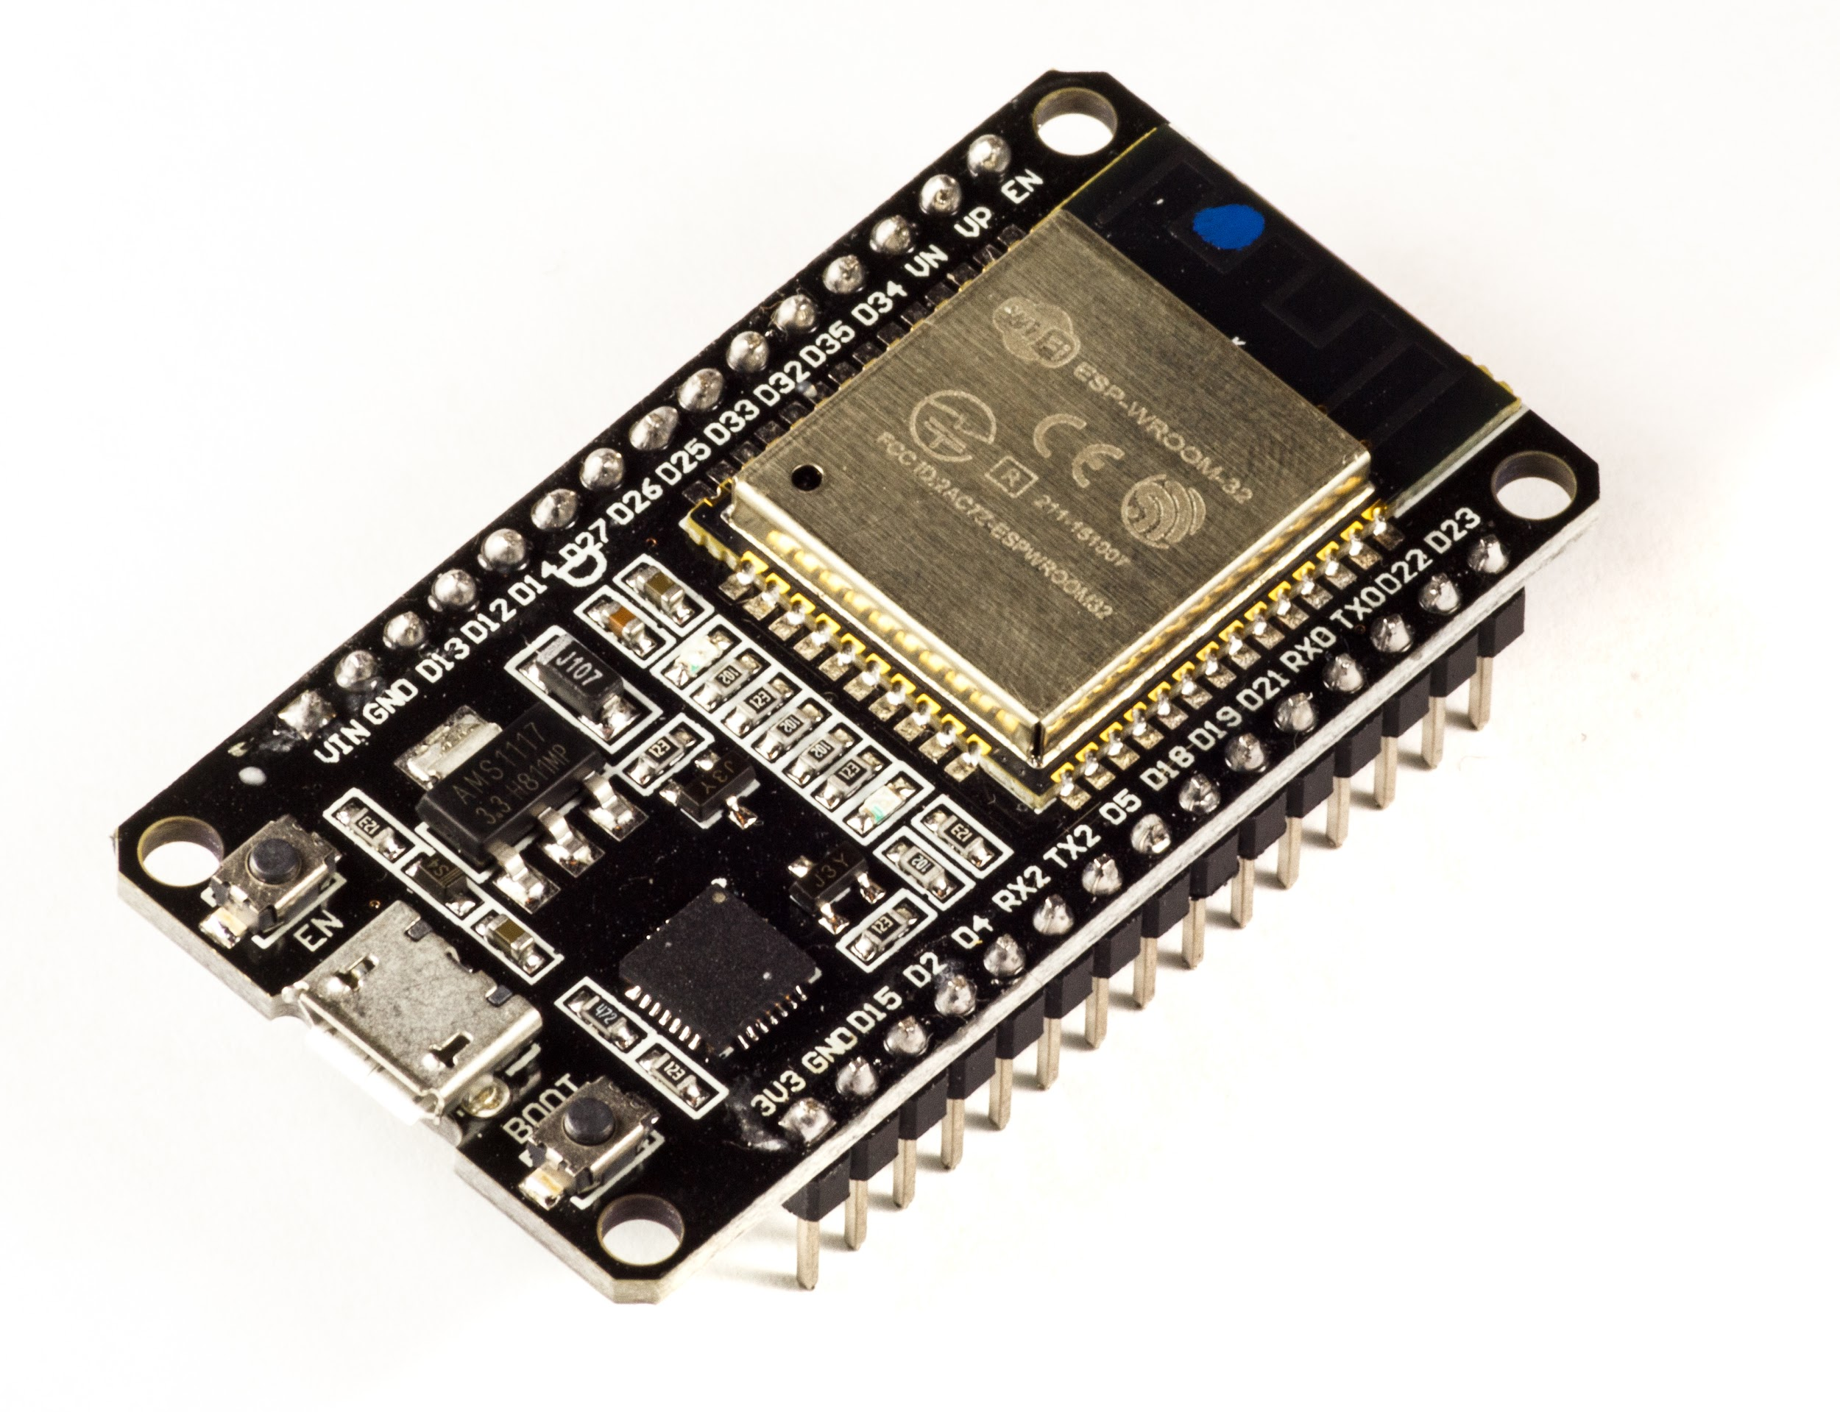
Esp32: The ESP32 is a microcontroller that can be used to control a motor pump in an irrigation system. The ESP32 can be programmed to turn the motor pump on and off based on the data analyzed by the software. Additionally, the ESP32 can be connected to the internet to allow for remote control and monitoring of the irrigation system.

Slide 20
The future of agriculture is not just about producing more food, but about producing it more sustainably, more equitably, and more resiliently.”

Slide 21
Thank You!
For any Questions?
You can contact me at
surajmaktala609@gmail.com
PH: +91 91541 56033

