Slide 1

A User-Friendly Music Player using JFRAMES
“JPLAY”
Group Member:- Farzan Khan, 12112338
Abhay Singh Suryawanshi, 12105660
Suraj Pandey, 12112175

Slide 2
INTRODUCTION
In this Java project, we have developed a simple GUI-based music player that allows users to play MP3 audio files and control the playback of their music tracks. The user interface has been designed using Swing components, and it features a minimalistic design that is easy to use and aesthetically pleasing.
Our music player supports a range of basic playback controls, including play, pause, next, and previous. Users can also add new tracks to their playlist and remove tracks that they no longer wish to listen to.
Overall, our music player provides a streamlined and efficient solution for playing MP3 audio files, making it an excellent choice for anyone who enjoys listening to music on their computer.

Slide 3
Proposed techniques
Some of the packages used in this project are as:
Java Swing Library: This library provide classes and interfaces for creating graphical user interfaces (GUIs) in Java, Inside this library there are many modules used in this project. Some of them are listed below as:
JFrame: This module is used to create a basic window that can hold other GUI components and , such as buttons, text fields, and labels.
JPanel: This module is used to create a container for other components that can be added to a JFrame. A JPanel can be used to group related components.
Java.awt: This package is an Abstract Window Toolkit in java and it provides a powerful set of tools for creating rich, interactive GUIs in Java. However, it has been largely supplanted by the more modern Swing and JavaFX frameworks. Some of the key classes and interfaces of “java.awt” we used in this project are as:
Graphics: An abstract base class for graphics contexts, which provides methods for drawing lines, shapes, text, and images.
Color: A class for representing colors in RGB (red, green, blue) format.
Font: A class for representing fonts, which can be used to render text in a GUI.

Slide 4
Jplay components
Header Section:
First, we have given the music player name along with an exit icon. In the main class named as Jplay we have used several methods to create this window and we make it responsive. We have used different functions such as JPanel, JLabel, etc.
.
We have used a png file of music logo and created an object to link it with the GUI and sets some parameter of it like setImage, setBackground so it looks attractive while experiencing by the user.
Same functions applied for the exit icon also creating an object scaling it setting some paramters.

Slide 5
Marquee Label:
To create this window, we have first created a separate file with class name MarqueeLabel.java.
In this java’s swing function JLabel along with the component “marquee” effect is working which is making the text display in right to left order with a constant speed continuously.

Slide 6

Music Player Logo:
We have added logo png to the main java class of this project and created a method named Decoration and stated some parameters to adjust this logo and fixed in the GUI window like its boundary it should be static in center and logo appears when music is not playing.

Slide 7
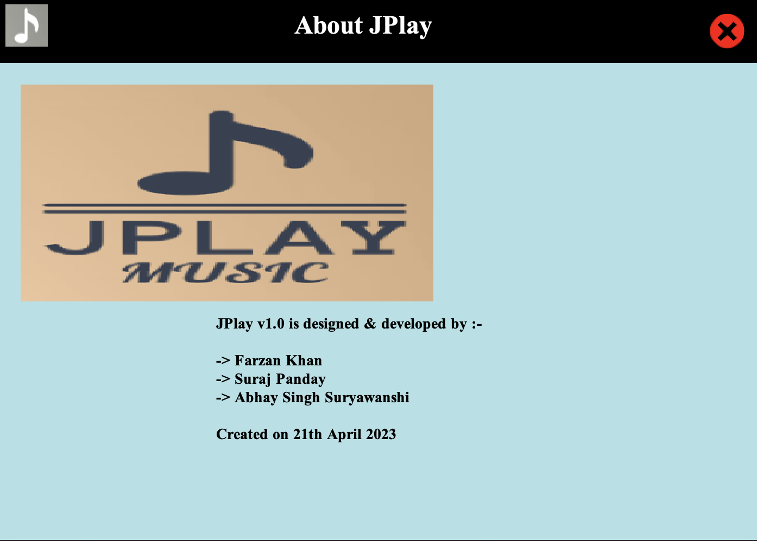
About Jplay:
It is a section about the music player when we tap on the Jplay logo it appears and shared some information about the music player and the developer.
To create this window we have created a file named Information.java same as the class name and used swing library function such as JPanel, JLabel, Jframe and created a method inside it where we have given text input using setText function, added Jplay logo using an object and setting boundaries, font, colors, etc.

Slide 8

Buttons:
We have created buttons using swing library functions, every button is having their own method and defined various parameters like using exception handling (try and catch) creating constructor to override the run method.
We used if and else conditions also so that it can check player is not null and give many other data to the buttons like InputStream, BufferInputStream, setting path as well.

Slide 9
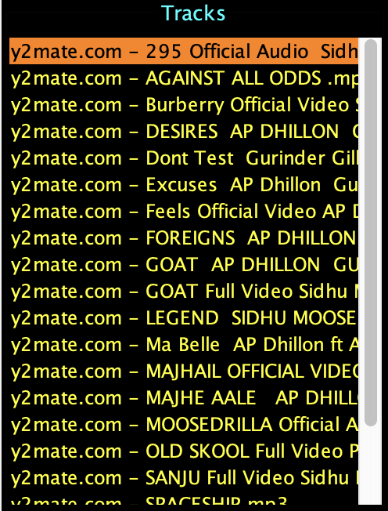
Tracklist:
First, we have created a TitledBorder named Tracks in which we have set parameters such as TitleColor, TitleJustification, TitlePosition and its border as well. We have added the specified mouse listener also to receive mouse events from the swing library component.
We have created few more objects so that when a song start playing an animation runs at the same time by setting some parameters and scaling it to default.

Slide 10
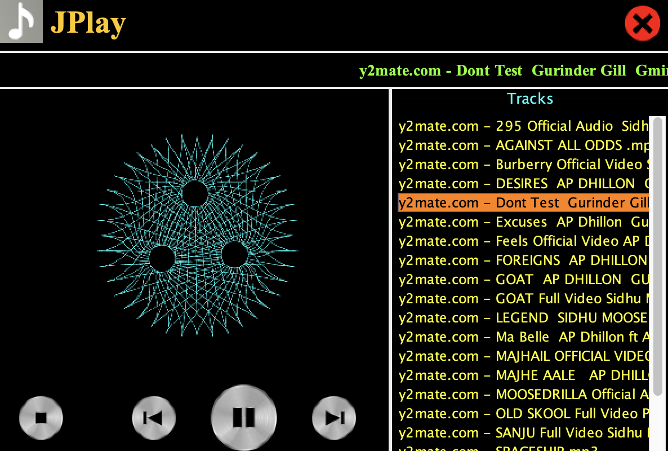
Animation:
For animation while playing the song, we have created a file named Animation.java same as class name in which swing library and java.awt is used to create icon setting its width and height and to animate this we have created a method named animate.
In that method, we have used many functions of the listed packages like getting the image, adding the animated gif file to the GUI and also used exception handling concept.

Slide 11
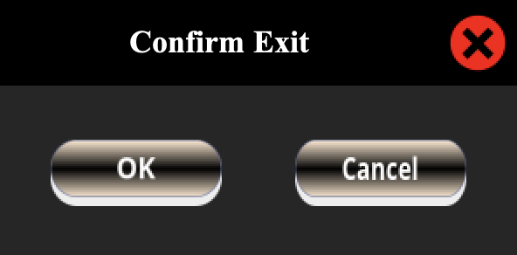
Exit:
For Exit, we have created a file named exit frame followed by class name “ExitFrame” and used java packages like swing library, java.awt.
In that class, we created functions using JFrame, JButton, JLabel and etc. and inside this class we have assigned a method in which functions are working and its parameters are assigned like setting Image, Layouts, Bounds and others.
By the help of JButton function, ‘OK’ and ‘cancel’ buttons are created and using an object we set the parameters of the buttons and assigning its functionality.

Slide 12
Conclusion
After developing this project music player using Java and JFrames has proven us to be an exciting and challenging work. The use of various modules and libraries such as Java Swing and Java.awt Frameworks have enabled the creation of a user-friendly GUI and the incorporation of multimedia functionalities.
The project has also provided an opportunity to apply key software development concepts, such as modular programming and exception handling, in a practical setting. Additionally, it has allowed us for the development of valuable skills in areas such as object-oriented programming and event-driven programming.
Overall, this music player project has been an excellent learning experience for our group members in Java and has demonstrated the versatility and power of this programming language. With further development, the music player can be enhanced with additional features and functionalities, making it a valuable tool for music lover and professionals alike.

