Slide 1
Network Traffic Analysis with Graph Neural Networks
Anshul Sharma (23M0821)
Suraj Kumar Patel (23M0795)

Slide 2
Task Description
This project aims to apply graph neural networks (GNNs) for self-supervised intrusion and anomaly detection in computer networks. GNNs are a deep learning approach for graph-based data that incorporate graph structures into learning to generalise graph representations and output embeddings.As traffic flows in computer networks naturally exhibit a graph structure, GNNs are a suitable fit in this context.

Slide 3
Challenges Addressed
Traditional NNs are not inherently designed to understand and leverage the graph structure of network data. They treat input data as flat vectors, potentially overlooking important relationships and dependencies between entities (e.g., IP addresses) in the network.

Slide 4
Methodology
Data Preprocessing
Graph Construction
Split Data
Graph Neural Network Architecture
Node and Edge Feature Preparation
Model Training
Evaluation

Slide 5
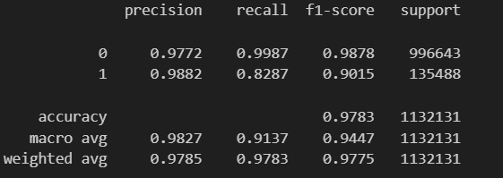
Experiment Details and main Result
The model was trained on NF-CSE-CIC-IDS-2018 dataset.

Slide 6
Conclusion
While traditional neural networks can be applied to tabular or sequential data, GNNs offer a more specialized and effective approach when the data exhibits a graph structure, as is often the case in network intrusion detection scenarios.

Slide 7
Work Split Up
Suraj - Data Preprocessing, Graph Construction
Anshul - Graph Neural Network Architecture, Node and Edge Feature Preparation, Model Training, Evaluation

Slide 8
THANK YOU

