Slide 1


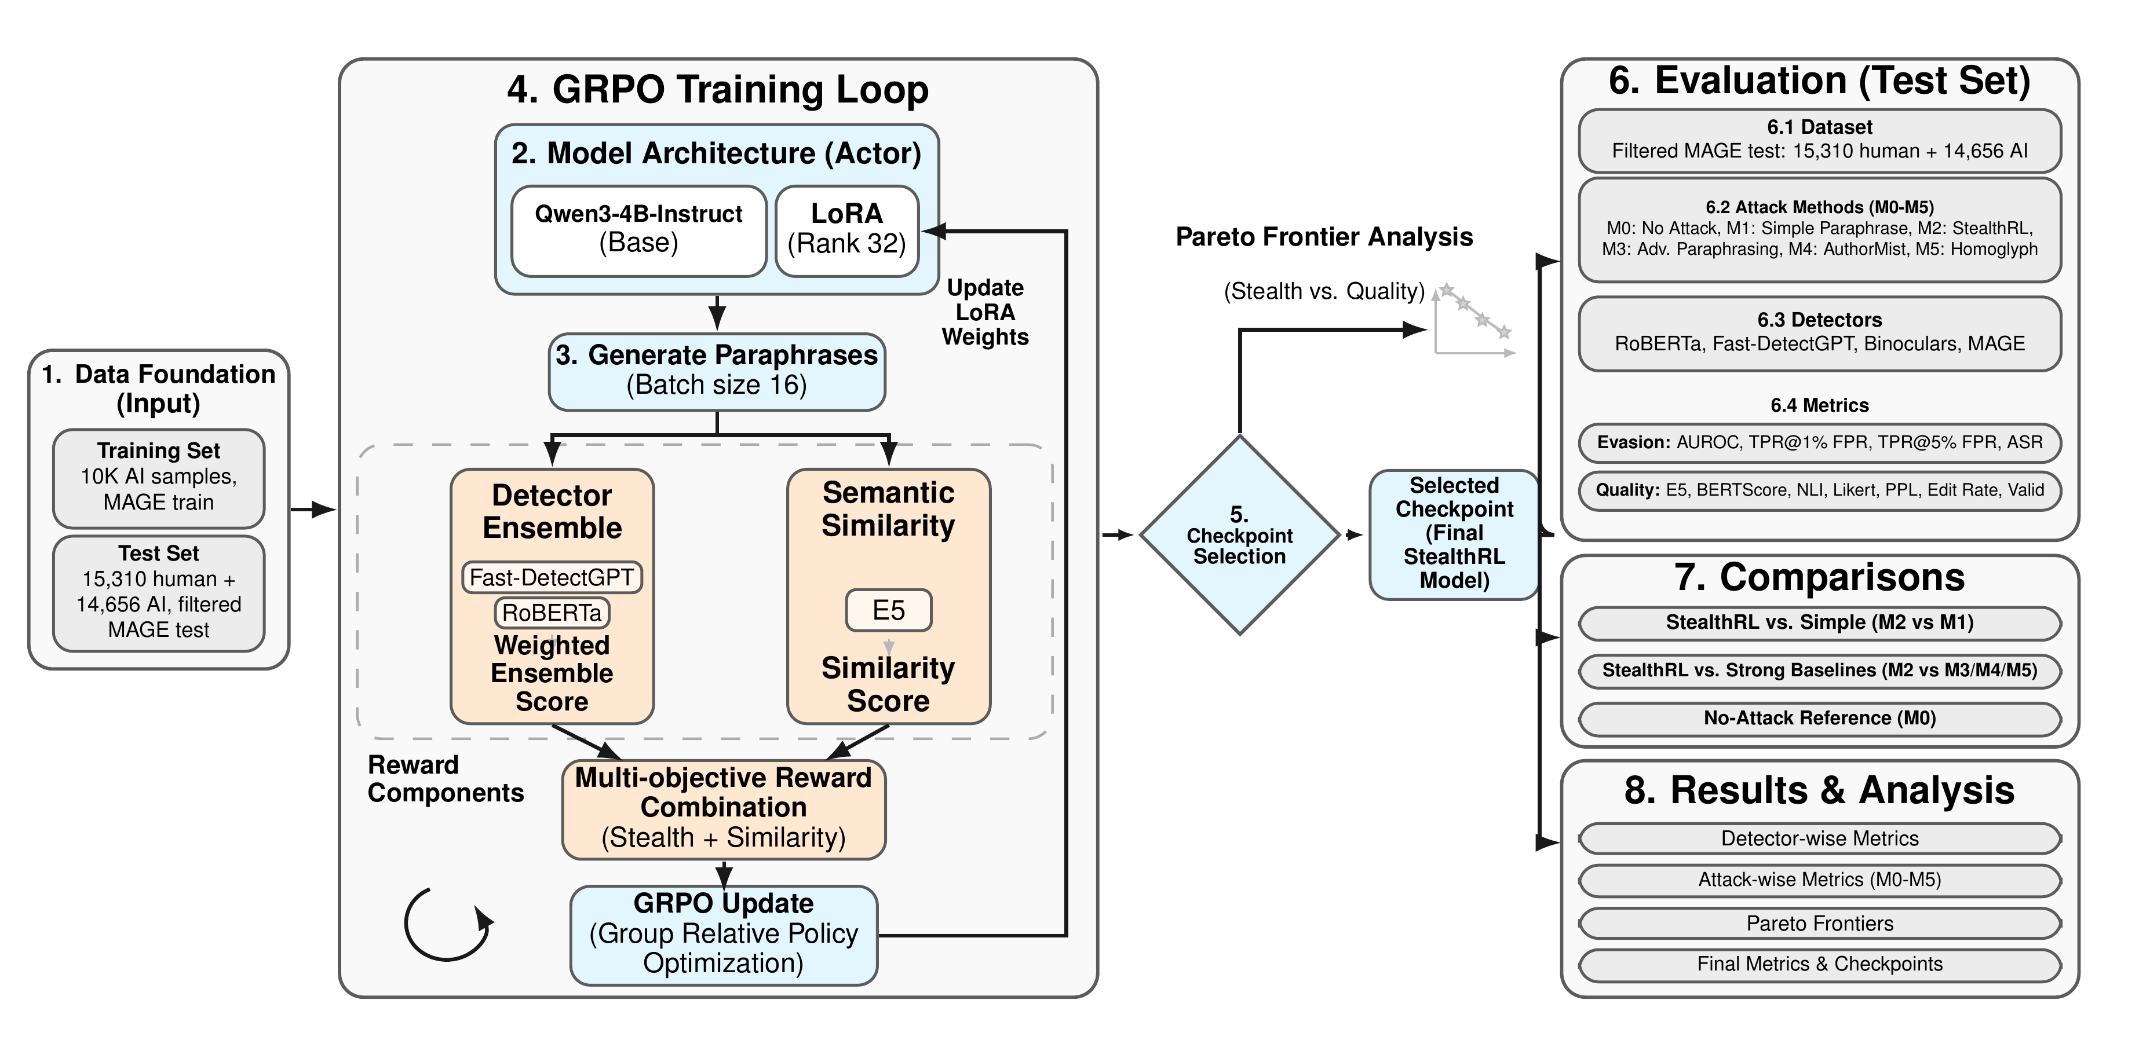
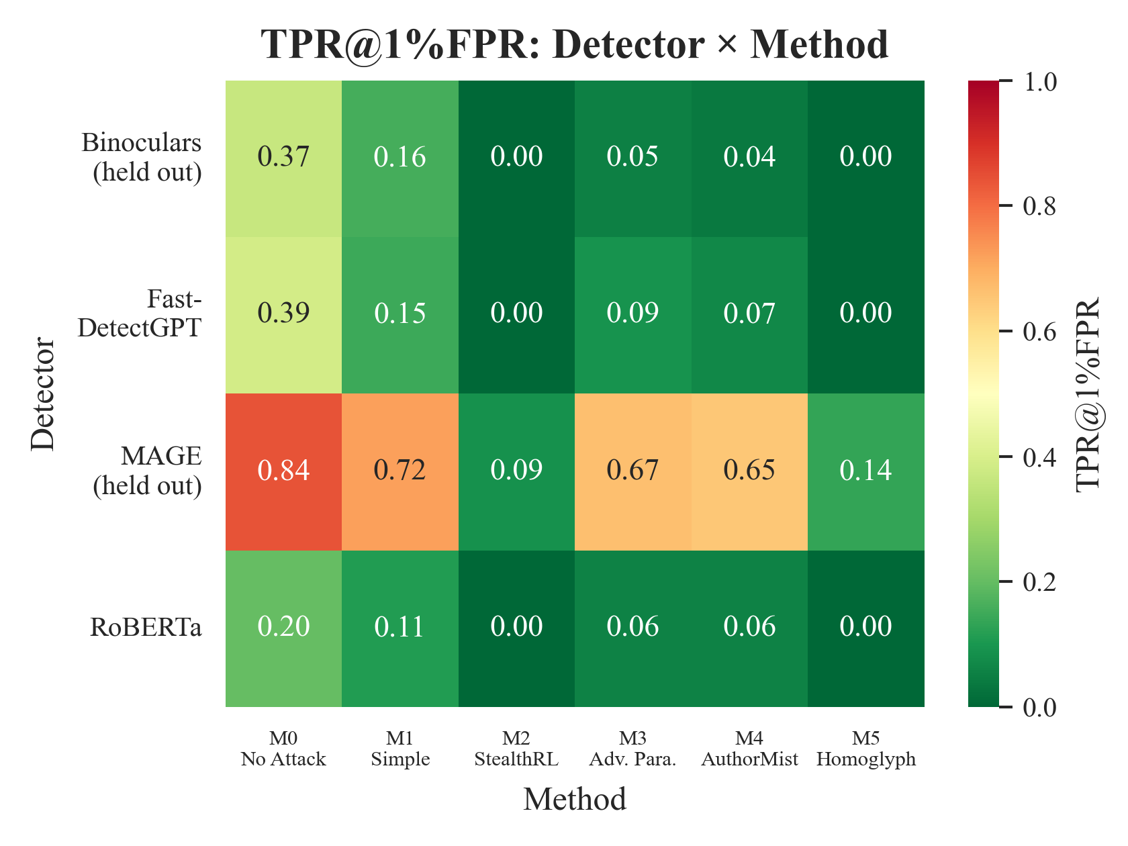
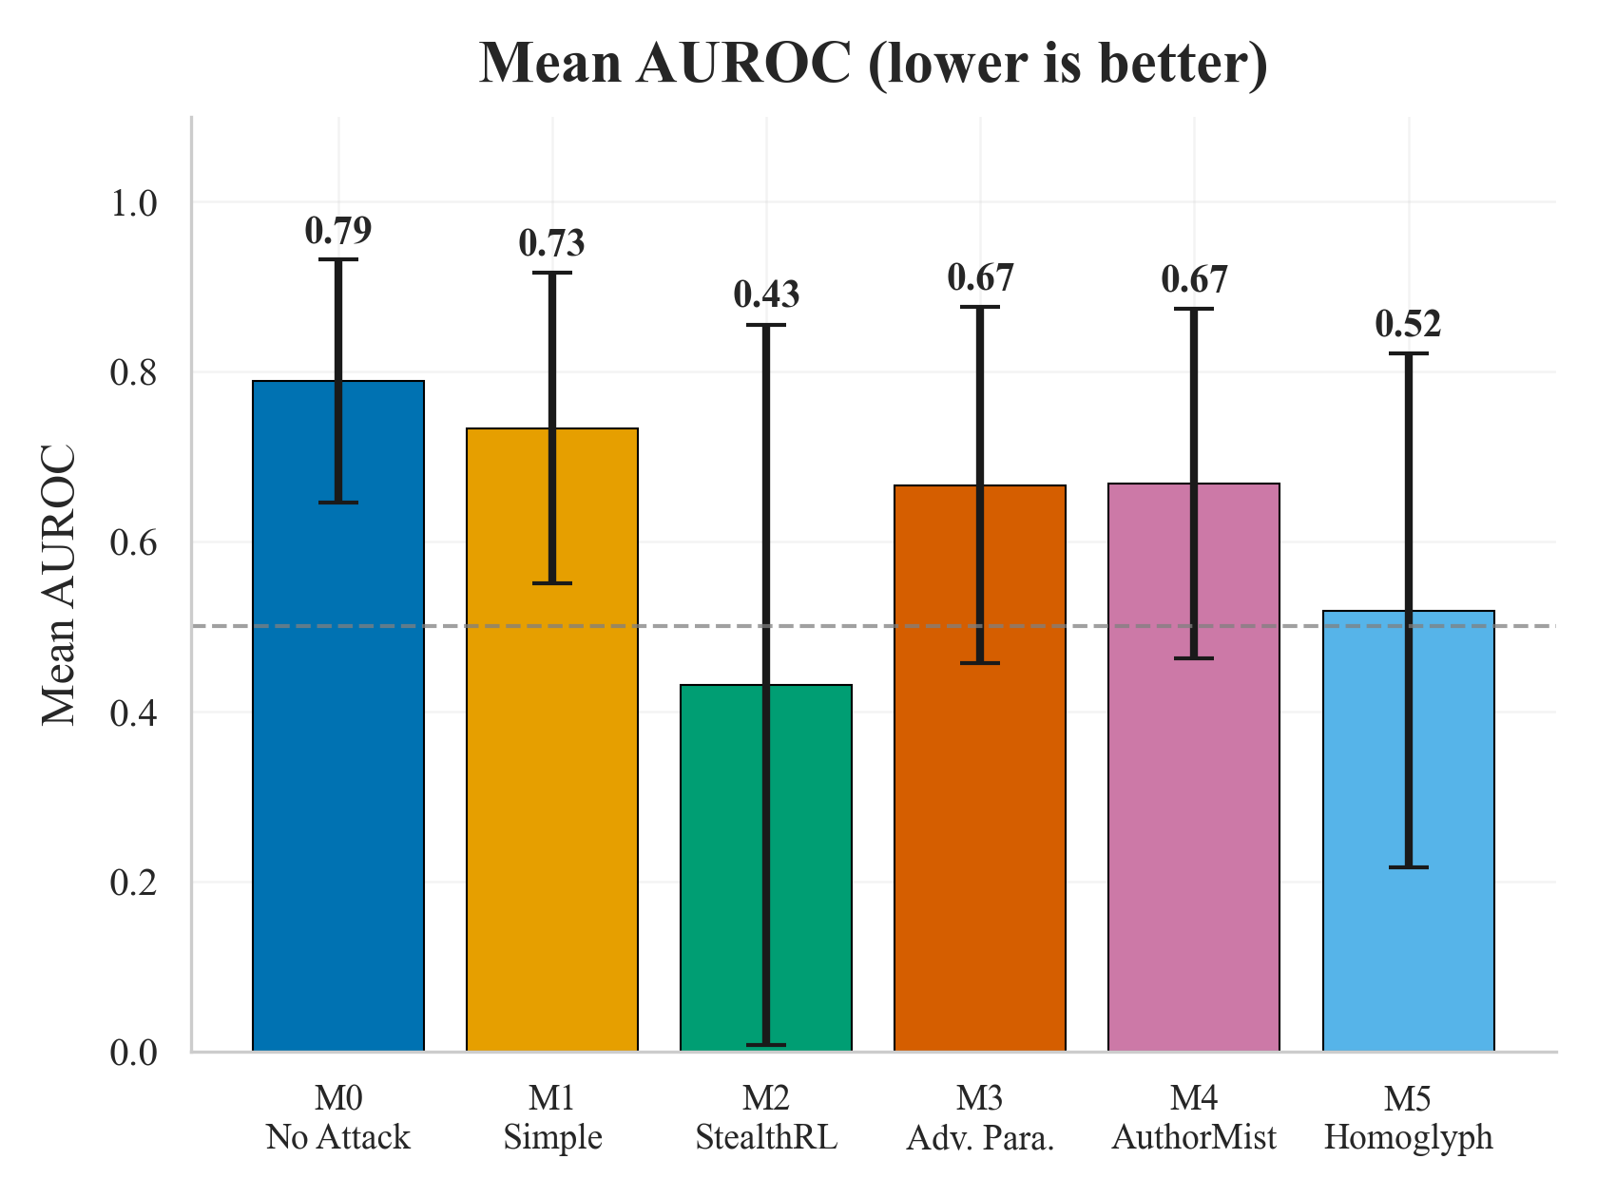
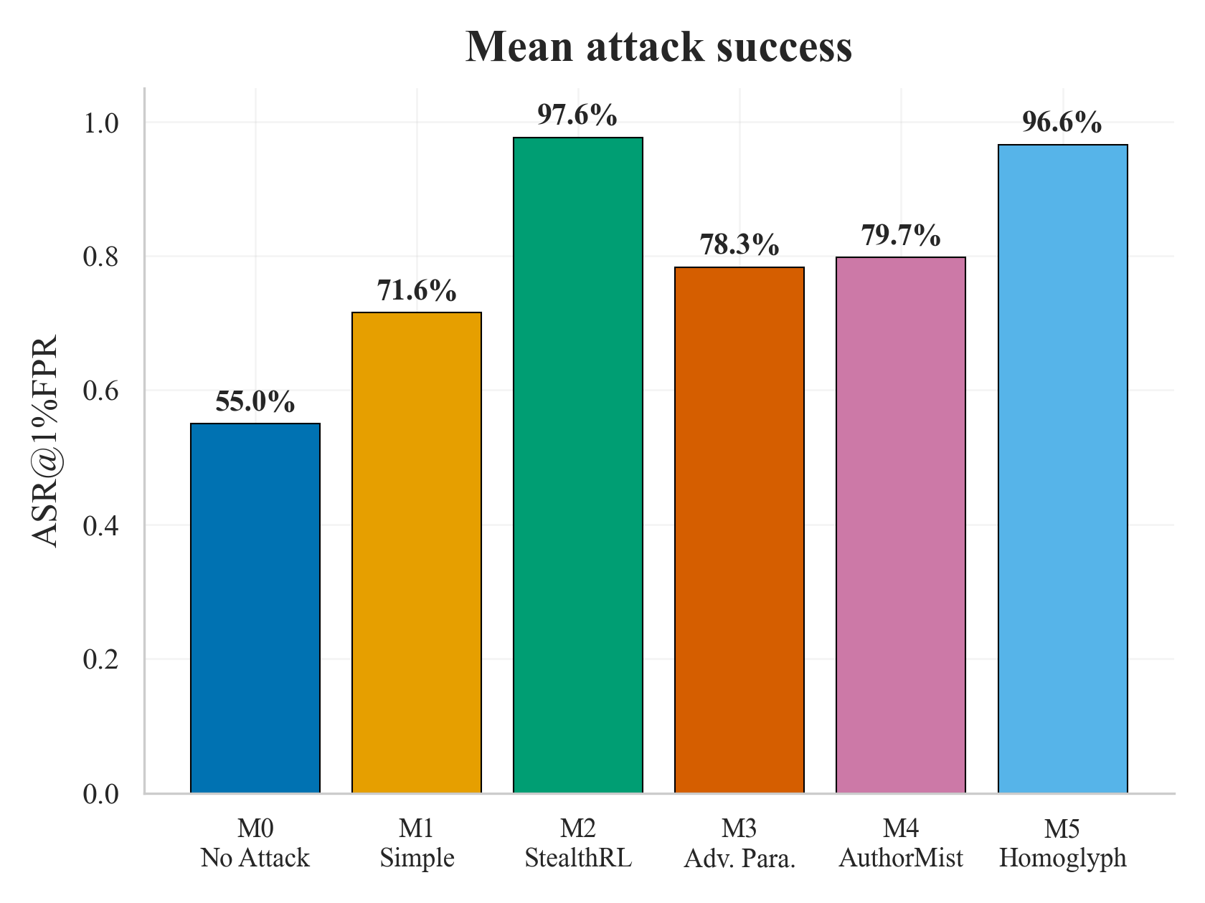
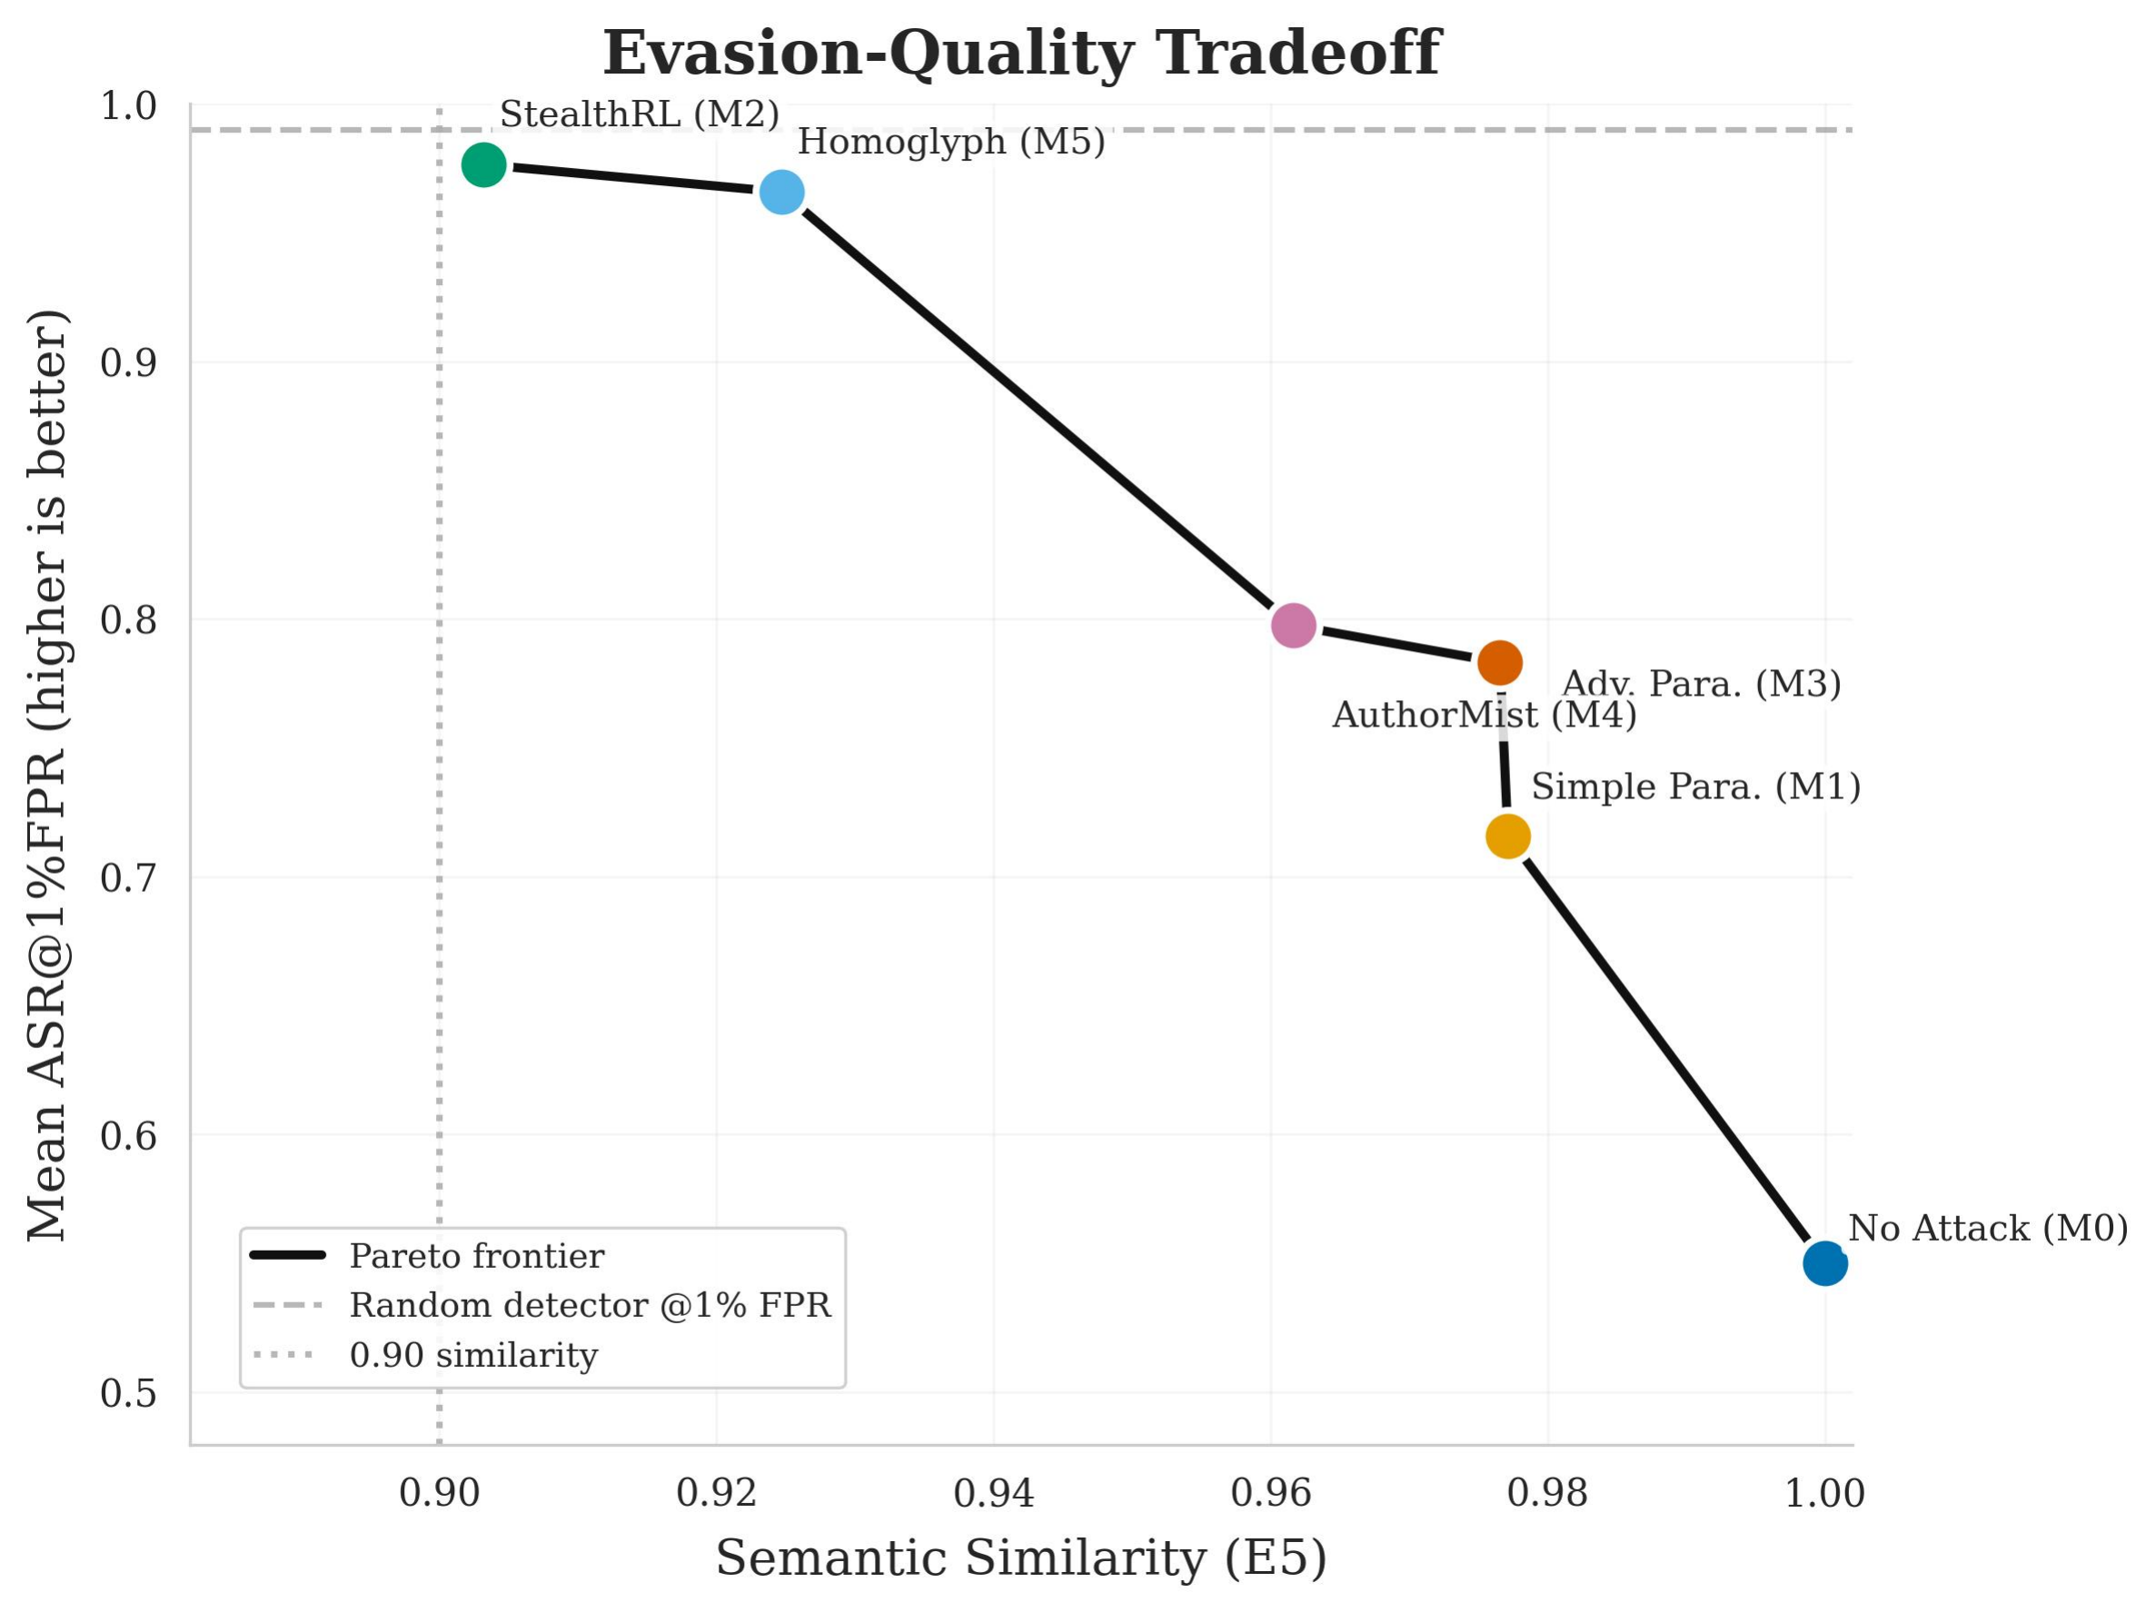
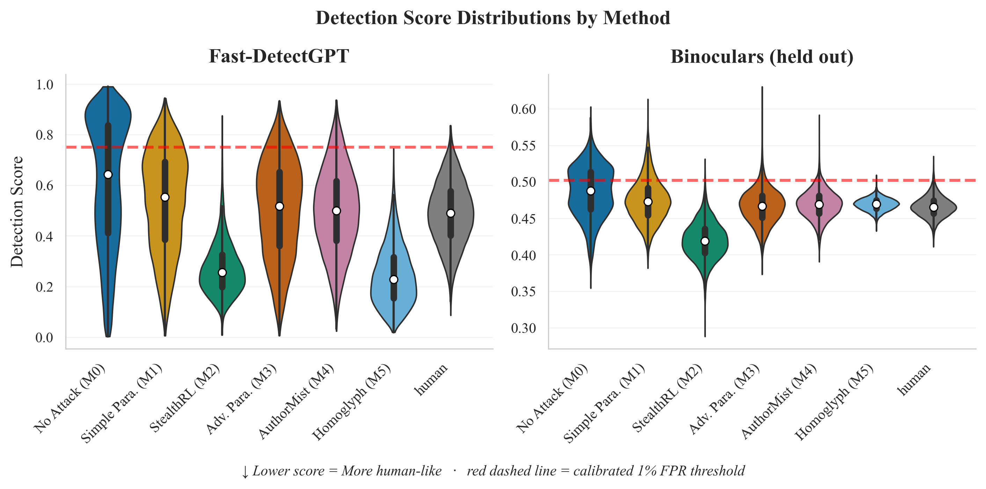
StealthRL: Reinforcement Learning Paraphrase Attacks for Multi-Detector Evasion of AI-Text Detectors
Code Available
Suraj Ranganath, Atharv Ramesh
PlurVA-LLM Workshop @ AACL-IJCNLP 2026
First Workshop on Pluralistic Value Alignment of LLMs · Hengqin, China
University of California, San Diego | suranganath@ucsd.edu | a3nair@ucsd.edu
0.024 mean TPR@1%FPR | 97.6% mean ASR | mean AUROC 0.79 → 0.43
4 detectors: RoBERTa, Fast-DetectGPT, Binoculars, MAGE • Transfers to 2 held-out detectors
Experimental Results
TPR@1%FPR: 6 attack methods × 4 detectors, MAGE test pool
Method | RoBERTa TPR@1% | Fast-DetGPT TPR@1% | Binoculars TPR@1% (held-out) | MAGE TPR@1% (held-out) | Mean TPR↓ | Mean ASR↑
M0 No Attack | 0.203 | 0.388 | 0.367 | 0.843 | 0.450 | 0.550
M1 Simple Para. | 0.111 | 0.148 | 0.158 | 0.720 | 0.284 | 0.716
M2 StealthRL | 0.002 | 0.002 | 0.002 | 0.089 | 0.024 | 0.976
M3 Adv. Para. | 0.058 | 0.092 | 0.051 | 0.666 | 0.217 | 0.783
M4 AuthorMist | 0.056 | 0.067 | 0.036 | 0.651 | 0.203 | 0.797
M5 Homoglyph | 0.001 | 0.000 | 0.000 | 0.136 | 0.034 | 0.966
Method
TPR@1%FPR heatmap, mean AUROC, and mean attack success
Reward: R = α(1 − p_{ens}) + β · sim_{E5}, α = 1.0, β = 0.1
Detector Ensemble: p_{ens} = 0.6 · p_{RoBERTa} + 0.4 · p_{Fast-DetectGPT}
Base Model: Qwen3-4B-Instruct + LoRA (rank 32)
• RL Algorithm: GRPO, 3 epochs, 10K AI-generated MAGE samples
• Threat Model: Black-box (score-only, no gradients)
• Transfer Test: Binoculars and MAGE held out during training
Evasion–quality tradeoff
StealthRL Quality
0.901
E5 Similarity
2.51/5
Likert Quality
0.868
BERTScore
0.316
NLI Consistency
Why Evasion Works: Score Distributions
Key Findings
• Robustness breakdown at strict operating point: StealthRL cuts mean TPR@1%FPR to 0.024 across four detectors (97.6% ASR), using one generation per input.
• Transfer to held-out detectors: On Binoculars and MAGE (never used in training), TPR@1%FPR falls from 0.367 to 0.002 and from 0.843 to 0.089.
• Stable across runs and operating points: The original run and two re-seeded repeats give mean TPR@1%FPR 0.024 ± 0.001; at 5% FPR, mean TPR is 0.076.
• Evasion–fidelity tradeoff: More readable than homoglyphs (Likert 2.51 vs 1.97), but less faithful than M1/M3 (NLI 0.316 vs 0.967/0.965).
StealthRL (M2) pushes most AI-sample scores below the calibrated 1% FPR threshold, so TPR collapses even where a detector such as RoBERTa keeps some global rank information. Binoculars (held out) AUROC drops from 0.705 to 0.055.

