Slide 1
Slop based Partitioning for Vertical Fragmentation
Submitted by : Arun Raveendran
16CS03F

Slide 2
Why Vertical Fragmentation is important?
A query does not require the entire attributes of a relation at the same time.
Enhances the Query Response Time(QRT) by dividing a complex large relation into the small fragments.
Most frequently accessed fragment is stored in the main memory : reduced page access from the secondary memory.

Slide 3

Why Slop Based Partitioning?
Optimal Binary Vertical Partitioning algorithm does not consider the impact of query frequency.
Graph Traversal Vertical Partitioning lead
to an inefficient partitioning results as the frequent queries and infrequent queries are given the same priority.
Clustering algorithm hard to implement without human’s interpretation as blocks may overlap each other.

Slide 4

Slop Based Partitioning
Input is Attribute Usage Matrix and Frequency matrix.

Slide 5
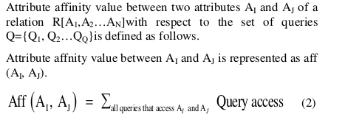
Slop Based Partitioning
Calculate Attribute Affinity matrix from these two matrices.

Slide 6
Slop Based Partitioning
Apply Bond Energy Algorithm to find out the affinity between attributes.
Output of Bond Energy algorithm is a Clustered affinity matrix.

Slide 7
Slop Based Partitioning
This SBPA is divided into three steps :
Initialization: In this step the user initializes the variables and array required by algorithm.
Processing: In the processing step, first row of CAM is taken for fragmenting the clusters from a relation. The user takes the difference of CAM (1, i) and CAM (1, i-1) and store it at Y [1, i].

Slide 8
Slop Based Partitioning
Comparison: In the last step the user finds the smallest value of Y [1, i] which represents the rapid diminishing of slop. The index i at which value of Y [1, i] is the smallest the corresponding value of X [1, i] is considered as Split-point.

Slide 9
Slop Based Partitioning
Find a set of attributes that are frequently accessed by distinct set of queries.
First row of CAM is taken for fragmenting the clusters from a relation.
The point between the neighbour attributes of the CAM is considered as Split-point if slop diminishes between these attributes very rapidly

Slide 10
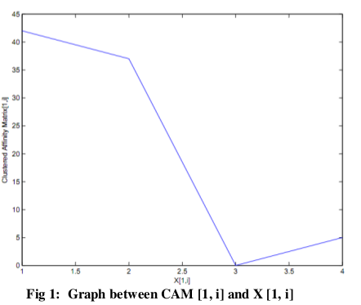
Partitioning based on the slope

Slide 11
Questions?

Slide 12
Thank you

